Slide 1
Using RePORT to Understand Who and What NIH Funds
Brian Haugen, Ph.D. and Cindy Danielson, Ph.D.
NIH Office Of Extramural Research
NIH Virtual Seminar
October 29, 2020

Slide 2
Learning Objectives
Use the NIH funding information in RePORT to help target your application, find key contacts at NIH and in the grantee community, and more.

Slide 3
Tools to Help Answer Questions Throughout the Grants Process
What is the NIH already funding in my research area?
What results came out of those projects?
Which ICs have priorities that align with my research ideas?
How can I find a relevant point of contact at NIH to discuss my research ideas?
How can I find collaborators?
What are other PIs at my institution working on?
Which types of programs should I apply for, and what are my chances of getting funded?

Slide 4
RePORT: One-Stop Shop for Data on NIH Programs
Uphold NIH’s commitment to public accountability in carrying out its scientific missions.
The Research Portfolio Online Reporting Tools website provides access to reports, data, and analyses of NIH research activities, including expenditures and the results of supported research.
Goals are to
Gather all NIH data and reports
Make these data easily accessible to the public
Highlight the links between NIH funding and research results and products
Access at https://RePORT.nih.gov
Support at RePORT@mail.nih.gov

Slide 5
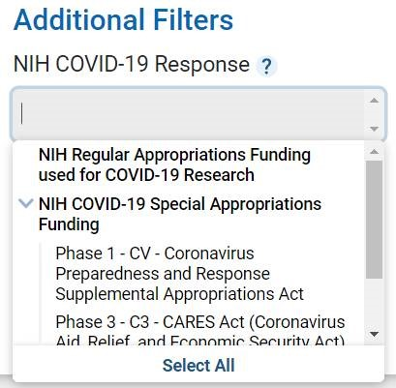

What’s New on RePORTER
Public COVID-19 Funding
Source Search
Preview of modernized
NIH RePORT and RePORTER
  https://nexus.od.nih.gov/all/2020/10/13/welcome-the-new-report-and-reporter-tools/

Slide 6
Using RePORTER to Help With Your Application
Find funded research projects in areas similar to yours
  See what’s been funded already
  Get additional background information on prior research
Identify collaborators
Find projects that were awarded earlier under similar Funding Opportunity Announcements (FOAs)

Slide 7
Information in RePORTER
RePORTER = Expenditures and Results
  Updated weekly with newly funded grants
Information is included from
  NIH, extramural and intramural since FY 1985
    Patents, publications, and other research outcomes
Projects supported by other components of HHS
  ACF, AHRQ, CDC, FDA
Projects supported by the VA

Slide 8
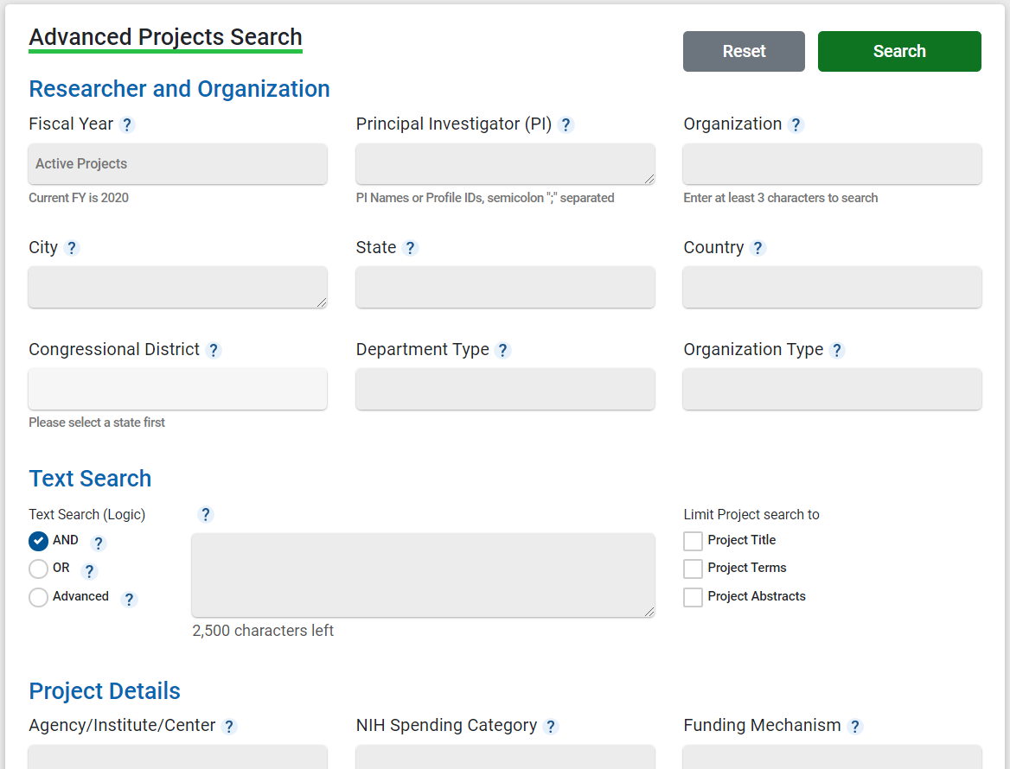
Multiple Ways to Search
Quick Search automatically queries across multiple fields, returning relevant results for common queries
Interactive charts let you jump into projects based on location or Institute/Center
Advanced Projects Search allows you to use precisely defined data fields

Slide 9
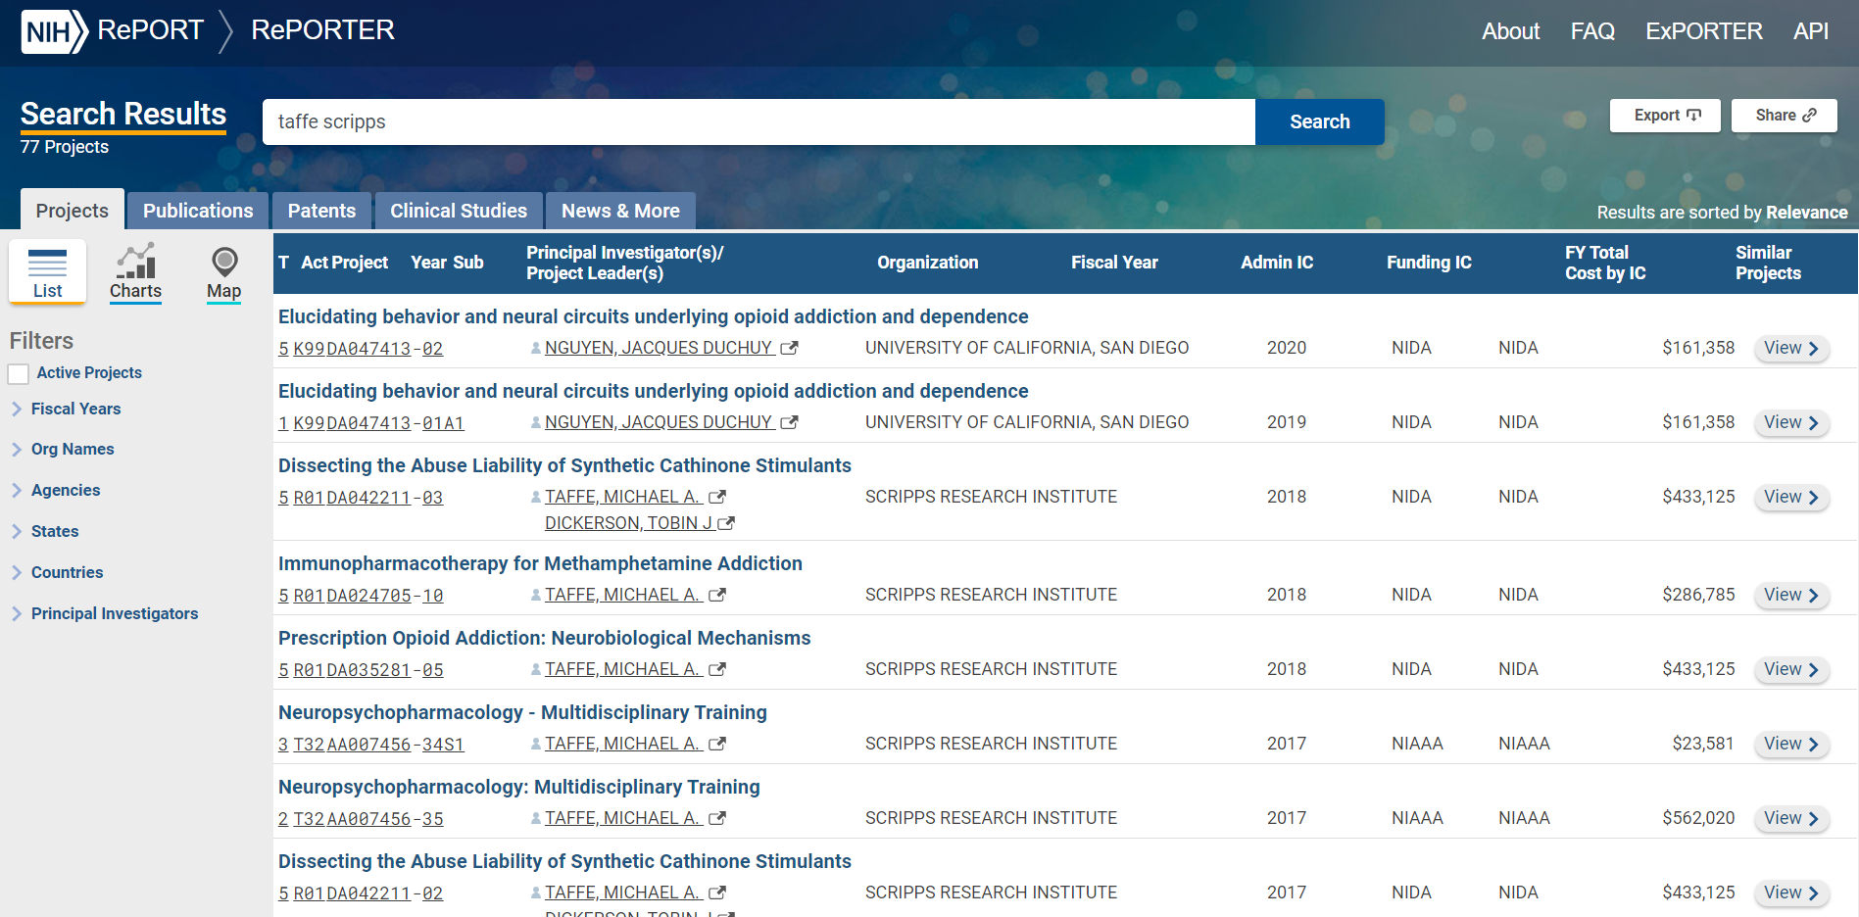
RePORTER Search Results – Projects, Publications, and More
Easily refine results without having to re-run a search
Explore projects, publications, and more
“Share” button creates a persistent URL for latest results

Slide 10
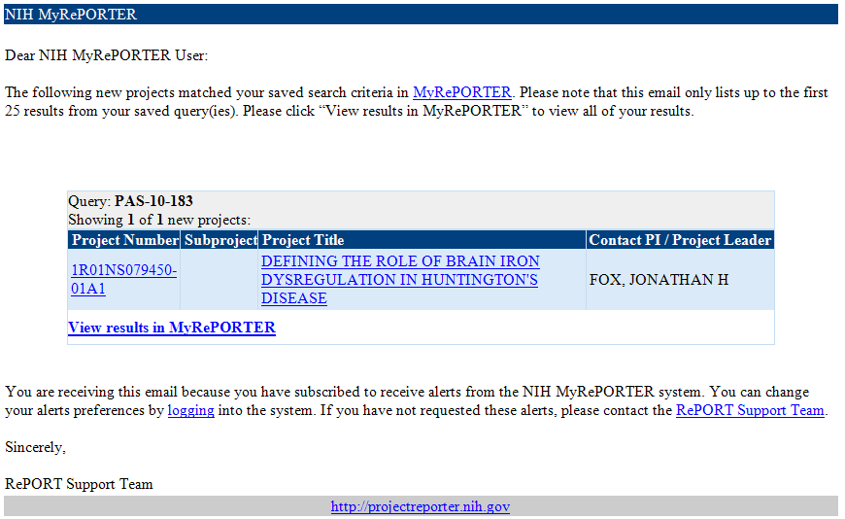
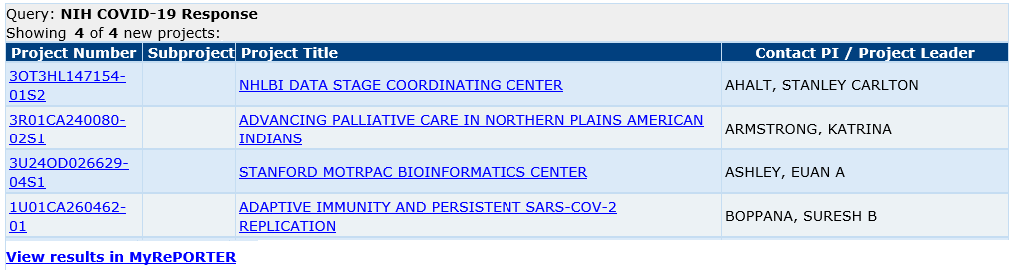
My RePORTER – Automated Email Alerts
Email alerts make it easy to stay up-to-date on current projects while you’re working on your application
Stay tuned for new version coming this winter

Slide 11
Matchmaker: What Projects Like Mine Have Already Been Funded, And Who Can I Contact to Discuss My Ideas?
Find similar projects, potential collaborators, and see which Program Officials or study panels may be appropriate for your application.
Go to https://reporter.nih.gov and click MATCHMAKER button
Enter scientific text – for example:
urinary tract infection escherichia coli
Select the SIMILAR PROGRAM OFFICIALS option
Click the SEARCH button and wait for text to be analyzed for key terms and concepts, which are matched with the key terms and concepts used in NIH-funded research
View list of Program Officials associated with most similar projects, and interact with charts to drilldown by IC and Activity Code

Slide 12
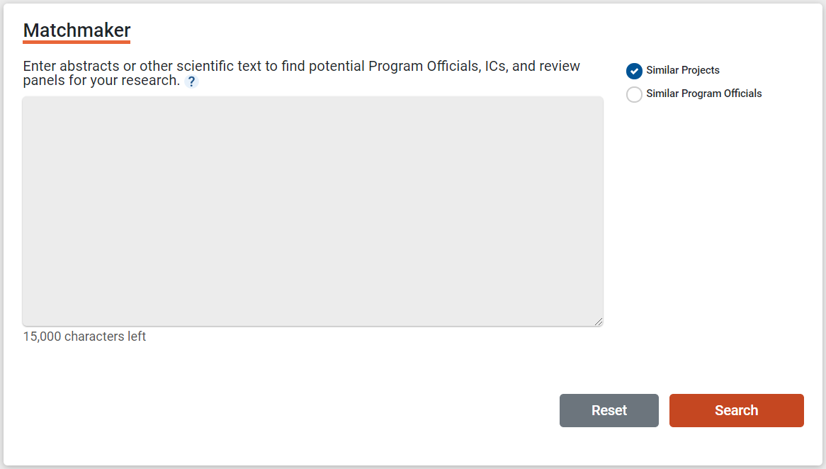
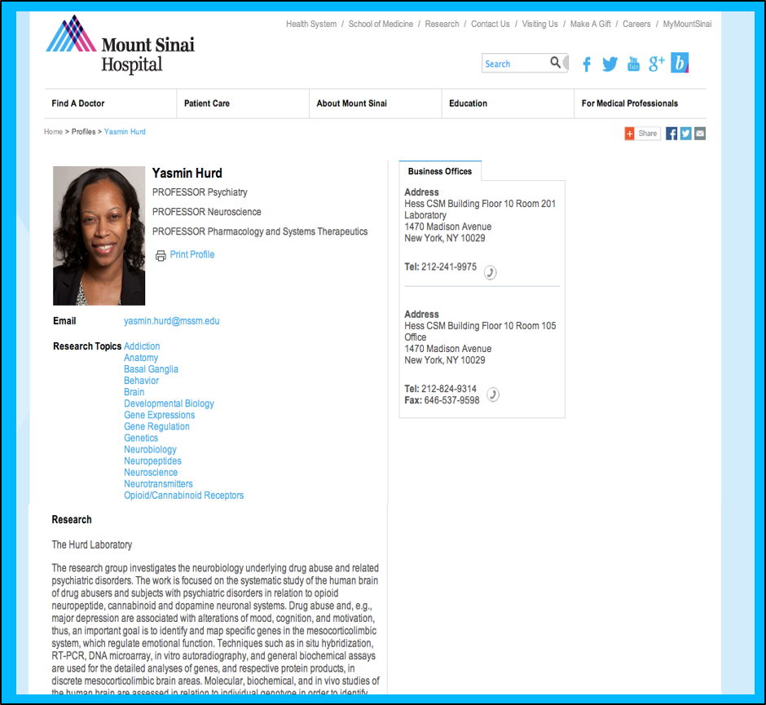
Matchmaker Demonstration: Find Similar Projects
The research group investigates the neurobiology underlying drug abuse and related psychiatric disorders. The work is focused on the systematic study of the human brain of drug abusers and subjects with psychiatric disorders in relation to opioid neuropeptide, cannabinoid and dopamine neuronal systems. Drug abuse and, e.g., major depression are associated with alterations of mood, cognition, and motivation, thus, an important goal is to identify and map specific genes in the mesocorticolimbic system, which regulate emotional function. Techniques such as in situ hybridization, RT-PCR, DNA microarray, in vitro autoradiography, and general biochemical assays are used for the detailed analyses of genes, and respective protein products, in discrete mesocorticolimbic brain areas. Molecular, biochemical, and in vivo studies of the human brain are assessed in relation to individual genotype in order to identify neurobiological correlates of functional genetic polymorphisms linked to addiction and affective disorders. Epigeneic mechanisms, e.g., DNA methylation, are also evaluated in relation to the regulation of gene expression.

Slide 13
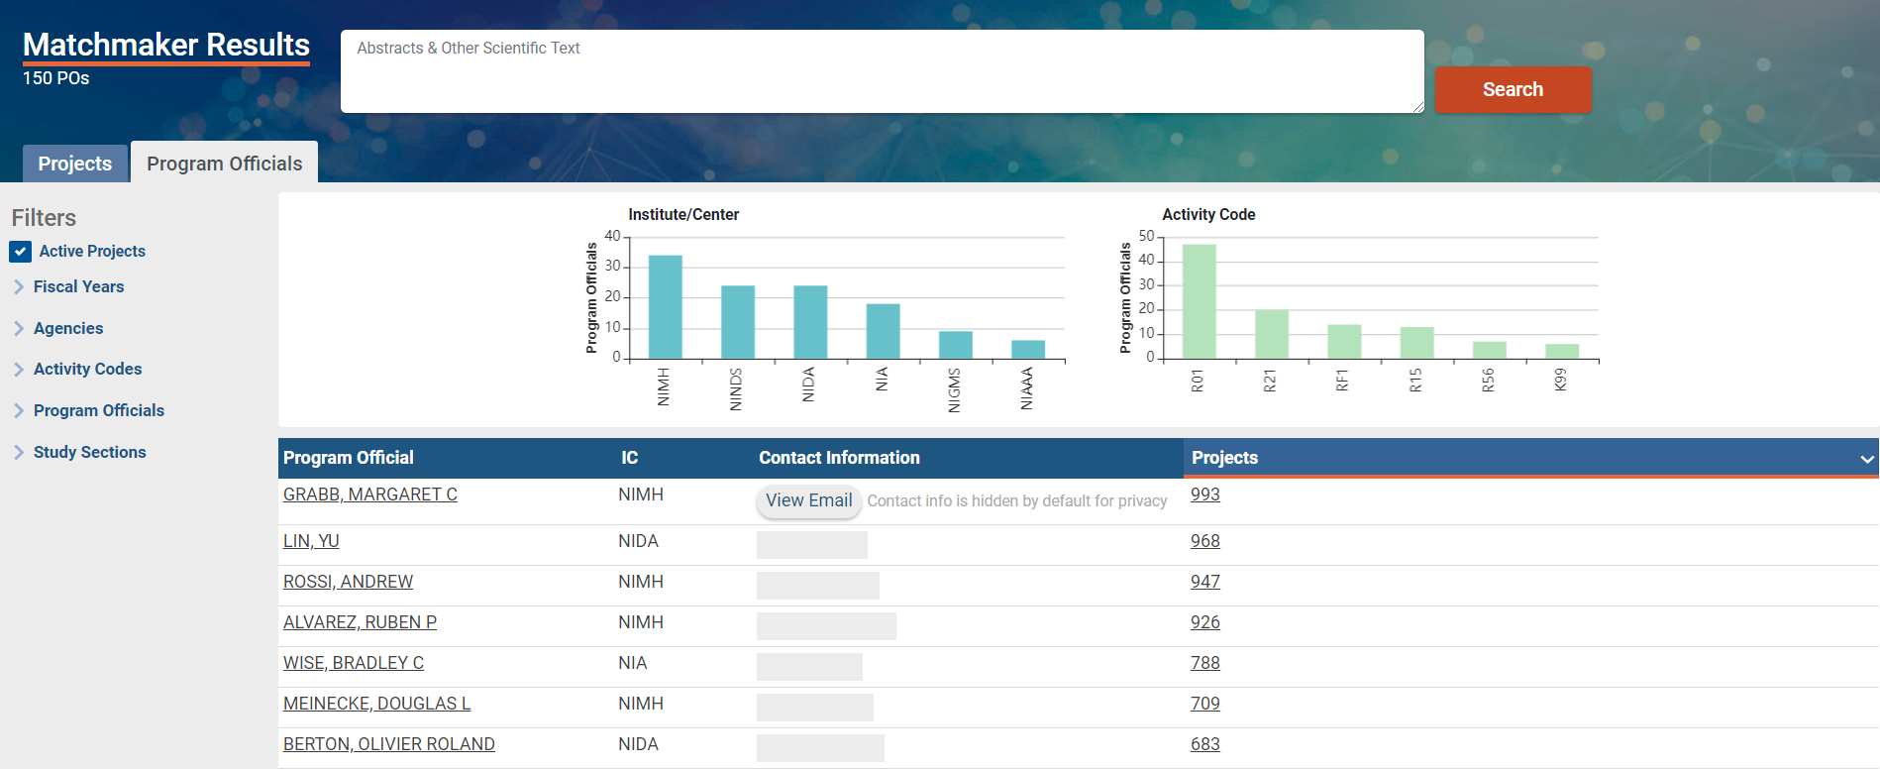
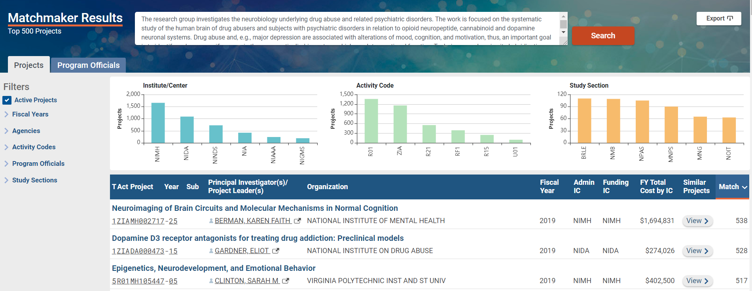
Matchmaker Results: Reach Out to NIH Staff in Your Research Area
Matchmaker summarizes the projects by the program official, institute or center, review panel, and activity code

Slide 14

NIH Awards by Location: Explore Funding to Your Organization
What types of organizations does NIH fund?
Who has NIH funding in my university system?

Slide 15
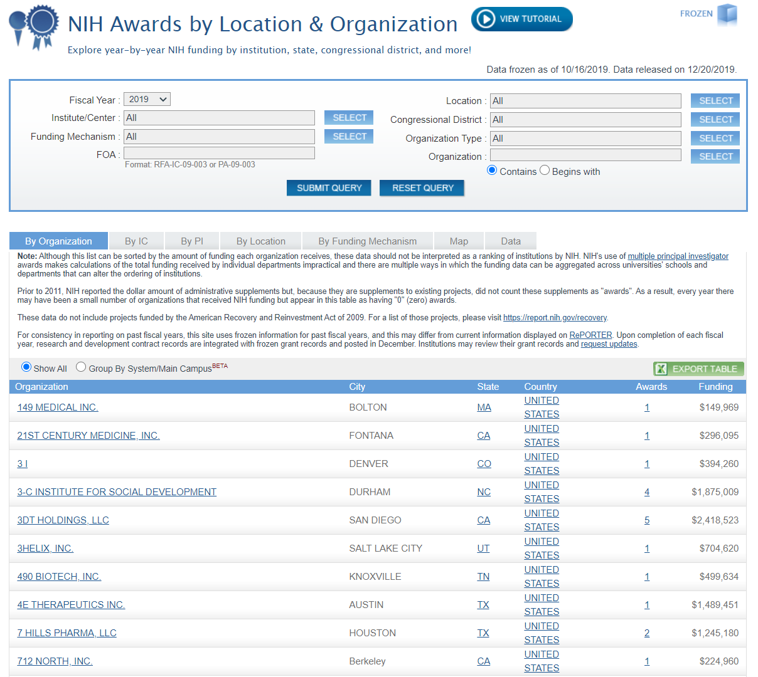
Looking for funding at your organization or state?
Use Awards by Location tool to view year by year funding by:
  Organization
  School
  Department
  State/country
  Congressional District
Uses frozen data for past fiscal years

Slide 16
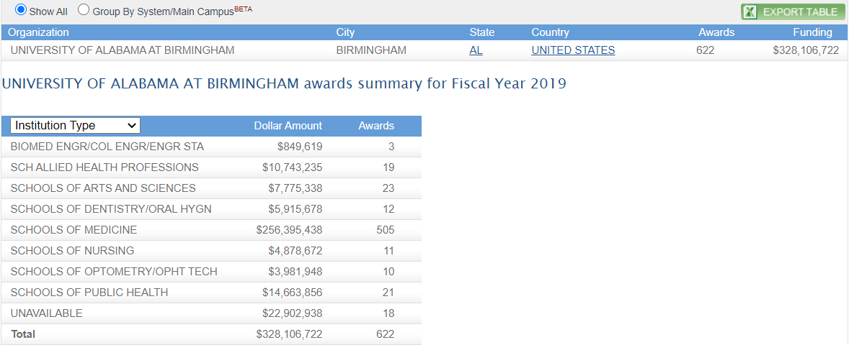
Institutional Funding – By School
Use Awards by Location tool to view year by year funding by:
  Organization
  School
  Department

Slide 17
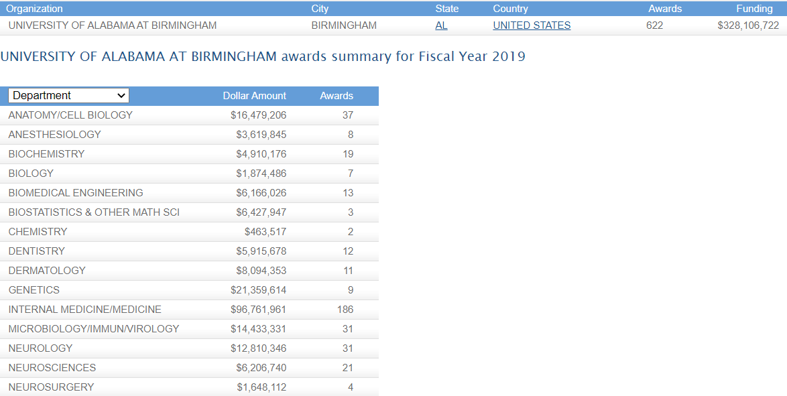
Institutional Funding – By Department
Use Awards by Location tool to view year by year funding by:
  Organization
  School
  Department

Slide 18
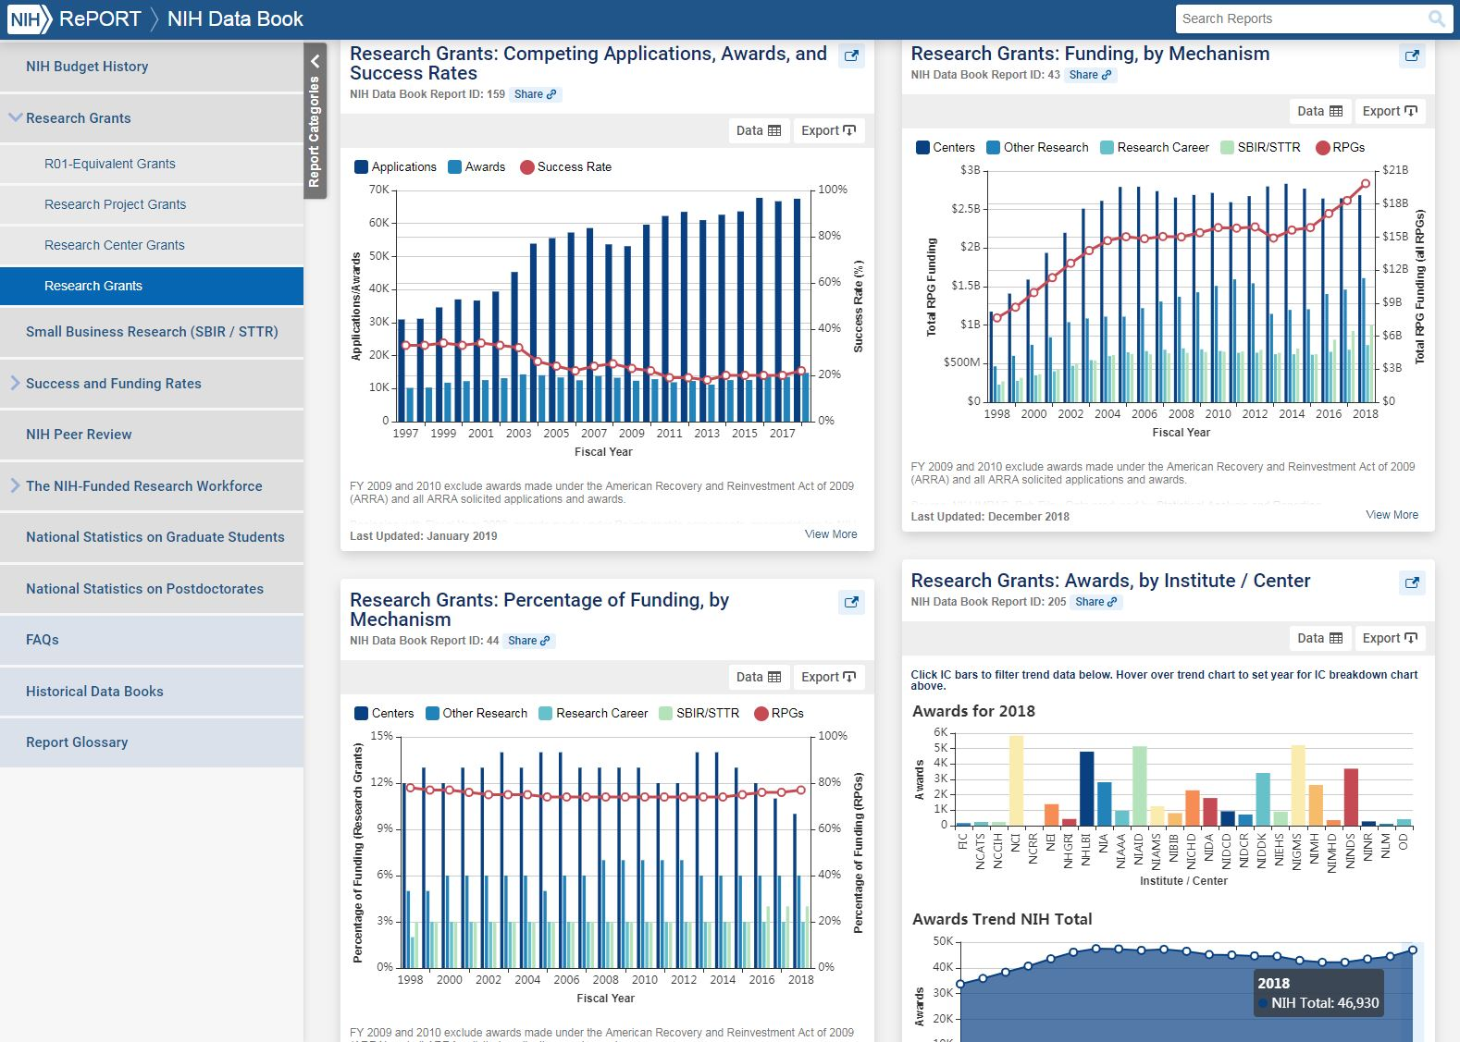
NIH Data Book: Which Programs Should I Apply for?
What Are My Chances of Getting Funded?
The NIH Data Book summarizes answers to the most commonly asked questions about the NIH budget and extramural programs.
Data are updated annually.

Slide 19
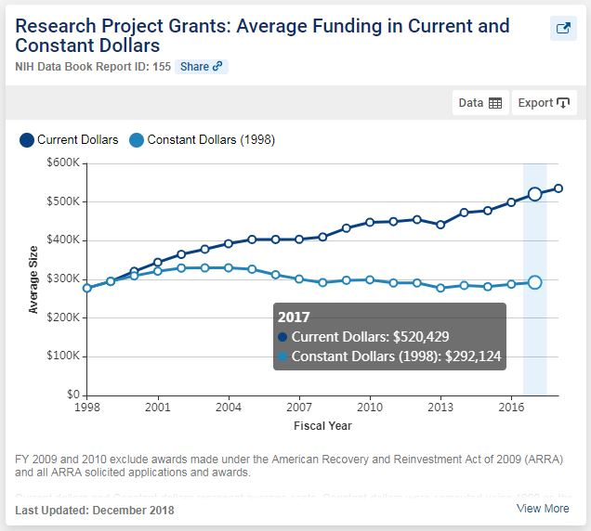
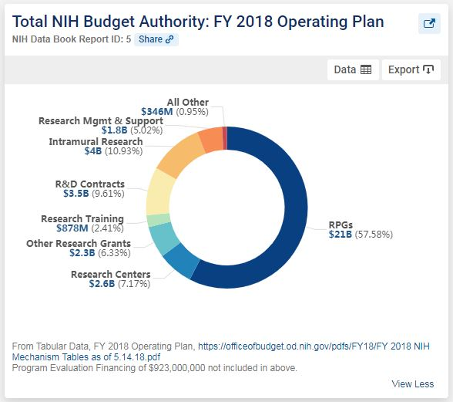
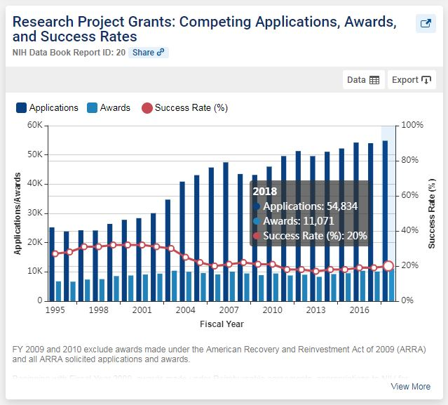
NIH Data Book Examples
Dozens of charts and tables in areas of –
Budget
Research Grants
Small Business
Success and Funding Rates
Peer Review
NIH-Funded Workforce
Charts and data are exportable for re-use.

Slide 20
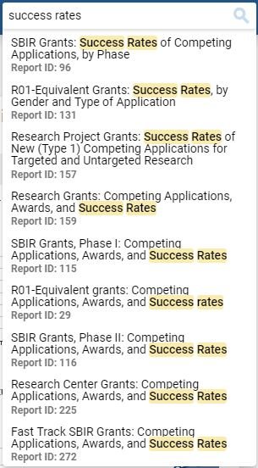
Easily Find the Data You’re Looking For
Intuitive to help you find what you’re looking for:
Built-in search
Interactive visualizations
View different subsets of data

Slide 21

How Much Does NIH Spend On …?
Categorical Spending provides levels of NIH funding over time for:
  Research areas
  Conditions
  Diseases

Slide 22
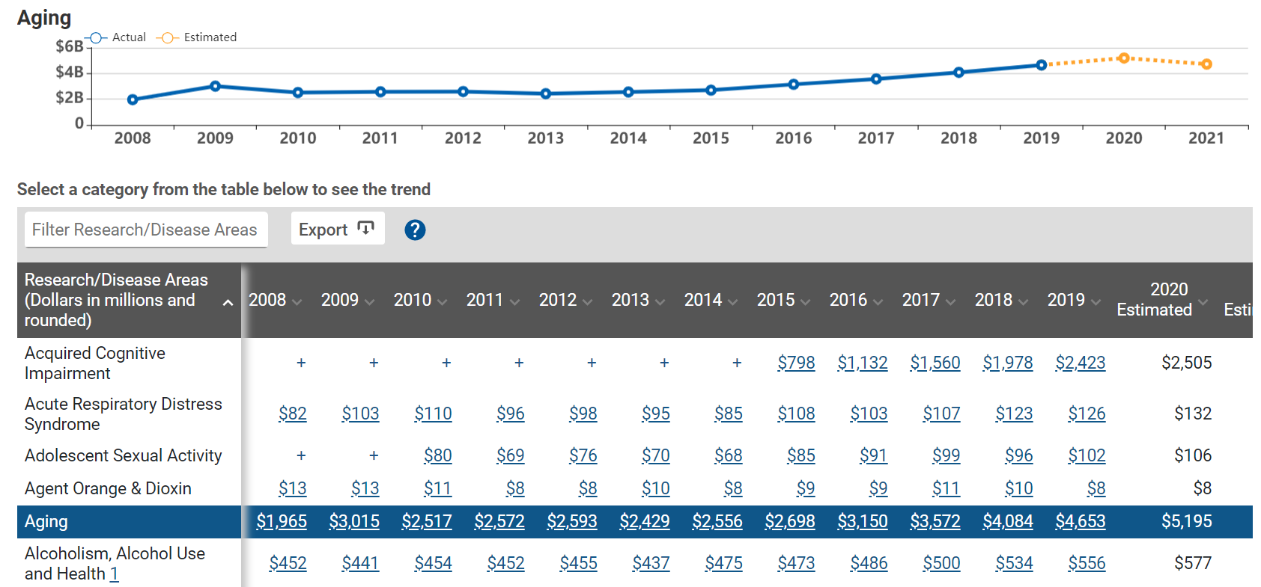
View Trends in Categorical Spending
Annual support level for various research, condition, and disease categories

Slide 23
Summary
What is the NIH already funding in my research area?
What results came out of those projects?
Which ICs have scientific priorities that align with my research ideas?
How can I find a relevant point of contact at NIH to discuss my research ideas?
How can I find collaborators?
What are other PIs at my institution working on?
Which types of programs should I apply for, and what are my chances of getting funded?
What is the NIH already funding in my research area? RePORTER text search
What results came out of those projects? RePORTER search results (tabs for Publications, Patents, Clinical Studies, News & More)
Which ICs have scientific priorities that align with my research ideas?
Matchmaker (summary by IC)
How can I find a relevant point of contact at NIH to discuss my research ideas? Matchmaker (Similar POs)
How can I find collaborators? RePORTER or Matchmaker
What are other PIs at my institution working on? NIH Awards by Location
Which types of programs should I apply for, and what are my chances of getting funded? NIH Data Book

Slide 24
What’s Next
Preview of modernized
NIH RePORT and RePORTER
  https://nexus.od.nih.gov/all/2020/10/13/welcome-the-new-report-and-reporter-tools/
More Preview features will be rolled out in the coming year, like those for MyRePORTER
Tell us your thoughts: RePORT@mail.nih.gov

Slide 25
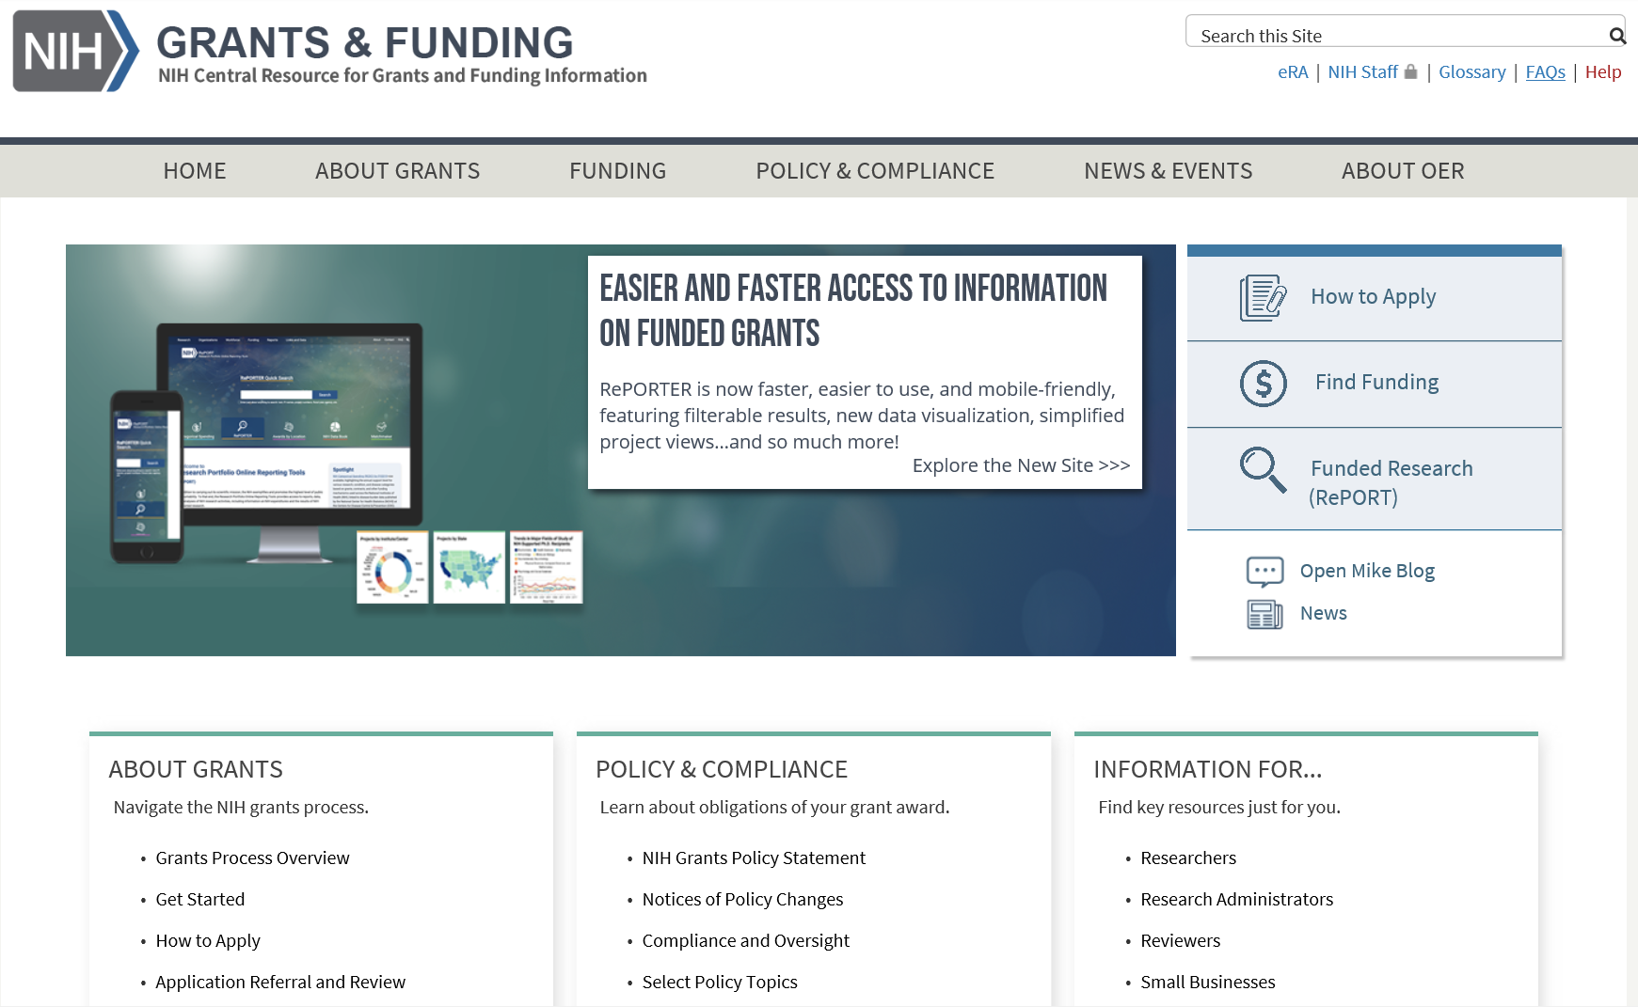
Other Resources for Understanding the Grants Process
More information to guide you through the application process can be found at https://grants.nih.gov

Slide 26
Thank You
Need Help? RePORT@mail.nih.gov
Websites
RePORT: https://report.nih.gov
RePORTER: https://reporter.nih.gov

