Slide 1

Understanding NRSA Fellowships (“F”) and Training (“T”) Grants
NIH Virtual Seminar
October 27 – 30, 2020
Presenters:
Dennis A. Twombly, Deputy Director, Office of Extramural Policy, Training
Officer, National Institute of Child Health & Human Development (NICHD – NIH)
Lisa Moeller, Team Leader, Grants Administration Branch
National Institute of General Medical Sciences (NIGMS – NIH)
1

Slide 2
Session Overview
Objective of Session:
Provide an overview of Individual NRSA Fellowships (F awards) and Institutional Training Grants (T awards), including the purpose of the programs, eligibility, application process, and post-award management.
Format of Presentation:
NRSA Programs: Fellowships and Training Grants (eligibility and general requirements)
Individual Fellowships (F): Programs and Applications
Institutional Training Grants (T32): Programs and Applications
Post-award Issues: Individual Fellowships
Post-award Issues: Institutional Training Grants

Slide 3
What and Why?
What are they?
NRSA awards support the training of biomedical, behavioral, and clinical researchers through individual pre- and postdoctoral fellowships, and institutional research training grants.
Program purpose?
Ensuring that a diverse pool of highly trained scientists is available in adequate numbers and in appropriate research areas to carry out the Nation’s biomedical, behavioral, and clinical research agenda.

Slide 4

























27 NIH Institutes and Centers (ICs)
Each with different:
  Mission & priorities
  Budget
  Funding strategy
  Workforce needs
NIGMS
International Center
Clinical Center

Slide 5
Research Training and Career Development
Fellowships & Career Awards
GRADUATE &
MEDICAL
STUDENTS
T32 Institutional Training Grants (Predoctoral slots)
F30 Pre-doctoral Fellowships (MD/PhD Programs)
F31 Pre-doctoral Fellowships (Parent F31)
F31 Diversity Pre-doctoral Fellowships
Training
POST-
DOCTORAL
FELLOWS
T32 Institutional Training Grant (Post-doctoral slots)
F32 Individual Post-doctoral Fellowships
Research Grants
K22 Career Transition Award (some ICs)
Transition
K99-R00 Pathway to Independence Award
R03 Small Grant
K12 Institutional Career Development Award
R21 Exploratory-
Developmental
Grant
K01 Mentored Research Scientist Development Award
K08 Mentored Clinical Scientist Development Award
K23 Mentored Patient-Oriented K Award
K25 Mentored Quantitative K Award
FACULTY
R01 Research Project Grant
Independent
K02 Independent Scientist Award
K24 Mid-career Award in Patient-Oriented Research
Notes:
This schematic shows where fellowships and training grants fit in the overall progression of career development. The ultimate objective is to train individuals to conduct independent research in the mission of one or more institutes. Applying for research project grants such as R01/R21/R03 are the final stage of this progression.

Slide 6




NRSA Fellowships & Training Grants
Individual Predoctoral Fellowships (F30, F31)
Individual Postdoctoral Fellowships (F32)
Institutional Training Grants (T32, T35)
  Awarded to the institution
  Supports group of pre- and/or postdoctoral fellows on “slots”
  Administered under direction of PD/PI or “Training Director”
Notes:
The NRSA programs fall into two general categories: Individual fellowships and institutional training grants.
NIH sponsors individual predoctoral fellowships for predoctoral students (F31), predoctoral students from underrepresented groups (Diversity F31), and students in formal dual degree programs (F30)
NIH supports individual postdoctoral fellowships via the F32 mechanism. This is open to any postdoctoral fellow.
Again, these are individual fellowships to support single graduate students or postdoctoral fellows.
T32 awards, in contrast, are awarded to an institution to support groups of pre- and/or postdoctoral fellows. The number of positions or “slots” varies with each award.
The PD/PI or “Training Director” for the T32s is almost by definition a nationally and often internationally renowned scientist.
The duration of support for pre- and postdoctoral fellows under any NRSA program is 5 years and 3 years, respectively.

Slide 7

NRSA Programs
Eligibility and Requirements
Citizenship: NRSA fellows and trainees must be U.S. Citizens, non-citizen nationals, or lawfully admitted for permanent residence at time of award (F) or time of appointment (T)
Degree Requirements:
Predoctoral: Must have a baccalaureate degree and be enrolled in doctoral program leading to PhD or equivalent, or dual research/clinical doctorate such as the MD/PhD
Postdoctoral: Must have a PhD or MD or comparable doctoral degree from an accredited domestic or foreign institution

Slide 8
NRSA Duration of Support
  Predoc: 5 years (6 years for dual degree, eg MD/PhD)
  Postdoc: 3 Years
  Aggregate limits apply: any combination from individual and/or institutional awards
Exceptions:
  Interruptions (break in service)
  Waiver request requires IC prior approval
  Exceptions are Rare
Notes:
Note: Some NIH Institutes are providing extensions of eligibility for COVID-impacted fellows or trainees

Slide 9
Time Commitment of NRSA Fellows/Trainees
Full-time Training: NRSA fellows are required to pursue full-time training, as defined by 40 hrs/week devoted to research training activities.
Part-time Training: Less than full-time training may be approved under certain conditions.
  Allowed in unusual personal circumstances (e.g., medical conditions, disability, personal or family situations such as child or elder care)
  Part-time training is not allowable to accommodate other sources of funding, job opportunities, or clinical practice or training
  NIH prior approval required: Program Director or Sponsor must submit written request, countersigned by fellow & authorized institutional official
  Fellow/trainee must continue to devote at least 50% effort. Less than 50% would require unpaid leave-of-absence from NRSA support.

Slide 10
NRSA Trainee Support includes…
Stipend – Subsistence allowance to help defray living expenses
Tuition & Fees – Full needs requested, actual formula is 60% of costs up to $16,000 (predoc) and $4,500 (postdoc)
Training-related expenses – Health insurance, staff, consultants, research supplies
F&A – 8% on base (excludes Tuition & Fees and Equipment)
Notes:
The NRSA programs provide funding for fellows and trainees in specific cost categories as shown here.

Slide 11
Stipends
Subsistence allowance to help defray living expenses during the period of training
Not a “salary”; fellows/trainees not considered employees of either the Government or the Institution
NIH publishes levels in NIH Guide when increases are approved
Predoctoral:
One level for all individuals, regardless of years of experience
FY 2020 Level = $25,320
Postdoctoral:
Based on years of relevant experience beyond qualifying degree (0 – 7)
For Ts, level set at time of appointment
Set annually; no mid-year changes
Relevant Experience = research, teaching, internship, residency, clinical duties, or other time spend in a health-related field
Notes:
Update
NIH publishes a Guide Notice each year that states the NRSA rates for that fiscal year.

Slide 12
Stipend Levels for FY2020
Career Level | Years of Experience | Stipend for FY 2018 | Monthly Stipend
Predoctoral | ALL | $25,320 | $2,110
Postdoctoral | 0 | $52,704 | $4,392
 | 1 | $53,076 | $4,423
 | 2 | $53,460 | $4,455
 | 3 | $55,596 | $4,633
 | 4 | $57,456 | $4,788
 | 5 | $59,580 | $4,965
 | 6 | $61,800 | $5.150
 | 7 or More | $64,008 | $5,334
See Guide Notice: NOT-OD-20-070

Slide 13
FY 2019 NRSA
Training Grant/ Fellowship Costs
13
Award Category | Predoctoral | Postdoctoral
Tuition/Fees | 60% up to $16,000 | 60% up to $4,500
 | 60% up to $21,000 for formally combined dual degree training | 60% up to $16,000 for formal degree granting program
Training Related Expenses | $4,200 (includes health insurance) | $11,850 (includes health insurance)
Institutional Allowance | $4,200 (includes health insurance) | $11,850 (includes health insurance)
 | $3,100 – federal and for-profit (includes health insurance) | $10,750 – federal and for-profit (includes health insurance)
Trainee Travel | $400 - $1,000 (typical range; varies by NIH awarding component)
F&A | Training Grant Rate = 8%; Base = MTDC less Tuition/Fees and Equipment Fellowships = 0%
See Guide Notice: NOT-OD-20-070
Notes:
FAQ: How do I find stipend levels for this fiscal year?
Google “NRSA stipend 2020”
Stipends and Tuition
Budget requests should request full amount for tuition & fees charged by the institution
NIH formula applied to the combined cost of tuition & fees and used for award calculation
Tuition/Fees per trainee basis: Predoctoral--60% up to $16,000, $21K if dual degree; Postdoctoral--60% up to $4,500; No escalation in future years
Trainee Travel
Usually per/trainee formula based for award calculation
Varies among IC’s
Scientific meetings OK
Cost of travel from residence to institution (unallowable)
Training experiences away from institution OK but requires IC prior approval
Training Related Expenses (TRE)
Can be used for: Health Insurance, staff salaries, Consultant Costs, Equipment, Research Supplies, Staff travel, and Other Expenses directly related to the training program
Health Insurance OK if applied consistently (Family Health Insurance allowable, Dental & Vision coverage also OK as long as it is consistently applied)

Slide 14
Payback Requirements
Predoctoral Trainees and Fellows:
Payback not required for predoctoral trainees/fellows
Postdoctoral Trainees and Fellows:
Incur obligation in first 12 months of Postdoc NRSA support
The 13th and subsequent months of Postdoc NRSA support can satisfy the Postdoc obligation
  Normally, individuals with two years of NRSA postdoctoral support have no further obligation
Qualifying service: > 20 hr/week on research, teaching, or “health-related activities” (description, diagnosis, prevention or treatment of disease – basic to applied)
Notes:
Remove some of these payback slides

Slide 15
Individual NRSA Fellowships
Programs and Applications

Slide 16
Individual Fellowship Types
Predoctoral Fellowships:
F30: Individual Predoctoral Fellowship for Institutions with NIH-funded dual degree programs (eg, MSTP funding for MD/PhD or other formal dual degree programs)
F30: Individual Predoctoral Fellowship for Institutions without NIH-funded dual degree training programs (eg, MD/PhD or other formal dual degree programs)
F31: Individual Predoctoral Fellowship (most under Parent FOA)
F31 (diversity): Individual Predoctoral Fellowship to promote diversity in Health-Related Research
Postdoctoral Fellowships:
F32: Postdoctoral Fellowship
F33: Postdoctoral Senior Fellowship (independent investigators with > 7 yrs of experience; for re-training, sabbatical, career development)
Notes:
Some NIH institutes do not participate in certain fellowship programs. Consult FOA and IC Table of IC-specific Requirements and Staff Contacts for participation of individual ICs and program parameters.
Eligible categories of ndividuals for the F31 Diversity are listed in the FOA.

Slide 17
Refer to Program Announcements (PAs) !!
Funding Opportunity Title
  Ruth L. Kirschstein National Research Service Award (NRSA) Individual Postdoctoral Fellowship (Parent F32)
Funding Opportunity Announcement (FOA) Number
  PA-20-242
Components of Participating Organizations (all NIH ICs, e.g.)
    National Center for Complementary and Integrative Health (NCCIH)
    National Cancer Institute (NCI)
    National Eye Institute (NEI)
    National Human Genome Research Institute (NHGRI)
    National Heart, Lung and Blood Institute (NHLBI)
    National Institute on Aging (NIA)
Special Note: Not all NIH Institutes and Centers participate in Parent Announcements. Applicants should carefully note which ICs participate in this announcement and view their respective areas of research interest and requirements at Table of IC-Specific Information, Requirements and Staff Contacts website. ICs that do not participate in this announcement will not consider applications for funding. Consultation with NIH staff before submitting an application is strongly encouraged.
Notes:
The Funding Opportunity Announcement (FOA) provides all of the relevant policies and requirements for any given program, including K awards.
Be sure to check if FOA has been re-issued
Look for important Related Announcements
Important: Click on Table of IC-Specific Information, Requirements, and Staff Contacts for eligibility, budget limits, and other requirements.

Slide 18
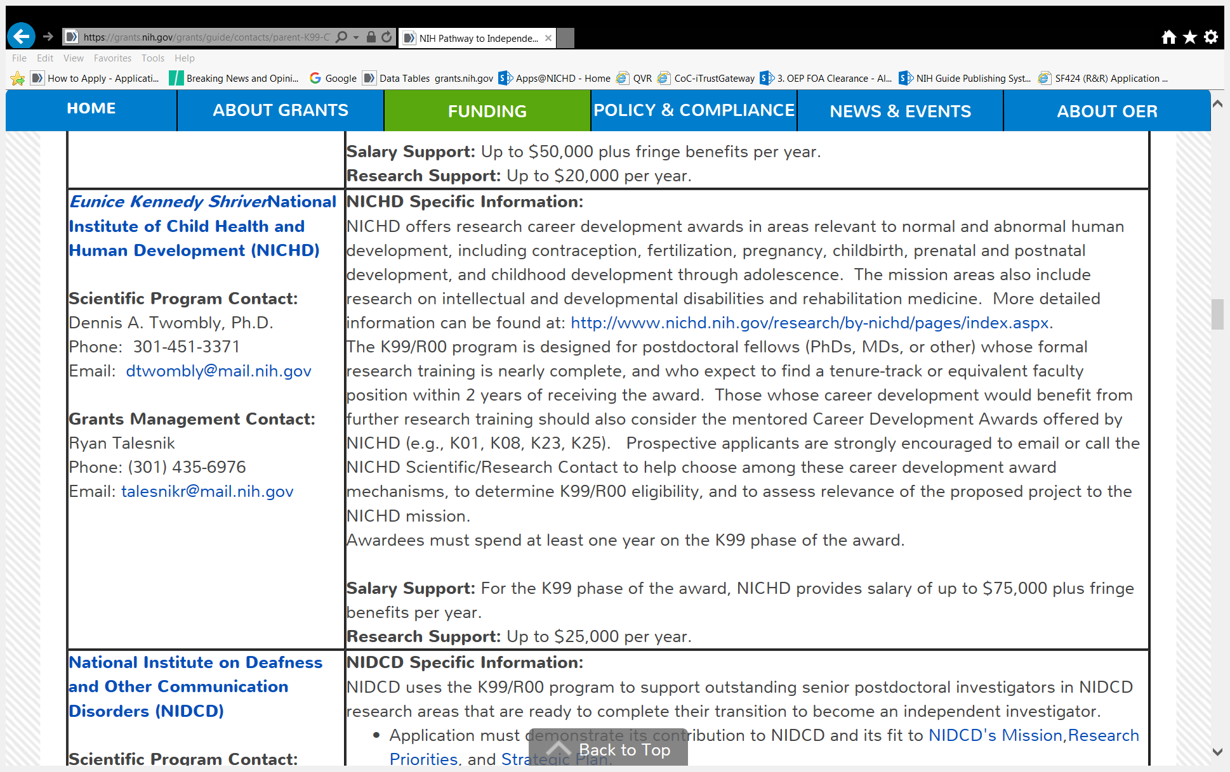
K99 Table of IC-specific Information
Notes:
This example is for the K99-R00 program to illustrate how an IC such as NICHD might specify certain cost limits and eligible topic areas. There will be a similar IC table for all of the F Parent announcements.

Slide 19
Fellowship Applications
Eligible Institutions = Domestic, non-Domestic, non-profit, public or private institutions
Research training must fall within the mission of the NIH awarding Institute or Center
Submitted electronically through Grants.gov using Application Package found with the FOA
Reference letters submitted separately through the NIH eRA Commons system; are matched with application at NIH
  Letters are due by the application receipt date
Notes:
FAQ: Are Clinical Trials allowed on F awards?
Fellowship applicants are permitted to conduct research involving human subjects; however, they are NOT permitted to lead an independent clinical trial.
Fellowship applicants proposing to gain clinical trial research experience must do so under a sponsor’s supervision.
Follow the SF424 Instructions for the Human Subjects and Clinical Trials Information Form !!
The sponsor or co-sponsor is required to include a statement to document leadership of the clinical trial. The statement must include the following:
Source of funding
ClinicalTrials.gov identifier (e.g., NCT87654321), if applicable
A description of sponsor(s) qualifications to guide the applicant in any proposed clinical trials research experience.

Slide 20
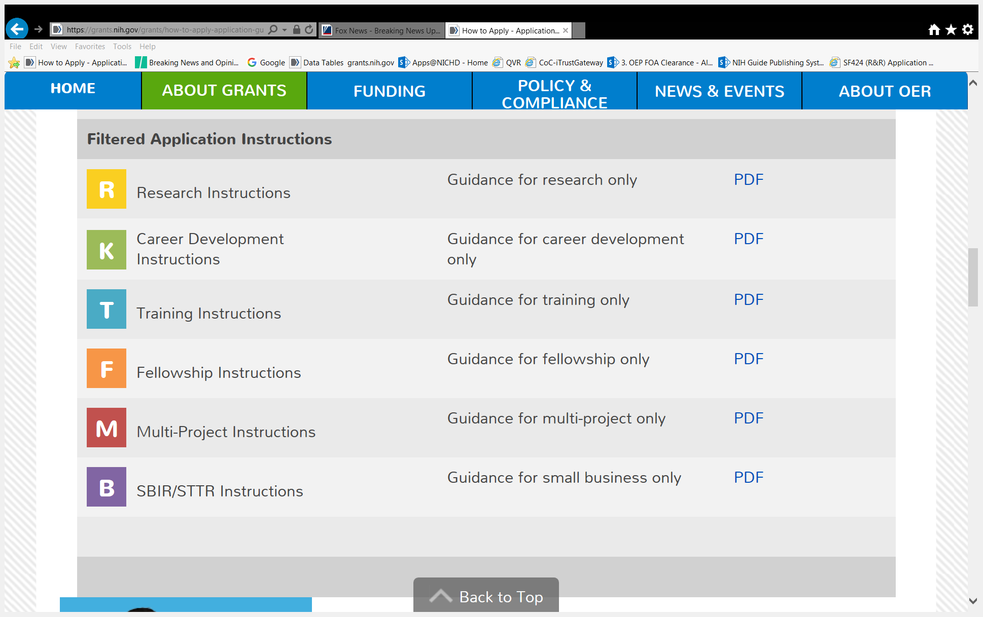
How to apply for a K award
20
Follow SF424 instructions
for F awards
Notes:
Application packet available via FOA link. These are SF424 instruction Guides.
FAQ: The FOA says to do one thing and the Application Guide says to do something else. Which do I follow?
Follow Application Guide instructions as default; follow FOA if it adds or replaces standard instructions

Slide 21
Fellowship Review and Award
Two-stage review:
  Initial Review Group (CSR Fellowship Study Sections or IC-based study sections)
  Institute/Center Program Staff (analogous to Council)
Generally 5-6 month period from receipt to earliest possible award (except October Council)
Actual start date depends on Council round, budgets, pay guidelines, grant processing time, etc.
Check Funding Opportunity Announcements for variations

Slide 22
Review Criteria for F’s
Scored Review Criteria:
Fellowship Applicant
Sponsor, Collaborators/ Consultants
Research Training Plan
Training Potential
Institutional Environment and Commitment to Training
Additional Review Criteria:
Protection for Human Subjects
Inclusion of Women, Minorities, and Children
Vertebrate Animals
Biohazards
Resubmission & Renewal factors
Additional Review Considerations:
Training in the Responsible Conduct of Research (RCR)
Select Agents Research
Resource Sharing Plans
Budget & Period of Support
Notes:
Consult Section V of the FOA for review criteria. Those are the questions reviewers will use to rate your application.
The Overall Impact score is not a numerical average of the Criterion scores. Reviewers can weight the criteria differently.

Slide 23

Institutional Training Grants Program Features and Applications

Slide 24
What are Institutional Training Grants ?
T32 programs offer research training in thematically focused area(s), often multidisciplinary
Programs are funded for specific number of pre- and/or postdoctoral slots
Participating Mentors/Faculty provide research training
Applicant Institutions must have:
  Strong research program in the proposed area(s)
  Competitive Applicant Pool
Program Director(s) responsible for:
  Overall direction of the training program
  Selection and appointment of NRSA eligible trainees

Slide 25
Examples of Institutional Training Grants
T32 - NIH National Research Service Award Institutional Research Training Grants -- Programs can be Predoctoral, Postdoctoral, or a combination of both. Most appointments are 12 months duration. Minimum is 9 months.
D43 – International Research Training Grant – Pre- or post-doctoral research training programs in low- and middle-income countries (global health).
T34 – Maximizing Access to Research Careers Undergraduate Student Training in Academic Research (MARC U*STAR Program) – Supports underrepresented students in STEM fields in final 2 years of undergraduate training (NIGMS)
T35 – NRSA Short-Term Institutional Research Training Grants -- Generally 3-6 months training for health professional students (medical, veterinary, or students of other health professional programs).
T90/R90 -- Kirschstein Interdisciplinary Research Training Award (T90) and combined Research Education Grant (R90) -- NIH Blueprint Training in Computational Neuroscience, undergraduate (R90) and graduate levels (T90 or R90).
Notes:
These are just a few examples of the types of available T programs. You can find what programs an IC participates in by going to the web site and looking under “training and career development”.
The T32 training grants are the most common type used by NIH institutes. Most of the examples in this presentation will focus on T32 programs.

Slide 26
Features of a T32 Program
26
Intensive training in a research specialty with a mentor
Choice of a spectrum of laboratories
Exposure to different methods and technologies
Courses & seminars with national experts
Training in Responsible Conduct of Research (RCR)
Human & animal subjects protections
Communication skills (manuscripts, grants, oral presentations, public outreach)
Alternative career paths (pharma, biotech, gov’t, teaching
Travel to other labs or scientific meetings

Slide 27
Preparing a T32 Application
Apply through Funding Opportunity Announcement (FOA)
Follow SF424 Application Guide Training (T) Instructions
Eligible Institutions = Domestic, non-profit public or private institutions
Research training must fall within the mission of the NIH awarding Institute or Center (confirm with NIH Program Staff or Training Officers!)
Application Due Dates: Standard Dates (Jan 25, May 25, Sept 25),
Except: See FOA or IC Tables linked to Parent FOA!
  Many ICs only use the May 25 due date each year
  Some ICs have different due dates for NEW vs RESUBMISSION
  Some ICs use different dates for AIDS vs non-AIDS applications
  Some ICs use different dates for predoctoral vs postdoctoral programs

Slide 28
Review of Training Grants
Two Levels of Review:
  Initial Review - Study Section
    Some Institutes have single study section
    Some Institutes use multiple study sections organized by topic
  Institute or Center National Advisory Council

Slide 29
Review Criteria for T32 Applications
Scored review Criteria:
Training Program and Environment
Training Program Director(s)/Principal Investigator(s) (PDs/PIs)
Preceptors/Mentors
Trainees
Training record
Additional Review Criteria:
Resubmissions (responsive to critiques?)
Renewals (progress, including on the Recruitment Plan to Enhance Diversity, training in Responsible Conduct of Research, evaluation of program, proposed changes)
Revision
Additional Review Considerations:
Diversity Recruitment Plan
Training in Responsible Conduct of Research
Select Agent Research
Budget and Period of Support

Slide 30

You received a fundable score -- now what?

Slide 31
Individual NRSA Fellowships
Post-award Issues

Slide 32
NRSA Fellowships
Initiation of Support
Awarding component will notify individual of intention to make an award
The fellowship Notice of Award will be issued
Fellow must start training within six months of the award issue date
Before the day Fellow begins training, Activation Notice and Payback Agreement (only for Postdoc fellows in first 12 months of NRSA support) must be completed and submitted to awarding component
Termination Notice due at end of fellowship and submitted via xTRAIN

Slide 33
Reporting Requirements
Activation Notice: (FORM PHS 416-5) Immediately upon initiation of training, fellow completes and returns this form to the NIH awarding component.
Payback Agreement: (FORM PHS 6031): Must be signed by each person who is to receive an individual Postdoctoral fellowship that covers their initial 12 months of NRSA postdoc support.
Termination Notice: (FORM PHS 416-7): For individual fellowships, this form is required upon completion of support. Electronic submission now required through eRA Commons xTrain.
Notes:
Activation and Termination are submitted thru xTRAIN
For early termination (before scheduled project end date), Termination Notice is due asap – will require a revised NoA; otherwise due 30 days after termination ends

Slide 34
Stipend Supplementation
Fellows and Trainees
Recipients may supplement stipends
  Amount determined according to formally established policies applied to all in similar training status
  Consistent treatment is key
Supplementation must be from Non-Federal funds
Without additional effort or obligation to trainee/fellow

Slide 35
Compensation
Trainees/Fellows may receive additional compensation for services associated with employment, e.g., teaching assistant, lab assistant
Individual receives salary; not considered stipend supplementation
Can compensation be from an NIH research grant?
  Yes, on a limited part-time basis (25% time = 10 hr/week)
  May not be from same grant that is part of training experience
  Fellowship Sponsor or Training Grant Program Director must approve
  May not interfere with or prolong the approved NRSA training
Notes:
Employer/Employee relationship
Different from the work being done on the NRSA program.
Stipend Taxability
IRS (not NIH) has domain over interpretation & implementation
NRSA Guidelines provide minimal guidance but individuals should consult local IRS offices

Slide 36
Progress Reports
Progress Reports: Progress reports must be submitted annually using the Research Performance Progress Report (RPPR) in the eRA Commons.
Final Progress Report: For individual awards, a final progress report is required as part of the Termination Notice. A separate final progress report is not required.
Federal Financial Report (FFR): A Financial Expenditure Report is not required for individual fellowship awards. However, institutions must complete the Federal cash transaction using the FFR to PMS (SF425).
Notes:
Annual progress reports due 60 days prior to anniversary/activation date.

Slide 37
Fellowships: Changes in Project
Individual fellowship awards are made for training at a specific institution under the guidance of a particular sponsor.
A transfer of the award to another institution or a change in sponsor requires the approval of the NIH awarding component. Should consult with NIH awarding component ASAP.
Any proposed change in the individual’s area of research training must be approved by the awarding component.
When the sponsor plans to be absent for a continuous period of more than 3 months, an interim sponsor must be named by the institution and approved by the NIH awarding IC.
Notes:
Transfer – may require new sponsor as well as keep original as a co-sponsor.
If change to Sponsor, institution & scope – may require submission of a new competing application.

Slide 38
Leave Policies: Fellows and Trainees
Vacations & Holidays: Predoc and Postdoc Fellows & Trainees may receive the same vacations and holidays available to individuals at the recipient or sponsoring institution. Trainees will continue to receive stipends.
Sick Leave: May continue to receive stipends for up to 15 calendar days (2 weeks) of sick leave per year.
Parental Leave: May receive stipends for up to 60 calendar days (8 weeks) of parental leave per year for the adoption or birth of a child.
Unpaid Leave: Extended leave beyond above allowances must be requested in advance from awarding component.
  Fellowship: award will be revised extending termination date by the number of months of leave.
  Trainee (T32): terminate & reappoint
  Stipends may not be reimbursed during unpaid leave; continued health insurance coverage is allowable if consistent with institutional policy.
See NIH Grants Policy Statement and NOT-OD-18-154
Notes:
Consistency is key.
Parental Leave: Previously, the NRSA program could not provide leave to NRSA-supported individuals unless those in comparable training positions at their institution also had access to this level of paid parental leave. While this requirement is now removed, the NRSA trainee or fellow is required to provide advance notice to their grantee institution and their supervisor according to their institution’s policy.

Slide 39
Institutional Training Grants (T) Post-Award Issues

Slide 40
xTRAIN — Appointment and Termination Notices
xTRAIN: eRA Commons electronic submission of trainee appointments, reappointments, amendments, and Termination Notices – REQUIRED
Appointment Forms (PHS 2271)
  Due on or before the start of the appointment period
  No stipend or other allowance may be paid until submitted
  Delinquent submissions (> 30 days) may result in disallowance
Termination Notices (PHS 416-7)
  Required at time an appointment is ending
  Reflects total period of support & NIH stipend only (do not include any supplementation)
  If there was a hiatus of support, report only current period

Slide 41
Trainee Appointments
Trainees considered full-time participants in training program (40 hrs/wk)
Most appointments are 12 months in duration
Appointments less than 9 months not allowed unless completing a planned training program
Appointments may begin any time during the budget period
Notes:
Full time is normally 40 hours – according to the grantee institution’s policies
Appt can be for 9-12 months

Slide 42
Appointments
42
Training slots vs. Training months
  Varies according to IC
  3 FTTPs = 36 training months (3 x 12)
  Look for footnote under terms and conditions or contact awarding IC
  Example: This award includes funds to support X trainees (xx Training Months). The maximum number of trainees that may be appointed without the prior written approval of NIGMS staff is X ( xx Training Months) if funds are available through rebudgeting.
Notes:
Check with your IC to see which philosophy they adhere to.
Why does this matter? If slots, if they have awarded 3 FTTPs/slots; IC may not allow you to appoint more than 3 fttps despite having some appointments that are less than 12 months in length. If training months, can appoint more than 3 fttps if there are unused training months as long as you adhere to the minimum of 9 months per trainee – how can you do that? By promising to reappoint in the upcoming budget year.
Some ICs are cautious because they do not want trainees leaving the program in less than 2 years – research has indicated postdocs in training 25-36 months more productive than postdocs less than 9 months.

Slide 43
“Overlapping” Appointment
An appointment period may overlap budget periods
Budget Year 1 (FY18) Budget Year 2 (FY19)
5/1/2018 – 4/30/2019 5/1/2019 – 4/30/2020
Trainee 1 Appointment
8/1/2018 – 7/31/2019
Trainee costs expensed from year of appointment.
“Overlapping” Stipend & Tuition (3 months) reported as unliquidated obligation on FFR. NOT carryover.
Notes:
Reminder that stipend level must correspond to the level provided from the support year. So if Year 2 includes a stipend increase, you’ll have trainees at 2 different levels if overlapping appt in YR 1. You can supplement to bring them in line but what is charged to the grant must reflect the level provided in that particular award year.
YR 01 award made with NIH FY2018 funds – must use FY2018 published stipend levels for trainees appointed in YR 01.

Slide 44

Training Grants: Allowable and Unallowable Costs
Allowable
Stipends
Trainee Tuition and Fees
Trainee Related Expenses
  Health Insurance (self or family)
  Medical liability and other special insurance (if required by the research)
  Staff Salaries
  Speaker Fees
Trainee Travel
Facilities and Administrative Costs (8%)
Unallowable
Pre-Award Costs
Trainee costs*- must be appointed
Stipends * mid-appointment changes
Trainee Travel – travel costs outside of the trainee appointment period
Notes:
8% F&A
Pre-award – stipends/health insurance – not until trainee is appointed
Training-Related Expenses (TRE): staff salaries, consultant costs, equipment, research supplies, staff travel, health insurance and other expenses directly related to the training program
Stipend Taxability
IRS (not NIH) has domain over interpretation & implementation
NRSA Guidelines provide minimal guidance but individuals should consult local IRS offices

Slide 45
Research Performance Progress Reports (RPPR)
Annual RPPR – Use to describe a grant’s scientific progress, identify significant changes, report on personnel, and describe plans for the subsequent budget period or year. [Due Date varies by IC]
Interim RPPR – Use when submitting a renewal (Type 2) application. If the Type 2 is not funded, the Interim RPPR will serve as the Final RPPR for the project. If the Type 2 is funded, the Interim RPPR will serve as the annual RPPR for the final year of the previous competitive segment. [Due 120 days after period of performance end date of competitive segment.]
Final RPPR – Use as part of the grant closeout process to submit project outcomes in addition to the information submitted on the annual RPPR. [Due 120 days after period of performance end date.]
Notes:
For T-5s, many IC’s adhere to 2 months before start date. NIGMS due Nov. 15 for July awards. IC’s encouraged to include a term on the award if it is not the 60 days prior to budget period for non-snaps.

Slide 46
Financial Reporting Requirements
  Use the Federal Financial Report [FFR]
  Quarterly Cash Report in the Payment Management System
  Expenditure reporting of FFR required annually to NIH through eRA Commons
    Required annually 90 days after end of calendar quarter in which budget period ends
    Example: Budget period ends 6/30; Expenditure report of FFR due 9/30
    Unliquidated obligations can be used to report any stipends and tuition charges for “overlapping” appointments
    Automatic Carryover of an unobligated balance for training grants is not generally allowed but awards are footnoted either way

Slide 47
Prior Approval Requests
  Change of PD/PI
  Rebudgeting from restricted categories
  Replacement of early termed trainee*
  Predoc/Postdoc substitution
  Trainee leave of absence
  NRSA limit waiver (5yr pre/3yr post)
Notes:
Replacement of early termed trainee – depends on IC’s. NIGMS does not require unless the new trainee appt for less than 9 months

Slide 48
Rebudgeting
Restricted Categories: Stipend, Tuition/Fees
  Rebudgeting allowed into and between these categories
  Not allowed into unrestricted categories w/o prior NIH approval (strong justification required)
Unrestricted Categories: Trainee Travel, Training-related Expenses (TRE)
  Rebudgeting allowed into any other category w/o prior NIH approval
Notes:
Caution on Moving Stipends into Tuition. Contact GMS prior to asses impact – may indicate unable to fill slots.
Some IC’s do not allow grantees to rebudget funds to increase the number of slots awarded. If this is the case, we advise that a term to added to inform the grantee because this policy is not consistent across NIH. If you do not see a term on your award, I would still advise that you contact the IC to confirm that funds can be rebudgetted to add trainees.
Last prior approval is RARE

Slide 49
No-cost Extensions
No prior approval required for first 12 months
Terms of award for final year:
  This award represents the final year of the competitive segment for this grant.
  If the grantee exercises its authority to extend this grant at the end of the project period, the grantee institution may not appoint any new trainee to the grant during the extension period without the written prior approval of NIH.
  A reappointment of a trainee is allowable during the extension period if funds are available; however, the stipend level must be consistent with the levels established for the fiscal year in which this award is made.

Slide 50
Training Resources
NIH Research Training Website: https://researchtraining.nih.gov/
T Kiosk (FOAs): http://grants.nih.gov/training/T_Table.htm
F Kiosk (FOAs): http://grants.nih.gov/training/F_files_nrsa.htm
How to Apply - Application Guide (includes Training and Fellowship application form instructions): http://grants.nih.gov/grants/funding/424/index.htm
RPPR Information (including Instruction Guide): http://grants.nih.gov/grants/rppr/index.htm

Slide 51
Grants Information: Contacts
General Application Questions:
    E-Mail: GrantsInfo@nih.gov
    Phone: 301-945-7573
Grants.gov Customer Support:
    E-Mail: support@grants.gov
    Webpage: http://grants.gov/
    Phone: 1-800-518-4726
eRA Service Desk (formerly eRA Commons Helpdesk):
    Web: https://grants.nih.gov/support/index.html
    Toll-free: 1-866-504-9552
    Phone: 301-402-7469
    Hours: Mon-Fri, 7a.m. to 8 p.m. Eastern Time

Slide 52
Grants Policy Contacts
Division of Grants Policy:
    E-Mail: GrantsPolicy@mail.nih.gov
    Phone: 301-435-0949
Division of Grants Compliance & Oversight:
    E-Mail: GrantsCompliance@mail.nih.gov
    Phone: 301-435-0949
Division of Extramural Inventions and Technology Resources:
    E-Mail: Inventions@nih.gov
    Phone: 301-435-1986

Slide 53
Resources for Applicants
NIH Program Announcements (PAs, RFAs)
  Purpose, eligibility, allowable costs, review criteria
  Tables of IC-specific Information, Requirements, & Staff Contacts
www.nih.gov (follow links to “training” or “peer review”)
  Office of Extramural Research (“OER” grant programs, forms)
  Center for Scientific Review: www.csr.nih.gov (review process)
  Institute web sites: www.nichd.nih.gov (program interests)
Mentor (current and/or proposed)
Department Chair or Administrator
University/School Sponsored Programs Office
Other colleagues & faculty
NIH Program Staff (before applying and after review) !!

Slide 54

Contacts
Dennis A. Twombly
Training Officer, NICHD-NIH
Email: dennis.twombly@nih.gov
Lisa Moeller
Team Leader, Grants Administration Branch, NIGMS-NIH
Email: moellerl@mail.nih.gov
NICHD Website: (Includes program, review, policy contacts)
http://www.nichd.nih.gov/

