Slide 1




NIH Regional Seminar
How Does eRA Commons Fit in the Grant Process Puzzle?
October 2020
electronic Research Administration (eRA)
OER, OD, National Institutes of Health

Slide 2
Your Presenters
Scarlett Gibb
  eRA Customer Relationship Manager, eRA Commons
Joe Schumaker
  Senior Communications Specialist, eRA Communications and Outreach

Slide 3
Our Path
eRA Commons Overview
NCE
Administrative Supplement
Detailed Status Information
Roles and
Delegations
Annual RPPR
Just in Time
Institutional Profile
Interim RPPR Final RPPR
Closeout
Personal Profile
Early-Stage Investigator
Publications

Slide 4
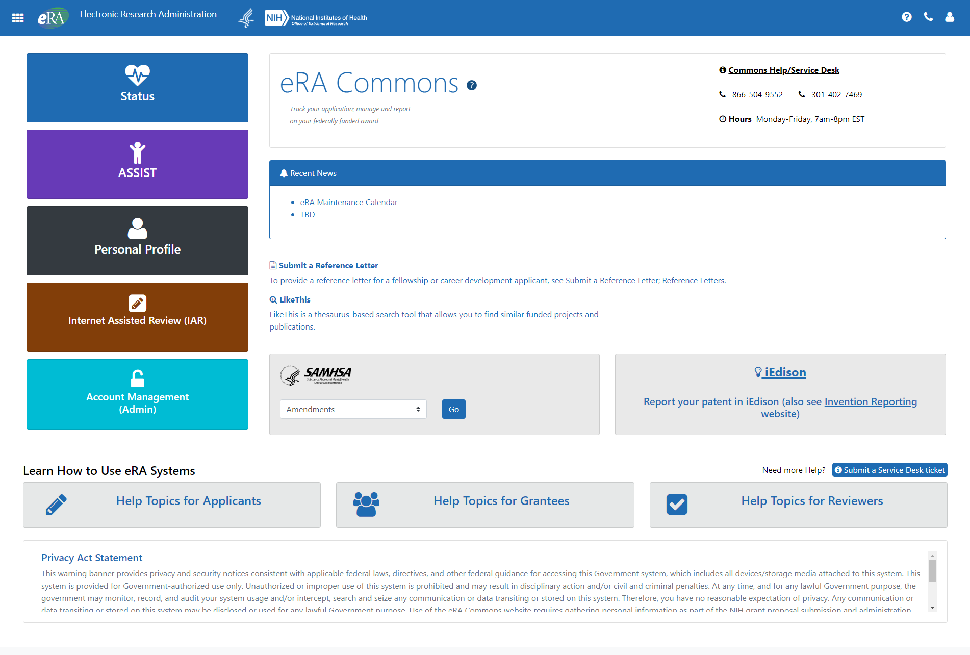

What Does eRA Commons Do?
The eRA Commons is an online interface where grant applicants, grantees and federal staff can access and share administrative information related to grant applications and awarded research grants.
ORCID ID
Applications
Progress
Reports
eSub Errors
Warnings
Application
Image
Institutional
Profile
Profile
Data
Assurances
Summary
Statement
Priority
Score
Prior
Approval
Reference
Letter
Notice
of
Award
Certifications
Publication
Data
Financial
Reports
Invention
Reports
Post-award
Correspondence
NCE
JIT
Training
Tables
Training
Appointments
Review
Assignment
HSS Data /
Integration
Relinquishing
Statement

Slide 5

Using Status to Track the Application

Slide 6
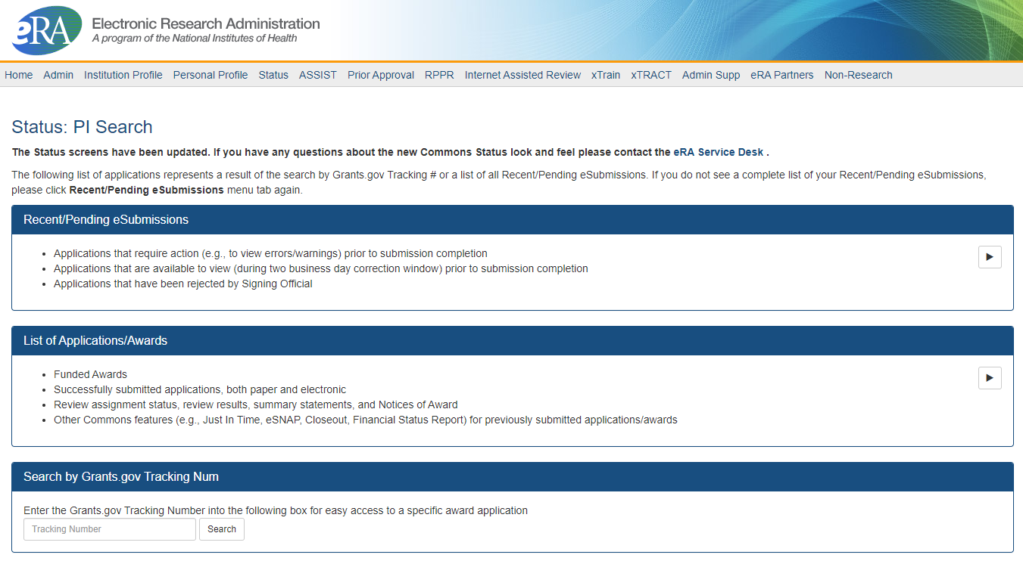
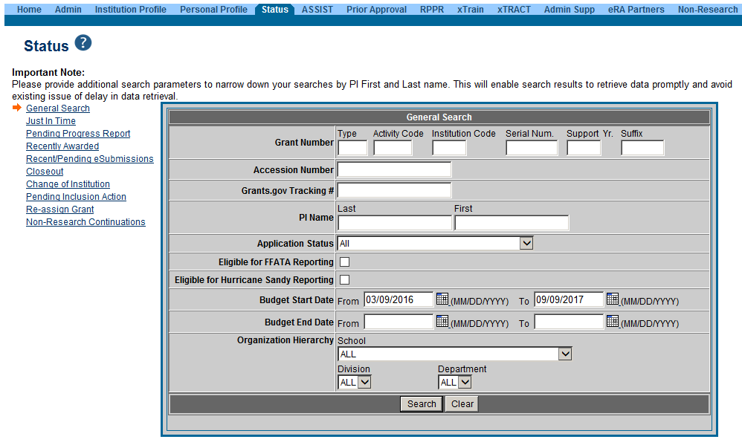
PI Status vs SO Status
Principal Investigators can view their Recent/Pending eSubmissions or List of Applications/Grants.
Signing Officials can search/view all submissions for their institution.

Slide 7
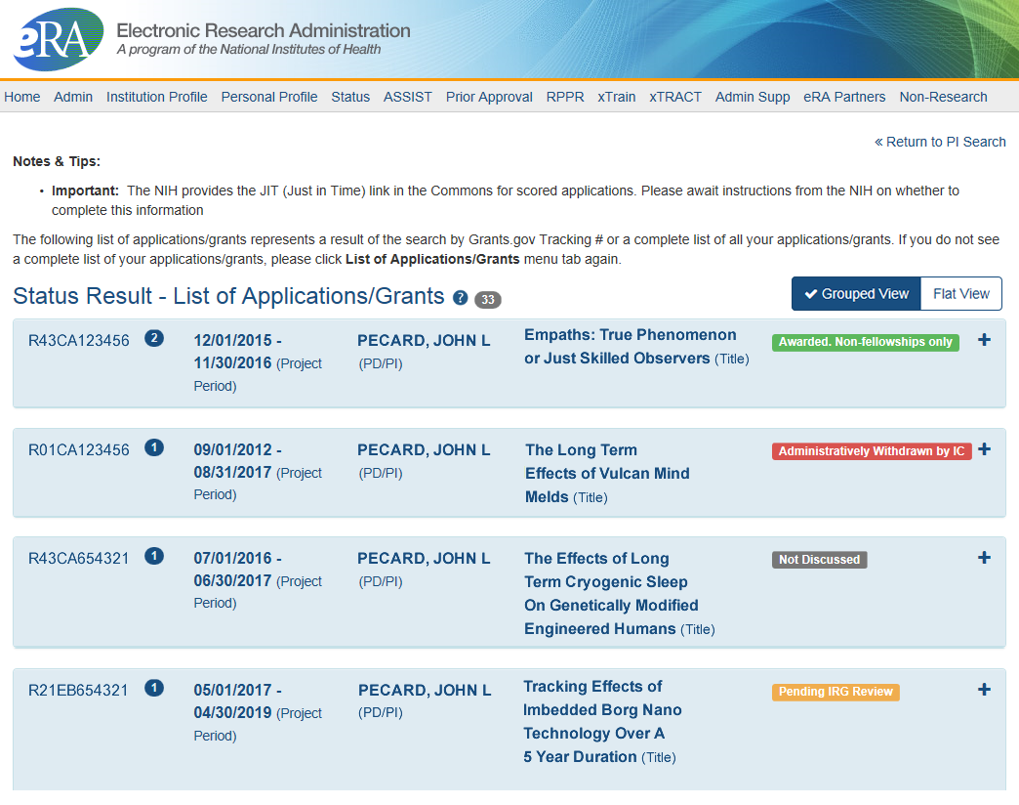
Status Result from General Search for PI
Click anywhere in the blue to get to more information, then select the Application ID link to view detailed status information for that particular application.

Slide 8
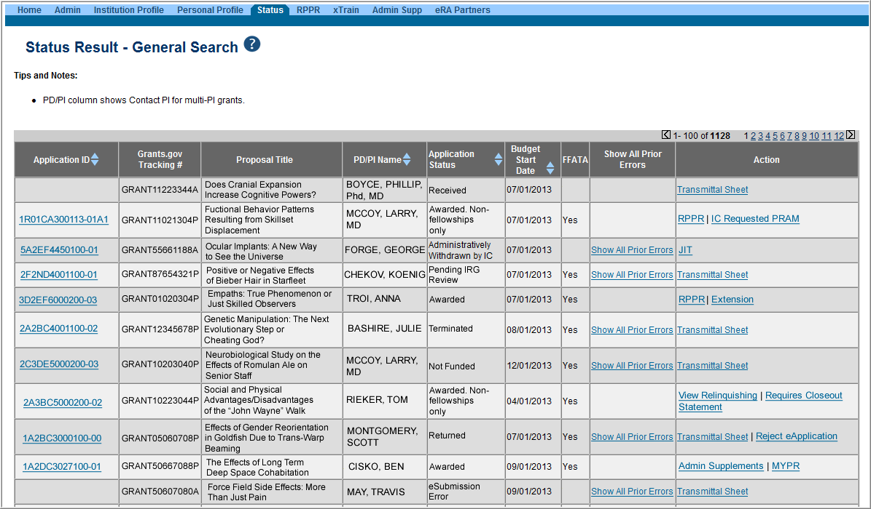
Status Result from General Search for SO
Select the Application ID link to view detailed status information for that particular application.

Slide 9
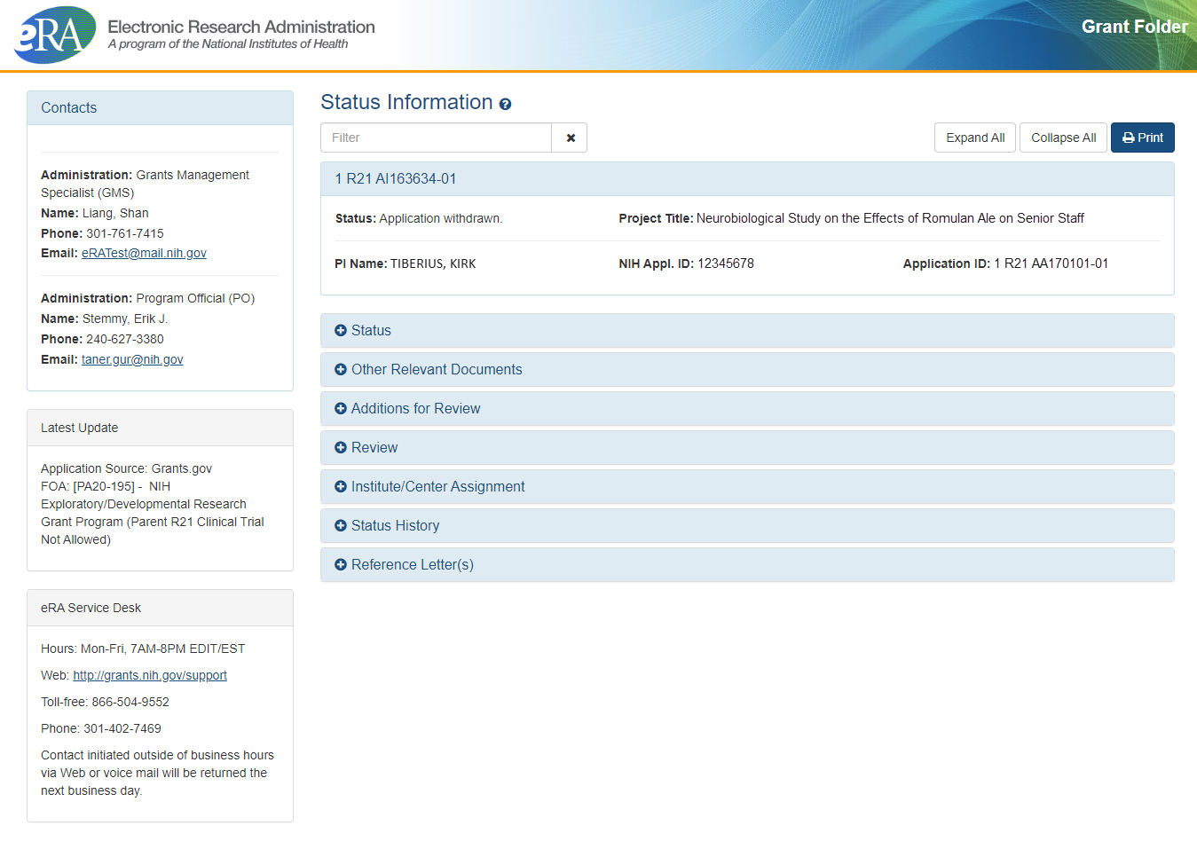
Detailed Status Information Screen
Control Buttons
Text Filter
NIH Contacts
Provides Updates

Slide 10
Detailed Status Information Screen
Provides Access to…
Check the Application Image
Check Review Information and IC Assignments
Check Review Outcomes
  Summary Statement
  Impact Score
  Percentile Score
Verify NI & ESI status at time of application submission
Check Reference Letters for Application
The Notice of Award
Just-in-Time Documents
Now available to the SO

Slide 11
Just-In-Time (JIT)
Applicants should never submit JIT info until specifically requested to do so by NIH. A JIT link or request from NIH are not indications that a grant award will be made.
  Other Support File, Budget Upload, Other Upload, Institutional Review Board (IRB) Date, Human Subject Education
  PD/PI can save info in Commons, but only SO can submit JIT info to NIH
  Must be PDF format
Allows an applicant organization to submit additional grant application information after the completion of the peer review, and prior to funding.

Slide 12
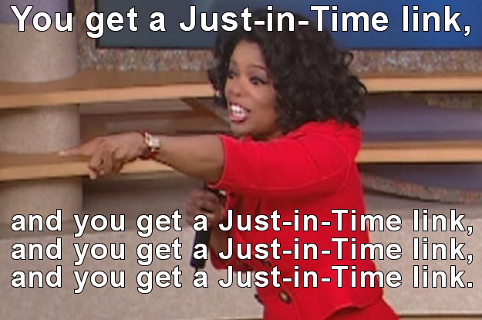
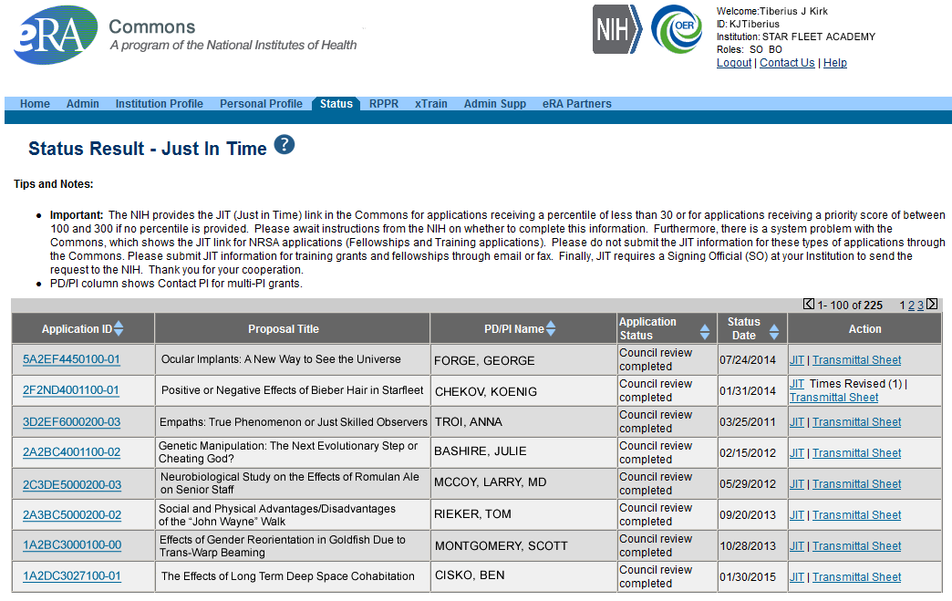
JIT Link (SO View)
Select JIT link

Slide 13



Personal Profile (PPF)
Individual Commons users are responsible for keeping their profile information accurate
Includes information such as:
  Name
  Demographics (important for Trainees)
  Employment history (important for COI)
  Education (important for NSI & ESI)
  Reference Letters
  Publications
Very few staff members at NIH have access to change information
Central repository for individual user information

Slide 14
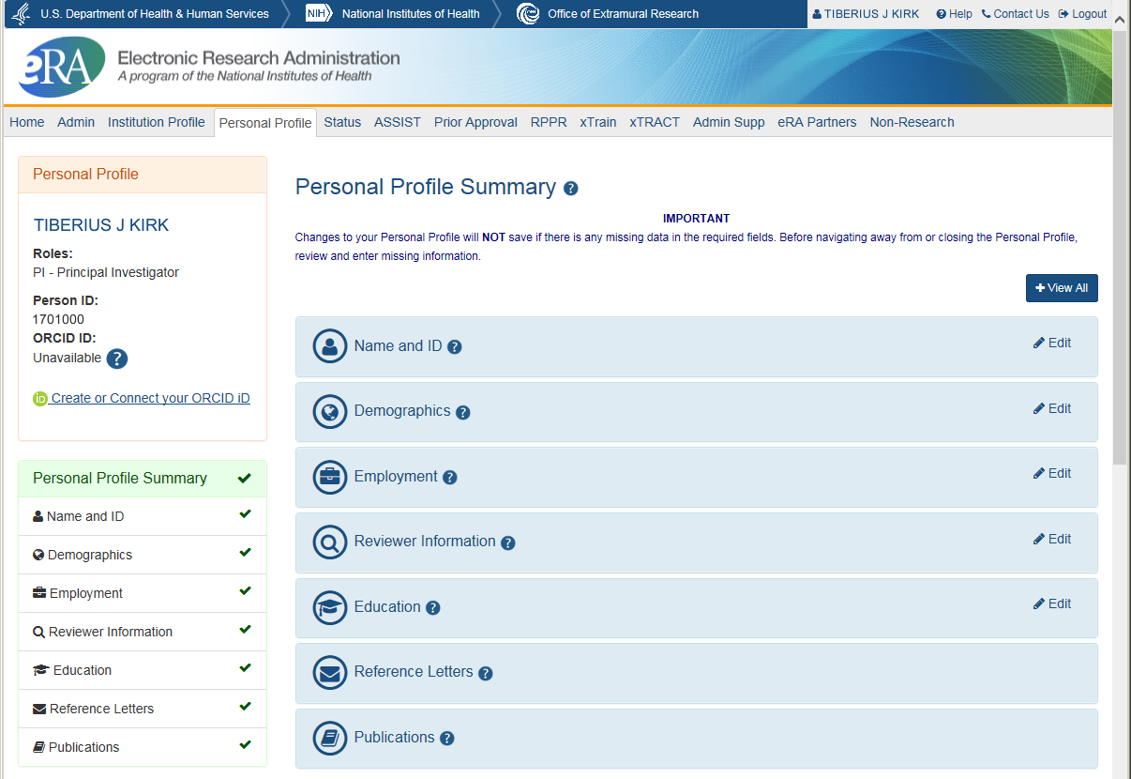
Personal Profile Screen
Verify information submitted in grant applications
Send you agency notifications
Complete aggregate reporting
Determine eligibility for New Investigator and Early Stage Investigator (ESI) status
Determine a reviewer’s eligibility for the Continuous Submission application submission policy

Slide 15
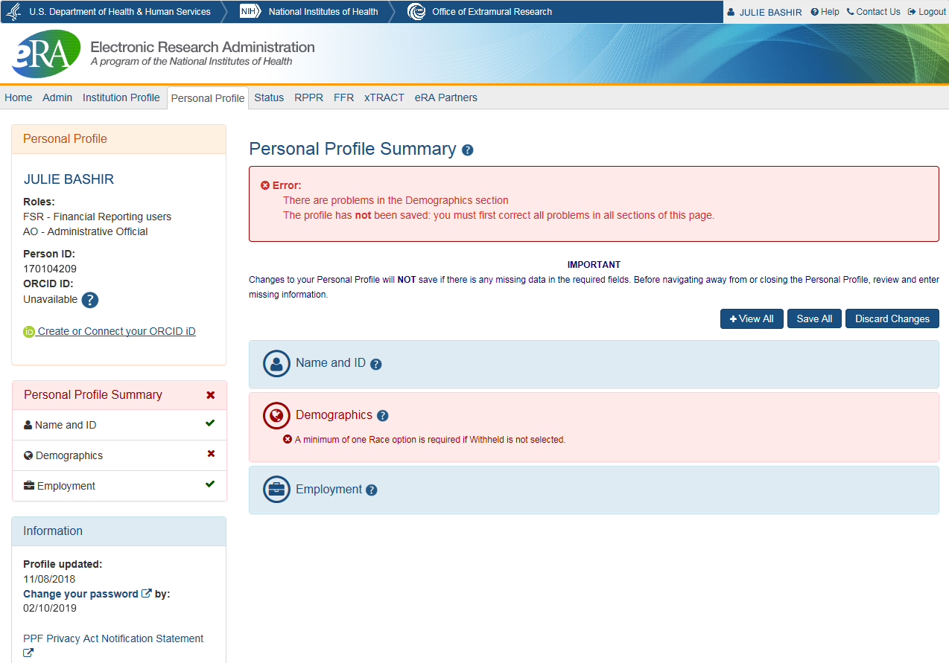
Saving Your Personal Profile
The PPF will show areas that need attention.
No data will be saved if required information is missing.
Do not navigate away from page until all required information is completed.
Leaving the page before all required information is completed, means changes will be lost.

Slide 16
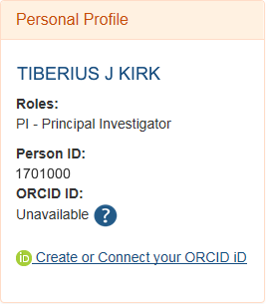
ORCID ID
ORCID ID (Open Researcher and Contributor ID)
a personal digital identifier that distinguishes every researcher
a new link to access ORCID.org added to the Personal Profile.
Allows principal investigators to create an ORCID ID to link to their Commons account, so that their publications can be linked to their grants.

Slide 17
ORCID iD Requirement
The requirement, starting October 2019, will be for:
T03, T15, T32, T34, T35, T37, T42, T90/R90, TL1, TL4, TU2, K12/KL2, R25, R38, RL5, RL9
At the time of appointment, the xTrain system will check whether appointees have ORCID iDs and appointments will be not be accepted for agency review unless an ORCID iD is linked to the individual's eRA Commons Personal Profile.
See Guide Notice NOT-OD-19-109

Slide 18
Personal Profile & ESI Extension
PD/PI’s with ESI status can request for extension of their ESI period for various reasons, including medical concerns, disability, extended periods of clinical training, natural disasters, active duty military service etc. All these requests will be reviewed on a case by case basis.
Notes:
An Early Stage Investigator is a status granted to an applicant who has “completed their terminal research degree or end of post-graduate clinical training, whichever date is later, within the past 10 years and who has not previously competed successfully as PD/PI for a substantial NIH independent research award.”

Slide 19
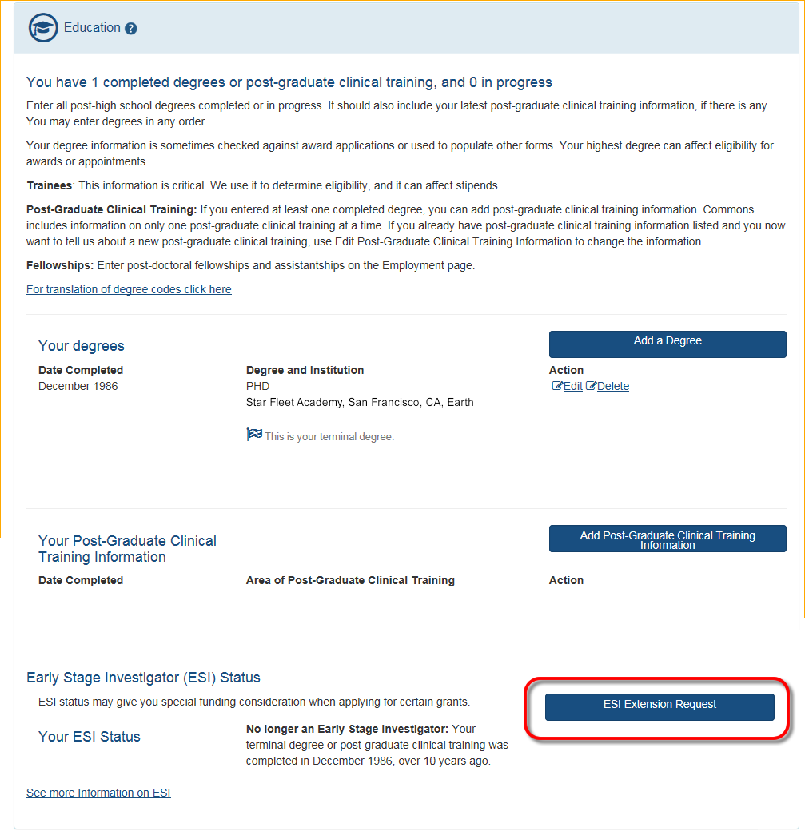
ESI Extension Under Education
ESI Extension Link will be available
Following link opens ESI Extension Request form
PI completes the information and submits for approval.
The PPF displays the date the extension request was submitted.

Slide 20
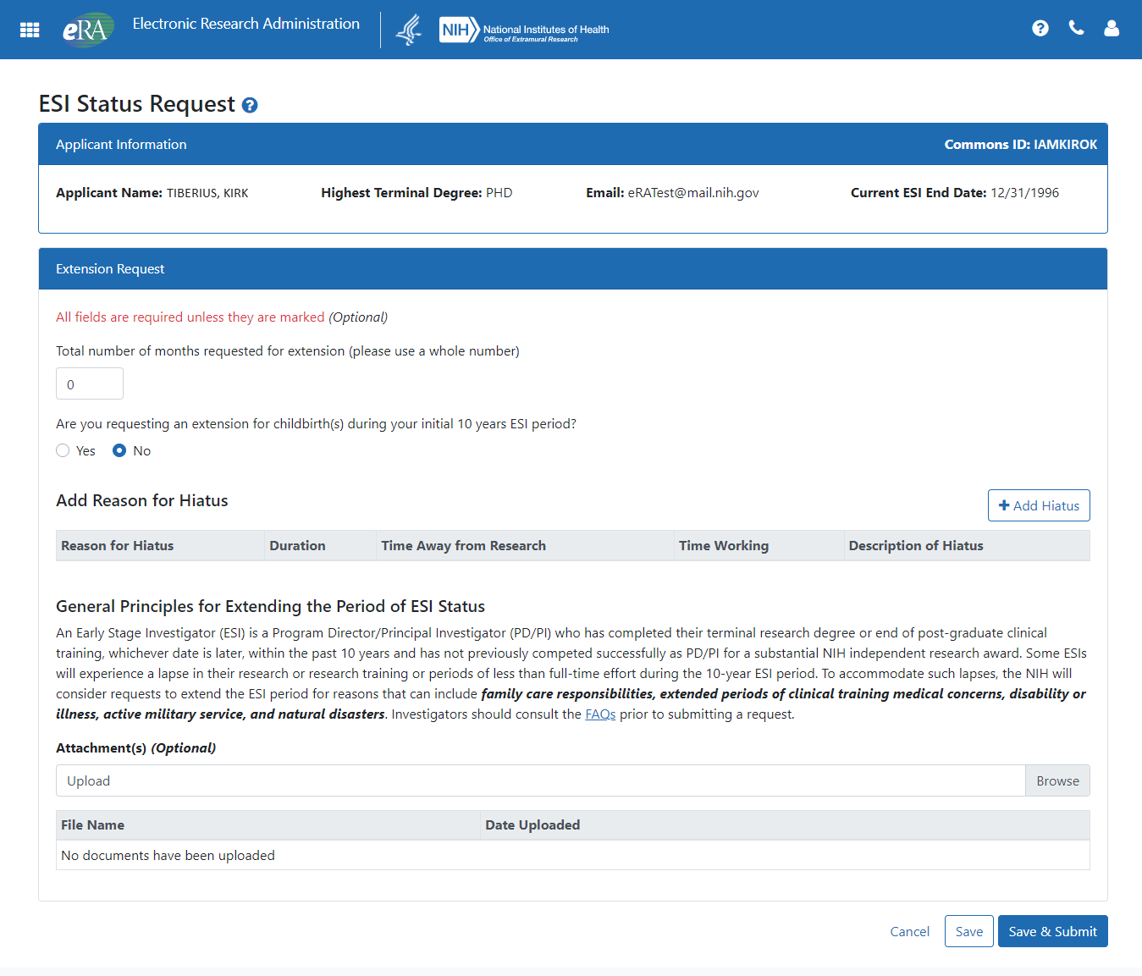
ESI Extension Screen
The number of months for the extension can be requested
If the reason for the request is the birth of a child, complete the requested information
The Add Hiatus button permits the selection of additional reasons for the request
Supporting documentation can be uploaded

Slide 21

Institution Profile (IPF)
Each organization establishes and maintains their organization’s profile data
Depending on their role, users can view and/or update Institution Profile information
  Only SOs can edit IPF information
  IPF displayed as a read-only page for users affiliated to the institution
  Includes two sections: Basic and Assurances & Certifications
Central repository for registered organization information

Slide 22
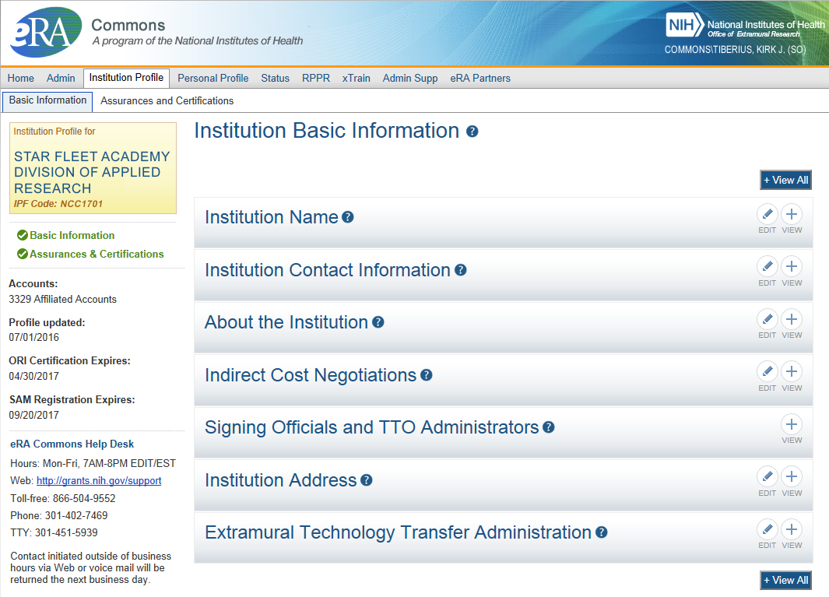
IPF Information
Basic: general information about the institution
  Name, address, Institution Contact information, list of Signing Officials, etc.
Assurances & Certifications: data elements that comprise assurance/certification information about an institution
  List of certifications
  (e.g., Financial Conflict of
  Interest, Human Subjects
  Research, Vertebrate
  Animals, etc.)
SAM Registration Expiration
Notes:
Institution name

Slide 23
eRA Commons Roles
The functions that a user can perform in the Commons are based on the role(s) assigned to his or her Commons account
Full, printable list of eRA Commons roles with descriptions:
  https://era.nih.gov/files/eRA-Commons-Roles-10-2019.pdf

Slide 24

Summary of Roles
IAR
PI
AA
FSR
SO
AO
Administrative
  SO – Signing Official
  AO – Administrative Official
  AA – Account Administrator
  BO – Business Official
  ASST – Assistant
  ASSIST Access Maintainer Role
Scientific
  Graduate Student
  IAR – Internet Assisted Review
  PI - Principal Investigator
  Post-Doc
  Project Personnel
  Scientist
  Sponsor
  Trainee
  Undergraduate
Other
  FCOI (Financial Conflict of Interest)
  FCOI_ASST
  FCOI_VIEW
  FSR (Financial Status Reporter)
  PACR (Public Access Compliance Role)
  OLAW (Reporting Animal Welfare)

Slide 25

Signing Official (SO)
During Commons registration, an applicant organization designates a Signing Official (SO)
  SO has authority to legally bind the organization in grants administration matters
  Equivalent to the Authorized Organization Representative (AOR) in Grants.gov
  SO is responsible for:
    maintaining institutional information
    submitting documents that require signature
    authority to act on behalf of the organization
    managing accounts

Slide 26
Signing Official (SO) & Managing Accounts
Signing Officials (and Account Administrators) have a responsibility to ensure duplicate accounts are not created for users.
  Users with Scientific roles should only have one (1) eRA Commons account for their entire career
    NIH needs to track funded researchers
    Used for reviewers to determine Continuous Submission status
    Used to determine New/Early Stage Investigator status
  Before creating new accounts, search across all eRA Commons accounts using AMS
  For more information, see:
    https://era.nih.gov/news_and_events/era-item-Oct2017.htm

Slide 27

Account Tips
Designate more than one Signing Official
  Certain Commons actions can only be taken by users with the SO role and you will want a back-up
Administrators should always check to see if a user already has a Commons account before creating a new account with a scientific role
  Ask the person if they already have an account, or search within the Commons
    If a user already has an account with a different organization,
    the SO should affiliate the existing account with the user’s
    new organization

Slide 28

Delegations
Summary
Progress Report (SO, AO, AA to PI)
Progress Report (PI to ASST)
Sponsor
Status
Personal Profile
Submit
xTrain
eRA Commons allows users to give other users permission to do specific actions on their behalf

Slide 29

Delegations Chart
Type (Name) | By | To | What it does
Progress Report | SO, AA, AO | PI on behalf of a PI | Enables the delegated PI to work on progress reports of another PI – includes Interim and Final RPPR, and HSS requests
Progress Report | PI | User within Institution with ASST or AO role | Enables the authorized user to work on progress reports for the PI – includes Interim and Final RPPR, and HSS requests
Sponsor | SO, AA (on behalf of Sponsor) | ASST | Allows the ASST to access the xTrain module
Status | PI | ASST | Allows the ASST to work with the Status module
PPF | All Users | User within Institution | Enables another user to edit someone else's personal profile
Submit | SO | PI | Enables the PI to submit RPPR and MYPR reports – now needed for PI if they are to submit Interim RPPR, Final RPPR, and HSS Data
xTrain | PI, Sponsor | ASST | Enables the ASST to work with the xTrain module and xTRACT

Slide 30
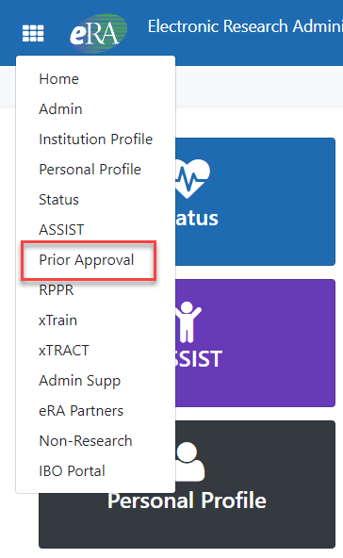
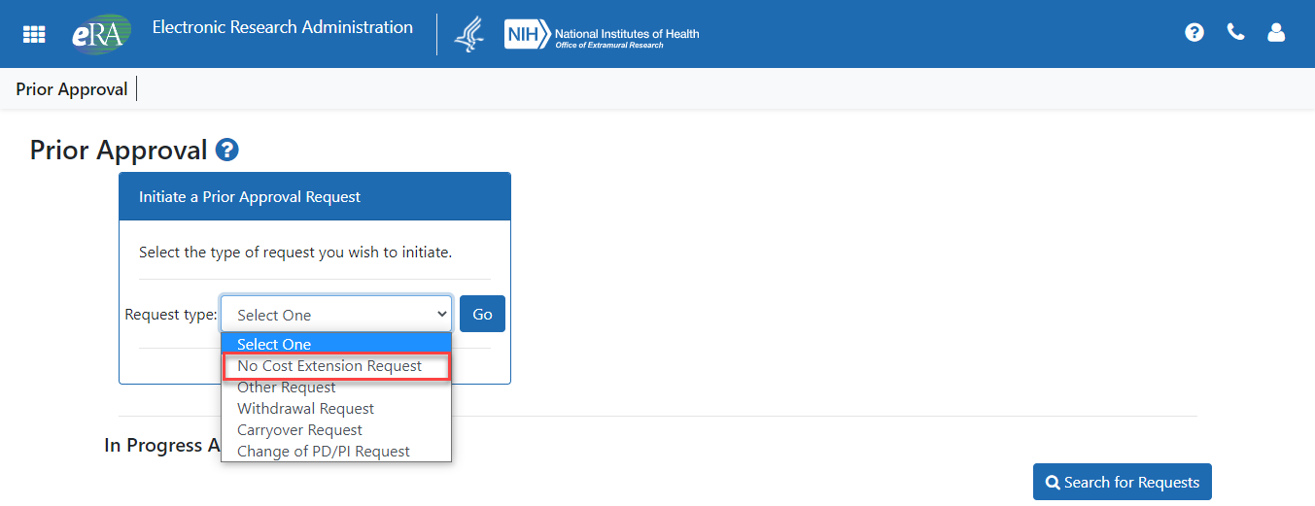
Prior Approval – NCE
No-Cost Extension (NCE)
  An extension of time to a project period and/or budget period to complete the work of the grant under that period, without additional Federal funds or competition
Notes:
Thank you. Scarlett. Next, lets talk about Prior Approval. The Prior Approval module allows Signing Officials the ability to electronically submit requests to NIH for certain types of actions. There is the Change of PD/PI, when the institution is going to add, and or remove a person from a project.
Carryover request – when you want to carryover funds from one budget period to the next
Withdrawal Request – is used when you want to remove an application submission from consideration, before it has gone to review. This option can be initiated but the principal investigator but must be submitted by the signing official
And the most common request is the No Cost Extension, when you want to extend the project period, but are not asking for additional funds

Slide 31

NCE Another Way
Extension link appears in the SO Status Search Results Screen
Notes:
Now there are two ways to request an NCE, or no cost extension. The traditional way is that within 90 days of the end of the project end date, an Extension link will be presented to the SO in the Status Results search screen as you can see here. This automatic IF your award is eligible under NIH’s expanded authority policy. The Notice of Award will let you know if your award is eligible for this option. The majority of NIH awards are eligible for an NCE, but the NoA will let you know for sure. This becomes more important with regards to the Prior Approval module as you will see in a minute.

Slide 32
NCE
Only SOs can submit the NCE notification
May be submitted no earlier than 90 days before end of project and no later than project end date
Can request extension of 1-12 months, in one-month increments
E-mail notification sent to NIH Grants Management staff when SO processes the extension
Electronically submit a notification to exercise one-time authority to extend without funds the final budget period of a project period of a grant.
Notes:
Remember, an NCE is a request to extend the project timeline without asking for additional funds. With this traditional option, the SO submits the request, within 90 days of the project period end date,
The request can for 1 to 12 months, using a whole number increments.
When the request is submitted, the Grants Management Specialist at the awarding IC will get an email notification and the request will be noted by them.

Slide 33
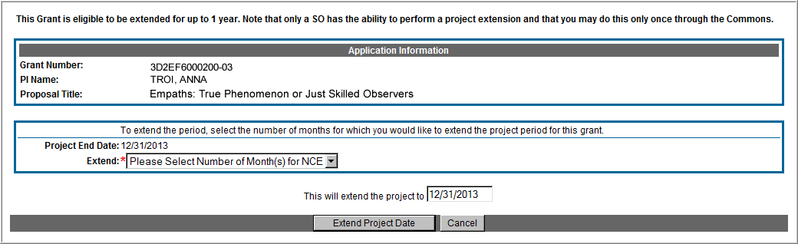
Extension Screen
Choose an extension of 1 to 12 months.
New calculated project end date
Notes:
Here is what the NCE screen looks like. You simply use the Extend drop down menu to select a number from 1 to 12, the system will automatically calculate the project end date, and the SO clicks the Extend Project Date button to summit the request. It’s that easy.

Slide 34
Prior Approval – No Cost Extension: When?
When is a grant eligible for a NCE through Prior Approval?
  When you have already used a NCE under expanded authority and you are within 90 days of the project end date.
  When you are not under expanded authority and you are within 90 days of the project end date.
  When the project end date has expired and has not been closed or has not entered unilateral closeout, whichever comes first.
Notes:
If an NCE is automatic for most awards, why do we have the Prior Approval option?
The Prior Approval module can be used if you have already been granted an NCE prior to the end of the project period end date –we will talk more about this in a moment.
The Prior Approval module can be used if the award is not covered by the expanded authority project. Of course in this case it will at the discretion of the IC if the request gets approved.
And then there is small window of opportunity if you have not already had an extension, and it is after the project period end date, so the extension link no longer is available in Status, but award has not gone into closeout, either by you, or been put into unilateral closeout by NIH.

Slide 35
Expanded Authority – You Get Just One
No Cost Extension (NCE) part of ‘expanded authority’
Can only extend once without express approval
Increasing trend of extending in the middle of the project period (i.e. end of year 2 of 5 year grant)
  If this is done, the Extension link will NOT appear 90 days from end of project end-date
  If in need of an NCE, submit Prior Approval NCE request
See June’s 2015 eRA Items of Interest for more:
  https://era.nih.gov/news_and_events/era_item_June_2015.htm#expanded
Notes:
So, NCE – you get just one…
What this means is that under you get one extension without the awarding institute providing specific approval of the request. The link appears, you fill out the form, it is submitted, and no other real action is needed. However, we have been seeing, sometimes due to catastrophic events like hurricanes, or floods, or pandemics, that institutions are requesting extensions before the 90-day window near the end of the project end date. For example, and institution may request a 12-month extension at the end of year 2 of a 5-year award. Thus making year 2, 24 months long. You would use the Prior Approval module, look up the award and submit the request. Now before doing that, we would urge to contact the Grants Management Specialist and the Program Officer before submitting the request through the Prior Approval module. They can guide as to what justification information and documents you may need to provide with the request. If this approved by the IC, note when you now get to 90 days out from the updated end of project date, you will not get an Extension link in status. You have used your one free extension request. If at this point you need to make another extension request, you will repeat the process as you did for the original 2 year request.
The article noted there by the url is old, but it still applies.

Slide 36
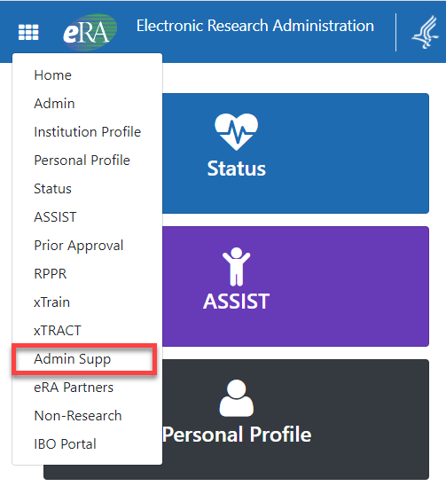
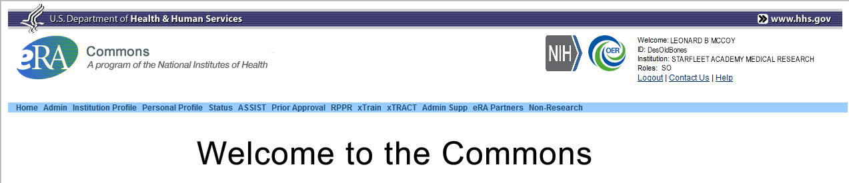
What Are Admin Supps?
A request for additional funds during a current project period to provide for an increase in costs due to unforeseen circumstances.
Requested additional costs must be within the scope of the peer reviewed and approved project
Streamlined eRA Commons process
  Commons pre-populates much of the data needed for request from awarded grant

Slide 37
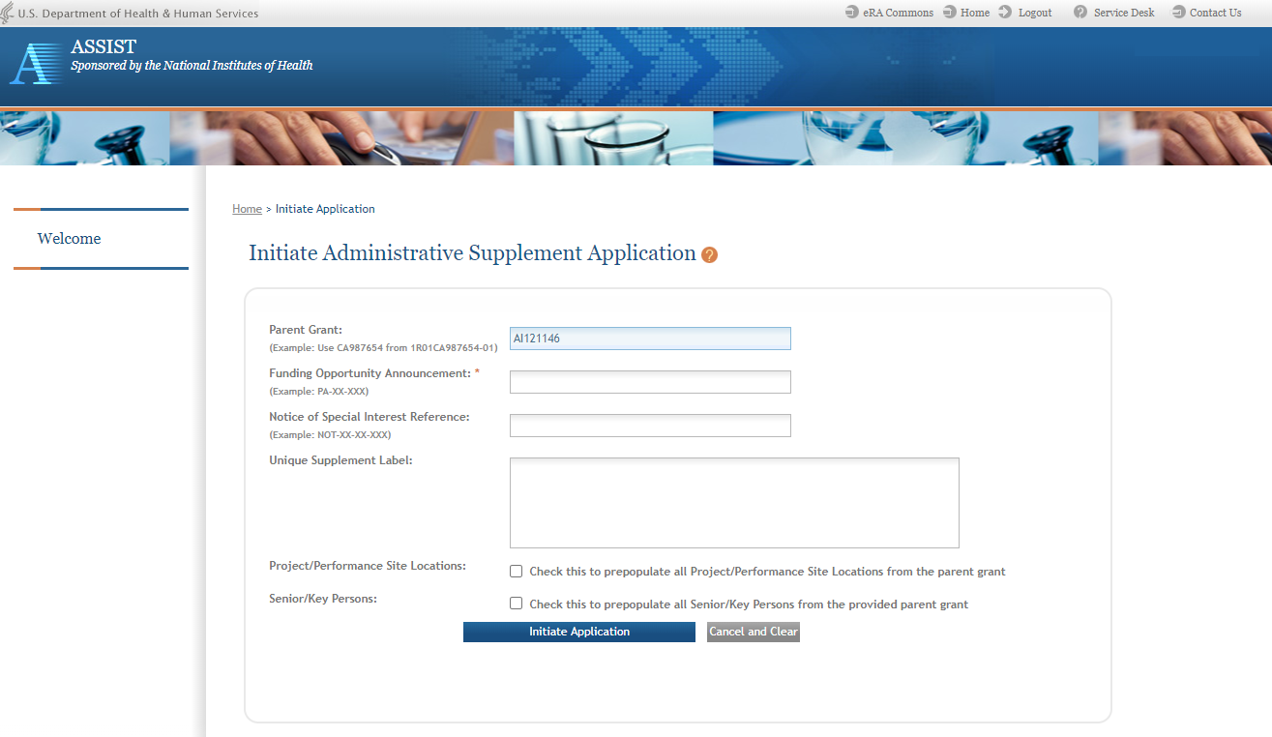
Admin. Supplement Changes
Use of ASSIST Expanded for Submission of Administrative Supplements
3 methods to initiate administrative supplements
  Initiate in ASSIST via FOA for admin supp, enter information manually
  Initiate in ASSIST with Federal ID number of the parent grant where some information from the parent award is prepopulated
  Initiate in eRA Commons, and be directed to ASSIST where some information from the parent award is prepopulated

Slide 38
What is the RPPR?
RPPR is the Research Performance Progress Report
A federally mandated report format used across all agencies that provide research grants and contracts
Used to document grantee accomplishments and compliance with the terms of the award
Describes the scientific progress, identifies significant changes, reports on personnel, and describes plans for subsequent budget period or year (annual reports only)

Slide 39
RPPR Data Entry
Initiation of RPPR by
  Principal Investigator
  ASST with the RPPR Delegation
RPPR sections (Annual)
  Cover Page
  Accomplishments
  Products
  Participants
  Impact
  Changes
  Special Reporting
  Budget (non-SNAP)
Watch for character limits in data entry fields
Ensure uploads are in PDF format
When completing data tables remember to click ‘Add/New’
RPPR sections (Interim & Final)
  Cover Page
  Accomplishments
  Products
  Participants (only section D.1)
  Impact
  Special Reporting
  Outcomes

Slide 40
RPPR Budgets
Submitting progress reports with budgets
  R&R budget and PHS 398 budgets are now available for Non-SNAP RPPR.
  If presented with an option of budget forms, the type that was submitted with the application should be used.
    PHS 398 Budget is available only on training grants.
  Help for R&R Budget and PHS 398 Budget forms can be found in the SF424 R&R User Guides.

Slide 41
RPPR & Human Subjects System (HSS)
HSS is the electronic system to manage human subjects and clinical trials information.
Allows principal investigators and signing officials to access and update all the human subjects and clinical trials data associated with their grants in one place.
  update participant information
  enrollment information
  inform NIH of ClinicalTrials.gov registration
  and revise other human subjects-related information as necessary, just-in-time for award or after a grant award is made.

Slide 42
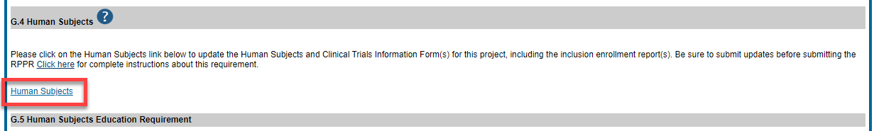
RPPR & Accessing HSS
The most common use of the Human Subjects System is for updates needed to the RPPR
You will find the Human Subjects link in Section G.4.b Inclusion Enrollment Data of the RPPR
The human subjects link is visible only for NIH applications and grants involving human subjects.

Slide 43
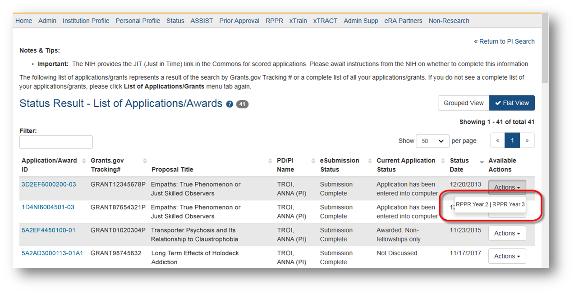
Multi-Year RPPR
MYRPPR
  Multi Year Progress Reports now use RPPR format
  Link available under the Action Column in Status

Slide 44
Complex, Multi-Project RPPR
Submitting progress reports for complex, multi-project grants
  After RPPR is initiated, PI will need to identify if RPPR should contain components.
  RPPR should have the same structure as the originally submitted application.
  Some sections are not available on Overall component (i.e. Budget)
  Some sections are not available on component level (i.e. Participants and Publications are reported on Overall)

Slide 45
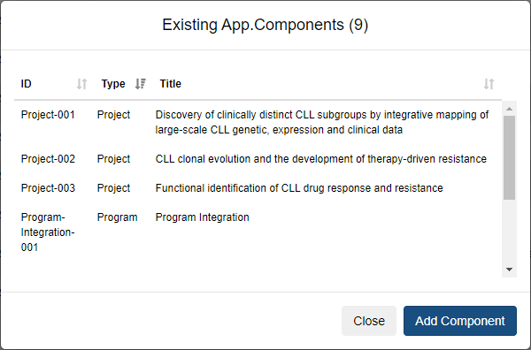
Ability to Select Awarded Components on RPPR Screen
Awarded components for multi-project grants will automatically show up on the RPPR Menu screen
The list of components displayed will be from the last competitive application that was awarded.
The Add Component button allows you to select the components from the existing application components list displayed.
You can then edit and modify the component for the RPPR as necessary.

Slide 46
The 3 variations of RPPR
Annual RPPR Interim RPPR Final RPPR
RPPR Type | How to Access RPPR Link | When Does the Link Appear? | When is the RPPR Due? | Who Can Initiate | Who Can Edit | Who Routes to the SO | Who Submits
Annual | Status Search Results Screen or RPPR tab | 1 day after the project segment end date | SNAP Awards due within 45 days of the next budget period start date Non-SNAP due within 60 days of the next budget period start date | Principal Investigator Or User within Institution with the ASST Role* | Signing Official Or Principal Investigator Or User within Institution with the ASST Role* | Principal Investigator | Signing Official Or Principal Investigator if assigned the Submit Delegation
Interim | Status Search Results Screen | Once the grant becomes eligible for submission of a Type 2 application, and the grant is not in Closeout | 120 days from period of performance end date for the competitive segment | Signing Official or Principal Investigator | Signing Official Or Principal Investigator Or User within Institution with the ASST Role* | Principal Investigator | Signing Official Or Principal Investigator if assigned the Submit Delegation
Final | Closeout Status Screen | Once the grant becomes eligible for closeout | 120 days from period of project end date | Signing Official or Principal Investigator | Signing Official Or Principal Investigator Or User within Institution with the ASST Role* | Principal Investigator | Signing Official Or Principal Investigator if assigned the Submit Delegation

Slide 47
Interim RPPR Scenarios
Since a renewal application is competitive, there is no guarantee it will be funded. Therefor the following scenarios should be noted:
Completing Renewal Application Status | Action
Not submitting a Competing Renewal application | Submit a Final RPPR no later than 120 days from the project period end date
Submitting a Competing Renewal application | Submit an Interim RPPR no later than 120 days from the project period end date
 | Funded | Not Funded
 | The Interim RPPR is accepted as the annual RPPR | The Interim RPPR is accepted as the Final RPPR

Slide 48
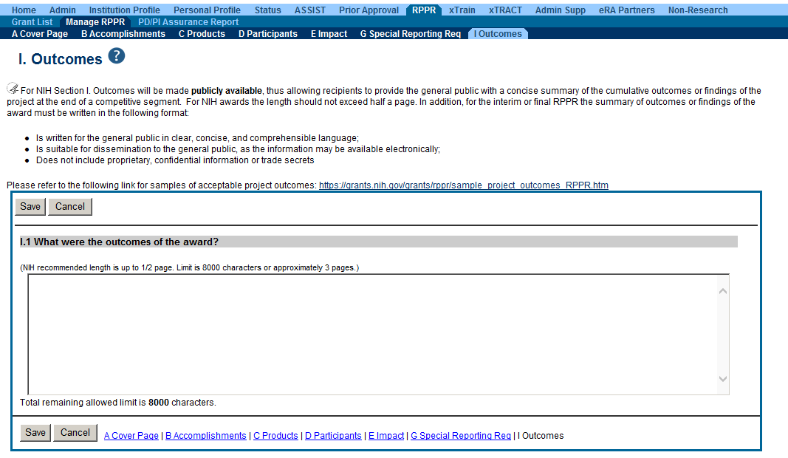
Outcomes
Information in Outcomes will be publically available. It should be written as a high level and in plain language.

Slide 49
Outcomes Requirements
Outcomes are specifically designed to be made publicly available by the agency (analogous to the abstract in the competing application)
Reporting in the Outcomes section is limited (by the federal-wide RPPR format) to 8,000 characters
The Outcomes should provide a concise summary of the findings of the award written in lay language for the general public
In an effort to increase transparency NIH will make the Outcomes data available in RePORTER

Slide 50
Progress Report Additional Materials (PRAM)
The PRAM feature provides a means for the grantee to enter, review, route, and submit information to agency following the submission of an RPPR.
  Public Access (PA) PRAM - Generated automatically after an RPPR is submitted with publications that are not compliant with Public Access Policy
  Agency Requested PRAM – Only available if requested by the Grants Management Specialist (GMS)
PD/PI can enter the PRAM, but can only submit it if they are delegated with Submit Progress Report authority. Otherwise, only the SO can submit the PRAM to Agency.

Slide 51


RPPR Publications
When selecting/deselecting publications for RPPR submissions
  Users will see a gold lock icon next to those publications added to their grant into NIHMS.
  Users see a silver lock icon for publications that have been reported on a previous RPPR.
  Neither can be removed on the RPPR, both need manual intervention.
  To delete a publication with a gold lock, users will need to contact the NIHMS help desk through their web form, which is accessible at http://www.nihms.nih.gov/.
  To delete a publication with a silver lock please contact the PublicAccess@nih.gov

Slide 52

Closeout
Closeout items for NIH include*:
  Final Research Performance Progress Report (F-RPPR)
  Federal Financial Report (FFR)
  Final Invention Statement
NIH automatically marks the grant “ready for close out,” making the link appear in Commons when:
  The project period end date has passed, and
  No Typ2 application has been submitted
Electronically submit required Closeout documents for grants in Closeout status
*Agency partners may require additional information
Notes:
Thank you, Scarlett! And congratulations to you all as well, because we have made it to the end of the line! Closeout..
At the end of the award you will need to submit 3 closeout reports
The Final Research Performance Progress Report, the Final RPPR,
The final Federal Financial Report (FFR)
And a Final Invention Statement. You only need this if your research resulted in anything, like a new devise or procedure, that needed or you wanted to have patented.
The Closeout link will appear in the Status Search results screen when the project period end date has passed and you have not submitted a Type 2 Renewal application, also known as a Competing continuation application.
Also it is good to note that while currently the FFR is done within Commons, in the not too distant future, the link will take you to the Payment Manage Module where program officials manage awards and the end-to end grant lifecycle.

Slide 53
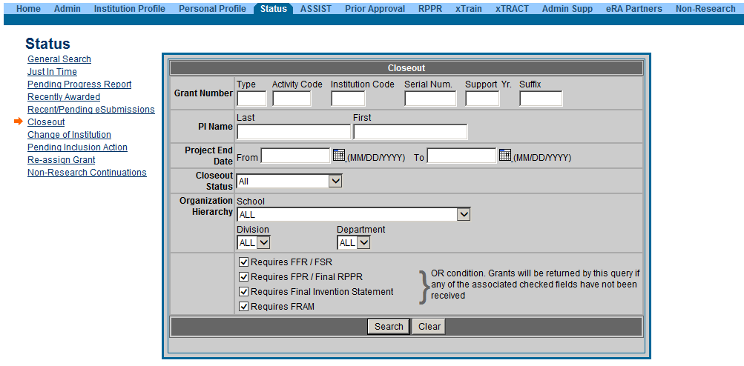
New Closeout Search screen provides additional search criteria
Notes:
So here is the Closeout search screen. Because Closeout is important it has its own search screen , you really want to avoid NIH putting an award into unilateral closeout because it usually means the closeout reports are so late (more than 120 days after the project end date) that NIH is forced to take action but putting into unilateral closeout.

Slide 54
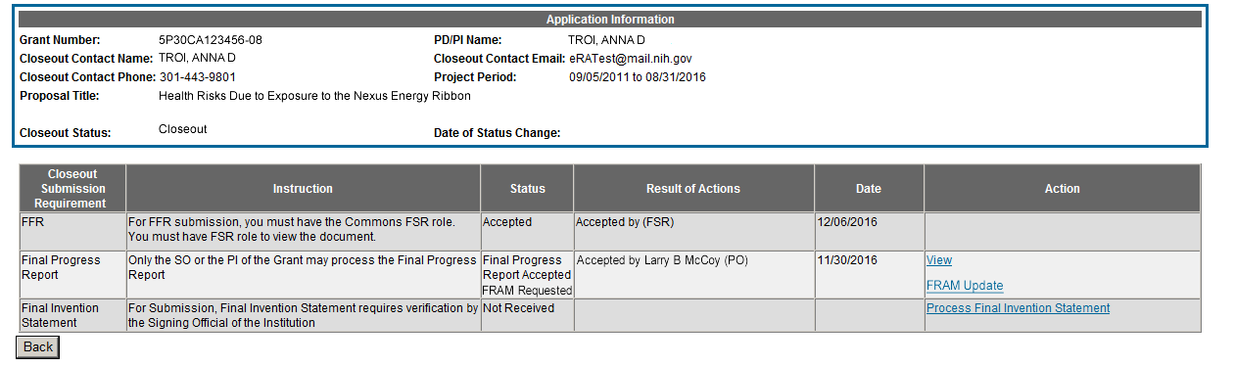
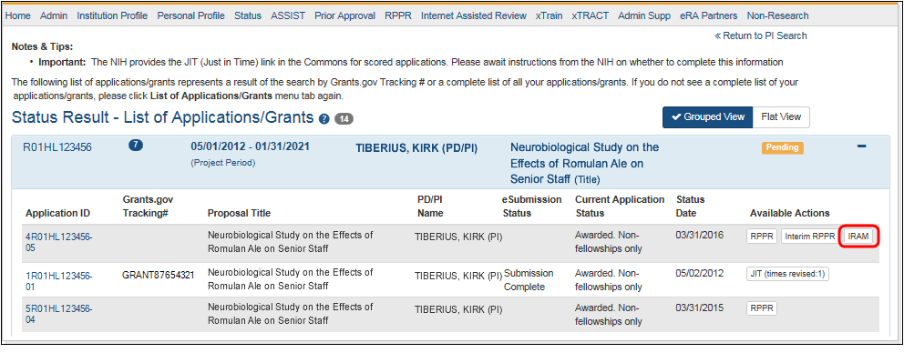
Final Report Additional Materials (FRAM)
Interim Report Additional Materials (IRAM)
FRAM & IRAM works in same manner as PRAM in RPPR
Awarding IC sets status to FRAM Requested or IRAM Requested
Awarding IC triggers email for requested information to the SO & PI
The FRAM Update or IRAM link appears in Action column
Notes:
S0 FRAM - the Final Report Additional Materials request. If you have submitted a Type 2 application, this would be called the I-RAM or Interim Report Additional Materials request. Basically this means the awarding IC needs clarification or additional information to complete the closeout of the award. If you get a FRAM or IRAM request, it will appear in the Status screen for both the signing official and the principal investigator under Action.

Slide 55

Thank you
Notes:
This concludes the presentation. Thank you for attending and don’ hesitate to ask questions or contact us for additional information.

