Slide 1
Scientific Workforce Diversity in Extramural Research
Transition
Training
Navigation
Mentorship
Support
Funding

Slide 2
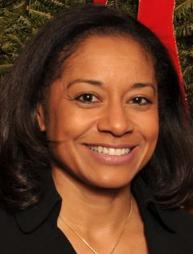

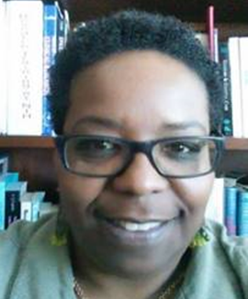
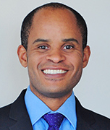


Your Guides
Charlene E. Le Fauve, Ph.D.
Senior Advisor to the Chief Officer for Scientific Workforce Diversity
charlene.lefauve@nih.gov
Marguerite Matthews, Ph.D.
Scientific Program Manager
Office of Programs to Enhance Neuroscience Workforce Diversity (OPEN)
National Institute of Neurological Disorders and Stroke (NINDS)
marguerite.matthews@nih.gov
Lauren Hill, Ph.D.
Acting Director
Office for Disparities Research and Workforce Diversity
National Institute of Mental Health (NIMH)
hillla@mail.nih.gov
Kenneth Gibbs, Ph.D., M.P.H.
Chief, Undergraduate and Predoctoral Cross-Disciplinary Training Branch
National Institute of General Medical Sciences (NIGMS)
kenneth.gibbs@nih.gov
Ericka M. Boone, Ph.D.
Acting Director,
Division of Biomedical Research Workforce
Office of Extramural Research (OER)
ericka.boone@nih.gov

Slide 3

Scientific Workforce Diversity - Guidance
Why Diversity Matters to NIH –
Dr. Le Fauve
NIH 101: A Primer for ESI and 1st Time Applicants – Dr. Lauren Hill
Strategies to Support Your Research Training – Dr. Marguerite Matthews
Career Stage Transitions – Dr. Kenneth Gibbs

Slide 4
Scientific Workforce Diversity - Guidance
Why Diversity Matters to NIH –
Dr. Le Fauve
NIH 101: A Primer for ESI and 1st Time Applicants – Dr. Lauren Hill
Strategies to Support Your Research Training – Dr. Marguerite Matthews
Career Stage Transitions – Dr. Kenneth Gibbs

Slide 5

Why Diversity Matters:
Capitalizing on the Opportunity
Excellence, Creativity, Innovation
Broadening Scope of Inquiry: Health Disparities
Changing Demographics: Types of Diversity
Global Research Preeminence
5
diversity.nih.gov

Slide 6


Chief Officer for Scientific Workforce Diversity (COSWD)
MISSION
To be the NIH thought leader in the science of scientific workforce diversity, using data-driven approaches to take advantage of the full range of scientific talent, fostering creativity and innovation in science.
MAIN
GOAL
To catalyze the development of cultures of inclusive excellence, allowing NIH and NIH-funded institutions to benefit from a full range of talent.
  Build the evidence using the NIH as a testbed for innovative scientific programs.
  Disseminate the evidence through work with the full scientific community, from trainees to established tenured scientists.
  Act on the evidence by piloting integrated, institution-wide systems to address bias, faculty equity, mentoring, and work/life issues.
Great Minds Think Differently
diversity.nih.gov
diversity.nih.gov

Slide 7
Diminishing Representation for Women and URG Scientists
Underrepresented
African American or Black
Hispanic or Latina/o/x
American Indian
Alaska Native
Native Hawaiian
Pacific Islander
Well-Represented
White
Asian
https://nces.ed.gov/programs/digest/2019menu_tables.asp; https://www.aamc.org/data-reports/faculty-institutions/interactive-data/data-reports/faculty-institutions/interactive-data/2018-us-medical-school-faculty
7
diversity.nih.gov

Slide 8
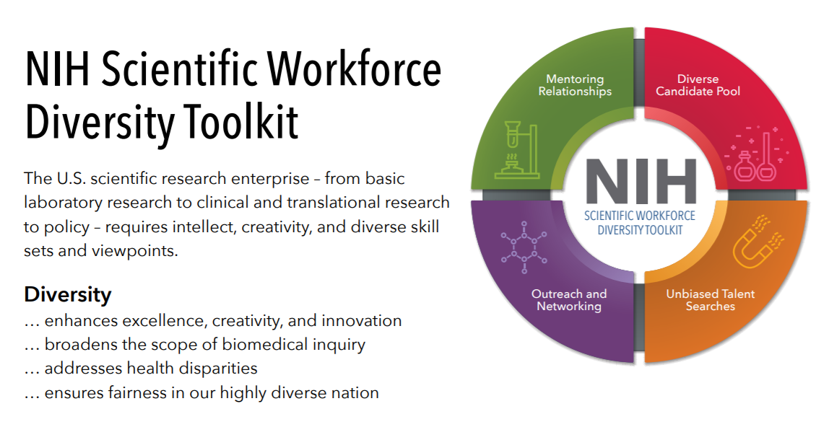
NIH Approaches to Inclusive Excellence
Distinguished Scholars Program
  Build a self-reinforcing community of PIs committed to diversity and inclusion
Faculty Institutional Recruitment for Sustainable Transformation (FIRST)
Trans-NIH searches for tenure track positions
NIH Equity Committee
  Transparency and accountability
National Research Mentoring Network (NRMN)
Implicit-bias mitigation
  NIH SWD Interactive Toolkit
Recruitment search protocol
Tips for reducing implicit bias
Contact NIH SWD for more information: SWDToolkit@od.nih.gov
8
diversity.nih.gov

Slide 9

NIH Approaches to Inclusive Excellence
9
diversity.nih.gov

Slide 10
NIH 101: A Brief Primer (Who’s On 1st ?)
Why Diversity Matters to NIH –
Dr. Le Fauve
NIH 101: A Primer for ESI and 1st Time Applicants – Dr. Lauren Hill
Strategies to Support Your Research Training – Dr. Marguerite Matthews
Career Stage Transitions – Dr. Kenneth Gibbs

Slide 11
Presentation Overview
NIH Institutes and Centers (ICs)
Finding the right “scientific home” for your research
Working with NIH Program Officers (POs)

Slide 12
NIH is composed of 27 Institutes and Centers (ICs)
Office of the Director
National Institute
on Aging
National Institute
on Alcohol Abuse
and Alcoholism
National Institute
of Allergy and
Infectious Diseases
National Institute
of Arthritis and
Musculoskeletal
and Skin Diseases
National Cancer
Institute
National Institute
of Child Health
and Human
Development
National Institute on
Deafness and Other
Communication
Disorders
National Institute
of Dental and
Craniofacial
Research
National Institute
of Diabetes and
Digestive and
Kidney Diseases
National Institute
on Drug Abuse
National Institute
of Environmental
Health Sciences
National Eye
Institute
National Institute
of General
Medical Sciences
National Heart,
Lung, and Blood
Institute
National Human
Genome Research
Institute
National Institute
of Mental Health
National Institute
of Neurological
Disorders and
Stroke
National Institute
of
Nursing Research
National Center
for Complementary
and Integrative Health
Fogarty
International
Center
National Center
for Advancing
Translational
Sciences
National Library
of Medicine
National Institute of
Biomedical Imaging
and Bioengineering
National Institute on
Minority Health and
Health Disparities
No funding authority
Clinical Center
Center for
Information
Technology
Center for
Scientific Review

Slide 13
The National Institutes of Health
Each IC has its own mission
Each IC has its own budget
Each IC has its own activities
Each IC has its own way of doing business
Contact a Program Officer at the IC before you submit a grant application

Slide 14
Typical NIH IC Organizational Structure
National Advisory Council
Office of the Director
Board of Scientific Advisors
Extramural Research
Intramural Research
Scientific Programs & Divisions
Laboratory Studies
Clinical Studies
Program
Review
Grants Management

Slide 15
Interacting with NIH: Extramural Investigators/Trainees
NIH People
Program Officer
Scientific Review Officer
Grants Management Officer
Scientist & Administrator
Identifies areas of scientific need
Communicates
NIH priorities to investigators and others
Manages grants
Communicates with IC Leadership about the science
Scientist & Administrator
Manages grant reviews
Appoints members to review groups & panels
Prepares summary statements
Implements the funding process
Oversees the budget
Ensures grantee compliance with NIH policies & regulations

Slide 16
Identifying the Appropriate IC and Program Officer
Talk to mentors and colleagues
Search NIH RePORTER for funded projects
Search NIH MATCHMAKER for similar projects and their POs
Review IC missions, strategic plans, & research priorities
Review IC division or program webpages

Slide 17
Contacting a Program Officer – General Guidelines
Contact POs via email
Include a 1-2 Page Concept Paper
  Research Project Grants (RPG) – include brief background, significance of the problem or question the project will address and specific aims
  Training (e.g., F30, R36, F31, F32) and Career Development Grants (e.g, K01, K08, K23) – brief background, significance of the problem or question the project will address, specific aims; training goals; mentoring team and their current funding and a CV or NIH Biosketch
Follow-up as needed – email piles are deep

Slide 18
Getting Engaged: Strategies to Support Your Research Training
Why Diversity Matters to NIH –
Dr. Le Fauve
NIH 101: A Primer for ESI and 1st Time Applicants – Dr. Lauren Hill
Strategies to Support Your Research Training – Dr. Marguerite Matthews
Career Stage Transitions – Dr. Kenneth Gibbs

Slide 19
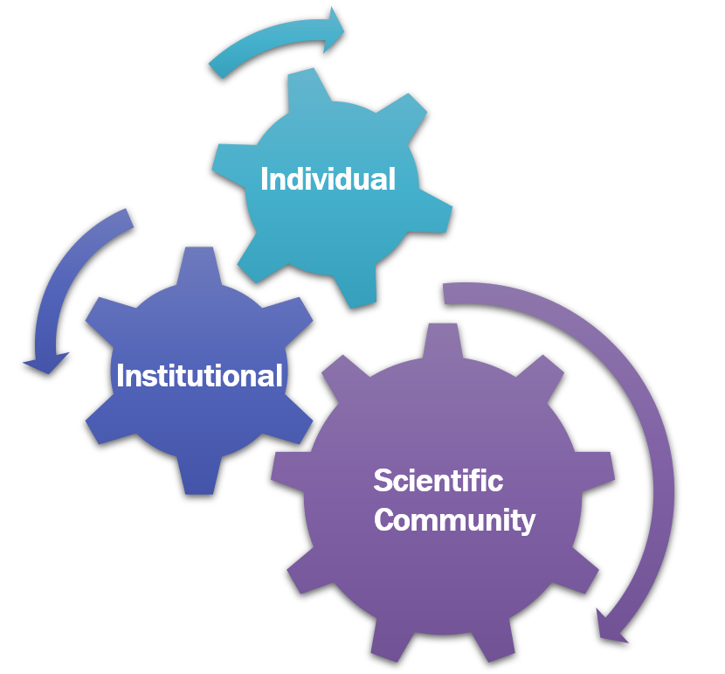

Utilize a Systemic Approach

Slide 20
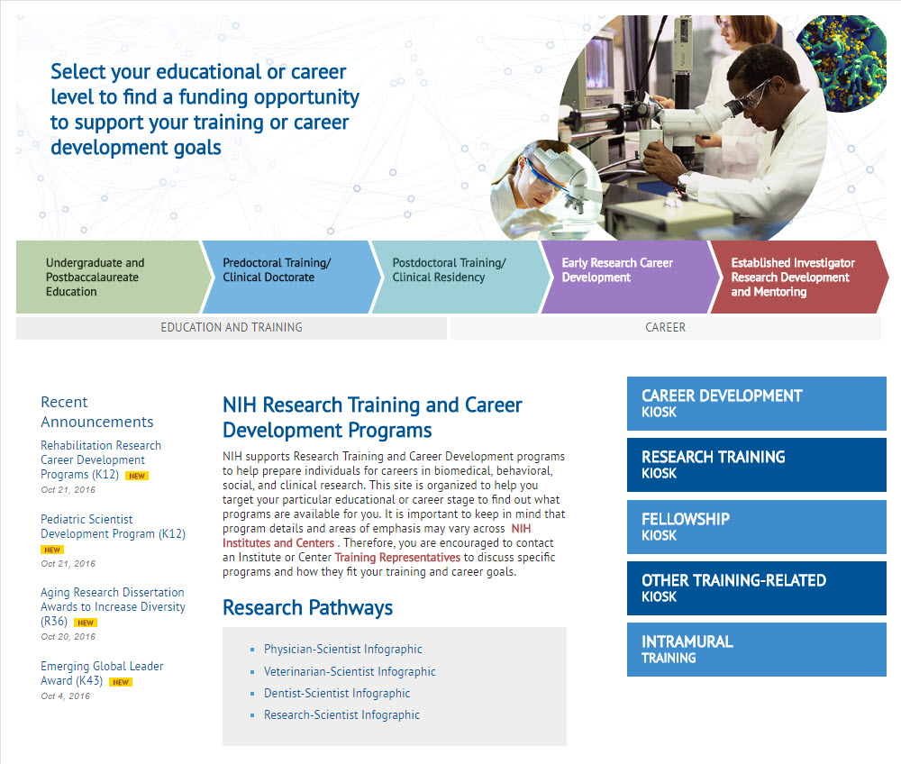
Research Training Website
https://researchtraining.nih.gov

Slide 21

Research Supplements to Promote Diversity
Supplement funding to active NIH research grants (e.g., R, P, U) to support research training of high school students through junior faculty.
  Research Transition Awards (R00) should check with their Program Officer before applying for a supplement.
All NIH ICs participate in the Diversity Supplement Program, but each IC has different deadlines and policies
Administratively reviewed (no peer review) by the IC funding the original grant – projects must be within scope of the parent grant
Supplements provide salary and fringe benefits; funds for supplies and trave; tuition for predocs
Typically, 1-3 years of “bridge funds” to allow the supplement awardee to gain the research experience, preliminary data, and/or other skills to prepare a strong application for independent NIH funding.
  Feeder program for training awards such as Fs and Ks
PA-21-071: IC Specific Contacts and Information

Slide 22
Pursuing Your Own Funding
Fellowships - F
F32 - Ruth L. Kirschstein Postdoctoral Individual National Research Service Award
  Parent F32 – supported by 20 ICs
  NINDS F32 – candidates can apply 12mo prior to but no more than 12mo after starting a postdoc position
  BRAIN F32 – candidates can apply 12mo prior to but no more than 12mo after starting a postdoc position
  NIA F32 – promoting diversity in AD/ADRD research
Career Development Awards - K
K01 - Mentored Research Scientist Career Development Award
  ~25 active FOAs for postdocs and/or junior faculty
K99/R00 - Pathway to Independence Award
  Parent K99/R00 – supported by most ICs
  MOSAIC K99/R00 – promoting diversity, supported by most ICs
  BRAIN K99/R00 – promoting diversity
  NINDS K99/R00 – promoting diversity in AD/ADRD research

Slide 23

NIH-Supported Training at Institutions
Ruth L. Kirschstein Institutional National Research Service Award (T32)
NIH supports ~1800 projects that enable over 200 institutions nationwide to recruit and support predoctoral and postdoctoral scientists and provide structured training in a various biomedical disciplines
Institutional Career Development Program Award (K12)
Prepare postdoctoral and clinician scientists for independent research careers

Slide 24

NIH-Supported Career Development and Networking Opportunities
Research Education Program (R25)
The purpose of this type of program is to support research education activities that complement and/or enhance training, enhance diversity , help recruit individuals with specific disciplinary backgrounds to research careers, and/or foster a better understanding of given research topics.
  NIH Neuroscience Development for Advancing the Careers of a Diverse Research Workforce – for predoc through junior faculty researchers
  Enhancing NIDCD's Extramural Workforce Diversity through Research Experiences (new) – for undergrad through mid-career faculty researchers
  Mentoring Networks to Enhance Diversity in NIDCD's Extramural Research Workforce (new) – for undergrad through predoc researchers

Slide 25
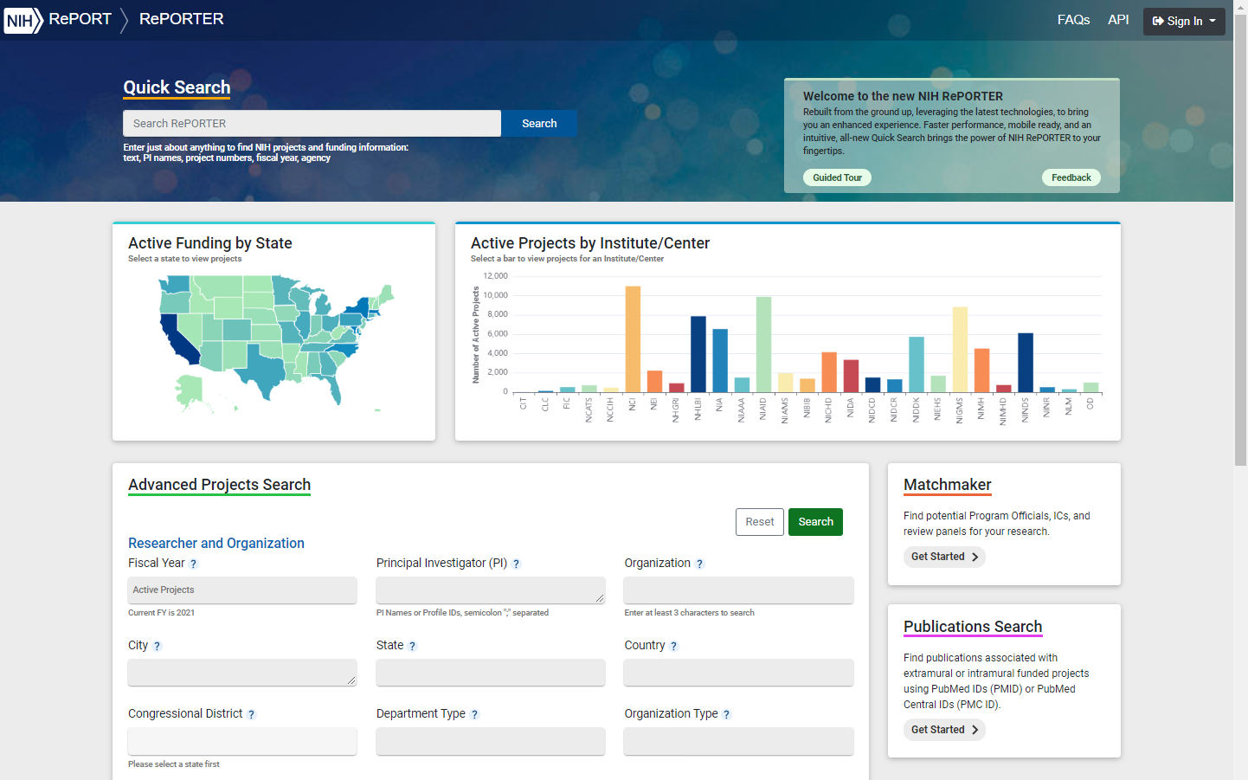
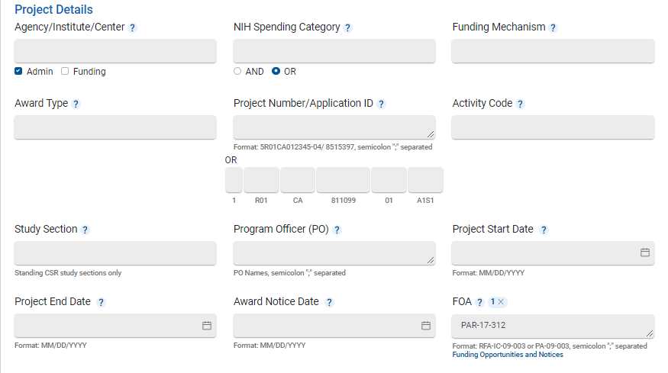
Finding an R25 Well-Suited for Your Needs
https://reporter.nih.gov/advanced-search

Slide 26
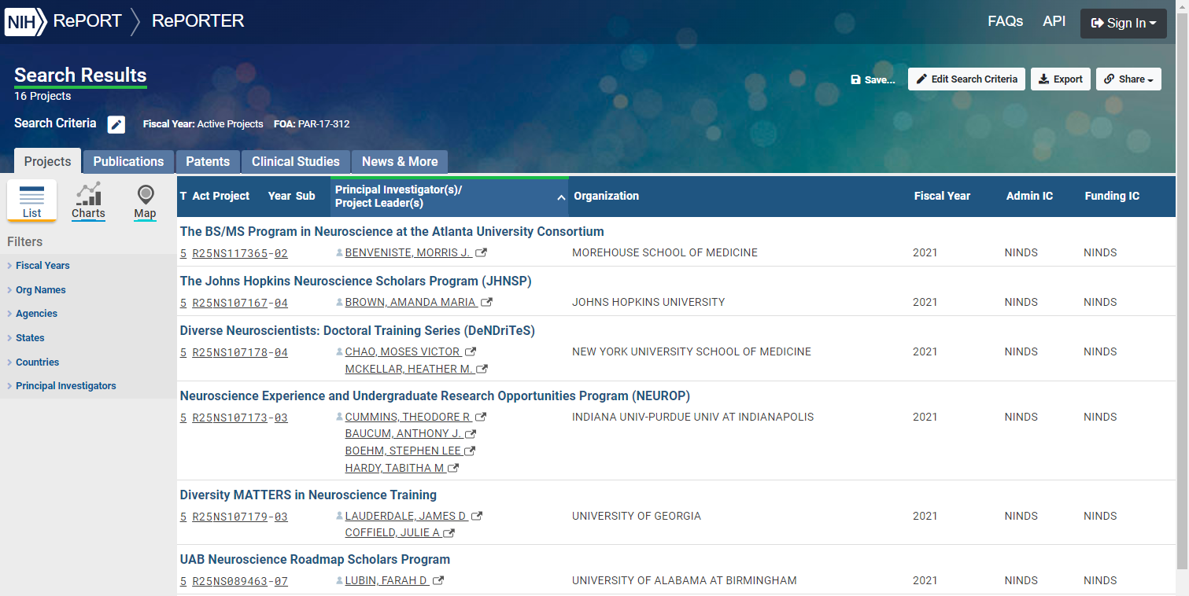
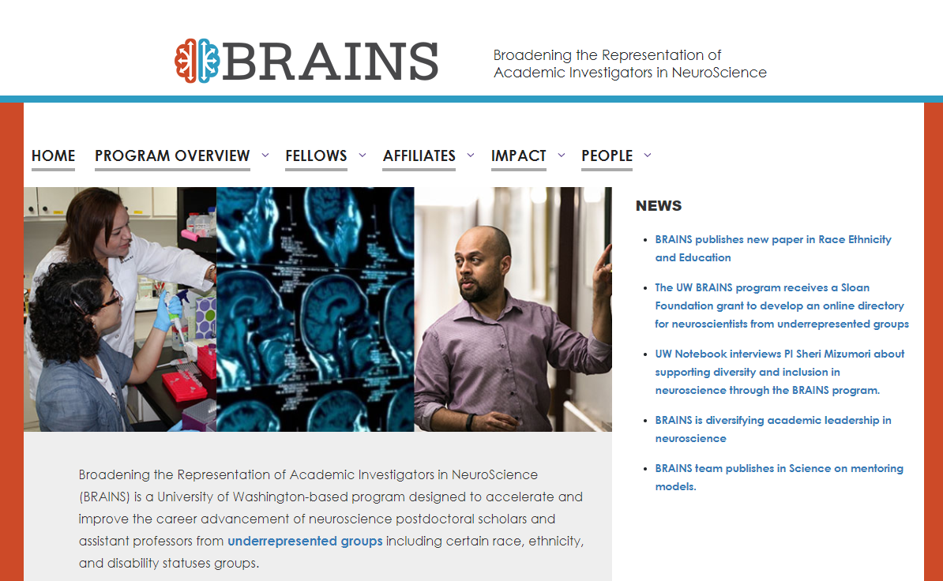
Finding an R25 Well-Suited for Your Needs

Slide 27
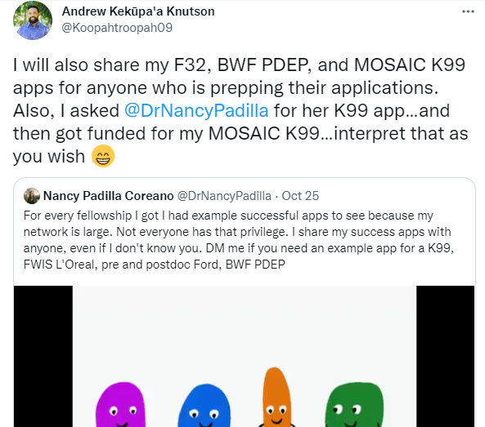
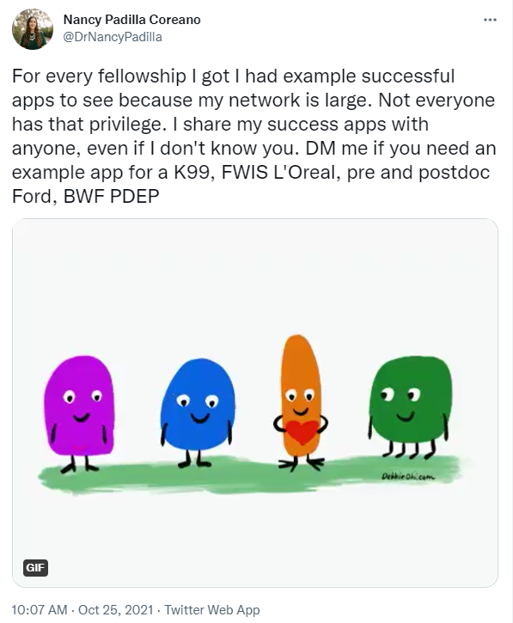

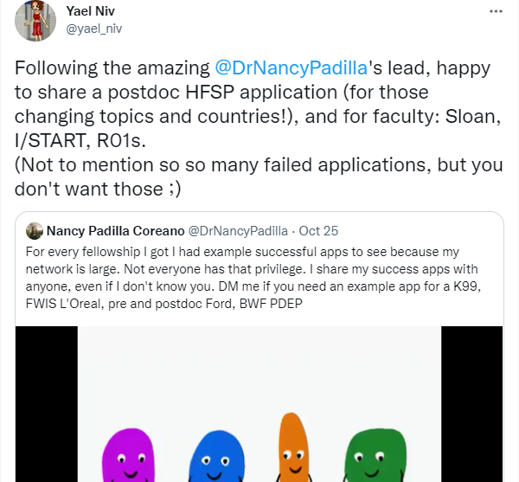
Using Social Networks for Support and Guidance

Slide 28
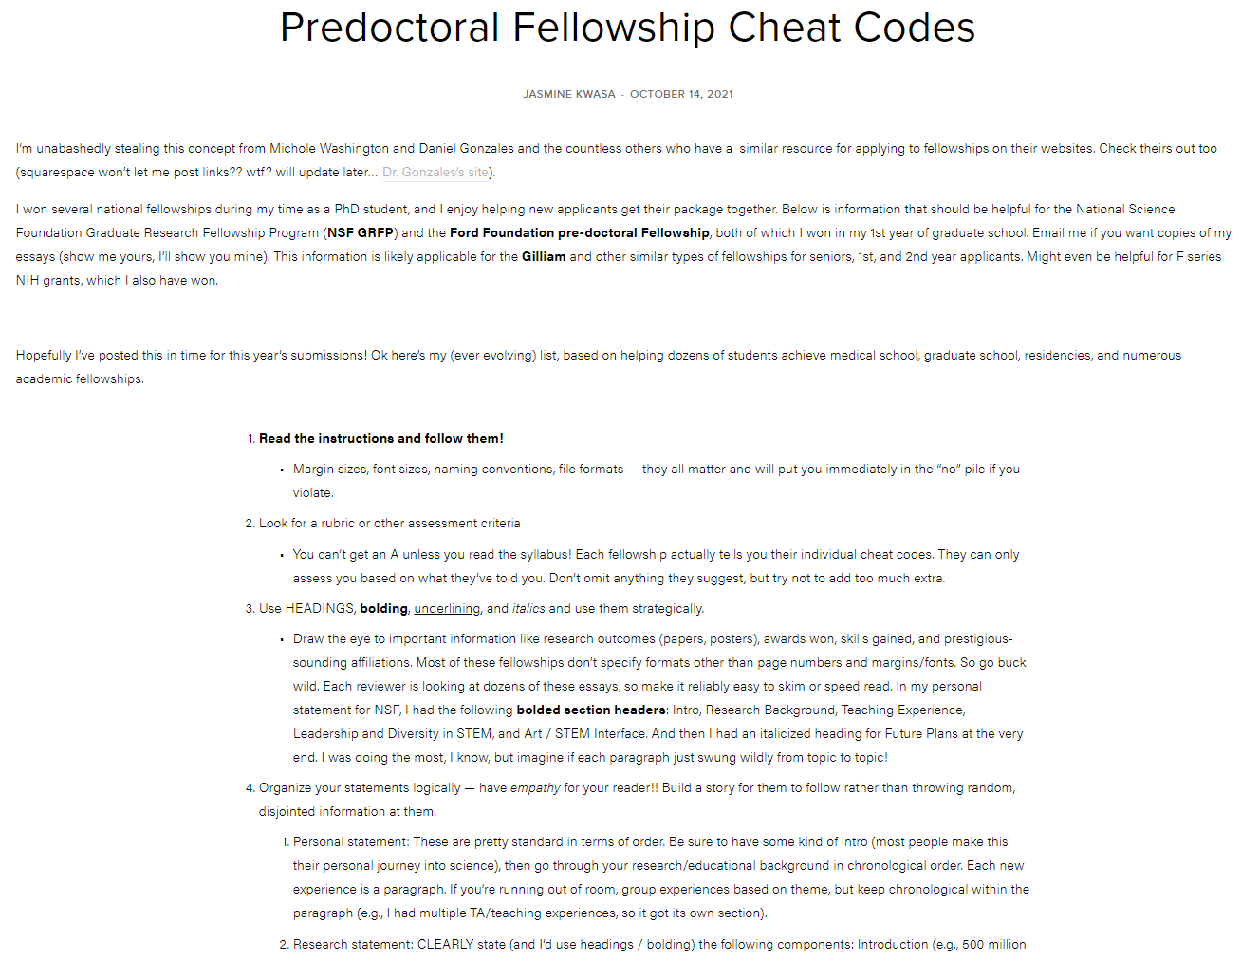
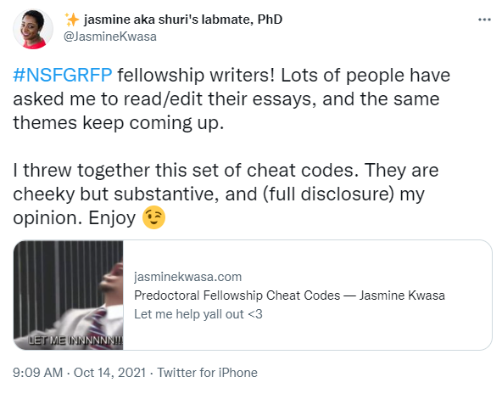

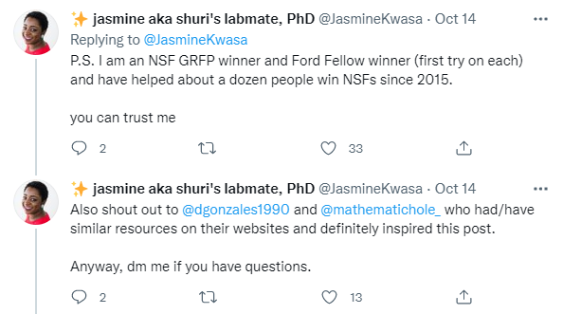
Using Social Networks for Support and Guidance
https://www.jasminekwasa.com/blog/fellowship-cheat-codes

Slide 29
Career Stage Transitions
Why Diversity Matters to NIH –
Dr. Le Fauve
NIH 101: A Primer for ESI and 1st Time Applicants – Dr. Lauren Hill
Strategies to Support Your Research Training – Dr. Marguerite Matthews
Career Stage Transitions – Dr. Kenneth Gibbs

Slide 30
MOSAIC Program to Promote Faculty Diversity
MOSAIC is designed to facilitate the transition of promising postdoctoral researchers from diverse backgrounds, for example individuals from groups underrepresented in the biomedical research workforce at the faculty level, into independent, research-intensive faculty careers
The overarching goal of the NIH MOSAIC program is to enhance the diversity of independent investigators conducting research within the NIH mission. Program priority is to address documented underrepresentation at the faculty level (e.g., see NIH’s Notice of Interest in Diversity).
https://www.nigms.nih.gov/training/careerdev/Pages/MOSAIC.aspx

Slide 31
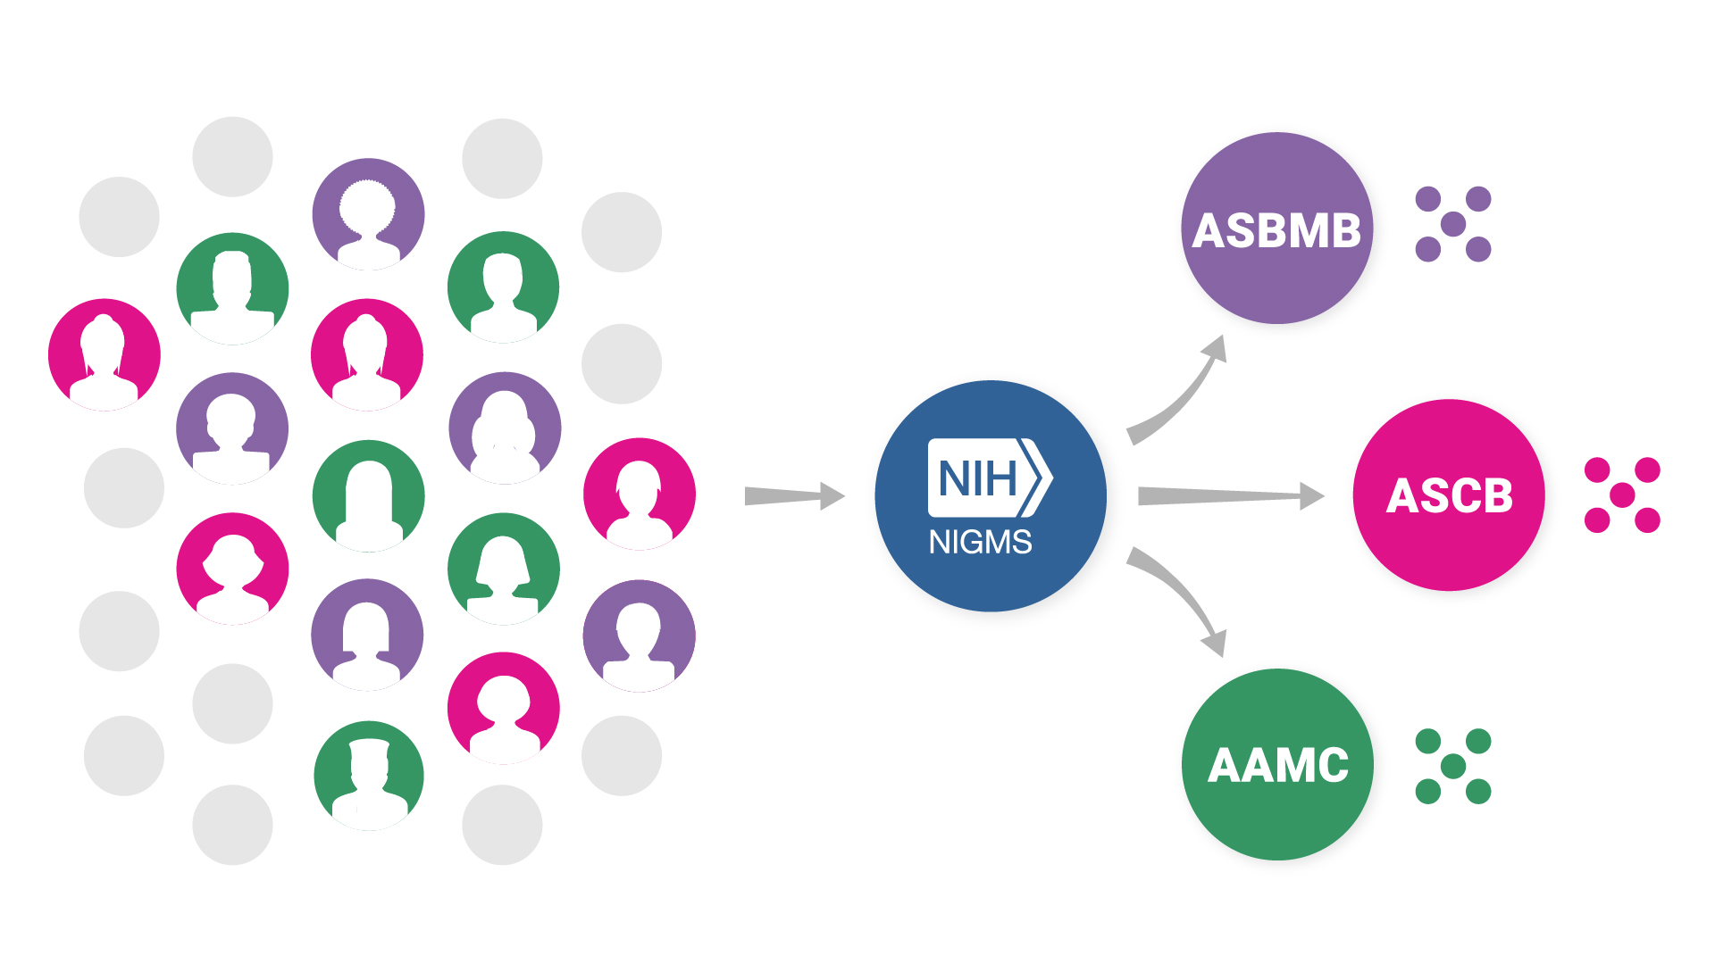
Maximizing Opportunities for Scientific and Academic Independent Careers (MOSAIC)
Postdoctoral Career Transition Award to Promote Diversity (K99/R00) – PAR-21-271, -272, and -273
Institutionally Focused Research Education Cooperative Agreement to Promote Diversity (UE5) – PAR-21-277
MOSAIC K99/R00 Applicants
https://www.nigms.nih.gov/training/careerdev/Pages/MOSAIC.aspx

Slide 32
Maximizing Opportunities for Scientific and Academic Independent Careers (MOSAIC)
Postdoctoral Career Transition Award to Promote Diversity (K99/R00) – PAR-21-271, -272, and -273
Institutionally Focused Research Education Cooperative Agreement to Promote Diversity (UE5) – PAR-21-277
MOSAIC K99/R00 Applicants
MOSAIC K99/R00 Scholars Participate in Cohorts Organized by UE5
https://www.nigms.nih.gov/training/careerdev/Pages/MOSAIC.aspx

Slide 33
Maximizing Opportunities for Scientific and Academic Independent Careers (MOSAIC)
Postdoctoral Career Transition Award to Promote Diversity (K99/R00) – PAR-21-271, -272, and -273
Institutionally Focused Research Education Cooperative Agreement to Promote Diversity (UE5) – PAR-21-277
MOSAIC K99/R00 Applicants
MOSAIC K99/R00 Scholars Participate in Cohorts Organized by UE5
Nearly all NIH ICs participate in the MOSAIC K99/R00 program
Special emphasis on contributions and commitment to promote diversity
K99/R00 applications accepted 3x per year (February, June, October)
To date, > 75% of applicants from URM groups
https://www.nigms.nih.gov/training/careerdev/Pages/MOSAIC.aspx

Slide 34
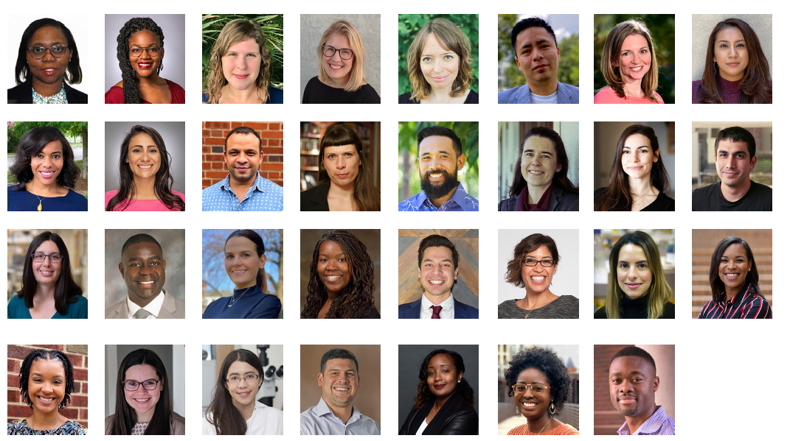
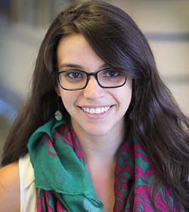
2021 NIH MOSAIC Scholars

Slide 35
Early-Stage Investigator (ESI)
An NIH ESI is a New Investigator who has completed their terminal degree or medical residency (or the equivalent and whichever date is later) within the past ten years and has not yet been awarded a substantial, competing NIH research grant.
Status can be extended for childbirth (1 year per childbirth in ESI window) and other reasons (e.g., COVID-19 related disruptions, family care responsibilities, active-duty military service) considered on a case-by-case basis.
Receive special attention at Review (career stage), National Advisory Council (high program priority) and potentially increased payline for scored R01 applications from Early-Stage Investigators
https://grants.nih.gov/policy/early-stage/index.htm

Slide 36
NIGMS MIRA (R35)
Applications focus on the investigator and the overall program of research in the lab within the mission of NIGMS
Significance of past and recent contributions to science and to the scientific community
Impact of proposed work while deemphasizing details of approach
Two FOAs:
  PAR-19-367: For Established Investigators
  PAR-20-117: For Early-Stage Investigators (preliminary data not required!)
https://www.nigms.nih.gov/research/mechanisms/mira/pages/default.aspx

Slide 37
Stephen I. Katz Early Stage Investigator Research Project Grant (R01)
New Research Directions (e.g., new approach, methodology, technique, discipline, target, paradigm) – specific attachment
Can rely on the applicant’s prior work and expertise as its foundation, but should not be an obvious or incremental advancement, expansion or extension of a previous research effort
Unpublished data not allowed
It is important to check which NIH ICs are signed onto each FOA
  PAR-21-038: Clinical Trial Not Allowed
  PAR-20-039: Clinical Trial Required
https://grants.nih.gov/funding/katz-esi-r01.htm

Slide 38

NIH Loan Repayment Program
2-year Research Commitment
Up to $50,000/year
New: ASSIST and REACH
LRP Resources
Extramural LRP
Application Deadline
November 18, 2021

Slide 39






Extramural LRP Subcategories
For individuals conducting research at non-profit institutions
Clinical Research
Patient-oriented research conducted with human subjects or materials of human origin (including cognitive phenomenon) on the causes and consequences of disease in humans
Pediatric Research
Research related to diseases or disorders in children
Health Disparities Research
Same as Clinical Research LRP
Contraception & Infertility Research
Clinical Disadvantaged Backgrounds
Research focusing on minority and other health disparity populations
Research focusing on conditions impacting ability to conceive or bear children and provide new or improved methods of preventing pregnancy
Basic research allowed
Basic, clinical, social and behavioral research allowed
Available to clinical researchers from verifiable disadvantaged backgrounds
Applications reviewed by Eunice Kennedy Shriver NICHD
Applications reviewed by NIMHD
Research in Emerging Areas Critical to Human Health (REACH)
Available beginning September 2021 to recruit and retain researchers pursuing major opportunities or gaps in emerging areas of human health
NIH ICs determine gap/emerging areas of research priority areas

Slide 40
Thank you!
Thank You Very Much For Attending!
Please check the Virtual Seminar agenda for
additional sessions that may be of interest!

