Slide 1


Roles & Responsibilities Throughout the Grants Life Cycle
Presenters:
Dr. Ashlee Lane, Scientific Review Officer, Center for Scientific Review (CSR)
Dr. Amanda Melillo, Branch Chief, National Institute of Dental and Craniofacial Research (NIDCR)
Ms. Susan Medve, Grants Management Specialist, National Institute of Dental and Craniofacial Research (NIDCR)
Moderator:
Ms. April L. Harrison, Grants Management Specialist, National Institute of Dental and Craniofacial Research (NIDCR)

Slide 2

Where do I turn when I need help or advice from the NIH?

Slide 3

The NIH Extramural Team
Review
Program
Grants
Management

Slide 4
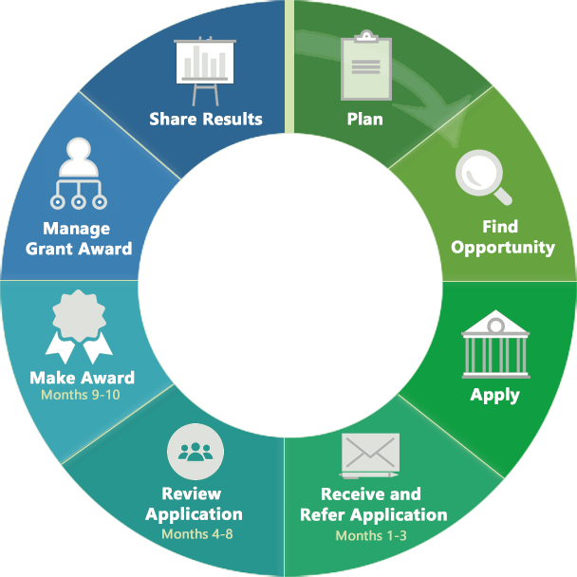
Roles of Your Scientific Review Officer
Recruits reviewers and assigns applications
Manages the meeting and conflicts
Prepares summary statements
Provides information to NIH Institutes and Centers
Grant Life Cycle

Slide 5
When Should You Contact Your Scientific Review Officer?
Before You Submit Your Application
A Program Officer at an NIH Institute or Center
Scientific Review Officer
  Locate at the bottom of funding opportunity announcement or Institute/Center’s website
After You Submit
Your Scientific Review Officer
  Assigned once application is submitted and assigned to a peer review panel
  Can be found in eRA Commons
  Post-submission materials – 30 days before review meeting
After Your Review
Your Assigned Program Officer
  Assigned once application is submitted
  Can be found on the upper left-hand corner of your summary statement

Slide 6
An SRO may help you determine an appropriate Study Section
Different Methods to Find an SRO
Center for Scientific Review study sections
  https://public.csr.nih.gov/StudySections
CSR Assisted Referral Tool (ART)
  https://art.csr.nih.gov/ART/selection.jsp
Study Section Rosters
https://public.era.nih.gov/pubroster/rosterIndex.era

Slide 7
Poll
Do you know who your program officer is?

Slide 8
Roles of your Program Officer
Scientific portfolio of awards within the mission of an institute
Initiative development
Recommends applications to be considered for award to the IC director
Programmatic, scientific, and/or technical guidance pre- and post-award
Post-award oversight by monitoring research progress
Grant Life Cycle

Slide 9
When Should You Contact Your Program Officer?
Before you submit your application
Discuss application topics for relevance
Discuss options for appropriate funding opportunities (FOAs)
Guidance on submitting a large budget application (>$500K in direct cost per year)
Guidance with application preparation
After you receive your Summary Statement
Discuss summary statement and next steps
Ask questions about NIH policies
During the award
Discuss natural disasters or other emergencies that may affect your research progress
Discuss other supplement opportunities
Questions about prior approvals for changes to your award
Discuss progress of funded award
After the Award
Share upcoming publications related to your award
If applicable, discuss preparing a competing renewal

Slide 10
Role of the Grants Management Branch
Grant Life Cycle

Slide 11


Chief
Grants Management Officer vs
Grants Management Specialist

Slide 12
Grants Management Specialist
Acts as an agent of the GMO
Assures compliance with Federal laws and NIH policies and procedures
Analyzes grant applications prior to award
Prepares award for GMO release
Provides technical assistance, interprets NIH policies and Institute procedures
Reviews and responds to grantee prior approval requests
Assures documentation of official grant files

Slide 13
Chief Grants Management Officer
Responsible for completion of business management requirements
Evaluates applications for administrative content and compliance with policy
Interprets grants administration policies
Monitors a grant’s administrative and fiscal aspects
Assures compliance with Federal laws and NIH administrative policies and procedures
Is the NIH official authorized to obligate the NIH to the expenditure of funds or to change funding amounts, budget/project period dates, or other terms and conditions of a grant award

Slide 14
When to Contact your Grants Management Specialist
Pre-award requests, our “just-in-time” process.
Delay in completing paperwork required to issue your award.
To discuss financial or grants administration issues- Budget questions.
Adding a foreign component
Questions about your budget or other support on your grant
Questions about any terms and conditions on your Notice of Award
Clarification of NIH Grants Rules and Policies.
For interpretation of grants policies.

Slide 15
When to Contact your Grants Management Specialist: Prior Approval
Any action that requires prior approval—read more in Some Actions Require Our Approval in Changes to Project or Budget
Common prior approval requests:
  Change of scope
  Reducing principal investigator (PI) effort by 25 percent or more
  Going from a single PI to a multiple PI award
  Carryover of un-obligated funds from a previous budget period to a subsequent budget period (only when automatic carryover is not authorized as a term and condition on the Notice of Award or if executing any carryover type will cause a change in scope)
  Any issue that your business office does not handle or cannot advise on

Slide 16
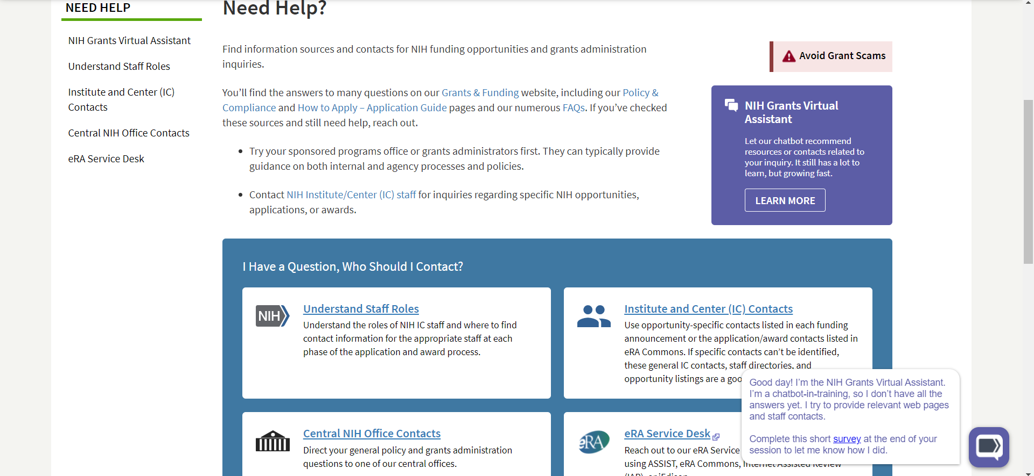
NIH Grant Quick Links and Virtual Assistant
https://grants.nih.gov/help
Valuable Guidance at Your Fingertips
Links to policies, application guide pages, and FAQs. Chatbot can help guide you to answers as well!

Slide 17
General Policies, Application Forms, and Guidance
NIH Grants Website: https://grants.nih.gov
General Policy Resources, Application Forms and Guidance
Links to policies, writing tips, deadlines, forms, and more:
Coronavirus Disease 2019 (COVID-19): Information for NIH Applicants and Recipients
Electronic submission (NIH)
Application forms and instructions (NIH)
How your application is reviewed
Details and additional information about the NIH application review process.
All About Grants Podcast (OER)
System of Award Management (SAM) Registration
Organizations must renew their SAM registration annually.
Policy on Resubmission Applications (NIH)
Institute and Centers also provide guidance:
Who can apply for funding
Lists of organization requirements, eligible institutions, and more.
Grant-writing advice and sample applications
Useful websites to help you plan, write, and apply for a research project grant.
Grantee Policies

Slide 18
Additional Resources
Where to Find Contact Information
Clinical Research Resources
After finding an FOA
Refer to section VII of the FOA for Financial/Grants Management Contact(s)
After application submission and/or award
Look in your eRA account for the name and contact information for the assigned grants management staff for your application
NCCIH Clinical Trial Funding Opportunity Announcements
NCCIH Clinical Research Toolbox
Natural Product Clinical Trial Resource
Understand FDA Requirements for a clinical trial that will use a natural product
Pre-Application Events and Summaries
Preapplication Technical Assistance Webinars
Grant Applications Over $500,000
Applications for Centers of Excellence for Research on Complementary and Integrative Health (P01) Over $500,000 in Direct Costs in Any Year
Applications for Large Budget Clinical Trials With Budgets Over $500,000 in Direct Costs in Any Year
*All Resources on this page provided by NCCIH.

Slide 19
NIH Acronyms
Frequently Encountered Abbreviations
NOA – Notice of Award
FFR-Federal Financial Report
OPERA – Office of Policy for Extramural Research Administration
CSR – Center for Scientific Review
RPG – Research Project Grant
RFA – Request for Application
PA – Program Announcement
FOA – Funding Opportunity Announcement
IC – Institute/Center
Complete NIH Acronym List: https://grants.nih.gov/grants/acronym_list.htm
NIH Grants Glossary: https://grants.nih.gov/grants/glossary.htm

Slide 20


Thank you

