Slide 1
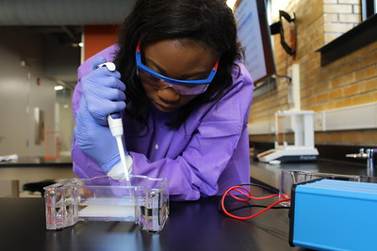

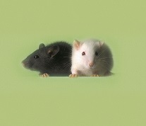
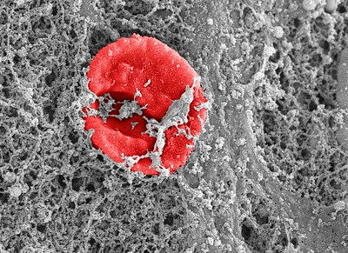
Review Integrity:
Mistakes You Don’t Want to Make
NIH Virtual Seminar
November 4, 2021
Michael Lauer, M.D.
Sally Amero, Ph.D.
Megan Columbus
NIH Office of Extramural Research

Slide 2
Review Integrity – A Shared Responsibility
Compromised peer review opens the door to:
    Inefficient expenditure of public funds
    Potential harm to human subjects and/or
    vertebrate animals
    Loss of public trust in biomedical research
  Any violation of a core value is a
  breach of review integrity
Core Values of Peer Review
Confidentiality
Expert Assessment
Fairness
Impartiality
Integrity
Security
Transparency
Efficiency

Slide 3
What’s Your Role in Review Integrity?
NIH
Investigator
Reviewer
Institution

Slide 4
Mini Case-Study 1: The Seminar Trip
Scene | Characters
Dr. A accepted invitation from graduate students in a prominent department to present a seminar Dr. A is a member of study section XYZ During the seminar trip, Dr. A is asked about specific applications reviewed in XYZ and their summary statements | Dr. A: Reviewer/Seminar Guest Graduate Students/Postdocs Department Faculty

Slide 5
Mini Case-Study 2: The Newbie
Scene | Characters
Dr. B just finished serving in peer review for the first time Dr. C, her Department Chair, tells Dr. B: “I know what you did on study section. We need to support one another. An old friend of mine had an application in that meeting.” | Dr. B: New Reviewer/New Investigator Dr. C: Dr. B’s Department Chair Vice President for Research NIH staff

Slide 6
Mini Case-Study 3: The Stash
Scene | Characters
Dr. D left University for another position In cleaning out his profile, University found NIH grant applications, critiques, and notes on their shared drive The (former) Department Chair contacted NIH Notes indicated “good ideas to consider” | Dr. D: Departed faculty Department Chair Vice President for Research NIH staff

Slide 7
Mini Case-Study 4: The Advisor
Scene | Characters
Dr. E is a New Investigator preparing her first R01 application Dr. F is in another institution, former member of Dr. E’s dissertation committee Dr. E asks Dr. F for help, who provides comments on first draft Dr. F is a reviewer on the study section where Dr. E’s application is reviewed | Dr. E: New Investigator Dr. F: Advisor/Reviewer Dr. E’s Vice President for Research Dr. F’s Vice President for Research NIH staff

Slide 8
Mini Case-Study 5: The Educator
Scene | Characters
Dr. G reported to the NIH that Dr. H circulated an application in a departmental grantwriting course Dr. H had not requested permission from Dr. I, PI on the application All three are in the same department | Dr. G: Postdoc 1 Dr. H: Faculty member Dr. I: Postdoc 2 Vice President for Research NIH staff

