Slide 1
Research Misconduct and Integrity
November 3, 2021
NIH Virtual Seminar
Patricia Valdez, PhD Ranjini Ambalavanar, PhD
Chief Extramural Research Integrity Officer Scientist-Investigator
Office of Extramural Research, NIH Office of Research Integrity, HHS

Slide 2






Everyone’s Responsibility
Integrity
Stewardship
Protection
UNIVERSITY

Slide 3
Overview of NIH Allegation Review Process
Research
Misconduct
Harassment
Grant
Fraud
Foreign
Interference
Peer Review
Integrity
ALLEGATION
ENTRY
INITIAL
ASSESSMENT
ACTIONS TO CONSIDER, DEPENDING ON
OUTCOME OF ASSESSMENT
Contact institution
Remove individual from peer review service
Refer to agency/office with oversight responsibility
Administrative actions
Regulatory actions

Slide 4
Research Misconduct and Integrity
Ranjini Ambalavanar, Ph.D.
Division of Investigative Oversight (DIO)
Office of Research Integrity (ORI)
November 2021

Slide 5
A Slippery Slope?
Research Laboratories
Most of the scientists conduct research with a high degree of integrity contributing to advancement in science
Lab 1
Lab 2
Lab 3
Research
Misconduct
Questionable Research Practices/Sloppy Science
High Degree of Integrity

Slide 6
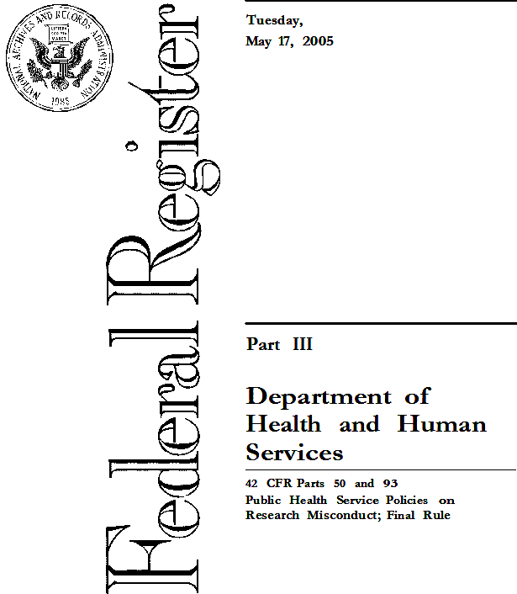
Research misconduct - 42 CFR § 93.103
Fabrication, falsification, or plagiarism in proposing, performing, or reviewing research, or in reporting research results.
Fabrication is making up data or results and recording or reporting them.
(b) Falsification is manipulating research materials, equipment, or processes, or changing or omitting data or results such that the research is not accurately represented in the research record.
(c) Plagiarism is the appropriation of another person's ideas, processes, results, or words without giving appropriate credit.
PHS Policies on Research Misconduct

Slide 7
Scenario 1- Are you liable?
You submit an NIH grant application not aware that the data and/or text included by others were falsified/fabricated and plagiarized.
Yes!
Decisions by an ALJ on two of the recent ORI cases established that a PI and/or corresponding author, can be liable for research misconduct even if he/she was completely unaware of any falsification or plagiarism.

Slide 8
Research Misconduct Findings are made when
The allegation is proven by a preponderance of the evidence
The misconduct is committed intentionally, knowingly, or recklessly.
There is a significant departure from accepted practices of the relevant research community.
Who
Significant departure
Not an honest error
FFP
Intent
Preponderance of the evidence

Slide 9
Steps in Research Misconduct Proceedings
ORI
oversight
Allegation
Assessment
Inquiry
Investigation
Colleagues
Peer reviewer s
Coauthors
Journal editors
60 days
120 days
Agree
Insufficient evidence for ORI finding
Research Integrity Officer (RIO)
Initial assessment
Organizes the remaining institutional processes
Recommend Administrative Actions:
Fix research record
Require special certification(s)
Suspend/terminate PHS-funding
Supervise offender(s)
Prohibit PHS-advisory role
Debar from future funding
All ORI Findings are published in The Federal Register, the ORI website and newsletter, and the NIH website
Institutional officials
Funding agency
Journal
ORI

Slide 10
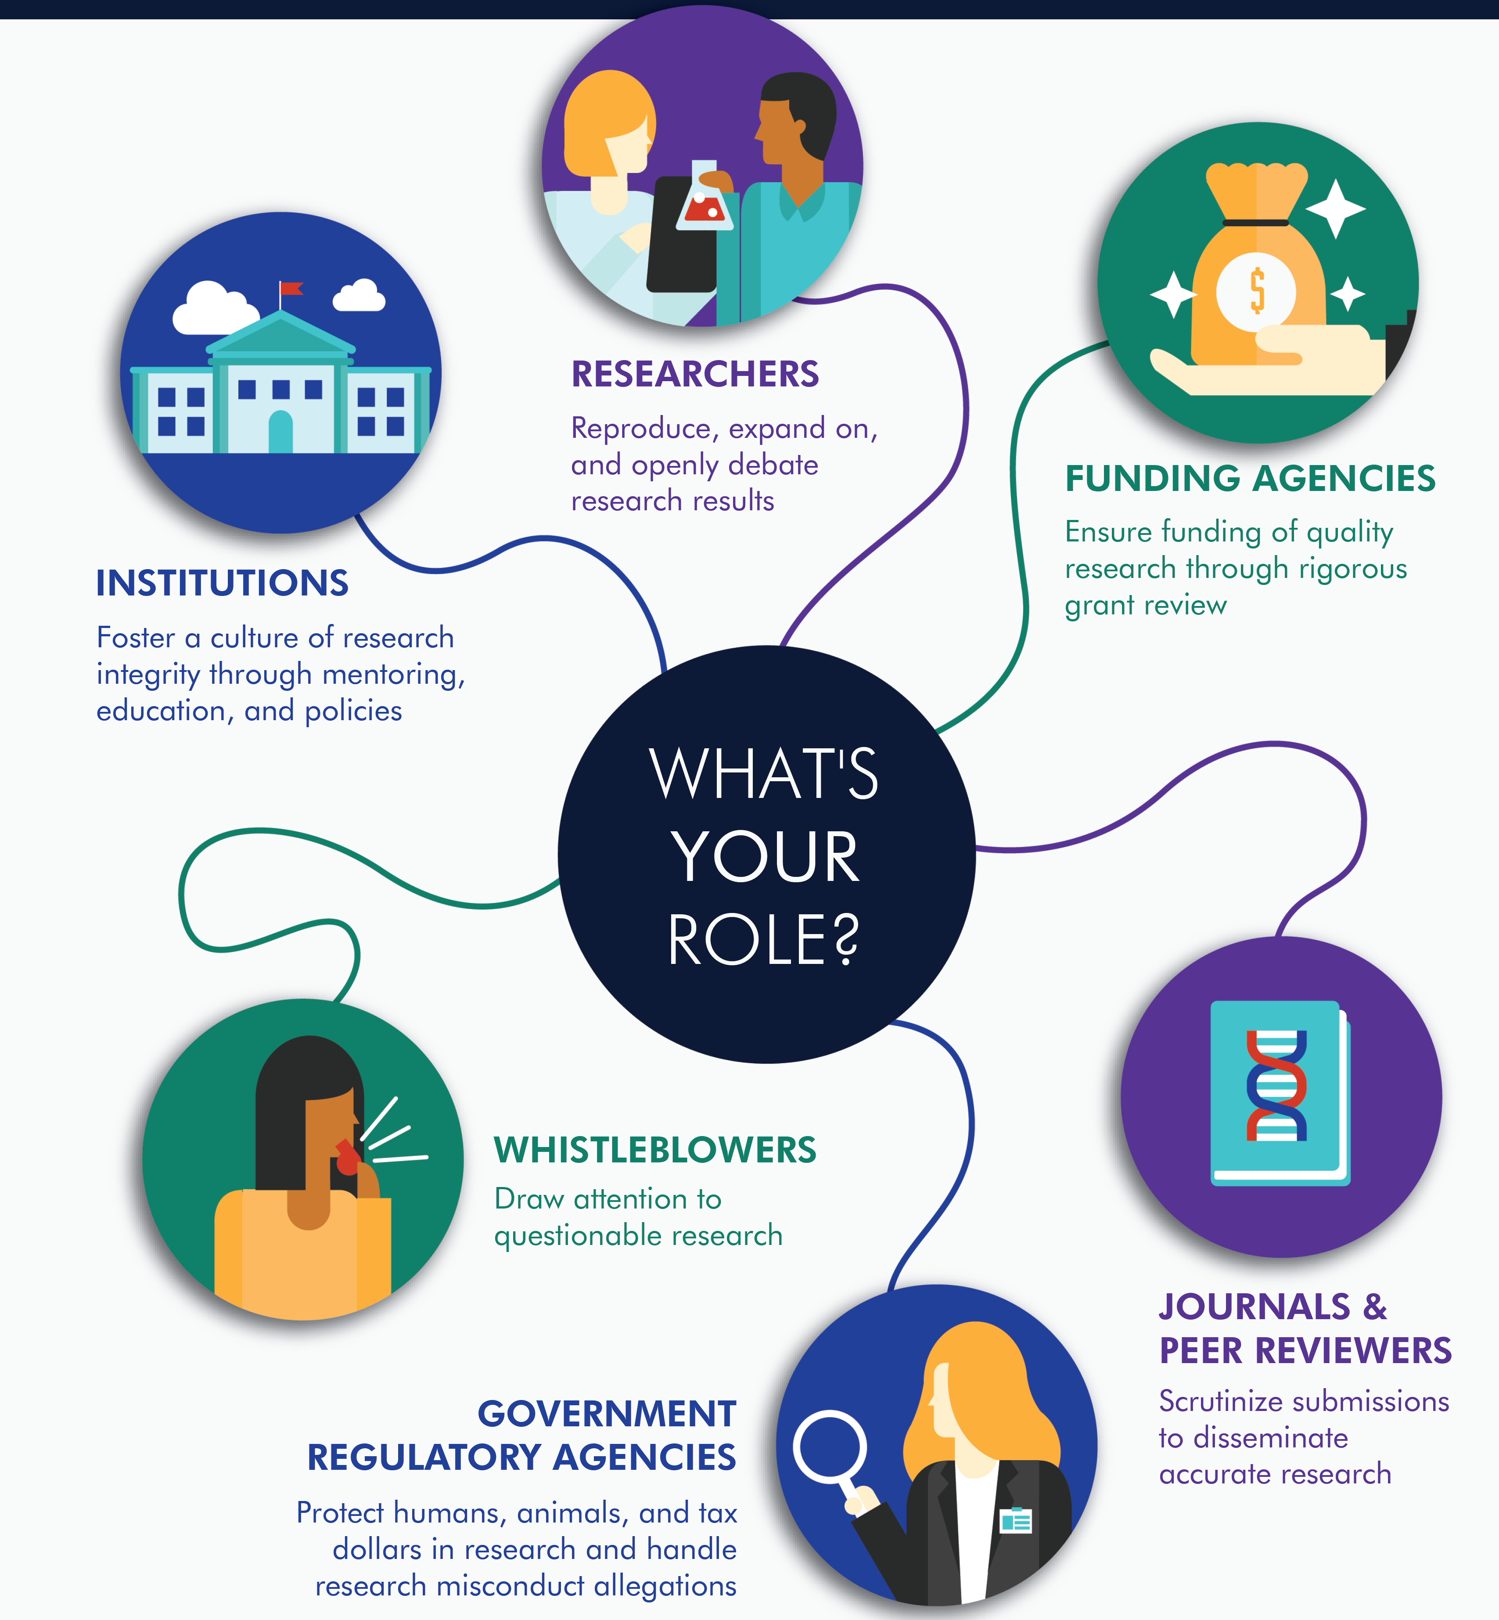
Your Role in Preventing Research Misconduct
Researchers
Perceived Pressure
Rationalization
Opportunity

Slide 11
Statements From Case Interviews

Slide 12
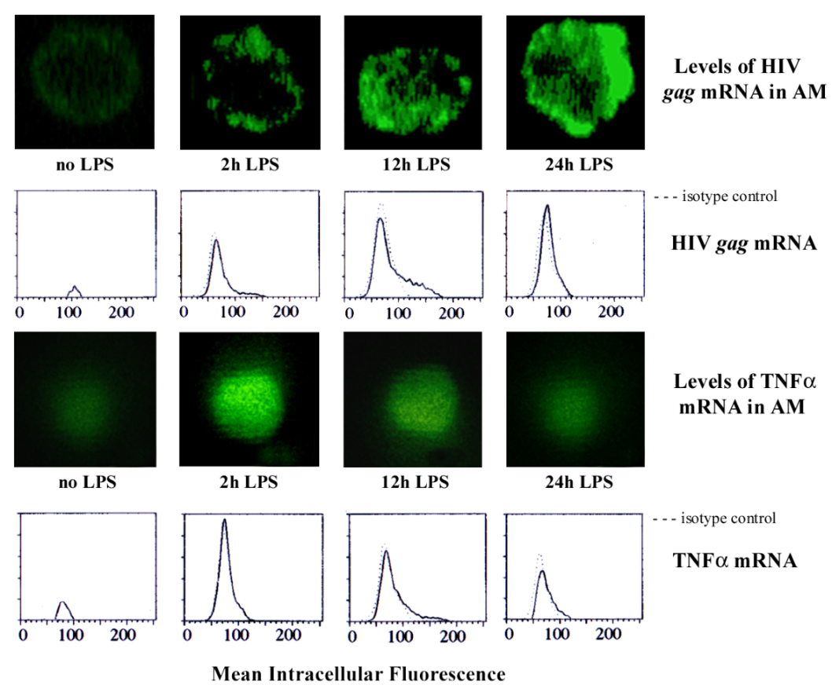
Same Cell Images to Represent Different Results
Figure C.2.5 in NIH grant application
Figure 3c in Nature Medicine

Slide 13
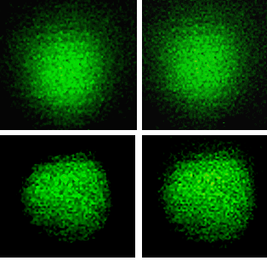
Intensity Enhanced and size adjusted
Same cell images representing
“2h LPS” and “12h LPS”
Same cell images representing
“no LPS” and “24h LPS”

Slide 14
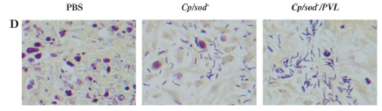
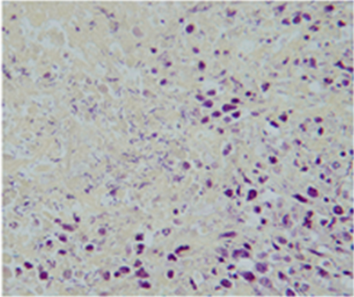
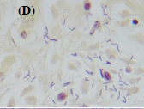
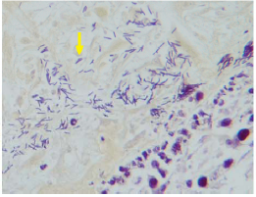
JCNI Figure 4D = Figure 6 in R21 CA120017-01+ Figure 6C in R21 CA120017-02 + Figure 10D R01 CA130897 01 A1
Pancreatic tumor
Rectangular section from Figure 6C in R21 CA120017-02 was rotated 90 degrees counter clockwise
JNCI 2008
Figure 4D
Figure 6C in R21 CA120017-02
pancreatic tumors, 5 days post injection with bacterial strain Cp/sod-
Figure 6 in R21 CA120017-01 submitted 2/05
hepatic tumor 2 days post iv Cp/plc-
Figure 10D R01 CA130897 01 A1
submitted 10/07
2 days pancreatic tumor 2days post cp/sod- in mice treated with control liposomes

Slide 15
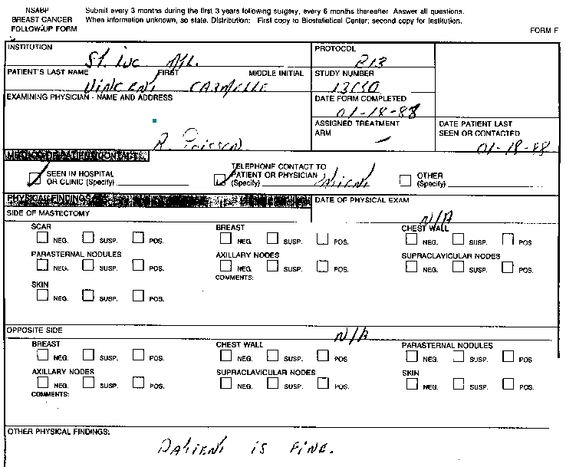
Follow up Visits For Patient 10: dated “01-18-88” and “11-29-88”

Slide 16
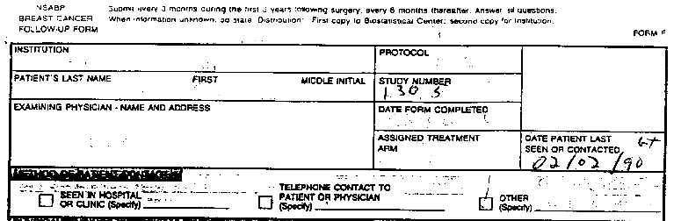
Follow up Visits For Patient 10: dated “03-21-89”and “02-02-90”
Date patient last seen or contacted

Slide 17
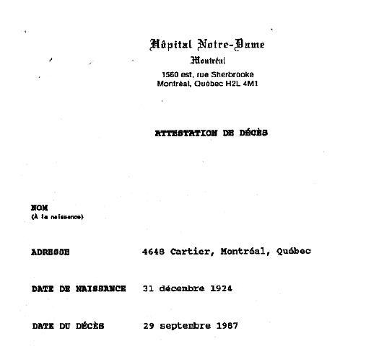
Patient 10: Death Certificate “September 29, 1987” 28 months prior to last reported follow-up (2-2-90) 4 months prior to first shown (1-18-88) follow up
FFP in clinical research involve
Interviews
Entry criteria
Screening logs
Approval forms
Follow-up visits, exams/data
Consent forms
Test scores
Laboratory results
Patient data
Number of subjects
Dates of procedures
Study results

Slide 18
When to Contact NIH: Changes in Project and Budget
Notify NIH of developments that have a significant impact on the award-supported activities
Notify NIH of problems, delays, or adverse conditions which materially impair the ability to meet the objectives of the award
Notification shall include a statement of the action taken or contemplated, and any assistance needed to resolve the situation
https://grants.nih.gov/grants/policy/nihgps/HTML5/section_8/8.1_changes_in_project_and_budget.htm

Slide 19
When to Contact NIH: Fraud, Waste & Abuse of NIH Grant Funds
Report false statements related to research misconduct to NIH or HHS OIG.
NIH may administratively recover misspent grant funds.
The Federal government may pursue administrative, civil, or criminal action under a variety of statutes relating to fraud and making false statement or claims.
https://grants.nih.gov/grants/policy/nihgps/HTML5/section_2/2.3.10_fraud__waste_and_abuse_of_nih_grant_funds.htm

Slide 20
Short Case Study
Months into a research misconduct investigation, it’s becoming clear that data in an NIH application were reused and relabeled as different experiments. The actual experiments were never conducted.
The PI of the grant notifies university officials that he has a tentative job offer at a new university out of state. The job offer requires that he bring the NIH grant with him, so he asks his current university to relinquish the active NIH grant to his new university.
The PI’s current institution has reservations about transferring the grant, especially since the data in the application may be unreliable.
What should the institution do?

Slide 21
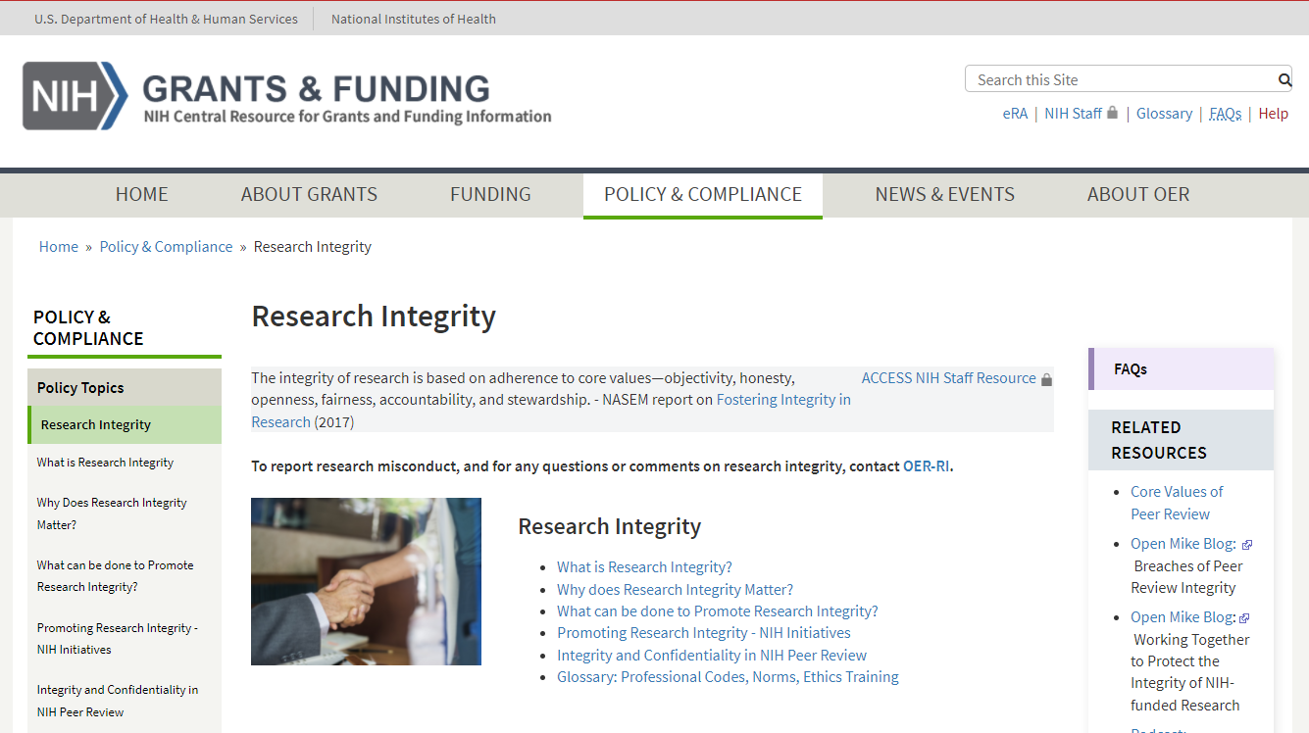
Research Integrity website
https://grants.nih.gov/policy/research_integrity/index.htm

Slide 22
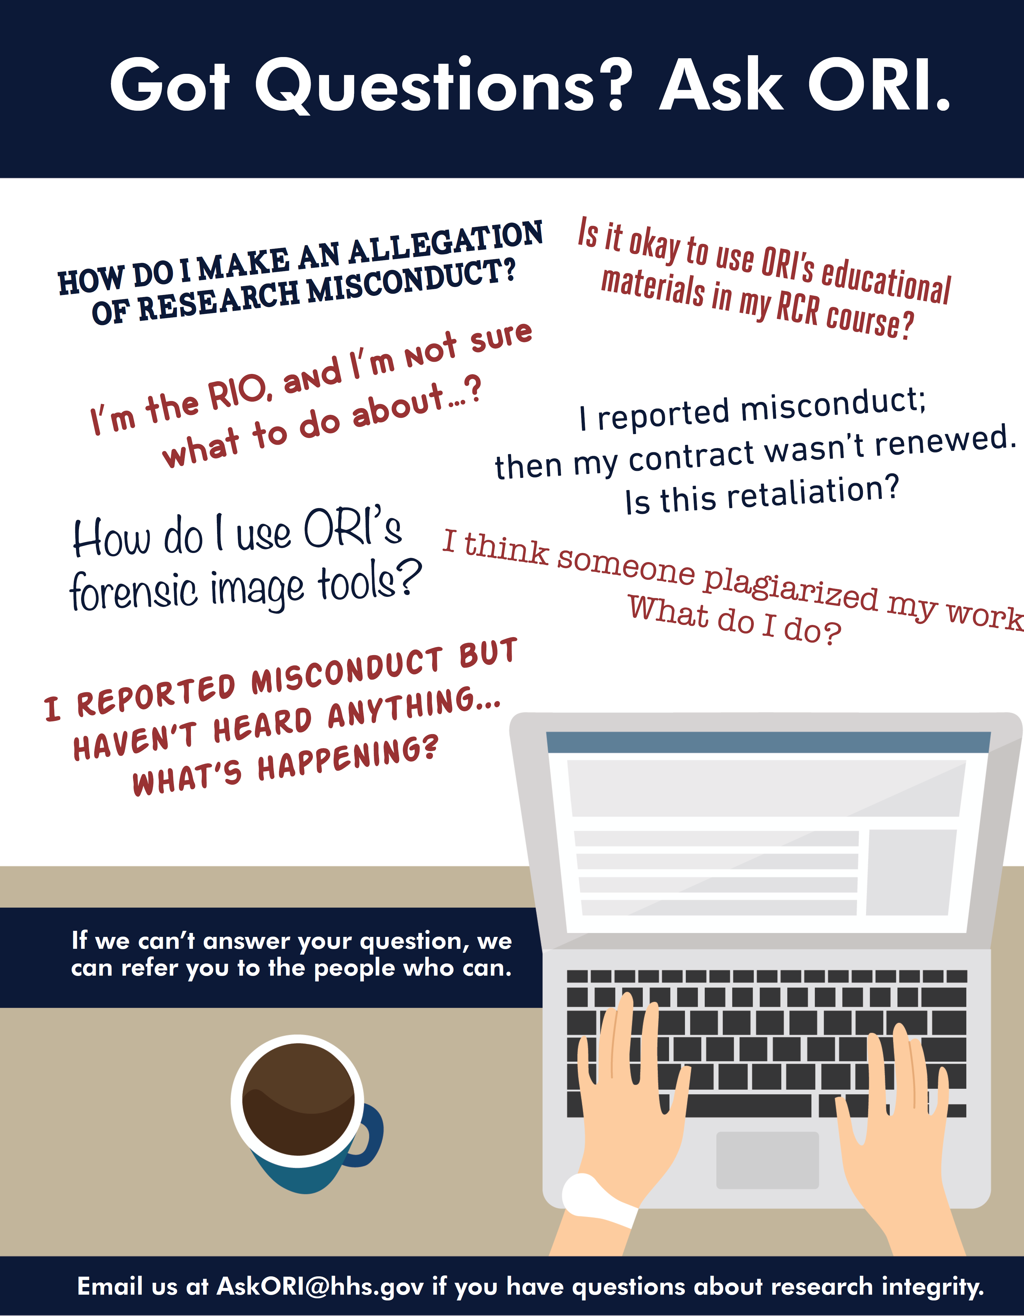

Got Questions? Ask ORI.

