Slide 1
Overview of the NIH Genomic Data Sharing (GDS) Policy, Other Sharing Policies, and Open Q&A
NIH Grants Conference​
February 2, 2023
Nonye Harvey, DrPH, MPH
Health Science Policy Analyst
NIH Office of Extramural Research (OER)
J.P. Kim, JD, MBA, MSc, MPP, MA
NIH Extramural Data Sharing Policy Officer
NIH Office of Extramural Research (OER)

Slide 2
Outline
Overview of the Data Management and Sharing (DMS) Policy
Other Sharing Policies
NIH Genomic Data Sharing (GDS) Policy
Harmonization of the GDS and DMS Policies
NIH Research Tools Policy
Model Organism Sharing Policy
Increasing Agency-Wide Access for Federally Funded Research Results: Public Access Policy
Q & A

Slide 3
NIH’s Data Sharing Initiatives & Milestones
NIH Intramural Human Data Sharing Policy
HHS Rule and NIH Policy on Clinical Trial Results Dissemination
White House Initiative
NIH Data Sharing Policy
Genome-wide Association (GWAS) Policy
Big Data to Knowledge (BD2K) Initiative
Genomic Data Sharing (GDS) Policy
All of Us Research Program
(RFI) on Proposed Provisions for a Draft Data Management and Sharing (DMS) Policy
Model Organism Policy
Research
Tools Policy
NIH Public Access Policy (Publications)
NCI Cancer Moonshot
NIH Data Commons Pilot
NIH Data Management and Sharing (DMS) Policy Effective
Modernization of NIH Clinical Trials
1999
2003
2004
2007
2008
2012
2014
2015
2016
2017
2019
*2020- 2022
2023
*DMS Final policy:
Released Fall 2020

Slide 4
Data Management and Sharing (DMS) Policy (2023)

Slide 5
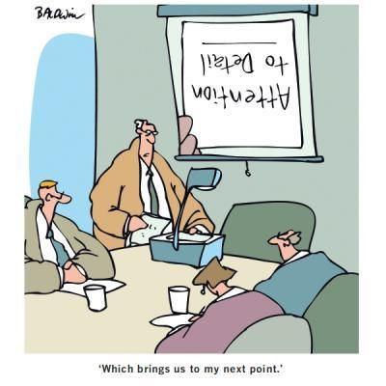
Policy Details
Requirements (effective Jan. 25, 2023):
Submission of Data Management & Sharing Plan
Compliance with ICO-approved Plan (may affect future funding)
Scope: All NIH-supported research generating scientific data
What’s in: “Recorded factual material… of sufficient quality to validate and replicate research findings, regardless of whether the data are used to support scholarly publications”
What’s out: Lab notebooks, preliminary analyses, peer reviews, physical objects
Timelines:
When to share data: No later than publication or end of award (for unpublished data), whichever comes first
How long to share data: Consider other relevant requirements and expectations (e.g., journal policies, repository policies)
Notes:
relates to the proposed research questions and can include findings underlying unpublished null results

Slide 6
NIH Genomic Data Sharing Policy (2015)

Slide 7
NIH Genomic Data Sharing (GDS) Policy
Purpose
Sets expectations and responsibilities for investigators and institutions to ensure broad, responsible, and timely sharing of genomic research data
Scope
Applies to all NIH-funded research generating large-scale human or non-human genomic data and secondary research using these data
Applies to all funding mechanisms (grants, contracts, intramural support) regardless of cost
Effective January 25, 2015
NIH Intramural – August 31, 2015

Slide 8
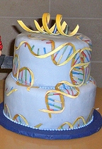
Categories of Genomic Data
The GDS Policy allows for two-tiered access for human data:
Unrestricted-access: Data are publicly available to anyone (e.g., The 1000 Genomes Project)
Controlled access: Investigators must obtain approval from NIH Data Access Committees (DACs) to use data from NIH-designated data repositories (e.g., dbGaP)

Slide 9
Process for Submitting or Accessing Human Genomic Data
Data Submission
Data Access
Institutional Certification provided
Any applicable data use limitations indicated
Data Access Request
Co-signed by institution
Agreement to terms of use in Data Use Certification
PI agrees to Code of Conduct
Submitted to NIH-Designated Data Repository
(e.g., SRA)
(e.g., dbGaP)
Data Access Committee
Review research proposal and compare with data use limitations
Verify PI credentials
Consider the potential for group harm (e.g., stigmatization)
Unrestricted Access Data:
Study Protocol
Descriptive Information
GSR Results*
Controlled-Access Data:
Coded Genotypes
Phenotypes
*Unless designated "Sensitive"
Notes:
Data Submission Header
Chart with arrows outlines the following
Data Submission with arrow to:
Institutional Certification provided
Any applicable data use limitations indicated
Next arrow points to:
Submitted to NIH-Designated Data Repository
Two Choices Provided:
-Unrestricted Access Data: e.g. SRA
Study Protocol
Descriptive Information
GSR Results*
*Unless designated “sensitive”
Or
Controlled-Access Data
Coded Genotypes
Phenotypes
E.g. dbGaP
Next session:
Data Access Header points to:
Data Access Request
Co-signed by institution
Agreement to terms of use in Data Use Certification
PI agrees to Code of Conduct
Arrow points to:
Data Access Committee
Review research proposal and compare with data use limitations
Verify PI credentials
Consider the potential for group harm (e.g., stigmatization)
Final arrow points to the boxes noted previously for Unrestricted access data and controlled-access data

Slide 10
PI and Institutional Responsibilities When Accessing/Using Data
To be approved for access, PIs submit a Data Access Request co-signed by their Institutional Signing Official agreeing to the Data Use Certification and Addendum
In the Data Use Certification & Addendum PIs agree to these terms and conditions:
Use the data only for the approved research
Protect data confidentiality
Follow applicable laws, regulations, and policies for data use
Not to attempt to re-identify individual participants
Share the data only with individuals listed in the data access request
Report immediately any GDS Policy violations
to the appropriate NIH Data Access Committee
Provide annual updates to NIH on research
Notes:
See website on DAR workflows …

Slide 11
Harmonization of the Genomic Data Sharing (GDS) policy with the Data Management and Sharing (DMS) policy

Slide 12
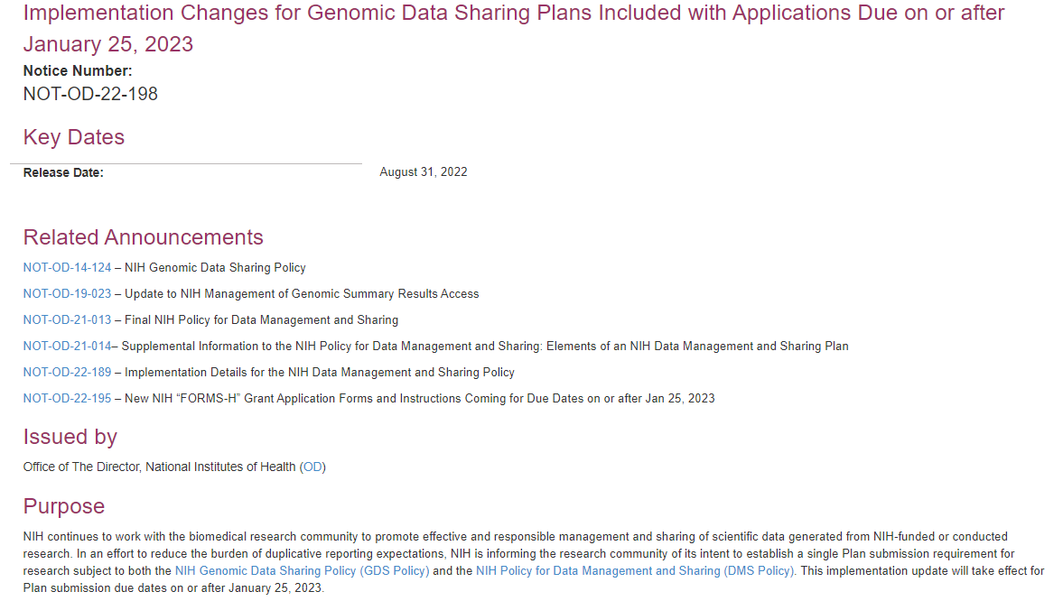
Request for Information on Proposed Updates and Long-Term Considerations for the NIH Genomic Data Sharing Policy
REMEMBER…
Published November 30, 2021 (NOT-OD-22-029)
Comments accepted until February 28, 2022 (90-day period)
Proposals/questions covering:
Principles for NIH-supported data platforms and repositories
Harmonizing aspects of the GDS Policy with DMS Policy
Expanding options for de-identification
Accepting and sharing potentially identifying information
Permitting data linkage and considerations for consent for linkage
Expanding the scope of the GDS Policy to include other research scenarios (e.g., projects of smaller size) or data types (e.g., proteomics, metabolomics)
Stakeholder support for a single data sharing plan

Slide 13
Recently Issued Public Guidance, Instructions, and Resources
Guide Notices to clarify implementation details
NOT-OD-22-189: Implementation Details for the NIH DMS Policy
Changes to forms and instructions to be implemented in FORMS-H, assessment of Plans and budgets, processes for revising Plans
NOT-OD-22-198: Implementation Changes for GDS Plans
Single Plan for research subject to both GDS and DMS Policies

Slide 14
What is NOT Changing
GDS Policy consent expectations for sharing human participants
Institutional Certification expected at Just-in-Time
GDS timelines for data submission and release, however, the latest possible time to submit data will be at the end of the award performance period
GDS expectations for amount and type of data to share
Indicate if a study should be designated as "sensitive" for the purposes of access to Genomic Summary Results

Slide 15
What Is Changing
DMS Plan: submit a single Plan that addresses GDS and DMS policies​
DMS Plan Review: conducted by program staff, not by peer reviewers​
Limitations on Sharing: described in DMS Plans, no alternative data sharing plan
Budget Considerations: detailed budget should include allowable costs for all data types​
Compliance: for awards will be handled in accordance with DMS policy compliance and enforcement terms ​

Slide 16
Elements to Include in a DMS Plan When Subject to GDS Policy
Writing a Data Management & Sharing Plan
Data Type
Briefly describe the scientific data to be managed and shared:
Summarize the types (for example, 256-channel EEG data and fMRI images) and amount (for example, from 50 research participants) of scientific data to be generated and/or used in the research. Descriptions may include the data modality (e.g., imaging, genomic, mobile, survey), level of aggregation (e.g., individual, aggregated, summarized), and/or the degree of data processing.
Describe which scientific data from the project will be preserved and shared. NIH does not anticipate that researchers will preserve and share all scientific data generated in a study. Researchers should decide which scientific data to preserve and share based on ethical, legal, and technical factors. The plan should provide the reasoning for these decisions.
A brief listing of the metadata, other relevant data, and any associated documentation (e.g., study protocols and data collection instruments) that will be made accessible to facilitate interpretation of the scientific data.
Instructions for all scientific data
Additional expectations for genomic data
For data subject to the GDS Policy:
Data types expected to be shared under the GDS Policy should be described in this element. Note that the GDS Policy expects certain types of data to be shared that may not be covered by the DMS Policy’s definition of “scientific data”. For more information on the data types to be shared under the GDS Policy, consult Data Submission and Release Expectations.
Ex: Sharing GWAS data (GDS Policy) versus only sharing data from GWAS dataset of sufficient quality to validate and replicate findings, per the DMS Policy
Notes:
Have annotated instructions for incl data subject to both policies in the plan

Slide 17
Monitoring Compliance with DMS Plans
Approved DMS Plan becomes a Term and Condition of Award
Grantee reports progress on implementing approved DMS Plan in Research Performance Progress Report (RPPR)
RPPR instructions will be updated
If additional details are needed, it may be necessary to communicate with NIH staff to resolve issues with DMS Plan
Will occur through standard Just-In-Time (JIT) process
Provide additional information and potentially a revised DMS Plan
NIH reviews compliance annually
Failure to comply may result in an enforcement action, including additional special terms and conditions or termination of award, and may affect future funding decisions

Slide 18
Recent DMS Policy Supplemental Notices
Supplemental Information: Protecting Privacy When Sharing Human Research Participant Data (NOT-OD-22-213)
Provides a basic framework for considering how to protect privacy when sharing data from human participants
Not intended as a guide for regulatory compliance
Not intended to replace consent expectations of the GDS Policy
Supplemental Information: Responsible Management and Sharing of American Indian/ Alaska Native Participant Data (NOT-OD-22-214)
Respect for Tribal Sovereignty
Partnerships and mutual agreements
Building trust
Best Practices
See Statements & Notices

Slide 19
Research Tools Policy (1999)

Slide 20
NIH Research Tools Policy
NIH Research Tools Policy
“Sharing Biomedical Research Resources: Principles and Guidelines for Recipients of NIH Research Grants & Contracts” (1999)
Principles
Ensure Academic Freedom and Publication
Ensure Appropriate Implementation of the Bayh-Dole Act
Minimize Administrative Impediments to Academic Research
Ensure Dissemination of Research Resources Developed With NIH Funds
Guidelines
Appendix: Guidelines for Disseminating Research Resources Arising Out of NIH-Funded Research

Slide 21
Models Organisms Sharing Policy (2004)

Slide 22
Model Organisms Sharing Policy
NIH Policy on Sharing of Model Organisms for Biomedical Research NOT-OD-04-042
All NIH applications and proposals that will produce unique model organism research resources
Expected to include a sharing plan for distributing these research resources in the application or proposal, or provide a justification for why such sharing is restricted or not possible.
Applies to extramural investigators funded by NIH grants, cooperative agreements, and contracts, including Small Business Innovation Research (SBIR) and Small Business Technology Transfer (STTR) mechanisms.
No cost threshold (not requiring 500K or more in NIH funding award application)

Slide 23
Definitions of Model Organisms and Related Resources
Model organisms include but are not limited to:
Non-human mammalian model organisms, such as:
Mouse; Rat
Non-mammalian model organisms, such as:
Budding yeast; Social amoebae; Roundworm; Arabidopsi; Fruit fly; Zebrafish; Frog
Resources include materials and data necessary for the production and understanding of model organisms. Examples include but are not limited to:
Genetically modified organisms; Mutant organisms; Sperm; Embryos; Vectors; Non-human embryonic stem cells; Established cell lines; Protocols for genetic and phenotypic screens; Mutagenesis protocols; Genetic and phenotypic data for all mutant strains
Genetically modified organisms are those in which mutations have been induced by chemicals, irradiation, transposons, or transgenesis (e.g., knockouts and injection of DNA into blastocysts), those in which spontaneously occurring mutations have occurred, and congenic or consomic strains.

Slide 24
Increasing Agency-Wide Access for Federally Funded Research Results NIH Public Access Policy

Slide 25
Then & Now OSTP Public Access MemoS
2013 OSTP Public Access Memo
Applies to all Federal departments and agencies with >$100 million in R&D expenditures
Develop and implement public access plans and policies for publications and data
Up to 12-month embargo before publications to become publicly accessible
Maximize access, by the general public and without charge, to digitally formatted scientific data created with Federal funds.
Data management plans for intramural & extramural research.
2022 OSTP Equitable Access Memo
Applies to all Federal R&D-funding agencies
Develop new, or update existing, public access plans
Publications resulting from federally funded research are made freely available and publicly accessible in repositories without embargo.
Scientific data underlying publications should be made accessible at time of publication
Develop approaches for sharing scientific data not underlying publications
Outline policies to establish researcher responsibilities on data management and sharing
Notes:
2013 OSTP Public Access Memo
Applies to all Federal departments and agencies with >$100 million in R&D expenditures
Develop and implement public access plans and policies for publications and data
Up to 12-month embargo before publications to become publicly accessible
Maximize access, by the general public and without charge, to digitally formatted scientific data created with Federal funds.
Data management plans for intramural & extramural research.
2022 OSTP Equitable Access Memo
Applies to all Federal R&D-funding agencies
Develop new, or update existing, public access plans
Publications resulting from federally funded research are made freely available and publicly accessible in repositories without embargo.
Scientific data underlying publications should be made accessible at time of publication
Develop approaches for sharing scientific data not underlying publications
Outline policies to establish researcher responsibilities on data management and sharing

Slide 26
Which Policies Apply to My Research?
Policy Decision Tool

Slide 27
Select NIH Grants Policy Excerpts
Grantees own the data they develop with federal funds.
NIH Grants Policy Statement 8.2.1.
Public Access Policy Final peer reviewed manuscript, upon acceptance for publication must be published at: http://www.pubmedcentral.nih.gov.
NIH Grants Policy Statement 8.2.2.
NIH Research Tools Policy requires sharing of unique research materials/biological materials (“research tools”).
NIH Grants Policy Statement 8.2.3.

Slide 28
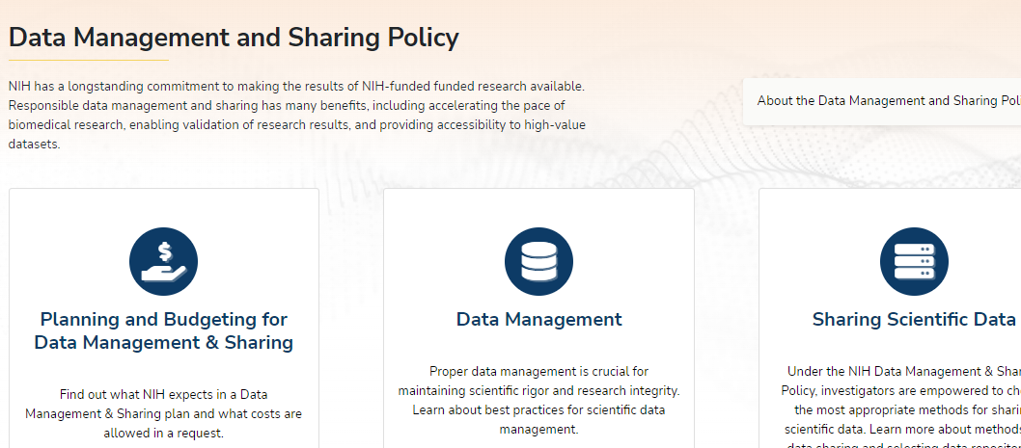
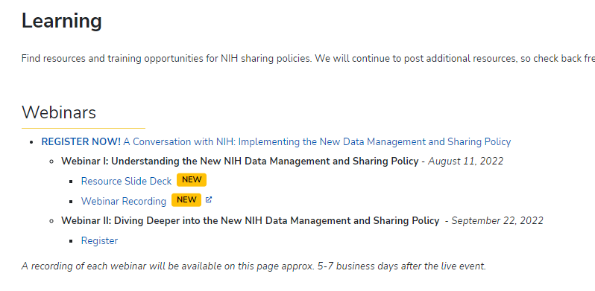
For More Information…
Website: NIH Scientific Data Sharing
FAQs: DMS Policy FAQs
Email Box: Sharing@nih.gov
Webinar Series: NIH DMS Policy Implementation

Slide 29
Resources

Slide 30
Policy and Supplemental Information
NOT-OD-21-013 – Final NIH Policy for Data Management and Sharing
NOT-OD-21-014 – Supplemental Information to the NIH Policy for Data Management and Sharing: Elements of an NIH Data Management and Sharing Plan
NOT-OD-21-015 – Supplemental Information to the NIH Policy for Data Management and Sharing: Allowable Costs for Data Management and Sharing
NOT-OD-21-016 – Supplemental Information to the NIH Policy for Data Management and Sharing: Selecting a Repository for Data Resulting from NIH-Supported Research

Slide 31
Recent Notices
NOT-OD-22-189 – Implementation Details for the NIH Data Management and Sharing Policy (August 5)
NOT-OD-22-195 – New NIH "FORMS-H" Grant Application Forms and Instructions Coming for Due Dates on or after January 25, 2023 (August 8)
NOT-OD-22-198 – Implementation Changes for Genomic Data Sharing Plans Included with Applications Due on or after January 25, 2023 (August 31)
NOT-OD-22-213 – Supplemental Information to the NIH Policy for Data Management and Sharing: Protecting Privacy When Sharing Human Research Participant Data (September 21)
NOT-OD-22-214 – Supplemental Information to the NIH Policy for Data Management and Sharing: Responsible Management and Sharing of American Indian/Alaska Native Participant Data (September 21)

Slide 32
Policy Links
NIH Data Management and Sharing Policy
https://grants.nih.gov/grants/guide/notice-files/NOT-OD-21-013.html
NIH Genomic Data Sharing Policy
https://osp.od.nih.gov/scientific-sharing/genomic-data-sharing/
NIH Research Tools Policy
https://grants.nih.gov/grants/intell-property_64FR72090.pdf
NIH Policy on Sharing of Model Organisms for Biomedical Research
https://grants.nih.gov/grants/guide/notice-files/NOT-OD-04-042.html
NIH Public Access Policy
http://publicaccess.nih.gov/

Slide 33
Thank You! Q & A
Meet us at the Data and Resource Sharing Booth [https://nihgrantsconference.vfairs.com/en/hall#Booth-204397]
(Must be logged into the NIH Grants Conference)
Thursday February 2, 2023, 12:00 – 5:00 PM EST
Notes:
Staff are here to answer questions and our booth is stocked with helpful resources

