Slide 1
Keynote: A Conversation with NIH Office of Extramural Research Leadership
Michael Lauer, MD
Deputy Director for Extramural Research; Director, Office of Extramural Research
Liza Bundesen, PhD
Deputy Director, Office of Extramural Research
National Institutes of Health (NIH)
NIH Grants Conference
February 1, 2023
Disclosures: None

Slide 2
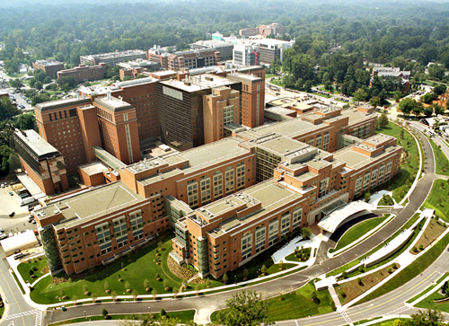
NIH Communities
NIH INTRAMURAL RESEARCH
NIH is an institution
NIH EXTRAMURAL RESEARCH
Supports:
Over 6,000 scientists
11% of NIH budget
Primary location: Bethesda, MD
A few labs throughout U.S.
Supports:
Over 2,600 institutions worldwide
Over 300,000 scientists & research personnel
Awards issued to over 100 countries
Clinical, Basic, & Translational Research
Over 80% of the NIH budget
*All figures are estimates.

Slide 3
Supporting a Growing Community: FY2022 Budget
Mechanism | Amount ($B) | Percent NIH Budget
Research Projects (RPG) | 24.2 | 54.3
SBIR/STTR | 1.20 | 2.7
Research Centers | 2.85 | 6.4
Other Research | 3.11 | 7.0
Training | 0.97 | 2.2
Research Contracts | 3.68 | 8.2
Intramural Research | 4.83 | 10.8
RMS | 2.16 | 4.8
Notes:
First Column: Mechanism
Second Column: Among $B
Third Column: Percent NIH Budget
Research Projects (RPG) $24.2 B 54.3%
SBIR/STTR $1.2 B 2.7%
Research Centers $2.85 B 6.4%
Other Research $3.11 B 7.0%
Training $0.97 B 2.2%
Research Contracts $3.68 B 8.2%
Intramural research $4.83 B 10.8%
RMS $2.16B 4,8%

Slide 4
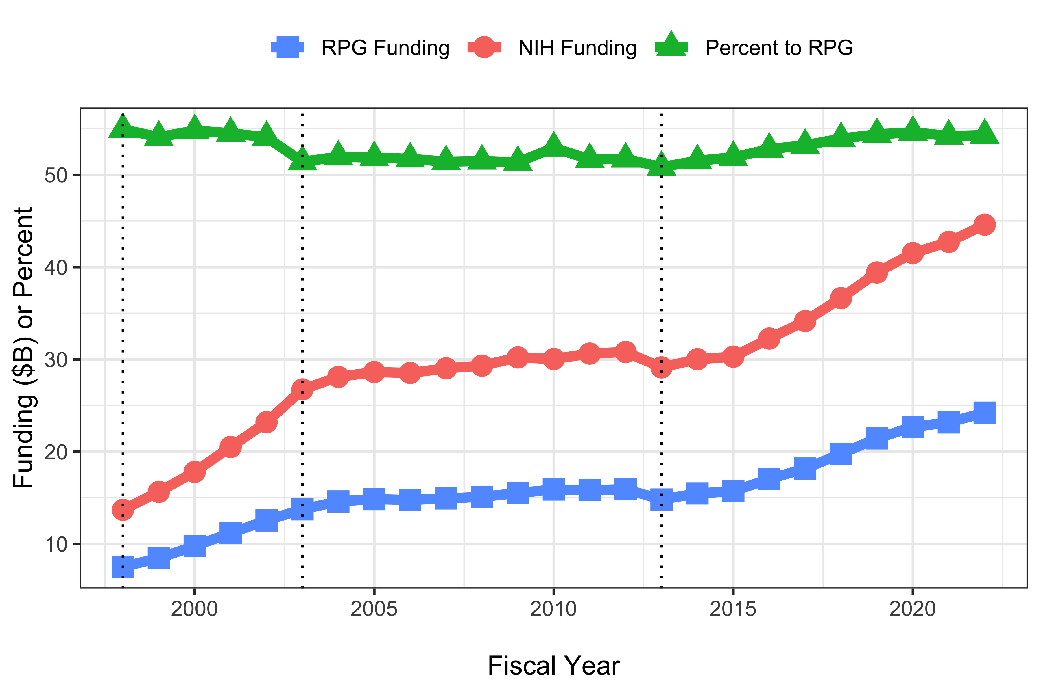
Funding

Slide 5
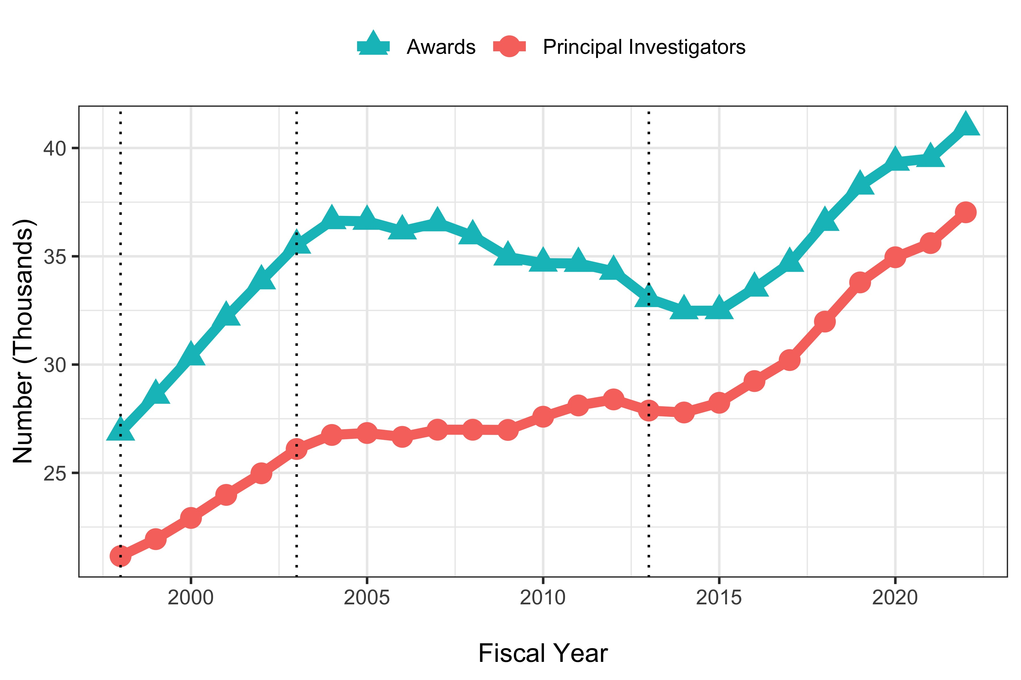
Awards and PI’s

Slide 6
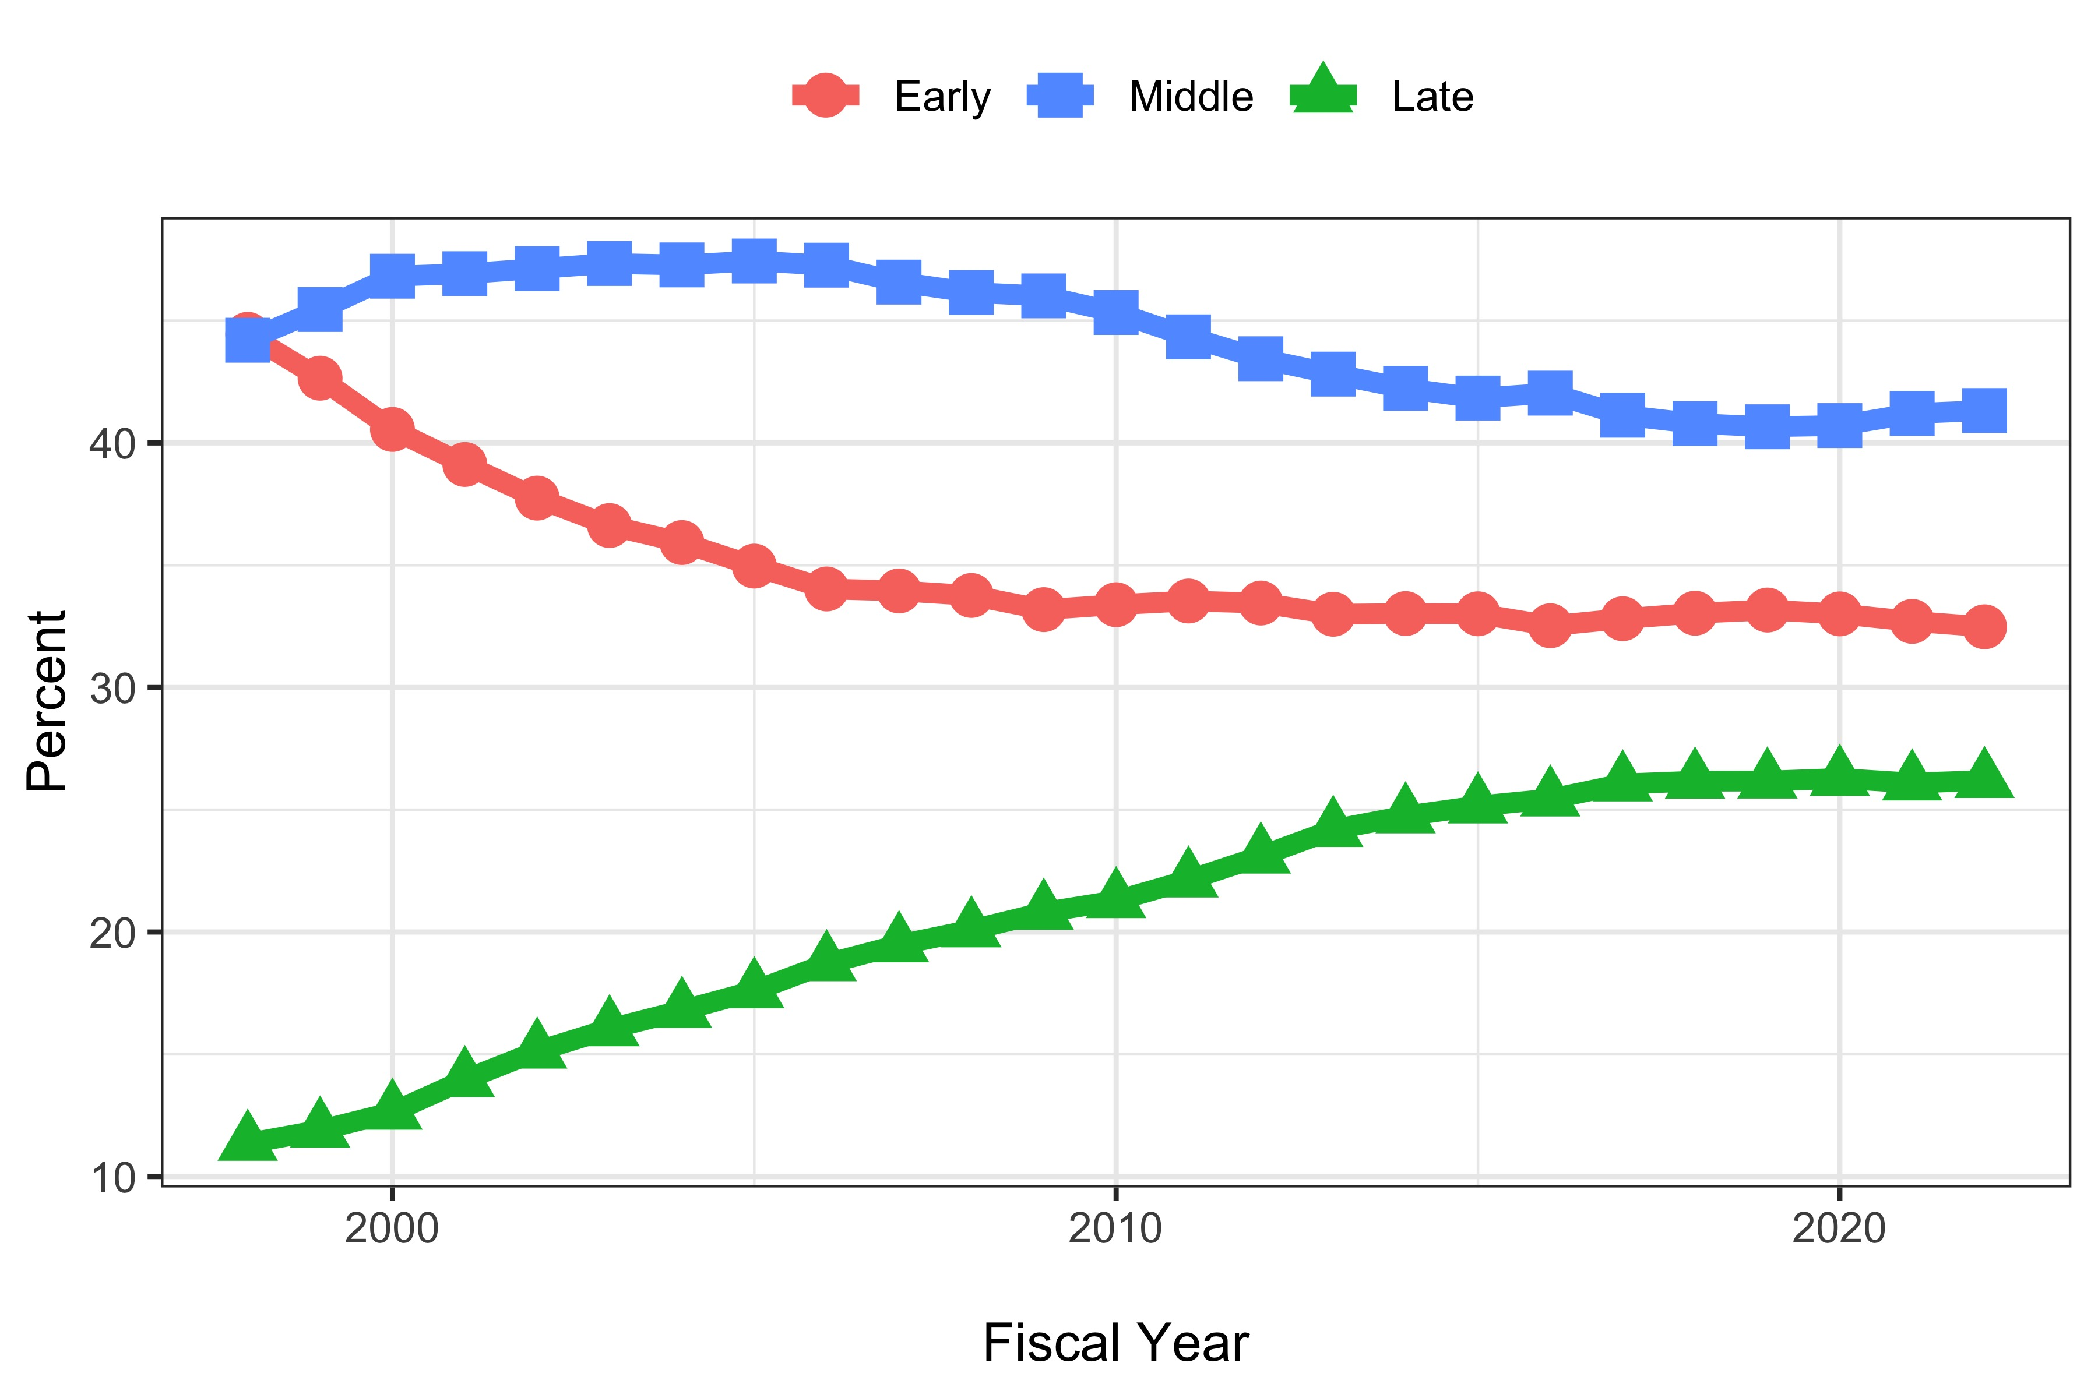
Career Stage

Slide 7
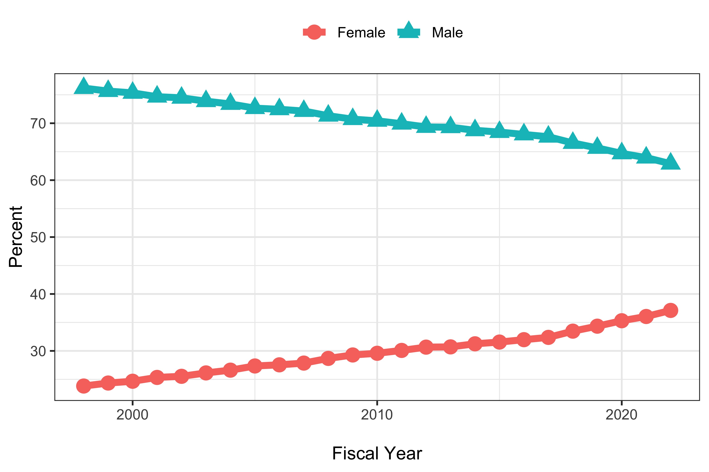
Gender

Slide 8
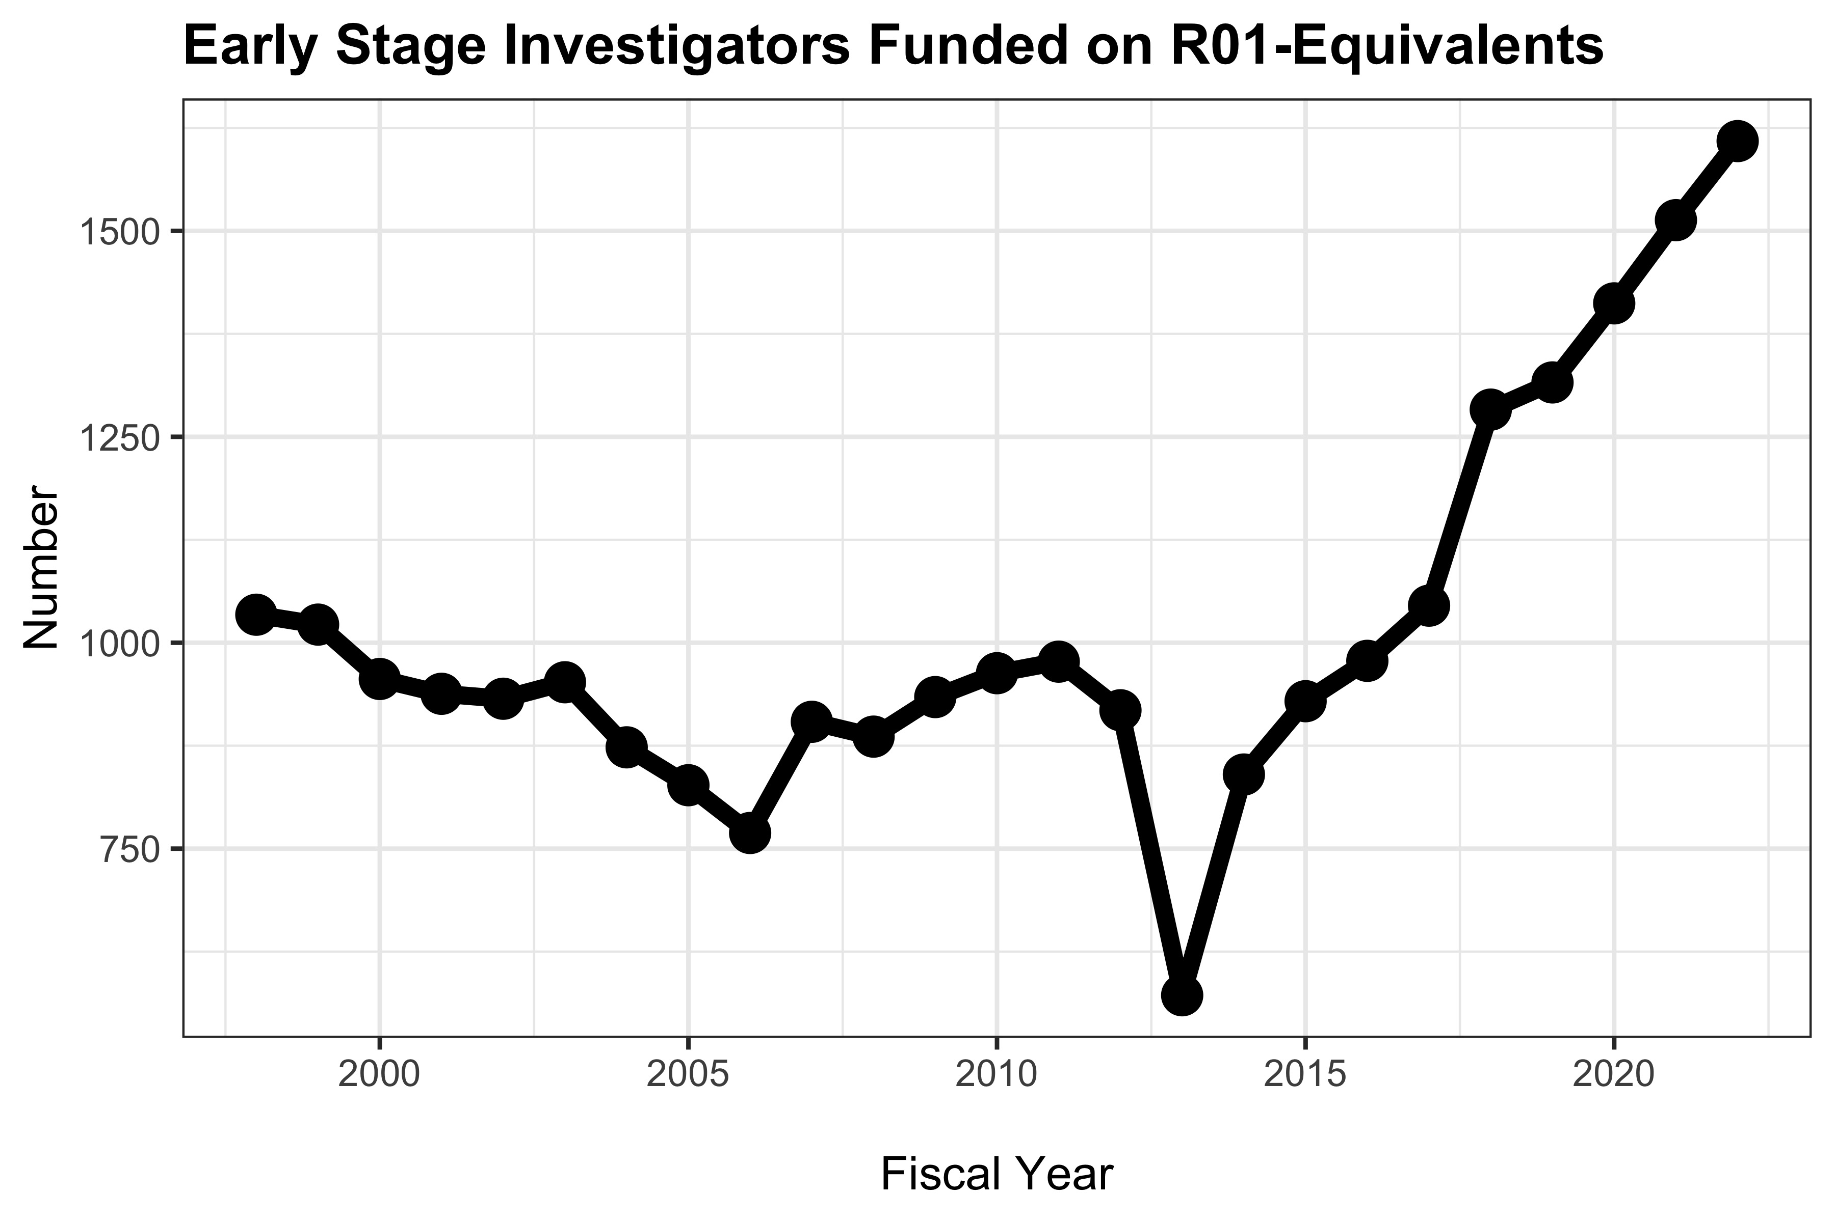
Early Stage Investigators Funded on R01-Equivalents

Slide 9
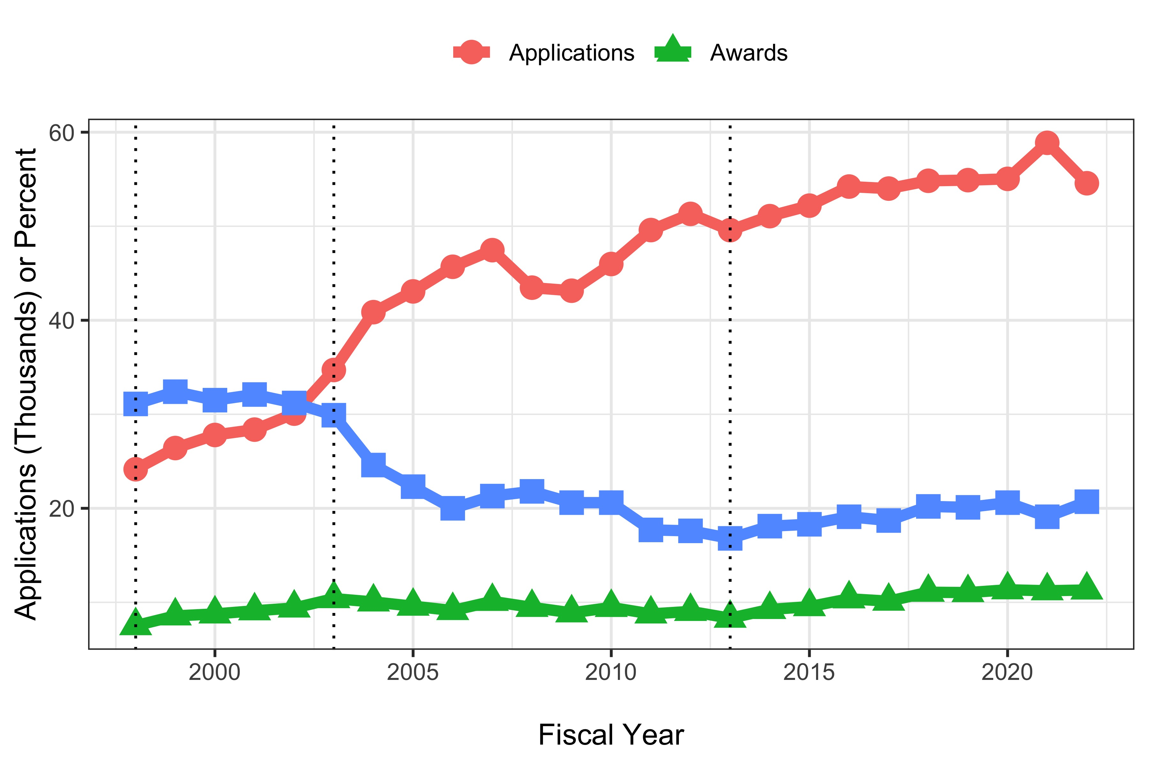
Award Competition

Slide 10
Summary of Trends: Growing Community
Increased number of awards and awardees
Increased number of Early-Stage Investigators
Increased proportion of women (but well below parity)
Increased success rates despite more applications
Still hypercompetitive environment

Slide 11
What’s New? ACD December 2022
Simplifying peer review criteria
Novel alternative methods
Post-doctoral fellowship working group
Data management and sharing
https://www.acd.od.nih.gov/meetings.html

Slide 12
Simplifying Peer Review Criteria
Goals: focus on science, mitigate reputational bias
Three factors:
  Should it be done? Importance of research (scored)
  Can it be done well? Feasibility and rigor (scored)
  Will it be done? Expertise and resources; investigator, environment (not scored, affects overall score)
Please see our Request for Information (RFI)*
* https://rfi.grants.nih.gov/?s=638509b5409baa49f803e572

Slide 13
Novel Alternative Methods Working Group
Examples: cell-free methods, microphysiological systems, machine learning, mathematical modeling and simulations
Identify types of alternative methods along with strengths and weaknesses
Types of research, conditions, or diseases for which alternative methods are most beneficial
Articulate high-priority areas for NIH research
https://www.acd.od.nih.gov/documents/presentations/12082022_Proposed_ACD_Novel_Alternative.pdf

Slide 14
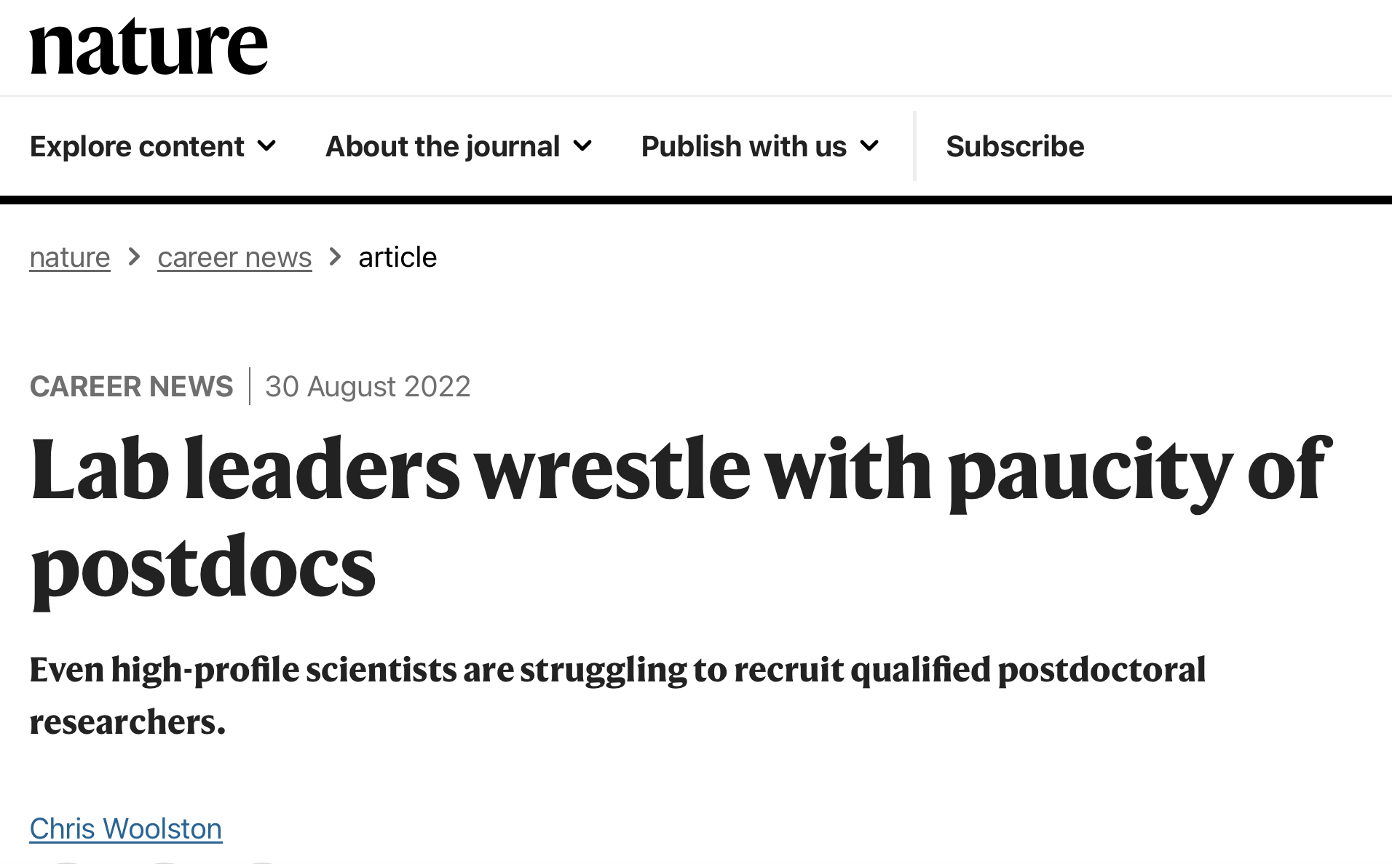
Concerns about Post-Doc’s
https://www.nature.com/articles/d41586-022-02781-x

Slide 15
Post-Doc Working Group
Evaluate perceived shortage in PhDs seeking U.S. postdocs
Assess and consider factors influencing the scope and persistence of the issue
Review, compare other approaches to postdoctoral training
Consider ways to support postdocs’ quality of life and work-life balance, increase retention
Engage key internal and external stakeholders
https://www.acd.od.nih.gov/documents/presentations/12082022_Postdoc_Working_Group.pdf

Slide 16

Data Management and Sharing: Announced October 2020
The extraordinary effort to speed the development of treatments and vaccines in response to the COVID-19 pandemic has put into sharp relief the need for the global science community to share scientific data openly … NIH is addressing this need with a new NIH Policy for Data Management and Sharing. This policy … establishes the baseline expectation that data sharing is a fundamental component of the research process ...
https://www.nih.gov/about-nih/who-we-are/nih-director/statements/statement-final-nih-policy-data-management-sharing

Slide 17

Visit our Web Site!
https://sharing.nih.gov/data-management-and-sharing-policy

Slide 18
Closing Thoughts
Growing, but still hypercompetitive, community
  Increasing numbers: awards, awardees (including early career)
Engaging with you on top priorities
  Enhancing peer review; mitigating bias
  Exploring alternative methods
  Re-examining the post-doctoral training experience
  Implementing data management and sharing policy

