Slide 1
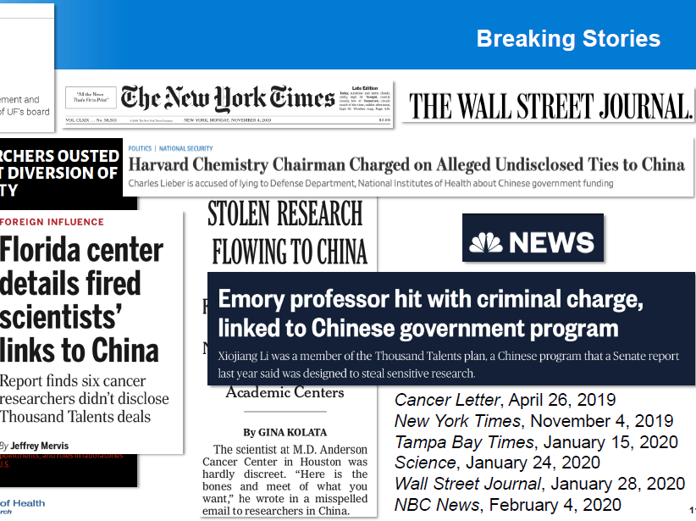
FOREIGN INTERFERENCE (FI)
November 9, 2022

Slide 2


Today’s Presentation Team
Moderator
Presenter
KASIMA GARST, M.F.S.
Systems Policy Analyst
Office of Policy for Extramural Research (OPERA)
Office of Extramural Research, NIH
KI-CHA FLASH-ZAPATA, M.S., M.B.A.
Deputy Director, Division of Grants Compliance and Oversight
Office of Policy for Extramural Research Administration,
Office of Extramural Research, NIH

Slide 3
Introduction
As the largest public funder of biomedical research in the world, NIH has invested ~$32 billion annually to enhance life, reduce illness and disability.
NIH has developed numerous policies and procedures to ensure scientific integrity and to facilitate the fulfillment of its mission within and throughout the Intramural and Extramural programs.
NIH’s core principles and values include promoting the principles of transparency, honesty, collaboration, integrity, fair merit-based competition, and protection of intellectual capital and proprietary information throughout the research enterprise and assure the public of the credibility of the scientific findings.
  These core principles and values align with the White House Office of Science and Technology Policy and the NSPM-33 implementation guidance.

Slide 4
Introduction – Cont’d.
Ensuring the integrity of science and science-based policymaking is at the heart fulfilling NIH’s mission.
Scientific collaborations, both domestic and international, are:
  important for scientific advances,
  critical to solving the most pressing and perplexing health challenges,
  essential part of innovation, and
  vital to our global competitiveness.
The NIH-funded biomedical enterprise depends on a competitive system, which, to be successful, must be fair, transparent, and trustworthy.
Some foreign governments have mounted systematic programs to take advantage of the long tradition of trust, fairness, and excellence.
NIH Policies and Procedures for Promoting Scientific Integrity

Slide 5
Foreign Interference
The U.S. government/NIH is attempting to address inappropriate interference by foreign governments, institutions, and researchers over federally funded research and technology (emphasized in NSPM-33).
Since 2016, NIH has worked on undue foreign interference in NIH-funded research resulting from discoveries of noncompliance with the requirements related to the submission of other support, invention reporting, and financial conflict of interest (FCOI).
Foreign Interference in National Institutes of Health Funding and Grant Making Processes: A Summary of Findings From 2016 to 2021

Slide 6
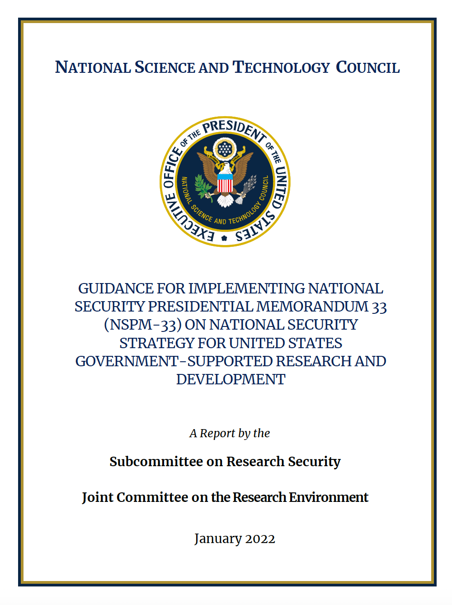
National Security Presidential Memorandum (NSPM) on
Research Security and Integrity
Provides guidance to all Federal departments and agencies regarding their implementation of NSPM-33 - to standardize and strengthen disclosure requirements for federally funded awards.
Strengthens protections of United States Government-supported R&D against foreign government interference and exploitation (such as implementing a research security program, e.g., cybersecurity)
Maintains/promotes core values: openness, transparency, honesty, equity, fair competition, objectivity, innovation, and democratic values.
The NSPM-33 provisions must be implemented in a nondiscriminatory manner throughout all agencies
NSPM-33 is broadened to include international students, scholars, and collaborations
Notes:
The Guidance provides a harmonized approached for federal departments and agencies across the research platform to strengthen disclosure requirements within the federal government.
Goal: to strengthen and support the research programs against foreign interference
NIH has implemented these provisions in a non-discriminatory manner

Slide 7
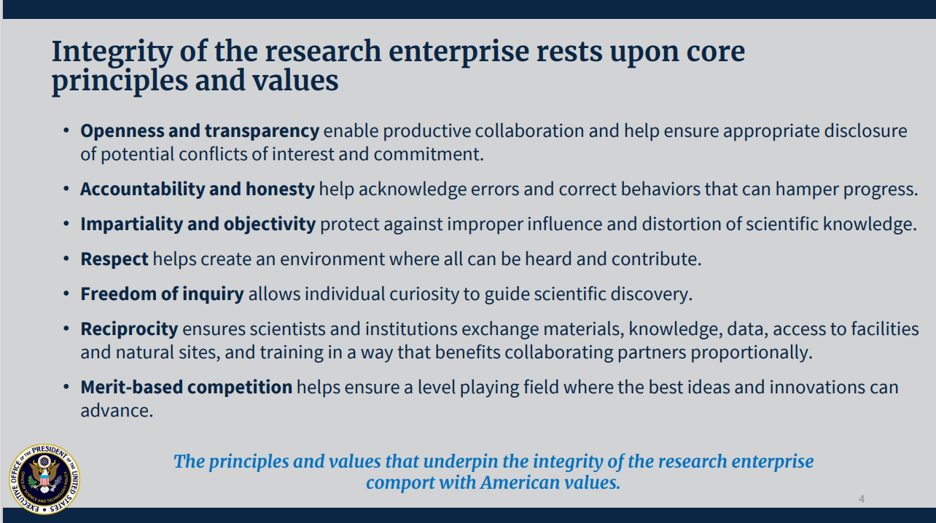
The White House Office of Science and Technology Policy
Notes:
Integrity of the research enterprise rests upon core principles and values
-Openness and transparency enable productive collaboration and help ensure appropriate disclosure of potential conflicts of interest and commitment
-Accountability and honesty help acknowledge errors and correct behaviors that can hamper progress
-Impartiality and objectivity protect against improper influence and distortion of scientific knowledge.
-Respect helps create an environment where all can be heard and contribute
-Freedom of inquiry allows individual curiosity to guide scientific discovery
-Reciprocity ensures scientists and institutions exchange materials, knowledge, data, access to facilities and natural sites, and training in a way that benefits collaborating partners proportionally.
-Merit-based competition helps ensure a level playing field where the best ides and innovations can advance
The principles and values that underpin the integrity of the research enterprise comport with American values.

Slide 8
Why is NIH Focused on Preventing FI
INTEGRITY – FI puts NIH core principles and values at risk
  NIH promotes transparency, honesty, accountability, objectivity, respect, freedom of inquiry, reciprocity, and merit-based competition throughout the research community
OVERLAP – FI increases the risk of budgetary, commitment, and/or scientific overlap due to non-disclosure and diminishes the agency’s ability to adequately assess a researcher’s qualifications and capacity.​
INNOVATION - FI could lead to intellectual property (IP) theft which weakens our national innovation base and threatens our security and economic competitiveness
COMPLIANCE – The failure to submit complete other support information and comply with the FCOI and invention and patent requirements represents a violation of the terms and conditions of NIH awards, including Federal regulations. Such noncompliance may impact funding decisions, compromise the objectivity of NIH-funded research, result in the loss of patent rights, etc.
PROTECT PEER REVIEW PROCESS - FI threatens the objectivity of the peer review process to identify the most promising biomedical and behavioral research
Reference Extramural Nexus News - Addressing Foreign Interference and Associated Risks to the Integrity of Biomedical Research, and How You Can Help
Notes:
Compliance – these are typical noncompliance areas – the FCOI and the Bayh dole requirements for IP has not changed.

Slide 9
NIH Requirements for Disclosure
Recipients are expected to provide full transparency in NIH applications and throughout the life of the NIH grant.
NIH Grants Policy Statement, Section 2.5.1 - Other Support expectations
Recipients are required to fully disclose all Other Support information for individuals designated as senior/key personnel designated in grant applications or progress reports.
  Other Support submissions that include foreign activities and resources must include copies of contracts, grants, or any other agreement specific to senior/key personnel foreign appointments and/or employment with a foreign institution as supporting documentation. The information must be submitted in English.
NOT-OD-21-073 - Other Support updates for applicants and recipients to provide full transparency and disclosure of all research activities, foreign and domestic.
Other Support – Other Support Requirements and FAQs

Slide 10
How Does NIH Identify FI
Anonymously disclosed
Recipient self disclosure
NIH staff review and referral – based on Research Performance Progress Reports (RPPR) or Other Support review, Biosketch analysis, IP review, FCOI review, Publications review, etc.
Law enforcement referral
Referral from another Federal Agency or OPDiv or DHHS Operating Divisions (OPDIVs)
Everyone (Individuals, institutions, and governments) has a responsibility to promote scientific integrity within the research enterprise and protect the Federal interest.

Slide 11
What We’ve Seen…
Failure to make complete disclosures
  employment, contracts, consulting agreements, talent awards, etc.
  foreign research support (grants – duplicative or overlapping)
  foreign research space (shadow labs) or research staff
Undisclosed “Significant Financial Interests” by an Investigator, thus no Institutional FCOI review
    Equity interest in foreign companies and receipt of remuneration from foreign institutions, for example
Egregious violations of peer review confidentiality rules
    Sharing confidential applications
Notes:
Undisclosed employment, appointments contracts, or consulting agreements
Undisclosed research support (grants) or compensation (potential FCOI issues), and/or significant financial interests(SFIs)
Other Support Submissions are Important! Other Support documentation should provide all resources made available to a researcher in support of and/or related to all of their research endeavors, regardless of whether or not they have monetary value and regardless of whether they are based at the institution the researcher identifies for the current grant
Undisclosed foreign research space (shadow labs) or research staff
Undisclosed commitments or obligations to assign credit to foreign entities or generate foreign patents using discoveries or innovations from NIH funded research
Undisclosed obligations to transfer propriety information and technologies to foreign institutions
Undisclosed obligations to keep foreign arrangements and scientific work secret
Egregious violations of peer review confidentiality rules.

Slide 12
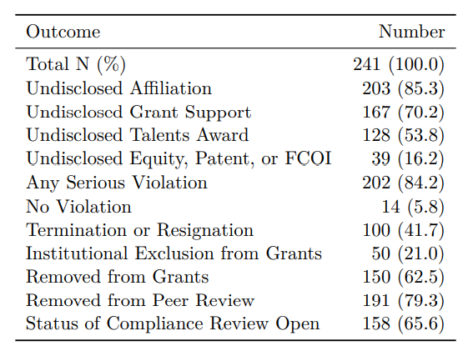
Outcome of NIH Foreign Interference Cases
Data as of 08/08/2022
Brief Summary of NIH Foreign Interference Cases
Notes:
Table show outcomes of compliance reviews to date.
Even though most reviews are still open, we have already determined that:
for over 80 percent of cases there was at least one serious compliance violation (that is undisclosed grant support, undisclosed talents award, undisclosed equity, undisclosed patent, or other undisclosed financial conflict of interest).
Less than 10 percent were found to have no violation (that is, no undisclosed foreign affiliation and no serious violation).
Over half of scientists were removed from NIH grants (either through institutional separation or other internal institutional actions).

Slide 13
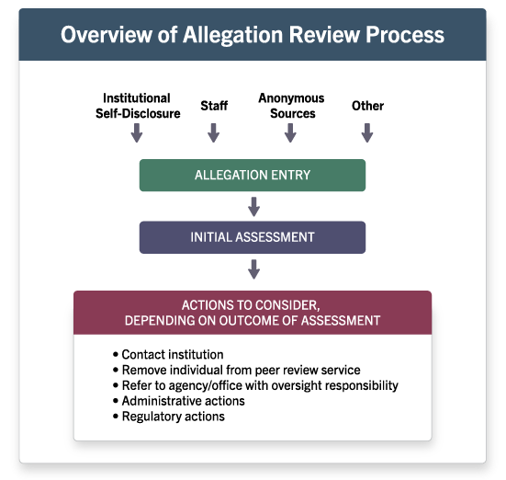
Overview of Allegation Review Process
Notes:
4 Areas listed:
Institutional Self-Disclosure
Staff
Anonymous Sources
Other
Arrows pointing to Allegation Entry
Arrow pointing to Initial Assessment
Arrow pointing to Actions to consider, Depending on Outcome of Assessment
Bullets follow:
-Contact institution
-Remove individual from peer review service
-Refer to agency/office with oversight responsibility
-Administrative actions
-Regulatory actions

Slide 14
Overview of OER Assessment and Process
Review NIH application/grant records, publications, and open-source documents
If serious concerns are identified, contact the institution, and request access to the foreign documents – grants, contracts, etc.
Review and analyze the institution’s response and documents received
Work with the institution if administrative/corrective actions are needed

Slide 15
Reminders
Know and abide by the Other Support, FCOI, Foreign Components, and IP policy requirements
  Other Support - Disclose all sources of research support, foreign components for senior/key personnel in research grant applications and progress reports. NIH Grants Policy Statement (NIHGPS) Section 2.5.1 and NOT-OD-21-073.
  FCOI - Investigators must disclose all domestic and foreign significant financial interests for the institution’s determination of a FCOI. NIHGPS Section 4.1.10 and NOT-OD-22-210
  Inventions and Patents - recipient must comply with the Bayh-Dole statute – NIHGPS Section 8.2.4
  Foreign Component - The performance of any significant scientific element or segment of a project outside of the United States, either by the recipient or by a researcher employed by a foreign organization, whether or not grant funds are expended. NIH GPS Section 16.2 and NOT-OD-19-114
When in doubt, ASK early and often
  Contact the program and/or grants management staff.
Notes:
Foreign Component – NIH GPS Section 16.2
The performance of any significant scientific element or segment of a project outside of the United States, either by the recipient or by a researcher employed by a foreign organization, whether or not grant funds are expended. Activities that would meet this definition include, but are not limited to, (1) the involvement of human subjects or animals, (2) extensive foreign travel by recipient project staff for the purpose of data collection, surveying, sampling, and similar activities, or (3) any activity of the recipient that may have an impact on U.S. foreign policy through involvement in the affairs or environment of a foreign country. Examples of other grant-related activities that may be significant are: collaborations with investigators at a foreign site anticipated to result in co-authorship;
use of facilities or instrumentation at a foreign site; or
receipt of financial support or resources from a foreign entity.
Foreign travel for consultation is not considered a foreign component. (See Grants to Foreign Organizations, International Organizations, and Domestic Grants with Foreign Components chapter in IIB).

Slide 16

Everyone has a part to play
Together we can protect the NIH research enterprise and embrace research collaborations abroad while maintaining NIH integrity and values​

Slide 17
References
Foreign Interference
NIH Grants Policy Statement, Section 2.5.1 - Just-In-Time
NIH GPS Section 4.1.10 Financial Conflict of Interest
Financial Conflict of Interest
42 CFR Subchapter D Part 50 Subpart F – Promoting Objectivity in Research
NOT-OD-21-073
Brief Summary of NIH Foreign Interference Cases
White House Office and Science and Technology Policy in June 2020
NSPM-33 implementation guidance
NIH Policies and Procedures for Promoting Scientific Integrity
Foreign Interference in National Institutes of Health Funding and Grant Making Processes: A Summary of Findings From 2016 to 2021
Foreign Component - NIH GPS Section 16.2 and NOT-OD-19-114

Slide 18

Questions
If you have any further questions, please contact us at ComplianceReview@mail.nih.gov

