Slide 1
Jon Lorsch
Director
NIGMS
Developing a Culture of Safety in Biomedical Research

Slide 2
Do You Know the Name Sheri Sangji?

Slide 3
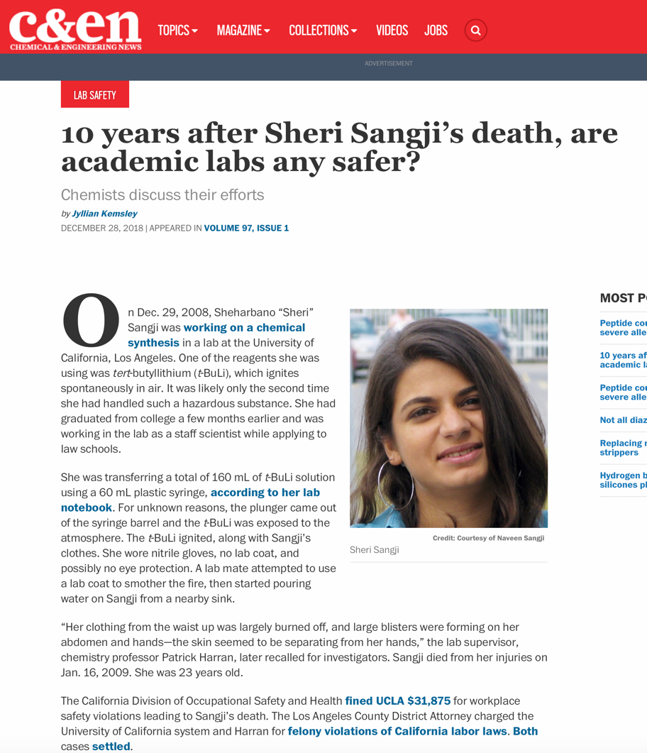
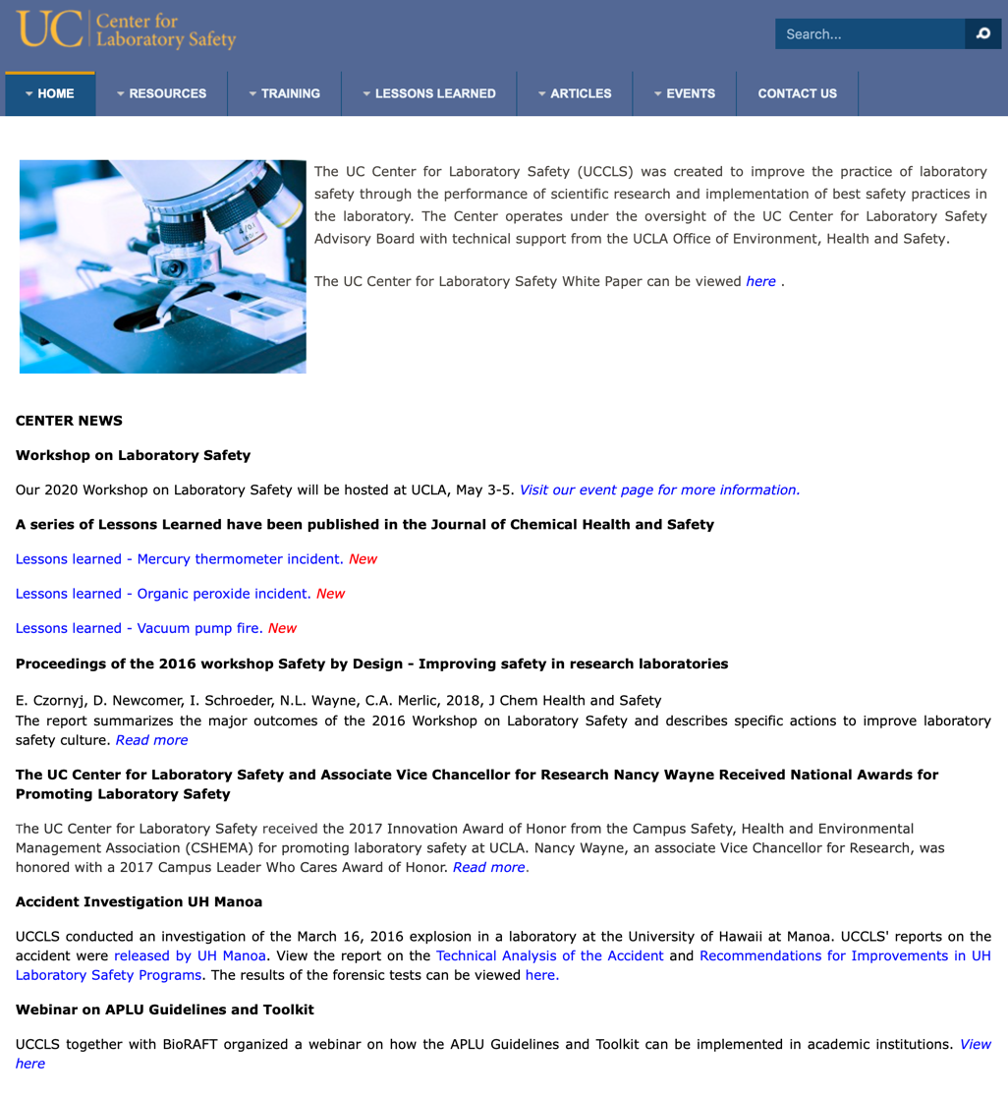
https://cen.acs.org/safety/lab-safety/10-years-Sheri-Sangjis-death/97/i1
Sheri Sangji’s Death Led to Criminal Charges against the PI and UCLA and to the Formation of the UC Center for Laboratory Safety

Slide 4
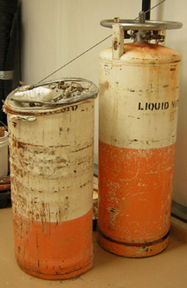
https://blogs.sciencemag.org/pipeline/archives/2006/03/08/how_not_to_do_it_liquid_nitrogen_tanks
2006 Liquid Nitrogen Tank Explosion at Texas A&M
Liquid N₂ tank’s pressure release valves sealed at some point in the past
Led to catastrophic failure in the middle of the night
Destroyed the lab, blew out windows and door, blew hole in the floor, turned floor tiles into shrapnel, shot the tank into the mechanical room on the floor above

Slide 5
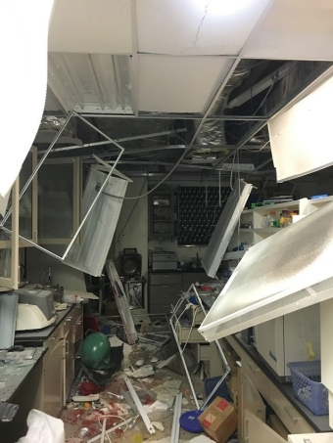
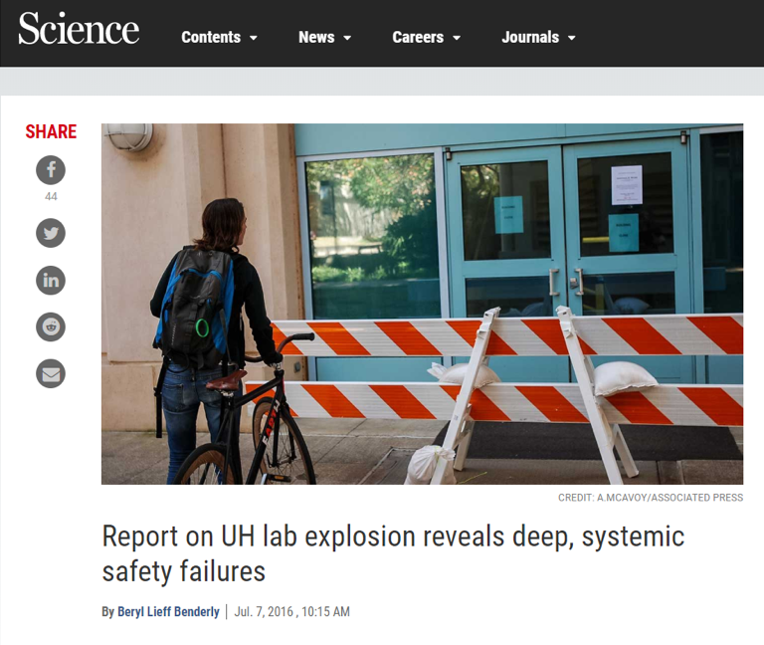
Left Photo Credit: Honolulu Fire Department
2016 University of Hawaii Explosion
Bioenergy researchers growing bacteria under atmospheres containing H₂ and O₂
Small detonation “sentinel event”
In scaled up experiment, static electricity ignited gas mixture leading to tank explosion
Postdoc lost arm and suffered other serious injury

Slide 6
https://www.sciencemag.org/careers/2016/07/report-uh-lab-explosion-reveals-deep-systemic-safety-failures
Some Other Tragic Lab Accidents in Recent Years
University of Chicago researcher working with attenuated strain of Yersinia pestis gets infected and dies
  Strain was compromised in its ability to take up iron, but researcher had hemochromatosis
  CDC investigation cited “inconsistent use of gloves” as a likely factor
Yale student killed when hair became caught in lathe while working alone at night
“But UCCLS, which was founded at UC Los Angeles in the aftermath of the Sangji catastrophe, notes in the report that many other institutions also tolerate poor safety cultures and practices. It therefore fittingly intends its report to also “serve as a direct call to action for researchers, administrators and [Environmental Health and Safety Office] staff not only at the UH, but at all institutions of higher education that conduct research.”

Slide 7
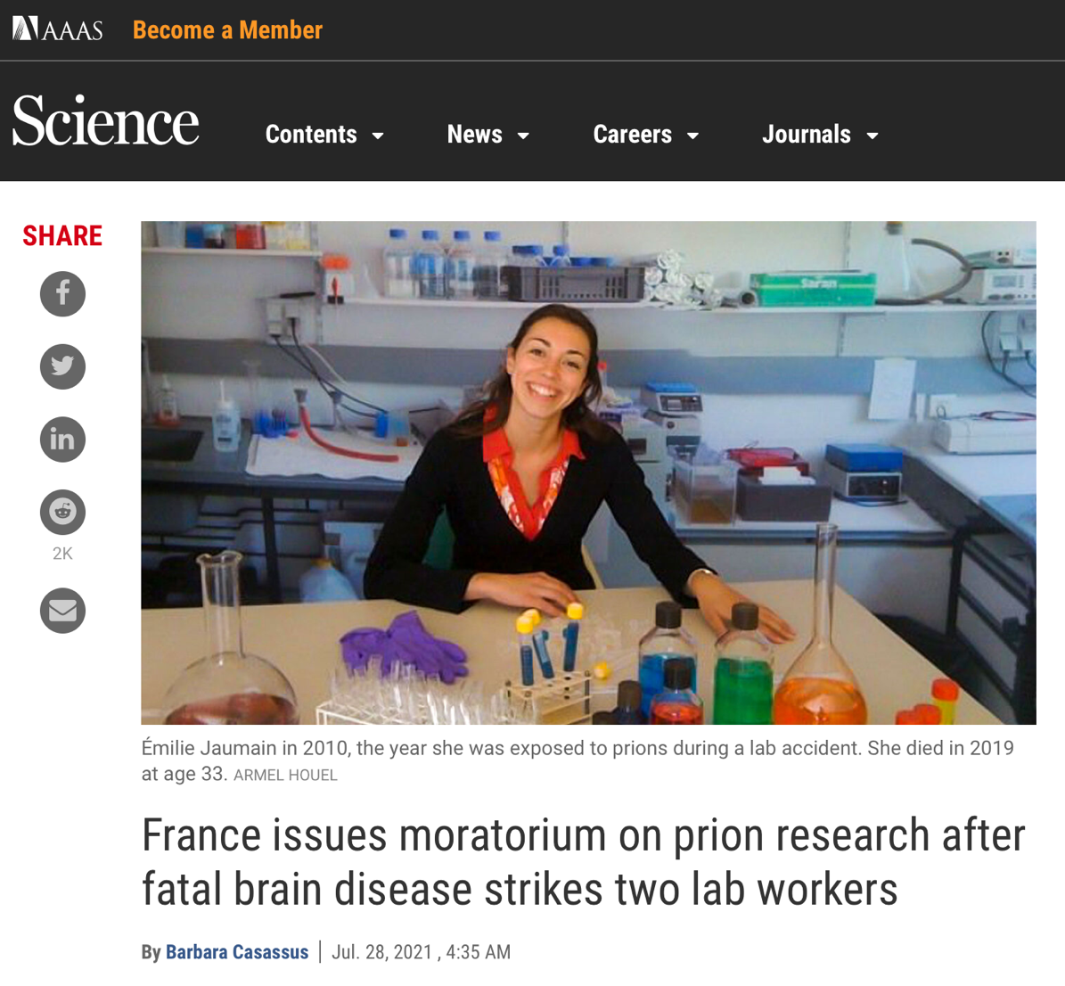
Some Other Tragic Lab Accidents in Recent Years

Slide 8
https://grants.nih.gov/grants/guide/pa-files/PAR-20-213.html
What to do?
Language in all NIGMS training FOAs, e.g.:
Program Considerations: “Additionally, safety in research training should encompass (1) environments free from harassment and intimidation, in which everyone participating is treated in a respectful and supportive manner, (2) laboratory and clinical settings where individuals exercise the highest standards of practice for chemical, biological and physical safety, and (3) practices at the institutional leadership and research community levels that demonstrate core values and behaviors to emphasize safety over competing goals.”
Institutional Letter: ”ensures that the research and clinical facilities as well as the laboratory and clinical practices promote the safety of trainees…”
Review Criteria: “Is the mechanism for ensuring that the trainees are learning the highest standards of practice in biomedical research (e.g., record keeping and safety) robust? Will the Participating Faculty teach laboratory safety throughout the didactic and mentored portions of the program? Is there a clear institutional commitment to develop and promote a culture in which the highest standards of safety, scientific rigor, reproducibility, and responsible conduct of research are advanced? Is there evidence that the research facilities and laboratory practices ensure the safety of trainees?”

Slide 9
What to do?
Had a plenary presentation at the NIGMS Training, Workforce Development and Diversity Program Directors’ meeting about laboratory safety
  Craig Merlic, Ph.D., UC Center for Laboratory Safety
  Most highly rated session at the meeting!
Providing administrative supplements to NIGMS training grants to develop new curricular activities related to safety

Slide 10
What to do?
R25s for safety training modules
  NOT-GM-20-047 (PAR-20-296)
Create a clearinghouse on the NIGMS website for links to safety training materials
  https://www.nigms.nih.gov/research-training/resources/laboratory-safety-and-guidelines
Encourage programs to teach to industry standards
Partner with professional societies?

Slide 11
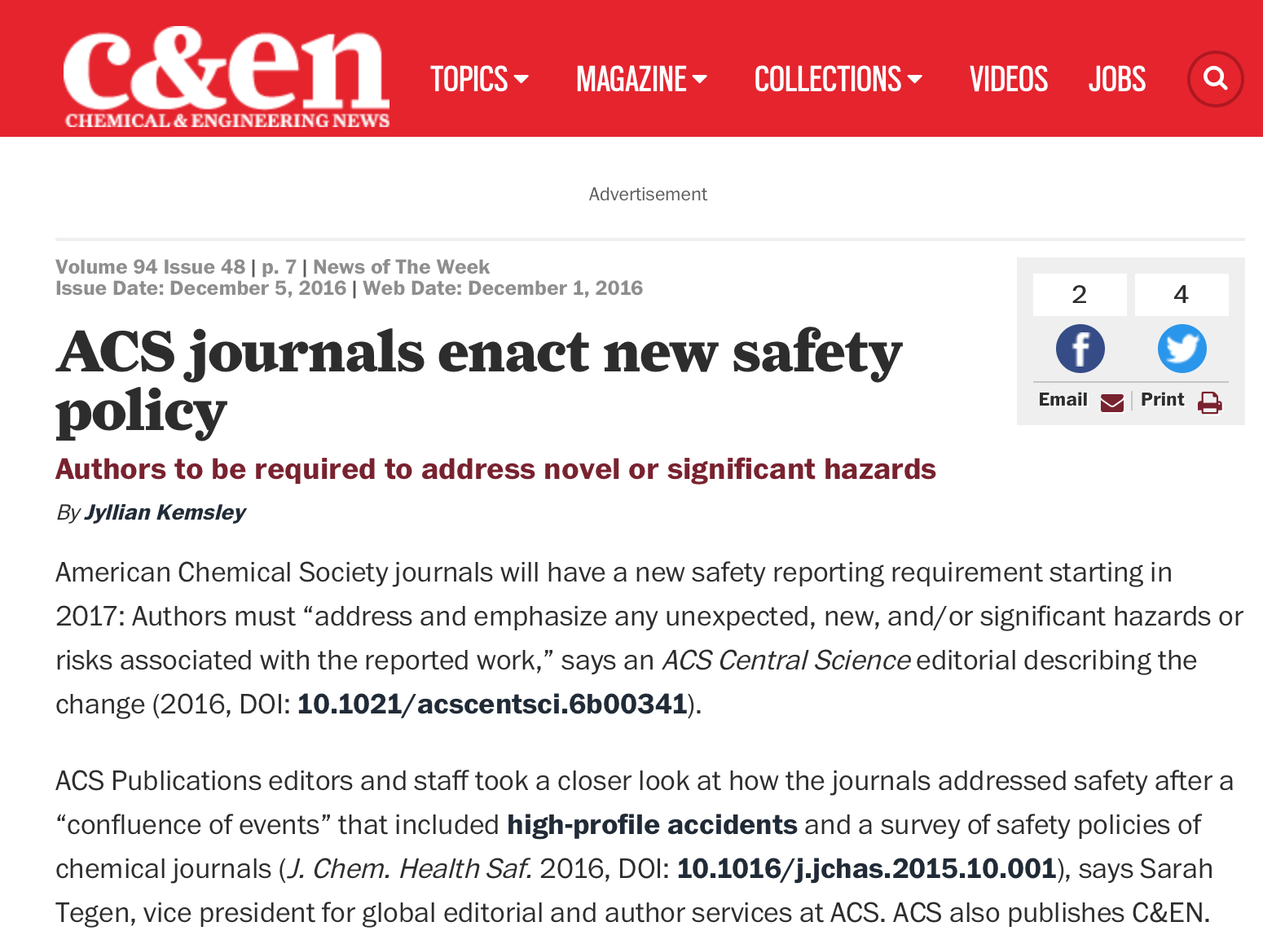
ACS has been a leader on lab safety including new policies for its journals

Slide 12
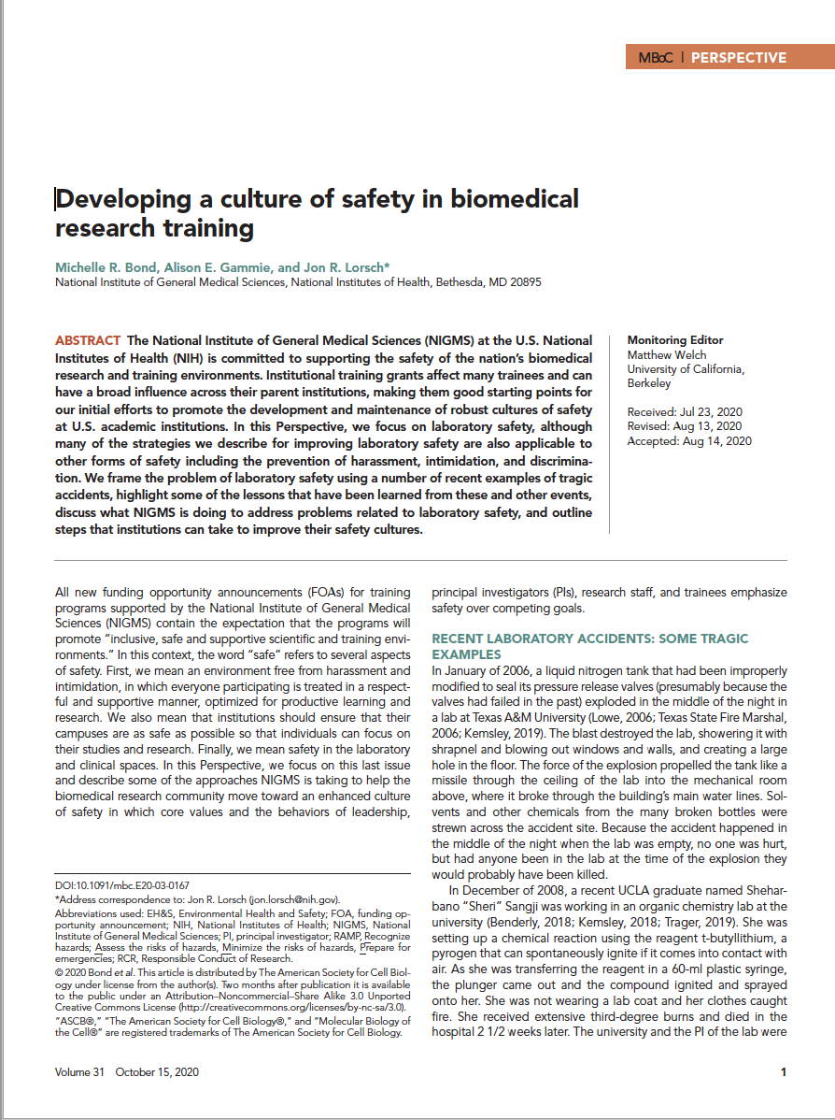

MBOC Paper: https://www.molbiolcell.org/doi/10.1091/mbc.E20-03-0167
Use Our Bully Pulpit (and Our Policies and $$$)

Slide 13
Teach Students to Do Hazard Assessments as Part of Experimental Design

Slide 14
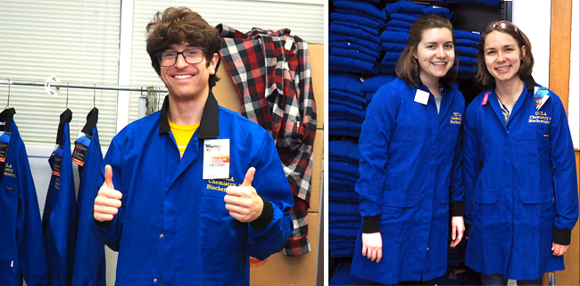
Photo Credit: UCLA
Teach Students to Question Their Assumptions

Slide 15
Bring Core Facilities into the Teaching Mission of the Institution?
Core facilities could be incorporated into lecture-based and active-learning courses
Could teach best practices
Could introduce students to the cores available for research, safety practices, SOPs, rigorous practices, etc. at the same time
Allows cores to provide additional value to institution

Slide 16

Values and behaviors emphasize safety and respect
Institutions
Values and behaviors emphasize safety and respect
Training program funding announcements emphasize safety – required in the training plan and part of the scored review criteria
Inclusive, supportive environments free from harassment and intimidation
Strong culture of safety in laboratory and clinical settings
Supplements to training awards to develop a culture of safety and to create safe, supportive, and inclusive research training environments
Laboratory and clinical leadership exemplify and reinforce the culture of safety
Safety training and oversight permeate all aspects of the enterprise
Funding announcement to develop training modules freely available to the community
Individuals practice the highest standards for safety
Hazards assessments are routine and pervasive
Promote safety through webpages, webinars, and meetings for training directors
Collaborative working relationships among Health and Safety Officials, leadership, scientists, and clinicians
Near miss accidents are widely reported, analyzed, and used to catalyze change

Slide 17
Questions or Comments?

