Slide 1


Deep Dive into FORMS-G & Related Policy Changes
All you need to know for submissions with due dates on or after 1/25/2022
Kasima Garst, OER/OPERA/SPB
Laurie Roman, OER/eRA

Slide 2
Take Home Messages
Upon completion of this session, participants will be able to:
Identify the changes to application forms that will be included in the transition to “FORMS-G” form versions;
Select the correct form package based on the due date of their planned submission;
Request childcare costs or technical assistance, when appropriate based on the activity code of their funding opportunity;
Select the correct templates for biosketch and other support;
Successfully submit their application with active eRA Commons ID entered for all individuals listed on the Senior/Key Person Profile (Expanded) form.

Slide 3
FORMS-G
Effective for application due dates on or after January 25, 2022.
See High-level Summary of Form Changes in FORMS-G Application Packages for full list of changes.
Learn more: NOT-OD-21-169; NOT-OD-22-018

Slide 4
Transition from DUNS to UEI
NOT-OD-21-170
In March 2019, the General Services Administration (GSA) announced that the U.S. Government is moving to a new government-owned Unique Entity Identifier (UEI) which will replace the DUN and Bradstreet (D&B) Data Universal Numbering System (DUNS) number in all systems.
By April 2022, the federal government will stop using DUNS to uniquely identify entities registered in SAM.

Slide 5
NIH UEI Implementation
For applications due on or after January 25, 2022, applicants must have a UEI at the time of application submission. UEI replaces DUNS on all FORMS-G application forms and packages.
All entities currently registered in SAM have automatically been issued a UEI.
  Note: DUNS still required for new registrants prior to April 2022. UEI will be issued as part of registration.
Beginning October 2021-
  eRA pulling UEI data for organizations in eRA Commons registered in SAM.gov. No action is required by the entity.
Organizations will begin to see their UEI in the eRA Commons IPF early in January 2022.

Slide 6
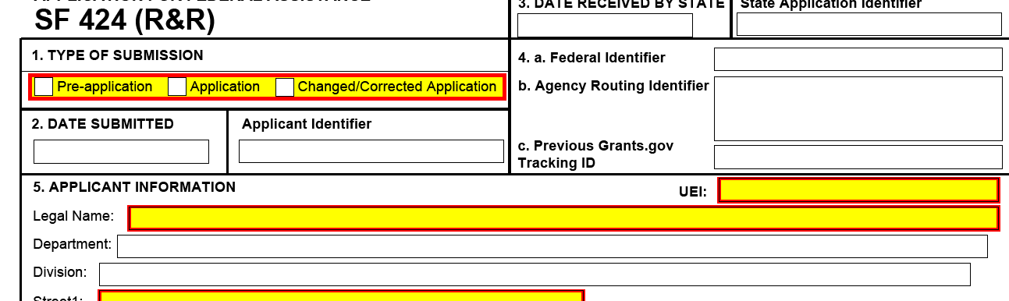
Unique Entity Identifier (UEI) and Department and Division
UEI Replaces DUNS
Dept and Division 30 to 100 table limit – truncate at 74

Slide 7
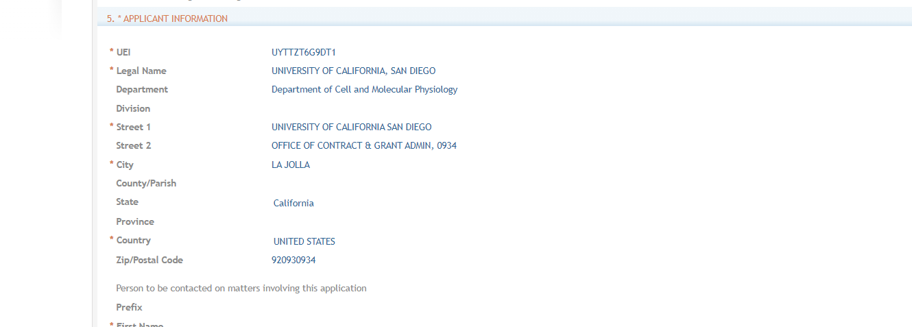
In ASSIST

Slide 8
UEI and FORMS-G
UEI replacing DUNS on all Grants.gov and NIH competing application forms:
  SF424 (R&R) (v5.0)
  SF424 R&R Multi-Project Cover (v4.0)
  Project/Performance Site Location(s) (v4.0)
  SBIR/STTR Information (v3.0*)
  R&R Budget 5 YR (v3.0)
  R&R Budget 10 YR (v3.0)
  R&R Subaward Budget Attachment(s) 5 YR (v) (v3.0)
  R&R Subaward Budget Attachment(s) 10 YR (v3.0)
  R&R Multi-project Budget 10 YR (v3.0)
  R&R Multi-project Subaward Budget Attachment(s) 10 YR (v3.0)
  PHS 398 Training Budget (v2.0)
  PHS 398 Training Subaward Budget Attachment(s) (v3.0)
  PHS Additional Indirect Costs (v2.0)
  *Form under development, see Grants.gov Forms Status Report
UEI replacing DUNS on NIH post-award forms, e.g. RPPR. Final implementation details forthcoming.

Slide 9
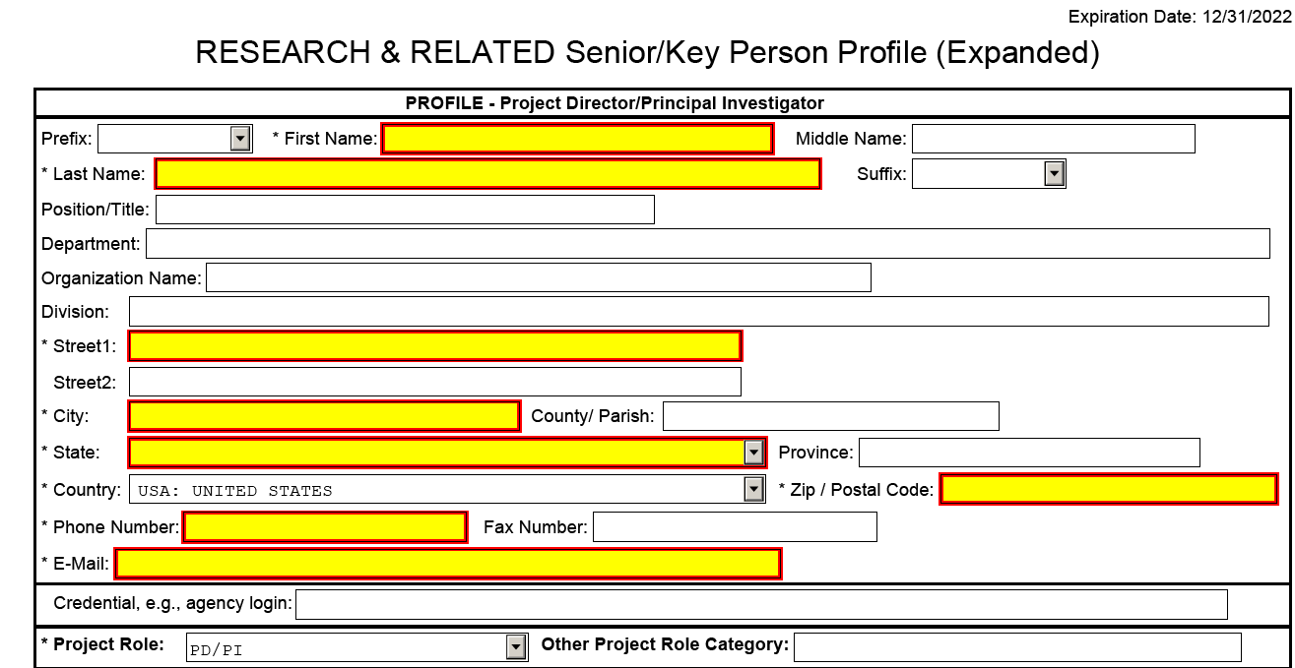
Country Codes & Commons ID for all Sr Key
NOT-OD-21-109

Slide 10
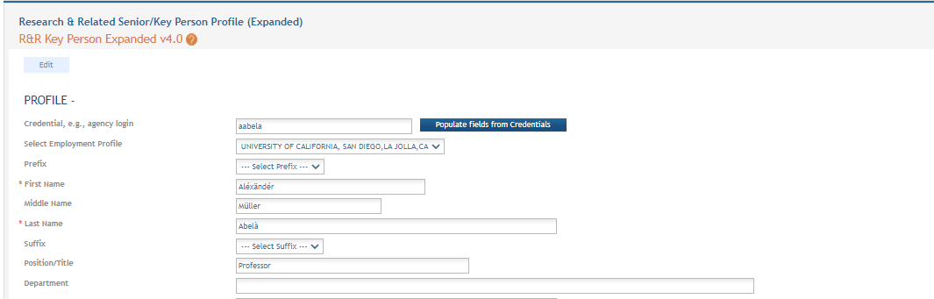
In ASSIST

Slide 11
Biosketch and Other Support
Learn more: NOT-OD-21-110; NOT-OD-21-073
Updated Biosketch resources, including FAQs and sample Biosketch format pages can be found here.
Updated Other Support resources, including FAQs and sample Other Support format pages can be found here.
Direct inquiries to nihosbiosketch@nih.gov

Slide 12
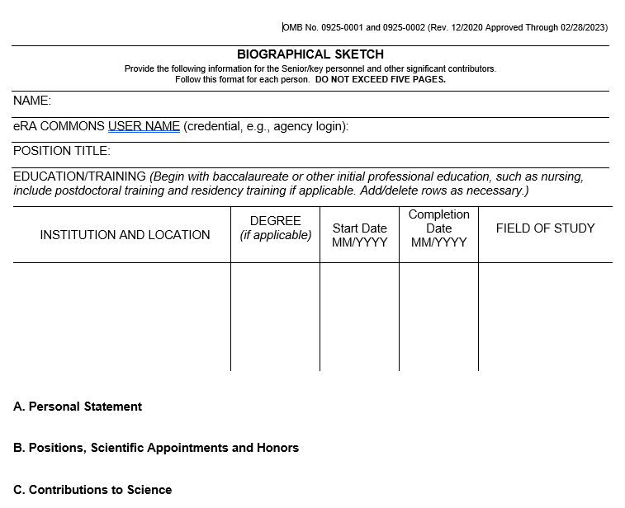
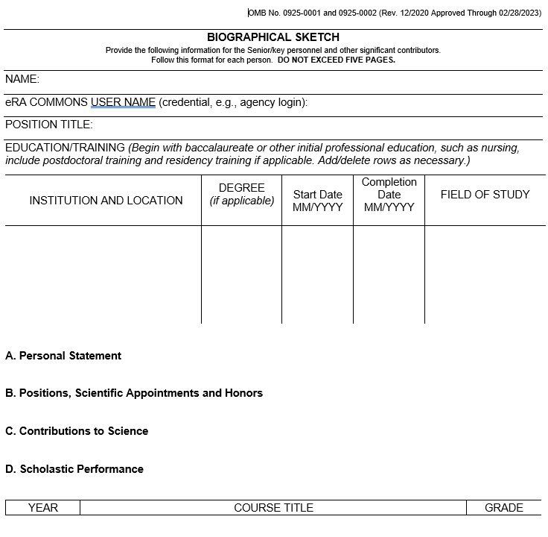
Biosketch
Non-Fellowship
Fellowship

Slide 13
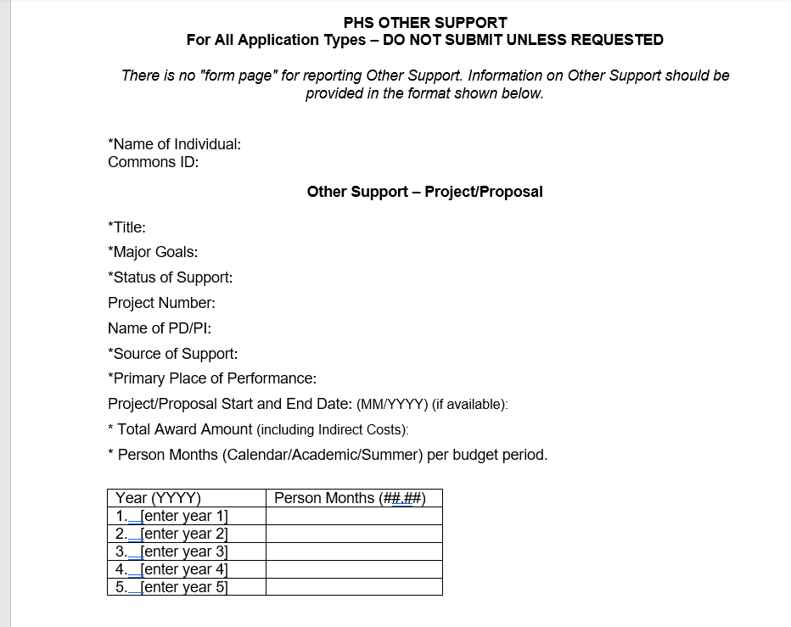
Other Support

Slide 14
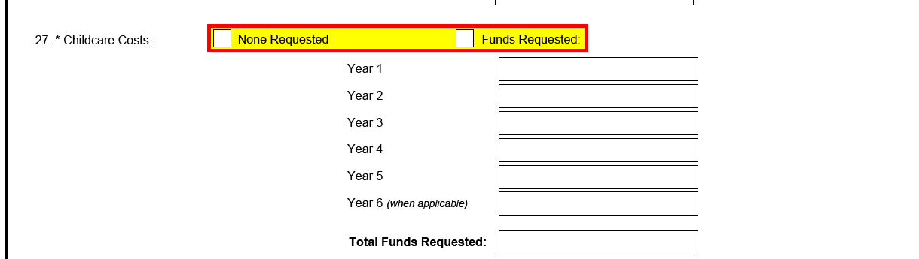
Childcare Costs on PHS Fellowship Supplemental Form
NOT-OD-21-177
$2,500/year
Frequently Asked Questions are available here

Slide 15
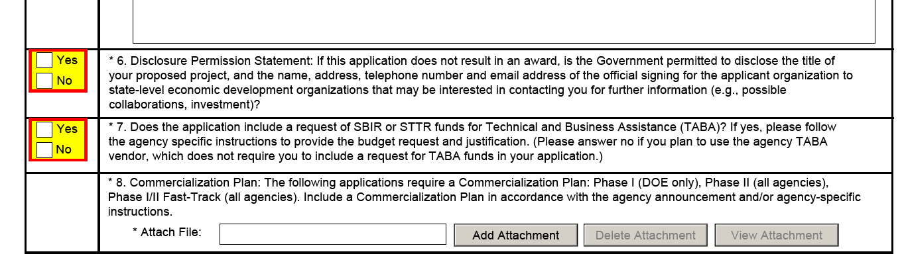
Technical Assistance on SBIR/STTR

Slide 16
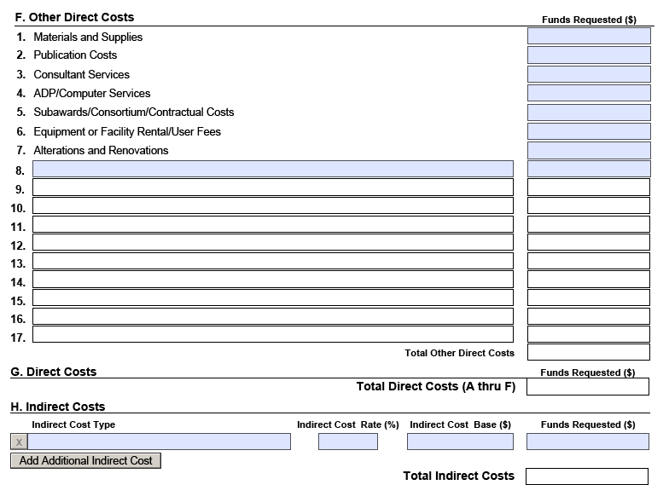
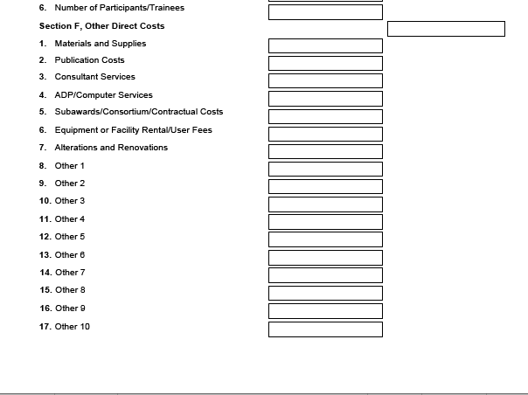
R&R Detailed Budget Other Direct Costs
Annual Budget Request
Cumulative Budget
Added 7 additional fields

Slide 17
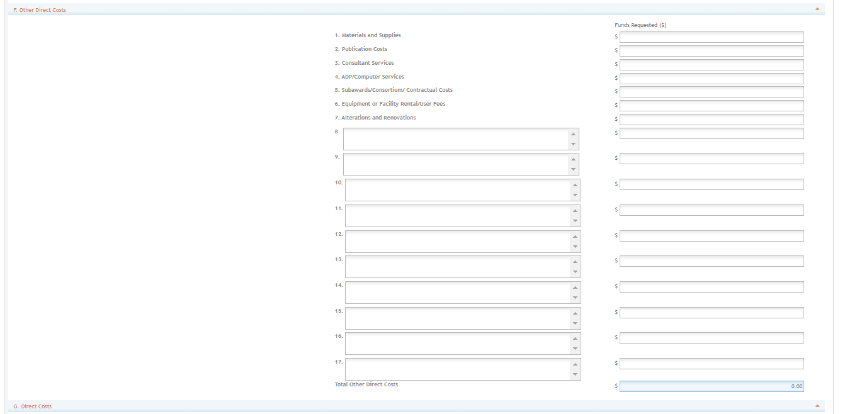
In ASSIST
Added 7 additional fields

Slide 18
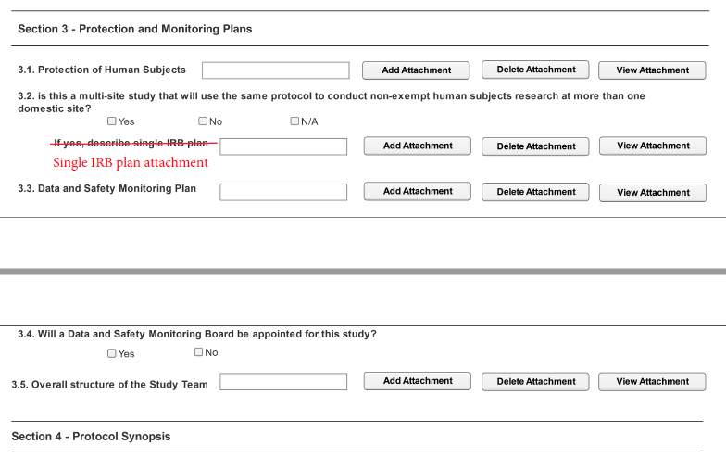
Human Subject Clinical Trial Information Form-
Study Record Label Change
Label change only

Slide 19
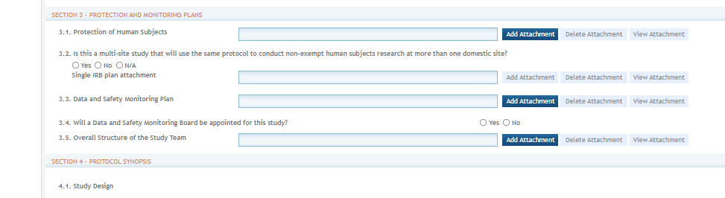
In ASSIST
Label change only

Slide 20
Reminder- Choose the Correct Forms
For a transition period, both FORMS-F and FORMS-G application packages will be active simultaneously. Applicants must choose the appropriate application package for their due date when presented with both FORMS-F and FORMS-G application packages on the same FOA.
Do I Have the Right Form Version For My Application?
If your intended due date is... | You must use...
On or before January 24, 2022, including: Applications submitted for due dates on or before January 24, 2022 Applications submitted under NIH Late Policy 2-week window of consideration for intended due dates on or before January24, 2022 Applications submitted by February 1, 2022 under NIH Continuous Submission Policy for the January 7, 2022 AIDS intended due date | FORMS-F application package
On or after January 25, 2022, including: Applications submitted for due dates on or after January 25, 2022 All application types (New, Resubmission, Renewal, Revision) Applications submitted early for intended due dates on or after January 25, 2022 | FORMS-G application package

Slide 21
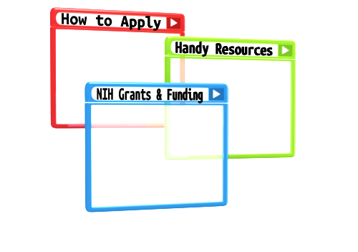
Resources

Slide 22
Help Desks
Systems Policy Inquiries
  OPERAsystemspolicy@nih.gov
eRA Service Desk
  Web: https://grants.nih.gov/support/
  Phone: 1-866-504-9552
  Hours : Mon-Fri, 7a.m. to 8 p.m. ET
Grants.gov Contact Center
  Toll-free: 1-800-518-4726
  Hours : 24x7 (Except Federal Holidays)
  Email : support@grants.gov
  Resources: https://www.grants.gov/web/grants/support.html

Slide 23
Online Resources & Websites
NIH Grants and Funding
https://grants.nih.gov/grants/oer.htm
How to Apply – Application Guide
https://grants.nih.gov/grants/how-to-apply-application-guide.html
Annotated form set
https://grants.nih.gov/grants/how-to-apply-application-guide/resources/annotated-form-sets.htm
Preparing Your Application Using ASSIST
https://grants.nih.gov/grants/how-to-apply-application-guide/prepare-to-apply-and-register/submission-options/assist.htm

Slide 24

Questions?

