Slide 1

Beyond Grants and Contracts:
Other Transactions
November 3, 2021
Office for Extramural Research (OER)
Office of Policy for Extramural Research Administration (OPERA)
Presented by OER/OPERA Staff

Slide 2
Welcome
Welcome to our Conversation about NIH Other Transactions
Michelle G. Bulls, Director of OPERA
Kristin Ta, Senior Advisor
Cory Upmeyer, Other Transactions Policy Analyst
Kristin Wegner, Lead Other Transactions Policy Analyst

Slide 3
Objectives
By the end of our session, you will be able to:
  Characterize Other Transactions (OTs)
  Identify Research Opportunity Announcements (ROAs)
  Discuss OT policy implementation
  Locate NIH’s contacts for Other Transactions

Slide 4
Other Transactions Authority (OTA)
Allows for Federal Government agencies to enter into Other Transactions (OTs)

Slide 5
Other Transactions
Special type of legal instrument other than a contract, grant, or cooperative agreement
Not subject to the FAR, nor grant regulations
Subject to OT Authority that governs the initiative and to applicable legislative mandates

Slide 6
OTA Origination
1958: National Aeronautics and Space Administration

Slide 7
Federal Departments & Agencies with OTA
Congress has authorized many Federal Departments & Agencies to use Other Transactions Authorities, including:
  1958 – NASA (National Aeronautics and Space Administration)
  1972 – NIH (National Institutes of Health)
  1989 – DOD (Department of Defense)
  1996 – FAA (Federal Aviation Administration)
  1998 – DOT (Department of Transportation)
  2002 – TSA (Transportation Security Administration)
  2002 – DHS (Department of Homeland Security)
  2005 – DOE (Department of Energy)
  2006 – HHS (Department of Health and Human Services)
  2011 – ARPA-E (Advanced Research Projects Agency – Energy)

Slide 8
NIH Other Transactions Authorities
NIH currently has three active OTAs:
  PHSA sec. 402(n), 42 U.S.C. sec. 282(n)
    NIH OTA for NIH Director’s unique research initiatives
  PHSA sec. 421(b)(3) 42 U.S.C. sec. 285b–3(b)(3)
    NHLBI OTA for NHLBI Director’s functions
  PHSA sec. 480(e)(3)(C), 42 U.S.C. sec. 287a(e)(3)(C)
    NCATS OTA for Cures Acceleration Flexible Research Awards
  *PHSA = Public Health Service Act

Slide 9
NIH OT Initiatives
NIH Initiatives under OTAs, include:
  All of Us Research Program
  Cancer Grand Challenges
  Common Fund Data Ecosystem
  Cure Sickle Cell Initiative (CureSCi)
  Early Phase Pain Investigation Clinical Network (EPPIC-Net)
  Helping to End Addiction Long-Term (HEAL) Initiative
  Human BioMolecular Atlas Program (HuBMAP)
  NHLBI BioData Catalyst
  Science and Technology Research Infrastructure for Discovery, Experimentation, and Sustainability Initiative (STRIDES)
  Stimulating Peripheral Activity to Relieve Conditions (SPARC) Program

Slide 10
NIH Awarding Instruments
Grant Agreements
Cooperative Agreements
FAR-based Procurement Contracts
Other Transactions Agreements

Slide 11
OTs Used in Research
Reasons to use OTs may include a combination of the following, among others:
Other Transactions Authority
Need for flexibility to negotiate terms and conditions appropriate for the specific program requiring fluid implementation
Science expected to be highly evolving, with requirements for additional aims or expertise added to, or removed from, the project throughout the term of execution
Intellectual property rights
Nontraditional research recipients

Slide 12
Research Opportunity Announcements (ROAs)
ROAs may be located on NIH institutes, centers, or initiatives’ websites; NIH Guide for Grants and Contracts; sam.gov; and other locations known to industry for specific research initiatives
NIH may reach potential applicants via other means, including but not limited to oral presentations, panel pitches, and targeted solicitations

Slide 13
OT Applications
Specific instructions in ROAs
Apply through eRA ASSIST (Application Submission System & Interface for Submission Tracking)
  Specific Guide for OTA Applications: https://era.nih.gov/help-tutorials/assist/era-training-assist.htm

Slide 14
OT Applications Reviewed/Evaluated
Scientific evaluation or Objective review
Contents outlined in ROA
Performed by persons expert in field of endeavor for support requested
Financial capability review, risk analysis and budget analysis

Slide 15
Staff on OT Award
Many staff from all parties may work OT
At minimum:
  Recipient Business Official and Principal Investigator/Principal
  NIH OT Agreements Officer, Agreements Specialist, and Program Official

Slide 16
OT Agreements Development
Negotiations: Process that involve discussing and reaching agreement on the terms and conditions for an Other Transaction or OT modification between NIH and applicant/recipient

Slide 17
OT Agreement Terms & Conditions
At minimum, OT sections include:
  OT Identification Number
  Parties
  Other Transactions Authority
  Description
  Term of Execution
  Termination
  Modification
  Accounting and Management
  Funding
  Obligation and Payment
  Cost Sharing
  Audits
  Disputes
  Statutes and Regulations
  Flow Down
  Reporting
  Restrictions
  Closeout

Slide 18
Lessons Learned
Agency
Institute/Center/Office

Slide 19
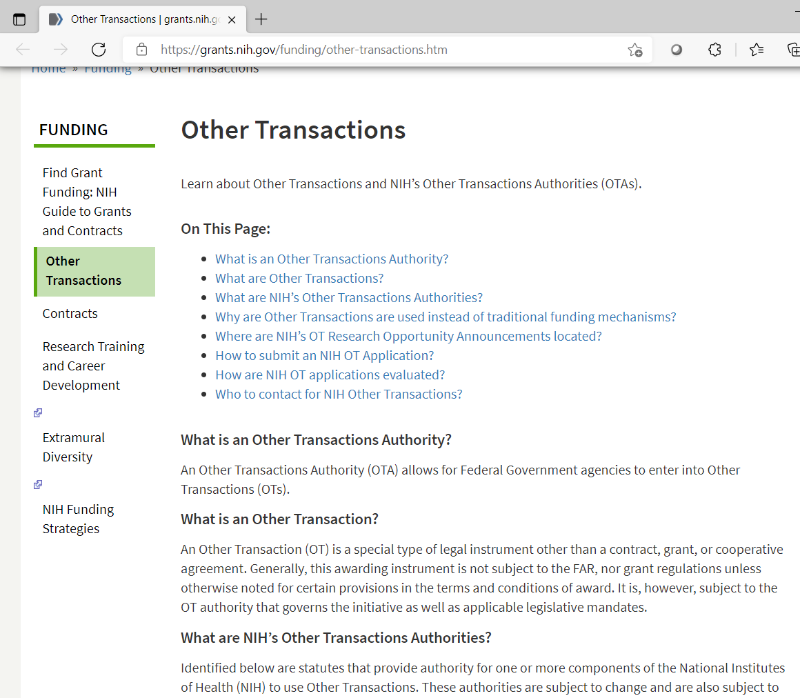
NIH OT Informational Webpage
https://grants.nih.gov/funding/other-transactions.htm

Slide 20
NIH OT Contacts
For general OT information, contact OER/OPERA Other Transactions Mailbox at NIHODOTA@nih.gov
For specific initiative information, contact NIH staff listed on the OT initiative ROA(s) or OT initiative websites

Slide 21

Questions

Slide 22
Recapitulation
Beyond Grants and Contracts: Other Transactions
Other Transactions Authorities (OTAs)
Other Transactions (OT)
Research Opportunity Announcements (ROAs)
Organization, Collaboration and Communication

Slide 23


NIH OT Contact Information
Visit:
NIH Other Transactions
Web Page
https://grants.nih.gov/funding/other-transactions.htm
Contact:
OER/OPERA OT Staff NIHODOTA@nih.gov

