Slide 1
An Overview of NIH Policies on Human Subjects
Pamela Reed Kearney, M.D.
Director, Division of Human Subjects Research (NIH/OER)
Lyndi Lahl, R.N., M.S.
Human Subjects Officer (NIH/OER)

Slide 2
Objectives
Identify NIH policies pertaining to research involving human subjects
Determine when research involving human subjects is a clinical trial
Review considerations when applying for an NIH award for research that involves human subjects
Identify NIH resources for investigators conducting research involving human subjects

Slide 3
Objectives
Identify NIH policies pertaining to research involving human subjects
Determine when research involving human subjects is a clinical trial
Review considerations when applying for NIH award for research that involves human subjects
Identify NIH resources for investigators conducting research involving human subjects

Slide 4
Human Subjects Research Policies
Disseminating Clinical Trial Information
Certificates of Confidentiality
FOA Policies
Inclusion across the lifespan
Human Subjects Research
BESH
Inclusion of Women and Minorities
Clinical Trials Policies
Human Subjects Education
GCP Training
Human Fetal Tissue
Data and Safety Monitoring

Slide 5
When do NIH Human Subjects Policies Apply?
Research activities that involve Human Subjects (HS)
  Human subjects defined in the Common Rule
  Some HS policies apply to clinical research (e.g., Inclusion)
  Some HS policies apply only to clinical trials (e.g., Data and Safety Monitoring)
NIH policies complementary or in addition to the Common Rule

Slide 6
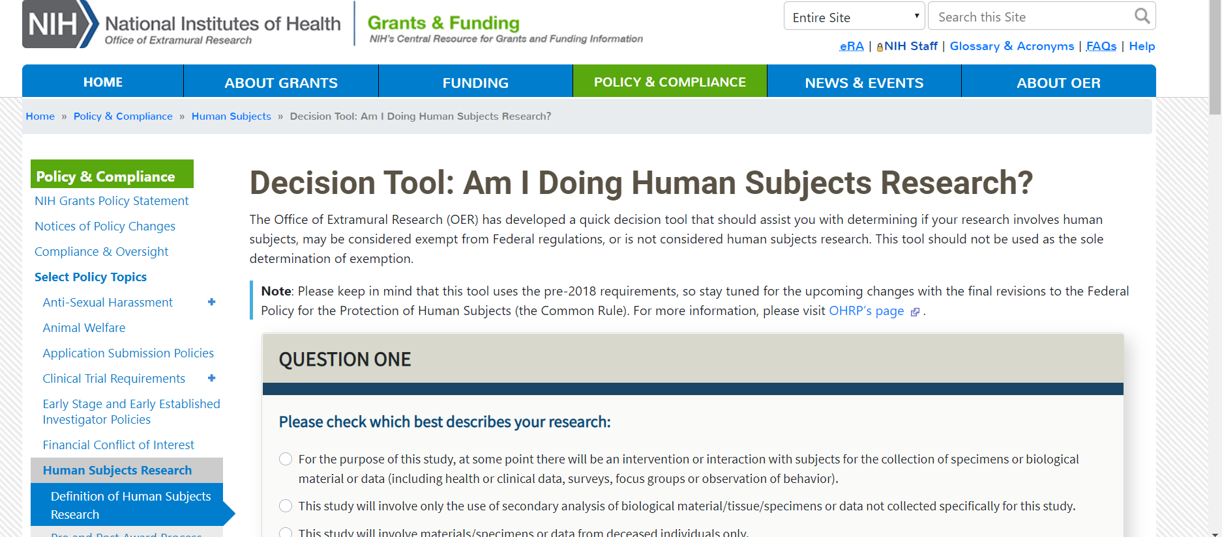
Decision Tool: Am I Doing Human Subjects Research
Decision Tool: Am I Doing Human Subjects Research?
Notes:
Decision Tool: am I doing human subjects research?: https://grants.nih.gov/policy/humansubjects/hs-decision.htm

Slide 7
Required Education In the Protection of Human Research Participants
All key personnel must have education on the protection of human research participants:
  Individuals responsible for design and conduct of the research
  Also applies to key personnel at performance sites
One-time training
Guide Notices
NOT-OD-00-039 & NOT-OD-11-061
Published
June 5, 2000 & September 5, 2001
Notes:
Guide Notice, REQUIRED EDUCATION IN THE PROTECTION OF HUMAN RESEARCH PARTICIPANTS, published June 5, 2000: https://grants.nih.gov/grants/guide/notice-files/not-od-00-039.html
Guide Notice, REQUIRED EDUCATION IN THE PROTECTION OF HUMAN RESEARCH PARTICIPANTS published September 5, 2001: https://grants.nih.gov/grants/guide/notice-files/NOT-OD-01-061.html

Slide 8

Certificates of Confidentiality (CoC) (1 of 2)
Applicable NIH research ongoing or awarded as of December 13, 2016 is deemed to be issued a Certificate
Must not disclose identifiable, sensitive information :
  In any Federal, State, or local civil, criminal, administrative, legislative, or other proceeding
  To any other person not connected with the research
Disclosure permitted only when:
  Required by Federal, State, or local laws (e.g., reporting child or elder abuse, mandatory disease reporting)
  With participants’ consent
  For other scientific research
CoC
Notes:
Alternate text: This graphic illustrates a shield.

Slide 9
Certificates of Confidentiality (CoC) (2 of 2)
    CoC protects “covered information”
      Names or any information, documents, or biospecimens
      If there is a small risk that covered information can be combined with other data to determine individual’s identity
    CoC applies to all copies of the data
      Secondary researchers must uphold CoC protections
    Covered information protected in perpetuity
Guide Notice
NOT-OD-17-109
Published
September 7, 2017
Notes:
Guide Notice, Notice of Changes to NIH Policy for Issuing Certificates of Confidentiality: https://grants.nih.gov/grants/guide/notice-files/NOT-OD-17-109.html

Slide 10
Human Fetal Tissue (HFT)
NIH implemented the HHS Policy, effective June 5, 2019
Applicants must provide:
  a justification of the use of HFT,
  details regarding procurement and costs,
  information about how the applicant/contract offeror will use HFT
NIH will not accept modular budgets for applications for research involving HFT
Applications that do not address all required information will be administratively withdrawn and not reviewed
Guide Notices
NOT-OD-19-128 & NOT-OD-19-137
Published
July 26, 2019 & August 23, 2019
Notes:
Guide Notice, Changes to NIH Requirements Regarding Proposed Human Fetal Tissue Research: https://grants.nih.gov/grants/guide/notice-files/NOT-OD-19-128.html
Guide Notice, Clarifying Competing Application Instructions and Notice of Publication of Frequently Asked Questions (FAQs) Regarding Proposed Human Fetal Tissue Research: https://grants.nih.gov/grants/guide/notice-files/NOT-OD-19-137.html

Slide 11

Inclusion (1 of 2)
Inclusion of women and minorities in all NIH funded or supported clinical research mandated by law
Additional requirements for Phase III clinical trials
  Can study be expected to identify potential differences by sex/gender, race, and/or ethnicity
SLIDE | 11

Slide 12
Inclusion (2 of 2)
Must include individuals across the lifespan when conducting clinical research, unless there is a scientific or ethical reason to exclude
Policies Goal: ensure individuals are included in clinical research in a manner appropriate to the scientific question under study
Guide Notices
NOT-OD-16-010, NOT-OD-18-104
& NOT-OD-18-116
Published
October 13, 2015, November 28, 2017
& December 19, 2017
Notes:
Guide Notice, Inclusion of Children in Clinical Research: Change in NIH Definition: https://grants.nih.gov/grants/guide/notice-files/NOT-OD-16-010.html
Guide Notice, Amendment: NIH Policy and Guidelines on the Inclusion of Women and Minorities as Subjects in Clinical Research: https://grants.nih.gov/grants/guide/notice-files/NOT-OD-18-014.html
Guide Notice, Revision: NIH Policy and Guidelines on the Inclusion of Individuals Across the Lifespan as Participants in Research Involving Human Subjects: https://grants.nih.gov/grants/guide/notice-files/NOT-OD-18-116.html

Slide 13
Single IRB Requirement
Revised Common Rule Cooperative Research Provision at 45 CFR 46.114(b)
  All cooperative research projects are expected to abide by the cooperative research provision, when applicable
  NIH sIRB Policy
  Nonexempt human subjects research studies with more than one domestic site are expected to use a single IRB
Guide Notice
NOT-OD-16-094 Published
June 21, 2016
Notes:
Guide Notice, Final NIH Policy on the Use of a Single Institutional Review Board for Multi-Site Research: https://grants.nih.gov/grants/guide/notice-files/not-od-16-094.html

Slide 14
Objectives
Identify NIH policies pertaining to research involving human subjects
Determine when research involving human subjects is a clinical trial
Review considerations when applying for NIH award for research that involves human subjects
Identify NIH resources for investigators conducting research involving human subjects

Slide 15
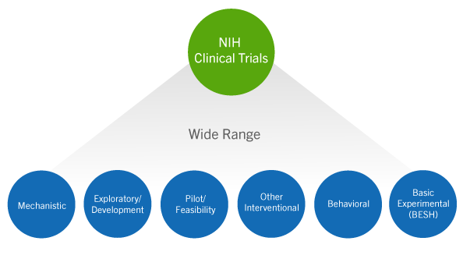
How Does NIH Define a Clinical Trial?
A research study in which one or more human subjects are prospectively assigned to one or more interventions (which may include placebo or other control) to evaluate the effects of those interventions on health-related biomedical or behavioral outcomes
Notes:
Helpful resource: https://grants.nih.gov/policy/clinical-trials/definition.htm

Slide 16
Clinical Trial Questionnaire
Does the study involve human participants?
Are the participants prospectively assigned to an intervention?
Is the study designed to evaluate the effect of the intervention of the participants?
Is the effect that will be evaluated a health-related biomedical or behavioral outcome?
Answers determine:
  Appropriate FOA type
  Application form requirements
  Review criteria for evaluation
  Requirement for registration and results reporting
  Requirement for GCP training
**If YES to all questions, study is a clinical trial

Slide 17
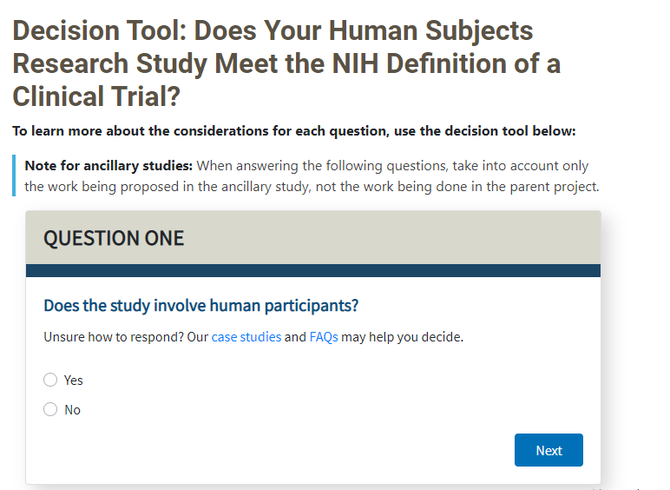
Clinical Trial Decision Tool
Does Your Human Subjects Research Study Meet the NIH Definition of a Clinical Trial?
Notes:
Website, Does your human subjects research study meet the NIH definition of a clinical trial?: https://grants.nih.gov/ct-decision/index.htm

Slide 18
Funding Opportunity Announcement (FOA) for Clinical Trials
  Applications involving clinical trials must be submitted to clinical-trial specific FOAs
  Applications submitted to incorrect FOA will be administratively withdrawn
  Purpose:
    Improve NIH’s ability to identify proposed clinical trials
    Ensure key pieces of trial-specific information are submitted with each application
    Uniformly apply trial-specific review criteria
Guide Notice:
NOT-OD-16-147
Published
September 16, 2016
Notes:
Guide Notice, Policy on Funding Opportunity Announcements (FOA) for Clinical Trials: https://grants.nih.gov/grants/guide/notice-files/not-od-16-147.html

Slide 19
Dissemination of NIH-Funded
Clinical Trial Information
Policy Requires Registration and Reporting:
  SUBMIT - a plan in the application outlining compliance with the policy
  REGISTER - no later than 21 days after enrolling the first participant
  REPORT - summary results no later than one year after primary completion date
Guide Notice:
NOT-OD-16-149
Published
September 16, 2016
Notes:
Guide Notice, NIH Policy on the Dissemination of NIH-Funded Clinical Trial Information: https://grants.nih.gov/grants/guide/notice-files/not-od-16-149.html

Slide 20
Basic Experimental Studies with Humans (BESH) FOAs (1 of 2)
BESH studies meet definition for both:
  Basic Research
  NIH clinical trial
  NEW BESH Website
Guide Notices
NOT-OD-18-212 & NOT-OD-21-088
Published
July 20, 2018 & March 23, 2021
Notes:
Guide Notice, Delayed Enforcement and Short-Term Flexibilities for Some Requirements Affecting Prospective Basic Science Studies Involving Human Participants: https://grants.nih.gov/grants/guide/notice-files/NOT-OD-18-212.html
Guide Notice: Continued Extension of Certain Flexibilities for Prospective Basic Experimental Studies With Human Participants: https://grants.nih.gov/grants/guide/notice-files/NOT-OD-21-088.html
New BESH website: https://grants.nih.gov/policy/clinical-trials/besh.htm
RESOURCES for the BESH community:
New funding opportunities specifically for BESH studies
BESH FAQs: https://grants.nih.gov/faqs#/clinical-trial-specific-foas.htm?anchor=header11627
Guidance for Determining if a Study Falls Within a BESH FOA: https://grants.nih.gov/policy/clinical-trials/besh.htm#answering

Slide 21
Basic Experimental Studies with Humans (BESH) FOAs (2 of 2)
Interim flexibilities for registration and results reporting through September 24, 2023.
Registration and results reporting is still expected for BESH FOAs, but with flexibility to use alternative publicly available platforms (other than Clinicaltrials.gov)
NOTE: This flexibility ONLY applies to BESH studies funded through BESH FOAs
Guide Notices
NOT-OD-18-212 & NOT-OD-21-088
Published
July 20, 2018 & March 23, 2021
Notes:
Guide Notice, Delayed Enforcement and Short-Term Flexibilities for Some Requirements Affecting Prospective Basic Science Studies Involving Human Participants: https://grants.nih.gov/grants/guide/notice-files/NOT-OD-18-212.html
Guide Notice: Continued Extension of Certain Flexibilities for Prospective Basic Experimental Studies With Human Participants: https://grants.nih.gov/grants/guide/notice-files/NOT-OD-21-088.html
RESOURCES for the BESH community:
New funding opportunities specifically for BESH studies
FAQs: https://grants.nih.gov/faqs#/clinical-trial-specific-foas.htm?anchor=header11627
Guidance for Determining if a Study Falls Within a BESH FOA: https://grants.nih.gov/policy/clinical-trials/besh.htm#answering

Slide 22

Good Clinical Practice Training
(GCP)
All NIH-funded clinical investigators and clinical trial staff involved in the design, conduct, oversight, or management of clinical trials should be trained in GCP
GCP training can be achieved through :
  class or course
  academic training program
  certification from a recognized clinical research professional organization
Training should be refreshed every 3 years
Guide Notice:
NOT-OD-16-148
Published
September 16, 2016
Notes:
Guide Notice, Policy on Good Clinical Practice Training for NIH Awardees Involved in NIH-funded Clinical Trials: https://grants.nih.gov/grants/guide/notice-files/not-od-16-148.html

Slide 23
Data and Safety Monitoring
Clinical trials must submit a Data and Safety monitoring plan
  Address overall data and safety monitoring framework
  Describe procedures for adverse event reporting
  Identify the monitor (e.g., PI, independent safety monitor, DSMB, etc.)
Data and Safety Monitoring Board (DSMB) generally required for NIH-defined phase III trials
Guide Notices
NOT-98-084 & NOT-OD-00-038
Published
June 10, 1998 & June 5, 2000
Notes:
Guide Notice, NIH POLICY FOR DATA AND SAFETY MONITORING: https://grants.nih.gov/grants/guide/notice-files/not98-084.html
Guide Notice, FURTHER GUIDANCE ON A DATA AND SAFETY MONITORING FOR PHASE I AND PHASE II TRIALS: https://grants.nih.gov/grants/guide/notice-files/not-od-00-038.html

Slide 24
Objectives
Identify NIH policies pertaining to research involving human subjects
Determine when research involving human subjects is a clinical trial
Review considerations when applying for an NIH award for research that involves human subjects
Identify NIH resources for investigators conducting research involving human subjects

Slide 25
Using the Human Subjects and Clinical
Trial Form
Form Section | If answered “No” to any questions in Clinical Trial Questionnaire | If answered “Yes” to all questions in Clinical Trial Questionnaire
Section 1 Basic Information | Required | Required
Section 2 Study Population Characteristics | Required; some fields optional if exemption 4 | Required
Section 3 Protection and Monitoring Plans | Some fields required; some fields optional | Required
Section 4 Protocol Synopsis | Not permitted | Required
Section 5 Other Clinical Trial-related Attachments | Not permitted | Required only if specified in FOA
Human Subjects and Clinical Trials Information Form
Notes:
Website for Human subjects and clinical trials information form: https://grants.nih.gov/policy/clinical-trials/new-human-subject-clinical-trial-info-form.htm

Slide 26

Plan Protection of Human Subjects (1 of 3)
1. Risks
  Study population, assignment and procedures
  Sources of materials –access to identifiers
  Potential Risks for ALL research interventions: physical, psychological, social, legal
2. Adequacy of Protection Against Risks
  The consenting process
  Procedures to minimize identified risks, including protecting participant privacy
  Additional protections for vulnerable subjects

Slide 27

Plan Protection of Human Subjects
(2 of 3)
3. Potential Benefits of Research to Human Subjects and Others
  Discuss risks in relation to anticipated benefits
  In some cases, there is no direct benefit to subjects
  Do not include financial compensation
4. Importance of Knowledge to be Gained
  Discuss in relation to risks

Slide 28
Plan Protection of Human Subjects
(3 of 3)
  Don’t assume reviewers will understand what you mean
    Explain how, what, when, where, why and who
  Common human subject issues identified in peer review:
    Physical or psychological risks not adequately addressed
    Inadequate protections for vulnerable populations
    Source of specimen and/or data
    Incidental findings not addressed
    Missing or inadequate Data & Safety Monitoring Plans

Slide 29
Multi-site Study Considerations
In general, funding recipient is considered engaged in human subjects (HS) research when nonexempt research involves HS
All engaged sites must have:
  FWA (can be covered under recipient’s FWA)
      Extending a FWA to Cover Collaborating Investigators
  IRB Approval
    U.S. sites to rely on one IRB under 45 CFR 46.114
      OHRP Institutional Review Board (IRB) Authorization Agreement
Notes:
OHRP website, Extending an FWA to Cover Collaborating Investigators: https://www.hhs.gov/ohrp/regulations-and-policy/guidance/extension-of-institutional-fwa-via-individual-investigator-agreement/index.html
Official version of 2018 requirements, 45 CFR 46: https://www.ecfr.gov/on/2018-07-19/title-45/subtitle-A/subchapter-A/part-46
OHRP website, Institutional Review Board (IRB) Authorization Agreement: https://www.hhs.gov/ohrp/register-irbs-and-obtain-fwas/forms/irb-authorization-agreement/index.html

Slide 30
Objectives
Identify NIH policies pertaining to research involving human subjects
Determine when research involving human subjects is a clinical trial
Review considerations when applying for an NIH award for research that involves human subjects
Identify NIH resources for investigators conducting research involving human subjects

Slide 31

Useful Resources: Human Subjects Protections and Inclusion
NIH Human Subjects Research Home Page
NIH Clinical Trial Requirements for Grants and Contracts
NIH Basic Experimental Studies Involving Humans (BESH)
Office for Human Research Protections (OHRP) Home Page
SLIDE | 31
Notes:
NIH human subjects research home page: https://grants.nih.gov/policy/humansubjects.htm
NIH clinical trials requirements for grants and contracts: https://grants.nih.gov/policy/clinical-trials.htm
NIH Basic experimental studies involving humans (BESH): https://grants.nih.gov/policy/clinical-trials/besh.htm
Office for Human Research Protections home page: https://www.hhs.gov/ohrp/index.html

Slide 32

Questions

