Slide 1

After-Hours Session:
Developing and Optimizing Your Mentor Relationships
NIH Virtual Seminar
Thursday, November 4, 2021

Slide 2
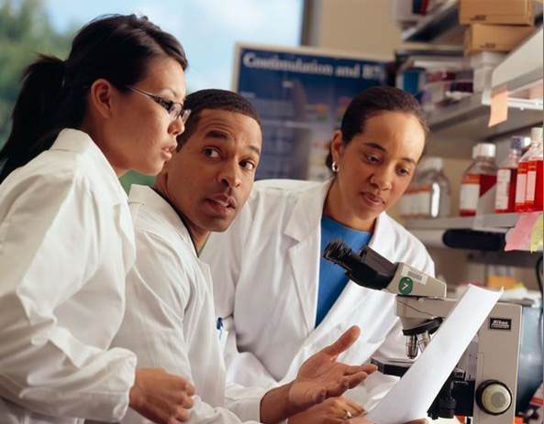
Session Overview
Impact of Mentorship Relationships
Panel Discussion on Developing and Optimizing Mentor Relationships
Sharing Resources on Finding a Mentoring and Cultivating Mentor Relationships

Slide 3
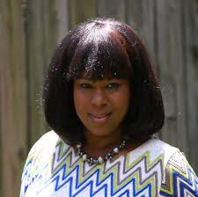
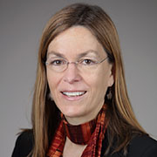
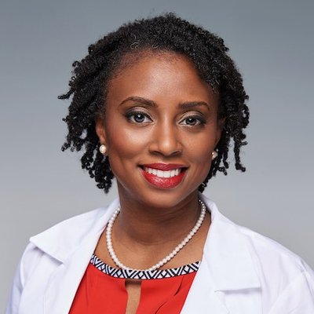
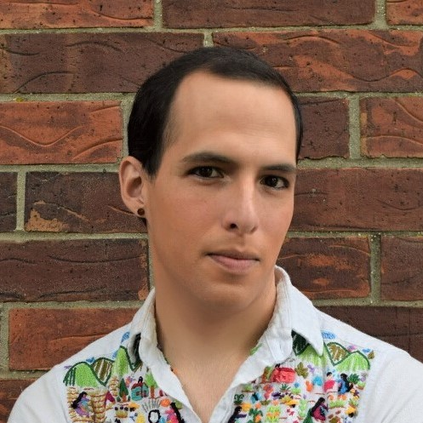
Moderator and Panelists
Rosalina Bray, MSc, CEP, NIH Extramural Staff Training Officer, Office of Extramural Research
Alison Gammie, Ph.D., Director, Training, Workforce Development and Diversity, NIH National Institute of General Medical Sciences
Nicole Redmond, MD, PhD, MPH, Program Officer, NIH National Heart, Lung, and Blood Institute
Fatima Sancheznieto, PhD., Assistant Researcher, National Research Mentoring Network

Slide 4

Data on Career Success with a Mentor/Mentor Network
Of those with a mentor, 97% say they are valuable – National Mentoring Day.org
89% of those who have been mentored will also go on to mentor others - McCarthyMentoring.com
Mentees are promoted 5 times more often than those without mentors - Forbes.com
87% of mentors and mentees feel empowered by their mentoring relationships and have developed greater confidence - Women-ahead.org

Slide 5

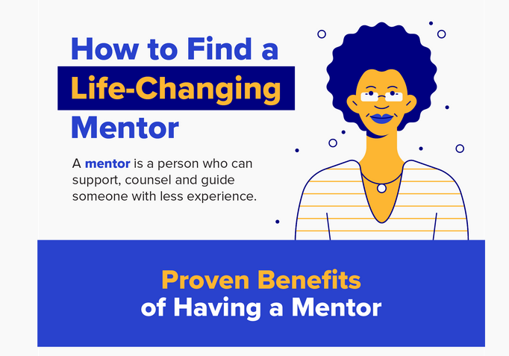
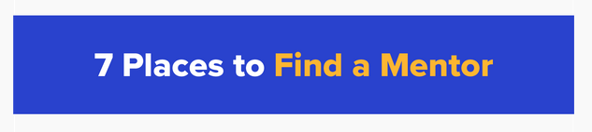
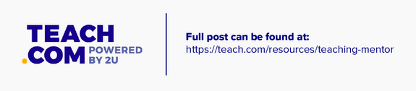
Mentor Resource from Teach.com
https://teach.com/resources/teaching-mentor/

Slide 6
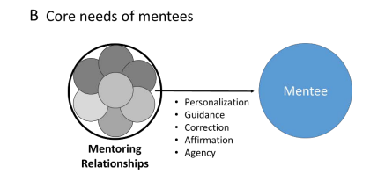
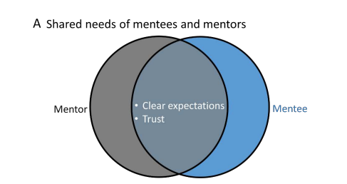
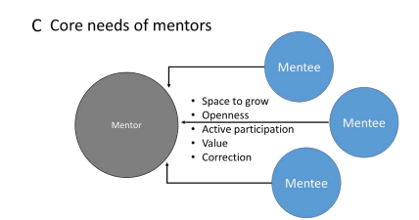
Needs of Mentees and Mentors
Source: Montgomery & Page (2019). Mentoring beyond Hierarchies: Multi Mentor Systems and Models, Duke University. Commissioned by National Academies of Sciences Engineering Medicine

Slide 7
Panel Discussion Topics
Importance of having a mentor or mentor network for career/professional success
Beneficial Mentoring Relationships
Finding and Approaching a potential mentor(s) to support your goals, aspirations, and interests
Nurturing mentor relationships
Resources on Mentors and Mentorship

Slide 8
Panel Discussion

Slide 9
Resources

Slide 10

Finding a Mentor for Your Career in Science
Using NIH RePORTER
Dr. Nicole Redmond, MD, PhD
http://reporter.nih.gov/

Slide 11
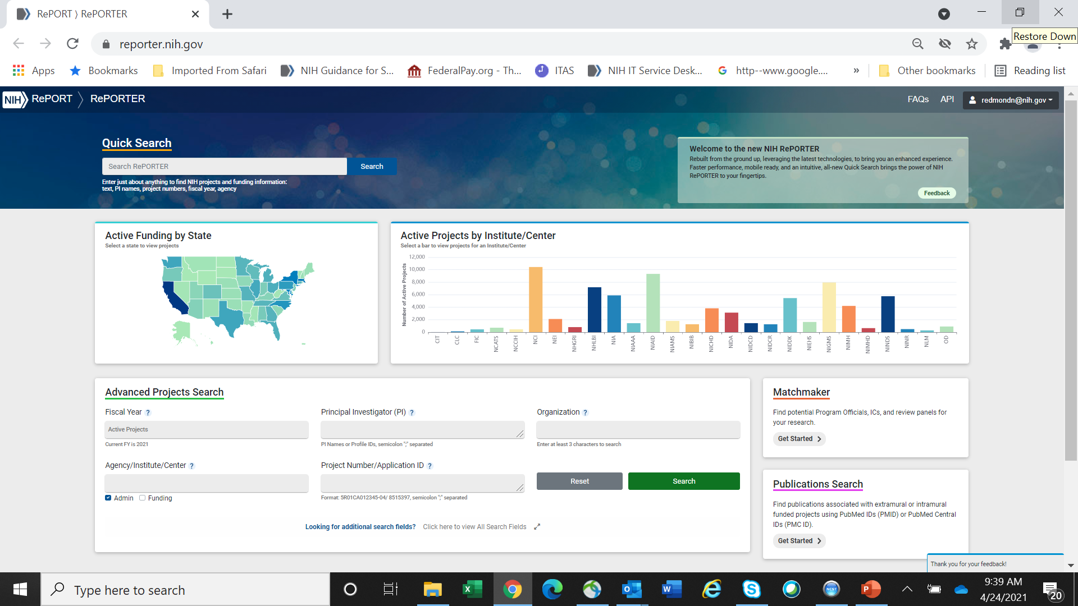
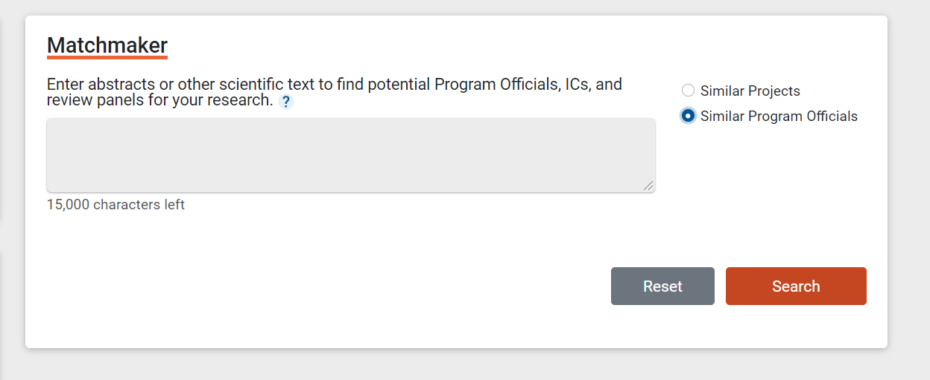
NIH’s Research Portfolio Online Reporting Tools (RePORT): RePORTER & Matchmaker
Matchmaker allows you to enter manuscript abstracts, research bios, or other scientific text, and retrieve a list of similar projects from the RePORTER database. After you submit your text (up to 15,000 characters in length), Matchmaker will analyze it for key terms and concepts, then pull up the top 100 most-similar NIH-funded projects, ranked by match score.
http://reporter.nih.gov

Slide 12
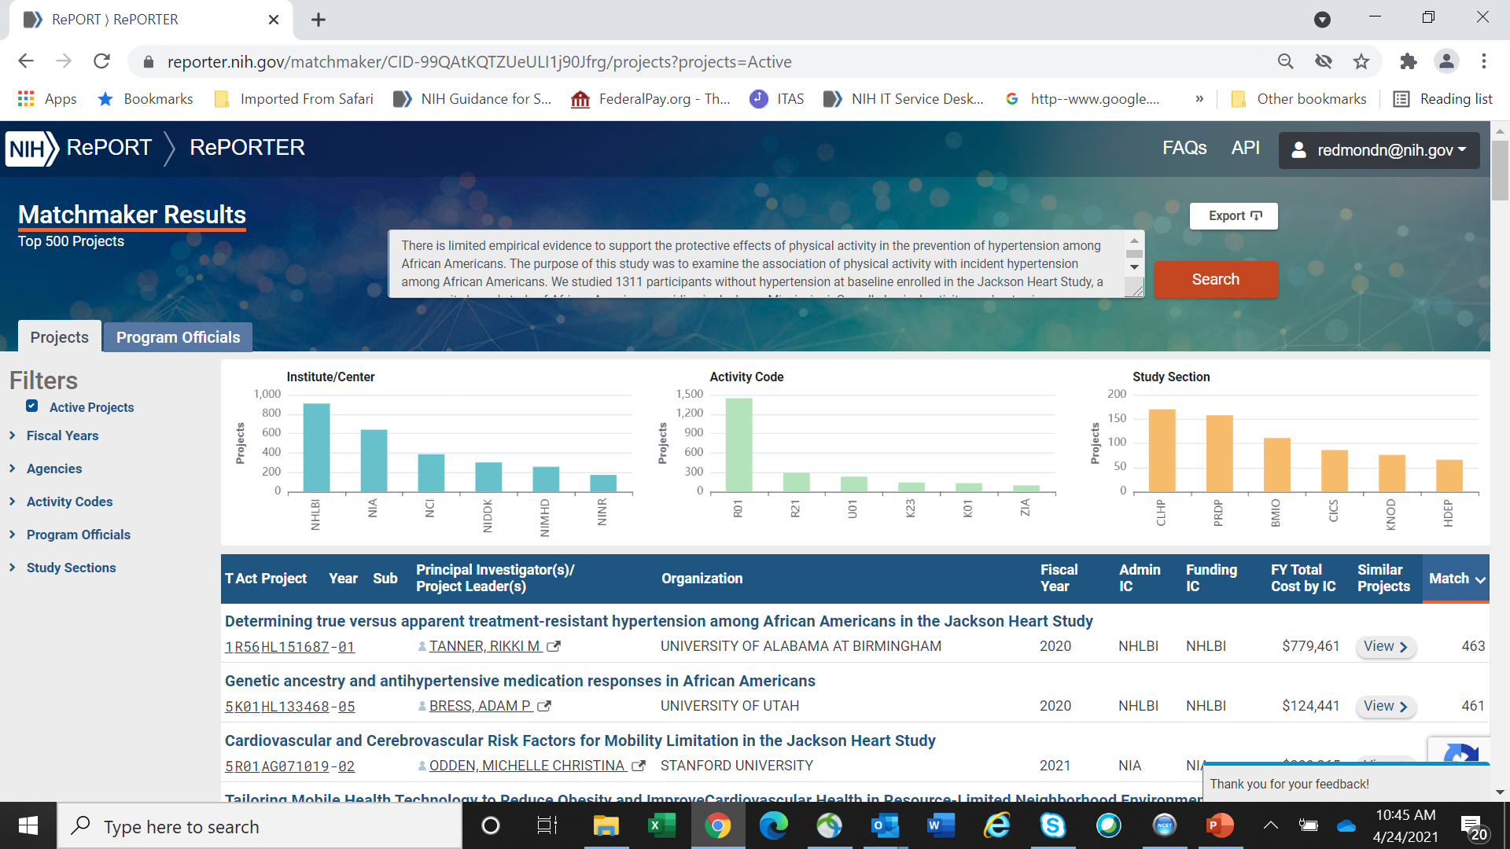
NIH’s Research Portfolio Online Reporting Tools (RePORT): Matchmaker Results

Slide 13
Resources: YouTube, Podcasts, eBooks, & Toolkits
Developing & Optimizing Your Mentoring Relationship
  2020 NIH Virtual Seminar, Nicole Redmond, MD, PhD, MPH, FACP - Developing & Optimizing Your Mentoring Relationships – YouTube
International Mentoring Group (I-mentoring) eBooks
  https://mentoringgroup.com/books/skills-for-sucessful-mentoring.pdf
  https://mentoringgroup.com/books/mentees-guide.pdf
  https://mentoringgroup.com/books/the-mentors-guide.pdf
National Research Mentoring Network
  NRMN Internet Website at NRMN.NET
The Science of Effective Mentoring in STEMM
  The National Academies of Sciences Engineering Medicine Podcast
Syracuse Advance Mentoring Toolkit
  Syracuse Advance Mentoring Toolkit

Slide 14

Thank you for joining our After-Hours Session

