Slide 1
Research Misconduct and Integrity
Patricia Valdez, Ph.D.
NIH Extramural Research Integrity Officer
October 2020
NIH Virtual Seminar

Slide 2






Everyone’s Responsibility
Integrity
Stewardship
Protection
UNIVERSITY

Slide 3
Overview of Allegation Review Process
Research
Misconduct
Sexual
Harassment
Grant
Fraud
Foreign
Influence
Peer Review
Integrity
ALLEGATION
ENTRY
INITIAL
ASSESSMENT
ACTIONS TO CONSIDER, DEPENDING ON
OUTCOME OF ASSESSMENT
Contact institution
Remove individual from peer review service
Refer to agency/office with oversight responsibility
Administrative actions
Regulatory actions

Slide 4

Research Misconduct and Integrity
Ranjini Ambalavanar, Ph.D.
Division of Investigative Oversight (DIO)
Office of Research Integrity (ORI)
October 2020

Slide 5

Office of Research Integrity – ORI https://ori.hhs.gov/
MISSION
To promote the integrity of PHS-supported extramural and intramural research programs by responding effectively to allegations of research misconduct and promoting research integrity
GOAL
Oversight Review of research misconduct Investigations
Education in Responsible Conduct of Research
Functions
Division of Investigative Oversight
Division of Education and Integrity

Slide 6
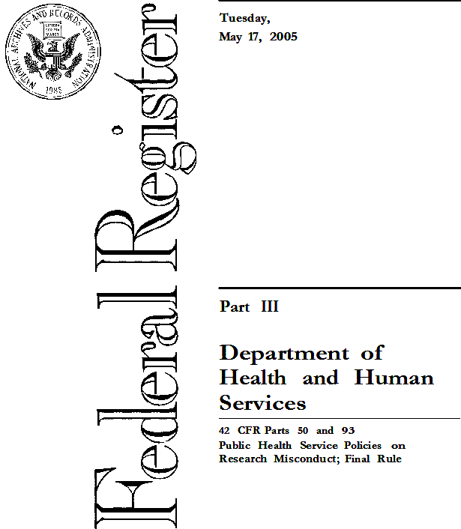
Research misconduct - 42 CFR § 93.103
Fabrication, falsification, or plagiarism in proposing, performing, or reviewing research, or in reporting research results.
Fabrication is making up data or results and recording or reporting them.
(b) Falsification is manipulating research materials, equipment, or processes, or changing or omitting data or results such that the research is not accurately represented in the research record.
(c) Plagiarism is the appropriation of another person's ideas, processes, results, or words without giving appropriate credit.
PHS Policies on Research Misconduct

Slide 7
Research Misconduct Findings are made when
The allegation is proven by a preponderance of the evidence
The misconduct is committed intentionally, knowingly, or recklessly.
There is a significant departure from accepted practices of the relevant research community.
Who
No honest error/differences in opinion
Significant departure
FFP
Intent
Preponderance of the evidence

Slide 8
A Slippery Slope Leading to Misconduct?
Most of the scientists conduct research with a high degree of integrity contributing to advancement in science
Lab 1
Lab 2
Lab 3
Research
Misconduct
Questionable Research Practices/Sloppy Science
High Degree of Integrity

Slide 9
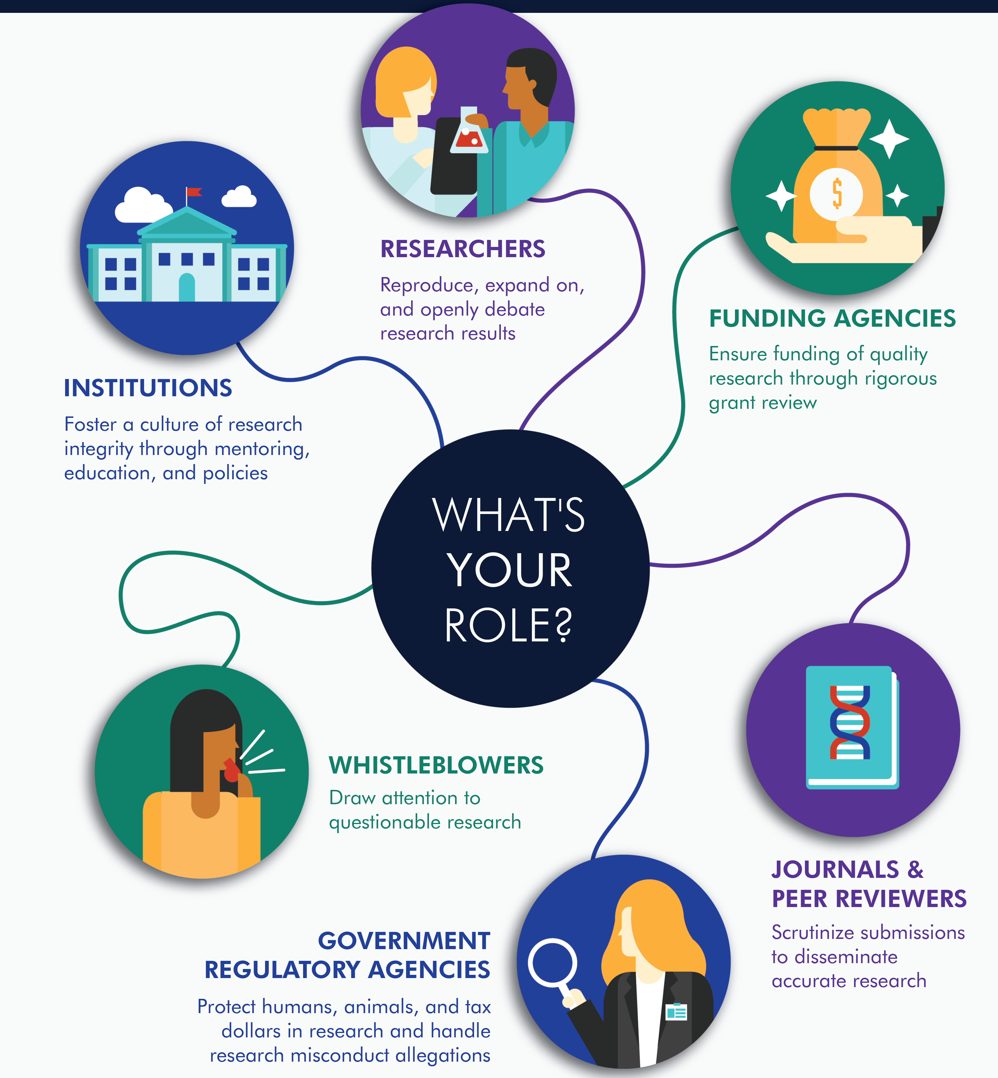
Do you Have a Role in Preventing Research Misconduct?
Starts with the Researchers
Perceived Pressure
Rationalization
Opportunity
Adopted from Cressey’s Fraud Triangle

Slide 10
What leads to Research Misconduct? Statements From Case Interviews

Slide 11
Scenario 1- Are you liable for research misconduct?
You submit an NIH grant application not aware that the data and/or text included by others were falsified/fabricated and plagiarized.
Yes!
Decisions by an ALJ on two of the recent ORI cases established that a PI and/or corresponding author, can be liable for research misconduct even if he/she was completely unaware of any falsification or plagiarism.

Slide 12
Steps in Research Misconduct Proceedings
ORI
oversight
Allegation
Assessment
Inquiry
Investigation
Colleagues
Peer reviewer s
Coauthors
Journal editors
60 days
120 days
Agree
Insufficient evidence for ORI finding
Research Integrity Officer (RIO)
Initial assessment
Organizes the remaining institutional processes
Recommend Administrative Actions:
Fix research record
Require special certification(s)
Suspend/terminate PHS-funding
Supervise offender(s)
Prohibit PHS-advisory role
Debar from future funding
All ORI Findings are published in The Federal Register, the ORI website and newsletter, and the NIH website
Institutional officials
Funding agency
Journal
ORI

Slide 13
Case Example:
Mentor first suspected research misconduct when his Postdoc
was leaving the laboratory, because:
Records, reagents, and samples were missing for a large majority of work reported in papers.
Experimental Records:
Only a single laboratory notebook with 107 pages for 5 years of work
Lack of primary data
Mentor arranged for backup of personal network drive and the entire group drive
Asked the Respondent for electronic data
Respondent promised to upload data from his/her computer to the group drive

Slide 14
Misconduct Investigation Found……..
2007 data by h
2010 data by ss
Respondent’s uploaded files:
Contained data taken from sequencing runs performed 2 years before he/she joined the lab in 2009
In total, the renamed files constitute a set of 38, with names between ss-01 and ss-40.

Slide 15
Reused DNA sequencing files in Electronic Records
Copied files show the same sequence run (here lane 53) in 2007 and dated October 11, 2010.
https://ori.hhs.gov/case_summary

Slide 16

Supporting Coordination & Collaboration
International Universities
American Association for the Advancement of Science
Association of American Medical Colleges
NIST/DOC
DOE
DOD
Medical
Centers
CDC
FDA
OIG
USDA
Council of Graduate Schools
AHRQ
Biotech
Companies
NSF
OGC
DOI
SAMHSA
Public Health Service
OHRP
National Academy of Science
Association of American University Professors
HRSA
IHS
NIH
DOJ
VA
US Colleges & Universities
Clinical sites
NASA

Slide 17

When Should Institutions Contact the NIH?
Special Circumstances (42 CFR 93)
Special circumstances that may impact the NIH-supported research, public safety, human subjects, animal welfare, or federal funds
Changes in Project and Budget (GPS 8.1)
Developments that have a significant impact on the award-supported activities; also in the case of problems, delays, or adverse conditions which materially impair the ability to meet the objectives of the award.

Slide 18
CASE STUDY

Slide 19
Part 1
Rebecca RIO assembles an investigation committee to review allegations of falsified data in an NIH grant application and multiple NIH-supported publications belonging to the PI, Dr. Smith.
Shortly after the investigation begins, Dr. Smith sends an email to his lab asking that the person responsible for the data falsification come forward immediately to end the investigation. One of the lab members forwards the email to Rebecca RIO.

Slide 20

Question
What should Rebecca RIO do about Dr. Smith’s actions?

Slide 21
Part 2
Rebecca RIO and university officials decide to place Dr. Smith on Administrative Leave while the investigation continues. Dr. Smith is not allowed on campus and is prohibited from communicating with members of his lab.
Rebecca RIO and university officials decide that Paula Postdoc is senior enough to oversee work on the NIH project.

Slide 22

Questions
Who needs to be notified about Dr. Smith’s change of status?
NIH GPS 8.1.3 Requests for Prior Approval
NIH GPS 8.1.2.6 Change in Status, Including Absence of PD/PI and Other Senior/Key Personnel Named in the NoA

Slide 23
Part 3
Several months later, the investigation continues, and Dr. Smith notifies university officials that he has a tentative job offer at a new university out of state. The job offer requires that he bring the NIH grant with him, so Dr. Smith asks his current university to transfer the active NIH grant to his new university.
Rebecca RIO and other university officials have reservations about transferring the grant, especially since the data in the application may be unreliable.

Slide 24

Questions
Should Rebecca RIO mention the ongoing investigation to the new institution?
Should the new university ask Dr. Smith if he is currently under investigation or if his former institution made findings of research misconduct against him?
Should Rebecca RIO mention the ongoing investigation to the NIH?
This Photo by Unknown Author is licensed under CC BY-NC-ND

Slide 25
More Questions
What are some options the university could consider for the active award?
Keep the award and request a change of PI and a change of scope, if possible, given the data issues;
terminate the award; or
relinquish the grant for transfer to the new university?
What do you think is the best course of action?
Who should be informed?
NIH GPS 8.1.2.5 Change in Scope
NIH GPS 8.1.2.7 Change of Recipient Organization

Slide 26
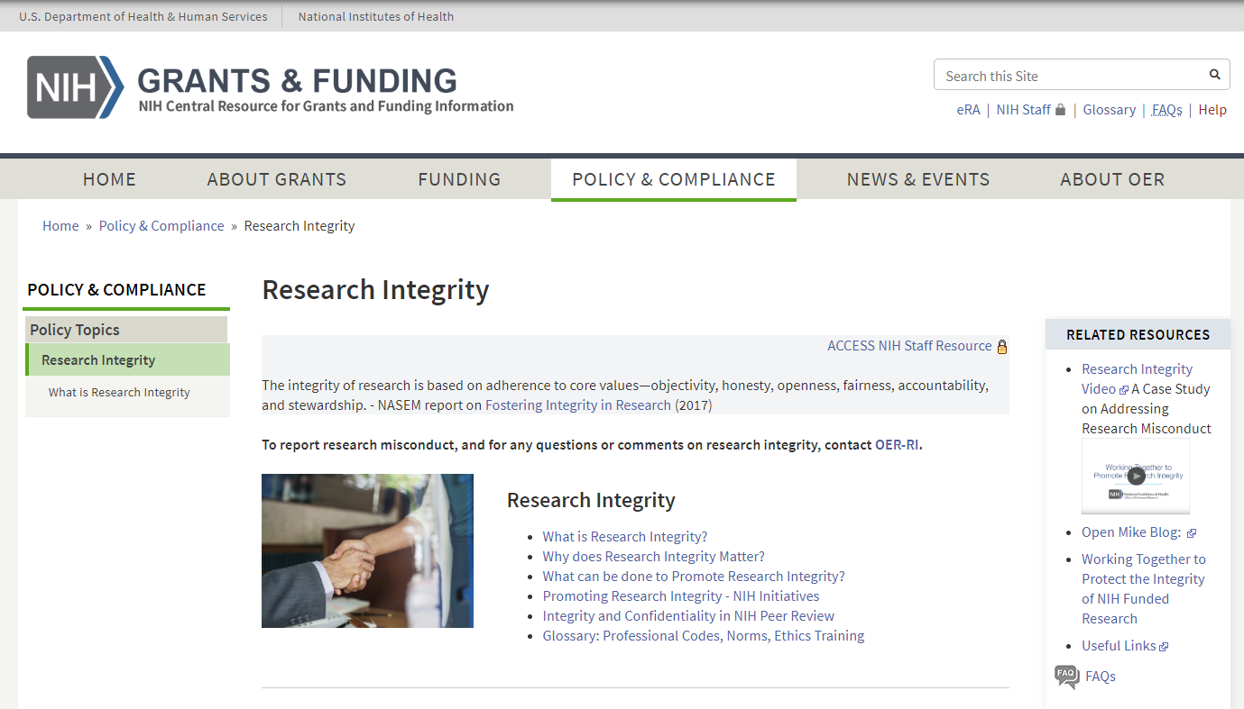
NIH Research Integrity Website
https://grants.nih.gov/policy/research_integrity/index.htm

Slide 27
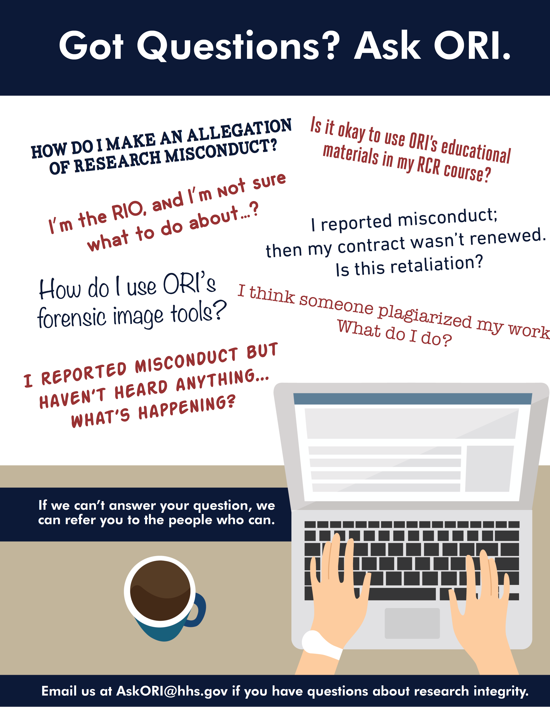
Questions

