Slide 1

NIH Loan Repayment Programs
Ericka Boone, PhD
Director
Division of Loan Repayment

Slide 2





























National Institutes of Health
NIH is made up of 27 Institutes and Centers, each with a specific research and research training agenda, focusing on particular diseases or body systems
Unified Goal:
Support the training
and career development
of the biomedical research workforce
INSTITUTES
CENTERS

Slide 3
LRPs = Important Career Path and Funding Option
Graduate/ClinicalTraining
Postdoctoral Training/
Clinical Residency
Early Research Career
Established Investigator
T32, T35
T32
K01, K07, K25 K12, KL2
K08,K23, K12, KL2
R03, R21, R01, R35
R01, R35, P01, P50
F30, F31
F32
R38, (K38)
R25, K12
K22,K99
K22, R00
K02,
K24
Loan Repayment Programs
Diversity Supplements
Re-Entry Supplements
https://researchtraining.nih.gov

Slide 4
About the LRPs
NIH Loan Repayment Programs (LRPs) are a vital component in our nation's effort to keep health professionals in research careers
Here’s how it works:
YOU: Commit to perform research for 2 years
NIH: Repays up to $50,000/year of your qualified educational debt and covers resulting Federal taxes (39%)
Outcome: Increase in nation’s stock of biomedical research scientists

Slide 5





6 Extramural NIH LRP Subcategories:
For individuals conducting research at non-profit institutions
Clinical Research
Patient-oriented research conducted with human subjects or materials of human origin (including cognitive phenomenon) on the causes and consequences of disease in humans
Pediatric Research
Research related to diseases or disorders in children
Health Disparities Research
Same as Clinical Research LRP
Contraception & Infertility Research
Clinical DB
Research focusing on minority and other health disparity populations
Research focusing on conditions impacting ability to conceive or bear children and provide new or improved methods of preventing pregnancy
Basic research allowed
Basic, clinical, social and behavioral research allowed
Available to clinical researchers from verifiable disadvantaged backgrounds
Applications reviewed by Eunice Kennedy Shriver NICHD
Applications reviewed NIH ICs
Reviewed by NIMHD
Research on Emerging Areas Critical to Human Health (REACH)
Available beginning September 2021
To recruit and retain researchers pursuing major opportunities or gaps in emerging areas of human health
NIH ICs determine gap/emerging areas of research priority areas

Slide 6







Basic LRP Eligibility Criteria
Extramural
Doctoral Degree
M.D., Ph.D., or equivalent
Exception: Contraception & Infertility Research LRP
Research Funding
Citizenship
Domestic nonprofit, university, or government organization; NIH grant support NOT required
U.S. Citizen or permanent resident
Educational Loan Debt
Research Time
At least 20% of applicant’s annual base income
At least 20 hours/week

Slide 7
Qualifying Loans
NIH WILL Repay:
Educational loans from undergraduate degree to first terminal degree
Educational loans backed by the U.S. government
Educational loans from accredited U.S. academic institutions and commercial lenders
NIH Will NOT Repay:
Non-educational loans (e.g. home equity loans)
PLUS loans to parents
      EXCEPTION: PLUS loans disbursed to graduate and professional students on or after July 1, 2006, qualify for LRP repayment
Loans from non-US governments or institutions
Loans converted to a service obligation, delinquent or in default
Loans consolidated with another individual (e.g. spouse or child)
Loans of full-time Federal government employees or VA Fellows
Notes:
Ericka: Now, let’s review the types of loans that DO and DO NOT qualify for NIH loan repayment.
NIH WILL repay --
Educational loans guaranteed by the US Government
Educational loans from accredited US academic institutions and commercial lenders, including PLUS loans – but only those made to the applicant. PLUS loans made to your parents for your education are not eligible.
Jigna: Yes, I often get asked whether the LRPs will repay undergraduate loans, and the answer is yes. The programs cover all educational loans from undergraduate to your last degree. Please note that all payments go directly to your lenders. The order, in which loans are paid, is listed on our website.
Ericka: Now that we’ve covered eligible loans, let’s take a look at loans NIH will NOT repay. These include
Non-educational loans (for example car or mortgage loans)
Loans that have been converted to a service obligation
Loans that are delinquent or in default
Loans from non-US governments or institutions; Last, and VERY IMPORTANT to note…
Loans consolidated with a spouse or child WILL NOT be considered under any circumstances for repayment

Slide 8
NIH LRP Applications & Awards, FY16-19
Largest Programs
~50% Success Rate Overall
FY16 FY17 FY18 FY19
Notes:
Not going to show lots of stats here, remember that more MDs than PhDs, renewal vs. new awards, more male than female awardees

Slide 9


NIH LRP Applicant Snapshot, 2019
65% in debt up to $150K
Avg Age/Award
Average Debt (New Awards)
Average Age
37
Average Award
~$56,000
Applications vs. Awards, by Gender
Applications vs. Awards, by Degree
1,567 Applications
697 Awards
Success Rate = 45%
1,136 Applications
565 Awards
Success Rate = ~50%

Slide 10

Career-Related Advancements of the LRPs
Notes:
We wanted to get an idea of how much debt our awardees were bringing into and exiting from the program

Slide 11
Extramural LRP Outcomes Study
Productivity (analytic sample)
61% of funded applicants (vs 46% unfunded) submitted at least one non-LRP grant application
31% of funded applicants (vs 19% unfunded) received at least one grant award (non-LRP)
34% of funded applicants (vs 17% unfunded) had at least one grant-link publication
Notes:
3053 funded/unfunded LRP applications (FY 2003-2009);
Exited LRPs by 2011
Follow-up period = time between application to August 2017
Productivity (analytic sample)
61% of funded applicants (vs 46% unfunded) submitted at least one non-LRP grant application
31% of funded applicants (vs 19% unfunded) received at least one grant award (non-LRP)
34% of funded applicants (vs 17% unfunded) had at least one grant-link publication

Slide 12
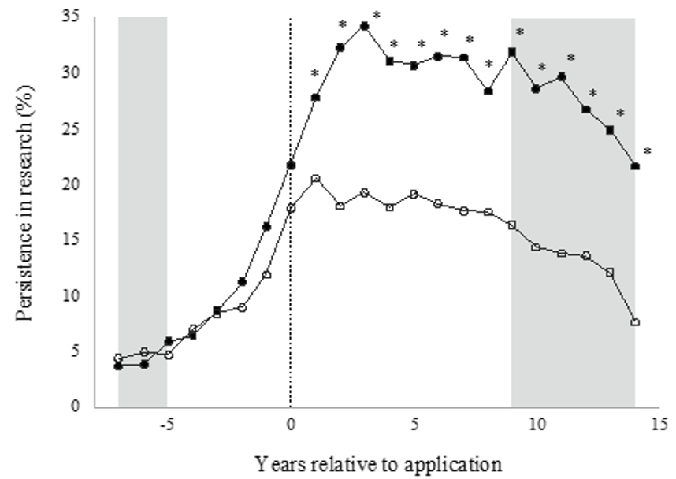
Extramural LRP Outcomes Study
Annual Persistence in Research (*p≤0.01)
Follow-up Begins
35
30
25
20
15
10
5
0
Funded Group
Persistence in Research (%)
Unfunded Group
-5 0 5 10 15
Years Relative to Application
Figure represents raw means for funded and unfunded groups 5-years prior to, and 14 years after, LRP application. Unfunded starting n=1,958; funded starting n=1,095.
Yearly retention rates quickly diverge post application:
Significant gains in research activity immediately after LRP award; 10-15% point difference (funded vs unfunded)
Overall two-to-three-fold increase in persistence in research each year, for 14 years (funded vs unfunded)
Notes:
The figure presents raw means for funded and unfunded groups in the analytic sample. All applications used for the inclusion sample were set to year-0. Then persistence in research was examined 5-years prior to, and 14 years after, LRP application.
The line with filled circles indicates the funded group (starting n=1,095) and the line with open circles indicates the unfunded group (starting n=1,958). Funded and unfunded groups were statistically significantly different each year after year-0 (p<0.01). The grey area indicates the years with a partial analytic sample (i.e., more recent cohorts have not had time to be >7 years post-LRP-application).

Slide 13
Direct Career and Personal-Related Benefits
$$$ -- Relief from the tremendous burden of student loan debt at a vulnerable career decision point
Ability to pursue career-related passions without as much worry about salary
Protected research time
Practice/preparation for applying for other NIH grant mechanisms
Added boost to career preparedness & increased productivity across career
Ego boost you need to show you that you can do this!! You are conducting work that is important and FUNDABLE!!

Slide 14


LRP Application = Reviewer Roadmap
LRP Application
=
Reviewer Roadmap
Where are you now?
Where are you going?
What kind of car do you have?
Who are your co-pilots?
What’s your plan? timeline?

Slide 15

The Application – Major Sections
Research Activities (‘meat and potatoes’)
Personal Statement
  Highlight previous training, development of scientific interests; accomplishments; short and long-term career goals
Training/Career Development Plan
  Skills acquiring along your path to independence (e.g., training, professional and leadership development opportunities; grantmanship workshops, conference attendance, etc.) – include 2-year timeline
Proposed Research Plans
  Planned research activities, specific roles/responsibilities – include 2-year timeline
  Research Environment
    Why are you where you are? Who or what is important there?
Loan Information (new applicants only)
  Lender and servicer information, loan number, total loan amounts, loan status (e.g., in repayment/forbearance)

Slide 16
What Are Reviewers Looking For?
Evaluate an applicant’s potential to succeed in a research career by rating:
Applicant’s previous training and research experience
Applicant’s commitment to a research career
Strength and quality of letters of recommendation
Quality and appropriateness of the research environment
Research progress (for Renewal applications only)

Slide 17

Most Common Mistakes…
More Obvious Reasons:
Not contacting PO prior to application ( a clear understanding of IC mission/priorities is essential to submitting a well-crafted application)
Rushed preparation (i.e. careless mistakes in the application)
Questionable research commitment and weak research plan
Failure to adequately describe the mentoring and training/career development plan, research timelines
Slim publication record
Lukewarm recommendation letters
Not applying
Less Obvious Reasons:
Many high achievers share a dirty little secret:
The Imposter Within

Slide 18

What is Imposter Syndrome?
Pattern of thought where a person discounts/doubts accomplishments and has a persistent fear of being exposed as ‘not as good/smart/prepared’
Feelings of anxiety, doubt; negative self-talk; dwelling on past mistakes
Perfectionism/overpreparation...no room for error
Experienced often by highly successful, intelligent people (i.e., does not = low self-esteem or intellect)
Often sparked by new opportunities
NO ONE EVER ADMITS IT, so you feel alone
Can lead to:
  Procrastination
  Missed Opportunities (e.g., jobs, new roles, giving deference where not deserved, etc.)
  Wasted Time and Emotional Energy

Slide 19



Develop a Different Relationship/Response to Imposter Fears
“If someone believes, by contrast, that people having their careers of their dreams grapple with consistent self-doubt; if they believe they don’t need any more confidence than they have right now in order to accomplish their most important goals; if they shift their vision of their ideal self from a confident rock star to a rock star that experiences self-doubt, they have a path forward from where they currently stand.” -- Tara Mohr

Slide 20

Free Yourself
Plant Your Feet....Breathe
Overwhelmed? Stop, unclench your teeth, take a breather
Separate true feelings/concerns from your fears
Silence is NOT Golden
You don’t have to go it alone; don’t have to know all the answers
It’s Ok (expected) that you ask questions and for help/support
Be Your Own Best Friend
Play a new mental tape; visualize your success (vs. imminent failure)
“ How can I make this happen?” versus, “I don’t’ think this will work out”
Brush Your Shoulders Off
Reframe internal “mistake-o-meter”; criticism or questions ≠ your lack of ability
Detach issues/criticism from feelings about who YOU are (not remotely the same thing)

Slide 21
Free Yourself
Cut Out the Instagram/Snapchat Mentality
“Comparison is the thief of joy” – Teddy Roosevelt
Stop idolizing mentors/”possibility models” and comparing your ‘blooper reels’ to their ‘success reels’!
Do Something Good for Yourself and Someone Else
Mentoring empowers you and someone else!
Engage in Self-Care
Self care is not selfish! What do you do to take care of yourself...recharge?
What’s Your Mantra?
What can you tell yourself everyday to support YOU?
Me? I want to be authentic to me and intentional with the energy that I put into the world

Slide 22
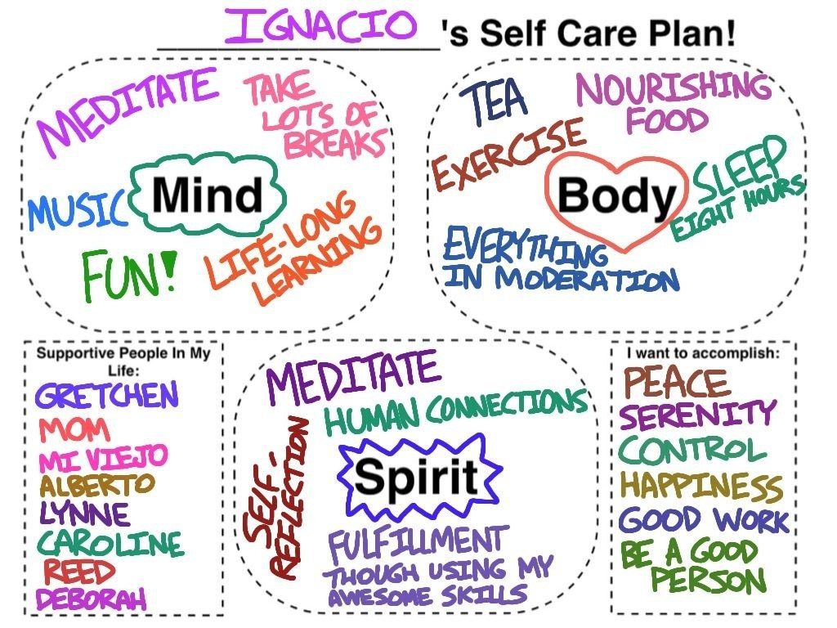
Self Care Plan

Slide 23

Advice to Those Experiencing the ‘Imposter Monster’
“Realize it is a natural visitor in your psyche and learn to control it and also leverage its good points like keeping you on your toes and making sure you strive for better,” Michelle Jones-London, Chief, Office of Programs to Enhance Neuroscience Workforce Diversity, NINDS
“Talk to others – especially someone you trust – tell them about your fears – ask yourself why you feel this way – remind yourself about how much you’ve accomplished. Remember a time when you worried that you were not good enough but discovered that you were much more qualified than what you thought!”, Hannah Valantine, M.D., Chief Officer Scientific Work Force Diversity

Slide 24
It’s not who we are that holds us back.... it’s who we think we are NOT
The biggest barrier to life…our goals…and our dreams is INSIDE OUR OWN HEAD/MIND!

Slide 25
Keep in mind what you need to do to rise to your next level
Instead of keeping your fears at the forefront of your mind…keep your dreams
I challenge you to activate your superpowers and make life your art!

Slide 26
Still Interested in Applying?

Slide 27
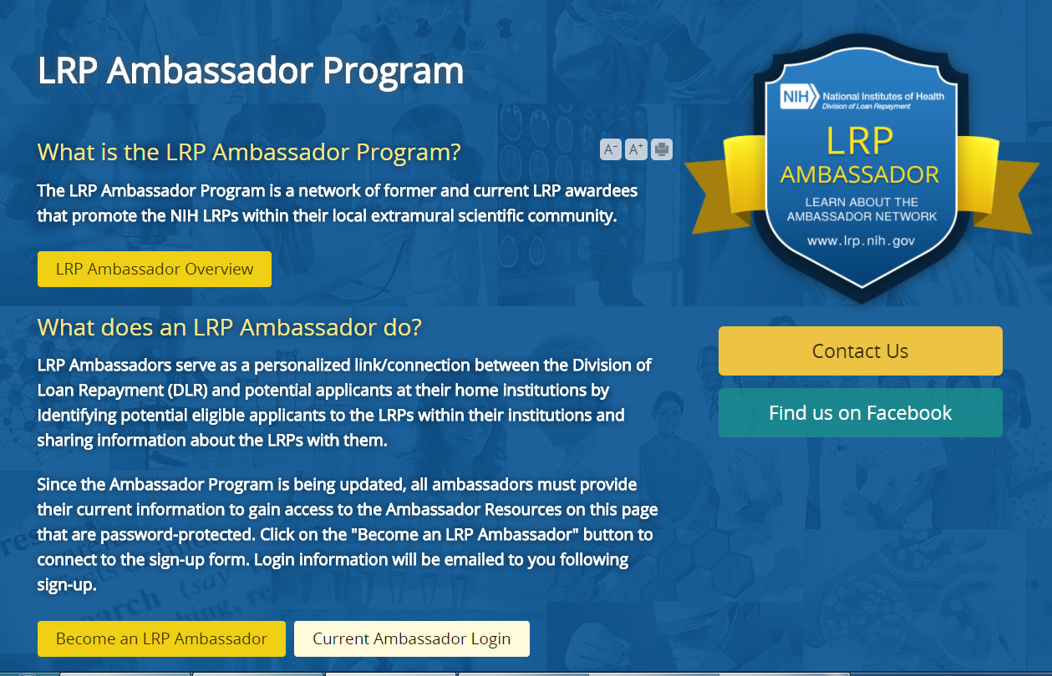
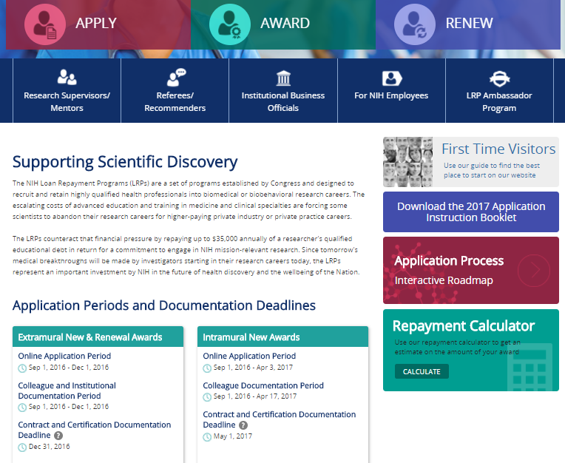
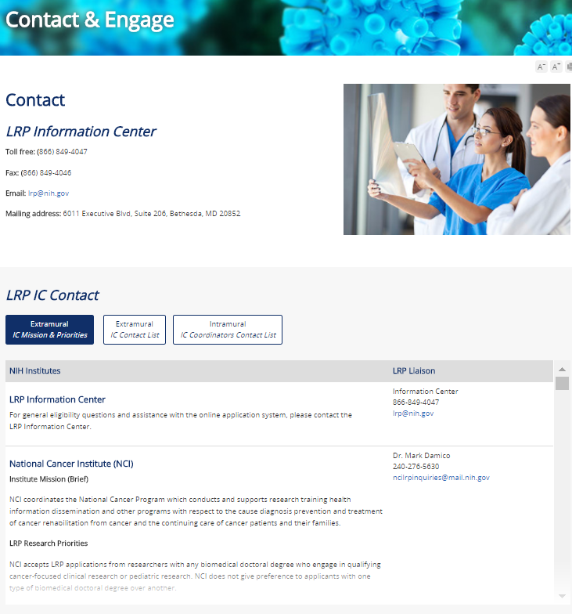
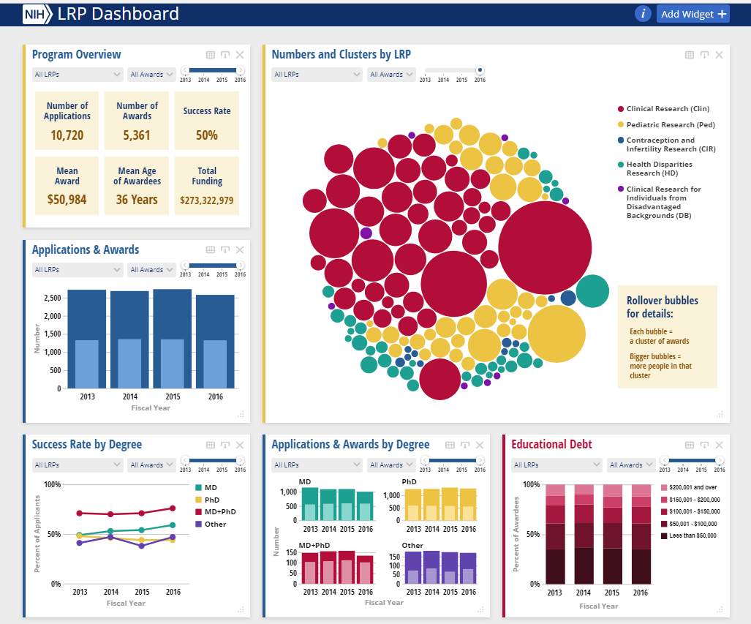
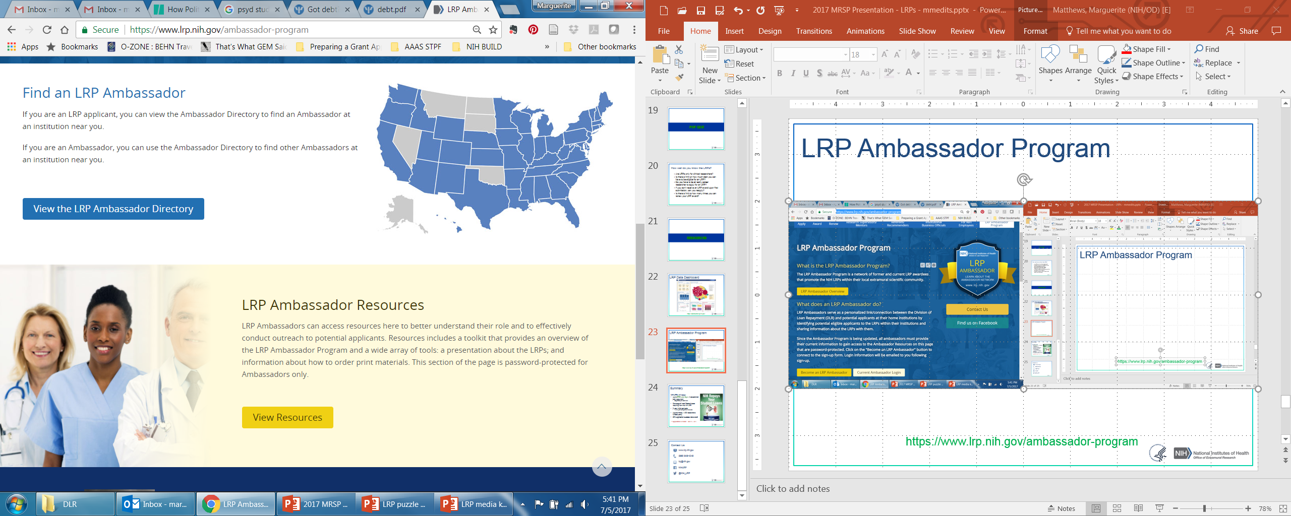
RESOURCES
LRP Data Dashboard
LRP Ambassador Site
Contact
and
Engage
LRP Website
https://lrp.nih.gov/

Slide 28

Summary
NIH LRPs will repay:
Up to $100K over 2 yrs in educational loan repayment
  Depending on debt level
Coverage of most Federal taxes resulting from the NIH LRP
2 year initial contracts
  1 or 2 year competitive renewals
50% application success rate overall
Extramural LRP Application Deadline
Nov 20, 2020

Slide 29





Contact Us
www.lrp.nih.gov
(866) 849-4047
lrp@nih.gov
NIHLRP
@NIH_LRP

