Slide 1
Invention Reporting Under Bayh Dole

Slide 2
Objectives
Learn how to disclose new Inventions to NIH.
Learn the basics of when, where and how inventions are reported to NIH in:
  iEdison
  The RPPR and
  The Final Invention Statement
Learn how to request extensions of time to fulfill specific reporting requirements.
Learn how to protect the government’s interest in NIH funded inventions.
Learn new invention compliance requirements.
Discuss your questions and examples……

Slide 3
Invention Reporting Under Bayh-Dole
Inventions and Invention Disclosures
Scott Cooper

Slide 4
Bayh-Dole, what is it?
The Bayh-Dole Act or Patent and Trademark Law Amendments Act (Pub. L. 96517, December 12, 1980) is United States legislation dealing with inventions arising from federal government-funded research. Sponsored by two senators, Birch Bayh of Indiana and Bob Dole of Kansas, the Act was adopted in 1980, is codified at 94 Stat. 3015, and in 35 U.S.C § 200-212 and is implemented by 37 C.F.R. 401 for federal funding agreements with contractors and 37 C.F.R. 404 for licensing of inventions owned by the federal government.
2018 Bayh-Dole regulations were revised and these changes were implemented by NIH October 1, 2018.

Slide 5
Bayh-Dole Act:
Selected Definitions
Invention:
“Any invention or discovery which is or may be patentable or otherwise protectable under this title or any novel variety of plant which is or may be protectable under the Plant Variety Protection Act (7 U.S.C. 2321 et seq.).”
35 U.S.C. § 201(d)
Subject Invention:
“Any invention of the contractor conceived or first actually reduced to practice in the performance of work under a funding agreement: Provided, that in the case of a variety of plant, the date of determination (as defined in section 41(d) of the Plant Variety Protection Act (7 U.S.C. 2401(d))) must also occur during the period of contract performance.”
(35 U.S.C. § 201(e))

Slide 6
Importance of Reporting Subject Inventions
Identifies NIH inventions that were conceived or first actually reduced to practice in the performance of the NIH funded work.
Inventions are one result of the NIH funded research that the NIH Program Officer and the public are informed of through annual and final reports and the USPTO. Patent applications and issued patents identify NIH supported research and
Technical description and information about subject inventions are provided to the public in research publications citing NIH funding.

Slide 7
Importance of Reporting Subject Inventions
Required by Bayh-Dole and the terms and conditions of NIH’s awards. (Grants Policy Statement 8.2.4)
NIH has contacted grantees concerning their lack of compliance.
Third parties have contacted NIH concerning the lack of compliance of NIH grantees.
  When this happens NIH contacts your president…………

Slide 8
Importance of Reporting Subject Inventions
If inventions and patents are not reported as required, NIH can:
  Take one or more enforcement actions as set forth in the NIH Grants Policy Statement at 8.5.2 or stated in Bayh-Dole.
    Withhold further awards to the investigator/inventor or the funding recipient.
    Suspend or terminate an award or future awards.
    Require the transfer of ownership of the invention and patents to NIH. (BD 37 CFR 401.14 (d)(1))

Slide 9
The Invention Disclosure
(EIR or Extramural Invention Report)
Each Subject Invention must be reported in iEdison.
It must be sufficiently complete in technical detail to convey a clear understanding to the extent known at the time of the disclosure.
If it is created in iEdison and doesn’t meet the “sufficient detail” requirement above, then NIH must reject the disclosure.

Slide 10
What Must Be Reported to NIH using iEdison?
Subject Inventions must be reported to NIH using iEdison within 60 days of disclosure to a technology transfer office or sponsored program office.
What is disclosed to NIH? – Subject Inventions - Any invention conceived or first actually reduced to practice in the performance of the NIH-funded research.
Exceptions:
  Inventions made with exclusively with scholarship, fellowship, or training funding awards that are primarily for educational purposes should not be reported.
  Examples of NIH funding awards primarily for educational purposes: “F”, Some “G”, and some “T” awards.

Slide 11

Recommended Coversheet for Invention Disclosure
Not required (But pretty darn helpful!)
Today’s Date:
Institute’s Docket No.:
EIR#: xxxxxxx-
Date Invention Reported to Institution
Invention Title:
Grant(s) Used:
Award Date(s):
Inventors:
Date/Location of First Publication (bar date):
For NIH: For each subject invention(s) made after 10/1/2018. For grants and for new contract date after May 18, 2018. New rules apply to new EIRs only. Current rules remain for EIRs disclosed under old rules.

Slide 12
How to Report a Subject Invention in iEdison
From the iEdison main menu, select the link to Create Invention Report.
After creating the Invention Report, select Submit.
Create the report, select Submit, then the Create New Invention Report confirmation screen is displayed, a permanent invention report number (i.e., EIR number) is assigned.
  OR, you can use your own invention docket number in place of using the EIR number.
You may upload the disclosure document as part of the Create New Invention Report process.
  Whether you upload the document before or after creating the Invention Report, before you upload the document ensure either the EIR or Invention Docket number is noted clearly on the document.
After creating the new Invention Report, note the new EIR (and Invention Docket Numbers if applicable) from the confirmation screen.

Slide 13
Common Reasons for EIR Rejection
If the Invention Disclosure describes what the Inventors hope to prove and not “the nature, purpose, operation, and the physical, chemical, biological or electrical characteristics of the invention.”
  Did the description come from a grant application?
  Invention disclosure should describe what the invention is, not what the invention will be if funded.
Not ALL awards were included in iEdison, add awards from other institutions if the invention is co-owned.
Not ALL awards were included in the disclosure.

Slide 14
Common Reasons for EIR Rejection (continued)
Award numbers are incorrect, e.g., missing numbers, numbers transposed, numbers entered incorrectly.
Title in the invention report does not match the title in the document.
Not ALL inventors are included.
Inventors’ names do not match.

Slide 15
Common Reasons for EIR Rejection (continued)
Date of First Publication, Sale, or Public Use field, if applicable, is not populated.
  Disclosure references a publication and the date of first publication, on sale, or public use field is not populated;
  Disclosure includes a publication and a publication date and the field is not populated;
  Disclosure includes a manuscript that has no publication date and does not indicate “Not Published” on the cover page of the manuscript; or
  Publication includes authors who are not inventors but not noted as such on the publication.

Slide 16
Resolving iEdison EIR Non-Compliance Messages
Notification Message Number | How to Address
#100 - Title to this invention must be timely elected. (e.g. 37CFR Section 401.14(c)(2)). | To clear: Update the invention status within the invention record. You can reference the invention reporting timeline requirements on the iEdison FAQ page: https://era.nih.gov/iedison/invention_timeline.htm
#120 - No written description of this invention (Disclosure) has been uploaded into iEdison. (e.g. 37 CFR Section 401.14(c)(1)). | To clear: Upload an invention disclosure into the invention record, under “Invention Disclosure File Location.” You can locate the invention disclosure requirements on the iEdison FAQ page section VIII: https://era.nih.gov/iedison/iedison_faqs.cfm#VIII1
#130 - The invention Disclosure submitted is not accepted. See the “Invention Disclosure Reject Comment” on the invention report screen. | To clear: Review the invention disclosure reject comments. You can locate the invention disclosure requirements on the iEdison FAQ page section VIII: https://era.nih.gov/iedison/iedison_faqs.cfm#VIII1 Please note: Please make sure to select the “submit” button twice at the bottom of the invention record screen, in order to save any changes made to the invention record.
#160 - Based on the "Date of First Publication, Sale, or Public Use" provided in the invention record, invention rights will be barred on the due date. Filing of a patent application will extend the protection of the rights. | To clear: Create a patent record and report a patent application. If you do not, the invention status will be set to “barred” one year after the “Date of First Publication, Sale, or Public Use" has been entered. You can reference to the Definitions section on the iEdison FAQ page Section III, for more information on the “Date of First Publication, Sale, or Public Use.“ https://era.nih.gov/iedison/iedison_faqs.cfm#III5

Slide 17
Invention Reporting Under Bayh Dole
RPPR and HHS 568
Carolyn Mosby

Slide 18
Research Performance Progress Report (RPPR)
Inventions are listed in Section C “Products” of the annual RPPR.
All inventions are reported in iEdison.
Due Dates of RPPR:
  Streamline Noncompeting Award Process (SNAP) Awards: due 45 days before start date of next budget period.
  Non-SNAP Awards: due 60 days before start date of next budget period.
  Multi-year: due on or before the anniversary date.

Slide 19
HHS 568 Report
HHS 568: Final Invention Statement and Certification for Grant or Award.
Reported by grant at the time of grant closeout.
Due: 120 days following the end of the project period.

Slide 20
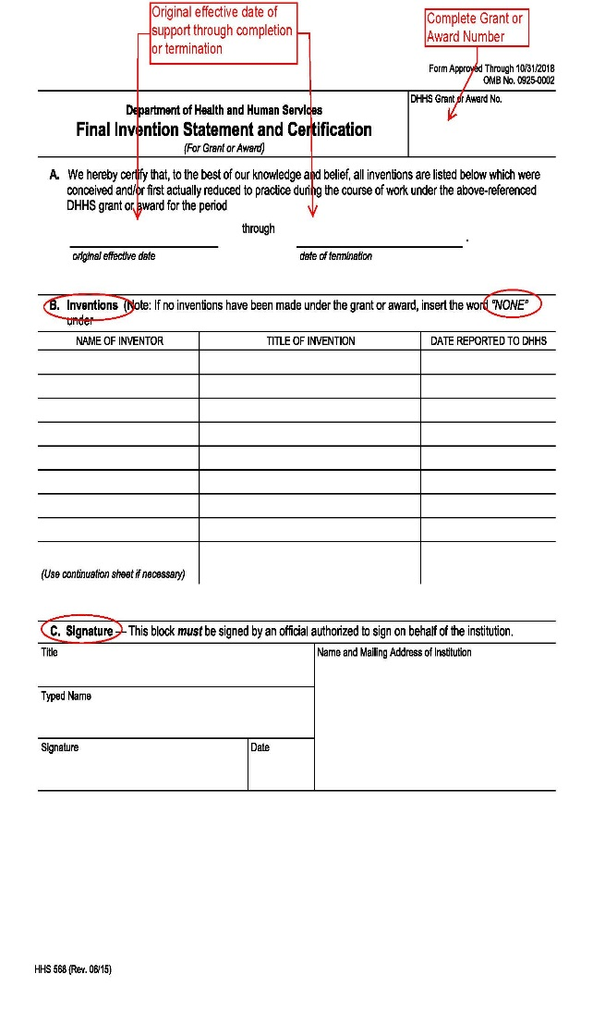
Completing the Final Invention Statement (FIS) (HHS-568)
Invention reporting NOT Patents.
The entire grant or award number must appear in the designated box on the form;
Original effective date of support through the date of completion or termination of the Award;
The “Date Reported to DHHS” should reflect the date the invention was reported in iEdison;
If no inventions were involved, insert the word “None” in the first block under item “Title of Invention”;
Each Statement requires the signature of an institution official authorized to sign on behalf of the institution.

Slide 21
NIH Verification of FIS
Ensure the grant number is complete and accurate, NIH searches iEdison for disclosed inventions using the Award Number. e.g. CA123456
For inventions that are generated as a result of the Award search, NIH determines if the title, grant number and Investigators listed on the HHS-568 match what has been reported in iEdison (can be accepted).
For Inventions that are NOT shown on either the HHS-568 or in iEdison, NIH communicates the findings to the Awardee Institution’s invention reporting office with a 30-day reminder.
Failure to report inventions may result in the risk of losing title to the invention or other actions.

Slide 22


Extension Request
Carolyn Mosby

Slide 23
Types of Extension Requests
File an Invention Disclosure
Elect Title to a Subject Invention
File an Initial Patent Application
2018 Bayh-Dole - File a Non-Provisional Patent Application AFTER filing a Provisional

Slide 24
Request for an Extension of Time to File an Invention Disclosure (37 CFR 401.14(c)(3) & (4))
Specify the request in an email to Edison@nih.gov in advance of the 60 day reporting deadline.
Include in the request an explanation of the reasons why an extension of time is needed to file an invention disclosure.
Include in the request the name of the organization requesting an extension and indicate in the subject line “Invention Disclosure Extension Request.”
The NIH will review the request for an extension of time to file an invention disclosure and reply by email to the requestor.

Slide 25
Request for an Extension of Time to Elect Title to a Subject Invention Disclosure
Election of title must be made BEFORE submission/reporting of filed patent applications.
Choose from the dropdown box in the “Request Title Extension Years” field either “1” or “2” additional years.
Attach your request for an extension of time to the iEdison invention record in the “Other Document” section.
  Provide details as to why an extension is needed.
  Identify the document being uploaded as “Extension of Time to Elect Title Request.”
  Only this document title can be used for submission.
  Then click “Submit” at bottom of the invention page.

Slide 26
Request for an Extension of Time to Elect Title to a Subject Invention Disclosure (continued)
If the title of the document that is submitted is “Extension of Time to Elect Title Request”:
  Submission will trigger a notice to NIH.
  NIH will review the extension request.
If the title to the document submitted is NOT “Extension of Time to Elect Title Request:
  Submission will NOT trigger NIH.
  NIH will NOT review the extension request.
Following NIH’s review, the invention record will reflect whether the request was approved and/or provide an explanation if the request was not approved.

Slide 27
Request for an Extension of Time to File an Initial Patent Application
Choose “Yes” in the “Request One Year Extension to File Initial Patent Application.”
Attach your “request for an extension of time” document to the iEdison invention record in the “Other Document” section.
  Provide details as to why an extension is needed.
  Identify the document being uploaded as “Extension of Time to File an Initial Patent Application.”
  Only this document title can be used for.
  Click “Submit” at bottom of the invention page.

Slide 28
Request for an Extension of Time to File an Initial Patent Application (continued)
If the title of the document that is submitted is “Extension of Time to File an Initial Patent Application”:
  Submission will trigger a notice to NIH.
  NIH will review the extension request.
If the title to the document submitted is NOT “Extension of Time to File an Initial Patent Application”:
  Submission will NOT trigger a notice to NIH.
  NIH will NOT review the extension request.
Following NIH’s review, the invention record will reflect whether the request was approved and/or provide an explanation if the request was not approved.

Slide 29
Changes in Bayh-Dole to Request Extensions of Time (37 CFR 401.14(c)(5)) Non-Provisional Application
NIH Grants – October 1, 2018
The contractor MUST submit an email to Edison@nih.gov to request an extension for filing a non-provisional application after filing a provisional application, a one-year extension will automatically be granted unless the Federal Agency notifies the contractor within 60 days of receiving the request.
Remember to Elect Title when filing an initial patent application in order to receive the extension.

Slide 30
Changes in Bayh-Dole to Request Extensions of Time (37 CFR 401.14(c)(5)) Non-Provisional Application
NIH Grants – October 1, 2018
Although the extension is automatic, please send an email via Edison@nih.gov with the following statement:
    Provisional patent application is recorded in iEdison – Request one-year extension.
  NIH will respond: “2018 Bayh-Dole Extension Granted”
  One-Year extension is from the date the provisional expires
  Can be requested at any time BEFORE 10 months of filing provisional

Slide 31
Resolving a Statutory Bar
Carolyn Mosby

Slide 32
Statutory Bar
The Date of First Publication, on Sale, or Public Use of the Invention must be filled in when any of the following occur:
  The subject invention, or any enabling portion thereof, is Published; or
  The subject invention is placed on Sale (offered for sale); or
  The subject invention is Used Publicly (no non-disclosure agreement in place that is signed by all who have access).

Slide 33
Statutory Bar (continued)
46
The Status of the Invention will change to BARRED ONE YEAR from the publication, on sale or public use date if:
  There is no patent application reported for the EIR within 1 year of the publication, used publicly, or the on-sale date.
The associated patent application filing date MUST be within one year of the publication, used publicly, or the on-sale date.
To clear this status, a patent record, filed prior to the statutory bar date, would need to be created. The patent record can be created with the Invention Status as BARRED, once created the invention status will automatically update.
  The patent application may be of any type, e.g., Provisional, Non-Provisional, PCT, or Issued.

Slide 34
Government Support Clause
Carolyn Mosby

Slide 35
What is a Government Support Clause?
(GSC)
GOVERNMENT SUPPORT CLAUSE: is a statement acknowledging federal support of a subject invention that MUST be included in the specification of a U.S. patent application or a U.S. issued patent (35 USC 202(c)(6)): References 37 CFR Sec. 401.14(f)(4), applicable NIH Grants Policy Statement.
Government Support Clause Statement:
“This invention was made with government support under (identify the contract or grant) awarded by the National Institutes of Health. The government has certain rights in the invention.”

Slide 36
GSC Statement for Discussion
Government Support Clause statement did not meet the requirements of the Bayh-Dole Act 37 CFR 401.14(f)(4).
  This invention was made in part with government support under contract number AA054321 awarded by NIH. The government may have certain rights in the invention.
Grant (s) were missing numbers, most commonly a leading zero. AA54321, AA05421
Grant number(s) does not match – 0D012345, OD012345 or A1987654, AI987654
Under the awarded agency, grantees list the institution rather than the agency itself. Example: NCI rather than NIH. The federal awarding agency must be listed.
  This invention was made with government support under contract number AA054321 awarded by NCI. The government has certain rights in the invention.

Slide 37
NIH Process for Accepting a GSC
To satisfy the Government Support Clause requirements, the Government Support Clause must be uploaded within the full Patent application along with the USPTO Filing receipt.
For provisional and PCT patent applications, a USPTO cover sheet that references the provisional or PCT application number will be acceptable.
EPAS requirements: grantees must upload the notice of recordation received from the USPTO for filing in EPAS, the GSC fillable form that was provided by the agency, and a notice of abandonment for which the application abandoned. A screenshot showing the application abandoned or issued patent expired from the USPTO or Google Patents will also suffice.

Slide 38
Utilizing EPAS for GSC’s
What is EPAS?
EPAS (Electronic Patent Assignment System) allows grantees to correct a government support clause statement free of charge to their organization/institution.
When can EPAS Be Used?
  EPAS can be used for previously waived records, abandoned non provisional patent applications, and expired issued patents. EPAS does not apply to provisional and PCT patent applications.
Who can use EPAS and where can I get all the documents necessary to file in EPAS?
  Currently, EPAS can be applied to records where NIH is the primary awarding agency

Slide 39
Changes in Bayh-Dole for Reporting Government Support Clauses
NIH Grants October 1, 2018
How does this affect the reporting process for a government support clause?
  A government support clause will be required for provisional patent applications.
What happens if the government support clause is missing or incorrect in the provisional patent application?
  Provisional patent applications cannot be amended, therefore if patent prosecution will continue, the GSC will need to be corrected in the next patent application (Non provisional/PCT).
If patent prosecution will not be further pursued due to abandonment or a waiver, you will need submit a request to edison@od.nih.gov for additional assistance.

Slide 40
Resolving iEdison GSC Non-Compliance Messages
# 220 - A Government Support Clause is missing for a non-provisional patent filing in this record. | In order to clear notification 220, you will need to upload the Government Support Clause within the full patent application along with the USPTO Filing receipt into the “Government Support Clause File” of the patent record. You can locate the government support clause requirements on the iEdison FAQ page section IX: https://era.nih.gov/iedison/iedison_faqs.cfm#IX
# 221 - A Government Support Clause is missing for an issued patent in this record. | In order to clear notification 220, you will need to upload the Government Support Clause within the full patent application along with the USPTO Filing receipt into the “Government Support Clause File” of the patent record for the issued patent. You can locate the government support clause requirements on the iEdison FAQ page section IX: https://era.nih.gov/iedison/iedison_faqs.cfm#IX
# 233 - A Government Support Clause is not accepted. See the “Government Support Clause Reject Comment” in the patent report screen. 37 CFR 401.14(f)(4). | In order to clear notification 233, please go the patent record and review the government support clause reject comments. You can locate the government support clause requirements on the iEdison FAQ page section IX: https://era.nih.gov/iedison/iedison_faqs.cfm#IX

Slide 41
Creating a Confirmatory License
Carolyn Mosby

Slide 42
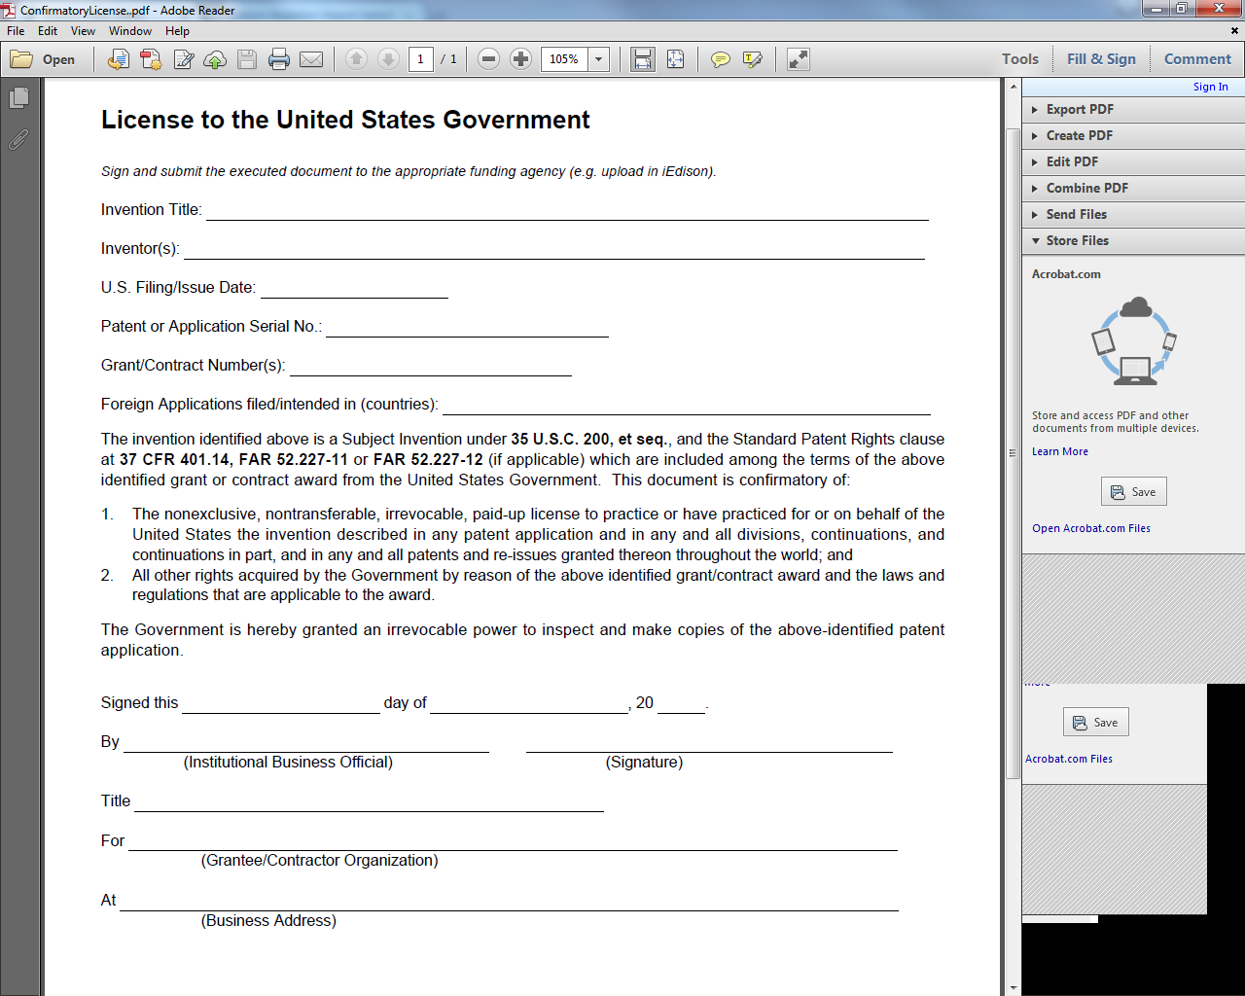
What is a Confirmatory License (CL)
The CL is used to notify the public of the granting to the government nonexclusive, nontransferable, irrevocable, paid-up license for the U.S government to practice, or have the invention practiced, on its behalf throughout the world. 37 CFR 401.14 (b)
If the CL is accepted in iEdison, DEITR will then file the CL with the USPTO through the EPAS system.
E.O. 9424 CL language must be standard license language.

Slide 43
Confirmatory License Requirements
The CL is used to notify the public of the granting to the government nonexclusive, nontransferable, irrevocable, paid-up license for the U.S government to practice, or have the invention practiced, on its behalf throughout the world. 37 CFR 401.14 (b)
If the CL is accepted in iEdison, DEITR will then file the CL with the USPTO through the EPAS system.
  Invention/Patent title needs to at least be a close match to the title listed in either the patent/invention record.
Inventors listed on the CL, must match the inventors listed in the patent record.
NIH Format: Institution Code (IC) followed by a six-digit serial number. All leading zeros must be included.
October 1st 19
Document MUST be signed and dated by the Institutional Business Officer (Someone who has signatory authority on behalf of institution/organization).
Organization name must match to what listed in iEdison, unless other approval was received from DEITR.

Slide 44
Confirmatory License Requirements
Please note: If you have an accepted CL for the earliest patent filing, this will cover all ”child” filings that are listed within the same record.
If ”child” filings are listed in other patent records, this is okay only if a parent/child linkage has been established between the patent records to reflect their relationship.
You can locate the confirmatory license requirements on the iEdison FAQ page XI: https://era.nih.gov/iedison/iedison_faqs.cfm#XI

Slide 45
Resolving iEdison CL Non-Compliance Messages
# 234 - The submitted Confirmatory License is not accepted. See the “Confirmatory License Reject Comment” in the patent report screen. 37 CFR 401.14(b). | In order to clear notification 234, please go to the patent record and review the confirmatory license reject comments. You can locate the confirmatory license requirements on the iEdison FAQ page XI: https://era.nih.gov/iedison/iedison_faqs.cfm#XI
# 240 - A Confirmatory License is missing for a non-provisional patent filing in this record. 37 CFR Section 401.14(b). | In order to clear notification 240, please submit a confirmatory license under the “New Confirmatory License File” within the patent record. You can locate the confirmatory license requirements on the iEdison FAQ page XI: https://era.nih.gov/iedison/iedison_faqs.cfm#XI

Slide 46
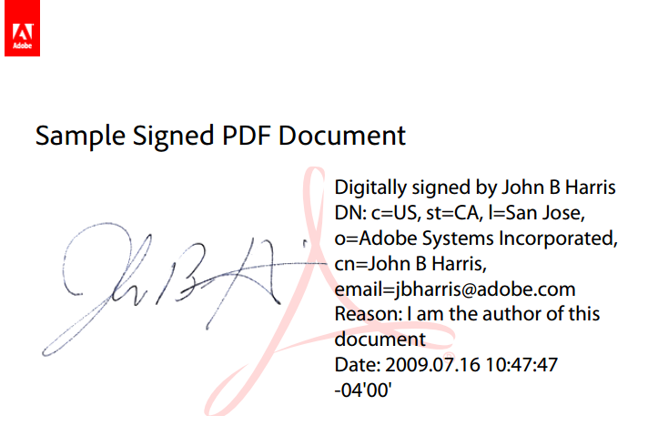
Digital Signatures
  Digital Signatures (authenticated by a signature authority with a certificate) are OK.
  Please do not simply type an individuals’ name in lieu of a signature.
  Digital signatures are
  of this general form and
  are obtained from a
  recognized signature
  authority.
  We believe this is a
  public sample from
  Adobe’s website.
  No requirement for the use of Adobe computer software should be inferred.

Slide 47
Changes in Bayh-Dole for Reporting Confirmatory Licenses
NIH Grants October 1, 2018
How does this affect the reporting process for a confirmatory license?
  A confirmatory license is required for all patent applications: Provisionals, PCTs, Non-Provisionals, Continuations, Divisionals, and Issued Patents.
Note: Currently a notification will not trigger in iEdison requesting a CL to be created/submitted when a Provisional is reported in the patent record.
    You are still responsible for creating/submitting a confirmatory license in iEdison.

Slide 48
Confirmatory License – Common Errors
Title does not match the invention record or the patent record.
Inventors listed on the CL do not match the inventors listed in the patent record.
Grantee provides filing/issue date for a different patent application.
Grantee lists multiple patent applications and issued patents on one CL.
Grantee lists a PCT patent application number in the “foreign applications filed/intended in (countries)” field, instead of the names of the countries.

Slide 49
Confirmatory License – Common Errors
(continued)
Grantee does not include the leading zero (if applicable) in a grant number.
Grantee will change the E.O. 9424 standard language.
The execution date is not legible, Institutional Business Officer is missing, title of Institutional Business Officer is missing, and/or business address is missing.
Grantee may provide department name/research foundation instead of grantee/contractor organization name.
NIH prefers the CL be pre-populated directly from the patent record to avoid these common errors.

