Slide 1
Including Diverse Populations in NIH-funded Clinical Research
Dawn Corbett, MPH
NIH Inclusion Policy Officer
Division of Human Subjects Research, Office of Extramural Research
NIH Virtual Seminar
October 30, 2020

Slide 2

“With the bright light now shining on this important issue, it is time to talk about the role research can play in reducing the disproportionate burden of COVID-19, as well as improving the health of all people in our great nation.”
https://directorsblog.nih.gov/2020/05/14/covid-19-brings-health-disparities-research-to-the-forefront/
SLIDE | 2

Slide 3
Timeline of NIH Inclusion Policies
1986
1993
1998
NIH establishes policy encouraging researchers to include women in studies
PL103-43 requires inclusion of women and minorities in NIH clinical research
NIH issues policy requiring inclusion of children in NIH clinical research
NIH changes definition of child to individuals under 18
2016
21st Century Cures Act includes new requirements for inclusion
2015
2017
2019
NIH requires Phase III trials report results of inclusion analyses in Clinicaltrials.gov
Inclusion Across the Lifespan policy became effective
3
SLIDE | 3
3

Slide 4
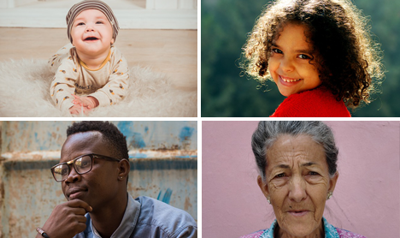
Inclusion of Women and Minorities in NIH Research
  NIH policy requires:
    Women and minorities be included in all NIH-funded clinical research studies unless there is a compelling rationale for exclusion
    NIH-defined phase III clinical trials be designed to permit analysis by sex/gender, race and ethnicity and report results of analyses in Clinicaltrials.gov
    NIH to support outreach efforts to recruit and retain women, minorities, and their subpopulations
SLIDE | 4

Slide 5

Inclusion Across the Lifespan
Effective for applications submitted for due dates on or after January 25, 2019 (and for contract solicitations issued and intramural studies initiated after that date).
  See NOT-OD-18-116
Requires individuals of all ages be included in NIH human subjects research unless there are scientific or ethical reasons not to do so
Requires submission of individual-level data on participant age at enrollment in progress reports
SLIDE | 5

Slide 6
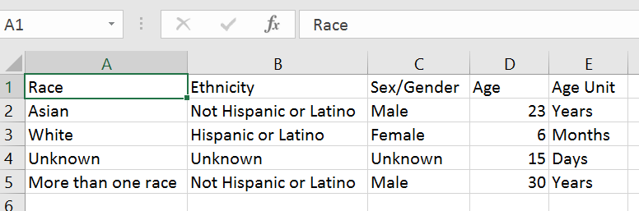
Individual-level Participant Data
SLIDE | 6

Slide 7

Knowledge Check
Cost is an acceptable reason to exclude women from an NIH clinical research study
FALSE

Slide 8

What’s Required When Applying for Funding?
Plans for inclusion of women and minorities
  Plans for analyses by sex/gender, race, and ethnicity for Phase III trials
Inclusion enrollment report
  Data on sex/gender, race, and ethnicity of the sample (planned and/or actual)
Plans for inclusion of individuals across the lifespan
  Age limits (if applicable) and justification

Slide 9
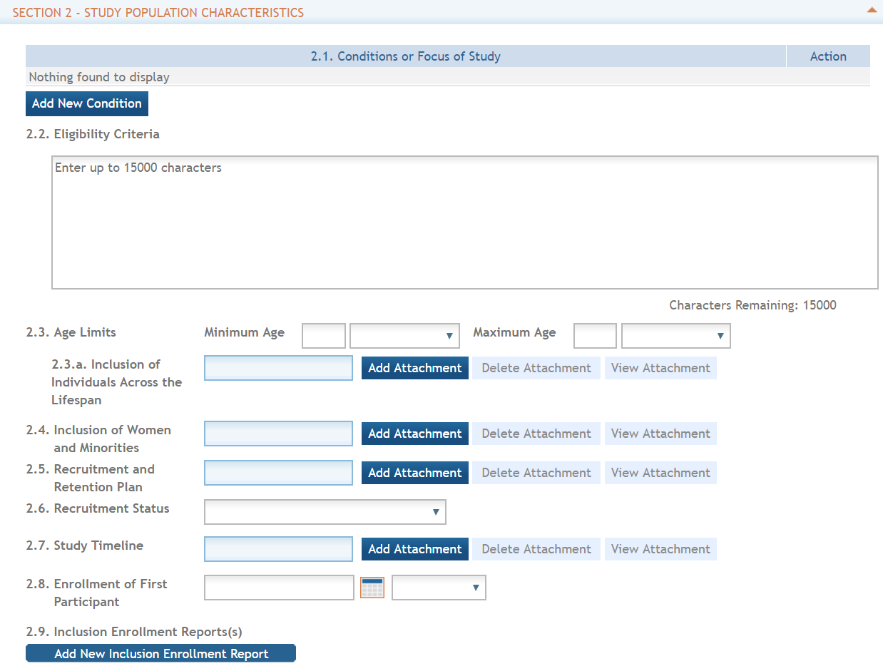
PHS Human Subjects and Clinical Trials Form
See the Application Guide for detailed information
  PHS HS/CT Information Form
  Study Record
    Basic information
    Study Population Characteristics
    Protection and Monitoring Plans
    Protocol Synopsis
    Other Clinical Trial-related Attachments
SLIDE | 9

Slide 10
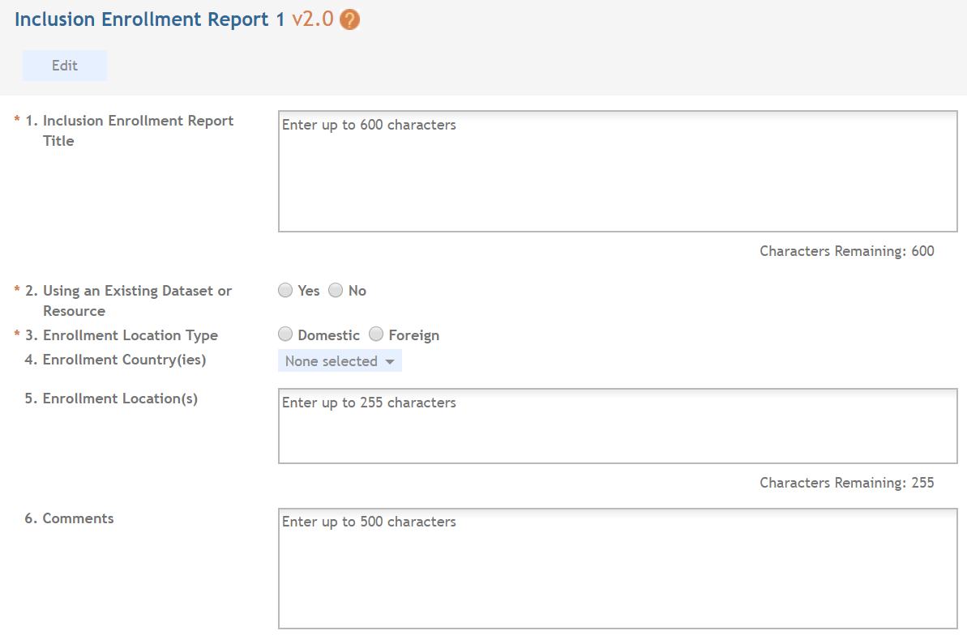
Inclusion Enrollment Report
NEW Inclusion Enrollment Report Title
Specify whether Existing Dataset or Resource will be Used
Include Separate Tables for Domestic/Foreign Populations

Slide 11
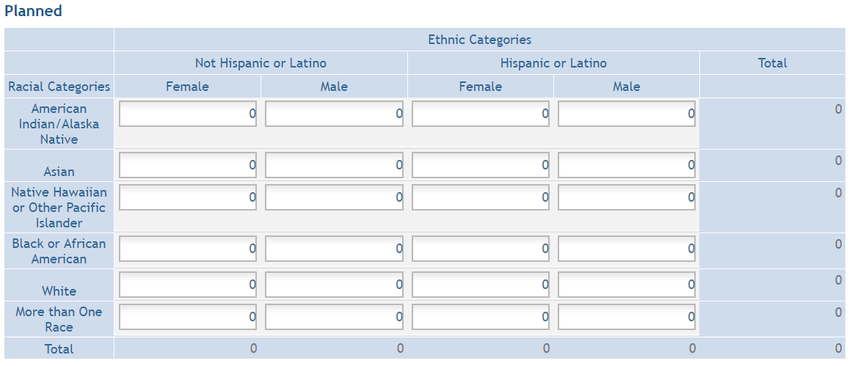
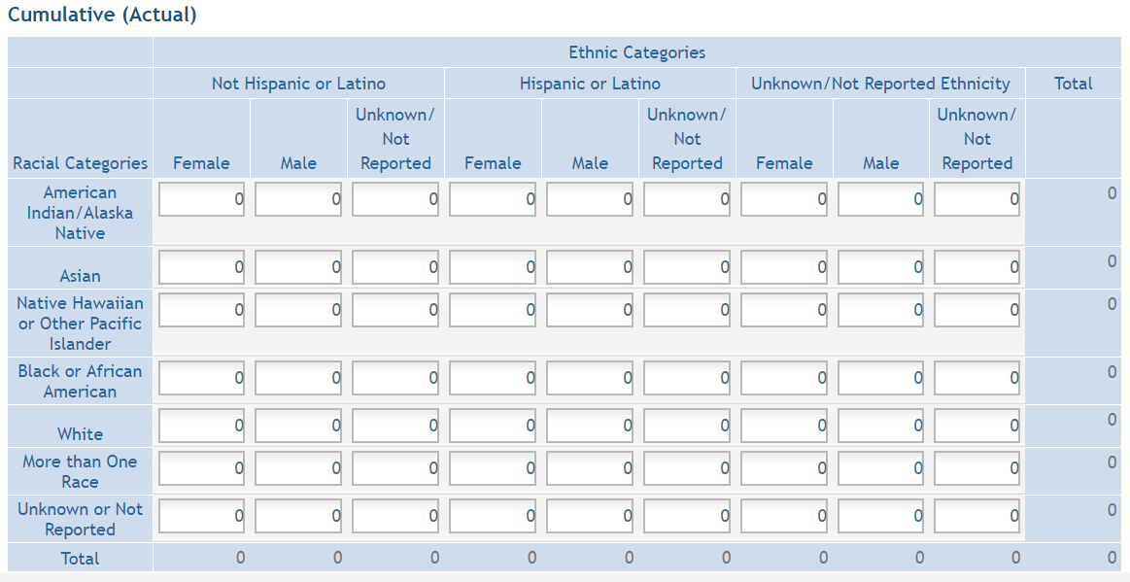
Inclusion Enrollment Reports
Notes:
And, there are separate tables for Planned and Cumulative enrollment data.

Slide 12

Peer Review of Inclusion
SUMMARY STATEMENT
PROGRAM CONTACT: (Privileged Communication) Release Date: 08/11/2020
Jane Doe
240 111-5555
janesmith@od.nih.gov
____________________________________________________________________________________
Application Number: 1 R01 IC12345-01
Principal Investigator
DOE, JOHN
Applicant Organization: ABC SCHOOL OF MEDICINE
Review Group: ZRG1 ABC-D(50)
Center for Scientific Review Special Emphasis Panel
Program for Collaborative Biomedical Research
Meeting Date: 07/20/2020 RFA/PA: IC 20-006
Council: OCT 2020 PCC: M51B B
Requested Start: 12/01/2020
Project Title: An Excellent Research Project
SRG Action: Impact Score: 24
Next Steps: Visit http://grants.nih.gov/grants/next_steps.htm
Human Subjects: 30- Human subjects involved
Animal Subjects: 30-Vertebrate animals involved - no SRG concerns noted
Gender: 1A-Both Genders, scientifically acceptable
Minority: 5A-Only foreign subjects, scientifically acceptable
Age: 3U-No children (only adults and older adults), scientifically unacceptable. Clinical Research - not NIH-defined Phase III Trial
SLIDE | 12
12
Notes:
12

Slide 13
What Makes a Good Inclusion Plan?
Complete
  Includes plans for inclusion of women, minorities, AND individuals across the lifespan and inclusion tables for each study
Scientifically appropriate
  Consider external validity
  Proposed subgroup analyses adequately powered
  Any exclusions are well-justified
    Minimum and maximum age range (enter N/A if none)
    Based on scientific or ethical reasons, NOT convenience alone
Realistic
  Describe collaborations and outreach plans, when appropriate

Slide 14
Inclusion Plans: Points to Consider
Demographics of source population
Inclusion and exclusion on criteria (e.g. comorbidities, literacy, cognitive abilities)
Participant burden (multiple visits, transportation, affordability, childcare, navigation)
Family and community involvement
Language and participant communication
Staff expertise
Evaluation of recruitment and retention strategies
Budget

Slide 15


Case Study #1
A researcher proposes a study to determine the efficacy of a novel treatment for prostate cancer. The study excludes individuals whose sex at birth is female.

Slide 16

Case Study #2
A researcher proposes a study to examine use of a smartphone app to improve glycemic control in diabetic individuals. The study excludes children and older adults due to generational differences in use of technology that may affect the statistical power of the study.
.

Slide 17
Case Study #3
A researcher proposes a study in individuals 18 to 60. The study indicates children are excluded because the legal age to consent to research is 18 in the state where the research will be conducted. Individuals over 60 will be excluded because of the likelihood of co-morbidities in this group.

Slide 18
Just-in-Time Requirements
  Work with Institute/Center staff to resolve unacceptable inclusion concerns
  Provide inclusion enrollment report(s) if missing or needs updated as a result of peer review and/or programmatic adjustments
18

Slide 19
After the Award…Now What?
Provide actual inclusion enrollment data in progress reports
For NIH-defined Phase III Clinical Trials – report status/results of analyses by sex/gender, race, and ethnicity
  For applicable NIH-defined Phase III Clinical Trials, report results by sex/gender and/or race/ethnicity in Clinicaltrials.gov within 1 year of primary completion date
Provide PHS Human Subjects and Clinical Trials Information Form for delayed onset studies

Slide 20
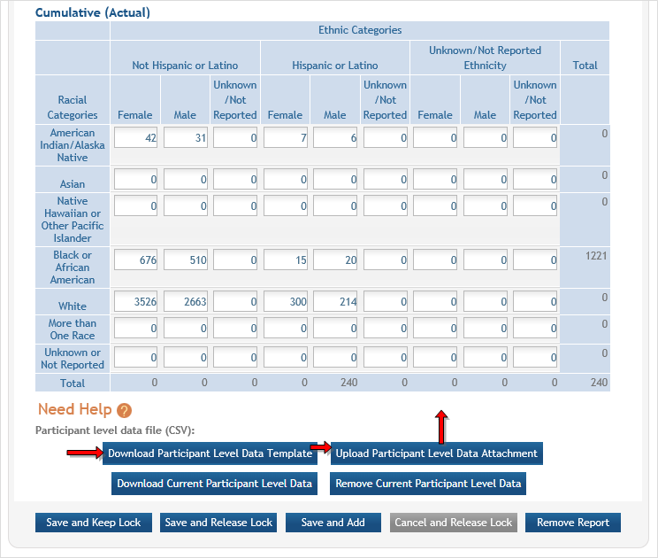
Uploading Participant-Level Data in HSS

Slide 21
Knowledge Check
If funded, NIH recipients will need to provide data on participant race, ethnicity, sex/gender, and date of birth
FALSE

Slide 22
RESOURCES
WEB
Inclusion of Women and Minorities
https://grants.nih.gov/grants/funding/women_min/women_min.htm
Inclusion Across the Lifespan
https://grants.nih.gov/grants/funding/lifespan/lifespan.htm
inclusion@mail.nih.gov
EMAIL

