Slide 1
GRANT WRITING FOR SUCCESS
Michelle R.J. Hamlet, PhD
National Institute of Nursing Research

Slide 2
overview
Start planning early
Apply for the right opportunities
Contact appropriate program staff early
Present ideas clearly
What to do after review

Slide 3
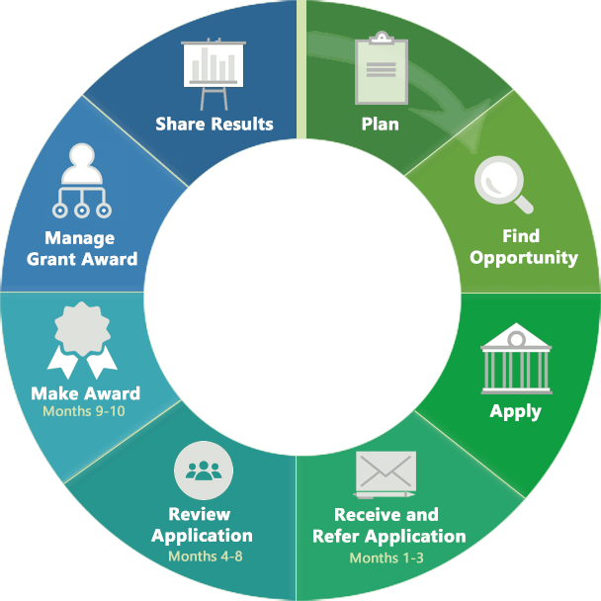
The grant life cycle
Start planning early
From “Plan” to “apply” could take 8+ Months

Slide 4
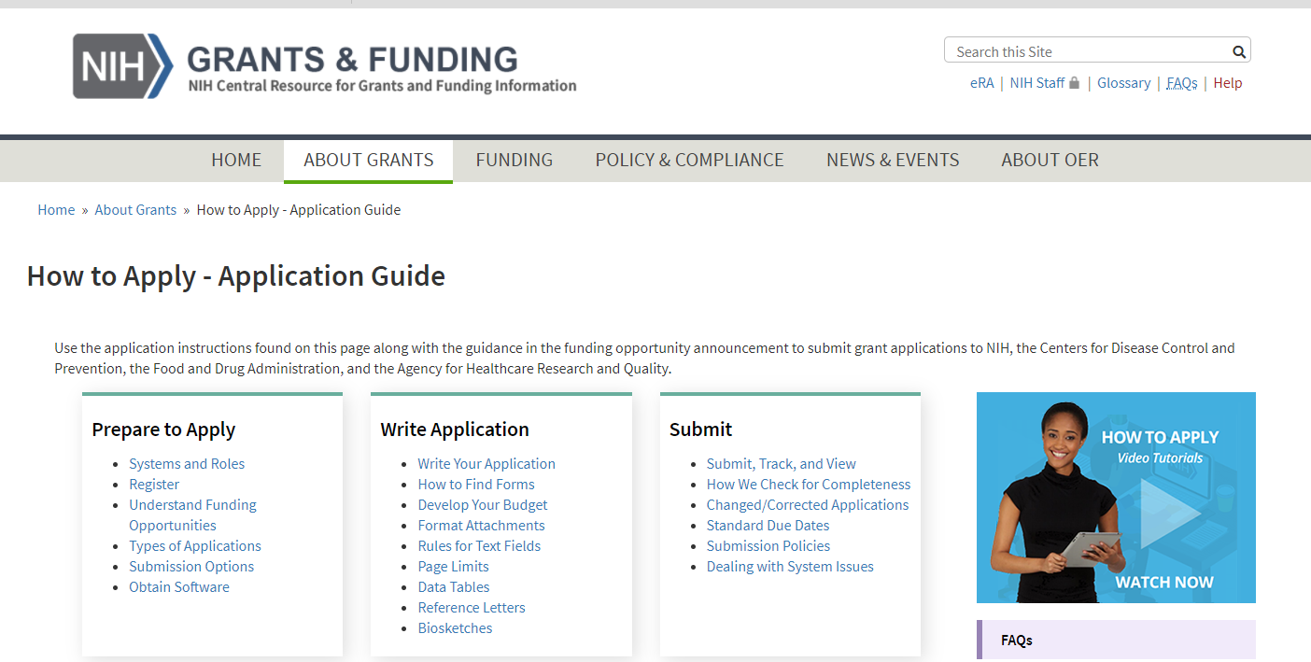
How to Apply – application guide
grants.nih.gov/GRANTS/HOW-TO-APPLY-APPLICATION-GUIDE.HTML

Slide 5
overview
Start planning early
Apply for the right opportunities
Contact appropriate program staff early
Present ideas clearly
What to do after review

Slide 6
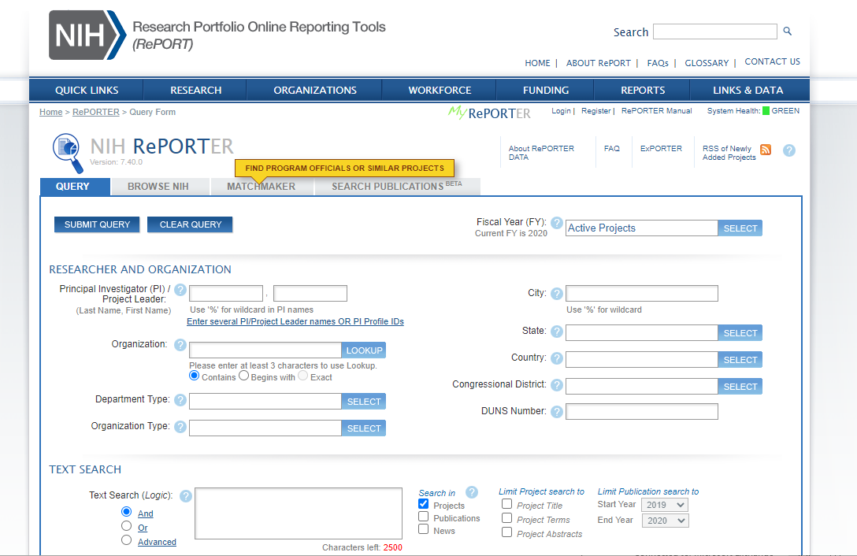
projectreporter.nih.gov
Notes:
Find similar work, institute and study section.

Slide 7
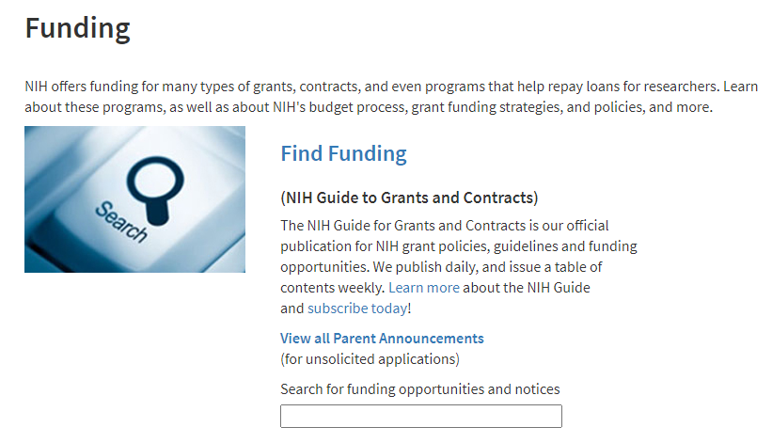
Use the NIH guide to find funding opportunities
RFA—funds set aside, special receipt date, special review panel
PA, PAR, PAS—iterations of the Program Announcement; “R” is for special receipt date or review process; “S” is for set-aside funds
‘Parent’ Announcement—investigator-initiated; activity code-specific (R01, R03, R15, R21)
Grants (NIH guide to grants and contracts)
Published daily
Weekly table of contents
Subscribe to email list
Grants.nih.gov/funding

Slide 8
Early stage investigator (ESI) or new investigator (NI)
Designation matters for R01 applications
ESI—never awarded an R01; earned terminal degree within 10 years of receiving R01 award
NI—never awarded R01 award
ESI/NI applications clustered and reviewed together
Institutes consider investigator status for funding decisions

Slide 9
overview
Start planning early
Apply for the right opportunities
Contact appropriate program staff early
Present ideas clearly
What to do after review

Slide 10

What do program officers do?
Manage grants, contracts, and cooperative agreements
Identify needs in scientific areas
Report on scientific progress and program accomplishments
Have many names: Program Director, Chief, Health Scientist Administrator, Program Official

Slide 11
What to discuss with program officer?
Your idea—e.g., provide specific aims page
Fit—is idea fit for Institute or Center (IC)
Priority—is idea a research priority for IC
Funding Opportunity Announcements (FOAs)
Funding mechanisms the IC supports

Slide 12
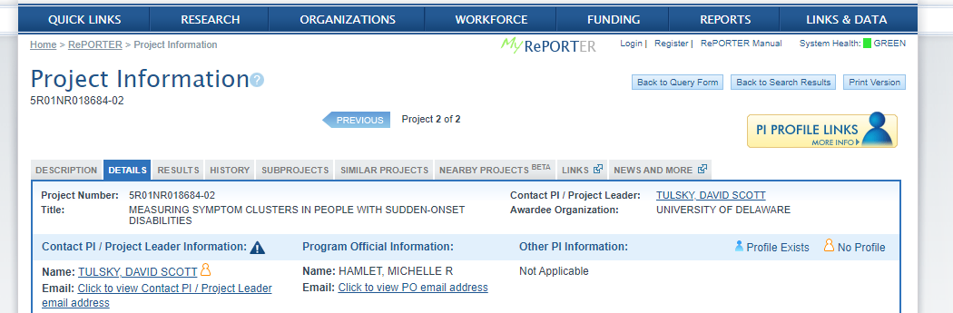
Identify program officers in NIH reporter

Slide 13
overview
Start planning early
Apply for the right opportunities
Contact appropriate program staff early
Present ideas clearly
What to do after review

Slide 14
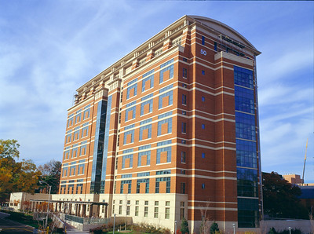
General grant-writing tips
Read instructions for application form
Be realistic … not overly ambitious
Discuss potential problem areas and possible solutions
Be explicit
  Reviewers cannot read your mind!
  Don’t expect reviewers to read between the lines!
  Don’t assume they know what you intend!
Notes:
14
14

Slide 15
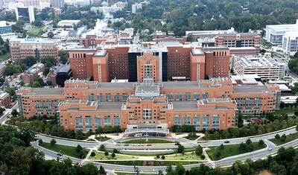
Align application with review criteria
  Core Review Criteria
    Significance
    Investigator
    Innovation
    Approach
    Environment

Slide 16
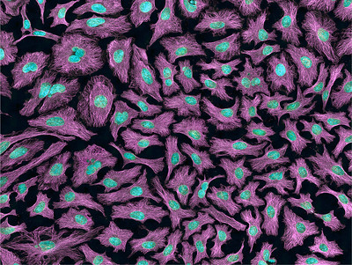
What is the overall impact of an application?
Two questions drive reviewer determination about the likelihood that the proposed studies will have a strong and sustained impact on the scientific field
  Should they do it?
  Can they do it?
Credit: Tom Deerinck, NIGMS-funded

Slide 17
Develop a strong research plan
Specific Aims
Grabs the reader immediately
Is roadmap for your application
Begin with an overall section
  State general purpose
  Include some key supporting data
  State the hypothesis
  State long-term objectives and expected impact
Organize the aims in a sequential, numeric format
Tell reviewers what the results will mean!

Slide 18
Develop a strong research plan
Significance
Answers the “so what” question
Shows overall understanding of the field
Demonstrates that questions are novel, important, and represent a logical next step in research
Highlights critical gaps that will be addressed by the proposed research

Slide 19
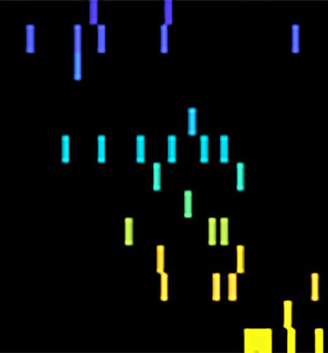
Develop a strong research plan
Innovation
Shows that proposed research is new and unique
Either by:
  Showing how research refines, improves, or proposes a new application of an existing concept or method, or
  Showing how the research would shift a current paradigm
    Make a very strong case
Notes:
Photo credit, NINDS

Slide 20
Develop a strong research plan
Approach:
Preliminary Studies
Strengthen your application
Show availability of key resources, familiarity with proposed methods and approach to interpreting results
Show that work is promising, feasible, has potential impact
Can be qualitative, quantitative and/or come from collaborator

Slide 21
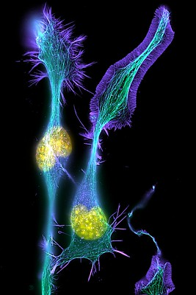
Develop a strong research plan
Approach
Does your plan flow logically from the literature review and prior studies?
How will each hypothesis be tested?
Do your measures capture the variables needed to test hypotheses?
Why did you choose those measures?
Methods and analyses must match.
Consider organizing each aim the same way, including the:
  Rationale
  Experimental approach
  Anticipated results
  Alternative approaches/pitfalls
Credit: Torsten Wittmann, University of California, San Francisco
https://www.nigms.nih.gov/education/life-magnified/Pages/11B_developing_nerve_cells.aspx

Slide 22
Develop a strong research plan
Approach-
Clinical Studies
For clinical studies, include information in the Research Strategy section about:
  Overall strategy
  Methodology
  Analyses
Detailed study information belongs in the Human Subjects and Clinical Trials Information form

Slide 23
Hallmarks of an outstanding grant application
Strong significance, important problem in public health: IMPACT is high
High degree of novelty and innovation
Strong track record of a well-qualified applicant; compelling publications
Clear rationale
Relevant, supportive preliminary data
Clear and focused approach that provides unambiguous results
Careful attention to details
  Spelling, punctuation, grammar, fonts, clarity of data, error bars, spelling, etc.

Slide 24
Common reasons cited for a weak application
Weak impact – avoid ‘descriptive’ or ‘incremental’ projects
Too ambitious, lacking focus, too many unrelated aims, aim dependency
Unclear hypothesis or rationale
Applicant lacks appropriate expertise
No evidence of feasibility (do not assume reviewers are as familiar with the subject as you are)
Approach flawed and no discussion of pitfalls and alternative approaches
Poor writing and lots of errors; small figures and densely packed text

Slide 25
overview
Start planning early
Apply for the right opportunities
Contact appropriate program staff early
Seek advice broadly—peers, mentors, colleagues
Present ideas clearly; pay attention to review criteria
What to do after review

Slide 26
After the review
Read and re-read the summary statement
Contact your program officer and be prepared to discuss:
  Reviewer comments from summary statement
  Scores and percentiles
  Funding prospects
  Resubmission and other options

Slide 27
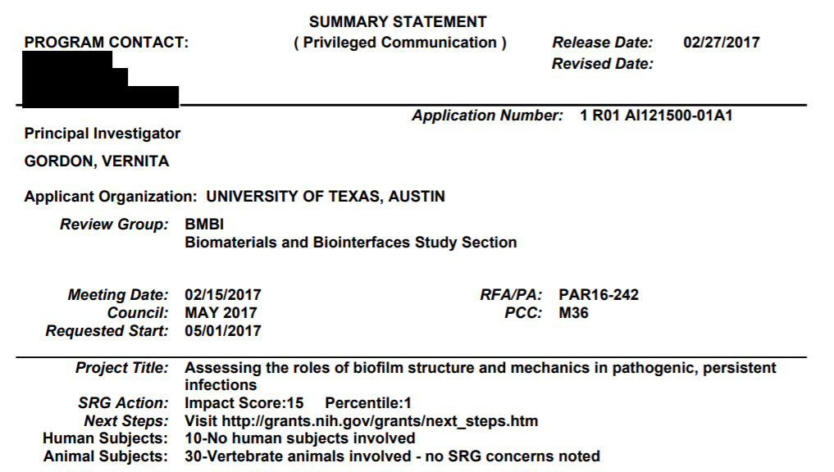
Summary statement
https://www.niaid.nih.gov/sites/default/files/1-R01-AI121500-01A1_Gordon_Summary-Statement.pdf
Notes:
Each reviewer give their overall impact and scores for the 5 criteria with strengths and weaknesses

Slide 28
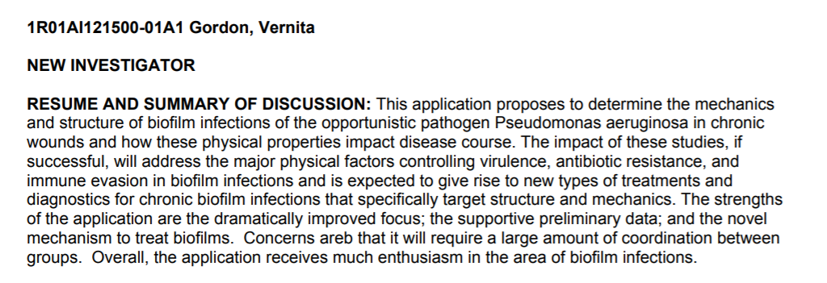
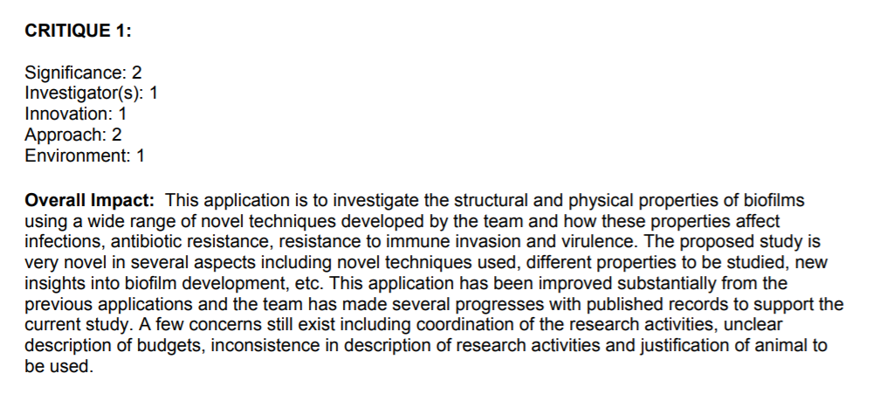
Summary Statement
Written by the Scientific Review Officer based on outcome of discussion, summarizes strengths & weaknesses, highlights areas of concurrence & disagreement between reviewers
Written by the individual reviewer to summarize his/her opinion on the overall strengths and weaknesses of the application
These scores are indices only. They have
no mathematical relationship to the priority score.
Notes:
Each reviewer give their overall impact and scores for the 5 criteria with strengths and weaknesses

Slide 29
Consider the criteria scores carefully
The written comments and summary of discussion will tell a more complete story
However, pay special attention to Significance and Approach
  Low significance, no matter what the other scores are, might be hard to fix
  High significance but weak approach may be fixable

Slide 30
If not funded, try again!
You are in good company
Know your options
Get advice, regroup
Contact your Program Officer

Slide 31
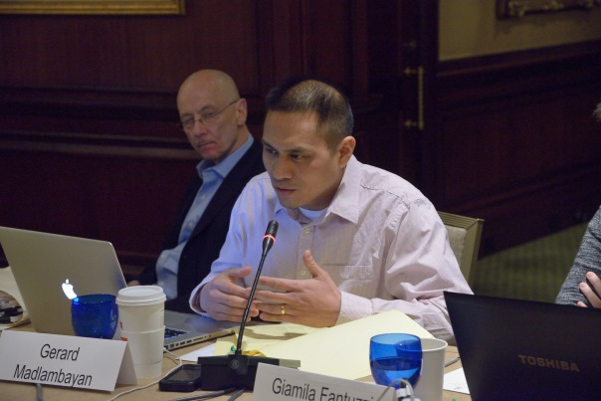


Gain review experience:
Early Career Reviewer Program
Train and educate qualified scientists to become critical and well-trained reviewers
Expose investigators to the peer review experience to help make them more competitive as applicants
www.csr.nih.gov/ECR

Slide 32
Revising and resubmitting
Opportunity to improve the application
Acknowledge and accept the help of reviewers
Write clear introduction section
Address criticisms thoroughly
Respond constructively and respectfully

Slide 33

Questions?
This Photo by Unknown Author is licensed under CC BY-NC-ND

