Slide 1

Small Business Programs and Policies
Stephanie Fertig, MBA
HHS Small Business Program Lead
Robert Vinson
Small Business Program Manager
SEED (Small business Education & Entrepreneurial Development)
Office of the Director | Office of Extramural Research |National Institutes of Health

Slide 2
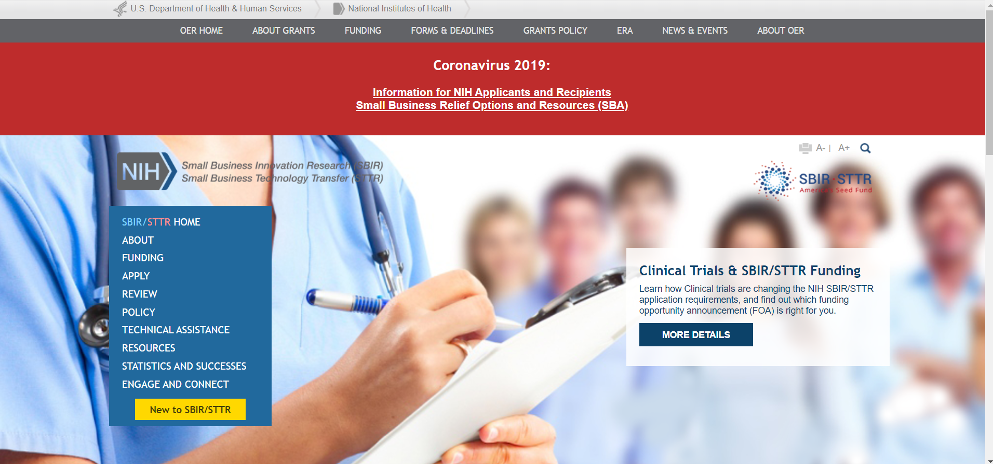
NIH SBIR/STTR Website
https://sbir.nih.gov
Notes:
Cover a number of different topics today but more information, including frequently asked questions and contact information, can be found on our website.

Slide 3





NIH Mission
To seek fundamental knowledge about the nature and behavior of living systems and the application of that knowledge to enhance health, lengthen life, and reduce illness and disability.
The Small Business Program helps NIH accelerate discoveries from bench to bedside
Notes:
Small business program helps NIH meet its mission by helping innovations get to the marketplace and into the hands of clinicians, patients, caregivers and researchers

Slide 4
Congressionally Mandated Programs
$1.2 Billion Dedicated Funding via Set-aside from NIH’s R&D Budget
SMALL BUSINESS INNOVATION
RESEARCH (SBIR) PROGRAM
Set-aside program for small business concerns to engage in federal R&D -- with potential for commercialization
SMALL BUSINESS TECHNOLOGY
TRANSFER (STTR) PROGRAM
Set-aside program to facilitate cooperative R&D between small business concerns and US research institutions -- with potential for commercialization
3.2%
$1 billion
0.45%
$146 million
Notes:
1.2 B that we are congressionally mandated to support small businesses

Slide 5
NIH SBIR/STTR Budget Allocations FY2020
3.2% SBIR $1 billion
0.45% STTR $146 million
Total FY20 $1.2 billion
Notes:
NIH supports innovations in a wide variety of disease areas and topics- from therapeutics to diagnostics to research tools
Multiple Institutes/Centers and each uses the program to meet their specific mission- important to contact us in advance of application
A larger budget does not equal a greater chance of success- some of the smaller institutes have higher funding rates and are looking for good SBIR/STTR applications

Slide 6
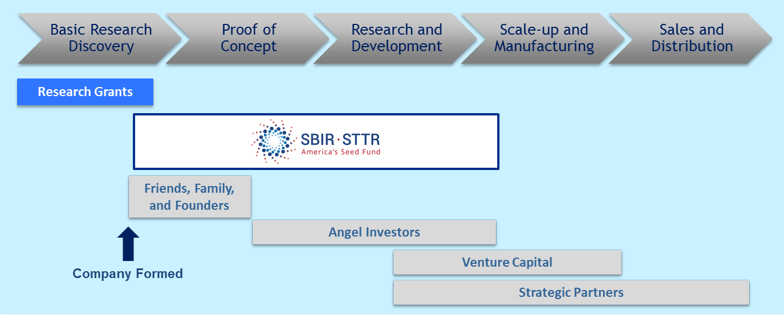
Benefits of NIH Funding
One of the largest sources of early-stage capital for life sciences in the United States
Non-dilutive capital – not a loan
IP/data rights protection through Bayh-Dole Act and SBIR Policy Directive
Awardees can leverage funding to attract investors and partners
Notes:
Largest sources of early-stage capital- not a loan and is non-dilutive (we won’t take part of your company)
NIH is not the final customer
Many awardees use funding to de-risk their innovation/product to attract investors and partners that will help support bringing the innovation to market.

Slide 7








NIH Application & Review Process
Applicant initiates
research idea
Small Business
Concern confirms
Eligibility
Submits SBIR/STTR
grant application to
NIH electronically
NIH Center for
Scientific Review
assigns to IC and IRG
1-2 Months
3 Months
IC staff prepare
funding plan for
IC Director
Advisory Council or
Board recommend
Approval
Scientific Review
Group evaluates
scientific merit
2-4 Months
IC allocates
funds
Grantee conducts
research
Notes:
Uses the NIH review process
Entire process from application to award takes 6-9 months but companies get feedback 3-4 months after submission
Start with the Eligiblity

Slide 8
Eligibility Criteria
Organized as for-profit US business
Small: 500 or fewer employees, including affiliates
Work must be done in the US (with few exceptions)
Individual Ownership:
  Greater than 50% US-owned by individuals and independently operated <OR>
  Greater than 50% owned and controlled by other business concerns that are greater than 50% owned and controlled by one or more individuals, an Indian tribe, ANC or NHO (or a wholly owned business entity of such tribe, ANC or NHO) <OR>
  Be a concern which is more than 50% owned by multiple venture capital operating companies, hedge funds, private equity firms, or any combination of these (SBIR only)
Determined at the Time of Award
Notes:
Highlights:
US company and the work needs to be done in the US (with few exceptions)
Individual Ownership is where most of the questions are- SBA has guidance documents and we can help answer questions
Determined at the time of award.

Slide 9
NIH Application & Review Process
Applicant initiates
research idea
Small Business
Concern confirms
Eligibility
Submits SBIR/STTR
grant application to
NIH electronically
NIH Center for
Scientific Review
assigns to IC and IRG
1-2 Months
3 Months
IC staff prepare
funding plan for
IC Director
Advisory Council or
Board recommend
Approval
Scientific Review
Group evaluates
scientific merit
2-4 Months
IC allocates
funds
Grantee conducts
research
Notes:
Next is the application submission process

Slide 10
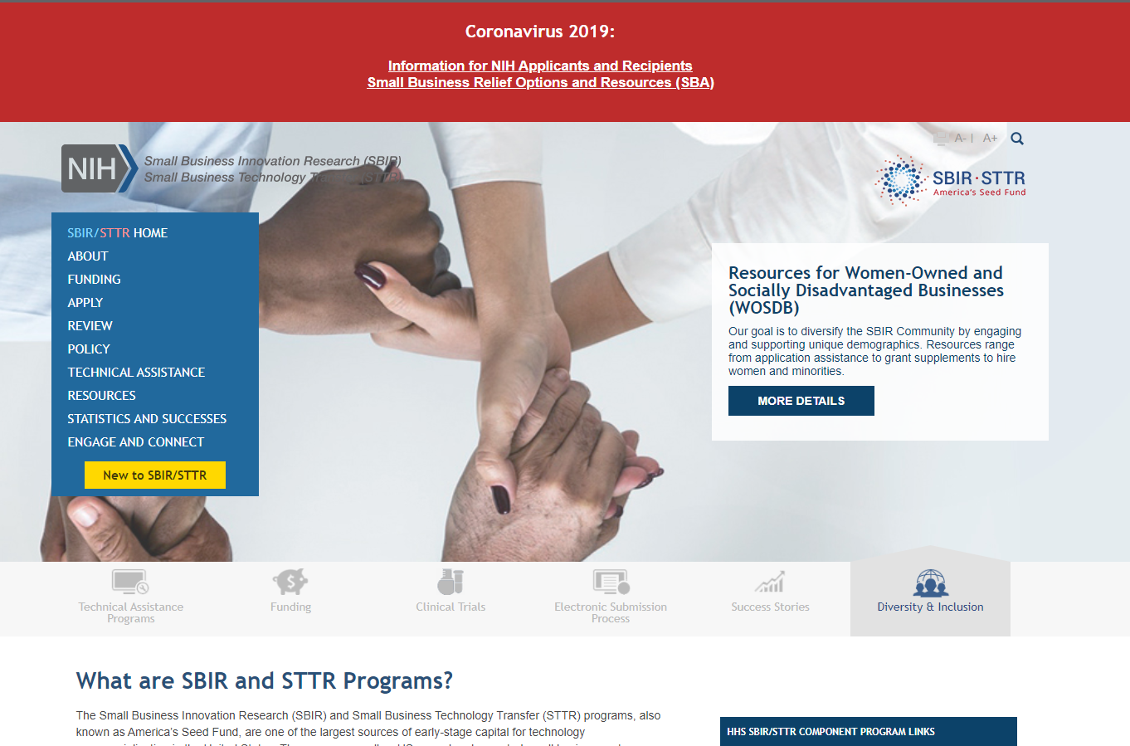
SBIR/STTR Website
https://sbir.nih.gov
Majority of the funding goes to investigator-initiated applications
Standard receipt dates: September 5, January 5, April 5
NIH Applicant Assistance Program
https://sbir.cancer.gov/programseducation/aap
Notes:
Website is a wealth of information, including funding opportunities (highlighted)
New to SBIR/STTR- flowchart (highlighted) to walk you through the process.
8 ICs participate in the Applicant Assistance program (NCI, NHLBI, NINDS, NIA, NCATS, NIEHS, NCCIH, NINR) to help new applicants with the process
Program is specifically for Phase I applicants who have not received an NIH SBIR or STTR previously
One of the goals is to increase participation by those groups that have been historically under-represented (women-owned, socially/economically disadvantaged small businesses, IDEA states)

Slide 11
WOSB and SDB Definitions
What is a Women-Owned Small Business (WOSB)?
A firm must be at least 51% owned and controlled by one or more women, and primarily managed by one or more women
The firm must be “small” in its primary industry in accordance with SBA’s size standards for that industry
SBCs self-certify on the SF 424 (R&R) Form
What is a Socially and Economically Disadvantaged Business (SDB)?
The firm must be 51% or more owned and control by one or more disadvantaged persons
The disadvantaged person or persons must be socially disadvantaged and economically disadvantaged
The firm must be small, according to SBA’s size standards
You must self-certify by registering your business in the System for Award Management
Notes:
What is a WOB and SDB- definitions are here
We use this information for our tracking purposes and encourage you to self identify if appropriate- not provided on your application to reviewers.

Slide 12
SBIR/STTR Funding Opportunities
SBIR/STTR Grant Solicitation Funding Opportunities:
  General Omnibus Solicitations
    Clinical Trial Not Allowed: SBIR (PA-20-260) and STTR (PA-20-265)
    Clinical Trials Required: SBIR (PA-20-262) and STTR (PA-20-261)
  Read the “Program Descriptions and Research Topics” Section in the Solicitation
  Targeted Solicitations (https://sbir.nih.gov/funding/individual-announcements)
*Not all of these have a separate set-aside or peer review- Read Carefully!
SBIR Contract Solicitation
  Only some Institutes/Centers participate
  FY2021 Contract Solicitation is now available
  Receipt date is October 26th
https://sbir.nih.gov/funding
Notes:
Stephanie Starts here:
Majority of our applications are investigator initiated and grants
Strongly encourage applicants to read the program descriptions and research topics section
Do have targeted solicitations and a contract solicitation- not all ICs participate- important to read carefully and reach out to the appropriate contacts.

Slide 13
SBIR and STTR Critical Differences
Award always made to
small business
 | SBIR | STTR
Partnering Requirement | Permits partnering | Requires a non-profit research institution partner (e.g. university)
Work Requirement | Guidelines: May outsource 33% (Phase I) 50% (Phase II) | Minimum Work Requirements: 40% small business 30% research institution partner
Principal Investigator | Primary employment (>50%) must be with the small business | PI may be employed by either the research institution partner or small business
Notes:
Major difference is partnering requirement- all the differences come from that
Award is always made to the small business
PI eligibility is at the time of award (not application)

Slide 14




Phased Programs
Discovery
Phase I
Development
Phase II
Commercial Market
Competing Renewal Award
Phase IIB
Feasibility
Full R&D
Commercialization Readiness Pilot (CRP)
Phase I Phase II
Fast-Track
Only Some NIH Institutes/Centers Participate
Direct to Phase II
(SBIR only)
Phase I: $256,580/1-2 years*
Phase II: $1,710,531/1-3 years*
*NIH has a waiver from the Small Business Administration to exceed these budgets for most topics
Notes:
Feasibility vs. Full R&D- vague and not defined.
Significant support to help companies get to commercial market or an inflection point (investor/partner) as biomedical research may take more time and money.
Competing renewal awards
CRPs
Larger budget than most people realize, and we have a waiver to exceed the SBA guidelines. IC specific- reach out and contact us.

Slide 15
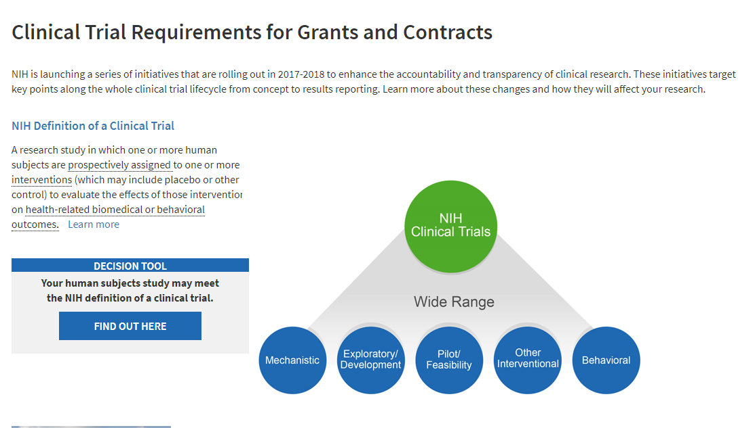
Clinical Trials
https://grants.nih.gov/policy/clinical-trials.htm
Notes:
Clinical trials- not all FOAs or ICs support clinical trials through the SBIR/STTR program
Definition of a clinical trial may be broader than you think (encourage use of the decision tool). Important to determine BEFORE applying and reach out to discuss with a program officer

Slide 16
Electronic Submission
SBIR/STTR grant applications and SBIR contract proposals must be submitted electronically.
REQUIRED REGISTRATIONS
  DUNS Number (Company)
  System for Award Management (SAM)
  Grants.gov (Company)
  eRA Commons (Company and all PD/PIs)
  SBA Company Registry at SBIR.gov
Grants submit via ASSIST or Grants.gov Workspace
For contracts, submit proposals with electronic Contract Proposal Submission (eCPS) website
Helpful NIH Grants Registration Infographic
Notes:
Very important to register and submit EARLY
Strongly recommend using ASSIST

Slide 17
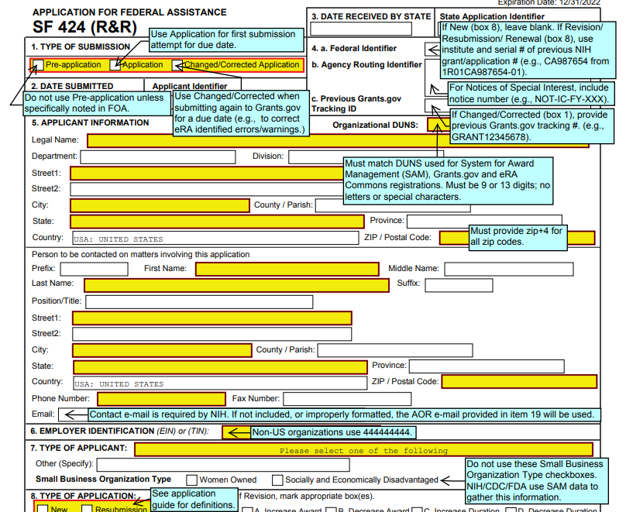
Electronic Submission
Annotated Form Set for NIH Grant Applications
FORMS-F Series

Slide 18
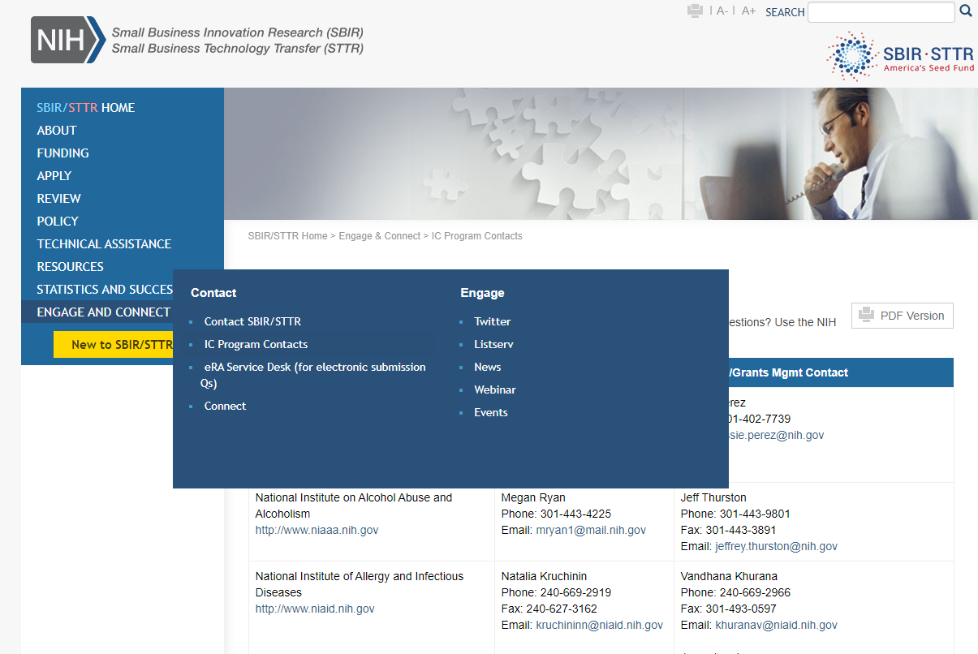
Most Important Piece of Advice
Talk to an HHS Program Officer at least a month before the application deadline!
List of HHS SBIR Program Managers: https://sbir.nih.gov/engage/ic-contacts
Research Portfolio Online Reporting Tools (RePORT): https://report.nih.gov/
Not sure who to contact?
https://public.era.nih.gov/commons/public/servicedesk/initseed.era
or
Email: sbir@od.nih.gov
Notes:
Very important to reach out prior to applying
Find the information:
On the website (highlighted)
Through NIH RePORT (which can help determine what ICs have funded previously)
Contact us

Slide 19
NIH Application & Review Process
Applicant initiates
research idea
Small Business
Concern confirms
Eligibility
Submits SBIR/STTR
grant application to
NIH electronically
NIH Center for
Scientific Review
assigns to IC and IRG
1-2 Months
3 Months
IC staff prepare
funding plan for
IC Director
Advisory Council or
Board recommend
Approval
Scientific Review
Group evaluates
scientific merit
2-4 Months
IC allocates
funds
Grantee conducts
research
Notes:
Finally- review process
Similar to the NIH review process and Criteria
Most SBIR/STTR applications go to specific SBIR/STTR application panels

Slide 20
Review Criteria
Overall Impact Score
Scored Review Criteria (score 1-9)
Significance (Real Problem/Commercial Potential)
Investigators (PI and team)
Innovation (New or Improved?)
Approach (Research Design, Feasible)
Environment (Facilities/Resources)
Additional Review Criteria
(not scored individually)
Protection of Human Subjects
Inclusion of Women, Minorities & Children
Vertebrate Animals
Biohazards
Center for Scientific Review
https://public.csr.nih.gov/
Notes:
Same review criteria but the focus is on product development and not on hypothesis driven research

Slide 21


Success Stories
Be Prepared to Resubmit!
“[SBIR] has been a long, trying, but worthwhile journey...from multiple submissions that were not discussed...to applications that scored below the funding levels...to concurrent applications (one Phase II and a Phase I) emerging from the rigorous peer review process with impact scores in the “Excellent" range.”
Laverne Morrow Carter, Ph.D.
Founder & President, REESSI
NIMHD SBIR Awardee
http://www.reessi.com
Notes:
Be Prepared to resubmit!
Offer to be a reviewer

Slide 22

More Than Funding: Introducing SEED
Small business Education and Entrepreneurial Development (SEED)
Supports the NIH innovator community (funding and resources) to validate and advance discoveries to products that improve patient care and health.
Develop relationships with strategic partners and build opportunities for NIH innovators to further their product development efforts.
Small Business Innovation
Innovator Support
Academic Innovation
seed.nih.gov
Notes:
More than just funding- supporting the entire community and encourage you to come to the sessions on day three focused on SEEDing the Marketpace.

Slide 23
Technical Assistance and Entrepreneurial Training
Discovery
Phase I
Development
Phase II/IIB
TABA Funding: Requested in the Application
Phase I- $6,500/year Phase II- $50K
Technical and Business Assistance (TABA)
Programs
Needs Assessment
Coming soon
Consulting Services
Coming soon
Additional Entrepreneurial Training and Assistance
NIH I-CorpsTM
NIH C3i: Medical Devices
Diversity Supplement (PA-18-837)
https://sbir.nih.gov/tap
Notes:
Awardees have access to a number of technical and business assistance programs as well as entrepreneurial training. We have a number of different programs to support companies, particularly those from first time entrepreneurs

Slide 24
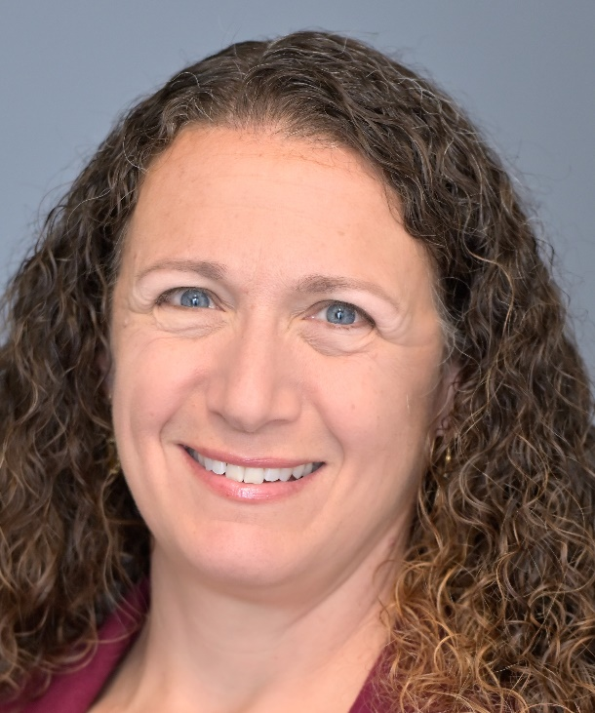
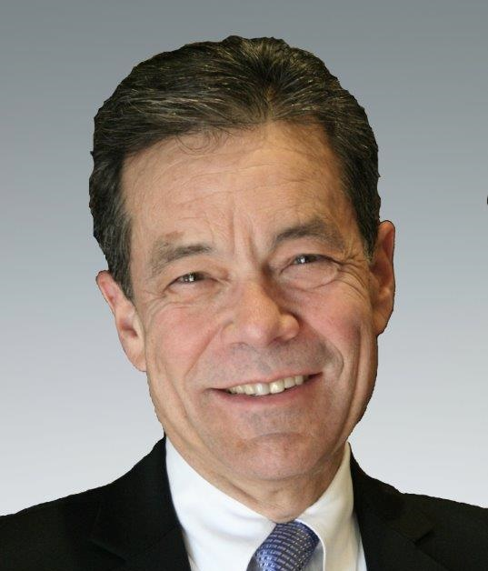




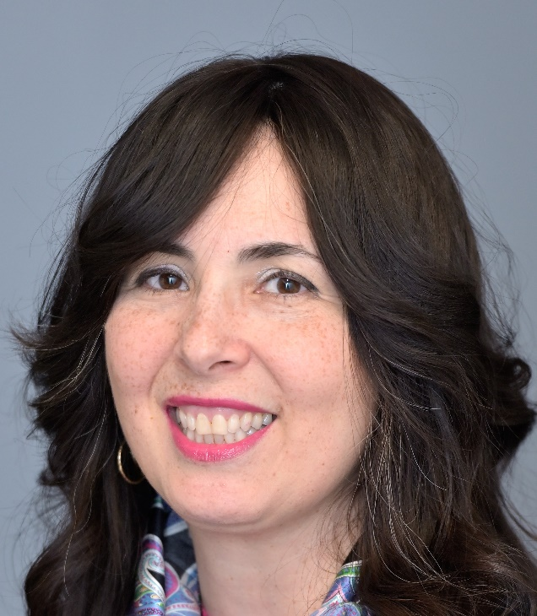
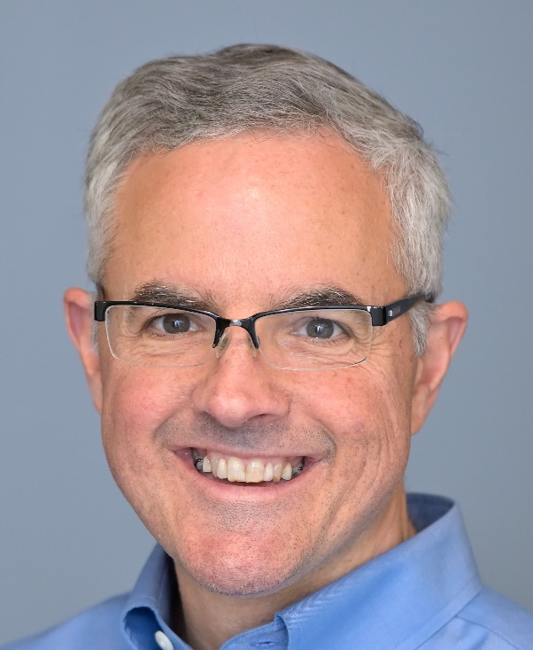
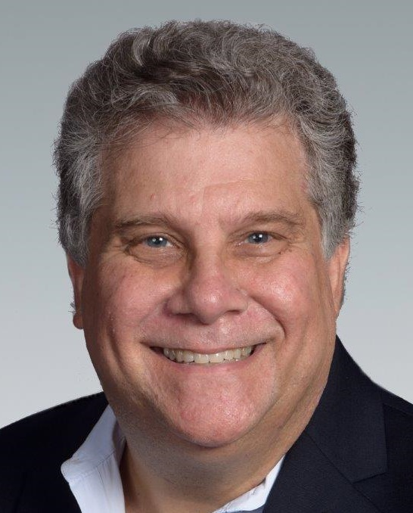
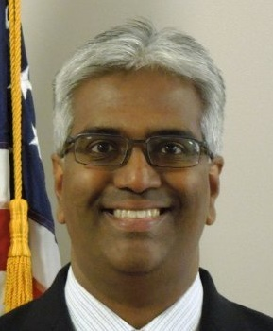

Innovator Support
Strategy, Finance & Commercialization Experts
Partnering Opportunities and
Pitch Coaching
Sr. Regulatory Specialist
Investor-in-Residence
Entrepreneurs-in-Residence
Intellectual Property (USPTO)
Notes:
In house innovator support for our companies includes regulatory, EIRs, investors and IP.
Use this expertise to help coach our companies and then support them to present at partnering and investing events.

Slide 25

Get Connected
Subscribe to the SBIR/STTR Listserv
Read our NIH SBIR/STTR Success Stories
@NIHsbir
sbir@od.nih.gov
NIH Guide for Grants and Contracts
(weekly notification)
Connect with Us
Notes:
Contact us!

