Slide 1
Developing and Optimizing your Mentoring Relationships
Nicole Redmond, MD, PhD, MPH, FACP
Physician
National Heart, Lung, and Blood Institute
NIH Regional Seminar
October 2020

Slide 2
Agenda
Definition of networking (WHAT)
Benefits of networking for career development (WHY)
Identifying people to be in your network (WHO)
  Developmental networks
  Network Diversity
  Managing the Mentor Relationship
Identifying networking opportunities (WHERE and WHEN)
Networking strategies (HOW)

Slide 3
Agenda
Definition of networking (WHAT)
Benefits of networking for career development (WHY)
Identifying people to be in your network (WHO)
  Developmental networks
  Network Diversity
  Managing the Mentor Relationship
Identifying networking opportunities (WHERE and WHEN)
Networking strategies (HOW)

Slide 4
What networking is…
A set of behaviors used to develop and maintain relationships that can potentially provide information, influence, guidance, and support to individuals in their careers.
Building authentic relationships for social support
Types of Social of support | Examples
Emotional | Trust, caring
Instrumental | Tangible aid (e.g., data collection, grant funding)
Informational | Training, subject matter expertise
Appraisal | Peer review, manuscript editing
Source: http://career.iresearchnet.com/career-development/networking/
Notes:
Ultimately, networking will result in authentic relationships that will provide social support.
Here, I’ve listed several types of social support , and some examples of each in the context of conducting research

Slide 5

What networking isn’t
Accumulating contact information
Quid pro quo
Selfish
Expecting favor without merit (favoritism)
Image source: https://www.rallypoint.com/answers/how-do-you-deal-with-favoritism

Slide 6
Agenda
Definition of networking (WHAT)
Benefits of networking for career development (WHY)
Identifying people to be in your network (WHO)
  Developmental networks
  Network Diversity
  Managing the Mentor Relationship
Identifying networking opportunities (WHERE and WHEN)
Networking strategies (HOW)

Slide 7

Why you should network
Social network and careers research have emphasized the importance of engaging in networking behaviors in the attainment of valuable career outcomes
  enhanced advancement
  equitable compensation
  career mobility
  career satisfaction

Slide 8
Why should you network
Science (and most other disciplines) is a human enterprise, driven by people
  NIH mission: support discovery and applied science to optimize human health
A hallmark of innovation is interdependence
  Exchange of new perspectives, new information and/or access to new (unadvertised) opportunities
Success never occurs in isolation
  Relationships matter!
  A virtuous cycle of generosity
Notes:
The NIH mission is to support discovery and applied science to optimize human health.
Innovation is at the core of scientific advances, and the hallmark of innovation is interdependence.
The exchange of often requires exchange of new perspectives and new information and/oraccess new opportunities that often are unadvertised and unanticipated.
The trainees you mentor today may be your collaborators tomorrow
The collaborator you work with on a smaller project may result in future collaborations

Slide 9
Agenda
Definition of networking (WHAT)
Benefits of networking for career development (WHY)
Identifying people to be in your network (WHO)
  Developmental networks
  Network Diversity
  Managing the Mentor Relationship
Identifying networking opportunities (WHERE and WHEN)
Networking strategies (HOW)

Slide 10

Myth of the singular mentor
https://pixabay.com/photos/yoda-starwars-actionfigure-667955/
Notes:
One mistake of early career individuals is a hyper focus on finding a single end-all, be-all mentor. Although there are some excellent individuals who can be a Yoda…

Slide 11
Developmental Networks
multiple social relationships that foster career development and personal growth
subset of an individual’s overall social network and consists of multiple career advisors for specific needs or resources
 | Navigator | Sponsor | Coach | Confidant
General description | Advises about organizational dynamics | Helps navigate organizational dynamics | Helps in the development of professional persona | Listens to the challenges and triumphs
Relation to career goals | Helps identify career development goals and advancement criteria | Promotes – steers toward advancement | Helps with reflection about goals and advancement options | Affirms your choices and cheers you on
How they help: | Helps translate implicit performance criteria to career development plan. | Identifies the most critical performance criteria necessary for a particular outcome. | Helps with skills needed to make the case for advancement. | Shares their experiences, their view of the rules.
Career/Life | Work related | Work related | Work and Personal | Work and Personal
Relationship type | Mutual relationship | Protégé relationship | Professional /formal relationship | Reciprocal relationship
Role in the network | An advisor in the developmental network. | Shapes the developmental network; connects protégé to people of influence. | An advisor in the developmental network | An advisor in the developmental network and possibly part of one’s social network
Garland, M. and Alestalo, S. (2014). Faculty Mentoring in a Networked World. Syracuse, NY: Syracuse University
https://suadvance.syr.edu/wp-content/uploads/2020/07/Faculty-Mentoring-in-a-Networked-World.pdf
Notes:
I’d like to introduce you to the concept of developmental networks
…read bulllets
Navigator—may be a senior faculty member or div/dept chair, a named mentor on your career development award. Helps with alignment of career goals with advancement (which could be advancing to independent research funding, or advancing through promotion/tenure process
Sponsor—typically a senior leader with decision making capacity and/or influence. Connects you to other people and/or opportunities—award nominations, special committees/projects,
Coach—focused on specific skills—methods—speaking, writing, data collection, data analysis.
A single Yoda may serve multiple roles at some point in your career (sequentially or simultaneously)
For those of you in graduate degree programs, your thesis or dissertation committee is one of your first formal developmental networks for research.

Slide 12

Importance of diverse networks
Network range: diversity of group affiliations and potential access to resources/info from network periphery
  Systemic bias/discrimination may constrain
Network positions: position in status hierarchy
  Having large/diverse network not sufficient if the
  contacts not of high enough status to be influential
“Best of both worlds”
  Interpersonal vs. Instrumental support
  Culturally concordant: Emotional support, behavioral strategies to manage systemic bias/discrimination, navigating organizational culture
  Culturally Discordant: new opportunity, innovation, resources
Ibarra H. Race, Opportunity, And Diversity Of Social Circles In Managerial Networks ACAD MANAGE 1995 38 (3):673-703
Ibarra, H. Personal Networks of Women and Minorities in Management: A Conceptual Framework http://amr.aom.org/content/18/1/56.short
Notes:
Historical and ongoing systemic bias/discrimination may constrain. Example: First generation student may not have access study notes/practice tests from siblings/friends previously in a course

Slide 13
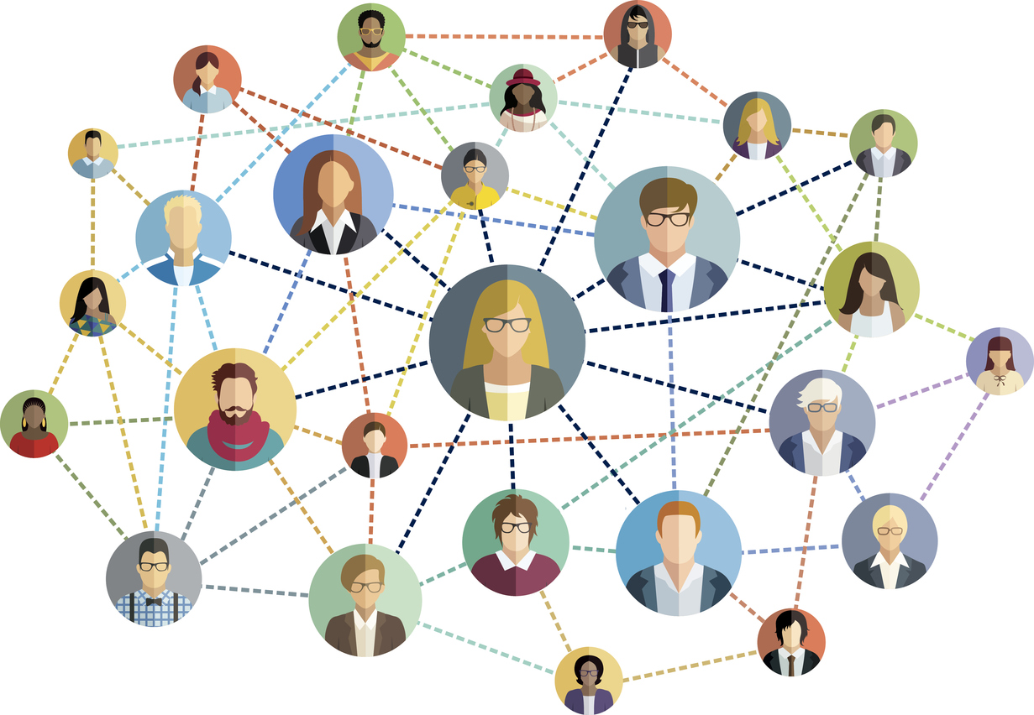
Map your Network
People who help you get the job done
  provision of important information
  scientific or technical advice (e.g., writing, data collection/analysis)
  professional expertise
  other resources
  coaches, peers, consultants
People who help you advance your career
  career guidance and direction
  exposure to critical people
  political/organizational culture advice
  advocates for on your behalf and/or provides opportunities, assignments, promotions, or critical resources (e.g., staffing, funding)
  mentors, sponsors, supervisors
People who provide personal support for you
  emotional well‐being and social support
  navigating organizational culture
  coping with/managing impacts of performance issues, work-life integration, systemic and interpersonal bias and discrimination
  mentors, confidants, friends
https://scholarlykitchen.sspnet.org/2017/04/07/updated-figures-scale-nature-researchers-use-scholarly-collaboration-networks/social-network-vector-illustration/
Christou H, Dookeran N, Haas A, et al. Establishing effective mentoring networks: rationale and strategies. MedEdPORTAL.2017;13:10571.https://doi.org/10.15766/mep_2374-8265.10571
Notes:
Identify individuals in your developmental network, i.e., those who fall into one or more of the following three types of relationships. (Those who fall into more than one type should be listed more than once.)
Networks vary in structure, content, and quality of relationships. Now that you have defined your Developmental Network, assess if it meets your goals. The questions below will help you determine the strengths and weaknesses of your network, and where you need to fill in gaps with new contacts. Be mindful of maintaining existing relationships, by staying in touch and “giving back” such as facilitating an introduction or sending an article of interest to the individual along with your comments. Professional conferences are another important way to reconnect with your existing developmental network and cultivate new connections.

Slide 14
Network Mapping Exercises
Mentorship Map Table
Domain | Description
Professional Development | These are individuals (or organizations) that provide the information or teach the skills needed to accomplish your work
Trusted Advisor/ Coach | Trusted individuals that can “give you the lay of the land” or provide guidance in your work (e.g., avoid pitfalls, strategize) without secondary gain
Safe Space/ Emotional Support | Trusted individuals with whom you can be completely open and vulnerable with about your emotional needs and struggles. They may also be your biggest cheerleaders
Role Model | These individuals provide examples for who/how you want to be
Substantive Feedback | Trusted colleagues who provide open, honest, and meaningful feedback related to your work and leadership
Sponsorship/ Access to opportunities | Individuals who promote you for certain positions or open doors for additional growth opportunities
Accountability | Individuals who are honest with you and hold you accountable to the things that are important to you, your priorities, and your development. This may be relevant for both personal and professional priorities/development.
Derived from workshop materials from 2018 Society of General Internal Medicine Annual Meeting Workshop (WF11): Mentorship for Mid-Career and Beyond. Zehnder N, Lee R, Aagaard E.
Notes:
Identify individuals in your developmental network, i.e., those who fall into these roles. These may be vertical relationships (above or below you in rank/seniority) or horizontal (peers/colleagues), inside or outside your home institution, sometimes outside of your discipline/profession.
Within professional development-you may want to further define specific domains of knowledge or skills/methods and who in your network can assist in those areas.

Slide 15
Assess Your Network
Evaluate the structure, content, and quality of relationships
Theme | Description
Diversity | How similar or different are these individuals (in terms of gender, race, function, geography, organizations) to each other and to you?
Redundancy | How much overlap is there? Does one person serve every function? Do you have many people helping you get the work done but no one providing personal support?
Interconnectivity | How closed is the network in the sense that most of the people know each other?
Strength of Connection | What is the spread of people in terms of closeness and distance to you?
Balance | Is your network balanced or in danger of tipping? Do you have too many mentors and no mentees? Or for more senior faculty, do you have too many mentees but no longer have mentors?
Connections to Power/Influence | How many individuals would you characterize as influential in the department or hospital or field?
Size | How large or small is your network? Does the size fit your goals? Is the network a size that you can maintain?
Christou H, Dookeran N, Haas A, et al. Establishing effective mentoring networks: rationale and strategies. MedEdPORTAL.2017;13:10571.https://doi.org/10.15766/mep_2374-8265.10571
Notes:
Networks vary in structure, content, and quality of relationships. Now that you have defined your Developmental Network, assess if it meets your goals. The questions below will help you determine the strengths and weaknesses of your network, and where you need to fill in gaps with new contacts. Be mindful of maintaining existing relationships, by staying in touch and “giving back” such as facilitating an introduction or sending an article of interest to the individual along with your comments. Professional conferences are another important way to reconnect with your existing developmental network and cultivate new connections.
CONCLUSIONS ABOUT YOUR NETWORK:
Summarize the PATTERNS you see in your network; your STYLE of networking, and/or what you
might want to do differently in the future. Think about how to maintain the strengths of your
network, how to diversify, and how with time to increase the number of mentees and advisees.

Slide 16
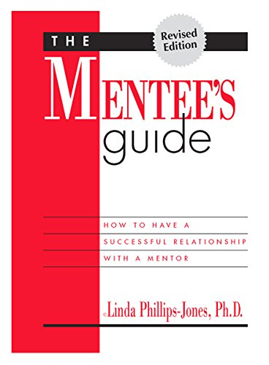
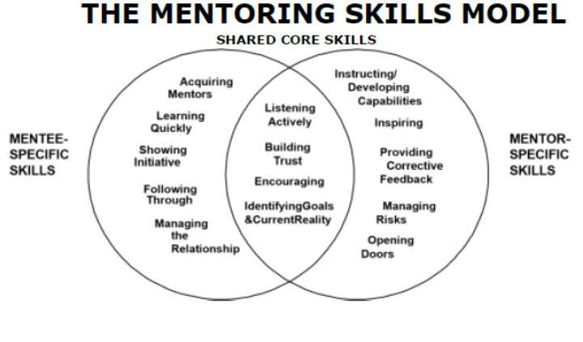
Utilizing Your Network: Optimizing your mentoring relationships
https://mentoringgroup.com/books/mentees-guide.pdf
https://mentoringgroup.com/books/skills-for-sucessful-mentoring.pdf
Notes:
Networks vary in structure, content, and quality of relationships. Now that you have defined your Developmental Network, assess if it meets your goals. The questions below will help you determine the strengths and weaknesses of your network, and where you need to fill in gaps with new contacts. Be mindful of maintaining existing relationships, by staying in touch and “giving back” such as facilitating an introduction or sending an article of interest to the individual along with your comments. Professional conferences are another important way to reconnect with your existing developmental network and cultivate new connections.
CONCLUSIONS ABOUT YOUR NETWORK:
Summarize the PATTERNS you see in your network; your STYLE of networking, and/or what you
might want to do differently in the future. Think about how to maintain the strengths of your
network, how to diversify, and how with time to increase the number of mentees and advisees.

Slide 17
Utilizing Your Network: Optimizing your mentoring relationships
Shared skills
Active Listening
Developing Trust
  Keep confidences shared between you
  Commit to consistent meetings
  Follow through on commitments
  Admit errors and take responsibility
  Tactfully disagree by offering additional information/context
  Elicit and receive feedback non-defensively
    (Resource: Thanks for the Feedback by Douglas Stone &Sheila Heen)
Identify (and revisit!) goals and desired outcomes
https://mentoringgroup.com/books/mentees-guide.pdf
https://mentoringgroup.com/books/skills-for-sucessful-mentoring.pdf
Notes:
Networks vary in structure, content, and quality of relationships. Now that you have defined your Developmental Network, assess if it meets your goals. The questions below will help you determine the strengths and weaknesses of your network, and where you need to fill in gaps with new contacts. Be mindful of maintaining existing relationships, by staying in touch and “giving back” such as facilitating an introduction or sending an article of interest to the individual along with your comments. Professional conferences are another important way to reconnect with your existing developmental network and cultivate new connections.
CONCLUSIONS ABOUT YOUR NETWORK:
Summarize the PATTERNS you see in your network; your STYLE of networking, and/or what you
might want to do differently in the future. Think about how to maintain the strengths of your
network, how to diversify, and how with time to increase the number of mentees and advisees.

Slide 18
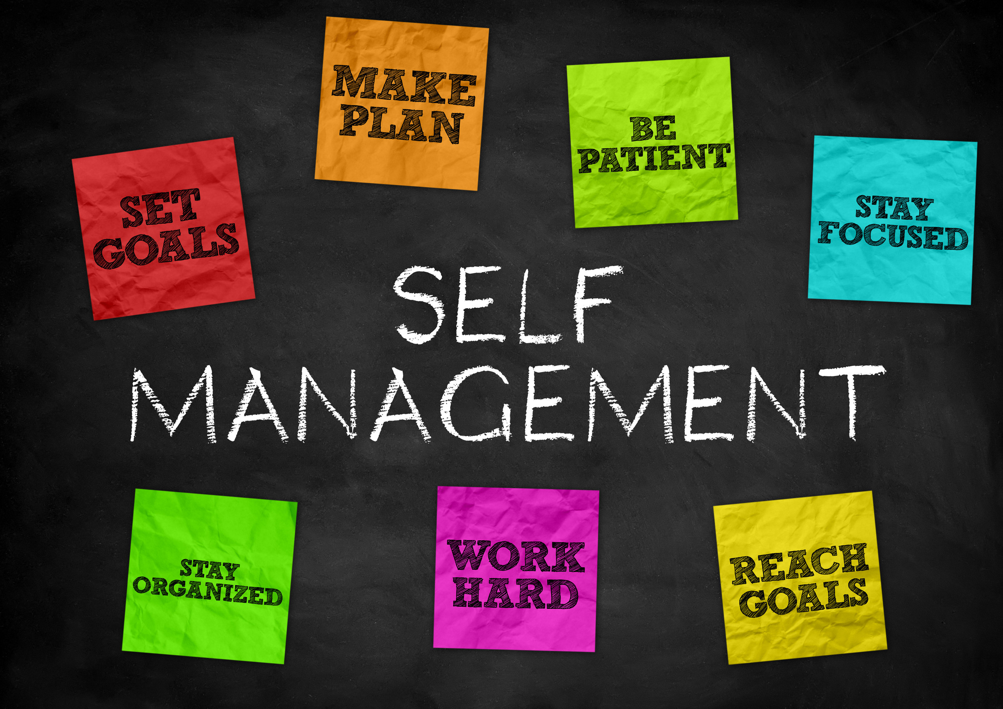
Utilizing Your Network: Optimizing your mentoring relationships
Manage Yourself
Acquire Mentors (and sponsors, coaches, etc.)
  Apply networking skills!
  Mutual interests
  Adequate availability and resources to support you
Know thyself
  Goals and values
  Current knowledge, skills, and abilities
  Strengths and areas for development
Be prepared
  Review previously provided materials
  Be ready to articulate goals/needs
Learn quickly
  Observe carefully
  Integrate new info/apply knowledge and skills to current tasks
  Elicit feedback/receive feedback non-defensively
    (Resource: Thanks for the Feedback by Douglas Stone &Sheila Heen)
Show initiative
  Ask questions to clarify
  Pursue additional resources independently
Follow-through
  Keep agreements
  Persist through challenge/discouragement
  Provide updates on progress or new issues
https://mentoringgroup.com/books/mentees-guide.pdf

Slide 19
Utilizing Your Network: Optimizing your mentoring relationships
Mentoring Up - Duke BioCoRE workshop July 2016 by Steve Lee,PhD, Asistant Dean of Diversity and Inclusion, UC Davis via Slideshare.net

Slide 20
Utilizing Your Network: Optimizing your mentoring relationships
Manage the Relationship
Identify (and revisit!) goals and desired outcomes
Negotiate the duration of mentorship and frequency of meetings
  Agenda setting
  Post-meeting actions/summaries
Establish preferred modes of communication
  May vary by content, urgency, context
  Written vs. oral
  Email vs. phone vs. in-person
  Inclusion of other peers/team members/leaders (who to cc:)
Method, type, and frequency of feedback
  Written vs. oral
  Informal vs. formal
  Appreciation, coaching, evaluation
Reassess and Renegotiate agreements on above as needed
https://mentoringgroup.com/books/mentees-guide.pdf
Stone D, Heen S. Thanks for the Feedback: The Science and Art of Receiving Feedback Well. 2014
Notes:
Networks vary in structure, content, and quality of relationships. Now that you have defined your Developmental Network, assess if it meets your goals. The questions below will help you determine the strengths and weaknesses of your network, and where you need to fill in gaps with new contacts. Be mindful of maintaining existing relationships, by staying in touch and “giving back” such as facilitating an introduction or sending an article of interest to the individual along with your comments. Professional conferences are another important way to reconnect with your existing developmental network and cultivate new connections.
CONCLUSIONS ABOUT YOUR NETWORK:
Summarize the PATTERNS you see in your network; your STYLE of networking, and/or what you
might want to do differently in the future. Think about how to maintain the strengths of your
network, how to diversify, and how with time to increase the number of mentees and advisees.

Slide 21
Agenda
Definition of networking (WHAT)
Benefits of networking for career development (WHY)
Identifying people to be in your network (WHO)
  Developmental networks
  Network Diversity
  Managing the Mentor Relationship
Identifying networking opportunities (WHERE and WHEN)
Networking strategies (HOW)

Slide 22
When and where do you network?
When
Before you need something!
After you identify a need
Ongoing
  Everyone is a teacher
Where
Professional meetings
Social settings
Email
Social media engagement
  Interact in Groups
  Comment on posts
  Direct Message

Slide 23
Agenda
Definition of networking (WHAT)
Benefits of networking for career development (WHY)
Identifying people to be in your network (WHO)
  Developmental networks
  Network Diversity
  Managing the Mentor Relationship
Identifying networking opportunities (WHERE and WHEN)
Networking strategies (HOW)

Slide 24
Networking Strategies: Prepare
Define goals for connecting
  Information/advice
  Introduction
  Opportunity
Building a relationship
  Active listening
  Elevator pitch is for context and setting expectations, not for “telling and selling”

Slide 25

Networking Strategies: Prepare
Who you are
  (e.g., My name is Mary Jones and I’m a first year research faculty…)
What and where you are studying/working
  (in the cardiology division studying the relationship of neighborhood characteristics with cardiovascular health…)
Give a snapshot of your relevant experience and preparation
  (I have submitted a manuscript and am preparing an application for a career development award…)
Goal of your conversation
  (and given your qualitative expertise I’d like to determine your interest in collaborating with me on my next project.)

Slide 26

Networking Strategies: Be Visible
Engage in professional and community activities
  STRATEGICALLY volunteer for leadership and committees
Increase organizational visibility through accepting challenging work assignments
  Interdisciplinary/Interdepartmental teams are best

Slide 27
Networking Strategies: Contact
Identify potential contacts
  Program speakers
  Colleagues, 2nd and 3rd degree friends/colleagues
  Cold contacts via web search, social media groups
Determine the “win” for the other person
  Acknowledge their inner guru
  Do your homework, don’t waste their time asking things easily found elsewhere
  Reciprocate whenever able, may mean “paying it forward”

Slide 28
Networking Strategies: Tips for introverts
Adjust your mindset
  Focus on your goal, not the crowd
  Once you’ve met 1-3 targeted people, you’ve met your goal. Ok to leave!
Prepare
  Review attendee/speaker list
  Consider emailing ahead of time (“I read your paper and saw you’re attending the conference. I’d love to get together during the lunch break and learn more about your research.”)
  Have some conversation starts ready (next slide)
  Volunteer to help plan/organize the event—early access to invited attendees and speakers
Use a sidekick
  Have a peer/colleague help introduce you
http://time.com/money/4166743/networking-tips-introverts/

Slide 29
Networking Strategies: Tips for introverts, cont.
Engage your natural observation and listening skills
  Open ended questions that make your person do the talking
  Nod and smile
Strategic entry and exit
  Give yourself a minimum time limit (e.g. 20-30 min)—nametag, one drink/snack, one convo.
  Head to the rear of the room, then work your way back to the door.
  Set a time to meet or other plan to follow up (“It was great talking to you, I’ll email you to (set up a meeting, send you my paper, connect on LinkedIn…)
Practice
  Try it out at your own institution (different department)
  Smaller meetings
http://time.com/money/4166743/networking-tips-introverts/

Slide 30
Networking Strategies: Conversation Starters
Have you attended this meeting before? It looks like an interesting agenda—which sessions should I be sure to attend?
Have you heard any of the speakers before?
It’s my first time coming to this meeting. Can you tell me what to expect?
Which organization are you with?
How did you get into the field?
What is the most enjoyable part of your job?
Do you have any advice for a newcomer like me?
Have you read Dr. Jones research/lecture on ________?
I saw your social media post on ___, tell me more about that issue…
Adapted from Harvard School of Public Health Career Services Office. “Step-By-Step Guide to Networking”

Slide 31
Networking Strategies: Follow-up
Actively maintain contacts inside and outside of one’s organization
  Attend the staff meeting
  Go to the “work party”
  Return to the conference annually
  Send a periodic “check-in” email
    Share your success
    Pay it forward
Stay engaged
  Listen actively

Slide 32
Networking Strategies: Follow-up
Thank you
  In person and/or by email
  Ask permission to stay in touch
Share your success--update on your progress/outcome
  Remind your contact of the context of your conversation (where you met, what you discussed)
  Opportunity to ask for additional contacts/information
    Example: “Dr. Jones, thank you so much for talking with me at the Annual Conference last week. I appreciated your advice on conceptual frameworks to consider. As you suggested, I have contacted your colleague at the University and we will be pursuing a collaboration. Thank you again!”
Return the favor/Pay it forward
  Email an article of interest with your comments
  Facilitate an introduction

Slide 33
Reflection/Discussion
What does your developmental network look like? Patterns, styles?
What is your style of networking?
How effective have you been with networking thus far in your career?
What are your networking action items?
  Elevator pitch?
  Expand/strengthen/diversify network?
  Effective follow-up with contacts?

Slide 34



Resources
Syracuse University
  SU ADVANCE: Best practice information in the world of mentoring and developmental networks
  https://suadvance.syr.edu/mentoring-resources/
Brigham and Women’s Hospital Mentoring Toolkit
  http://bwhmentoringtoolkit.partners.org/mentoring-and-career-development/developmental-networks/
International Mentoring Group (iMentoring) eBooks
  https://mentoringgroup.com/books/skills-for-sucessful-mentoring.pdf
  https://mentoringgroup.com/books/mentees-guide.pdf
  https://mentoringgroup.com/books/the-mentors-guide.pdf
Harvard Business Review
  https://hbr.org/2020/01/how-to-build-a-great-relationship-with-a-mentor
  https://hbr.org/topic/managing-up
  https://hbr.org/topic/managing-yourself

