Slide 1
Preparing a Budget
Live Case Study

Slide 2
1. R01 Modular Budget
Start with an itemized budget (R&R budget component)
Create out-year budgets
Divide total budget for all years by number of years
Request same number of modules each year*
Consortia total costs are calculated separately and may be rounded to nearest $1,000
* exception for equipment

Slide 3
Direct Costs – Year 1
Cal Req. Fringe Funds
Mos Salary Benefits Req.
A. Senior/Key Person
PI 2 15,333 4,293 19,626
co-investigator 1 0 0 0
B. Other Personnel
Postdoc Assoc 12 52,704* 14,000 66,704
Grad Student 12 24,816* 6,900 31,716
Grad Student 12 24,816* 6,900 31,716
C. Equipment – Microscope 19,000
D. Travel - (2 meetings) 4,000
E. Participant/Trainee usually left blank
F. Other Direct Costs
Materials/Supplies 25,533
Publication Costs 1,500
Subaward/Consortium/Contractual costs none
Tuition Remission 7,000
G. Total Direct Costs 206,795
* Based on FY 2020 NRSA stipend levels, NOT-OD-20-070

Slide 4
Direct Costs - Add it all up
Calculate the direct costs for the first year.
(in the example, Year 1 budget = $206,795)
Calculate the direct costs for subsequent years taking into account salary and research cost increases (e.g., 3% per year) and changes in funds requested for equipment.
Year 1 = $187,795 + $19,000 [equipment]
Year 2 = $193,428
Year 3 = $199,231
Year 4 = $205,208
Year 5 = $211,364

Slide 5
Determining the Need for a Modular Budget?
Calculate the total direct costs for all years
Total direct costs for 5 years = $1,016,026
Divide total by the number of years requested
Average direct costs = $203,205/year
Investigator-initiated R01s up to $250,000/yr must use modular format*
Except applications from foreign (non-U.S.) institutions

Slide 6
Converting Average Direct Costs to the Modular Format
Round up to the next module (number divisible by $25,000)
In the example, $203,205/year rounds up to $225,000/year
No yearly increases for inflation
First year may include additional modules for one-time expenses like equipment
In this example, PI adds one additional module to year 1 = $250,000

Slide 7
Record Modular Budget: PHS 398 Modular Budget, Period
A. Direct Costs Funds Requested ($)
*Direct Cost less Consortium F&A $250,000
Consortium F&A $ 0
*Total Direct Costs $250,000
B. Indirect Costs Funds Requested ($)
MTDC [less equipment $19K, tuition $7K] $224,000 [DC base]
Indirect cost rate [63%] $141,120
C. Total Direct and Indirect Costs Funds Requested ($)
(A + B) $365,120

Slide 8
Record Modular Budget: PHS 398 Modular Budget, Periods 2-5
A. Direct Costs Funds Requested ($)
*Direct Cost less Consortium F&A $225,000
Consortium F&A $ 0
*Total Direct Costs $225,000
B. Indirect Costs Funds Requested ($)
MTDC [less tuition] $218,000 [DC base]
Indirect cost rate [63%] $137,340
C. Total Direct and Indirect Costs Funds Requested ($)
(A + B) $355,340
This is the bottom line total of your budget request

Slide 9
What if I have a collaboration with an investigator at another institution that requires funds?
This requires a consortium agreement
NIH will only make one grant award (parent)
Your Budget will list costs for Consortium/Subaward Costs (consortium budget)
Your Co-I/Co-PI/MPI will need to prepare a budget for the consortium to be included in the application
If the grant is awarded the consortium will have a contractual arrangement with your institution
An application with a Consortium does not automatically require a Detailed Budget

Slide 10
2. R01 Budget with Consortium Costs
Prepare an itemized budget for the parent award
Prepare an itemized budget for consortium/subcontract costs, including:
Personnel
salary and benefits $33,000
Travel
professional or investigator meeting $ 2,000
Other Direct Costs
Materials and Supplies $10,000
Total Direct Costs = $45,000
Don’t forget the budget justification

Slide 11
Total Consortium Costs
Consortium Direct Costs = $42,250
Consortium F&A
consortium institution (at 60%) = $25,350
Consortium Total Costs = $67,600
*Remember you may round to the nearest $1,000

Slide 12
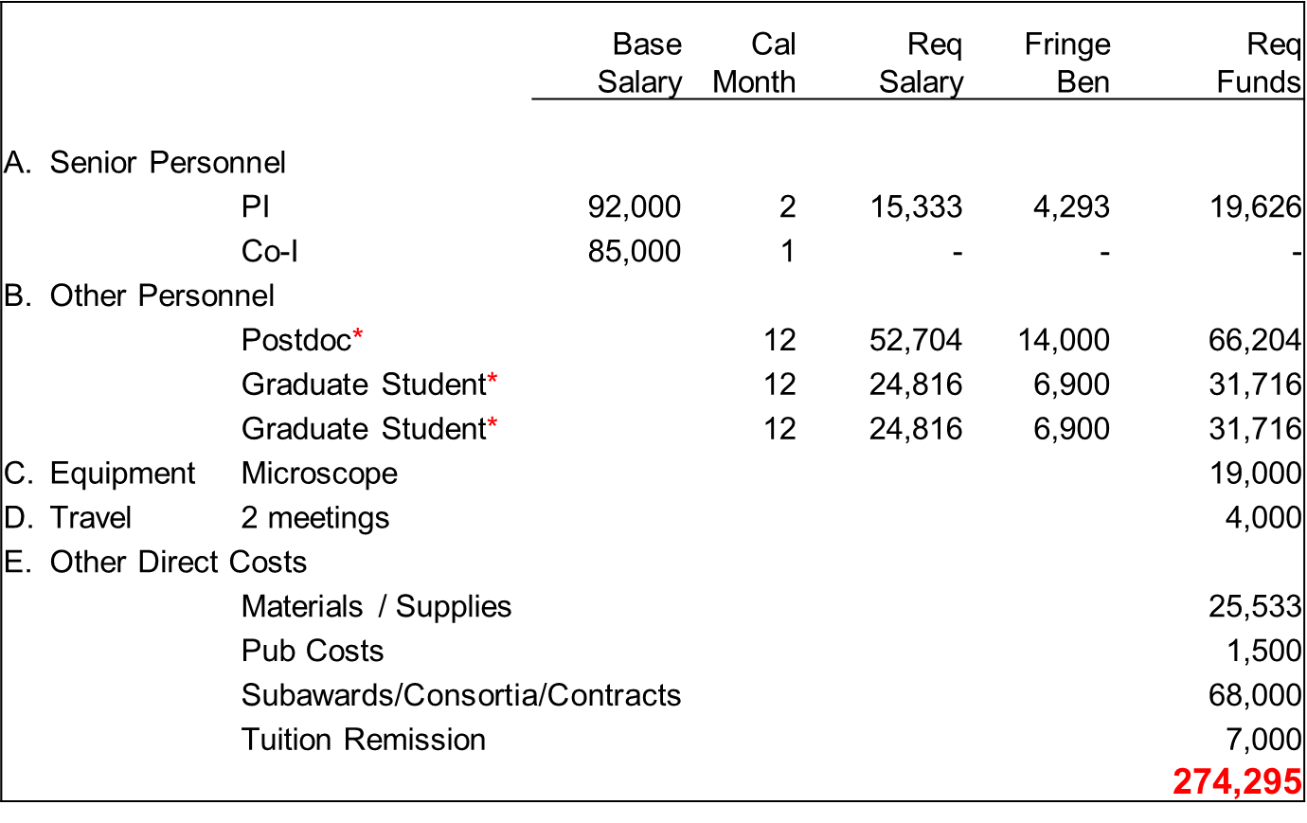
Direct Costs – Year 1 with Consortium
Should you request a modular budget?

Slide 13
R01 Grant with Consortium Budget
Submit as a modular budget
when requesting Direct Costs at or below $250,000 per year…
… excluding Consortium F&A costs.

Slide 14
Modular Grant with Consortium Budget
In the example,
Year 1 – Itemized Total DC = $274,295
minus Consortium F&A = $ 25,350
Year 1 – Itemized DC excluding Consortium F&A = $248,945
Year 1 – Itemized DC = $229,945 + $19,000 [equip]
Year 2 – Itemized DC = $236,843
Year 3 – Itemized DC = $243,948
Year 4 – Itemized DC = $251,266
Year 5 – Itemized DC = $258,803
Average Direct Cost per yr (less consortia F&A) = $247,961
Round up to the next module = $250,000

Slide 15
Record Modular Budget with Consortium: PHS 398 Modular Budget, Period 1
A. Direct Costs Funds Requested ($)
*Direct Cost less Consortium F&A $250,000
Consortium F&A $ 25,530
*Total Direct Costs $275,530
The total direct costs requested are allowed to exceed the modular maximum ($250,000) by the amount of F&A associated with the subcontract ($25,530).

Slide 16
Record Modular Budget: PHS 398 Modular Budget, Period 1
A. Direct Costs Funds Requested ($)
*Direct Cost less Consortium F&A $250,000
Consortium F&A $ 25,530
*Total Direct Costs $275,530
B. Indirect Costs Funds Requested ($)
Direct costs [less consortium TC: $68,000] $207,530
MTDC [- equip, tuition: + consortium costs*] $206,530 [base]
Indirect cost rate [63%] $130,114
C. Total Direct and Indirect Costs Funds Requested ($)
(A + B) $405,644
* Up to $25,000/each consortium total costs
Notes:
NOTE: consortium costs of $45,000 DC + $22,500 F&A = $67,500 TC
(TDC) $272,500 – (con TC) $68,000 = DC $204,500 >> $205,000;
MTDC: $205,000 – (equip+tuit) $26,000 = $179,000; $179,000 + $25,000 = $204,000 [base]
F&A: 68% x $204,000 [base] = $128,520;
TDC $272,500 + 128,520 = $401,020

Slide 17
Record Modular Budget: PHS 398 Modular Budget, Period 2
A. Direct Costs Funds Requested ($)
*Direct Cost less Consortium F&A $250,000
Consortium F&A $ 25,530
*Total Direct Costs $275,530
B. Indirect Costs Funds Requested ($)
Direct costs [less consortium TC: $68,000] $207,530
MTDC [- equip, tuition: + consortium costs*] $200,530 [base]
Indirect cost rate [63%] $126,334
C. Total Direct and Indirect Costs Funds Requested ($)
(A + B) $401,864
* Up to $25,000/each consortium total costs
Notes:
NOTE: 3% inflation is not being considered for consortium expenses in this example
Consortium costs of $46,350 DC + $23,175 IC = $69,525 TC
DC $273,175 - $69,525 = $203,650
MTDC $203,650 - $26,000 = $177,650 + 25000 = $202,650 [base]
TC 63% of base: $127,670 + $273,175 = $400,865

Slide 18
R01 Budget Reminders
All budget requests to NIH for R01 applications use:
the modular format when requesting direct costs of $250,000 or less each year
the non-modular format when requesting direct costs greater than $250,000 in any year, or if the application is submitted from a foreign institution
When including collaborator(s) at another institution(s)
A modular format budget may be appropriate even with consortium
Consortium F&A costs are not factored into the modular direct cost limit

