Slide 1
An Overview of NIH Policies on Human Subjects
Pamela Reed Kearney, M.D
Director, Division of Human Subjects Research (NIH/OER)
Lyndi Lahl, R.N., M.S.
Human Subjects Officer (NIH/OER)

Slide 2
Objectives
Identify NIH policies pertaining to research involving human subjects
Determine when research involving human subjects is a clinical trial
Review considerations when applying for an NIH award for research that involves human subjects
Identify NIH resources for investigators conducting research involving human subjects

Slide 3
Objectives
Identify NIH policies pertaining to research involving human subjects
Determine when research involving human subjects is a clinical trial
Review considerations when applying for NIH award for research that involves human subjects
Identify NIH resources for investigators conducting research involving human subjects

Slide 4
Human Subjects Research Policies
Disseminating Clinical Trial Information
Certificates of Confidentiality
FOA Policies
Inclusion across the lifespan
Human Subjects Research
BESH
Inclusion of Women and Minorities
Clinical Trials Policies
Human Subjects Education
GCP Training
Human Fetal Tissue
Data and Safety Monitoring

Slide 5
When do NIH Human Subjects Policies Apply?
Research activities that involve Human Subjects (HS)
  Human subjects defined in the Common Rule
  Some HS policies apply to clinical research (e.g., Inclusion)
  Some HS policies apply only to clinical trials (e.g., Data and Safety Monitoring)
NIH policies complementary or in addition to the Common Rule

Slide 6
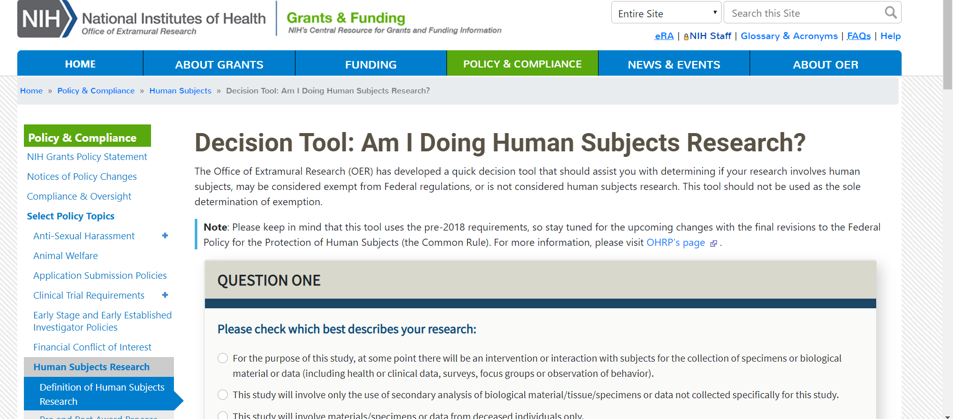
Decision Tool: Am I Doing Human Subjects Research
Notes:
Helpful resource: https://grants.nih.gov/policy/humansubjects/hs-decision.htm

Slide 7
Required Education In the Protection of Human Research Participants
All key personnel must have education on the protection of human research participants:
  Individuals responsible for design and conduct of the research
  Also applies to key personnel at performance sites
One-time training
Guide Notices
NOT-OD-00-039 & NOT-OD-11-061
Published
June 5, 2000 & September 5, 2001

Slide 8

Certificates of Confidentiality (CoC)
Applicable NIH research ongoing or awarded as of December 13, 2016 is deemed to be issued a Certificate
Must not disclose identifiable, sensitive information :
  In any Federal, State, or local civil, criminal, administrative, legislative, or other proceeding
  To any other person not connected with the research
Disclosure permitted only when:
  Required by Federal, State, or local laws (e.g., reporting child or elder abuse, mandatory disease reporting)
  With participants’ consent
  For other scientific research
CoC
Notes:
Alternate text: This graphic illustrates a shield.

Slide 9
Certificates of Confidentiality (CoC) cont’d
    CoC protects “covered information”
      Names or any information, documents, or biospecimens
      If there is a small risk that covered information can be combined wither other data to determine individual’s identity
    CoC applies to all copies of the data
      Secondary researchers must uphold CoC protections
    Covered information protected in perpetuity
Guide Notice
NOT-OD-17-109
Published
September 7, 2017
Notes:
Helpful resource: https://grants.nih.gov/faqs#/certificates-of-confidentiality.htm

Slide 10
Human Fetal Tissue (HFT)
NIH implemented the HHS Policy, effective June 5, 2019
Applicants must provide:
  a justification of the use of HFT,
  details regarding procurement and costs,
  information about how the applicant/contract offeror will use HFT
NIH will not accept modular budgets for applications for research involving HFT
Applications that do not address all required information will be administratively withdrawn and not reviewed
Guide Notices
NOT-OD-19-128 & NOT-OD-19-137
Published
July 26, 2019 & August 23, 2019
Notes:
Note: Additional requirements must be met within existing applicable page limits
all required information, includes a detailed budget,

Slide 11

Inclusion
Inclusion of women and minorities in all NIH funded or supported clinical research mandated by law
Additional requirements for Phase III clinical trials
  Can study be expected to identify potential differences by sex/gender, race, and/or ethnicity
SLIDE | 11
Notes:
Inclusion of Women and Minorities in NIH Research
Public Law (42 U.S. Code § 289a–2) requires:
Women and minorities included in all NIH-funded clinical research studies unless there is a compelling rationale for exclusion
Analyses by sex/gender, race and ethnicity for NIH-defined Phase III clinical trials
Applicable* NIH-defined Phase III trials awarded December 13, 2017 or later must report results of “valid” analyses to Clinicaltrials.gov
Inclusion Across the Lifespan
Inclusion of Children Policy revised in 2015
Individuals under 18
Inclusion Across the Lifespan Policy effective for applications submitted for due dates on or after January 25, 2019 (and for contract solicitations issued after that date).
Requires individuals of all ages included in NIH human subjects research unless there are scientific or ethical reasons not to do so
Requires submission of individual-level data on participant age at enrollment in progress reports

Slide 12
Inclusion cont’d
Must include individuals across the lifespan when conducting clinical research, unless there is a scientific or ethical reason to exclude
Policies Goal: ensure individuals are included in clinical research in a manner appropriate to the scientific question under study
Guide Notices
NOT-OD-16-010, NOT-OD-18-104
& NOT-OD-18-116
Published
October 13, 2015, November 28, 2017
& December 19, 2017

Slide 13
Objectives
Identify NIH policies pertaining to research involving human subjects
Determine when research involving human subjects is a clinical trial
Review considerations when applying for NIH award for research that involves human subjects
Identify NIH resources for investigators conducting research involving human subjects

Slide 14
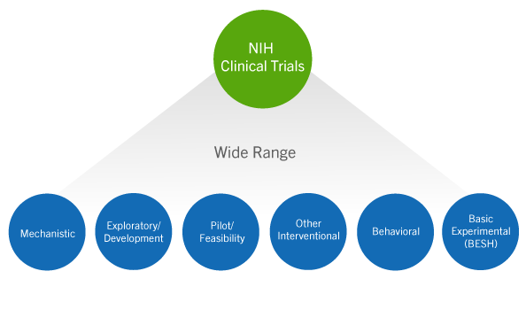
How Does NIH Define a Clinical Trial?
A research study in which one or more human subjects are prospectively assigned to one or more interventions (which may include placebo or other control) to evaluate the effects of those interventions on health-related biomedical or behavioral outcomes
Notes:
Helpful resource: https://grants.nih.gov/policy/clinical-trials/definition.htm

Slide 15
Clinical Trial Questionnaire
Does the study involve human participants?
Are the participants prospectively assigned to an intervention?
Is the study designed to evaluate the effect of the intervention of the participants?
Is the effect that will be evaluated a health-related biomedical or behavioral outcome?
Answers determine:
  Appropriate FOA type
  Application form requirements
  Review criteria for evaluation
  Requirement for registration and results reporting
  Requirement for GCP training
**If YES to all questions, study is a clinical trial

Slide 16
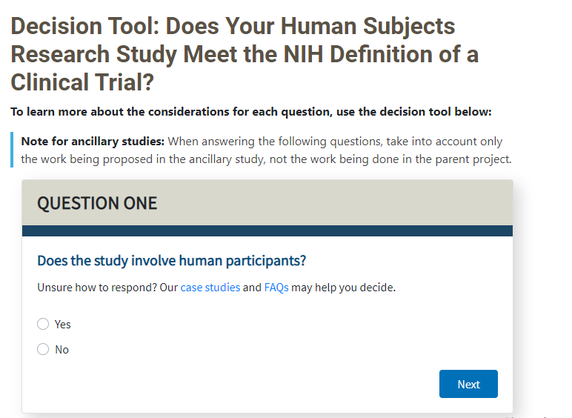
Clinical Trial Decision Tool
Notes:
Helpful resource: https://grants.nih.gov/ct-decision/index.htm

Slide 17
Funding Opportunity Announcement (FOA) for Clinical Trials
  Applications involving clinical trials must be submitted to clinical-trial specific FOAs
  Applications submitted to incorrect FOA will be administratively withdrawn
  Purpose:
    Improve NIH’s ability to identify proposed clinical trials
    Ensure key pieces of trial-specific information are submitted with each application
    Uniformly apply trial-specific review criteria
Guide Notice:
NOT-OD-16-147
Published
September 16, 2016

Slide 18
Basic Experimental Studies with Humans (BESH) FOAs
BESH studies meet definition for BOTH:
  Basic Research
  NIH clinical trial
*NIH extended interim policy flexibilities for registration and results reporting through September 24, 2021
Registration and results reporting is still expected for BESH FOAs, but with *flexibility to use alternative publicly available platforms (other than Clinicaltrials.gov)
*NOTE: The flexibilities only apply to BESH studies funded through BESH FOAs
Guide Notices
NOT-OD-18-212 & NOT-OD-19-126
Published
July 20, 2018 & July 24, 2019
Notes:
RESOURCES for the BESH community:
New funding opportunities specifically for BESH studies
FAQs
Guidance for Determining if a Study Falls Within a BESH FOA

Slide 19
Dissemination of NIH-Funded
Clinical Trial Information
Policy Requires Registration and Reporting:
  SUBMIT - a plan in the application outlining compliance with the policy
  REGISTER - the clinical trial no later than 21 days after enrolling the first participant
  REPORT - Submit summary results no later than one year after primary completion date
Guide Notice:
NOT-OD-16-149
Published
September 16, 2016

Slide 20

Good Clinical Practice Training
(GCP)
All NIH-funded clinical investigators and clinical trial staff involved in the design, conduct, oversight, or management of clinical trials should be trained in GCP
GCP training can be achieved through :
  class or course
  academic training program
  certification from a recognized clinical research professional organization
Training should be refreshed every 3 years
Guide Notice:
NOT-OD-16-148
Published
September 16, 2016

Slide 21
Data and Safety Monitoring
Clinical trials must submit a Data and Safety monitoring plan
  Address overall data and safety monitoring framework
  Describe procedures for adverse event reporting
  Identify the monitor (e.g. PI, independent safety monitor, DSMB, etc.)
Data and Safety Monitoring Board (DSMB) generally required for NIH-defined phase III trials
Guide Notices
NOT-98-084 & NOT-OD-00-038
Published
June 10, 1998 & June 5, 2000
21

Slide 22
Objectives
Identify NIH policies pertaining to research involving human subjects
Determine when research involving human subjects is a clinical trial
Review considerations when applying for an NIH award for research that involves human subjects
Identify NIH resources for investigators conducting research involving human subjects

Slide 23
Using the Human Subjects and Clinical
Trial Form
Form Section | If answered “No” to any questions in Clinical Trial Questionnaire | If answered “Yes” to all questions in Clinical Trial Questionnaire
Section 1 Basic Information | Required | Required
Section 2 Study Population Characteristics | Required; some fields optional if exemption 4 | Required
Section 3 Protection and Monitoring Plans | Some fields required; some fields optional | Required
Section 4 Protocol Synopsis | Not permitted | Required
Section 5 Other Clinical Trial-related Attachments | Not permitted | Required only if specified in FOA

Slide 24

Plan Protection of Human Subjects
1. Risks
  Study population, assignment and procedures
  Sources of materials –access to identifiers
  Potential Risks for ALL research interventions: physical, psychological, social, legal
2. Adequacy of Protection Against Risks
  The consenting process
  Procedures to minimize identified risks, including protecting participant privacy
  Additional protections for vulnerable subjects
Notes:
Address plans for handling incidental findings

Slide 25

Plan Protection of Human Subjects cont’d
3. Potential Benefits of Research to Human Subjects and Others
  Discuss risks in relation to anticipated benefits
  In some cases, there is no direct benefit to subjects
  Do not include financial compensation
4. Importance of Knowledge to be Gained
  Discuss in relation to risks

Slide 26
Plan Protection of Human Subjects cont’d
  Don’t assume reviewers will understand what you mean
    Explain how, what, when, where, why and who
  Common human subject issues identified in peer review:
    Physical or psychological risks not adequately addressed
    Inadequate protections for vulnerable populations
    Source of specimen and/or data
    Incidental findings not addressed
    Missing or inadequate Data & Safety Monitoring Plans
Notes:
Investigator was involved in original data collection or has direct association w/ source

Slide 27
Multi-site Study Considerations
In general, funding recipient is considered engaged in human subjects (HS) research when nonexempt research involves HS
All engaged sites must have:
  FWA (can be covered under recipient’s FWA)
      http://www.hhs.gov/ohrp/policy/guidanceonalternativetofwa.html
  IRB Approval
    U.S. sites to rely on one IRB under 45 CFR 46.114
      Reliance agreement http://www.hhs.gov/ohrp/assurances/forms/irbauthagree.html

Slide 28
Objectives
Identify NIH policies pertaining to research involving human subjects
Determine when research involving human subjects is a clinical trial
Review considerations when applying for an NIH award for research that involves human subjects
Identify NIH resources for investigators conducting research involving human subjects

Slide 29

Useful Resources: Human Subjects Protections and Inclusion
NIH OER Human Subjects website https://humansubjects.nih.gov
OHRP website
https://www.hhs.gov/ohrp/
SLIDE | 29

Slide 30

Questions

