Slide 1
Mike K. Reddy
Program Director
(“Health Scientist Administrator”)
National Institute of General Medical Sciences
(NIGMS)) michael.reddy@nih.gov
“After your first NIH Award”
(Now What??)
NIH Regional Seminar
October 2020
The Matrix

Slide 2
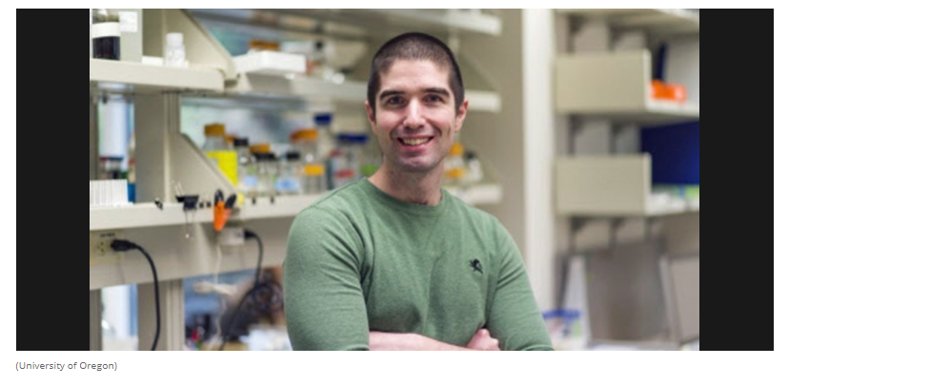
This is dedicated to the memory of
Dr. Jeff McKnight
Assistant Professor of Biology
University of Oregon

Slide 3
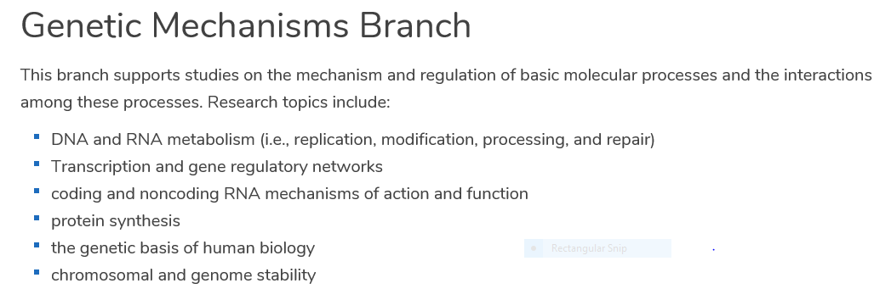
Division of Genetics and Molecular, Cellular, and Developmental Biology (GMCDB)
https://www.nigms.nih.gov/
Notes:
NIGMS has 5 different Divisons. My Division has 3 different Branches.

Slide 4
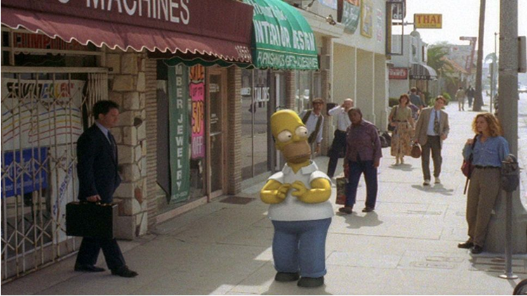
Mike in 3D

Slide 5
Imagine it is New Year’s Eve in the year 2049….…… what do you think your career will have looked like going into 2050?

Slide 6
Career Significance
Roll

Slide 7
What should be your overarching mindset as you begin to develop your own
Research Program?

Slide 8
Think like a Farmer.

Slide 9
How to Cultivate a Research Program
Apply fertilizer
Rotate crops
Don’t overwater
What’s selling for the highest price
at the Market?
Plan for a drought!!!

Slide 10
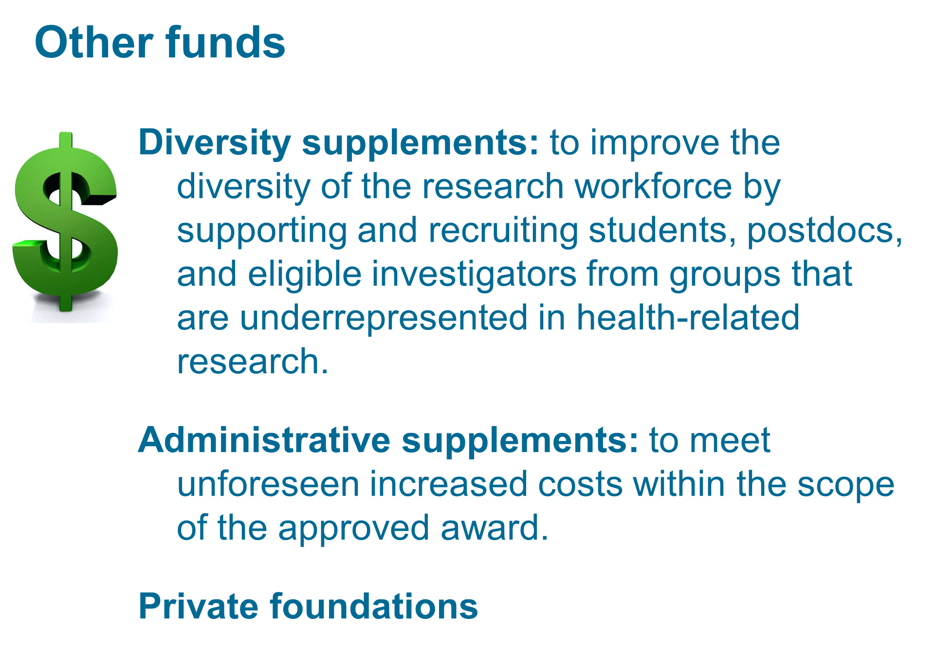
Secondary Sources of Funding:
“Spare Change” for some
…..a lifeline for others.

Slide 11
Mentorship
One size doesn’t fit all.

Slide 12
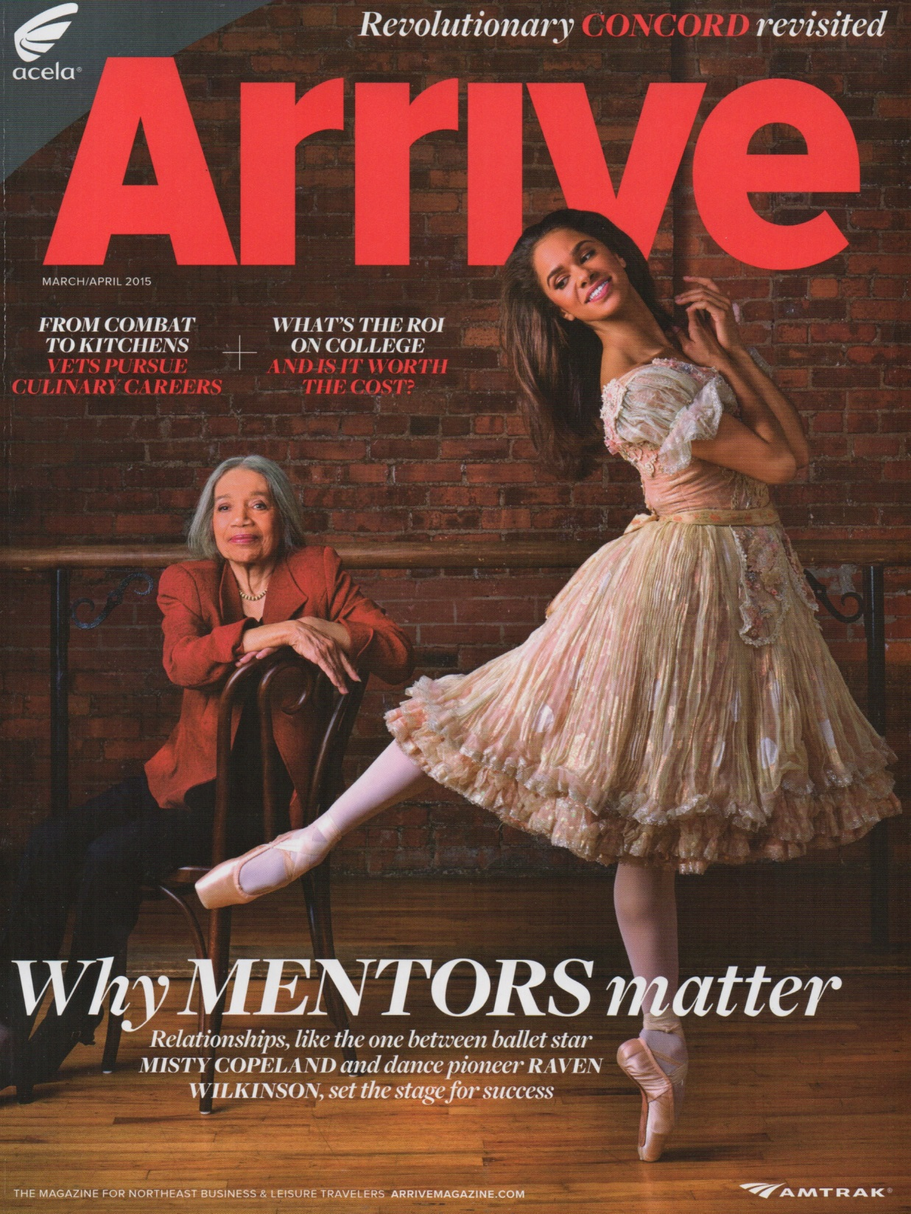
Mentors

Slide 13
MISTY COPELAND
(Ballerina
“You have to be open and receptive. There can be people in front of you who could be great mentors, but if you can’t be open to it, it’s pointless.”

Slide 14
Being a Mentor to your Mentees…..
Just one Rule:
DO NO HARM.

Slide 15
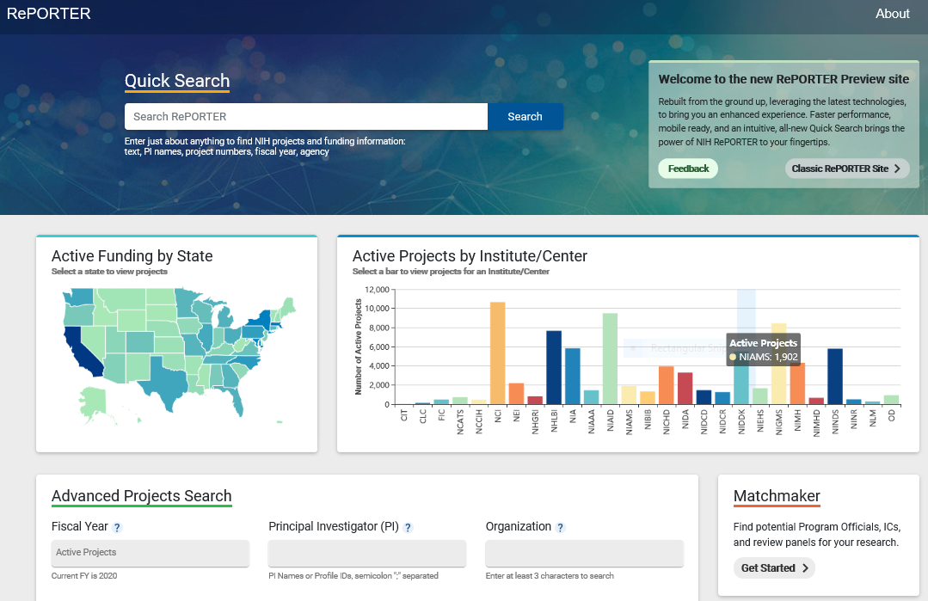
RePORTER good way to Find Possible Mentors/Collaborators
https://reporter.nih.gov/

Slide 16
Choosing a collaborator
At this early stage of your Career, perhaps the best strategy is to:
HOLD OUT FOR A COLLABORATOR WHO IS GENUINELY MORE INTERESTED IN ASSISTING YOUR CAREER THAN ONE WHO IS LOOKING FOR YOU TO HELP THEIR CAREER.

Slide 17
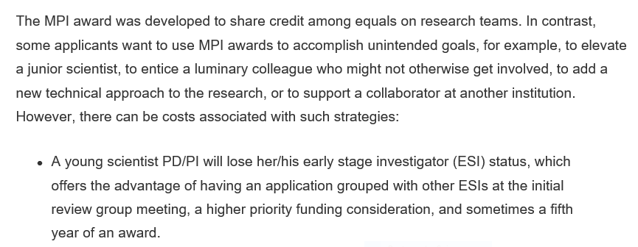
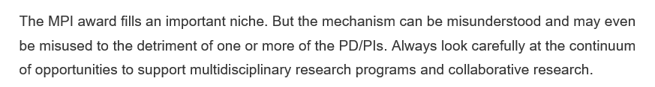
Early Stage Investigators (ESI) should think long and hard about submitting a multi-PI (MPI) application…..
Notes:
Written Sept 20, 2017 by Dr. ROCHELLE LONG, Director of PBCB in NIGMS
https://loop.nigms.nih.gov/2017/09/multiple-principal-investigator-mpi-application-when-is-it-the-right-choice

Slide 18
Your Interactions with your
Program Director
A mentor (of sorts) as well……..
But there’s a built-in “Firewall”
between us.
We can’t be your “Friend” per se…
Nor can we can give you specific input about the scientific details in your application.

Slide 19
Good or Bad?
8:00 AM: Scores from your application are released.
8:03 AM: You call up your Program Director and ask if your 31% score will be funded.
Notes:
WAIT FOR SUMMARY STATEMENT

Slide 20
Good or Bad?
It’s 3 hours before the Deadline of receipt-of-your-application. So you pick up the phone, dial-up your Program Director and ask them penetrating questions such as:
Is 10 pt font allowed if I use “Baskerville Old Face” as my font?
I grew up in Europe so I am only familiar with the metric system: Is the current margin limit equal to exactly 25.4 mm or can I get away with using 24.0 mm?
The instructions indicate that I can send in a one-page update to the Study Section after I submit my application. However, I’m a New Investigator - who works in an IDeA State - and I was wondering if I could get permission to send in 1.5 pages instead?

Slide 21
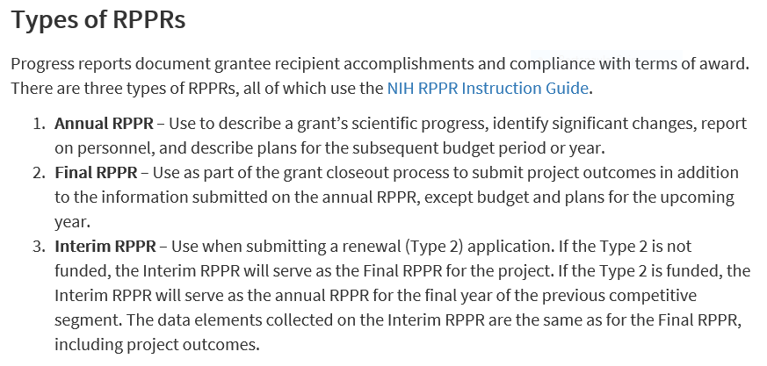
Research Performance Progress Report
(RPPR)
“Annual Reports”
Believe it or not………..we really DO read them!
https://grants.nih.gov/grants/rppr/index.htm

Slide 22
Partner with your AOR
You should establish and maintain a vibrant relationship with your Institute’s Authorized Organizational Representative
AKA
“Business/Funding Official”
I assure you that a time will come when you are crawling to your AOR hours before the submission deadline.
☺

Slide 23
AORs Keep Current with NIH Policy
A vital component of the AOR’s job is to keep current with the latest requirements, FOAs (Funding Opportunity Announcement), RFAs (Requests for Applications) and NOSIs (Notice of Special Interest) available from the NIH.

Slide 24
Be Proactive
May I suggest that you be proactive and schedule an Annual Presentation at Faculty Meetings where your AOR can efficiently cover issues such as:
new compliance directives
changes in deadlines
new requirements or other significant changes.
Etc.

Slide 25
Ability to make things right
Some of you use animals in your Research (or use animals to make antibodies). There are a lot of “hoops” to jump through in NIH Grant Applications to legally use animals. One of the most important is that your Institute must have a current IACUC Animal Authorization license. It turns out that yours has expired 6 months ago.
You had no idea at all about this!
But guess who DOES know this situation and can begin to make things right and is Authorized to contact the NIH Office of Laboratory Animal Welfare (OLAW)??
Notes:
IACUC = Institutional Animal Care and Use Committees

Slide 26
Official correspondence come from AOR
Of final overriding importance:
NIH requires ALL official correspondence from your Institute to come through the AOR.
NOT the PI!!
So when a PI is unaware of this fact and sends a vital document directly to the
NIH Grants Administrator
- on the same day the sole AOR handling your submission has left for their 2-week vacation -
well that’s just too bad.
Ain’t it?

Slide 27
IF/WHEN you are ever given the opportunity to Review for the NIH……SEIZE IT.
YOU MAY - OR MAY NOT - BE ASKED BY THE CENTER for SCIENTIFIC REVIEW (CSR) AFTER YOUR FIRST INDEPENDENT NIH AWARD.
IF YOU HAVE APPLIED FOR NIH AWARDS - BUT NOT YET BEEN SUCCESSFUL - YOU MIGHT WANT TO CONSIDER LOOKING INTO THIS:

Slide 28
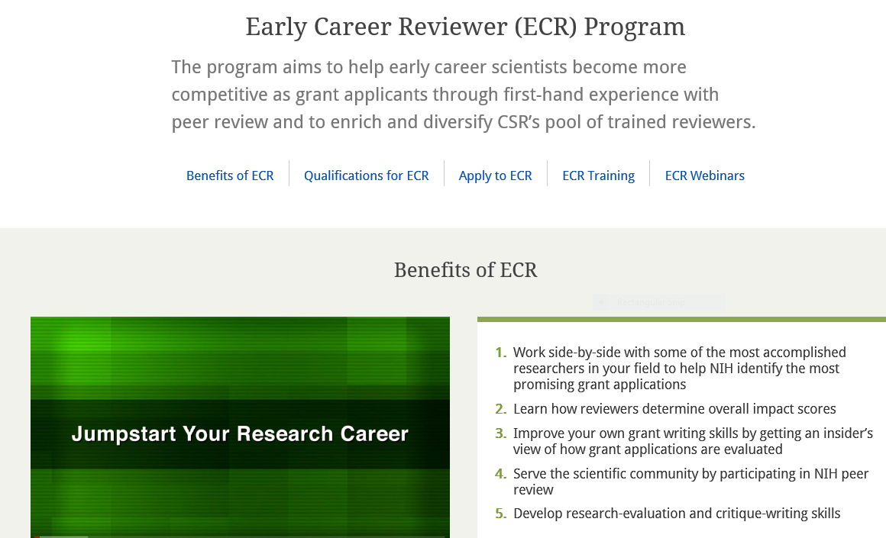
https://public.csr.nih.gov/ForReviewers/BecomeAReviewer/ECR
Nota Bene:
-this Program NOT for post-docs nor tenured (Associate) professors
-geared towards applicants who have received a Summary Statement
already but not yet secured an Award

Slide 29
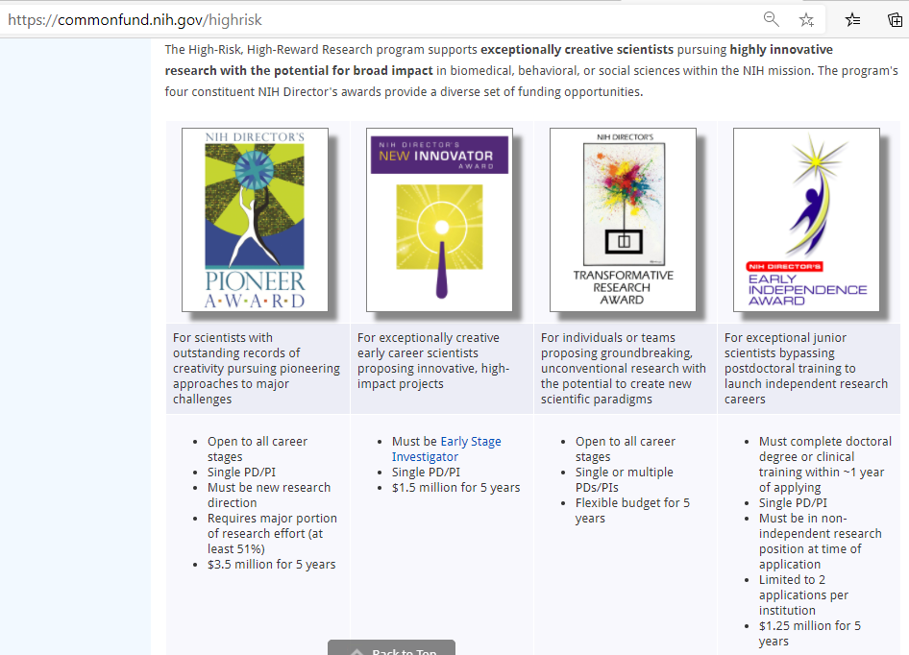
High-Risk, High-Reward Research Program for outstanding scientists at all career stages

Slide 30
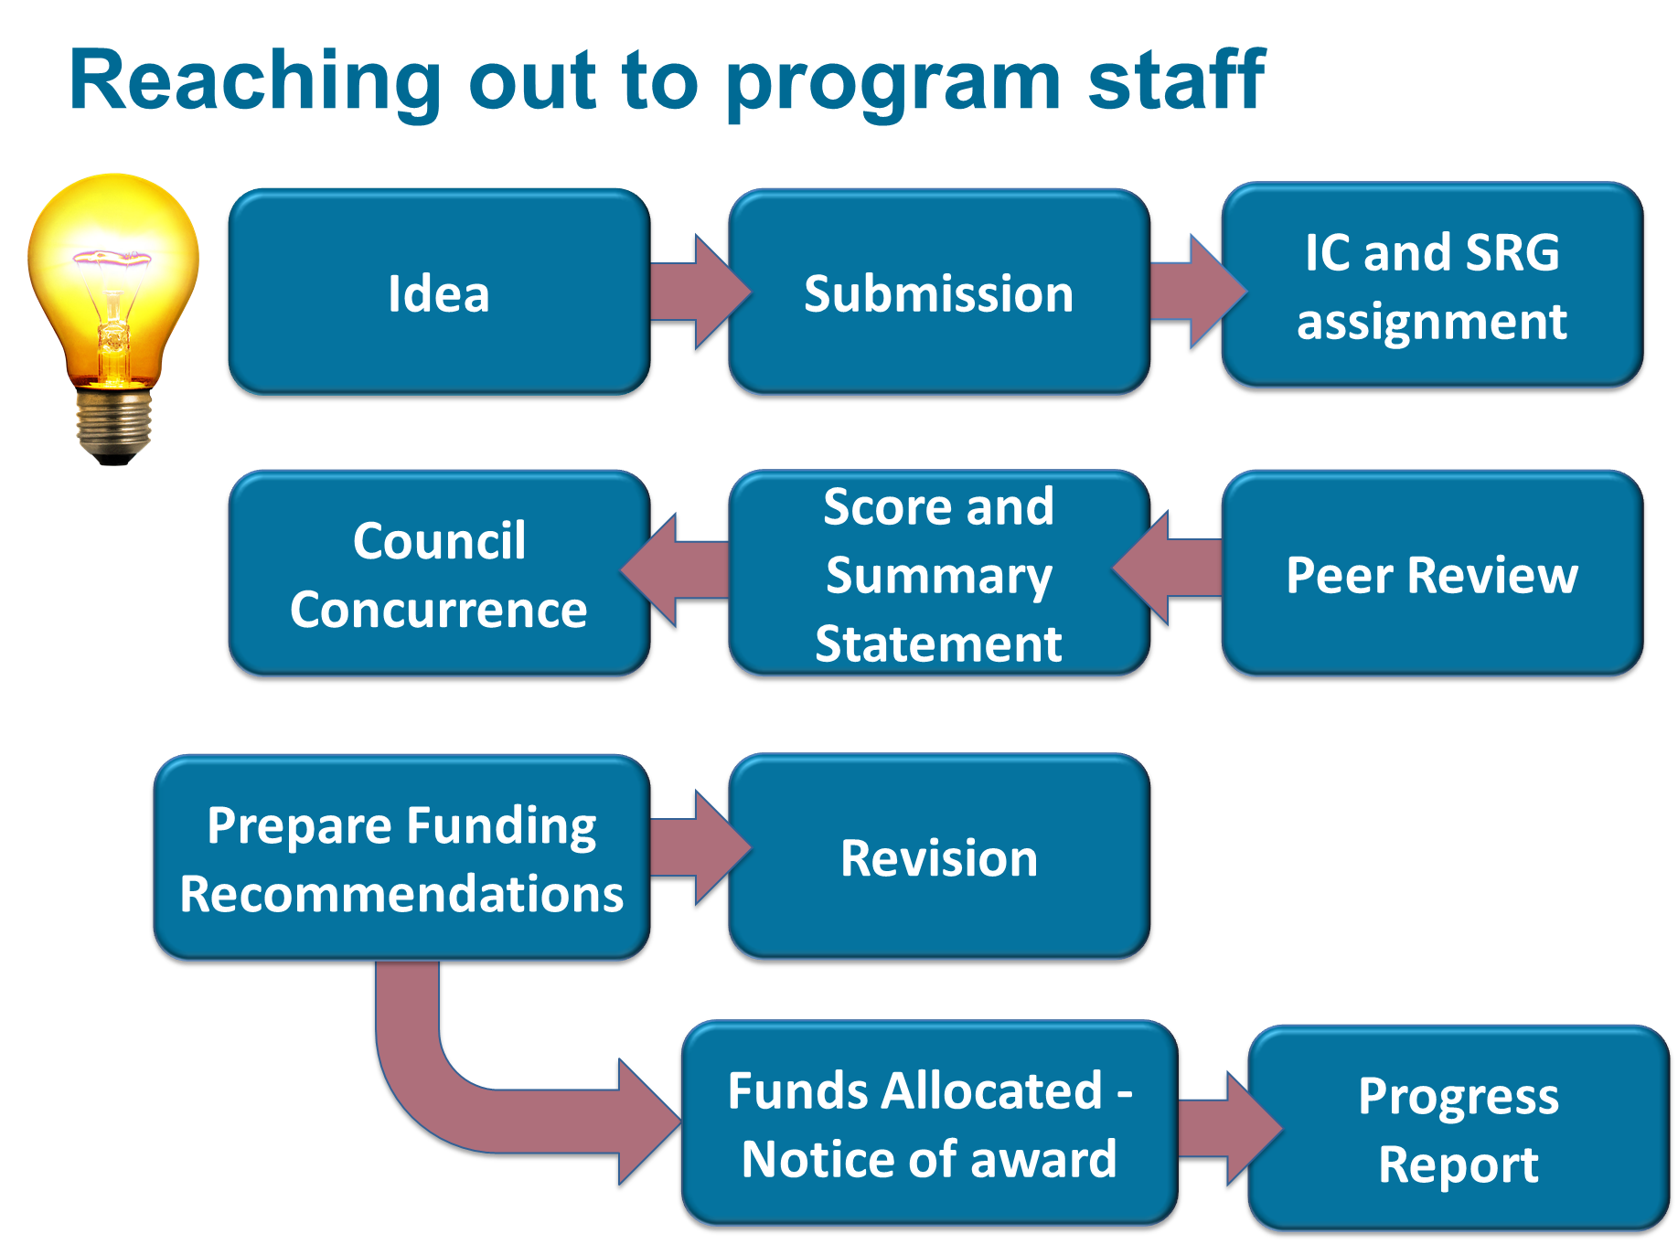


The Whole Nine Yards……..

Slide 31
Balancing your Life and your Career
Learn to say NO!
Wake up earlier.
Yes, including weekends.
OK….especially weekends.
Watch Sesame Street. Regularly.

Slide 32
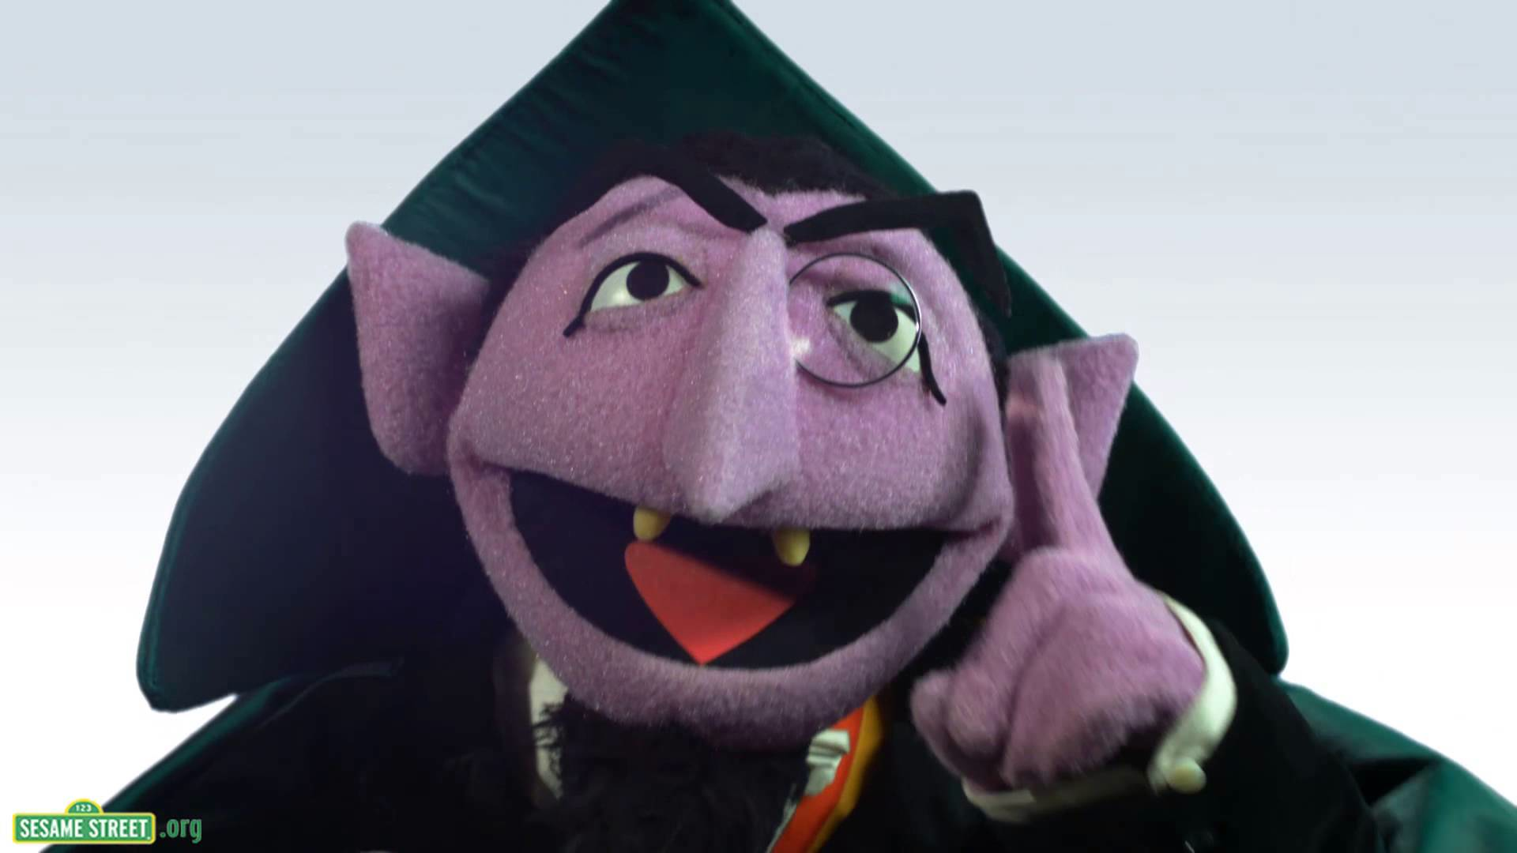
Questions
How Many Questions Do you Have?
1, 2, 3 or 4???

