Slide 1
Addressing Sexual Harassment in the Biomedical Workplace
NIH Virtual seminar 2020

Slide 2



Our Panelists
Michael S. Lauer, M.D
Michelle Bulls
PaULA GOODWIN, Ph.D
Deputy Director for Extramural Research
National Institutes of Health
Director, Office of Policy for Extramural Research Administration (OPERA)
Office of Extramural Research, NIH
Program Administration Officer
Office of Extramural Research, NIH

Slide 3
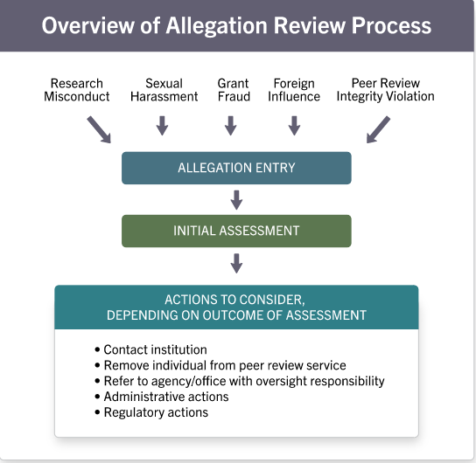
How NIH Handles Allegations

Slide 4
NIH Policies on Safe Work Environment
NIH GPS Section 4: NIH recipients are expected to provide safe and healthful working conditions for their employees and foster work environments conducive to high-quality research.
NIH expects that institutions:
  Develop and implement policies and practices that foster a harassment-free environment
  Maintain clear, unambiguous professional codes of conduct
  Ensure employees are fully aware and are regularly reminded of applicable laws, regulations, policies and codes of conduct

Slide 5
Notifying NIH – Impact on Awards
NIH requires recipient organization to proactively notify NIH of changes in senior/key personnel status that impact the ability of the employee to continue in their role on the award. For example:
  Restricting access to campus/lab space
  Restricting ability to interact with students
  Placing the employee on extended administrative leave, when they cannot perform their duties
Institutional officials should contact the NIH Grants Management Specialist listed on the Notice of Award to request a change in PI or notify NIH of any issues impacting the award

Slide 6
Updated Guidance regarding Change in Status: PD/PI and Recipient Institution
Change in PD/PI/key personnel requests and requests for change in recipient institution should include:
  mention as to whether the change is related to concerns about safety and/or work environments (e.g. due to concerns about harassment, bullying, retaliation, or hostile working conditions).
This information allows NIH to make informed grant-stewardship decisions regarding matters including, but not limited to, substitute personnel and institutional management and oversight.
Learn more: NOT-OD-20-124
https://grants.nih.gov/grants/policy/harassment.htm

Slide 7
NIH Process for Handling Allegations
NIH Office of Extramural Research (OER) receives allegations centrally via harassment mailbox and webform
  granteeharassment@nih.gov
  https://grants.nih.gov/grants/policy/harassment/find-help.htm
Institutions are encouraged to use this mailbox to contact OER with questions or when concerns arise regarding harassment at your institutions.
When NIH learns of an allegation of harassment that may impact NIH-funded research, we will contact the recipient institution to learn more

Slide 8

Resources
NIH website grants.nih.gov/grants/policy/harassment
Contact NIH:
Webform: https://public.era.nih.gov/shape/public/index.era
Email: GranteeHarassment@od.nih.gov

Slide 9
Discussion & Questions

