Slide 1
Doing Human Subjects Research?
Changing NIH Policies May Impact You

Slide 2
Reforms & Initiatives To enhance the stewardship of research involving human subjects, NIH is implementing the following:
All Research Involving Human Participants
Research that Meets the NIH Definition of a Clinical Trial
New forms to collect human subjects information
Use of a single Institutional Review Board (IRB) for multi-site studies
Certificates of confidentiality for all research that uses “identifiable, sensitive information”
Training in Good Clinical Practice (GCP)
Clinical trial-specific Funding Opportunity Announcements (FOAs)
New review criteria
Expanded registration and results reporting in ClinicalTrials.gov

Slide 3
NIH Initiatives to Enhance Clinical Trial Stewardship
Clinical Trial FOAs
Good Clinical Practice
Registration & Reporting
Enhancing Clinical Trial Stewardship at NIH
Single IRB
New Application Forms
Accountability
Transparency
Efficiency
Dissemination
Clinical Trial Review Criteria
Learn more at https://grants.nih.gov/policy/clinical-trials.htm

Slide 4
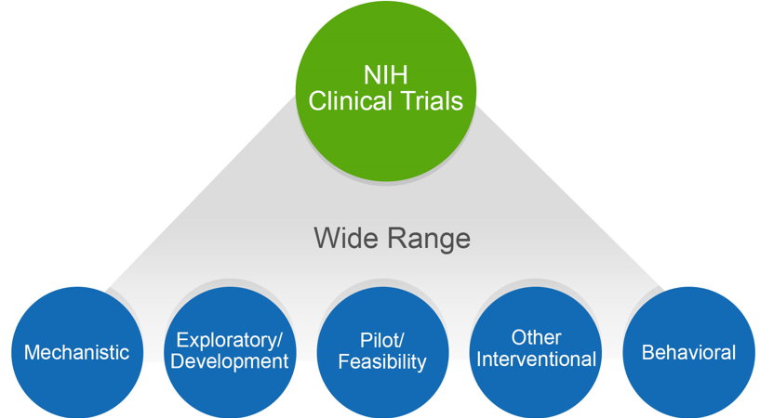
NIH Might Consider Your Human Subjects Research to be a Clinical Trial
Does your study…
Involve one or more human subjects?
Prospectively assign human subject(s) to intervention(s)?
Evaluate the effect of intervention(s) on the human subject(s)?
Have a health-related biomedical or behavioral outcome?
If “yes” to ALL of these questions, your study is considered a clinical trial
Unsure how to answer the questions? We have a tool that can help! https://grants.nih.gov/ct-decision/

Slide 5
Identifying Whether NIH Considers Your Study to be a Clinical Trial is Crucial
It impacts whether you need to:
Respond to a clinical trial-specific FOA
Address additional review criteria specific for clinical trials
Register and report your clinical trial in ClinicalTrials.gov

Slide 6
Identifying the Right Funding Opportunity Announcement (FOA) is Key
Due Dates on or after January 25, 2018
All clinical trial applications MUST be submitted to an FOA that allows clinical trials
How to determine if an FOA accepts clinical trials?
Refer to Section II. Award Information
Indicated in FOA title (new FOAs only)
Tip: Check your FOA at least 30 days before the due date for any updates
Notes:
See policy notice for table that provides dates for reviewers eligible for continuous submission, late applications, etc.

Slide 7
Good Clinical Practice (GCP) Training
Who:
All NIH-funded investigators involved in the conduct, oversight or management of clinical trials
Investigators are expected to receive Good Clinical Practice training
To assure the safety, integrity, and quality of clinical trials
Through a class or course, academic training program, or certification from a recognized clinical research professional organization
Effective January 2017. Training should be refreshed every 3 years
What:
Why:
How:
When:
See https://grants.nih.gov/policy/clinical-trials/good-clinical-training.htm
Notes:
The NIH GCP policy does not specify that a particular GCP course or program be taken. The policy includes links to GCP training courses sponsored by NIAID and NIDA. In addition, NCATS has developed a GCP training program geared to behavioral clinical trial investigators. These courses are free of charge. Other free courses as well as fee-based courses are available.

Slide 8
Clinical Trial Specific Review Criteria
FOAs will include additional criteria:
Scored Review Criteria
Significance
Investigator
Innovation
Approach
Environment
Additional Review Criteria
Study Timeline & Milestones
Read the FOA carefully and be sure your application addresses the review criteria appropriately

Slide 9
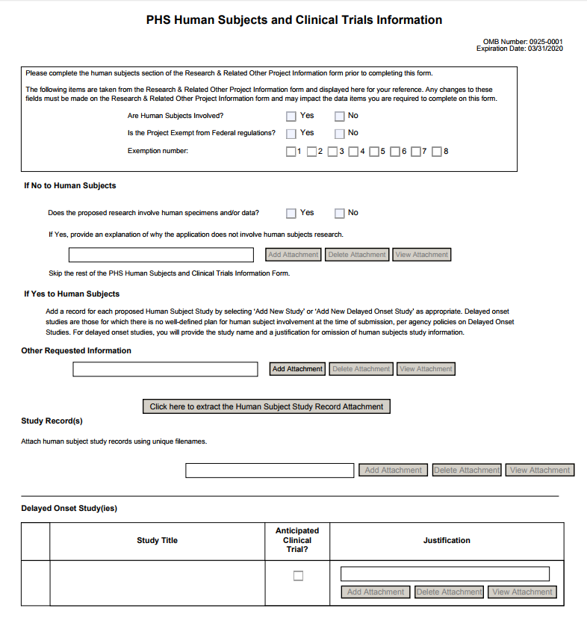
New Application Packages (FORMS-E)
Due Dates on or after January 25, 2018
FORMS-E Application Packages is REQUIRED (including new Human Subjects and Clinical Trials form)
PHS Human Subjects and Clinical Trials Information Form
Consolidates information from multiple forms
Incorporates structured data fields
Collects information at the study-level
Be sure you are using the correct application forms for your due date.
FORMS-E will be available October 2017.
See https://grants.nih.gov/policy/clinical-trials/new-human-subject-clinical-trial-info-form.htm
Notes:
See table in guide notice NOT-OD-17-062 for timing for continuous submitters, late applications, etc. . More information on new form at https://grants.nih.gov/policy/clinical-trials/new-human-subject-clinical-trial-info-form.htm

Slide 10
Changes to the Appendix Policy
Due Dates on or after January 25, 2018
Since the new Human Subjects and Clinical Trials Information form collects key elements from the protocol, the optional protocol submission will be removed from the Appendix Policy.
Parent FOAs
Will NEVER allow inclusion of the protocol in the application
If the protocol is included, the application will be sent back
IC issued FOAs
Protocols and other materials allowed only when specified as required in the FOA
See NIH Guide Notice: https://grants.nih.gov/grants/guide/notice-files/NOT-OD-17-098.html

Slide 11
Registering & Reporting NIH-funded Clinical Trials in ClinicalTrials.gov
Who:
All clinical trial applications requesting support for a trial that will be initiated on/after January 18, 2017
Register and report the results of trials in ClinicalTrials.gov
Increase the availability of information about clinical trials and their results to the public in a timely manner
Effective for applications due on/after January 18, 2017
What:
Why:
When:
See https://grants.nih.gov/policy/clinical-trials/reporting/steps.htm

Slide 12
Single Institutional Review Board (sIRB) Policy for Multi-site Research
Domestic multi-site non-exempt human subjects research studies will require a single IRB of record
Key Dates
Grants: Applications due on or after January 25, 2018
Contracts: Solicitations published starting January 25, 2018
Exceptions
sIRB not applicable for Career Development (K), Research Training (T), or Fellowship (F)
See https://grants.nih.gov/policy/clinical-trials/single-irb-policy-multi-site-research.htm

Slide 13
Updated Certificates of Confidentiality (CoC) Policy
Effective October 1, 2017 - CoCs will be issued automatically for any NIH-funded project using identifiable, sensitive information that was on-going on/after December 13, 2016
Eliminates the need for NIH funded investigators to apply for a CoC
Enhances the privacy protections of individuals participating in NIH-funded research
Requires investigators to only disclose information under specific circumstances
Applies to NIH awards funded wholly, or in part, by NIH
Disclosure restrictions also apply to anyone who receives a copy of identifiable sensitive information protected by the policy, even if they are not funded by NIH
CoC is issued as a term and condition of award (no physical certificate)
Learn more at https://humansubjects.nih.gov/coc/index

