Slide 1
Updates to Institutional Training Grant Applications
Drop-in slides – the first 8 can be used as a set; slides 9-12 are provided in case you’d like to present in more detail
Updated: February 25, 2025

Slide 2
Use these slides if you want to cover the topic briefly

Slide 3
Changes Coming: Updates to Institutional Training Grant Applications
Aims:
Reduce applicant and reviewer burden.
Further support the development of a biomedical research workforce that will benefit from the full range of experiences needed to advance discovery.
Scope:
Applies to applications submitted for due dates after January 25, 2025, using the following activity codes:
Institutional Training– T series, e.g., T15, T32, T34, T35, T37, T90/R90, TL1, TL4
International Institutional Training – D43, D71, U2R
Institutional Career Development – KL2, K12
Guide Notice
NOT-OD-24-129

Slide 4
Why are Changes Being Made?
Over the past decade, NIH has made significant investments to develop, implement, assess and disseminate innovative, effective approaches to research training and mentoring and to prepare trainees for a variety of career paths in the biomedical research workforce.
The updates are driven by:
A need for evidence-informed mentoring practices that promote trainee development.
The need to support trainees pursuing the full breadth of scientific career paths to advance the NIH mission.
The desire to reduce training grant applicant and reviewer burden.

Slide 5
Overview of the Updates
Key application changes:
Parent T32 Notice of Funding Opportunity (NOFO) – Define mentor training expectations.
Update NRSA Data Tables to reduce burden and promote consistent information collection across training programs.
Key changes to peer review:
Move “Responsible Conduct of Research” to Additional Review Considerations so it contributes to the overall impact score.

Slide 6
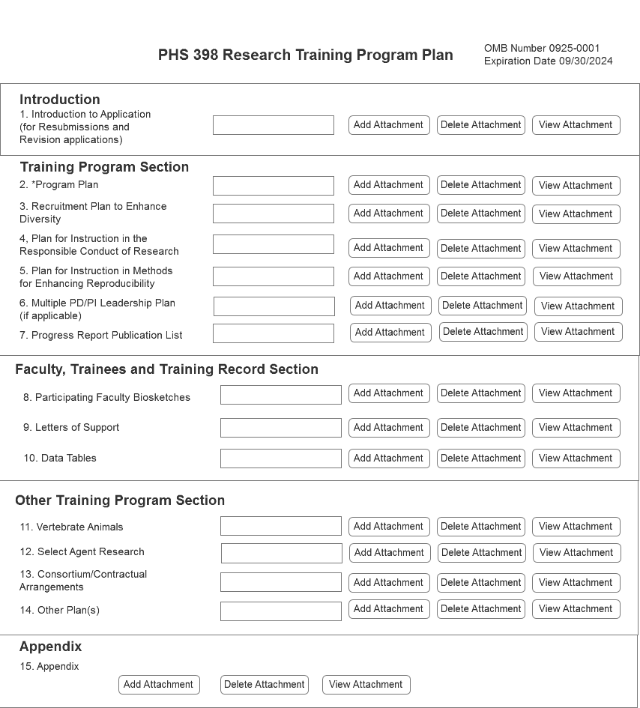
Application Updates PHS 398 Research Training Program – Updated Form
The Recruitment Plan to Enhance Diversity will no longer be considered by reviewers
Updated form
Program Plan (25-Page Limit)
Background
Program Plan
Plan for Instruction in the Responsible Conduct of Research
Plan for Instruction in Methods for Enhancing Reproducibility
Multiple PD/PI Leadership Plan (if applicable)
Progress Report (for Renewal applications)

Slide 7
Funding Opportunity Updates Mentor Training Expectations and Career Outcomes
Parent T32s will include language to better define and support expectations for mentor training
Addressed in the program considerations, program plan, and review criteria
Potential mentor training topics include:
Aligning expectations
Maintaining effective communication
Fostering independence
Assessing scholars' understanding of scientific research
Enhancing professional development
Articulating mentoring philosophy and plan
Programs should adapt mentor training topics to suit program and trainee needs.

Slide 8
Peer Review Updates
Training grants will retain the five scored review criteria currently used in review.
Training Program and Environment
Training Program Director(s)/Principal Investigator(s)
Preceptors/Mentors
Trainees
Training Record
“Training and the Responsible Conduct of Research” will be moved to Additional Review Criteria
Will now contribute to the overall impact score
Previously post-score considerations

Slide 9
Data Table Updates General and Program-Specific Updates
Changes are intended to reduce burden and promote consistency in the requested information
For all data tables
Updated table instructions to clarify terms and lettering for training stage
Remove redundancies by not asking for structured data available elsewhere in the application
Multiple changes specific to predoctoral, postdoctoral, undergraduate, and international training tables, including:
Update Table 1 - applicants will only be required to provide information relevant to the training stage(s) in the proposed program.
Realign table 5 - focus on the outcomes only on trainees supported by the grant.
Table 6 - remove some trainee characteristics.
Table 8 - remove “Part II. Those Clearly Associated with the Training Grant” & encourage reporting this information in the Program Plan Section or RPPR narrative.

Slide 10
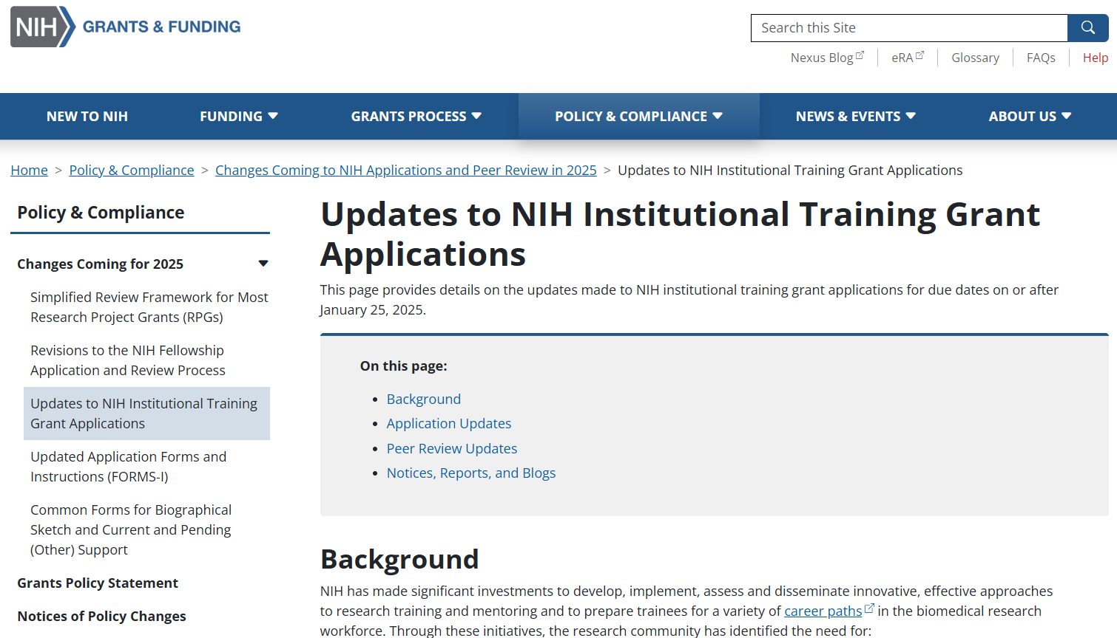
NIH Grants Page on Updates to Institutional Training Grant Applications
Background
Overview of changes
Notices, reports, and blogs
Training, resources, and FAQs
Contact information
Link: grants.nih.gov/policy/changes-coming-jan-2025/updates-to-training-grants.htm

Slide 11
Extra slides to consider including

Slide 12
Data Table Updates Changes Impacting all Applications
Overall, updates to reduce burden and promote consistency in requested information.
Table 1 (Census of Participating Department or Interdepartmental Programs)
Currently, T32 applicants provide information on predoctorates and postdoctorates, regardless of the training stage of the proposed program.
Planned update:
Applicants will be required to provide data only relevant to the training stage(s) in the proposed program.
Undergraduate training programs (T34) will include this table.
Table 8: Program Outcomes
Currently, asks T32 grantees to include “Clearly associated” trainees.
Planned Update: Remove “Part II. Those Clearly Associated with the Training Grant” – encourage to report in Program Plan Section or RPPR narrative.
Notes:
We are not asking them to do more (except T34, where we’re looking for consistency with other Ts)
Information removed can be provided in the narrative if applicants/grantees want to

Slide 13
Data Table Updates Table 5 – Publications of Those in Training
Currently oriented around the training faculty as opposed to trainee outcomes.
Planned updates
Re-align table to focus on outcomes for trainees supported by the grant.
Allow inclusion of interim research products (such as preprints) only when final publication not available.
Similar to what happens for R, F, and K applications.
Undergraduate: Can include external, published conference abstracts.
Notes:
Issues
Misalignment between title (focused on trainees) and data presented (focused on participating faculty).
Applicants are confused about which trainees to include.
Participating faculty change – trainee outcomes for faculty who’ve left (positive or negative) are not captured here.
Centering on faculty record can discourage programs from including ESI trainers because lack of “training record”

Slide 14
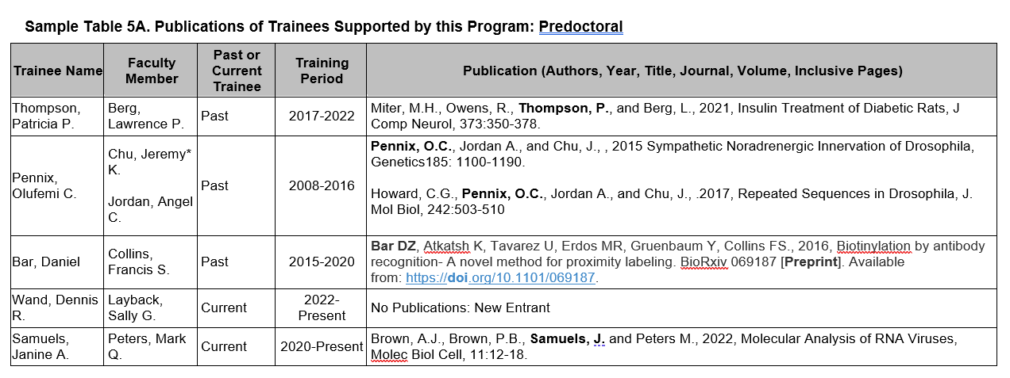
Data Table Updates Table 5 – Example
List trainees first (followed by PI); trainees will match those listed on Table 8 (up to 10 years)
Add pre-print example
Options
Add co-mentor
Can denote former trainers (*)

Slide 15
Data Table Updates Table 6 - Applicants, Entrants, and their Characteristics for the Past Five Years
Currently, T32 applicants collect detailed trainee characteristics on anyone who applied to and entered the training program.
Predoc: Mean months of prior research experience, prior institution, and GPA.
Postdoc: Mean number of publications (total and first author), prior institutions.
Counters NOFO instructions for “multifactorial” candidate review process.
Program admissions is the applicant’s responsibility – NIH wants to focus on post-appointment outcomes.
Planned update: Remove above referenced trainee characteristics.

