Slide 1
Simplifying Review Framework for NIH Research Project Grants
Drop-in slides – the first 4 can be used as a set; slides 8-22 are provided in case you’d like to present in more detail

Slide 2
USE THESE if you want to cover the topic briefly

Slide 3
Changes Coming: Simplified Framework for NIH Peer Review
Goals:
Enable peer reviewers to better focus on answering the key questions necessary to assess scientific and technical merit
Should the proposed research project be conducted?
Can the proposed research project be conducted?
Mitigate the effect of reputational bias
Reduce reviewer burden
When?
Applies to most research project applications submitted for January 25, 2025 due dates
Guide Notice NOT-OD-24-010

Slide 4
What Will Change Under the Simplified Review Framework for Research Project Grants?
Improve reviewer focus
Existing five review criteria reorganized into three factors
Some Additional Review Criteria (inclusions, study timeline) related to human subjects moved to Factor 2
Reduce reputational bias
Investigator/Environment will be evaluated as sufficient or gaps identified (considered in overall impact score, but no individual score)
Reduce reviewer burden
Most Additional Review Considerations shifted from reviewers to NIH staff
Improve identification of the strongest, potentially highest-impact research

Slide 5
The Simplified Review Framework Reorganizes Five Regulatory Criteria into Three Factors
On or after Jan 25, 2025 - Simplified Framework
(all considered in Overall Impact Score)
Factor 1: Importance of the Research
Significance, Innovation
Scored 1-9
Factor 2: Rigor and Feasibility
Approach (also include Inclusions and Study Timeline for clinical trials)
Scored 1-9
Factor 3: Expertise and Resources
Investigators, Environment
Evaluated as appropriate or gaps identified; gaps require explanation
Considered in overall impact; no individual score
Before January 25, 2025
Significance - scored
Investigator(s) – scored
Innovation – scored
Approach – scored
Environment - scored
Notes:
Currently, the 5 review criteria all received criterion scores. The new Simplified Framework will recontextualize these criterion into 3 Factors. The first factor is asking reviewers to assess the importance of the proposed research and will be supported by the Significance and Innovation criterion and receive the same 1-9 scoring scale. The second factor assesses the Rigor and Feasibility of the proposed methodology to achieve the proposed aims and thanks to the Clinical Trials Working group has rightly incorporated the assessment of the Inclusion of women, minorities and ages across the lifespan and the clinical trial design into Factor 2 to focus the evaluation of human subjects research on the science proposed. Factor 2 will also receive a criterion score on the existing 1-9 scale.
Finally, Factor 3 will evaluate the Expertise and Resources and this will be a binary evaluation of the Investigators and Environment for their ability to support the science being proposed so it will be evaluated as appropriate or gaps identified where the reviewers will write an explanation of any deficiencies. This factor will be weighed into the final impact assessment but will not receive a criterion score

Slide 6
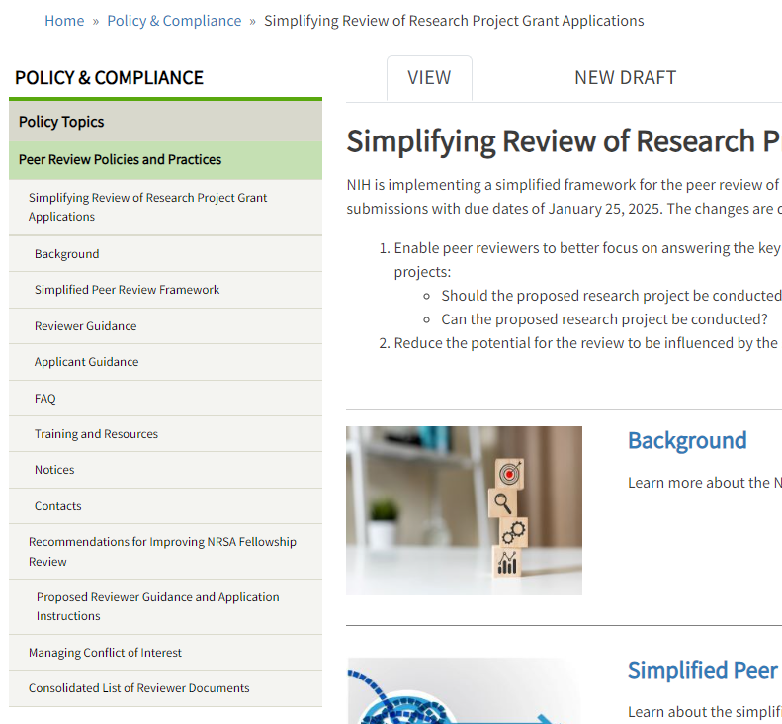
Learn More & Stay Informed
Development background
Description of changes
Guidance for reviewers
Guidance for applicants
Training and resources
Notices and reports
FAQs
Contacts
grants.nih.gov/policy/peer/simplifying-review.htm

Slide 7
A DECK with More detail (intro, implementation, details of changes) follows

Slide 8
INTRO SLIDES

Slide 9
Changes Coming: Simplifying Review of Research Project Grant Applications
What’s changing?
The five peer review criteria are reorganized into three factors
Investigator/Environment will be assessed with a binary choice – sufficient or not
Most Additional Review Considerations shifted from peer reviewers to NIH staff
What’s the scope of the changes?
Affecting RPGs with the following activity codes:
R01, R03, R15, R16, R21, R33, R34, R36, R61, RC1, RC2, RC4, RF1, RL1, RL2, U01, U34, U3R, UA5, UC1, UC2, UC4, UF1, UG3, UH2, UH3, UH5, (including the following phased awards: R21/R33, UH2/UH3, UG3/UH3, R61/R33)
When will the Simplified Framework be Implemented?
Applies to applications submitted for January 25, 2025 due dates
Summer 2025 peer review and October 2025 Advisory Council
Learn more: grants.nih.gov/policy/peer/simplifying-review.htm

Slide 10
Motivation for Examining Application Review
Organization of peer review criteria had become too complex
Persistent feedback from reviewers and observed by NIH Staff
Expansion of administrative and policy-compliance expectations for reviewers
Detracts attention away from the critical, primary role of reviewers to evaluate scientific merit
Undue influence of reputation in NIH peer review
Concerns from the community
Observations by NIH staff or NIH leadership
Affects judgements of merit when well known places/people are given a pass and others treated with more scrutiny

Slide 11
What Will Change Under the Simplified Review Framework for Research Project Grants?
Existing five review criteria reorganized into three factors
Investigator/Environment will be evaluated as sufficient or gaps identified (considered in overall impact score, but no individual score)
Some Additional Review Criteria (inclusions, study timeline) related to human subjects to be evaluated within Factor 2, for more rigorous review
Most Additional Review Considerations shifted from reviewers to NIH staff
Facilitate the overarching goal of peer review: identification of the strongest, potentially highest-impact research

Slide 12
Implementation and support

Slide 13
Public Website on Simplified Review Framework
Development background
Description of changes
Guidance for reviewers
Guidance for applicants
Training and resources
Notices and reports
FAQs
Contacts
grants.nih.gov/policy/peer/simplifying-review.htm

Slide 14
April 17, 2024 Public Webinar
What:
Details on the reissuance of funding opportunities affected by the Simplified Review Framework for Research Project Grants
When:
April 17, 2024 from 1-2 PM ET
Where:
Register: https://grants.nih.gov/learning-center/srf-updates-to-funding-opportunities
View recording after event: https://grants.nih.gov/policy/peer/simplifying-review.htm
Subscribe to the NIH Guide to stay abreast of future webinars and related announcements. https://grants.nih.gov/funding/subscribe.htm

Slide 16
Detail on Simplifying Review changes

Slide 17
The Simplified Review Framework Reorganizes Five Regulatory Criteria into Three Factors
On or after Jan 25, 2025 - Simplified Framework
(all considered in Overall Impact Score)
Factor 1: Importance of the Research
Significance, Innovation
Scored 1-9
Factor 2: Rigor and Feasibility
Approach (also include Inclusions and Study Timeline for clinical trials)
Scored 1-9
Factor 3: Expertise and Resources
Investigators, Environment
Evaluated as appropriate or gaps identified; gaps require explanation
Considered in overall impact; no individual score
Before January 25, 2025
Significance - scored
Investigator(s) – scored
Innovation – scored
Approach – scored
Environment - scored
Notes:
Currently, the 5 review criteria all received criterion scores. The new Simplified Framework will recontextualize these criterion into 3 Factors. The first factor is asking reviewers to assess the importance of the proposed research and will be supported by the Significance and Innovation criterion and receive the same 1-9 scoring scale. The second factor assesses the Rigor and Feasibility of the proposed methodology to achieve the proposed aims and thanks to the Clinical Trials Working group has rightly incorporated the assessment of the Inclusion of women, minorities and ages across the lifespan and the clinical trial design into Factor 2 to focus the evaluation of human subjects research on the science proposed. Factor 2 will also receive a criterion score on the existing 1-9 scale.
Finally, Factor 3 will evaluate the Expertise and Resources and this will be a binary evaluation of the Investigators and Environment for their ability to support the science being proposed so it will be evaluated as appropriate or gaps identified where the reviewers will write an explanation of any deficiencies. This factor will be weighed into the final impact assessment but will not receive a criterion score

Slide 18
The Simplified Review Framework Updates the Main Review Factors and Additional Criteria
MAIN REVIEW FACTORS – all affect Overall Impact score
Factor 1: Importance of the Research [scored] - strengths/weaknesses​
Significance, Innovation ​
Factor 2: Rigor and Feasibility [scored] - strengths/weaknesses​
Approach​
Factor 3: Expertise and Resources [not scored - drop down- appropriate, or identify gaps] ​
Investigators, Environment​
Study Timeline (for clinical trial (CT) only)
Inclusion of Women, Minorities, and Across the Lifespan
ADDITIONAL CRITERIA – not scored, but can affect Overall Impact score
Study Timeline (for CT only)
Human Subject Protections​ (for Human Subjects (HS) research and Clinical Trials)
Inclusion of Women, Minorities, and Across the Lifespan (for HS and CT) ​
Vertebrate Animal Protections​
Biohazards​
Resubmission/Renewal/Revisions
Plus: Reviewers briefly comment on Budget and Chem/Bio resources authentication plans

Slide 19
The Simplified Review Framework Reduces Additional Review Considerations
Most Additional Review Considerations removed from first-level peer review; responsibility will shift to awarding institute/center
Current | Simplified Framework
Additional Review Considerations (no effect on overall impact score) Applications from Foreign Organizations Select Agent Research Resource Sharing Plans Authentication of Key Biological and/or Chemical Resources Budget and Period of Support | Additional Review Considerations (no effect on overall impact score) Authentication of Key Biological and/or Chemical Resources Budget and Period of Support
Notes:
To reduce reviewer burden overall, we have dramatically reduced the number of additional review considerations, which do not factor into the overall impact assessment, that reviewers must evaluate during the first level of peer review. Only the Authentication of Key Biological and/or Chemical Resources and the Budget will be commented on by reviewers.

Slide 20
Details on Factor 1- Importance of the Research
Combines Significance and Innovation criteria
Significance
Evaluate the importance of the research in the context of current scientific challenges and opportunities.
Assess the rationale for the proposed study in the context of the current literature and preliminary data.
Innovation
Assess whether the proposed work applies novel concepts or approaches in ways that will enhance the impact of the project.
Scored 1-9

Slide 21
Details on Factor 2 - Rigor and Feasibility
Assesses Approach
Rigor
Evaluate the potential for the work to produce unbiased, robust, reproducible data based on:
Experimental design and proposed analyses
Inclusion of Women, Minorities, and Across the Lifespan
Study Timeline (for clinical trials)
Feasibility
Assess whether the studies can be completed well within the proposed timeframes and considering:
Potential challenges and alternative approaches
The impact of uncertainties in light of potential advances
Scored 1-9

Slide 22
Details on Factor 3- Expertise and Resources
Combines Investigator and Environment criteria
Investigator
Evaluate whether the investigator(s) have demonstrated background, training, and expertise, as appropriate for their career stage, to conduct the proposed work. For Multiple Principal Investigator (MPI) applications, assess the quality of the leadership plan to facilitate coordination and collaboration.
Environment
Evaluate whether the institutional resources are appropriate to ensure the successful execution of the proposed work.
Selection of either Appropriate or Additional Expertise and/or Resources Needed (if gaps, narrative explanation required)
No individual score; affects Overall Impact Score

Slide 23
List of Changes Under the Simplified Review Framework
Before January 25, 2025
Review Criteria (affects overall impact score)
Significance [scored] – strengths/weaknesses
Investigator(s) [scored] - strengths/weaknesses
Innovation [scored] - strengths/weaknesses
Approach [scored] - strengths/weaknesses
Environment [scored] - strengths/weaknesses
Additional Review Criteria (concerns can affect Overall Impact Score)
Human Subject Protections
Inclusion of Women, Minorities, and Across the Lifespan
Vertebrate Animal Protections
Biohazards
Resubmission/Renewal/Revisions
Additional review considerations (no effect on overall impact score)
Applications from Foreign Organizations
Select Agent Research
Resource Sharing Plans
Authentication of Key Biological and/or Chemical Resources
Budget and Period of Support
On or After January 25, 2025
Review Criteria (affects overall impact score)
Factor 1: Importance of the Research
[scored] - strengths/weaknesses
Significance, Innovation
Factor 2: Rigor and Feasibility
[scored] - strengths/weaknesses
Approach
Inclusion of Women, Minorities, and Across the Lifespan
Study Timeline (for clinical trials)
Factor 3: Expertise and Resources
[not scored - drop down- appropriate, gaps identified]
Investigators, Environment
Additional Review Criteria (concerns can affect Overall Impact Score)
Human Subject Protections
Vertebrate Animal Protections
Biohazards
Resubmission/Renewal/Revisions
Additional review considerations (no effect on overall impact score)
Authentication of Key Biological and/or Chemical Resources
Budget and Period of Support

