Slide 1
Information for NIH Applicants and Recipients of NIH Funding Related to COVID-19
Updated July 17, 2020

Slide 2
Patient Care and Researcher Safety is the First Priority
The NIH is deeply concerned for the health and safety of people involved in NIH research, and about the effects of the COVID-19 public health emergency on the biomedical enterprise.
NIH is providing many administrative flexibilities to help the research continue.

Slide 3

Stay Up to Date
This is a rapidly evolving situation
Information provided in this presentation is current as of July 17, 2020
Visit our page and check back often for updates!
https://grants.nih.gov/policy/natural-disasters/corona-virus.htm

Slide 4
NIH is Open for Business
Extramural staff are working remotely
We continue to process applications and make awards
We are conducting peer review meetings virtually
We are working diligently to provide funding opportunities to support COVID-19 research

Slide 5
COVID-19 Funding Opportunities
Funding through competing supplements, administrative supplements, new awards
Many opportunities listed on Coronavirus Disease 2019 (COVID-19): Information for NIH Applicants and Recipients of NIH Funding website

Slide 6
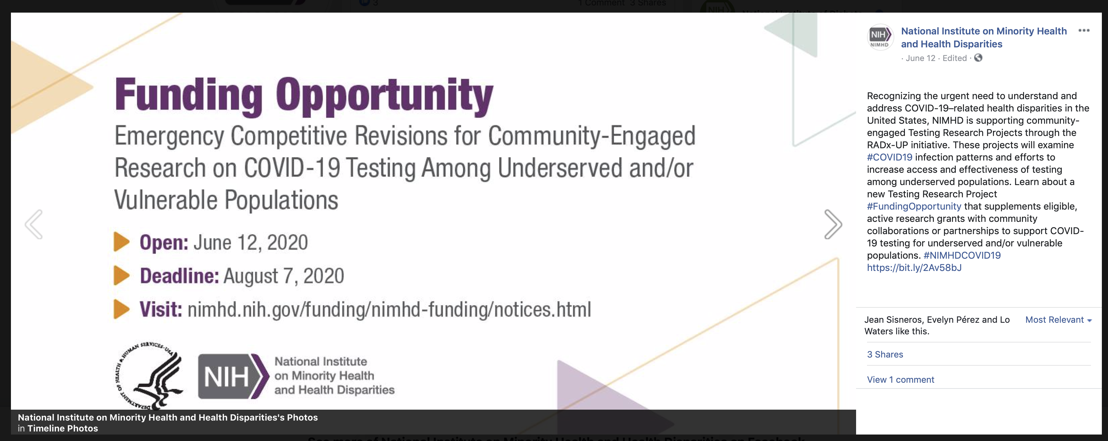
RADx-UP Notice of Special Interest
Learn more: NOT-OD-20-121
Rapid Acceleration of Diagnostics (RADx) and RADx Underserved Populations (UP)

Slide 7

NIH Point-of-Care Technology Research Network Opportunities
Learn more: NIH POCTRN

Slide 8
Donating Research Supplies
As long as recipients are not repurposing NIH grant projects in order to donate PPE and other lab supplies to hospitals, medical centers, and other local entities, they may do so without prior approval to serve the public health emergency crisis for COVID-19 response.
Reach out to your NIH program officer and grants management staff with specific questions.
FAQs: grants.nih.gov/faqs#/covid-19.htm

Slide 9
Application Deadlines
Some NIH Institutes have extended deadlines for select FOAs
For all other FOAs NIH is taking a very flexible stance for applications submitted within the standard two week late policy
Late application policy notices are listed on the Coronavirus Disease 2019 (COVID-19): Information for NIH Applicants and Recipients of NIH Funding website

Slide 10
Post-Submission Materials
NIH has implemented a special exception to allow preliminary data as post submission materials beginning with due dates/on/after May 25, 2020:
  Preliminary data must be submitted 30 days before the study section meeting
  AOR concurrence required
  One page of preliminary data will be accepted for single component applications or for each component of a multi-component application
  Funding opportunity must allow preliminary data (i.e. does not explicitly indicate preliminary data is not allowed)
  Post-submission materials will not be accepted for applications for emergency competitive revisions and urgent competitive revisions which undergo expedited review
Learn more: NOT-OD-20-123

Slide 11
Salaries & Stipends
Recipients must exhaust other available funding sources to sustain its workforce and implement necessary steps to save operational costs to preserve Federal funds for grant supported activities
Recipients may charge salaries and stipends to grant projects on a cases by case basis
  Upon documenting the efforts to exhaust all other available funding sources
  Only if organization’s policy allows such charges from all funding sources, federal and non-federal
Per OMB Memo M-20-26, this flexibility remains available through September 30, 2020
Learn more: NIH Implementation of OMB Memo M-20-26
FAQs: grants.nih.gov/faqs#/covid-19.htm

Slide 12
Guidance on Human Research Affected by COVID-19
Ensure the safety of all human participants and research staff involved in clinical trials and human subject studies
Consult with IRBs and institutions about protective measures, such as:
  Limiting study visits to those needed for participant safety or coincident with clinical care
  Conducting virtual study visits
  Implementing flexibilities for required laboratory tests or imaging needed for safety monitoring
NIH will be flexible regarding project extensions and accommodating unanticipated costs
Learn more: NOT-OD-20-087
FAQs: grants.nih.gov/faqs#/covid-19.htm

Slide 13
Guidance to Help IACUCs Prepare for and Cope with the COVID-19 Pandemic
Facility inspections may be extended by 30 days beyond the six-month interval
IACUC can determine the best means of conducting the facility inspections, to include ad hoc consultants
IACUCs may institute virtual meetings
The number of IACUC meetings may be reduced to as few as one every six months
The IACUC may choose to expand their use of designated member review
Learn more: NOT-OD-20-088
olaw.nih.gov/covid-19.htm

Slide 14
Administrative Flexibilities
OMB previously authorized agencies to utilize administrative flexibilities for recipients conducting COVID-19 research and recipients affected by COVID-19
For recipients affected by COVID-19, many of these flexibilities have ended, effective June 16, 2020
For recipients of NIH emergency COVID-19 supplemental appropriations, the flexibilities outlined in OMB Memo M-20-11 remain available for those awards through the end of the public health emergency.
Learn more: NOT-OD-20-086
FAQs: grants.nih.gov/faqs#/covid-19.htm

Slide 15
Administrative Flexibilities (continued)
Requests for the following flexibilities going forward may be considered by ICs on a case by case basis:
  Prior approval requests for delayed report submission
  Second/third no-cost extensions
  Carry over requests
We continue to provide maximum flexibility in approving these requests.
  Note that standard policies for allowable pre-award costs continue to apply
Learn more: NOT-OD-20-086
FAQs: grants.nih.gov/faqs#/covid-19.htm

Slide 16
Accommodations for Loss of Research Time
Extensions for early stage investigator eligibility due to COVID-19-related disruptions will be considered
NIH will be flexible with extending time constraints for fellowship, career development, and training awards, including phased awards
FAQs: grants.nih.gov/faqs#/covid-19.htm

Slide 17

Advice for Applicants & Recipients
For general questions regarding COVID-19 flexibilities, contact NIH’s Office of Extramural Research at grantspolicy@nih.gov
For questions specific to your NIH award, contact the grants management or program staff at the funding institute or center
FAQs frequently updated. Check back often!
https://grants.nih.gov/policy/natural-disasters/corona-virus.htm

