Slide 1
Age Distributions
Percentage of AAMC Medical School Faculty Compared to the Percentage of NIH RPG Principal Investigators at Different Ages in All Settings
1980-2015
Notes:
Information on all (regardless of degree) AAMC faculty from 1980 to 2015 use AAMC data provided by Hershel Alexander on 15 June 2016. Information on all NIH RPG Principal Investigators was provided by Cassandra Spears and Robert Moore of the NIH Division of Statistical Analysis and Reporting, Office of Extramural Research
on 15 June 2016 (data file 191-16)
Data assembled and processed by Walter Schaffer, Division of Biomedical Research Workforce, Office of Extramural Programs, Office of Extramural Research, NIH
Excludes awards made from American Recovery and Reinvestment Act of 2009 (ARRA). Research Project Grants (RPG) are based on FY 2015 RPG definition and include activity codes R00, R01, R03, R15, R21, R22, R23, R29, R33, R34, R35, R36, R37, R55, R56, RC1, RC2, RC3, RC4, RF1, RL1, RL2, RL9,
P01, P42, PN1, PM1, RM1, UA5, UC1, UC2, UC3, UC4, UC7, UF1, UG3, UH2, UH3, UH5, UM1, UM2, U01, U19, U34, DP1, DP2, DP3, DP4, and DP5. The RL5 activity code was formerly classified as a RPG but was reclassified as Other Research in fiscal year 2015.

Slide 2
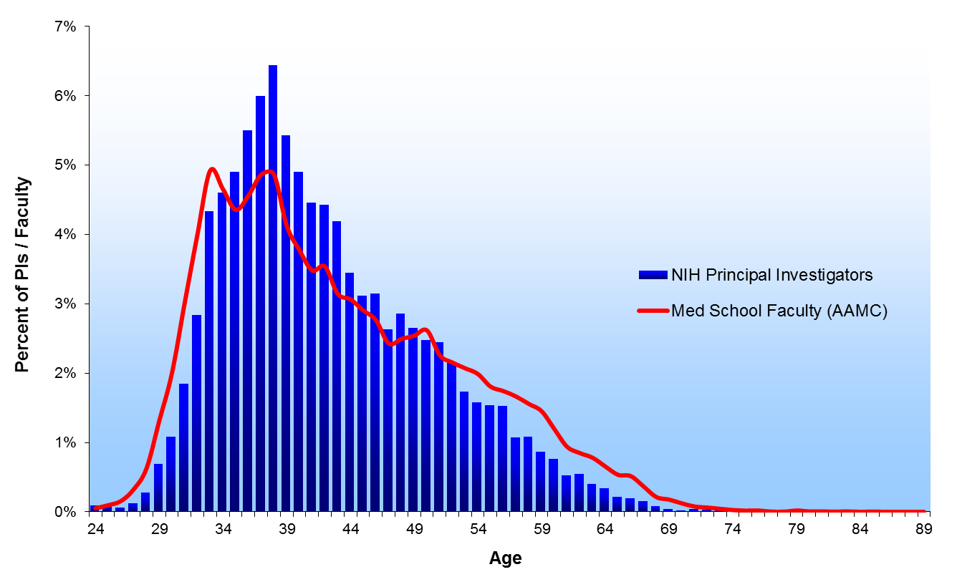
1980

Slide 3
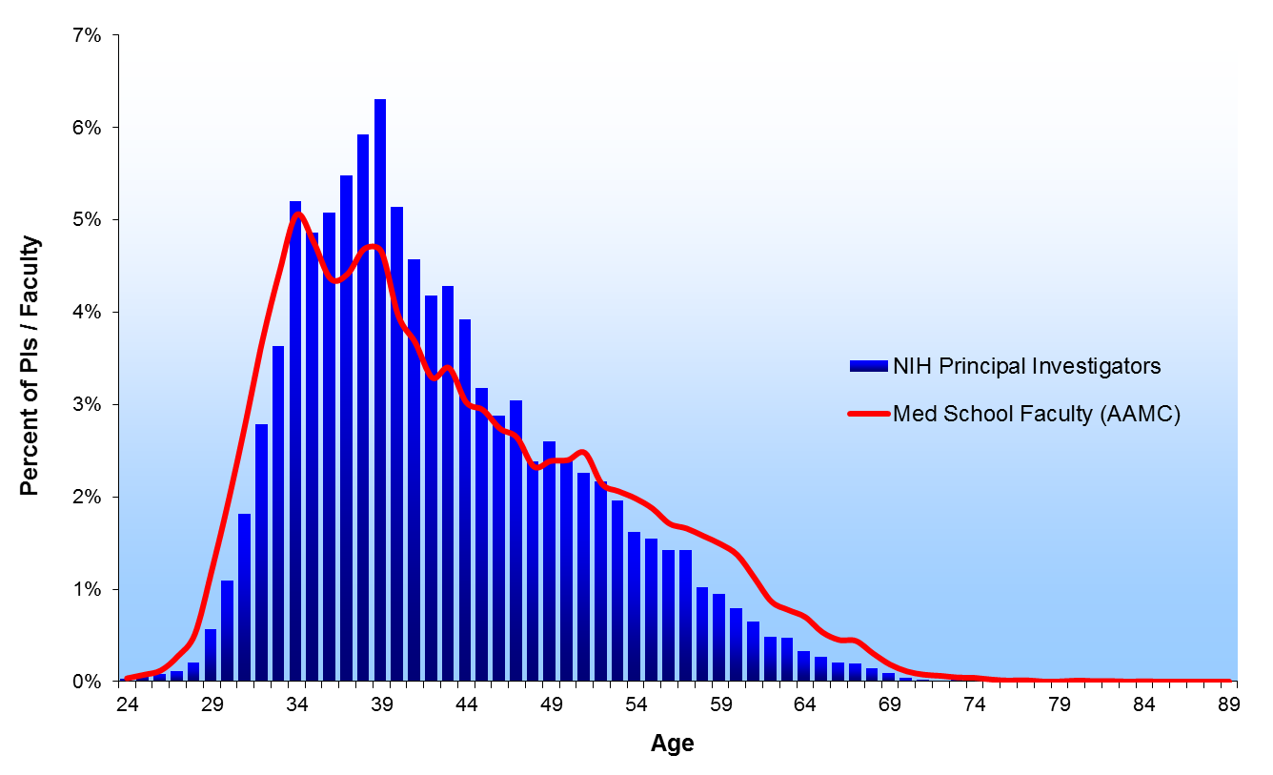
1981

Slide 4
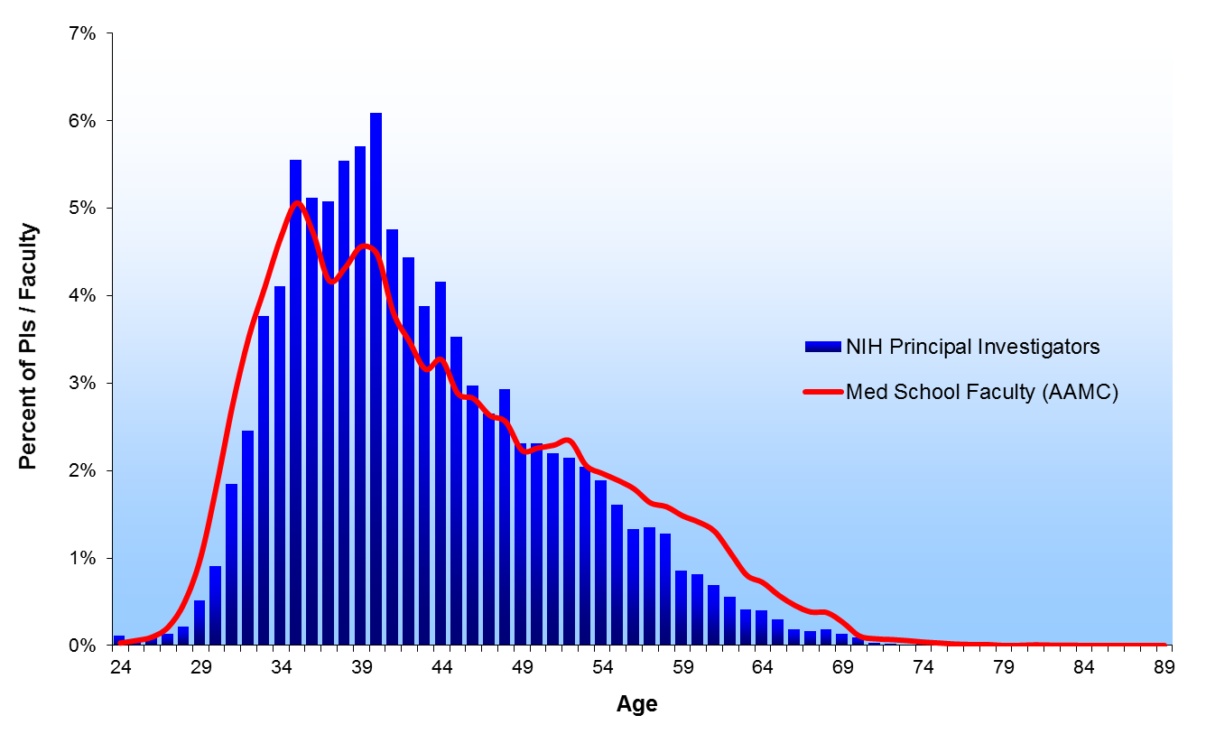
1982

Slide 5
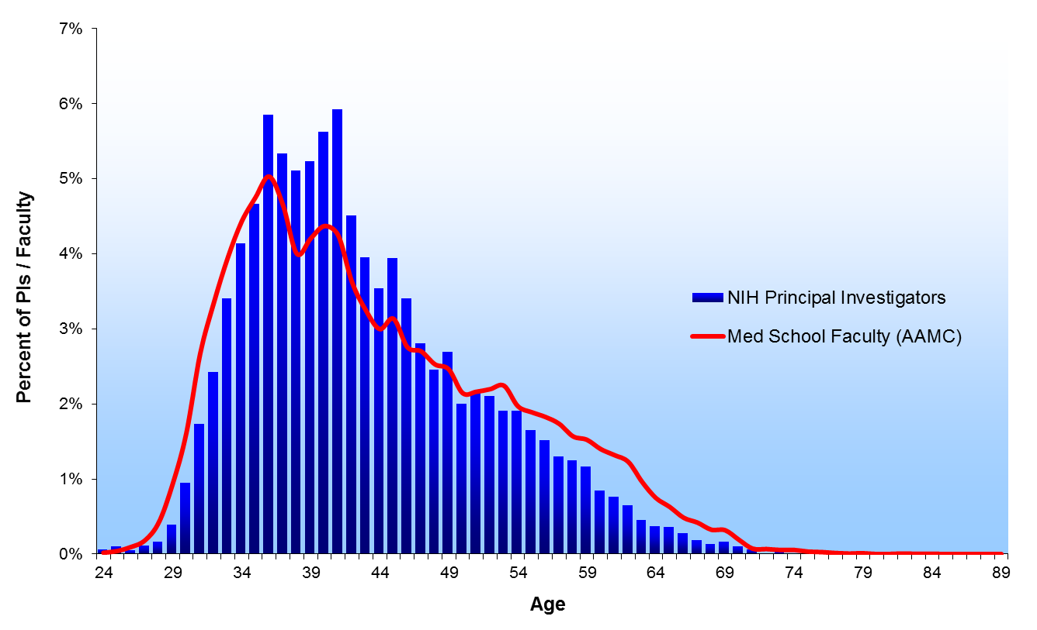
1983

Slide 6
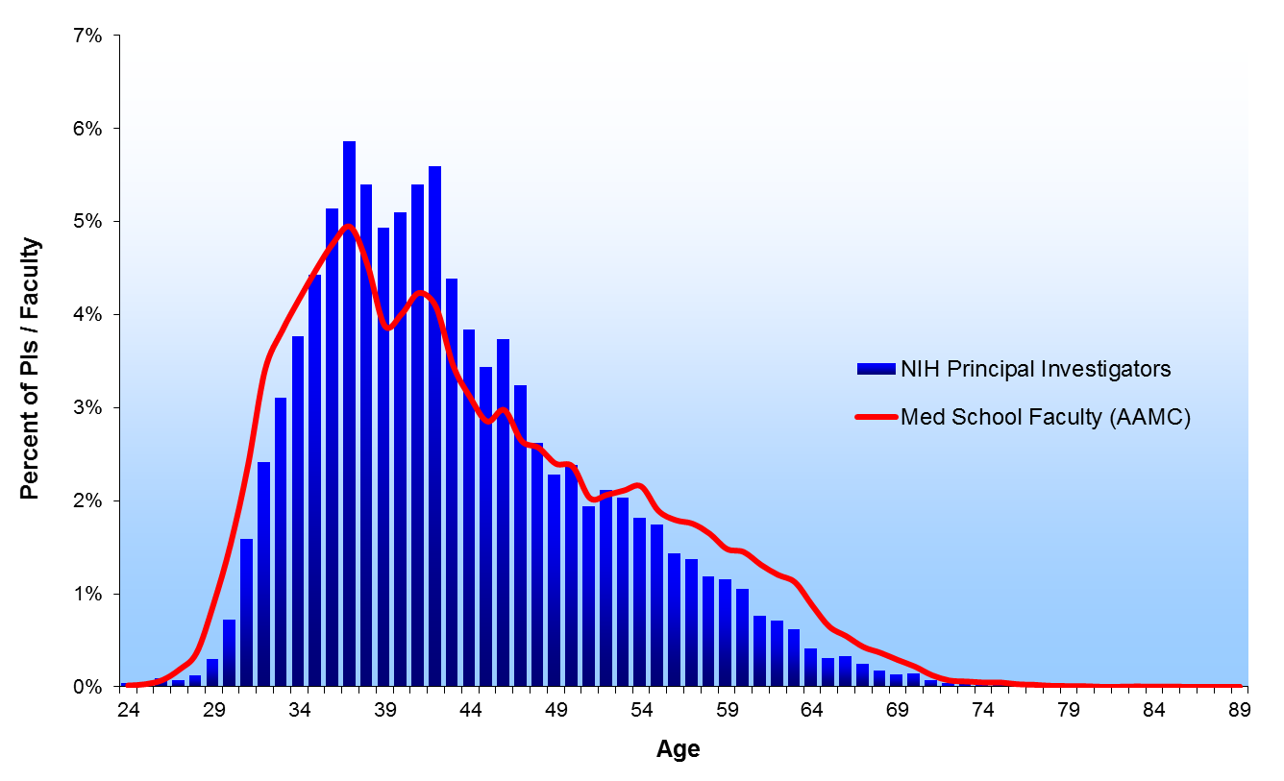
1984

Slide 7
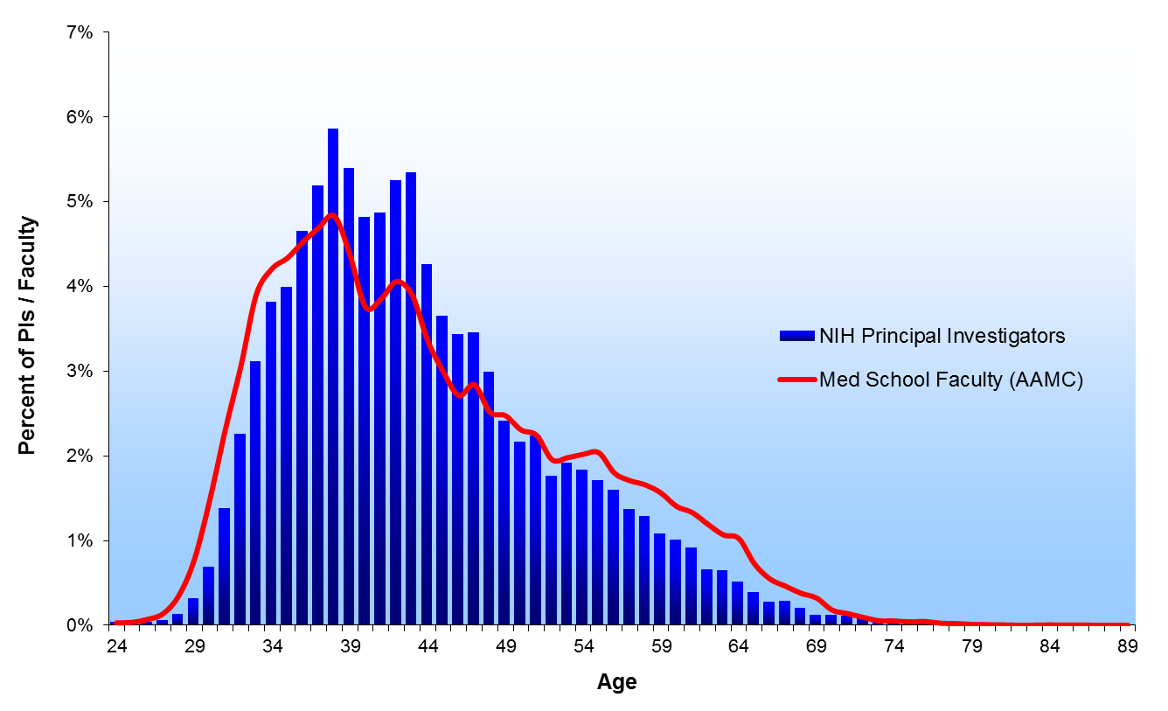
1985

Slide 8
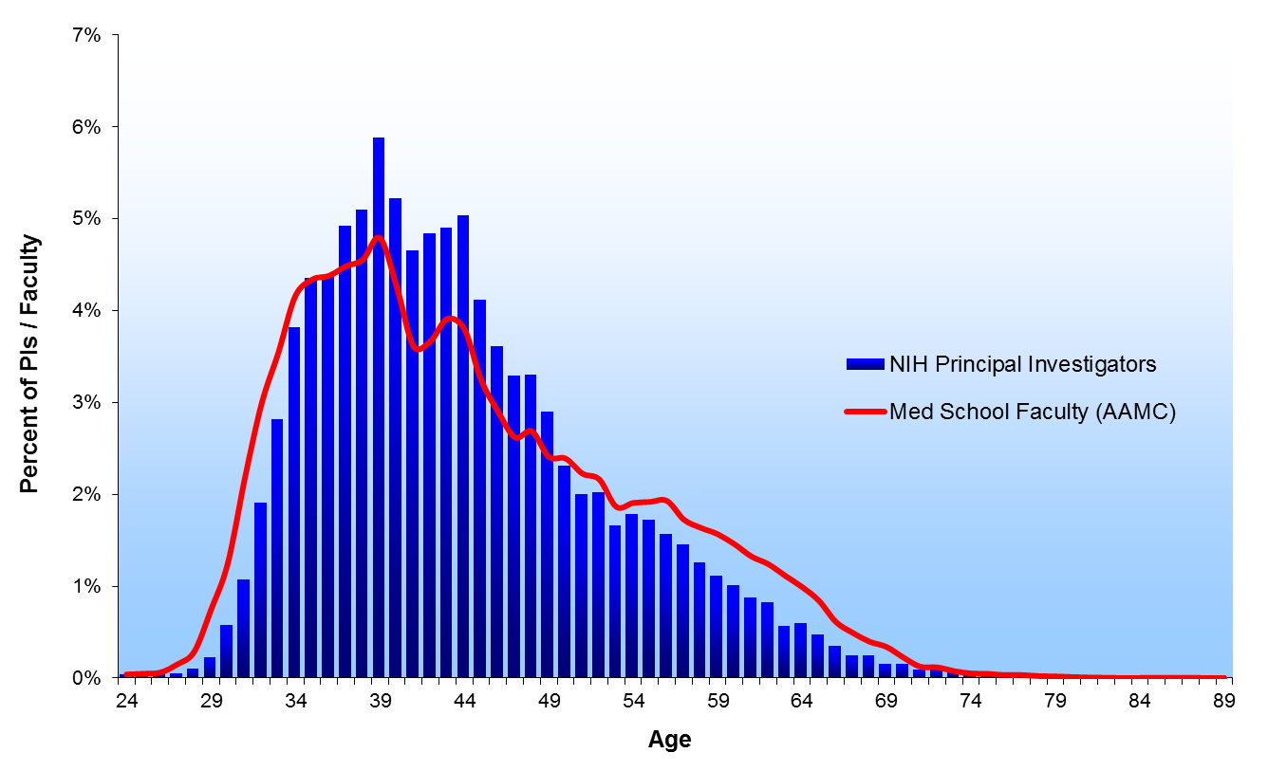
1986

Slide 9
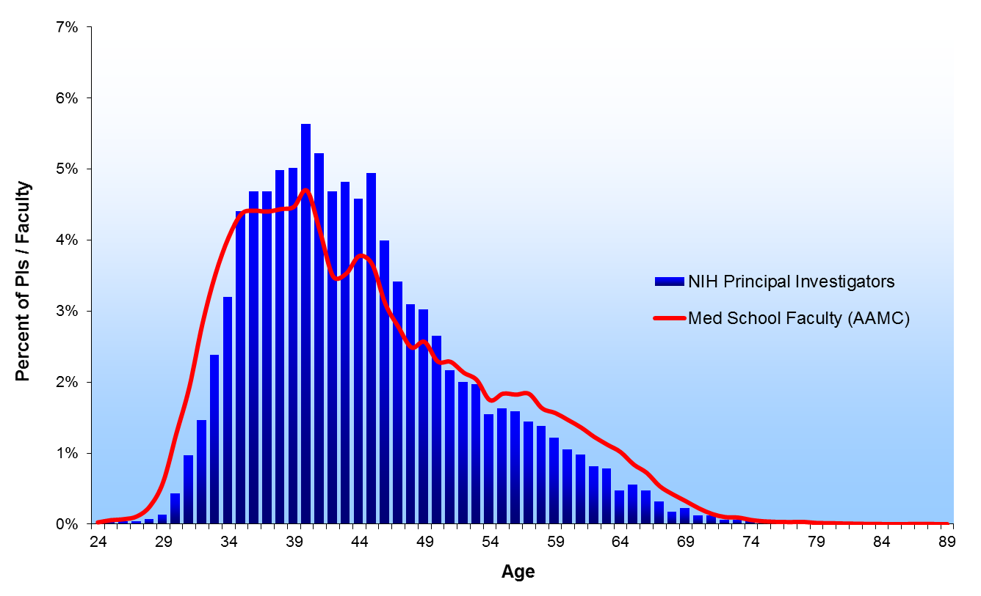
1987

Slide 10

1988

Slide 11

1989

Slide 12
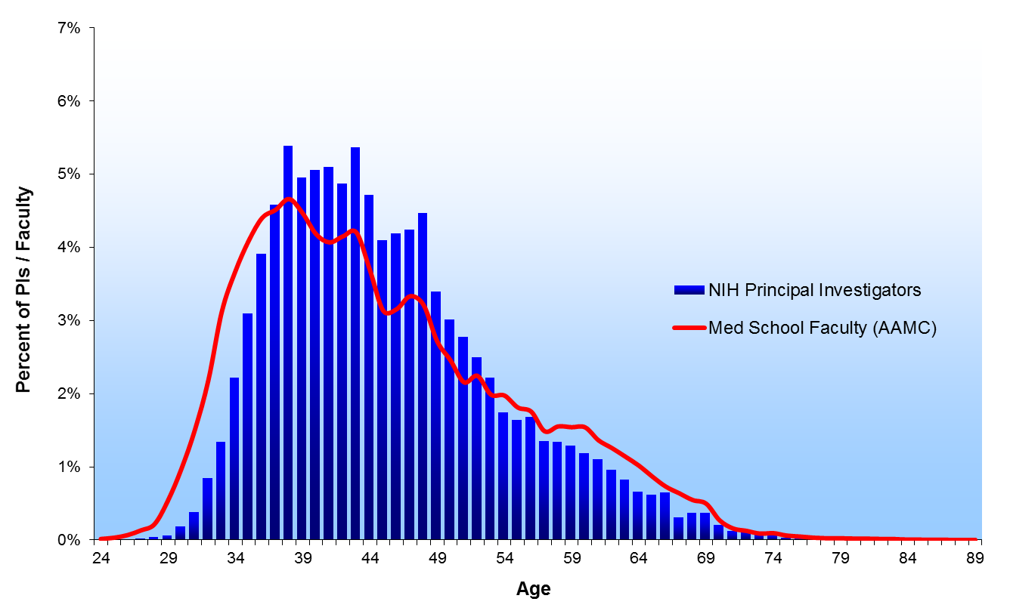
1990

Slide 13

1991

Slide 14

1992

Slide 15
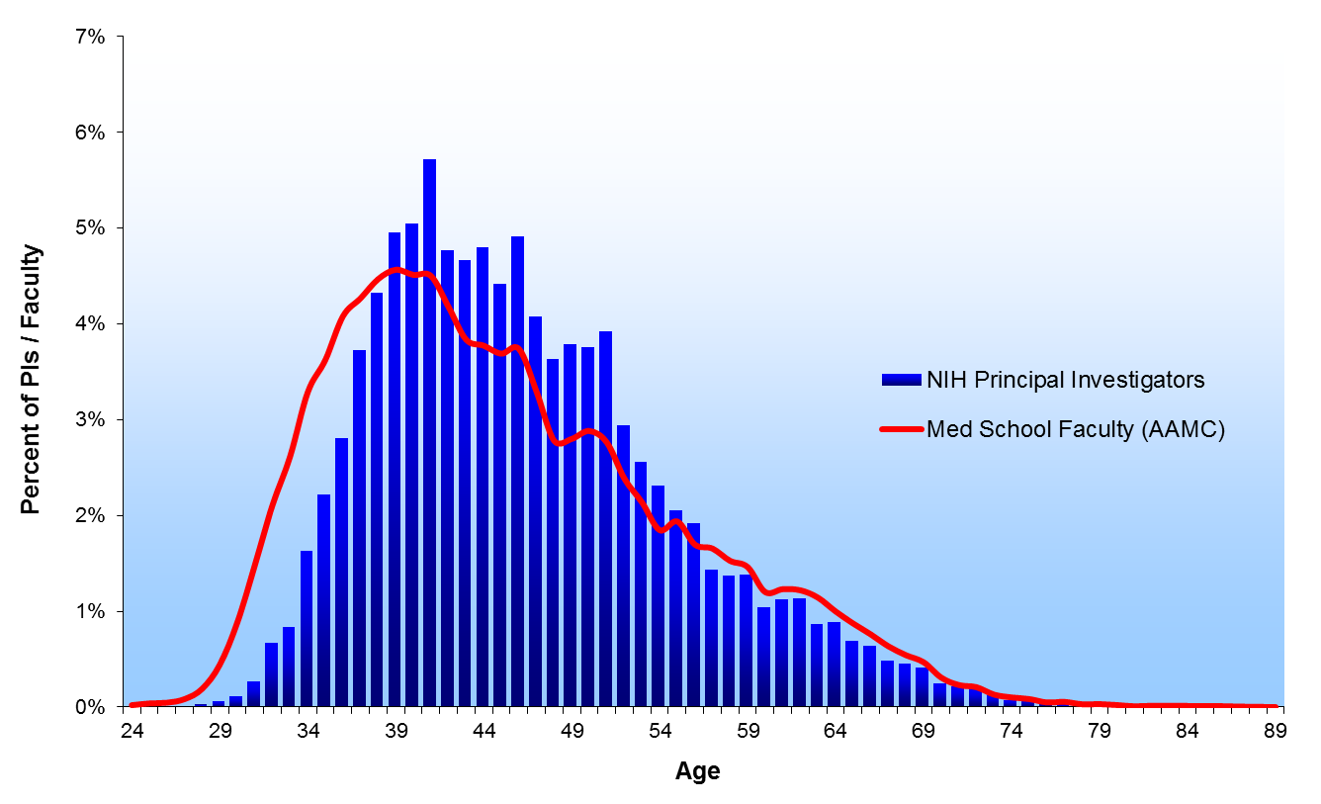
1993

Slide 16

1994

Slide 17
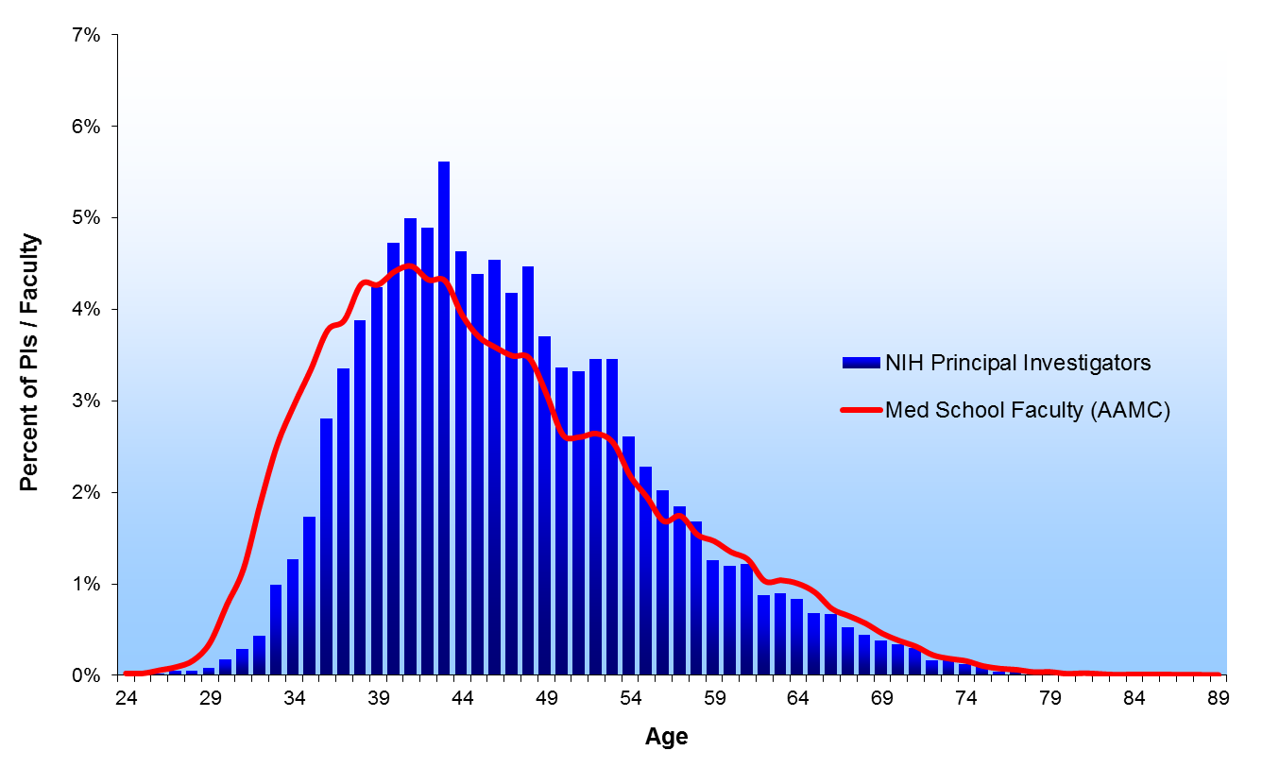
1995

Slide 18
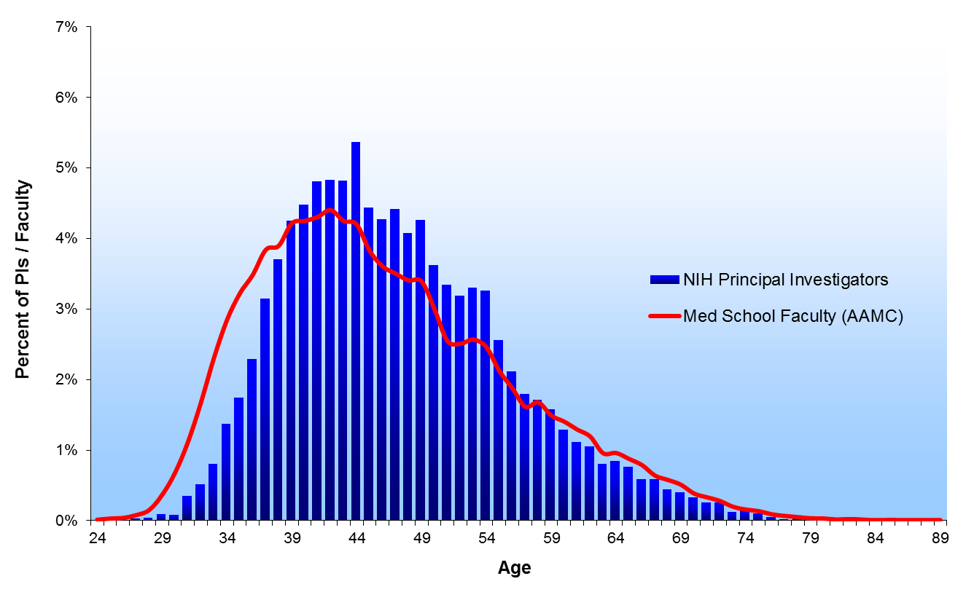
1996

Slide 19
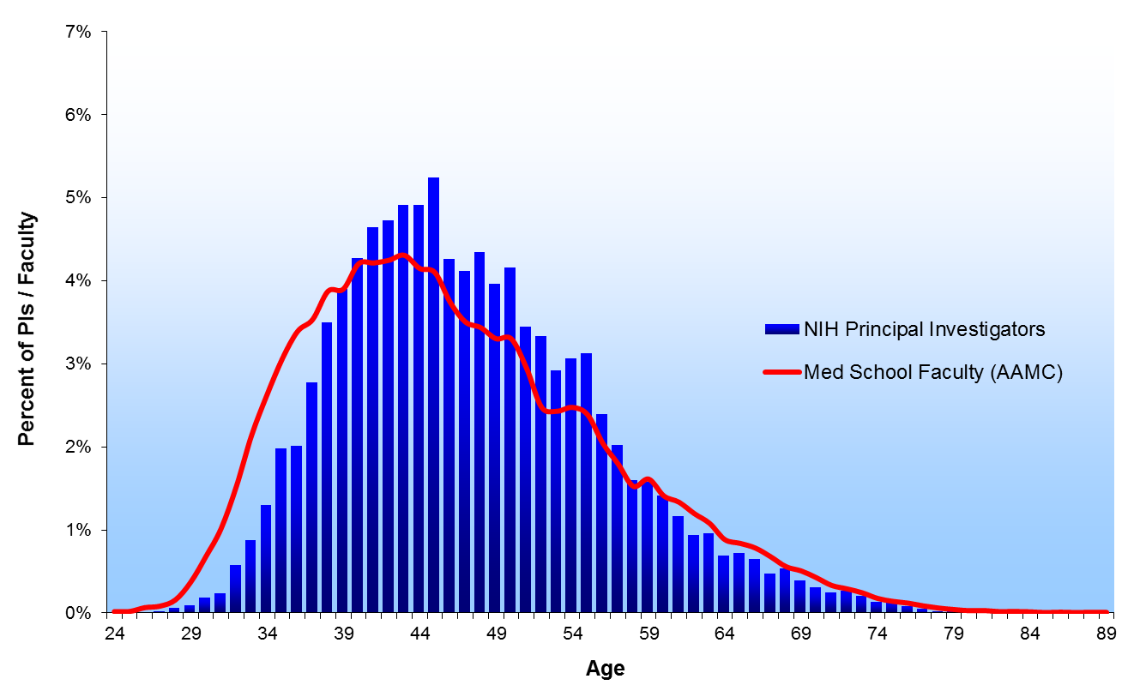
1997

Slide 20

1998

Slide 21

1999

Slide 22
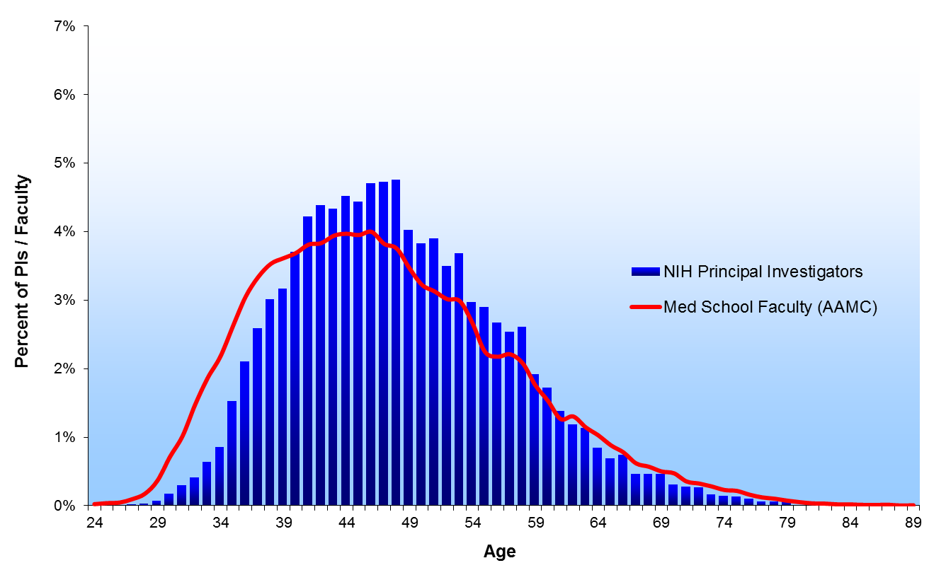
2000

Slide 23
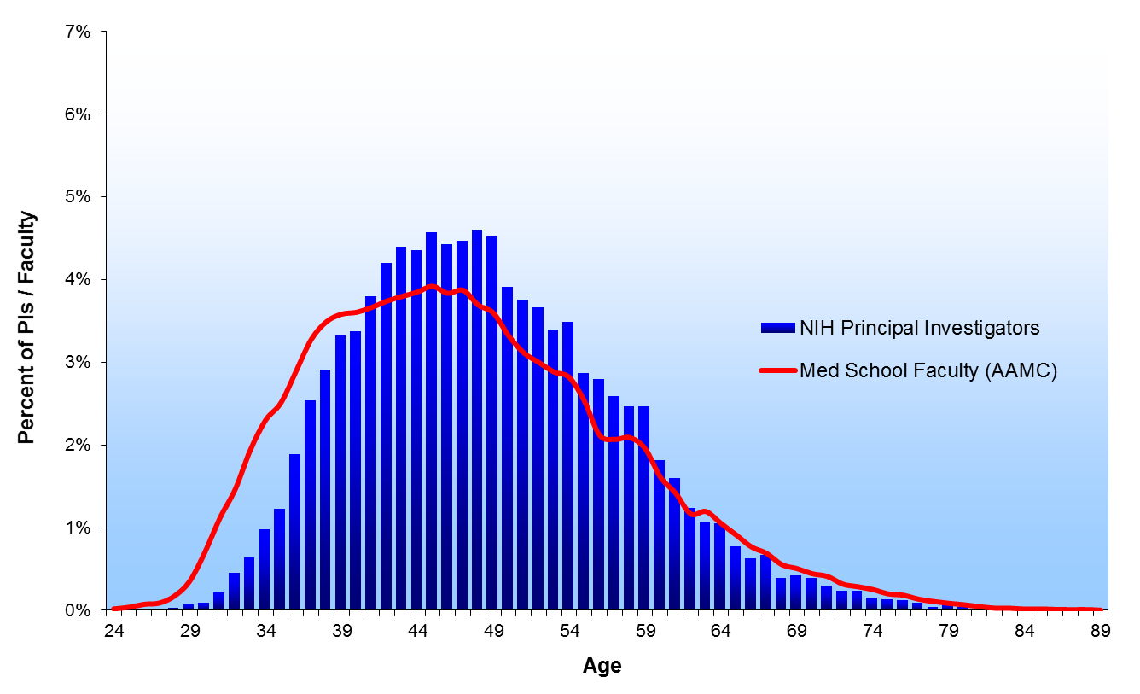
2001

Slide 24
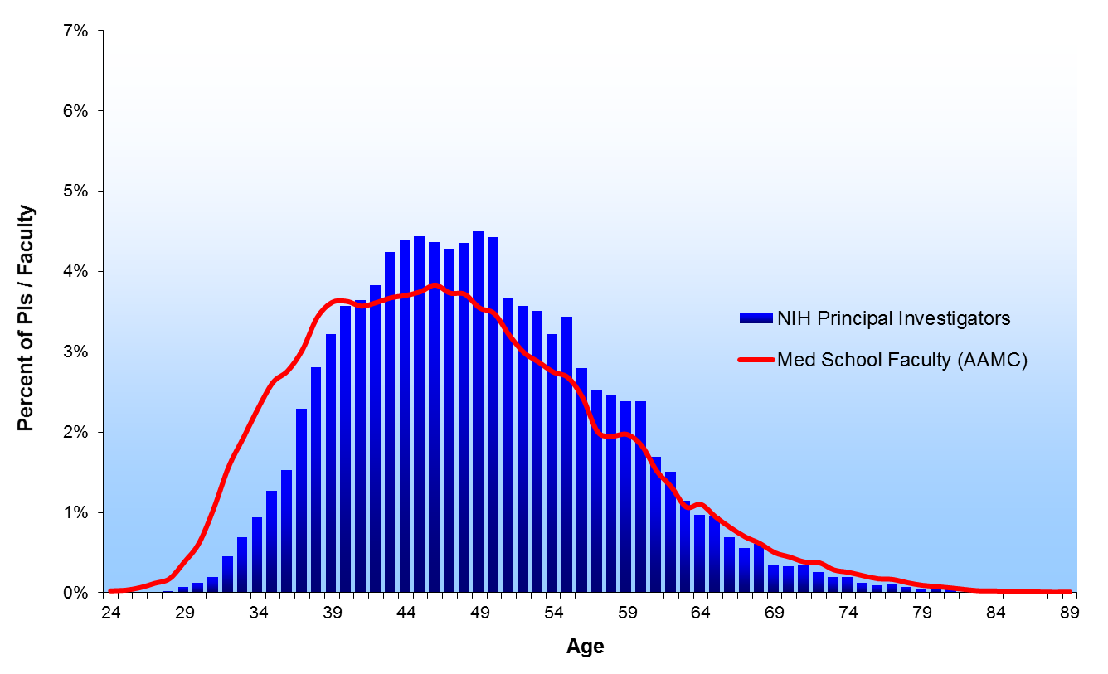
2002

Slide 25

2003

Slide 26

2004

Slide 27
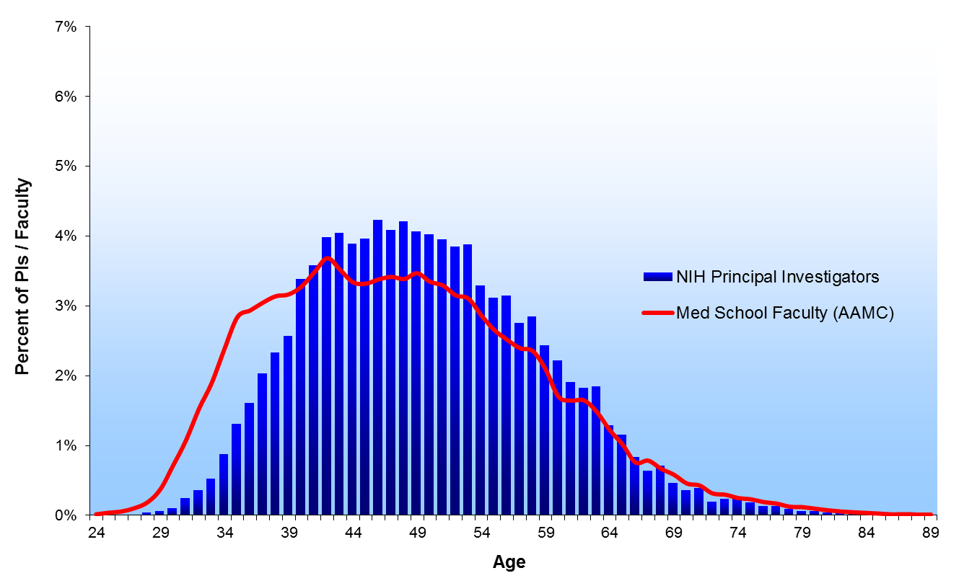
2005

Slide 28
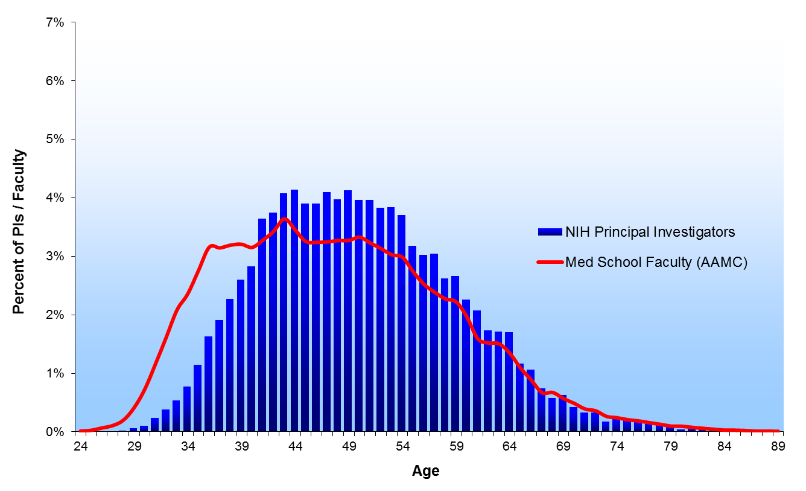
2006

Slide 29
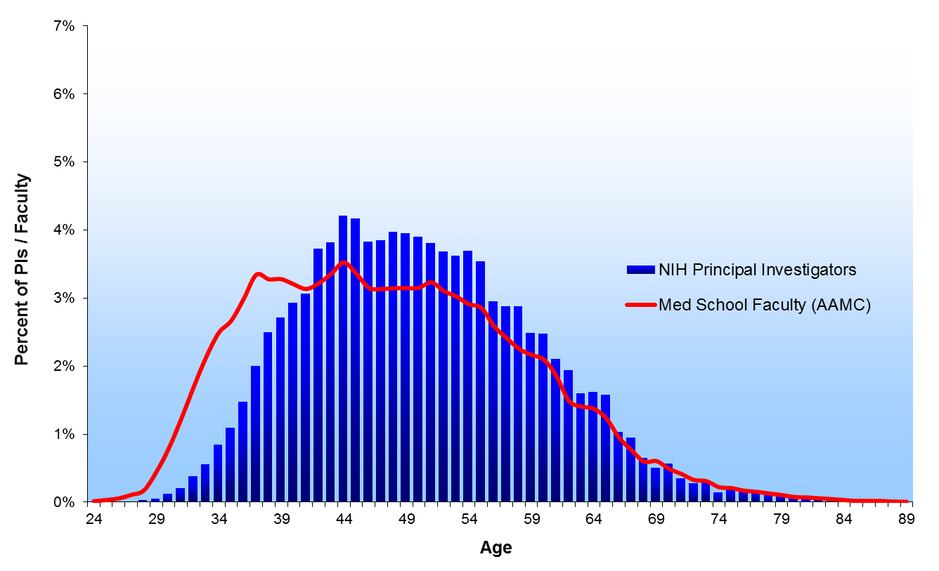
2007

Slide 30
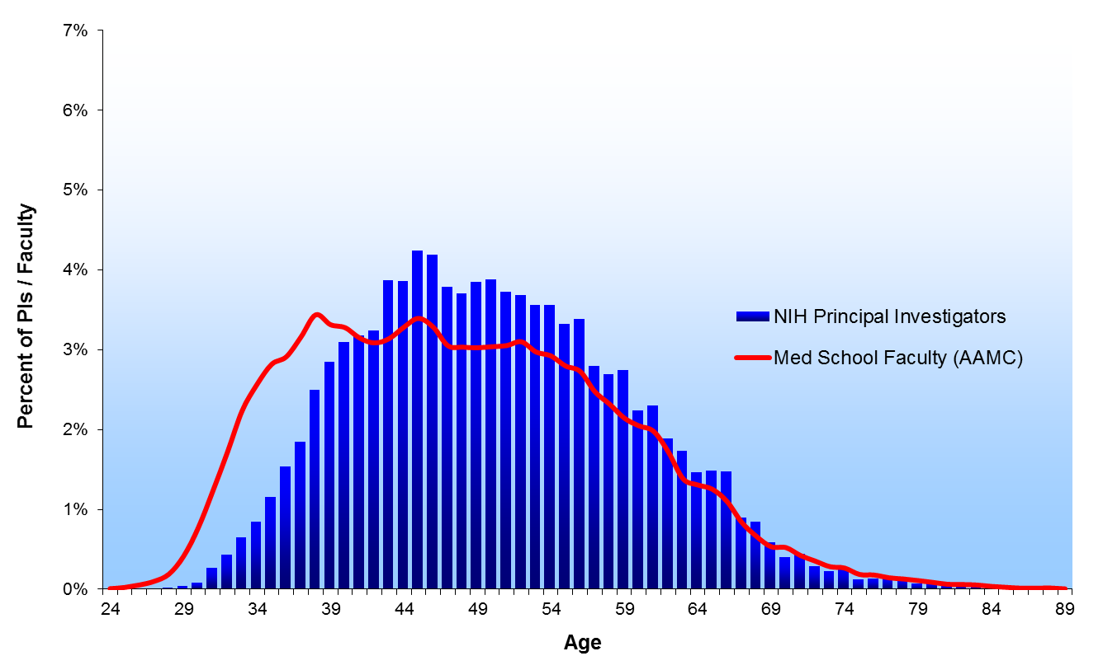
2008

Slide 31
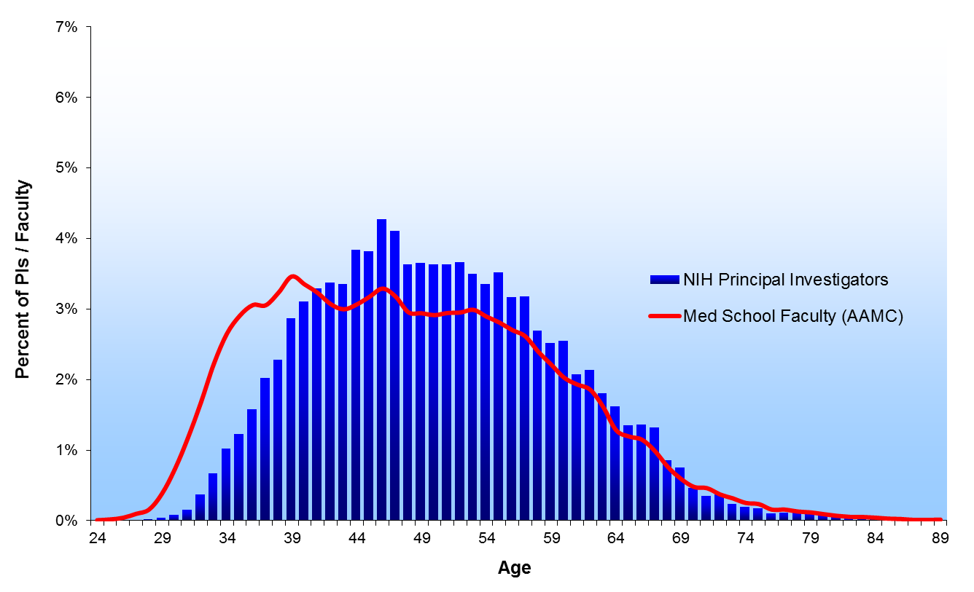
2009

Slide 32

2010

Slide 33
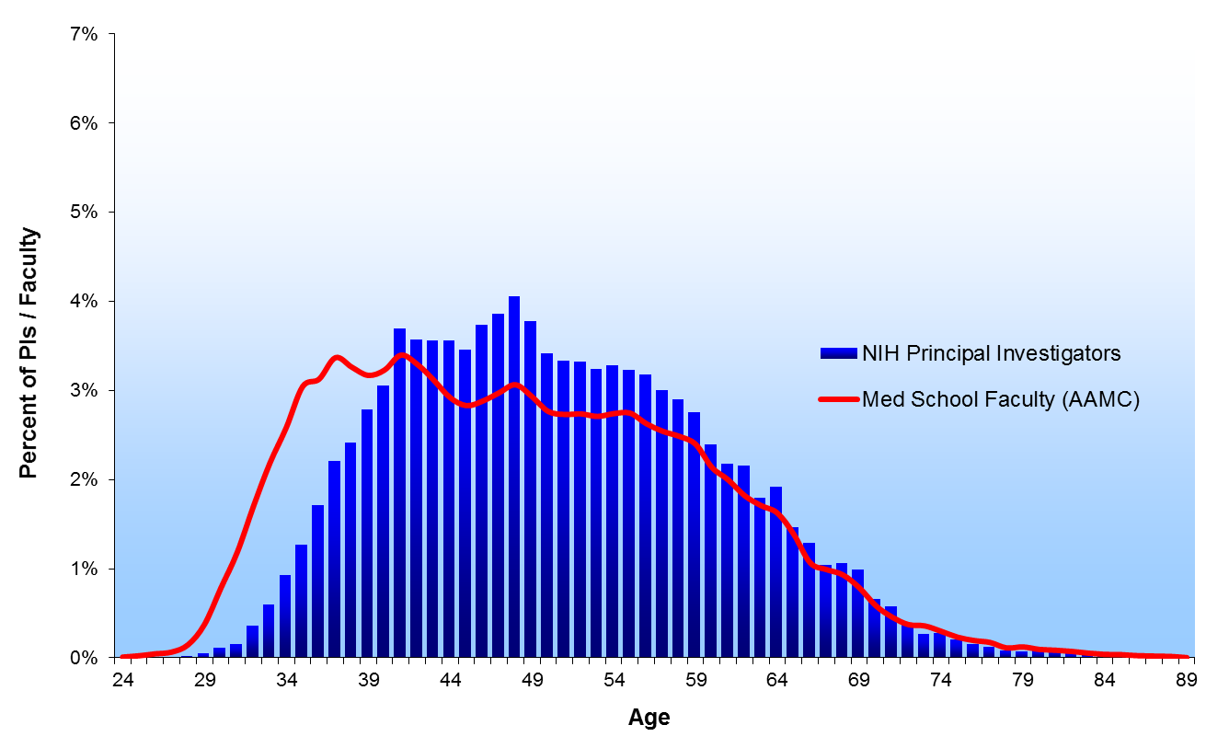
2011

Slide 34
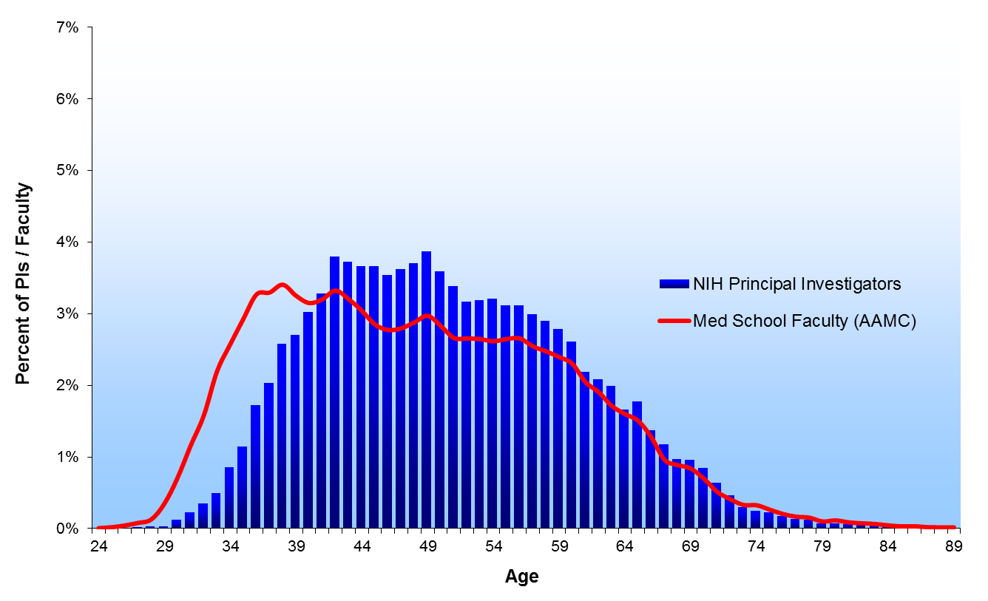
2012

Slide 35

2013

Slide 36
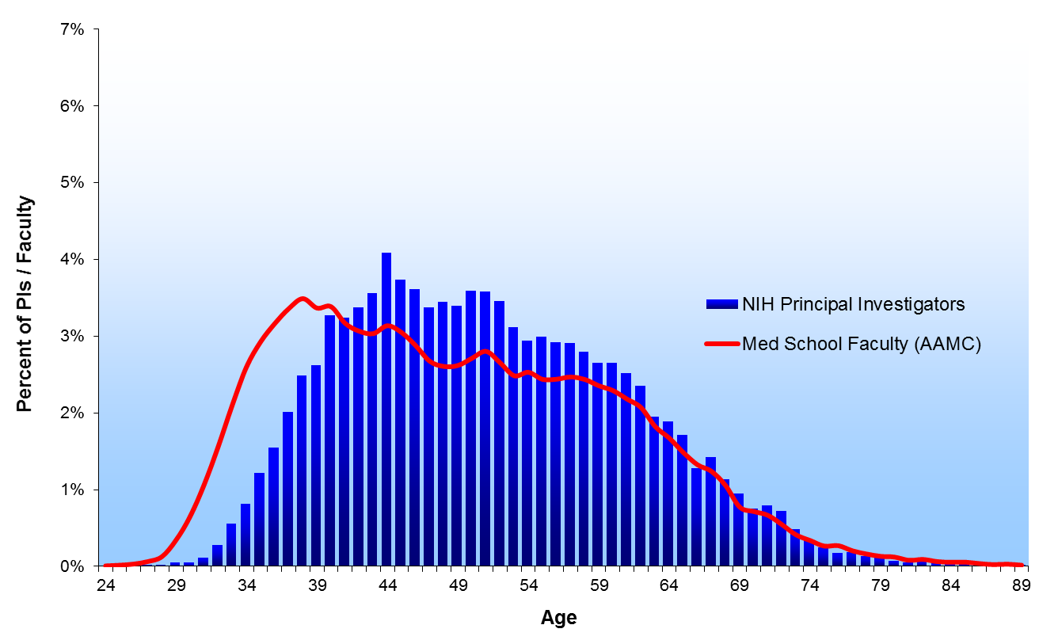
2014
Notes:
No AAMC data for FY2014 when slide was created.

Slide 37
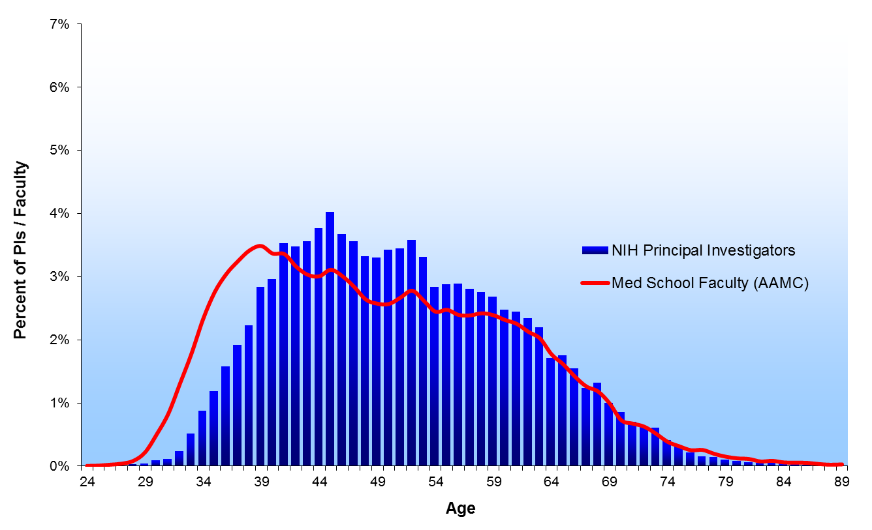
2015
Notes:
No AAMC data for FY2014 when slide was created.

Slide 38
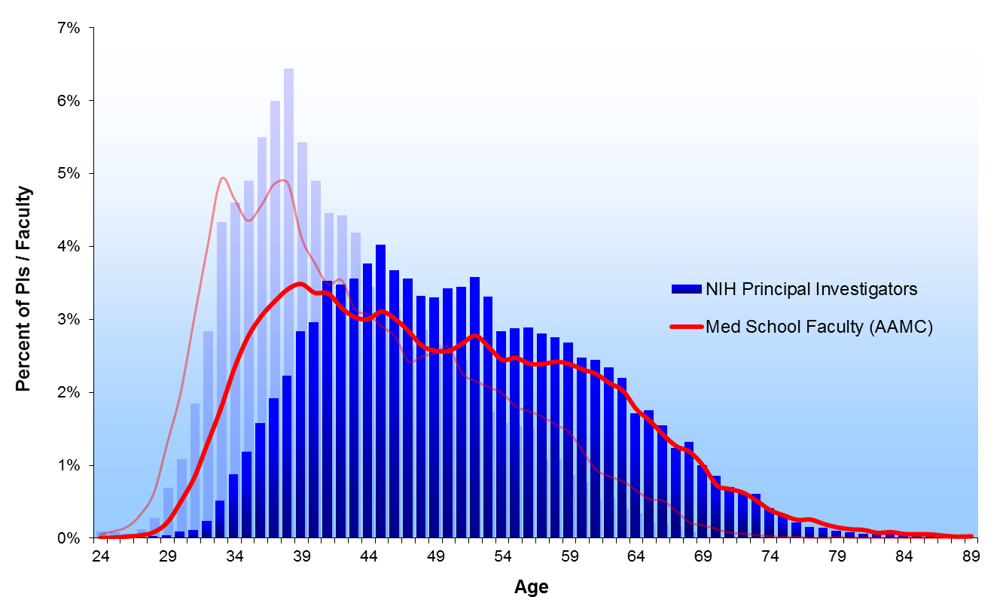
1980 & 2015
1980
2015
Notes:
Note: NIH 2013 was used to coincide with the most recent data available for AAMC.

Slide 39
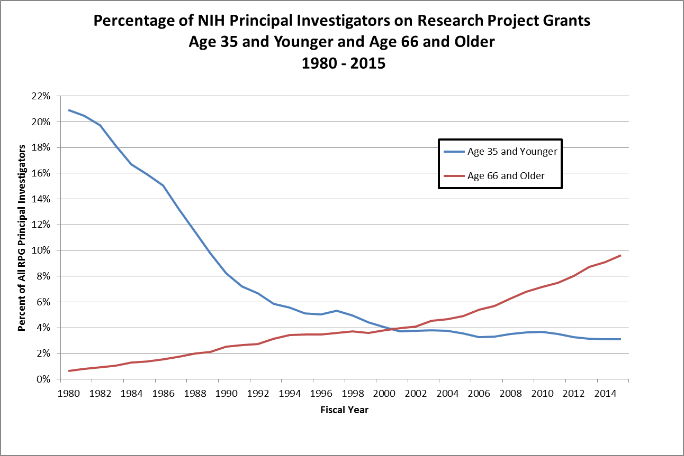
Notes:
Include all common doctoral level degrees or equivalents (e.g., MD/PhD/DVM/DDS) and any other professional degrees (e.g.. MDOT, BOTH, etc.).
R01 includes R01 equivalents (i.e. R01, R23, R29 and R37).

Slide 40
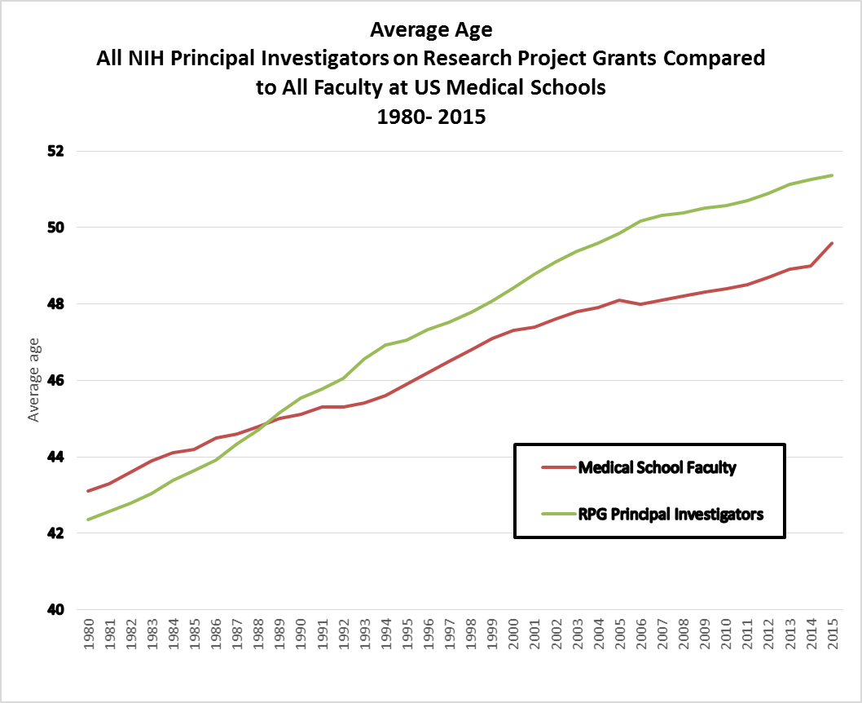
Notes:
Include all common doctoral level degrees or equivalents (e.g., MD/PhD/DVM/DDS) and any other professional degrees (e.g.. MDOT, BOTH, etc.).
R01 includes R01 equivalents (i.e. R01, R23, R29 and R37).

