Slide 1
Tips for Electronic Grant Submission Success
Notes:
I'd like to share with you the top 10 tips for electronic grant submission success.

Slide 2
Ensure all registrations are in place and active.
Notes:
Number 1: Ensure all registrations are in place and active.

Slide 3
Notes:
Grant application submission to NIH requires multiple registrations, including: Dun & Bradstreet, the System for Award Management, the eRA Commons, Grants.gov, and, if applying to a small business opportunity, the Small Business Administration Company registry.
It can take six weeks to complete all registrations. So, if they aren’t already in place, you’ll want to start immediately.
The System for Award Management (known as SAM) requires annual renewal to remain active. Don’t let it expire or you’ll be unable to submit your application.

Slide 4
Follow instructions!
Notes:
Number 2: Follow instructions!
Conformance to all instructions documented in Funding Opportunity Announcements referred to as FOAs, in application guides, supplemental instructions and in notices in the NIH Guide for Grants & Contracts is required and strictly enforced.

Slide 5
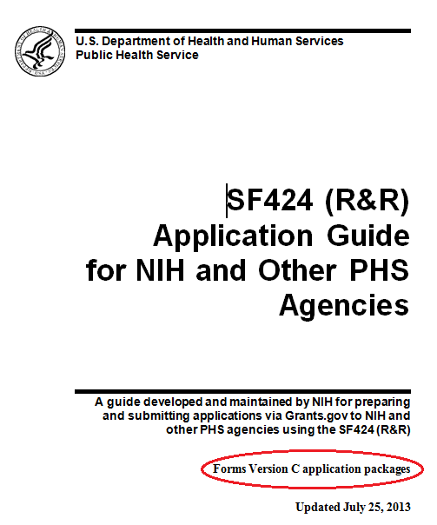
http://grants.nih.gov/grants/funding/424/index.htm
Notes:
The Application Guide includes detailed guidance for Preparing and Submitting an Application to NIH.
Agency-specific guidance used by NIH is identified with the HHS logo. <click>
Additional guidance for Preparing the Protection of Human Subjects Section of your Research Plan and information on policies and assurances can be found in the Supplemental instructions document.
These guides are great electronic resources. I highly recommend that you bookmark them so they’re always available to pinpoint an answer with a simple search.
We sometimes maintain information, like our table of page limits, on our grants.nih.gov website and link to that information from funding opportunity announcements and guides. Using the guides in their electronic format, also makes accessing this linked information quick and easy.

Slide 6
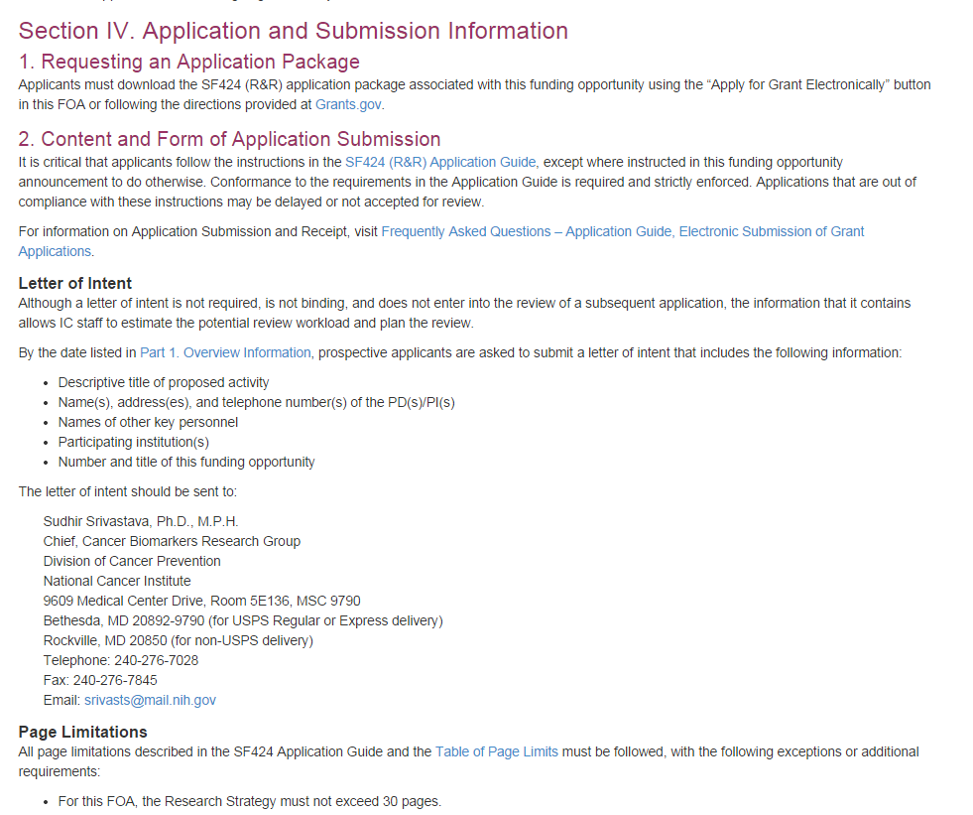
FOA-Specific Application Information
Notes:
Although it is important to thoroughly read your entire funding opportunity announcement, pay special attention to Section IV. Application and Submission Information. It includes any FOA-specific submission instructions <click>, like the Research Strategy page limit exception in this example.
If the instructions in the FOA conflict with the application guide, the FOA instructions must be followed.

Slide 7
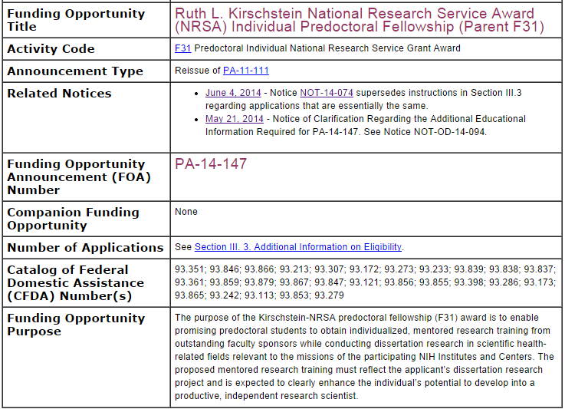
Related Notices
Notes:
You’ll also want to periodically check the Related Notices section of the FOA.
This section contains any FOA-specific clarifications to instructions and policy guidance made after the FOA was initially posted.
At a minimum, check this section when you download your application forms package and again when finalizing your application for submission.

Slide 8
Submit early!
Notes:
Number 3: Submit early!

Slide 9
‘Early’ = Days
(not minutes or hours)
Notes:
By ‘early’ I mean days - not minutes or even hours - before the 5 pm local time submission deadline.
Remember, any corrective submissions must be made before that deadline.
If it’s two days before the due date, then 4:45 pm is a perfectly acceptable time to submit. Otherwise, it’s not recommended. You simply wouldn’t have time to receive and correct any system-identified errors or to properly review your assembled application.

Slide 10
View your entire application image in eRA Commons.
Notes:
Number 4: View your entire application image in eRA Commons.

Slide 11
If you can’t View it, we can’t REVIEW it!
Notes:
The assembled application image you see in eRA Commons is the exact file that NIH staff and reviewers would see.
If you can’t VIEW it, we can’t REVIEW it!

Slide 12
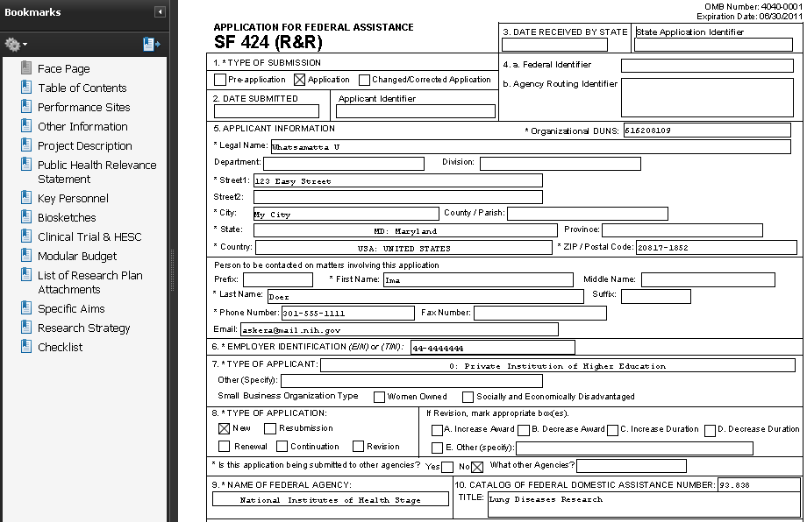
Application Image
Notes:
Be sure to click through all the bookmarks and look at all aspects of your application. It’s very easy to attach the wrong file by mistake or to forget to swap out placeholder information with final data.
If you find a technical issue with how we assembled the application, notify the eRA Commons help desk immediately.

Slide 13
Notify eRA Commons Help Desk if system issues threaten your on-time submission.
Notes:
Number 5: Notify the eRA Commons Help Desk by the deadline if system issues threaten your on-time submission.

Slide 14
http://grants.nih.gov/grants/ElectronicReceipt/support.htm#guidelines
Notes:
System issues are problems with federal systems like ASSIST, SAM, Grants.gov and eRA Commons that impact all or large subsets of applicants.
Failure to follow instructions or not leaving enough time to receive and correct errors identified by the system are not considered system issues.
Only the eRA Commons help desk has the authority to verify that you have, in fact, encountered a system issue beyond your control and to provide the needed documentation to support your good faith effort to submit.

Slide 15
Include all required attachments.
Notes:
Number 6: Include all required attachments.

Slide 16
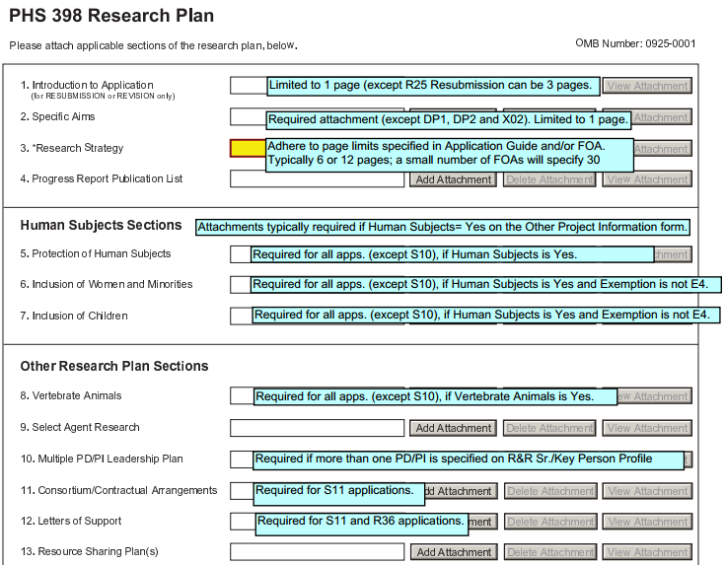
Conditional Requirements
Annotated form sets:
http://grants.nih.gov/grants/ElectronicReceipt/communication.htm
Notes:
Annotated form sets provide a visual of each application form and helpful tips for many fields. They also indicate when attachments are generally required.
Whether an attachment is required or not, is often based on how you answer specific questions throughout the application.
For example <click>, if you indicate that Vertebrate animals are involved in your application, then you will need to include the Vertebrate Animals attachment as noted in this tip.
Since the annotated form sets are general resources, you will still want to look out for FOA or program-specific requirements, but they are a handy visual reference for a quick application check. Find them by visiting grants.nih.gov and searching for annotated form sets.

Slide 17
Use PDF format for all attachments.
Notes:
Number 7: Use PDF format for all attachments.

Slide 18
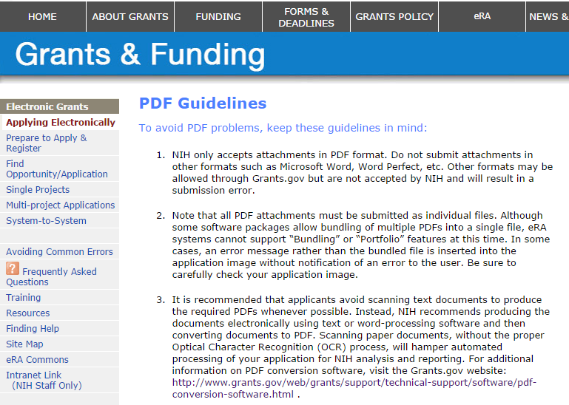
Pdf guidelines
PDF Guidelines:
http://grants.nih.gov/grants/ElectronicReceipt/pdf_guidelines.htm
Notes:
Prepare simple pdf attachments without enhanced security options or electronic signatures.
A quick search for ‘PDF Guidelines’ on our main grants.nih.gov site will provide you with a page full of additional advice for creating PDF documents that work with NIH systems.

Slide 19
Watch out for NIH required fields not marked required on federal-wide forms.
Notes:
Number 8: Watch out for NIH required form fields that are not marked required on federal-wide forms.
When NIH requires data entry in a field that isn’t marked required, you’ll find an agency-specific instruction in the application guide.
There are three fields that fall into this category.

Slide 20
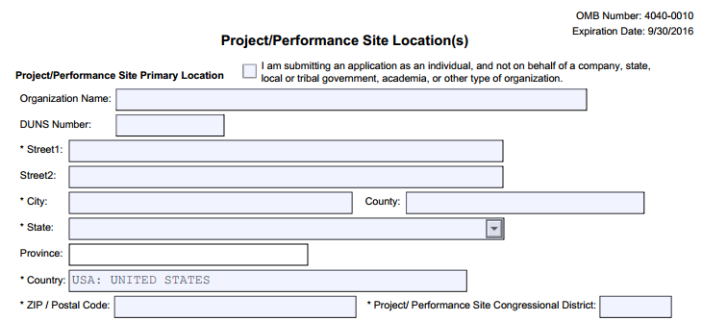
Notes:
First is the DUNS Number for the primary site on the Project/Performance Site Locations form.

Slide 21
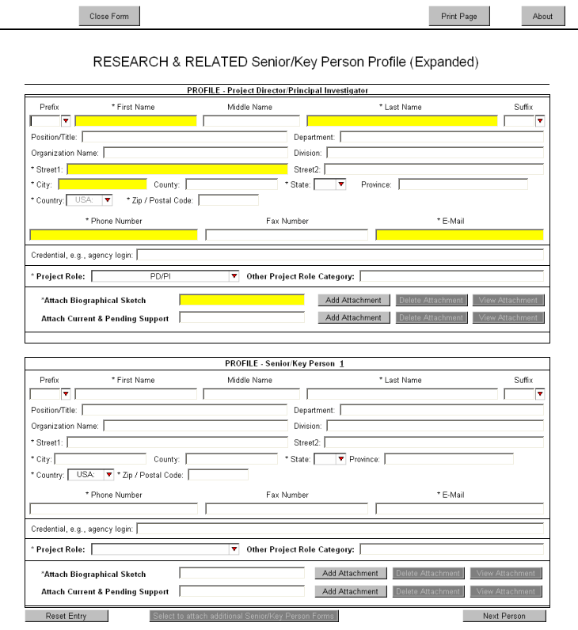
Credential Field
Enter PI Commons Username
Enter Commons Username
Notes:
The second is the Credential field on the R&R Senior/Key Person form.
In order to successfully process your application, NIH needs to know where in Commons to put the processing results. So, you must include the PD/PIs eRA Commons Username in the Credential field. <click>
eRA Commons Usernames are also required for any additional PD/PIs on a multi-PD/PI application, the sponsor on a Fellowship application and component project leads on a multi-project application.

Slide 22
Organization Name - Required
Notes:
The third field is Organization Name which is also on the R&R Senior/Key Person form.
Organization Name is required for all listed personnel and is used by NIH staff as a first check for reviewer conflicts.

Slide 23
Use the correct DUNS
Notes:
Number 9: use the correct DUNS.

Slide 24
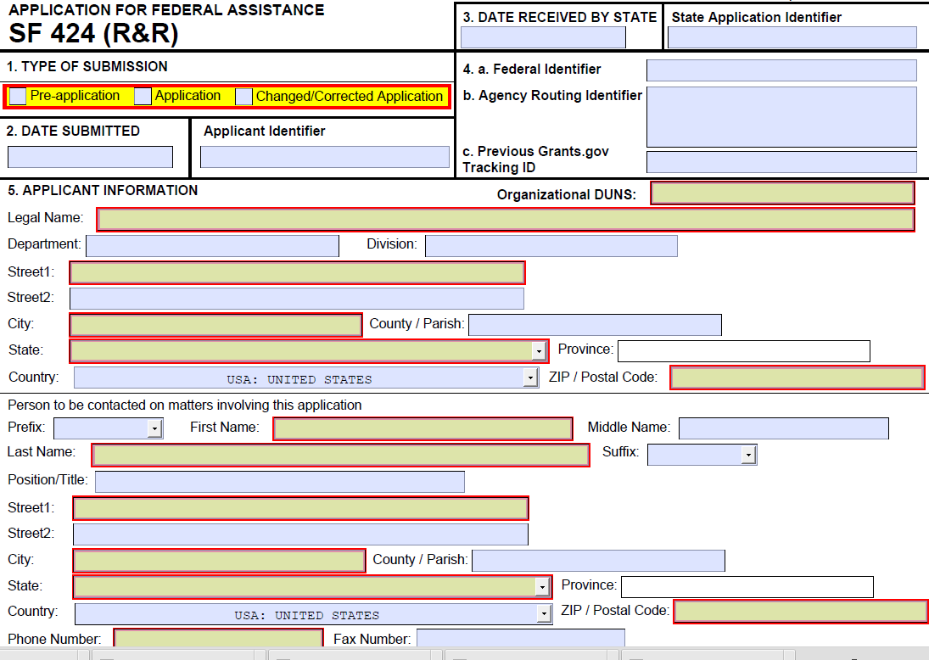
DUNS
Notes:
The DUNS number on the SF424 R&R Cover form must be the same DUNS used in all registrations including SAM, Grants.gov and eRA Commons.
And, the application submitter must be authorized in Grants.gov to submit on behalf of the DUNS.

Slide 25
Provide measurable effort for all Sr/Key in R&R Budget.
Notes:
Finally, Number 10: Provide measurable effort for all Senior/Key personnel listed in section A of the R&R Budget form.

Slide 26
12
4
1.5
12
9
3
Notes:
That means to get past NIH system validations, you must provide effort in person months using <click> either Calendar months or <click> a combination of Academic and Summer months <click>.
Providing effort in all three month categories or failing to provide any effort in any category will result in an error.

Slide 27
Ensure all registrations are in place & active
Follow instructions!
Submit early!
View entire application image in eRA Commons
Follow system issue policy
Include all required attachments
Use PDF format for all attachments
Watch out for unmarked NIH-required fields
Use the correct DUNS
Provide measurable effort for all Sr/Key on budget
Notes:
Following each of the tips we’ve just reviewed will ensure your grant application success.

