Slide 1
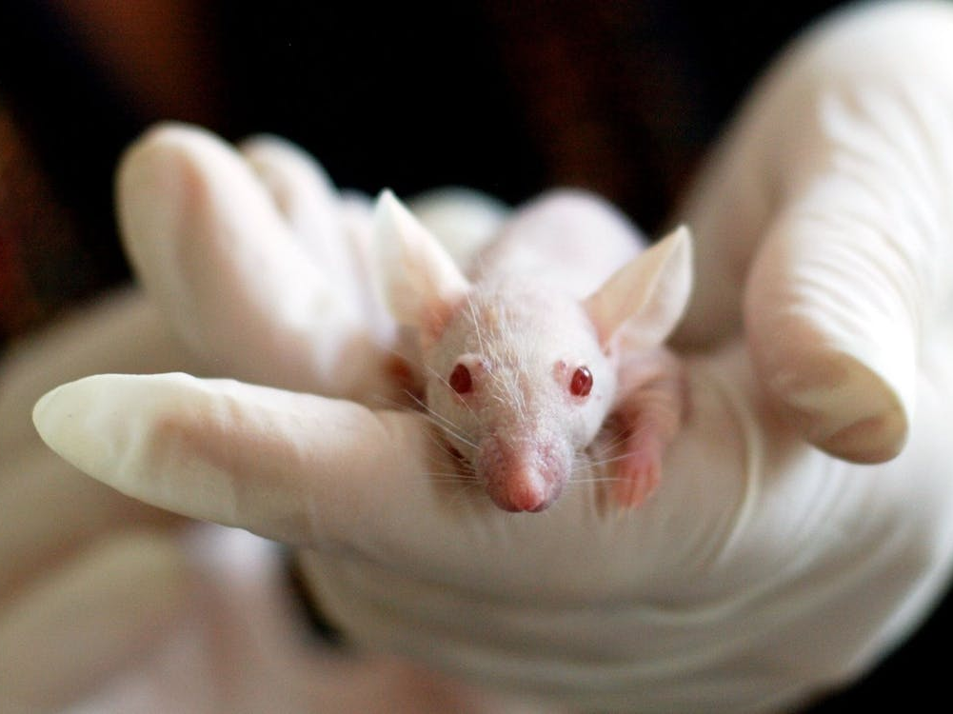
Animals in Research: Tips to Keep Out of the Doghouse
Brent C. Morse, DVM, DACLAM / Jacquelyn T. Tubbs, DVM, DACLAM
Division of Compliance Oversight
Office of Laboratory Animal Welfare
National Institutes of Health

Slide 2
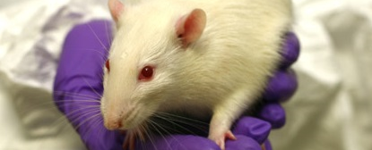
Institutional Reporting:
Photo courtesy of Dr. Cathy Schuppli, DVM, MSc, PhD, University of British Columbia
Reporting is required by PHS Policy IV.F.3.
Any serious or continuing noncompliance with PHS Policy
Any serious deviation from the provisions of the Guide for the Care and Use of Laboratory Animals
Any suspension of an activity by the IACUC
Notes:
The Public Health Service Policy on Humane Care and Use of Laboratory Animals, or “PHS Policy; Policy” was established by the Health Research Extension Act of 1985. OLAW has responsibility for the general administration and coordination of the Policy. These are the three general categories under which institutions must report noncompliance to OLAW… NEXT SLIDE

Slide 3
Reporting is a Cooperative Process
✓OLAW will provide assistance and guidance.
✓Institution must demonstrate that corrective actions are being implemented.
✓OLAW will evaluate appropriateness of the actions in correcting and preventing the reportable issue.
✓Self-reporting is part of enforced self-regulation.
Notes:
Although OLAW works directly with institutions, we understand that our actions often directly impact investigators and the research teams… NEXT SLIDE

Slide 4
TYPES OF REPORTABLE INCIDENTS IN 2020
Notes:
This chart illustrates the types of reportable incidents OLAW received in 2020.
Almost 90% of protocol issues relate to not following or not being familiar with the protocol. For example, animal users aren’t reading the protocols, are not properly trained on protocols, and may not even have access to current protocols. Let’s look a little closer at the types of animals involved in noncompliance reports to OLAW in 2020… NEXT SLIDE

Slide 5
TYPES OF ANIMALS INVOLVED
Notes:
Not surprisingly, rodents still account for the greatest number of animals involved with reports. I call your attention to the involvement of fish especially since incidents that involve fish often result in significant animal welfare issues and high mortality.
Birds, amphibians and reptiles made up the remaining 4% … NEXT SLIDE

Slide 6
INDIVIDUAL RESPONSIBLE FOR REPORTABLE ISSUES:
Notes:
Data refers to reportable issues for the 2020 calendar year. We at OLAW and also those who oversee the animal care and use program at your institution understand that performing research with animals is very complicated. Investigators often perform complex and intricate procedures with animals and may be involved with their research animals on a daily basis. This chart reflects that involvement and the opportunity for things to go awry.

Slide 7
INSTITUTIONAL CORRECTIVE ACTIONS:
Retrain personnel
Counsel, reprimand, terminate employment
Modify institutional policies
Repair or modify facility
Enhance PI and study oversight, probation
Modify, suspend, or terminate animal study protocol
Notes:
The goal of the PHS Policy, its underlying authority of the Health Research Extension Act of 1985, and OLAW regarding noncompliance is that “the entity (institution)… has been given a reasonable opportunity to take corrective action…” A very general statement, but it’s at the core of self-monitoring and self-correction. Some of the more common tactics for institutional self-correction are listed here…
OLAW may suggest other potential actions such as temporarily appointing a Co-PI experienced with animal research; improving environmental monitoring, or; increasing IACUC oversight and monitoring of a lab with repeated noncompliance. OLAW does expect increased intensity of corrective actions for repeated noncompliance because of the negative implications of repeated noncompliance... NEXT SLIDE

Slide 8
IMPLICATIONS OF REPORTABLE ISSUES:
Corrective actions and improved systems with better research outcomes
Special terms and conditions of awards
Enhanced reporting requirements
Cost disallowance. Unable to publish data or use it for grant proposals
Suspension or termination of award (possible repayment of funds)
Damage to reputation, assessment of peers/collaborators
Retract or withdraw scientific publication
Corrigendum or Errata to published article
Criminal prosecution
Notes:
Some of the possible outcomes and consequences of noncompliance are listed here with the most desirable and frequent outcome listed first.
Let’s take a break from the slides and see if anyone has questions so far… NEXT SLIDE

Slide 9
Common findings seen with noncompliance:
lab members lacking familiarity with the protocol.
Inadequate training of individuals on the protocol.
Use of expired drugs.
The conduct of unapproved activities on a protocol.
Rodent cages without Food or water.
Inadequate monitoring of animals.
Notes:
Sometimes all lab members do not know what is approved in the protocol and assume certain procedures/techniques are approved, leading to noncompliance.
Sometimes a noncompliance is related to less experienced lab members performing procedures/techniques which resulted in a noncompliance (i.e., dosing miscalculations resulting in animal death, post-surgery complications, etc.).
It is not uncommon to receive reports of use of expired drugs. Corrective actions for this type of noncompliance usually includes creation of an internal audit system to keep track of expiration dates.
Sometimes individuals assume procedures are approved on the protocol or perform approved procedures on animals that are assigned to a different protocol, each circumstance still results in the conduct activities have not been reviewed and approved by the IACUC.
Whether the error is made by the husbandry or research staff, missing food or water is commonly reported to OLAW.

Slide 10
HOT ISSUES IN COMPLIANCE OVERSIGHT
Post-procedural analgesia – removal of ambiguous language from protocols and/or SOPs regarding “professional judgment” or “when required” and assisting the research team by allowing them to create records or charts to document administration.
Failed CO2 euthanasia – insufficient exposure time; lack of appropriate post-exposure observation; no secondary physical means. No flow meter or proper instructions for use of chamber(s). Welfare issue if animals are found to have survived CO2 AND awoke in freezer/refrigerator. Some institutions are more closely monitoring CO2 euthanasia areas and/or carcass disposal freezers (to mitigate negative impact on the surviving animal).
Fish – physical plant or husbandry failures often lead to catastrophic losses. Many fish species are exquisitely sensitive to multiple environmental parameters (temperature, salinity, pH, nitrates, chlorine, oxygen, water flow, ozone).

Slide 11
MORE HOT ISSUES IN COMPLIANCE OVERSIGHT
Lack of Food and/or water– combination of issues result in drinking water not being available to rodents. (wrong cages without lixits, recoil hose not connected to Rack, cages not properly docked, bottles not placed properly, Mice too small to reach nipple, responsibility for feeding not clear, new cages not supplied with feed or water, etc.).
Atmospheric/testing chamber failure – lack of chamber (hypoxia, smoke inhalation, UV exposure, behavioral activity) monitoring and/or lack of alarm systems have contributed to animal death from mechanical failure.

Slide 12
Questions???
Notes:
12

Slide 13
Real-Life Scenarios
Photo - courtesy of Dr. Cathy Schuppli, DVM, MSc, PhD, University of British Columbia
Notes:
Now we’re going to give you some things to “Chew” on for your “environmental enrichment” …

Slide 14
Case Scenario 1
Investigator Aaron Rodgers (at green bay university) conducted a protocol approved surgery on mice and the Animals recovered successfully. During veterinary rounds, the surgery cards on the cages indicated the animals were administered an opioid (buprenorphine SR) and the mice exhibited no signs of pain or distress. However, the protocol states an opioid and nsaid (meloxicam) will be administered as the analgesic regimen.
Is the administration of 1 of 2 approved analgesics considered a noncompliance?
Yes
No
unsure
Notes:
Yes, this is a noncompliance because the investigator must adhere to what is written in the protocol. So, both meloxicam and buprenorphine would need to be administered to avoid a noncompliance. Internal notes: Scenario based on case 4752-3H. Corrective actions included: lab members that performed the surgery and post-op care underwent retraining with the veterinary staff.

Slide 15
How can case scenario 1 be avoided?
Ensure all lab members are familiar with the protocol (especially if amendments were recently approved and added to the protocol).
Assign roles and designate which individuals will perform post-op care and administer drugs. Will it be the surgeon, lab manager, or person performing evening checks?
utilize a post-surgery form or checklist to ensure items have been completed.
Notes:
Lab members that perform the surgery can undergo retraining with the veterinary staff.

Slide 16
Case scenario 2
During morning husbandry checks, a cage of mice was discovered lacking an appropriate amount of special diet. The mice were found in poor condition but recovered with supportive care. Discussions with the Rodgers lab revealed the lab was responsible for providing the special diet and the mice had not been monitored as frequently as described in the protocol.
Would you consider the decreased frequency of monitoring to be a noncompliance?
Yes
No
unsure
Notes:
Yes, this is a noncompliance. Adhering to the monitoring frequency would likely have initiated a replenishment of the diet in a timely manner. Internal notes: Scenario based on case 4752-3I (animals were euthanized due to poor condition). Corrective action by institution: IACUC met with PI and lab members to review the protocol and lab SOPs on providing food. All lab members understand the importance of following the monitoring plan in the protocol.

Slide 17
How can case scenario 2 be avoided?
Create weekday and weekend feeding schedule among lab members.
Document when feedings occur (recommend keeping the form in the husbandry room if possible).
Communicate with the husbandry team that services the animal room. Provide contact numbers so lab members can be reached readily.
Review the protocol with all lab members, emphasizing the importance of adhering to the monitoring plan and lab’s responsibilities.
Notes:
Also, important to communicate with the husbandry team if lab members will be at a conference and husbandry needs to provide the special diet. If the husbandry team knows the schedule, they know someone will be down at 2pm to provide feed and won’t need to contact the lab.

Slide 18
Case scenario 3
A lab member performed co2 euthanasia involving a cage of mice. The individual did not perform a secondary method of euthanasia (as REQUIRED BY the euthanasia SOP referenced in the protocol). Mice that recovered from the incomplete euthanasia were found alive in the carcass refrigerator later that day.
Would you consider the lack of conducting a secondary method of euthanasia to be a noncompliance?
Yes
No
unsure
Notes:
Yes, this is protocol noncompliance as well as an animal welfare issue.

Slide 19
How can case scenario 3 be avoided?
Determine if training is appropriate (review lab sop, protocol training).
Determine if policies are clear and well disseminated (notices via email, posting of appropriate signage).
regarding euthanasia equipment, one must ask: Is the equipment considered easy to use? Is an automated euthanasia station available for use?
Regarding location, Is euthanasia only occurring in a central location and/or by “Animal resources” personnel?
Use of a security camera/card reader at euthanasia stations may be beneficial.
Notes:
Ask yourself- Is the lab SOP or protocol training up to date and compliant with the institutional policy on euthanasia?
From an institutional POV, is the policy clear to everyone, how are updates to the policy distributed to the research community? Is the signage posted in animal areas easily understood?
Is the equipment automated or are users required to complete several steps to perform euthanasia. Researchers should seek assistance when troubleshooting.
Stations located near animal care personnel may provide researchers quick access to assistance when they need it. Access to personnel allows researchers to ask questions and avoid getting themselves into trouble.
Card reader or camera allows for accountability and tracking down individuals that may be involved in failed euthanasia attempts.

Slide 20
Case scenario 4 (Oh, no little buddy!)
Doctor Gilligan is an NSF-funded researcher at Uncharted Desert Isle University. She uses sea bass in research and some tanks at the university aquatic center contain her NSF-funded fish and some contain bass on her projects funded by the state department of agriculture. Recently, several tanks of state-funded fish died when the biofilters failed due to lack of maintenance. 600 fish were lost over a 4-month period. None of Doctor Gilligan’s NSF-funded fish were affected.
Is the loss of the 600 fish reportable?
Yes
NO
unsure
Notes:
Yes. The unexpected death of any animal should be reported to the veterinarian and the IACUC, regardless of funding source. In this case, the lack of proper maintenance could have affected the NSF-funded fish.

Slide 21
Thoughts

