Slide 1
Research Involving Animals
NIH Virtual Seminar on Program Funding and Grants Administration
Paula Knapp, Animal Welfare Policy Scientist
Office of Laboratory Animal Welfare (OLAW)
October 2020
Notes:
Hello. Thank you for joining me to talk about research involving animals. My name is Paula Knapp. I serve as an Animal Welfare Policy Scientist in OLAW, the Office of Laboratory Animal Welfare. This presentation is about policy requirements for research involving animals.

Slide 2
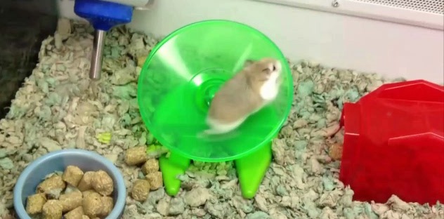
Feel like you are spinning in circles
Notes:
I’ll begin with acknowledging that the grant application process may have you feeling like this little guy - spinning around in circles accomplishing little?
In this presentation I hope to provide you with an understanding of how to navigate this process when your research involves the use of live vertebrate animals.

Slide 3
Learning Objectives
Define live vertebrate animal for PHS award purposes;
Describe requirements of the Vertebrate Animal Section (VAS);
Recognize significance of verifying Institutional Animal Care and Use Committee (IACUC) approval;
Identify three types of Animal Welfare Assurances;
Describe non-compliance and understand its implications.
Notes:
After today’s session, you will be able to …….

Slide 4
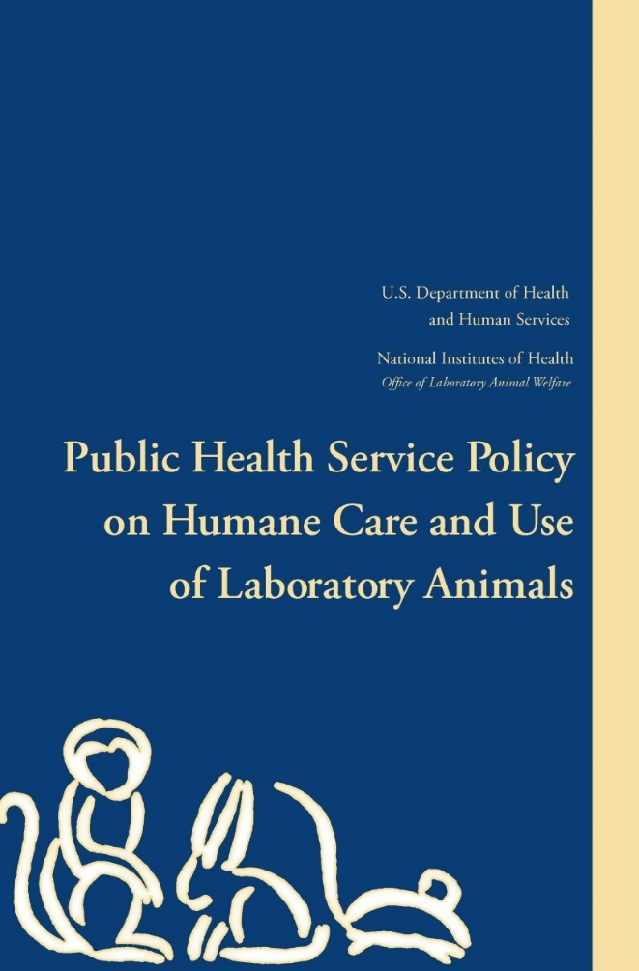
Public Health Service Policy on Humane
Care and Use of Laboratory Animals (PHS Policy)
Implements Health Research Extension Act of 1985 (Public Law 99-148);
Applicable to Public Health Service (PHS) conducted or supported activities involving animals;
Base animal program on the Guide for the Care and Use of Laboratory Animals (Guide);
Must comply with all other Federal statutes and regulations;
OLAW administers and coordinates.
Notes:
In order to accomplish our objectives for this presentation, I’d like to begin with some regulatory framework.
Federally funded research involving the use of live vertebrate animals must follow the Public Health Service Policy on Humane Care and Use of Laboratory Animals.
The Health Research Extension Act of 1985 (Public Law 99-158) provides the legislative mandate for the PHS Policy.
The Policy requires that assured institutions base their animal care program on the Guide for the Care and Use of Laboratory Animals (aka the Guide).
Although the Guide may differ from USDA regulations in some areas, please be advised that the PHS Policy requires compliance with the Animal Welfare Regulations for USDA if your institution maintains USDA covered species.
OLAW is the NIH office responsible for the administration and coordination of the PHS Policy.

Slide 5
OLAW Mission
The Office of Laboratory Animal Welfare (OLAW) provides guidance and interpretation of the Public Health Service Policy on Humane Care and Use of Laboratory Animals (PHS Policy), supports educational programs, and monitors compliance with the Policy by Assured institutions and PHS funding components to ensure the humane care and use of animals in PHS-supported research, testing, and training, thereby contributing to the quality of PHS-supported activities.
Notes:
OLAW’s mission is to ensure humane care and use of animals used in PHS funded research.
We sit within the Office of Extramural Research at NIH, and we support institutions receiving PHS funding for research involving animals.
All of this is to contribute to the overall quality of PHS supported activities.

Slide 6
OLAW Responsibilities
Request, negotiate, withdraw Assurances;
Distribute list of institutions that have an approved Assurances;
Advise awarding units and awardee institutions concerning the implementation of the PHS Policy;
Support educational programs;
Authority to approve waivers to the PHS Policy;
Evaluate allegations of noncompliance with the PHS Policy;
Conduct site visits to selected institutions.
Notes:
OLAW accomplishes its mission by:
Negotiating assurances with institutions that receive PHS funds for animal activities. This means that an institution writes a document describing their animal care program and OLAW works with that institution to develop their program description so that it is compliant with PHS Policy.
OLAW maintains a list of all assured institutions on its website.
We oversee the implementation of the PHS Policy by providing interpretation and guidance,
… as well as supporting educational activities through workshops, resources, training and webinars.
OLAW does have the authority to review and approve or disapprove waivers to the PHS Policy.
We monitor compliance mainly through institutional self-reporting, as well as third party allegations,
And, OLAW routinely conducts site visits to assured institutions, again contributing to the quality of PHS supported activities.

Slide 7
NIH Grants Policy Statement
Complete Vertebrate Animal Section (VAS);
Verification that IACUC reviewed and approved;
Animal Welfare Assurance for applicate and all performance sites.
Notes:
The NIH Grants Policy Statement spells out the terms and conditions of NIH grants, which align with PHS Policy.
There are three requirements in the NIH Grants Policy specific to vertebrate animal use:
There must be a completed VAS.
The IACUC review and approval must occur prior to the conduct of any (PHS supported) animal activity.
And, there must be a valid Animal Welfare Assurance.
We will talk more about all three of these requirements throughout the presentation.

Slide 8
Which federal agency or agencies require research institutions to comply with PHS Policy?
NIH
Department of Veterans Affairs (VA)
National Science Foundation (NSF)
National Aeronautics and Space Administration (NASA)
HHS BARDA
All of the above
Notes:
I’d like you to take a moment to look over this list and think about which federal agency or agencies you think require research institutions to comply with PHS Policy.
BARDA = Biomedical Advanced Research & Development Authority

Slide 9
Fedaral Agencies Required to Comply with PHS Policy
PHS funding agencies
NIH
Agencies with MOUs
VA
NSF
CDC
FDA
HHS BARDA
NASA
*NOT DOD, USDA, non-profit, for-profit
Notes:
I hope you thought that all of these federal agencies are required to comply with PHS Policy.
OLAW assures and oversees PHS funded animal activities.
There are 4 federal agencies account for most of the extramural funding for research involving animals – those are NIH, CDC, FDA and HHS BARDA.
OLAW is also authorized to oversee animal activities and negotiate assurances on behalf of several funding components that have MOUs with OLAW.
OLAW does not oversee animal activities funded by DoD, USDA, non-profit or for-profit organizations.

Slide 10
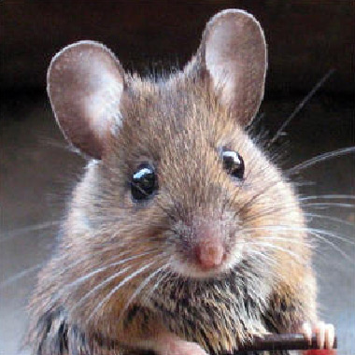
PHS Policy Definition of Animal
“Animal” is defined by PHS Policy as:
“any live vertebrate animal used or intended for use in research, research training, experimentation, or biological testing or for related purposes”.
Notes:
Now that we reviewed the regulatory framework for the use of animals in research, let’s talk about the definition of an animal.
(not Webster or Urban Dictionary definition)
The Public Health Service Policy defines an animal as …

Slide 11
Which studies should be considered vertebrate animal use?
zebrafish
tadpole
mosquito malaria study using rabbit host
octopus
cow spleen from slaughterhouse
pre-hatched embryos
goat antibodies
chimp behavior study
Notes:
We’re going to do a fun exercise. I want you to look over this graphic and think about which of these studies should be considered vertebrate animal use.

Slide 12
Which studies should be considered vertebrate animal use?
zebrafish
tadpole
mosquito malaria study using rabbit host
octopus
cow spleen from slaughterhouse
pre-hatched embryos
goat antibodies
chimp behavior study
Notes:
Zebrafish and tadpole are vertebrates so they are vertebrate animal use.
A mosquito using a rabbit host would be considered animal use because of the rabbit host.
An octopus is not a vertebrate (Cephalopod), so it would not be considered vertebrate animal use, BUT institutions should use best practices when research involves invertebrates with highly complex nervous system such as an octopus.
A cow spleen from a slaughterhouse is not animal use if the cow is used for another purpose and not for the sole purpose of the spleen collection.
An embryonated egg would be animal use if the study involves the mother or if the study extends all the way to hatching. However, the current AVMA guidance on euthanasia states that embryonated eggs at 80% incubation have neural tube, therefore perceive pain.
Goat antibody study is not animal use if the antibodies are off the shelf / commercially available. If the antibodies are custom made such that they are generated specifically for the purpose of the grant, it would be animal use.
A chimp behavior study is animal use if the study alters or modifies the behavior of the animal, but if it is purely observational and does not affect the behavior of the animal, such as in a zoological setting, it would not be considered animal use.
[OLAW issued a guidance notice on NIH Research Involving Chimpanzees (NOT-OD-16-095) on May 16 2016 which states that Beginning on May 25, 2016, NIH will not fund any research involving chimpanzees proposed in new or other competing projects (renewal and revisions) unless the research is consistent with the definition of “noninvasive research,” as described in the “Standards of Care for Chimpanzees Held in the Federally Supported Chimpanzee Sanctuary System” at 42 CFR part 9. Grant applicants who propose the use of chimpanzees or chimpanzee biomaterials in new or competing research will undergo an extensive review process (two-level peer review process)].

Slide 13
Vertebrate Animal Section (VAS)
1. Description of Animal Procedures
2. Justifications
3. Minimization of Pain/Distress
concise description of proposed procedures
identify species, strains, ages, sex and total number of animals by species
dog or cat source
species are appropriate for research
why not alternative model (e.g. computational, human, invertebrate, in vitro)
interventions such as analgesia, anesthesia, sedation, palliative care
humane endpoints
Notes:
Now that we have defined a live vertebrate animal, we will talk about the VAS (click again).
A complete VAS is required in a grant application per the NIH Grants Policy.
There are three criteria that must be complete in the VAS, as a stand-alone document. If the required information is elsewhere in the grant (specific aims), it still has to be included in the VAS.
Go through slide.

Slide 14
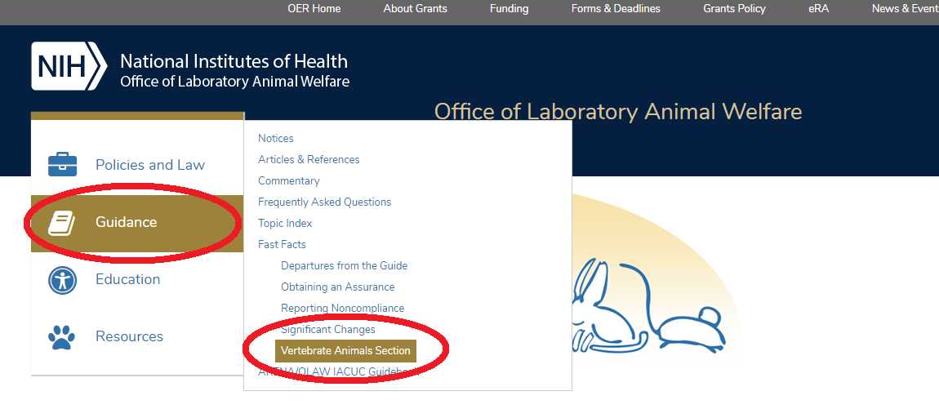
VAS Online Training Module!
https://olaw.nih.gov/vas-e-module/story.html
Notes:
OLAW recently developed and released a VAS Online Training Module! This training module is fantastic!
It is an interactive overview of the requirements, a checklist for applicants and reviewers, and provides detailed instructions.
It takes 20-30 minutes. I’ve done it, it is put together well and is very informative. The graphics are amazing.
I strongly recommend that you check it out so that you can submit a complete and acceptable VAS the first time, and avoid having it returned as unacceptable and then have to revise and resubmit.

Slide 15
Verification of IACUC approval
No funds may be used for animal activity until verification of IACUC approval;
No animal activity conducted without IACUC approval;
Approval within three years of the budget period start date;
Just-in-Time procedures;
Institutional responsibility to ensure congruency.
Notes:
Now let’s talk about our third learning objective, IACUC approval.
It’s important for you to know that costs for activities with animals may NOT be charged to NIH grants if there is not a valid IACUC approval.
NIH will delay an award for research involving animals until the awardee organization provides verification of IACUC approval (and all Animal Welfare Assurances are in place).
IACUC approval must be granted within three years of the budget period start date to be valid but it may also be submitted with Just-in-Time procedures.
It is an institutional responsibility to ensure that the IACUC protocols are congruent with the research described in the application.
(Following peer review and notification of impact score/percentile, applicant organizations with approved Assurances may wish to proceed with IACUC review if the study appears to be in a fund-able range).

Slide 16
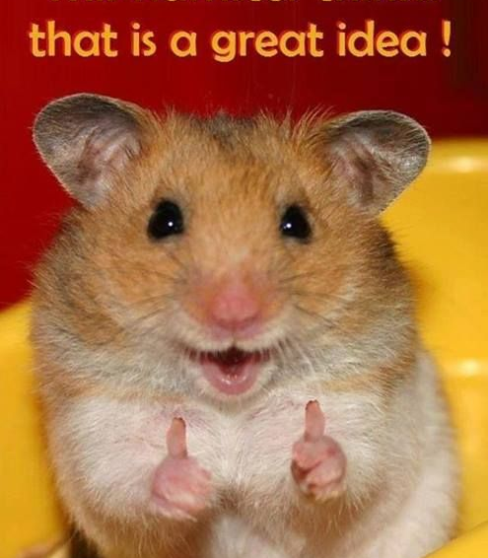
Animal Welfare Assurance
Notes:
Now we’ll focus on the Animal Welfare Assurance and this hamster thinks that is a great idea!

Slide 17
Animal Welfare Assurance
The PHS Policy, section IV.A., requires that:
“No activity involving animals may be conducted or supported by the PHS until the institution conducting the activity has provided a written Assurance acceptable to the PHS, setting forth compliance with the Policy.”
Agreement with federal government;
Commits organization to proper care and treatment of animals;
Required for PHS funded grants, contracts and cooperative agreements.
Notes:
Visiting the PHS Policy again … it states that …
As you’ve been hearing, OLAW is charged with overseeing PHS funded animal activities, and so OLAW is the entity that will negotiate the required assurance (click again).
It’s an agreement that commits an organization to humane care of animals used in their research program.
If using animals in PHS funded research, each awardee organization and its performance sites must have an assurance in place.
The negotiation process begins with a request to OLAW from the funding component.
Take away here is that if you do not have an Animal Welfare Assurance, you may not conduct animal activity using PHS funds.

Slide 18
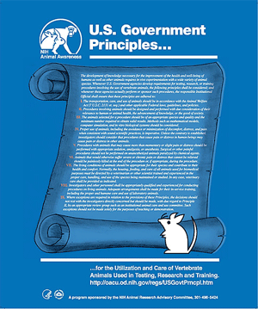
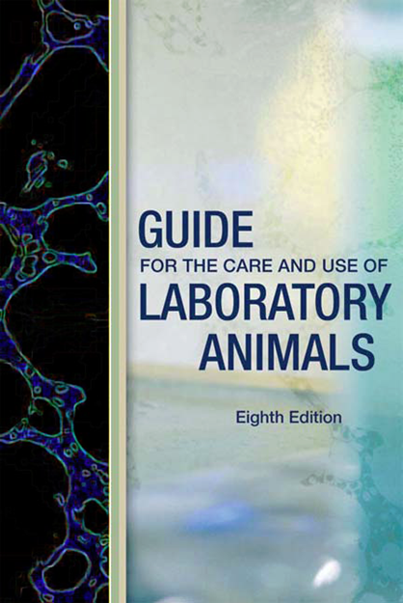
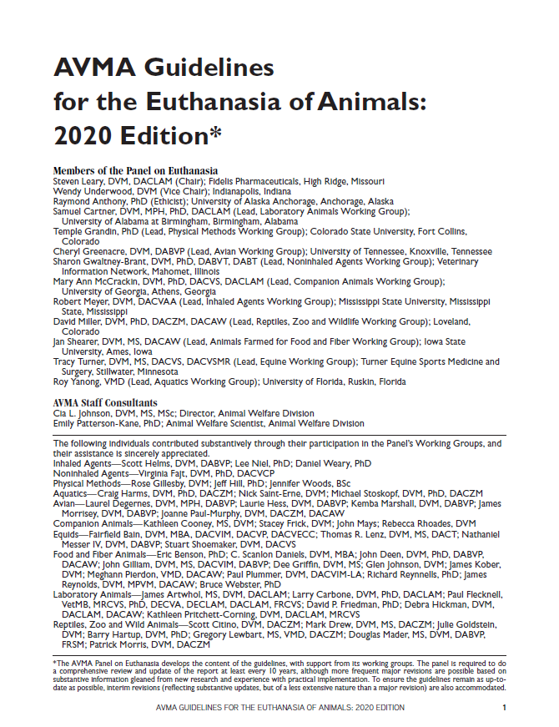
PHS Policy Standards for Animal Care and Use
Notes:
Before I move on to the specific types of Assurances, I want to point out that several resources together make up the standards for animal care that are spelled out in the Assurance document.

Slide 19
Animal Welfare Assurances
Domestic Assurance
US organization controls own facility and conduct research on site
Animal program with IO, IACUC, veterinarian
Foreign Assurance
Foreign awardee or foreign performance site
Regional regulations and policies
International Guiding Principles for Biomedical Research Involving Animals
Performance site has assurance
Tie grantee to performance site
Performance site IACUC
Has PHS funding
Interinstitutional Assurance
Notes:
Now I will provide a brief overview of the three types of Assurances (click again).
The domestic negotiated:
US org controls own animal facility
Complete animal care and use program with an IO, IACUC and veterinarian
And conducts PHS supported animal activities on-site.
A foreign assurance negotiated:
awardee is a foreign org, OR a domestic awardee is conducting animal activity at a foreign site. (In which case, domestic awardee’s IACUC approves the animal activity that is performed at the foreign site.)
foreign org states its compliance with all laws, regulations and policies regarding the humane care and use of animals in the region that the research is to be conducted
must be guided by the International Guiding Principles for Biomedical Research Involving Animals.
The interinstitutional assurance (IA) negotiated
grantee org does not have an animal care program, animal facilities and an IACUC and the animal work will be conducted at a performance site that does have a valid Assurance.
Purpose of an IA - tie the unassured org receiving the award to the assured performance site.
Performance site provides IACUC approval.

Slide 20
Interinstitutional Assurance Example
Bob’s Biotech (BB) received a grant that involves animals. BB does not have an animal care and use program of their own so the animal activity will be performed at John’s Hopkins (JHU), an assured organization. The IC or Grants management will request an IA between BB, the performance site JHU and OLAW.
Signed by IO of BB and by the IO and IACUC Chair of JHU to verify approval
Notes:
Let’s go over an example of the IA.
Bob’s Biotech = non-assured grantee
John’s Hopkins = assured performance site

Slide 21
Consortium Agreements
Applies to all parties in collaboration (primary and subs) where animal research conducted
Dual IACUC approval is not required for the same animal activity;
But Animal Welfare Assurances and IACUC approvals must be in place (dated within 3 years).
https://olaw.nih.gov/guidance/obtaining-an-assurance.htm
Notes:
We can not talk about Animal Welfare Assurances without addressing consortium agreements or sub-awards.
PHS applies to all parties in collaboration (primary and subs) where animal research conducted but …
If all have their own Assurance, the prime awardee is accountable per NIH Grants Policy and must confirm that they have an Assurance and valid IACUC approval.
That wraps up the three types of Assurances. For more information about obtaining an Assurance, please visit the URL.

Slide 22
What are the PHS Policy and NIH Grants
Policy requirements when making an award involving animals?
Completed VAS in the application
Verification that the IACUC has reviewed and approved those sections of the application that involve the use of vertebrate animals.
Assurance for the applicant organization and all performance sites
Assurance for only the applicant organization even though there are other performance sites
Notes:
Based on what we’ve gone over so far, I’d like for you to take a look at this list and think about what the PHS Policy and NIH Grants Policy requirements are when making an award involving animals.

Slide 23
What are the PHS Policy and NIH Grants
Policy requirements when making an award involving animals?
Completed VAS in the application
Verification that the IACUC has reviewed and approved those sections of the application that involve the use of vertebrate animals.
Assurance for the applicant organization and all performance sites
  Assurance for only the applicant organization even though there are other performance sites
Notes:
The first three are required when making an award.
There must be an Assurance for the applicant organization and all performance sites.

Slide 24

Grant Application
SF 424 Project Performance Site Locations
PHS 398: Other Research Plan and Cover Page Supplement
Notes:
Now that you know the PHS and NIH Grants Policy requirements when using animals in research, let’s take a look at the grant application itself.
There are three places that need to be completed when using vertebrate animals:
The SF 424 Project Performance Site Locations
PHS 398: Research Plan Section 5 and the Cover Page Supplement

Slide 25
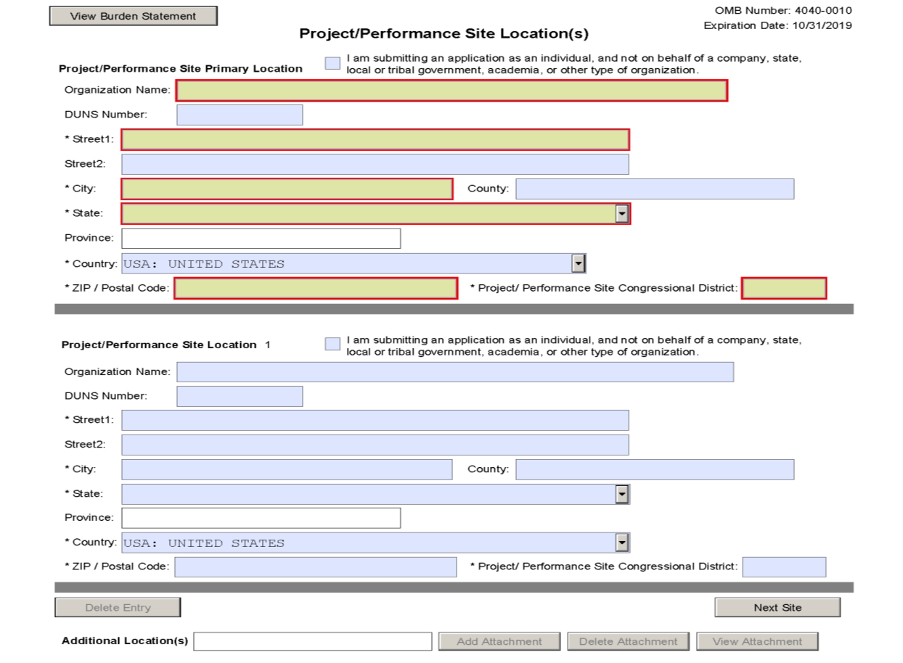
Project/Performance Site Location(s) Form
SF 424
Notes:
On the SF 424, each performance site where live, vertebrate animals will be used should be listed on the Project/Performance Site Location(s) page.

Slide 26
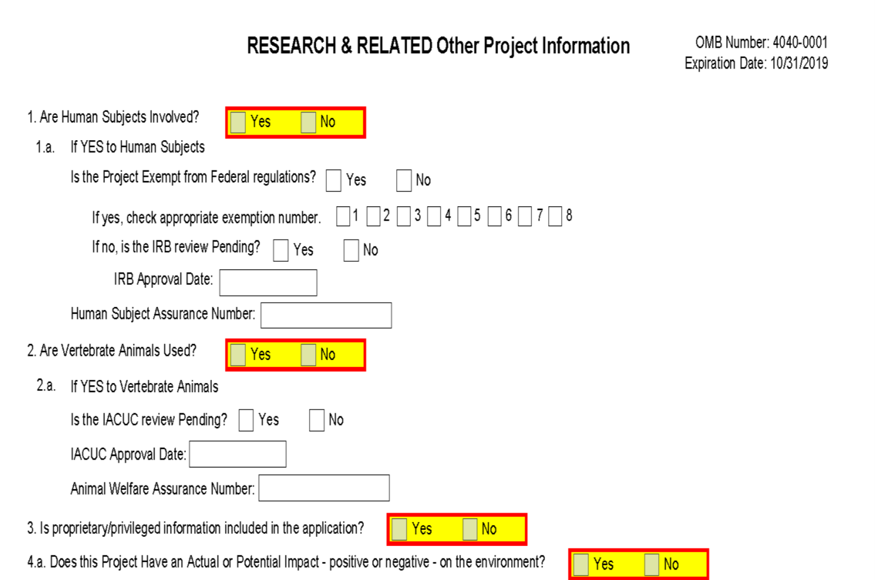
Research & Related Other Project Info Form
SF 424
Notes:
Then you will complete sections 2 and 2a.
2 asks if vertebrate animals are used? You would check YES.
If you check YES, you must complete 2a, which asks if IACUC review is pending.
If it is pending, you would check YES and leave the IACUC Approval Date blank.
If the IACUC has approved the animal activity (not pending), you would check NO and provide the IACUC Approval Date.
Then it asks for the Animal Welfare Assurance Number, which is ALWAYS the applicant organization’s Assurance number.
If the applicant organization does not have an Assurance, the response would be “None”, and OLAW will negotiate the appropriate Assurance.

Slide 27
PHS Research Plan Form
PHS 398
Notes:
In Research Plan Section of the PHS 398, you would upload your completed VAS as a pdf document in item 5 of the Other Research Plan Section.
Remember to be sure to complete all three criteria of the VAS.

Slide 28
PHS Cover Page Supplement Form
PHS 398
If the proposed method of euthanasia is inconsistent with the recommendations of the American Veterinary Medical Association (AVMA) Guidelines for the Euthanasia of Animals: 2020 Edition (AVMA Guidelines)-
  Euthanasia method must be described
  Must provide a scientific justification
Notes:
Then, in the cover page supplement, it asks if vertebrate animals will be euthanized.
If yes, you need to state whether the method of euthanasia is consistent with the recommendations of the American Veterinary Medical Association (AVMA) Guidelines for the Euthanasia of Animals (2020 Edition).
If the method of euthanasia is not consistent with the AVMA, you will need to provide a description of that method along with scientific justification and OLAW will review prior to award.

Slide 29

Reporting Noncompliance
Prompt self reporting required by PHS Policy;
Institutions address and correct to improve animal welfare;
OLAW evaluates, assesses and monitors;
Implications:
  Special terms and conditions of awards
  Cost disallowance
  Suspension or termination of award
  Restriction or withdrawal of Assurance
  Enhanced reporting requirements
  Criminal prosecution
Notes:
Now I will close with some information about reporting noncompliance.
Prompt reporting is required for any serious or continuing noncompliance with PHS Policy, serious deviation from the Guide, and any suspension of an activity by the IACUC.
PHS Policy requires institutions to self-report noncompliance.
Some of the implications of noncompliance include …
(Especially egregious)

Slide 30
Learning Objectives
Define live vertebrate animal for PHS award purposes;
Describe requirements of the Vertebrate Animal Section (VAS);
Recognize significance of verifying Institutional Animal Care and Use Committee (IACUC) approval;
Identify three types of Animal Welfare Assurances;
Define noncompliance and understand its implications.
Notes:
We have now completed our 5 learning objectives.

Slide 31
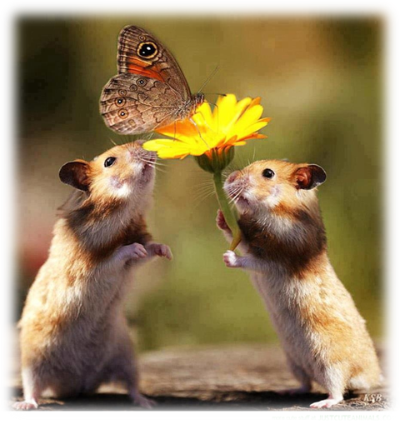
Outreach
ICARE Dialogs: https://olaw.nih.gov/education/icare-interagency
FAQs: http://grants.nih.gov/grants/olaw/faqs.htm
Upcoming Workshops and Conferences: https://grants.nih.gov/policy/olaw/workshop.htm
OLAW online webinars series: http://grants.nih.gov/grants/olaw/e-seminars.htm
Recordings of past webinars: http://grants.nih.gov/grants/olaw/educational_resources.htm
Notes:
Here are some links from our website for educational opportunities.
(ICARE) = Interagency Collaborative Animal Research Education Project uses active learning

Slide 32
Resources
VAS E-module: https://olaw.nih.gov/vas-e-module/story.html
VAS What Investigators Need to Know: https://olaw.nih.gov/guidance/vertebrate-animal-section.htm
Obtaining an Assurance: https://olaw.nih.gov/guidance/obtaining-an-assurance.htm
List of Assured institutions: https://olaw.nih.gov/assured/app/index.html#DOMESTIC
Notes:
Here are some resource URLs that you can refer to later.

Slide 33
Contact OLAW
OLAW website: http://olaw.nih.gov
OLAW main: 301-496-7163: olaw@od.nih.gov
Division of Policy and Education: olawdpe@mail.nih.gov
Division of Assurances: assurances.olaw@od.nih.gov
Division of Compliance Oversight: olawdco@mail.nih.gov
ListServ or RSS Feed: subscribe through the OLAW webpage for current announcements, notices, policy interpretations.
Notes:
Here are some ways to contact OLAW.
Thank you for your time and interest in policy requirements for research involving animals. Please feel free to reach out with any questions,
and remember that you can sign up for one on ones in our booth. Have a great day.

Slide 34
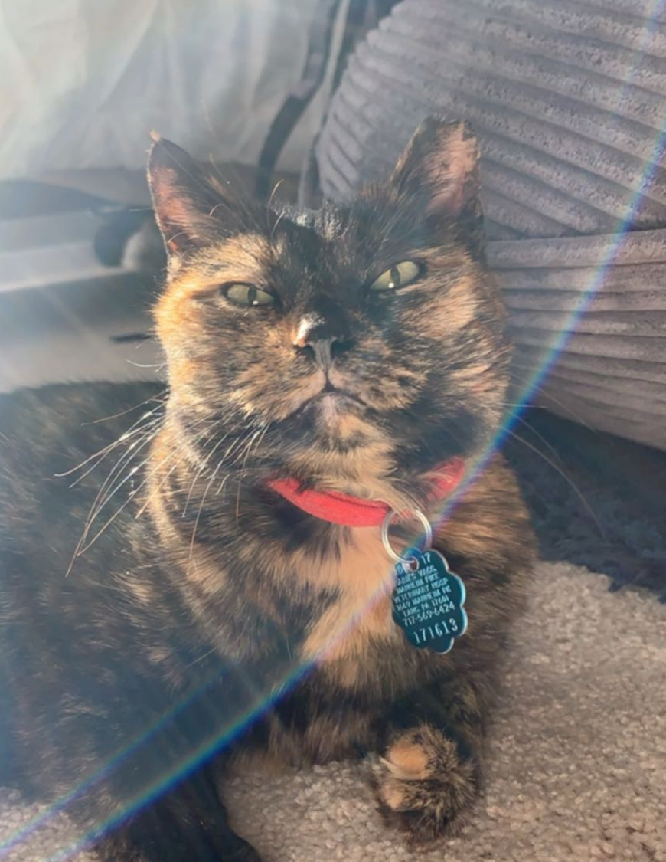
Have a great day!

