Slide 1
Helping Academics Address Unmet Medical Needs
Ashim Subedee, PhD
Matt McMahon, PhD
SEED (Small business Education and Entrepreneurial Development)
Office of Extramural Research, NIH
2020 NIH Virtual Seminar
October 30, 2020

Slide 2
Poll Question 1
Are you an academic and have received NIH academic award(s) (R01, R21, K99, U01, P01, U54 etc.)?
Yes
No

Slide 3
Poll Question 2
Are you?
Faculty
Post-doc
Student (Graduate, Undergraduate)
University Administrator
Small Business
Other

Slide 4
Poll Question 3
Do you believe your research has the potential to be developed into a technology/product including therapeutics, diagnostics, medical devices etc.?
Yes
No

Slide 5
Academic Institutions as Innovation Engines
The Opportunity: The majority of biomedical innovations stem from basic research in academia
PRODUCTS
Drugs
Therapies
Vaccines
Devices
Tests
eHealth
~$30B per year
grants
research
Notes:
A gap in funding between basic research discoveries and scientific proof of feasibility or validation studies required to define the product for early stage technology development
A lack of knowledge and understanding by academic innovators about how new technologies are brought to market
A lack of access to sufficient technology development and commercialization resources that are required for early stage technology development and company formation
Confused and frustrated innovators

Slide 6
Academic Institutions as Innovation Engines
The Opportunity: The majority of biomedical innovations stem from basic research in academia
PRODUCTS
Drugs
Therapies
Vaccines
Devices
Tests
eHealth
~$30B per year
grants
research
The Problem: Turning university-derived discoveries into tangible products is slow and inefficient
Notes:
A gap in funding between basic research discoveries and scientific proof of feasibility or validation studies required to define the product for early stage technology development
A lack of knowledge and understanding by academic innovators about how new technologies are brought to market
A lack of access to sufficient technology development and commercialization resources that are required for early stage technology development and company formation
Confused and frustrated innovators

Slide 7
Academic Institutions as Innovation Engines
The Opportunity: The majority of biomedical innovations stem from basic research in academia
PRODUCTS
Drugs
Therapies
Vaccines
Devices
Tests
eHealth
~$30B per year
grants
research
The Problem: Turning university-derived discoveries into tangible products is slow and inefficient
Why is this? Academic researchers often lack …
Funding for product definition or development studies
Knowledge about the commercialization process
Access to product development expertise
Incentives for pursuing product-focused research
Notes:
A gap in funding between basic research discoveries and scientific proof of feasibility or validation studies required to define the product for early stage technology development
A lack of knowledge and understanding by academic innovators about how new technologies are brought to market
A lack of access to sufficient technology development and commercialization resources that are required for early stage technology development and company formation
Confused and frustrated innovators

Slide 8
NIH SEED: Funding – Knowledge – Access
Small business Education and Entrepreneurial Development (SEED)
Supports the NIH innovator community (funding and resources) to validate and advance discoveries to products that improve patient care and health.
Develop relationships with strategic partners and build opportunities for NIH innovators to further their product development efforts.
Small Business Innovation
Innovator Support
Academic Innovation
seed.nih.gov
Notes:
More than just funding- supporting the entire community and encourage you to come to the sessions on day three focused on SEEDing the Marketpace.

Slide 9
Poll Question 4
Have you heard about the NIH Proof of Concept Network programs including NCAI, REACH, and NIGMS STTR Regional Technology Transfer Accelerator Hubs for IDeA States?
Yes
No

Slide 10
Poll Question 5
Have you applied to and/or received funding or other support from NIH Proof of Concept Network?
Yes
No

Slide 11
NIH Proof-of-Concept Network: Supporting Product Development in Academia
Product development grants + education + mentoring + network
Upfront consideration of business case:
Product? Unmet need? Stakeholders? Market? Patents?
FDA? Reimbursement?
“Fail fast” philosophy – milestones; go/no go; tranche funding
Access to and review by industry & federal experts
Industry-style project management
Project Funding
Training and Resources
Up to $200K in project funding
Product definition/development
1:1 non-federal match required
Business development
Regulatory planning
Financing and partnerships
Educational Coaching
Personalized feedback
Project management
Mentoring and coaching
Industry-experienced mentors
Life science industry experts
FDA, CMS, NSF, USPTO
Kaiser Permanente

Slide 12
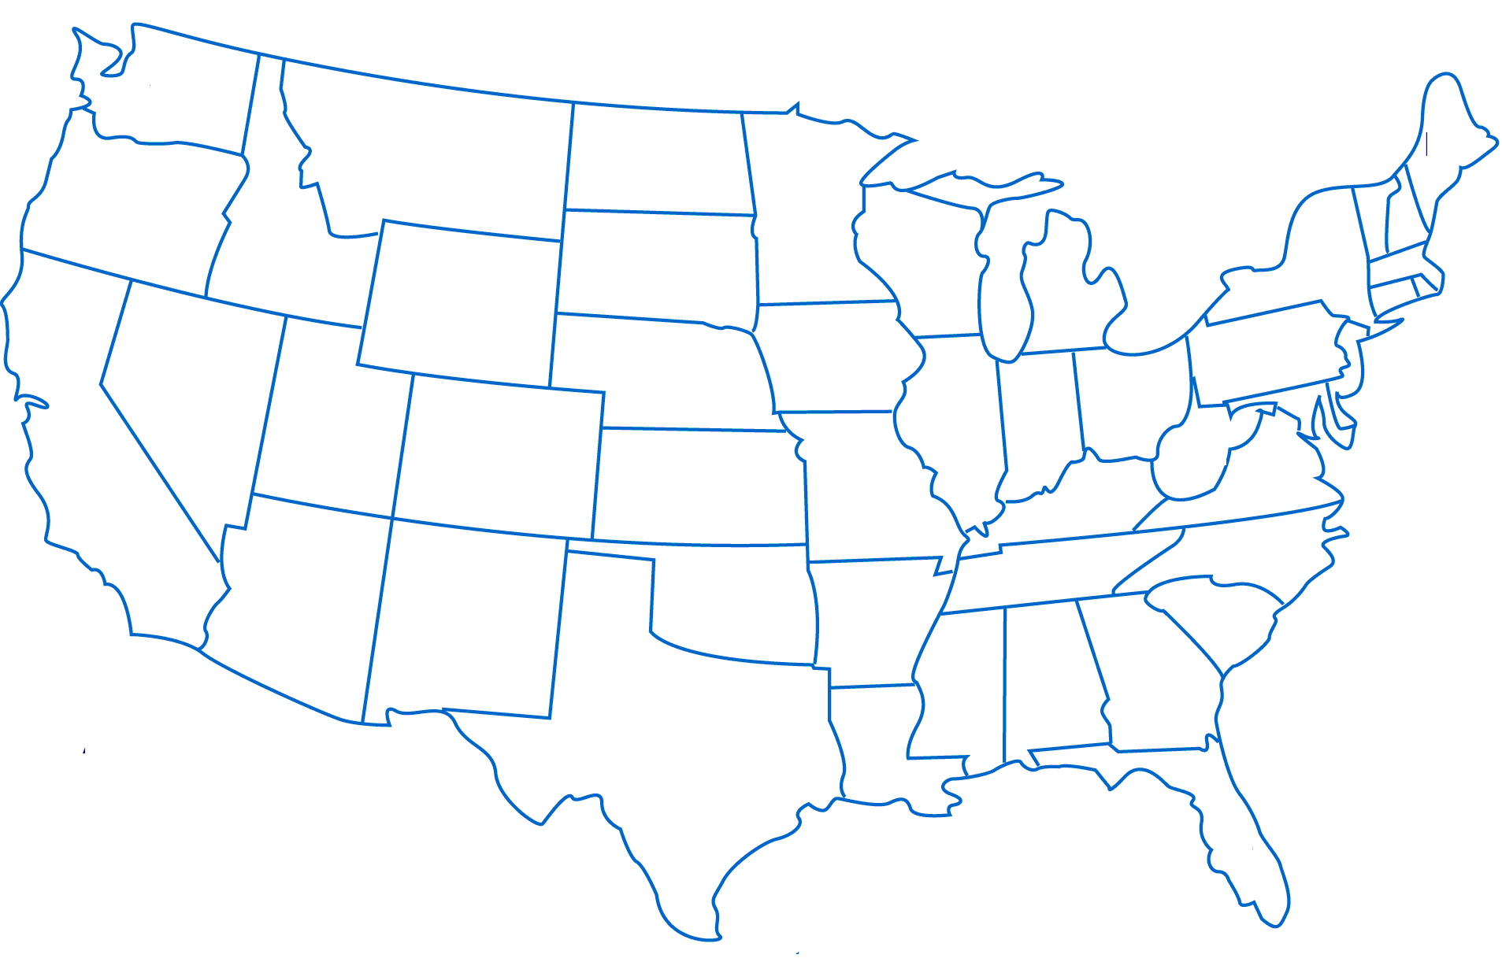
NIH Proof-of-Concept Network: NCAI and REACH
NCAI Centers:
NHLBI focus, established 2013
REACH 2015 Hubs:
Trans-NIH, established 2015
REACH 2019 Hubs:
Trans-NIH, established 2019
NIH Centers for Accelerated Innovation (NCAI)
Research Evaluation And Commercialization Hubs (REACH)
MN-REACH: University of Minnesota
MBArC: University of Missouri-Columbia, U Kansas Medical Center
NCAI-CC: Cleveland Clinic, Case Western Reserve University, The Ohio State University, University of Cincinnati & Cincinnati Children’s
ExCITE:
University of Louisville
B-BIC: Brigham and Women’s Hospital, Harvard Medical School, Massachusetts General Hospital, Massachusetts Institute of Technology, et al.
WE-REACH: University of Washington, Seattle Children’s
LIBH: Stony Brook University, Cold Spring Harbor Laboratory, Brookhaven National Laboratory, Feinstein Institute for Medical Research
UC-CAI: UCLA, UC Davis, UC Irvine, UC San Diego, UC San Francisco
ROI: Rutgers (BHS, University, Cancer Institute)
Colorado REACH:
Colorado Anschutz Medical Center
NIH & Partners: NSF, FDA, USPTO, CMS, Kaiser Permanente
KYNETIC: University of Kentucky, University of Louisville, KY CED, et al.

Slide 13
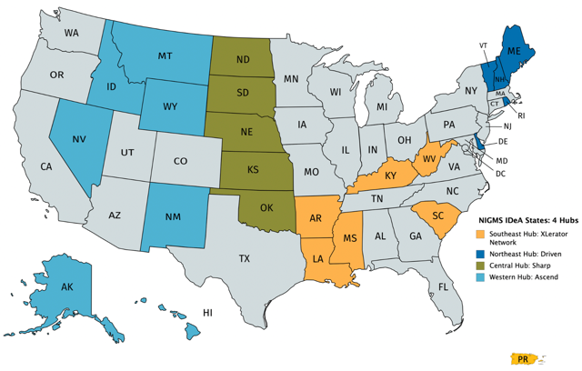
NIH Proof-of-Concept Network: Regional Technology Transfer Hubs
NIGMS STTR Regional Technology Transfer Accelerator Hubs for IDeA States
→ 35 additional institutions, facilitated by STTR awards to 4 small businesses
NIGMS IDeA States Regional Hubs
Southeast: XLerator Network
Northeast: DRIVEN
Central: SHARP
Western: ASCEND

Slide 14
NIH Proof-of-Concept Network: Outcomes to Date*
289
Funded Projects
NCAI + REACH
Small Business Program Award
New Companies
Technology
Licenses/Options
Follow-on
Funding
Academic Innovators
receiving entrepreneurial training
29
74
69
$802M
more than 2,250
*As of October 26, 2020

Slide 15
Success Story
Pathway to Independence Award ($680K total) led Jonathan Thon to believe he could use pluripotent stem cells to manufacture human platelets.
NCAI funding ($350K) to build a platelet bioreactor. Technology Review Committee led directly to connection with CBER to discuss regulatory path.
2016 Spin-out company received a Direct to Phase II SBIR ($1.5M)
Commercialization Assistance Program award (to support IP development)
2017 $10 million in Series A venture capital financing
2018 Entrepreneur-in-Residence mentoring and support to attend BIO
2018 $3.5 million DoD grant
2019 $26 million Series A1 venture capital financing
2019 $5 million (with potential to reach $56 million) contract from BARDA
If not for acceleration effect of BBIC, this would have been a continuation of an academic project.

Slide 16
Success Story
Pathway to Independence Award ($680K total) led Jonathan Thon to believe he could use pluripotent stem cells to manufacture human platelets.
NCAI funding ($350K) to build a platelet bioreactor. Technology Review Committee led directly to connection with CBER to discuss regulatory path.
2016 Spin-out company received a Direct to Phase II SBIR ($1.5M)
Commercialization Assistance Program award (to support IP development)
2017 $10 million in Series A venture capital financing
2018 Entrepreneur-in-Residence mentoring and support to attend BIO
2018 $3.5 million DoD grant
2019 $26 million Series A1 venture capital financing
2019 $5 million (with potential to reach $56 million) contract from BARDA
Hear from innovators like Jonathan!
4:00 PM – 4:45 PM EST
Innovators in Action: Case Studies
If not for acceleration effect of BBIC, this would have been a continuation of an academic project.

Slide 17
Poll Question 6
Have you heard about product development resources and programs at the NIH (eg. NCATS BrIDGS and TRND, NCI NExT, and NINDS Blueprint program)?
Yes
No

Slide 18
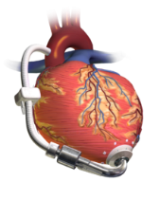
Product Development Resources at the NIH
Concept
Early Product Development
Clinical Trials
FDA
Product Definition
Preclinical
Disease
Target
Develop
Assay
Hit-to-Lead
Lead
Optimization
In vivo efficacy
IND enabling
Phase 1
trial
Phase 2
trial
HTS
Concept
Design
Prototype
Development
Verification/
Validation
Animal Testing
Scale
Manufacturing
Feasibility trial
Pivotal
trial
Academic
Grants
NCI Experimental Therapeutics (NExT) Program
NCI Experimental Therapeutics Clinical Trials Network
NCATS Bridging Interventional Development Gaps (BrIDGs)
NCATS Clinical Translational Science Awards (CTSA)
NCATS Therapeutics for Rare and Neglected Diseases (TRND)
NIAID Biopharmaceutical Product Development Services
NIH Blueprint for Neuroscience Research
NINDS Translational Devices Program
SBIR/STTR
Funding
Resources/Support
Both
Point-of-Care Technologies Research network

Slide 19
Product Development Resources at the NIH
Concept
Early Product Development
Clinical Trials
FDA
Product Definition
Preclinical
Disease
Target
Develop
Assay
Hit-to-Lead
Lead
Optimization
In vivo efficacy
IND enabling
Phase 1
trial
Phase 2
trial
HTS
COMING SOON
One webpage with information on all the relevant NIH programs
Concept
Design
Prototype
Development
Verification/
Validation
Animal Testing
Scale
Manufacturing
Feasibility trial
Pivotal
trial
Academic
Grants
NCI Experimental Therapeutics (NExT) Program
NCI Experimental Therapeutics Clinical Trials Network
NCATS Bridging Interventional Development Gaps (BrIDGs)
NCATS Clinical Translational Science Awards (CTSA)
NCATS Therapeutics for Rare and Neglected Diseases (TRND)
NIAID Biopharmaceutical Product Development Services
NIH Blueprint for Neuroscience Research
NINDS Translational Devices Program
SBIR/STTR
Funding
Resources/Support
Both
Point-of-Care Technologies Research network

Slide 20
NIH SEED: Funding – Knowledge – Access
Small business Education and Entrepreneurial Development (SEED)
Supports the NIH innovator community (funding and resources) to validate and advance discoveries to products that improve patient care and health.
Develop relationships with strategic partners and build opportunities for NIH innovators to further their product development efforts.
Small Business Innovation
Innovator Support
Academic Innovation
seed.nih.gov
Notes:
More than just funding- supporting the entire community and encourage you to come to the sessions on day three focused on SEEDing the Marketpace.

Slide 21
NIH SEED: Funding – Knowledge – Access
2:00 PM – 2:45 PM EST
From Bench to Boardroom: Support for Small Businesses
Small business Education and Entrepreneurial Development (SEED)
Supports the NIH innovator community (funding and resources) to validate and advance discoveries to products that improve patient care and health.
Develop relationships with strategic partners and build opportunities for NIH innovators to further their product development efforts.
Small Business Innovation
Innovator Support
Academic Innovation
3:00 PM – 3:45 PM EST
Beyond Funding: NIH Support for Innovators
Notes:
More than just funding- supporting the entire community and encourage you to come to the sessions on day three focused on SEEDing the Marketpace.

Slide 22
Get Connected
seed.nih.gov
Subscribe to the SBIR/STTR Listserv
Read our NIH SBIR/STTR Success Stories
@NIHsbir
sbir@od.nih.gov
NIH Guide for Grants and Contracts (weekly notification)
Connect with Us
ncai.nhlbi.nih.gov
Notes:
Contact us!

