Slide 1
Fundamentals of the NIH Grant Process & Need to Know Resources
Fall 2020
Notes:
Welcome to Fundamentals of the NIH Grant Process & Need to Know Resources.

Slide 2
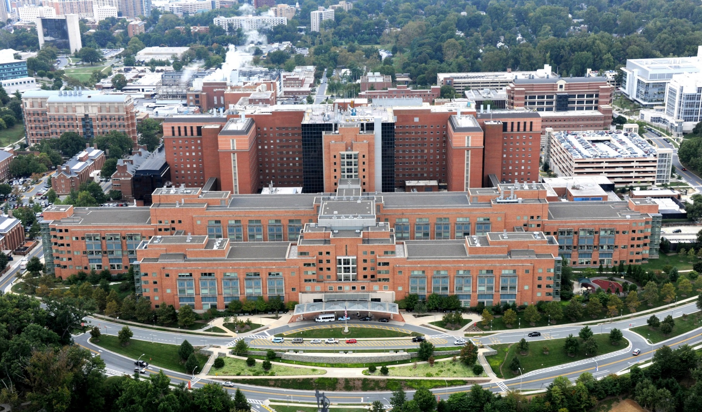
Who We Are
Largest public funder of biomedical research in the world.
Clinical Center (Building 10), NIH Campus
Notes:
NIH is the largest public funder of biomedical research in the world.

Slide 3
NIH Mission
To seek fundamental knowledge about the nature and behavior of living systems and the application of that knowledge to enhance health, lengthen life, and reduce illness and disability.
Notes:
Its mission is to seek fundamental knowledge about the nature and behavior of living systems and the application of that knowledge to enhance health, lengthen life, and reduce illness and disability.

Slide 4
NIH FY2019 By The Numbers
55,012 extramural grant awards totaling $29.466 billion
Supported research at 2,738 organizations
Notes:
In fiscal year 2019 NIH awarded over 55,000 extramural grants totaling more than $29.4 billion in funding. That funding supported research at 2,700 organizations throughout the U.S. and abroad.
All of us together have a shared responsibility for the appropriate stewardship of that tremendous investment.

Slide 5
Questions we’ll cover
Where do I start?
Where’s the funding?
Where do I turn when I need help or advice?
What opportunities are available & how can I find them?
What’s the application process & how long does it take?
Notes:
If you are new to working with NIH, then chances are you’ve asked one, or maybe all, of these questions:
Where do I start?
Where’s the funding?
Where do I turn when I need help or advice?
What opportunities are available and how can I find them?
What’s the application process & how long does it take?
These are precisely the questions we’ll cover and I’ll point out those need-to-know resources along the way.

Slide 6
Where do I start?
Notes:
Where do I start?

Slide 7
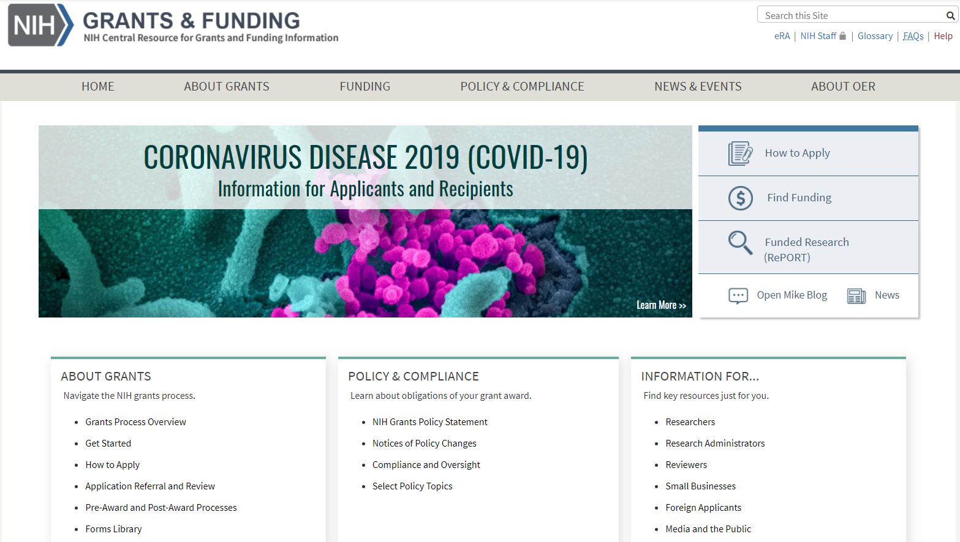
Grants.nih.gov
grants.nih.gov
Notes:
You’ll find all you need to know on the NIH Grants & Funding website.
Not familiar with an NIH term or acronym? Look it up in our Glossary.
Have a question? See if it’s answered in our FAQs.
You’ll also find our grant application instructions,
NIH Guide to Grants & Contracts
RePORTER and other tools to explore funded projects,
General grants process information, and
Policy and compliance pages.
We’ll talk more about many of these resources. For now, just be aware that it’s all there.

Slide 8
Where’s the funding?
Notes:
Where’s the funding?

Slide 9
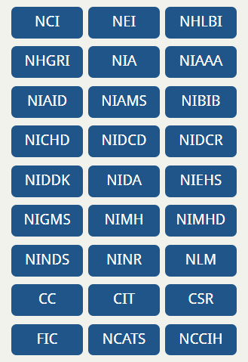
National Institutes of Health
27 Institutes and Centers (ICs)
Each IC has its own
mission,
priorities,
budget, and
funding strategy.
Notes:
To answer this question, you need to know a bit about how the National Institutes of Health is structured. NIH is made up of 27 different institutes and centers (or ICs) of which 24 offer funding opportunities and award grants. This is a very important point. NIH funding is made through these institutes and centers.
Each IC has its own mission, priorities, budget, and funding strategy which are stated on each IC’s website.
The vast majority of grant processes and polices apply across NIH. That said, you will find some variability from one IC to the next. .
Do your homework. Identify which ICs might be interested in your area of science. Determine if your proposal fits within that ICs mission and priorities. Find out what has already been funded? By law, NIH can’t support a project already funded or pay for research that’s already been done.
You need to know and be able to articulate what sets your proposal apart.
In 2019 our overall success rate for competing research grants was around 20%. This is a highly competitive process.

Slide 10
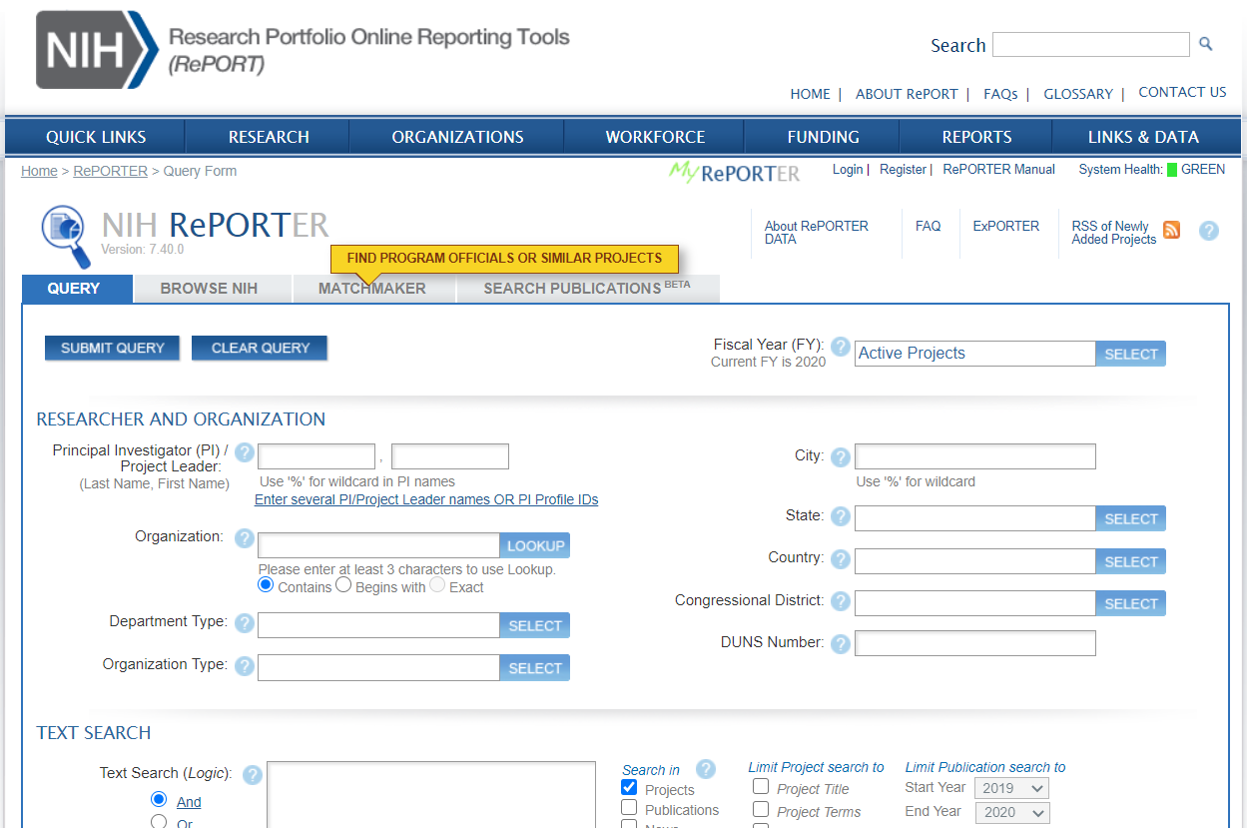
RePORTER (projectreporter.nih.gov)
Notes:
Let’s talk about finding that target IC. We have a great tool, called RePORTER at projectreporter.nih.gov, that can help identify ICs with potential interest in your area.
RePORTER allows you to explore decades of funded awards. If you’ve used RePORTER then you already have an idea of the wealth of information you can glean from it.
If you’ve never used it, …

Slide 11
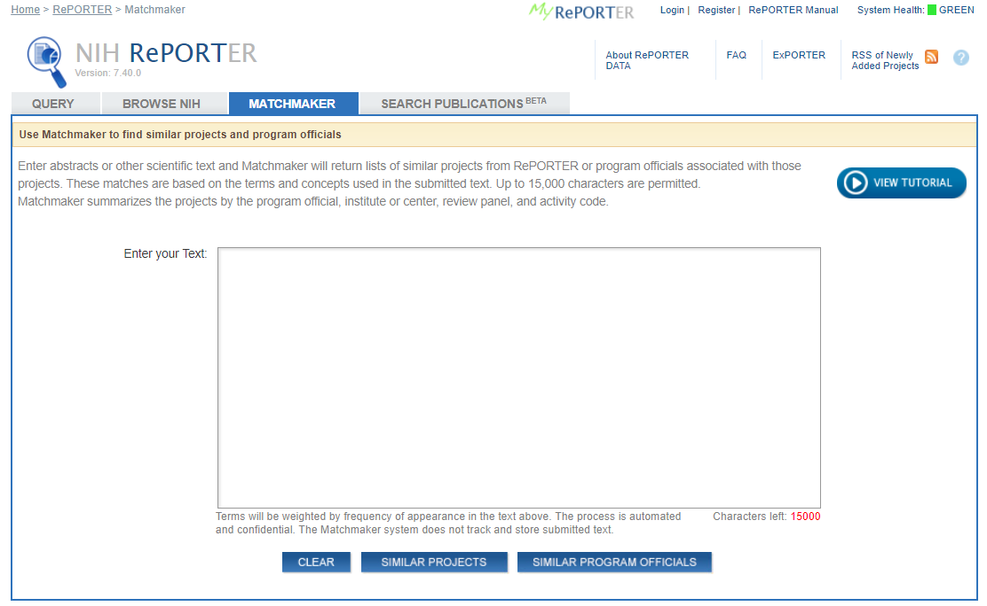
RePORTER - Matchmaker
Notes:
… I recommend starting with the Matchmaker tool.

Slide 12
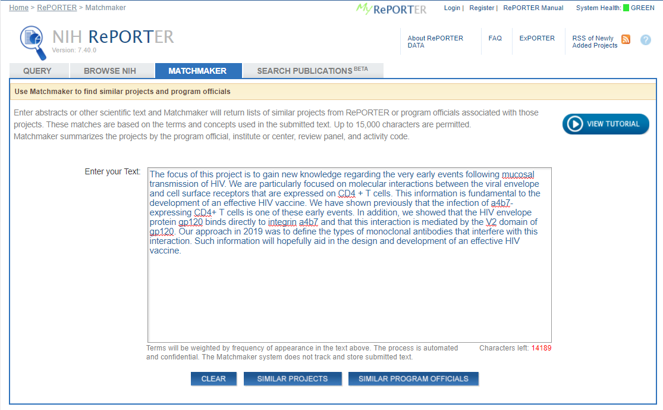
RePORTER - Matchmaker
Notes:
You give Matchmaker up to 15,000 characters of text which you can pull from your abstract, specific aims, or other source that describes your proposed research …

Slide 13
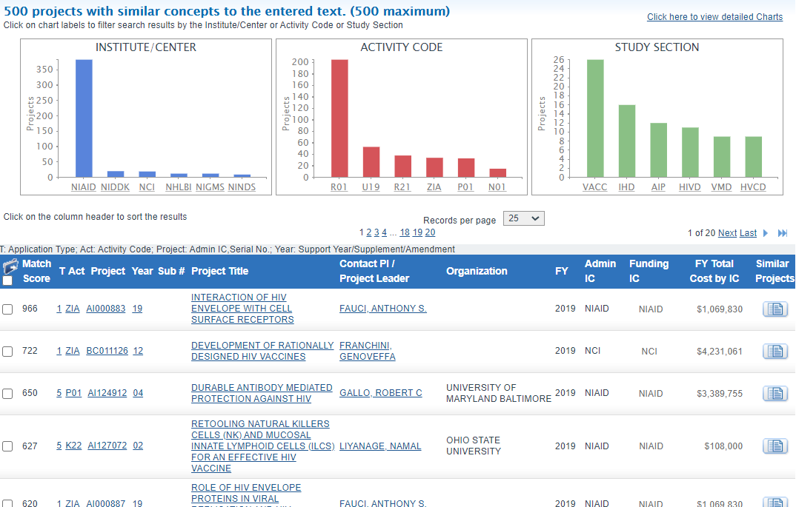
RePORTER – Matchmaker results
Notes:
… and Matchmaker returns the awarded projects that most closely match that text.
And, the results include graphs along the top for the ICs, activity codes and study sections associated with those projects.
This example clearly has a strong match with NIAD - our National Institute of Allergy and Infectious Diseases. You can click on the NIAD bar in the graph …

Slide 14
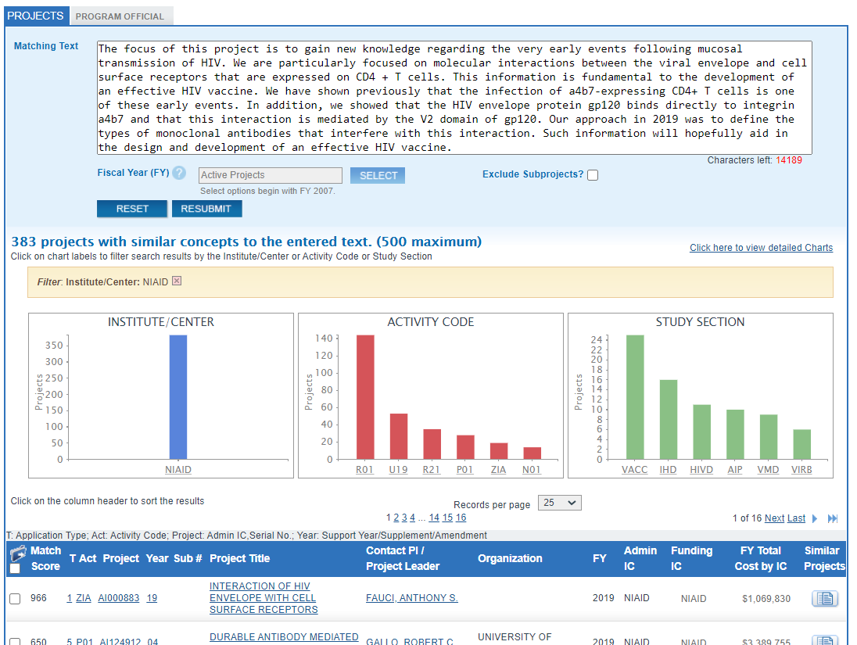
RePORTER – Filtered results
Notes:
and the results automatically filter to just those projects funded by that IC. You can drill down into each project and read the abstract and other details to get a feel for what’s been funded.
At the top, you can even move from the Projects tab to the Program Officials tab …

Slide 15
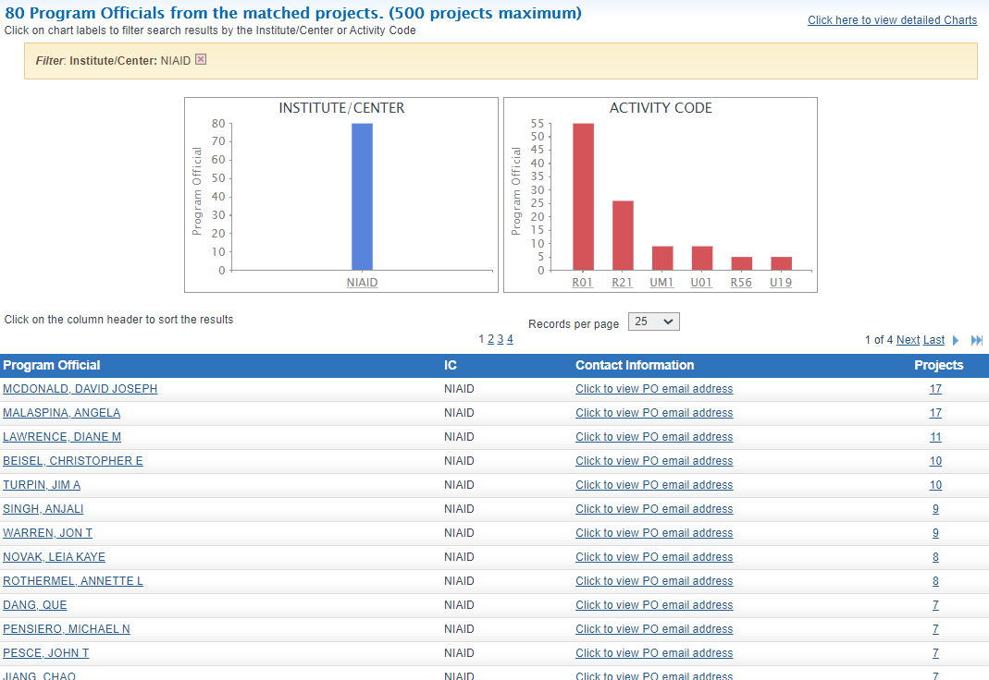
RePORTER – Program Officials
Notes:
to get a list of NIH scientific staff whose portfolios include the identified projects.
Using the RePORTER Matchmaker tool, with just a few queries and clicks, we identified both a potential funding institute and staff contacts. Pretty cool, huh?
Let’s take a moment to talk about reaching out to NIH and answer the question …

Slide 16
Where do I turn when I need help or advice?
Notes:
… where do I turn when I need help or advice?
Notice I didn’t say “if” - I said “when you need help or advice.”

Slide 17
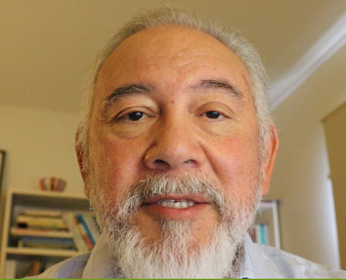
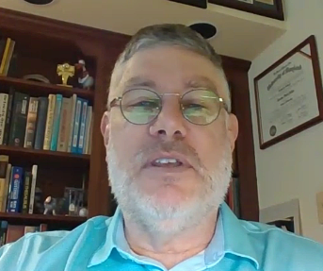
The NIH Extramural Team
Program Official (PO)
Scientific Review Officer (SRO)
Grants Management Officer (GMO)
Notes:
17
We just saw one way to identify potential Program Officials using Matchmaker. Program Officials are one of three players in the NIH Extramural Team. The other two are Scientific Review Officers and Grants Management Officers.
Each has a role in the application and award process.
I’ve solicited a little help from some colleagues to talk about these various roles. Let’s listen to what they have to say …

Slide 18
Program Official
Scientific portfolio of awards within the mission of an institute
Initiative development
Programmatic, scientific, and/or technical guidance pre- and post-award
Recommends applications to be considered for award to the IC director
Post-award oversight by monitoring research progress
Dr. Michael Sesma (NIGMS)
Program Official
Notes:
Program Official

Slide 19
Scientific Review Officer
Responsible for scientific and technical review
Ensures fair and unbiased evaluation of scientific and technical merit
Provides a summary of the evaluation
Reviews applications for completeness and conformance with application requirements
Point of contact for applicants during the review process
Dr. Alexander Politis (CSR)
Scientific Review Officer
Notes:
Scientific Review Officer

Slide 20
Grants Management Officer
Responsible for completion of business management requirements
Evaluates applications for administrative content and compliance with policy
Negotiates Awards
Interprets grants administration policies
Dede Rutberg (NIDCR)
Grants Management Officer
Notes:
Grants Management Officer

Slide 21
When in doubt, reach out!
PO
GMO
SRO
Notes:
21
Thanks, everyone.
It’s important to know that reaching out is not only okay, it’s encouraged.
And its equally important to know, who to contact and when.

Slide 22
What opportunities are available & how can I find them?
Notes:
Now, let’s look at the available opportunities and how to find them.
So, what opportunities are actually out there and where can I find them?

Slide 23
Funding Opportunity Announcements (FOAs)
Used to advertise grant opportunities
Contain information for successful application
Notes:
We use funding opportunity announcements, or FOAs, to advertise our grant opportunities.
They contain all the information you need to successfully submit an application.

Slide 24
FOAs Include
Opportunity description
Participating ICs
Due dates
Award information
Eligibility
Submission requirements
Review criteria
Award administration
Agency points-of-contact
Notes:
FOAs include
An opportunity description
A list of participating institutes and centers
Key dates like due dates and expiration date
Award information like whether clinical trials are allowed and any project period or budget limitations.
Eligibility information for both the applicant organization and the designated principal investigators. For my international friends out there, we clearly indicate in this section whether foreign institutions are eligible to apply and any citizenship requirements for the PD/PI.
It includes any opportunity-specific submission requirements
Review criteria
Award administration information
And, scientific/research (think program), peer review, and financial/grants management contacts within the participating ICs.

Slide 25
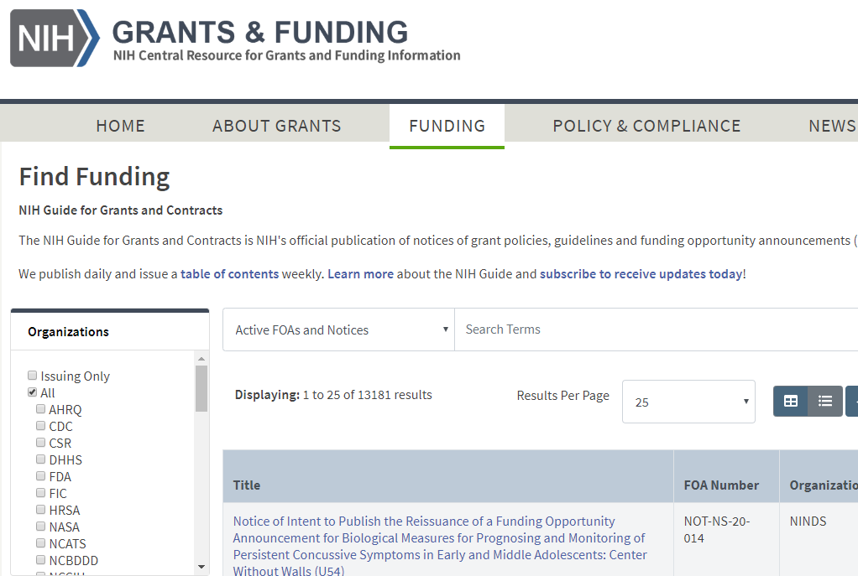
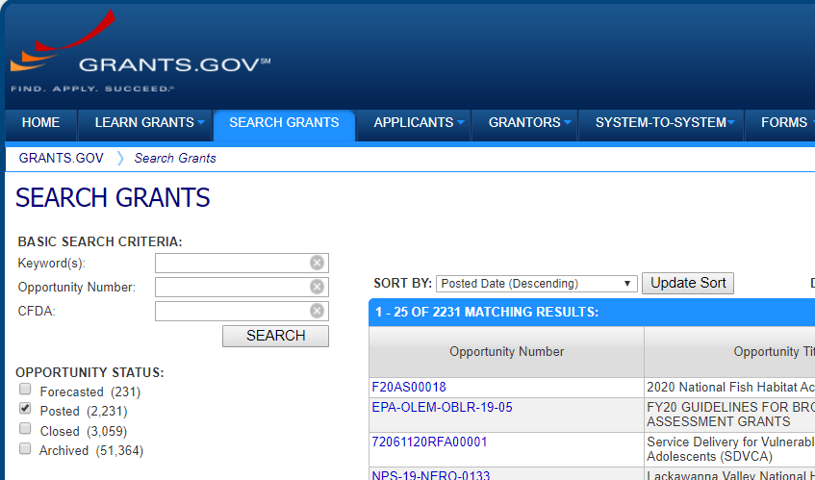
Find Opportunity of Interest
NIH Guide to Grants & Contracts
Grants.gov
Notes:
You can find all NIH opportunities in the NIH Guide to Grants & Contracts – remember that “Find Funding” link on our Grants page. And at Grants.gov which is the federal-wide portal for all grant making agencies.
You can also find subsets of our opportunities on our program specific pages like our small business page and on IC websites.
Both the NIH Guide and Grants.gov have robust search capabilities and I recommend searching both sites.

Slide 26
Grants.gov
FOAs for all federal grant-making agencies
Notes:
Since Grants.gov is federal-wide, you may find opportunities at other agencies you won’t find in the Guide.

Slide 27
NIH Guide
FOAs
Notices
Notices of special interest
Policy updates
Changes to FOAs
Webinars and training events
Notes:
In the NIH Guide, in addition to the FOAs advertised in Grants.gov, you’ll also find notices, including
Notices of special interest
Policy updates
Changes to FOAs
Webinars and training events
And more
I also recommend subscribing to our weekly emails that summarize the NIH Guide postings for the week. You’ll find the links to subscribe to our listservs under the News and Events tab on the grants site.

Slide 28
NIH Funding Opportunities
FOA Types
Requests for Applications (RFAs)
Parent Announcements
Program Announcements (PAs)
Notices of Special Interest (NOSIs)
Notes:
We post several types of FOAs
Requests for Applications or RFAs,
Parent Announcements, and
Program Announcements or PAs.
We also use notices of special interest to highlight research areas of interest.

Slide 29
Requests for Applications (RFAs)
Narrowly defined scope
Set-aside funds
Often a single receipt date
Notes:
Requests for Applications have a narrowly defined scope and the participating IC or ICs set aside funds in their budgets to award applications submitted to that RFA. The award information section of the FOA indicates the number of expected awards and/or the amount of set-aside funding.
RFAs often have a single receipt date and may not be posted again.

Slide 30
Parent Announcements
Many NIH institutes and centers participate
No science specified
For “investigator initiated” or “unsolicited” research
Use standard due dates
Notes:
Many ICs participate in our parent announcements which are used for investigator initiated or unsolicited research.
They don’t specify a particular area of research. They simply provide the infrastructure and information needed to submit a research proposal that fits within the missions of a participating ICs.
They use a standard due date schedule that defines three submission, review, and award cycles per year. They are posted for up to 3 years and are then reissued.
We have parent announcements for research grants, fellowship, career development, administrative supplements and post-award administrative actions like a change of institution request. And, we have different parent FOAs depending on whether applications are allowed to propose clinical trials.
Parent Announcements is a filter when searching in the NIH Guide. We also have a dedicated web page that list them all that you can easily find with a quick internet search on “NIH parent announcements”.

Slide 31
Program Announcement (PA)
Highlights areas of focus
Usually ongoing (3 yrs)
Use standard receipt dates
Special types
PAR – PA with special receipt, referral or review considerations
PAS – PA with set-aside funds
Notes:
Unlike the parent announcements, our program announcements or PAs highlight areas of focus.
They are typically on-going programs posted in increments of up to 3 yrs.
They use the same standard due date schedule as parent announcements, unless they are identified as a PAR – a program announcement with special receipt, referral or review considerations.
Applications to parent announcements and program announcements all compete for the same funding. They don’t have set-aside funds, unless they are identified as a PAS – which is a program announcement with set-aside funds.
Let’s pause for a second. As you work with NIH, you will hear the words “except”, “unless” and my personal favorite “it depends” a lot.
With so many funding organizations covering a broad range of topics, its not surprising that NIH processes are filled with nuances. Read the announcement carefully and reach out if you have questions.

Slide 32
Notices of Special Interest (NOSIs)
Increasingly used instead of program announcements
Highlight areas of scientific interest
Designate existing FOAs to use for application submission
Notes:
It takes many months and lots of resources to get a full FOA approved and posted. With over 1200 opportunities posted at any given time some would get few or no responses.
A few years ago, we took a hard look at our program announcements and determined that much of their content is standard text repeated in each FOA.
We already have parent and other announcements that can be used to accept applications. All we needed was a way to provide the unique bits, the areas of scientific interest, that were buried in the PAs.
Some institutes were already successfully leveraging NIH Guide notices for that task since we can post a Guide notice in a matter of weeks, not months. So, we formalized that approach in the form of Notices of Special Interest, or NOSIs.
NOSIs provide the unique information for an initiative in a succinct document which is easier for applicants and they point to existing funding opportunity announcements for application submission which is more efficient for NIH. Win, win. We have a 5-minute video on our NIH Grants Youtube channel you can watch to learn more about NOSIs.

Slide 33
Types of Grant Programs
Research Grants (R series)
Career Development Awards (K series)
Research Training and Fellowships (T & F)
Program Project/Center Grants (P series)
Resource Grants (various series)
Notes:
As I already hinted when talking about parent announcements, our FOAs cover a wide range of grant programs, including
Research,
Career development,
Training,
Fellowship,
Program Project and Center grants, and
Resource grants.
We identify these programs through the use of 3-character codes we call activity codes. For example, we use the R series for research grants and we have activity codes like R01, R03, R15,and many others.
K01 is an example of a career development activity code in our K series. T32 an example of training code. F30 an example of a fellowship code. And, P01 an example of a Program Project code.

Slide 34
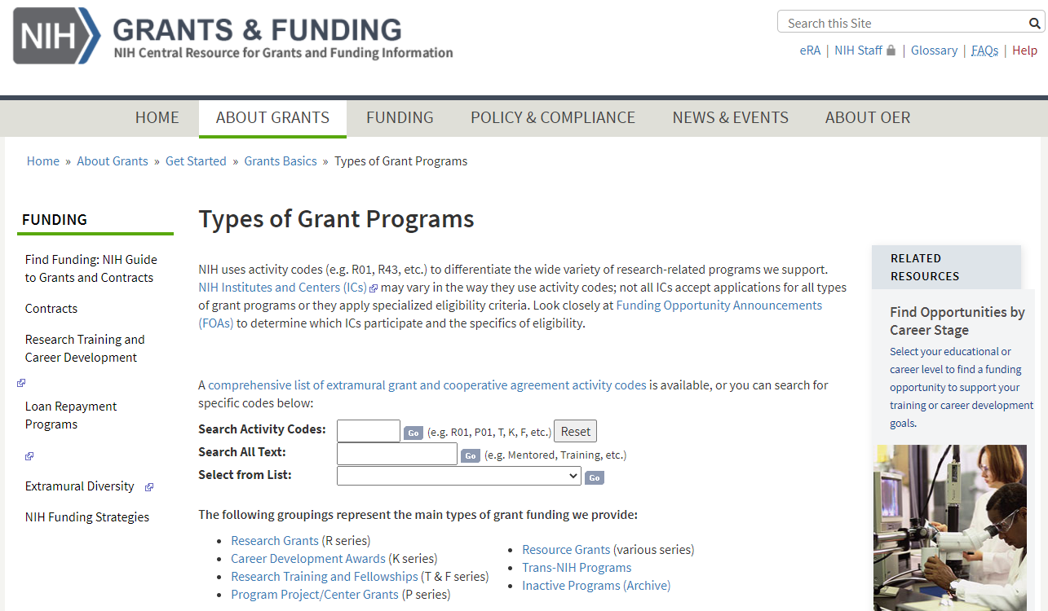
Types of Grant Programs
Notes:
You can learn about these activity codes on our Types of Grant Programs page. On the far right of the page there’s a link to a handy site that helps match programs and career stage from undergrad through to established investigator.

Slide 35
What’s the application process & how long does it take?
Notes:
We’ve talked about identifying your target IC, available programs, and finding an FOA or NOSI that’s a good fit. Which brings us to our next question – What’s the application process and how long does it take?

Slide 36
Grants Process Overview
Grants Process Overview
Notes:
You’ll find a Grants Process Overview on the grants.nih.gov site.

Slide 37
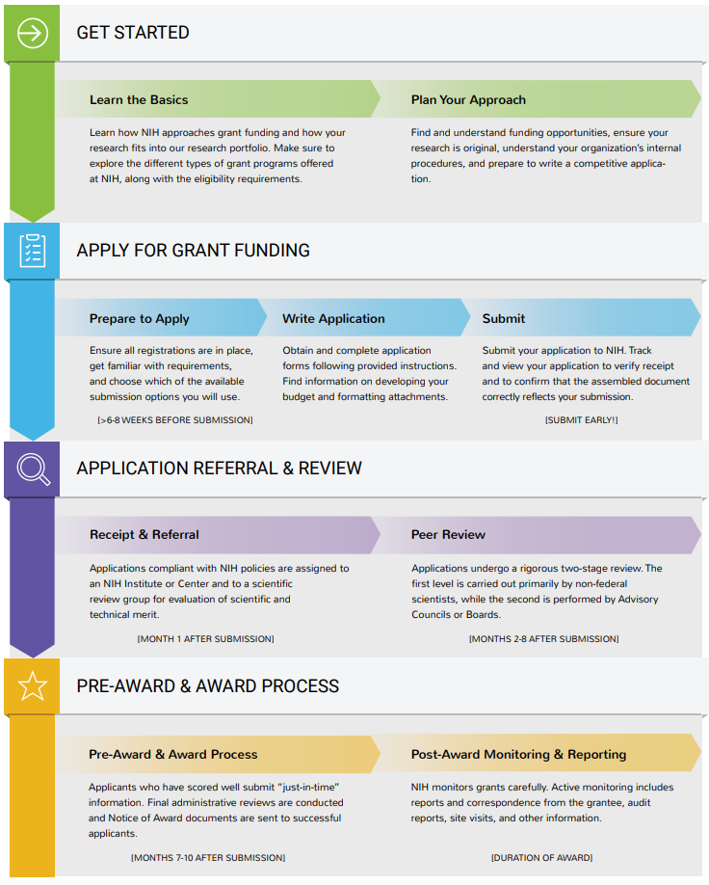
Grant Process Overview
Notes:
It takes you through the process from getting started, to applying for funding, to application referral & review, and finally the pre-award & award process.
You can click on each topic in the graphic to learn more about each step. But, I’ll walk you through the key points and help you get a feel for the timeline.

Slide 38
Plan
6+ months prior to due date
Refine your research idea
Reach out to NIH staff
Build your team & internal plan
Notes:
We’ll start with planning. At least 6 months prior to your target due date you should be well on your way to refining your research idea.
Reach out to NIH staff. Discuss your proposal. Make sure it fits within the IC mission and priorities.
We talked about the NIH team of program officials, grants management officers and scientific review officers. You’ll also need a team within your own organization and a plan to coordinate that team.

Slide 39
Your Team
Members
Authorized Organization Official (AOR)/ Signing Official (SO)
Project Directors/Principal Investigators (PD/PI)
Others
Discuss roles, process & timelines
Notes:
NIH awards grants to organizations, not to individual investigators. So, right of the bat, your team includes an Authorized Organization Representative or AORs (we refer to them as signing officials in eRA Commons). The AOR is responsible for submitting the application and it’s their electronic signature that is signing off on the terms and conditions of the grant on behalf of the applicant organization.
Of course you’ll have one or more Project Director/Principal Investigators responsible for directing the supported project or program. You’ll hear them referred to as PD/PIs or PIs.
You may also have additional senior/key individuals, administrative staff, or collaborators. You’ll want to identify some colleagues to review your application and provide feedback. And, if they have grant or review experience, even better.
Once you have your team in place make sure everyone knows their role, the process that will be followed, and your timeline.
Establish that plan upfront.

Slide 40
Prepare to Apply
Confirm registrations
6+ weeks to complete
Confirm funding opportunity
Identify submission method
Notes:
You’re then ready to prepare to apply. If your organization has never submitted a grant application before, you’ll need to get started on multiple organization registrations, including the System for Award Management, Grants.gov and eRA Commons. It can take 6 or more weeks to complete the organization registrations, so don’t wait to get that started.
If your organization has submitted previously, make sure all registrations are current and active. The System for Award Management requires annual renewal. You can’t submit unless its active.
Confirm your funding opportunity. NIH posts opportunities 30-60 days prior to the first due date. You may find a newly published opportunity that is an even better fit than the one you originally chose. You’ll also want to check the Related Notices section of the opportunity for any late breaking changes or corrections.
And you must identify the submission method you will use to prepare and submit your application.

Slide 41
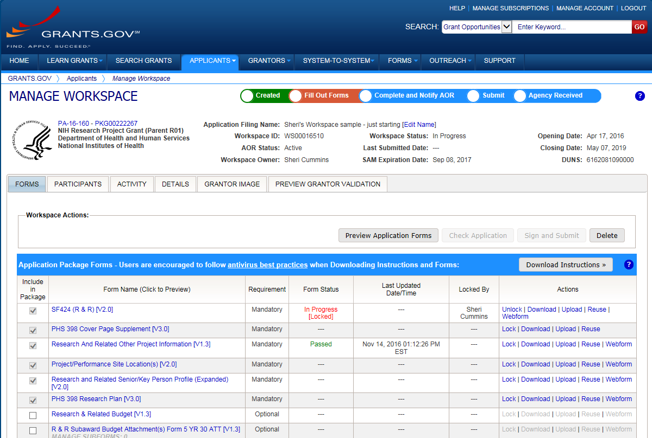
Application Submission Options
Access & prepare application forms using one of these submission options.
ASSIST
System-to-System
Workspace
Notes:
Grant application forms must be prepared and submitted using NIH’s ASSIST, Grants.gov’s Workspace, or your institution may have its own system-to-system solution. Your office of sponsored research can help identify the best option for your situation.
Honestly, it doesn’t matter which option you choose.
Your application will flow through the Grants.gov federal portal and then on to eRA Commons - which is our system to exchange information electronically with our applicants and grantees.
Since all application follow that same flow, they’re all subject to the same
Registrations
Business rule validations
And, are assembled into a consistent format for funding consideration.
By the time the applications are seen by NIH staff we can’t even tell which system was used to submit them.

Slide 42
Write Application
Complete application forms and attachments
Write strong proposal that addresses review criteria
Read & follow all instructions
Notes:
You’ll login to your submission option, provide the funding opportunity number, and you’ll be presented with the exact set of forms needed to write your application.
Much of the really good stuff in your application - your abstract, specific aims, research strategy, biosketches and more - will be in attachments which are uploaded in pdf format into specific form fields. All of these critical pieces of your proposal can be started well in advance of pulling together the application forms.
Write a strong proposal that addresses the review criteria in the opportunity.
Most importantly, read and follow all instructions.

Slide 43
How to Apply – Application Guide
How to Apply – Application Guide
How to Apply – Application Guide
Notes:
Our How to Apply – Application Guide, which is easily found on our grants page and linked within every opportunity, contains your general application instructions.

Slide 44
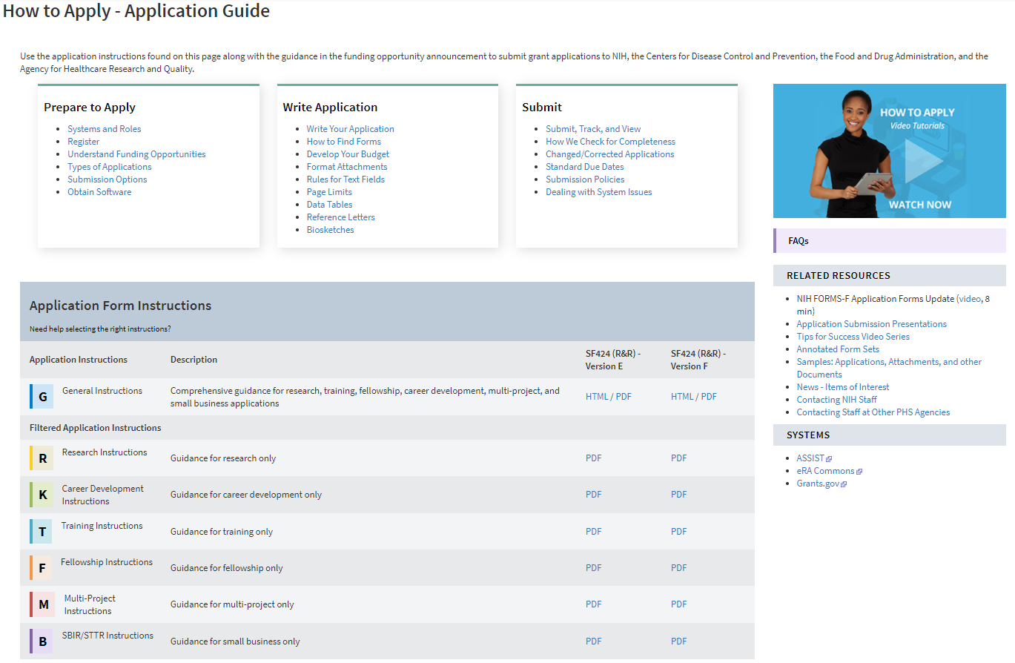
How to Apply Application Guide home page
Notes:
On the How to Apply – Application Guide page you’ll find sections for Prepare to Apply, Write Application, and Submit. Here are a few highlights.
In the Prepare to Apply section you’ll find details on the organization and individual registrations needed to apply. Understand Funding Opportunities talks about the different types of announcements – RFAs, PAs, parent announcements and NOSIs. Types of Applications explains the difference between new, revision, renewal, and resubmission applications. And, you can learn about ASSIST, Workspace and system-to-system solutions under Submission Options.
Write Application includes some great information on developing your budget. Remember I said much of your proposal is in pdf attachments. The Format Attachments page describes our rules for fonts, margins, filenames, images, links and more. Many of the attachments have strict page limits all applicants must follow for fairness. There is a link to our standard page limits table and any exceptions would be noted in your FOA or NOSI.
Under Submit we explain the process for submitting and tracking your application and how we validate your application using a combination of system and manual checks. There’s a link to the standard due dates we talked about earlier. A link to Submission Policies that explain what happens if your due date falls on a weekend or holiday or when Washington area government offices are closed, or your institution is closed due to weather or natural disaster. And finally what to do if a problem with a government system impacts your ability to submit your application on time.
We have videos, FAQs, resources, and most importantly form-by-form, field-by-field instructions for completing your application forms.

Slide 45
Follow All Instructions Carefully
Notes:
You must read and follow all instructions.
The application guide provides general instructions and the FOA provides opportunity-specific instructions that augment or may even differ from the application guide. So, when completing your application forms you’ll follow the application guide unless the FOA tells you to do something different.
Many of our opportunities are active for up to 3 years. We can change a lot of policies in 3 years. And, from time to time, we make mistakes and need to post corrective notices for an opportunity. NIH Guide Notices win over both the FOA and general application guide instructions.

Slide 46
Submit Early!
Applications routed through Grants.gov to NIH’s eRA Commons
Days before due date
Allow time to check application image in eRA Commons and address any unforeseen issues
Notes:
You’ve followed all the guidance and written a strong proposal. You’re checking off items in your internal plan. You’ve reviewed the application internally and its in the hands of your Authorized Organization Representative ready to submit.
Applications are due at 5pm local time of the submitting organization on the date specified in the opportunity.
After you submit your application it flows through Grants.gov and then on to NIH’s eRA Commons. Track your application. If errors are identified at Grants.gov or eRA Commons, your application will not complete the submission process. If free of system-identified errors, however, the system will assemble all your forms and application attachments into a consolidated document in a consistent format with headers, footers, a table of contents and bookmarks and place it in eRA Commons. From this point forward, you will continue to use eRA Commons from checking status of your application to closeout of an awarded grant.
Submit early! When we say “early” we mean days, not hours or minutes ahead of the deadline. This gives you time to address unforeseen issues and thoroughly check that final assembled application image in eRA Commons. That assembled eApplication is the same document that will be used by reviewers and staff for funding consideration. It’s your responsibility to check it in eRA Commons and notify us of any assembly issues within the 2 days following the submission.

Slide 47
Receipt & Referral
Additional application checks
Application Number assigned
IC assignment
Assignment to Integrated Review Group (IRG)
IRG Chief assigns study section
Assignment details placed in eRA Commons (~2 weeks)
Notes:
After the 2-business day viewing window, your application automatically moves on to our receipt and referral staff.
NIH referral staff conduct additional application checks, then assign an application number, a potential funding institute, and an Integrated Review Group or IRG. An IRG is a cluster of scientifically related study sections. An IRG chief assigns the applications to specific study sections for review. Assignment details show in eRA Commons in about 2 weeks.
NIH staff conduct additional application checks, then assign an application number, a potential funding institute, and a review group to your application. Within about 2 weeks the assignment details will show in eRA Commons.

Slide 48
Peer Review
Key contact – SRO
Study section reviews for scientific merit
Priority score & percentile ranking in eRA Commons (2-3 days after meeting)
Summary statement in eRA Commons (~1 month)
Notes:
During the Peer Review stage the Scientific Review Officer is your key contact and will be listed on the application’s eRA Commons status page. The SRO manages the initial peer review. Reviewers are selected. Applications assigned for review. The study section meets and assesses the applications against the review criteria in the FOAs. The priority scores and percentile rankings are available in eRA Commons 2-3 days after the meeting. It takes a bit longer for the SRO to prepare the Summary Statements which document the official outcome of the review, but many are available in eRA Commons within about a month.
Now, that’s clearly an oversimplification of the peer review process. You’ll find lots more information including full videos on the grants.nih.gov and Center for Scientific Review websites.

Slide 49
Pre-Award & Award Process
Key contacts – PO & GMO/GMS
IC review
Just-in-time information may be requested
Notes:
Once the Summary Statement is released, the Program Official becomes your key contact. They can help clarify points made in the summary statement though they can’t discuss details of the review beyond what’s covered in the summary statement. If your application didn’t receive a favorable score, they can provide advice on next steps.
During the pre-award and award process and on through the life-cycle of a grant, the program officer and the grants management officer or specialist work together much like the administrators and researchers in your own organization. The PO handles scientific and programmatic aspects of a project and the grants management officer or specialist handles the business and administrative aspects of the award.
If you receive a score that is broadly in the competitive range, you may be asked to submit additional information through the just-in-time function in eRA Commons. This would be stuff like other support and additional human subjects and animal welfare information. The just-in-time request is not an indicator of award, but the information requested would need to be in place prior to making an award if chosen for funding. So, it behooves you to submit the information when requested.

Slide 50
Pre-Award & Award Process
Council – funding recommendations
IC Director – funding decisions
Notice of Award (~9 months)
Notes:
NIH uses a 2-level peer review process. Level 1 is that initial scientific peer review. Level 2 is what we call Council. Council procedures can vary across ICs, but each IC Director chairs a National Advisory Council for their IC. The Council recommends applications for funding, but the IC Director makes final funding decisions.
If your application is selected for award, you will receive a Notice of Award or NoA which is viewable in eRA Commons. It takes about 9 months from the submission due date to receiving that notice of award.

Slide 51
Notice of Award (NoA)
Legally binding document
Award data and fiscal information
Grant payment information
Terms and conditions of award
Grantee accepts terms and conditions of award as soon as funds are drawn down
Notes:
The NoA is a legally binding document. It includes award data, payment information, and the terms and conditions of the award. When the grantee organization draws down funds, it is considered an acceptance of the award and associated terms and conditions.

Slide 52
NIH Grants Policy Statement
Term and condition of grant awards
Explicitly defines roles, responsibilities
Updated each fall
Notes:
Those terms and conditions are documented in the NIH Grants Policy Statement or GPS. The Grants Policy Statement is updated each fall and details all the rules, responsibilities and expectations for appropriate stewardship of a grant throughout its life cycle.

Slide 53
Post-Award Monitoring & Reporting
Reports
Prior approval requests
Audits
Site visits
Notes:
Grantees are responsible for managing the day-to-day operations of their grants. NIH monitors grants carefully. Active monitoring includes reports and correspondence from the grantee, audit reports, and site visits.

Slide 54
Let’s Review
Notes:
We’ve covered a lot. Let’s do a quick review.

Slide 55
Where do I start?
Grants.nih.gov
Notes:
Where do I start?
Grants.nih.gov. From that site, you’ll find all the other need-to-know resources we talked about.

Slide 56
Where’s the funding?
Funding is done through NIH institutes/centers (ICs)
Matchmaker in NIH RePORTER can help identify ICs with potential interest
Notes:
Where’s the funding?
The funding is done through the NIH institutes and centers and we saw how Matchmaker can help identify ICs and program officials in your scientific area.

Slide 57
Where do I turn when I need help or advice?
Reach out to NIH staff
Program Official (PO)
Scientific Review Officer (SRO)
Grants Management Officer (GMO)
Additional contacts
grants.nih.gov help page
FOA contact section
Notes:
Where do I turn when I need help or advice?
We talked about the 3 players in the NIH Extramural team – the program official, scientific review officer, and grants management officer.
You can also find additional contacts, including the eRA Commons Support Desk on the grants.nih.gov help page and in the contact section of all FOAs.

Slide 58
What opportunities are available & how can I find them?
Funding opportunity Announcements (FOAs)
RFA, parent announcements, PAs, NOSIs
Research, career development, training, fellowship, program project, resource grants
Posted
NIH Guide and Grants.gov
Notes:
What opportunities are available and how can I find them?
We discussed the different types of FOAs – RFAs, parent announcements, PAs, and NOSIs. And, the programs we offer. All of which can be found in the NIH Guide and Grants.gov.

Slide 59
What’s the application process & how long does it take?
Planning (6+ months)
Refine idea, reach out, build team
Prepare to apply
Registrations (6+ weeks)
Submission method (ASSIST, Workspace, system-to-system)
Notes:
What’s the application process & how long does it take?
We discussed how it takes a lot of time and planning to apply for funding. At least 6 months ahead of the due date you should be reaching out to NIH and building your internal team and plan.
Your must complete or confirm your registrations and choose a submission option before you can pull together your application.

Slide 60
What’s the application process & how long does it take?
Write Application
Follow instructions, address FOA review criteria
Submit early (days ahead)
Notes:
When writing your application you must follow application guide, FOA-specific and any relevant guidance in NIH Guide notices. And be sure to address the FOA review criteria in your proposals.
Any, you’ll submit days ahead of the due date to make sure you have time to address any unforeseen issues.

Slide 61
What’s the application process & how long does it take?
Receipt & referral
Assignment – ~2 weeks
Peer review
Priority score & percentile – ~2-3 days
Summary statement – ~1 month
Notes:
About 2 weeks after you submit, your referral and review assignment will be available in eRA Commons status.
The peer review meeting will take place on the day indicated in eRA Commons. Two-three days after the meeting, the priority score & percentile information will be added to the status And the summary statement will follow about 1 month after review.

Slide 62
What’s the application process & how long does it take?
Council – funding recommendations
IC Director – final funding decisions
Notes:
Peer review is our first level of review. The second level is council where funding recommendations are made. Following council the IC director makes final funding decisions.

Slide 63
What’s the application process & how long does it take?
Pre-award & award
NoA - ~9 months
Post-award monitoring & reporting
Duration of award
Notes:
If selected for funding you’ll receive the notice of award which will be approximately 9 months after your application due date.
Post-award monitoring and reporting are carried out through the duration of the award.

Slide 64
Stay Connected
Notes:
One final thought

Slide 65
Stay Connected – News & Events
Stay connected – News & Events
Notes:
Check out the News & Events section of our website to stay on top of what’s happening. It has links to our “Open Mike” blog, NIH Extramural Nexus newsletter, listservs, Youtube channel, podcasts, and social media.
Change is a constant. It’s important to keep informed.

Slide 66
Thank you!
Notes:
Phew! We covered a lot, didn’t we? That’s the end of the formal presentation.

