Slide 1


Successfully Submitting a Small Business Grant Application to NIH
January 2015
Office of Extramural Research
OD, National Institutes of Health

Slide 2


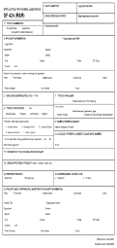

High Level Process Overview
AOR/SO
Find and download announcement, instructions and form package.
Prepare application per institution & agency guidelines.
Authorized Organization Rep. (AOR) submits application to Grants.gov.
eRA downloads application and verifies compliance with application instructions.
PI/SO check submission status and view assembled application in eRA Commons.

Slide 3

Prepare to Apply & Register
Registrations
Software needed
Submission plan
Success depends upon previous preparation, and without such preparation there is sure to be failure.
-Confucius

Slide 4

Multiple Organization Registrations Required
Allow a minimum of 6 weeks
to complete all registrations!
http://grants.nih.gov/grants/ElectronicReceipt/files/registration_handout.pdf

Slide 5


DUNS
Dun & Bradstreet (D&B) provides a free, unique nine-digit identification number for your business/institution
  Dun and Bradstreet Universal Numbering System (DUNS)
  Begin the process at:
    http://fedgov.dnb.com/webform
After obtaining your DUNS, you can begin SAM, SBA Company and eRA Commons registrations
Telephone Number:
866-705-5711

Slide 6

System for Award Management
System for Award Management (SAM) combines federal procurement systems and replaced Central Contractor Registry (CCR) in July 2012
As part of SAM registration process, you will designate an E-Business Point-of-Contact (E-Biz POC)
  SAM registration and E-Biz POC needed for Grants.gov registration
  Annual renewal in SAM is needed to keep Grants.gov credentials active
Telephone Numbers:
US Calls: 866-606-8220
International Calls: 334-206-7828
DSN: 866-606-8220

Slide 7
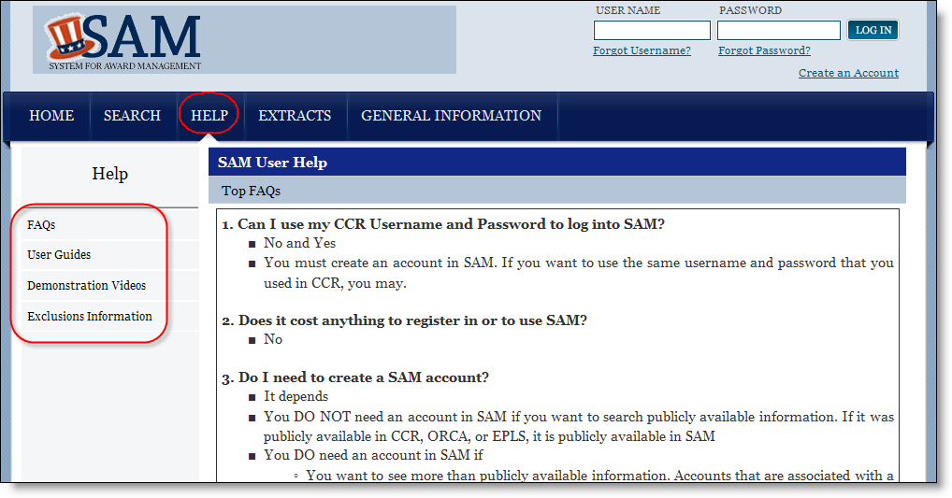
SAM Support
SAM.gov is supported by the Federal Service Desk
  https://www.fsd.gov

Slide 8

Grants.gov
Federal-wide portal to find and apply for Federal grant funding
Used by all 26 Federal grant-making agencies
Prior to registering in Grants.gov you must obtain a DUNS number and register in SAM
E-Biz POC approves Authorized Organization Representatives (AORs) to submit applications
No registration needed to find opportunities or download forms
Telephone Numbers:
US Calls: 1-800-518-4726
International Calls: 606-545-5035

Slide 9
eRA Commons
Agency system that allows applicants, grantees and Federal staff to share application/grant information
Used by NIH and a few other HHS divisions
  AHRQ, CDC, FDA
As part of registration process, you will designate a Signing Official (SO)
  Registers or affiliates Project Directors/Principal Investigators (PD/PIs)
NIH 2-week “good faith effort” for Commons registration
Support:
http://grants.nih.gov/support/index.html

Slide 10

eRA Commons Registration - Tips
If a PD/PI already has an eRA Commons account, affiliate that account to your organization rather than creating a new account
Don’t combine Principal Investigator (PI) and Signing Official (SO) roles on the same account
  Other combinations are fine
    E.g., PI and Internet Assisted Review (IAR) roles are OK together
  A person needing both the PI and SO roles should have two separate accounts - one for scientific roles (e.g., PI and IAR) and another for administrative roles (e.g., SO)
Make sure the contact PD/PI listed on the application
is affiliated with the applicant organization

Slide 11

SBA Company Registry
All SBIR and STTR applicants are required to register with the Company Registry Database
  http://www.sbir.gov/registration
  Applies to all HHS SBIR/STTR programs, including NIH, CDC, FDA, and ACF
Attach proof of registration in the Other Project Information, Other Attachments section of the application
  See section IV.2 of your FOA instructions for details
FAQs:
http://www.sbir.gov/faq/general

Slide 12

Obtain Software
Adobe Reader required to prepare/submit Grants.gov application forms
PDF conversion program
  All application attachments must be converted to PDF format
Grants.gov download software page
  http://www.grants.gov/help/download_software.jsp

Slide 13

Make a Submission Plan
Application preparation responsibilities
Sharing applications in progress
Internal review & approval process
Internal deadlines
Post-submission responsibilities
  How to deal with errors/warnings
  Who will verify application in Commons?
Make a plan before you need one!

Slide 14

Find & Initiate an Application
Finding opportunities
Downloading application package
Application instructions
Success is where preparation and opportunity meet.
-Bobby Unser

Slide 15



Find an Opportunity
NIH Guide for Grants & Contracts
Grants.gov Search Opportunity

Slide 16
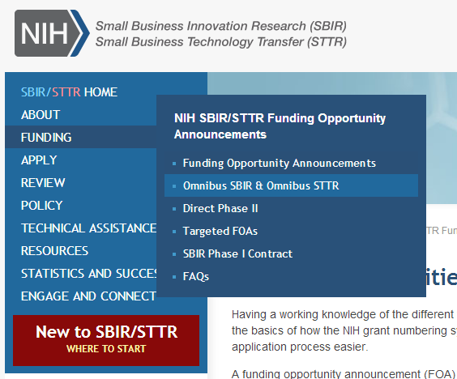

SBIR/STTR Parent Announcements
The SBIR/STTR website provides direct links to omnibus and other funding opportunity announcements.
SBIR: PA-14-071
STTR: PA-14-072
http://sbir.nih.gov/

Slide 17
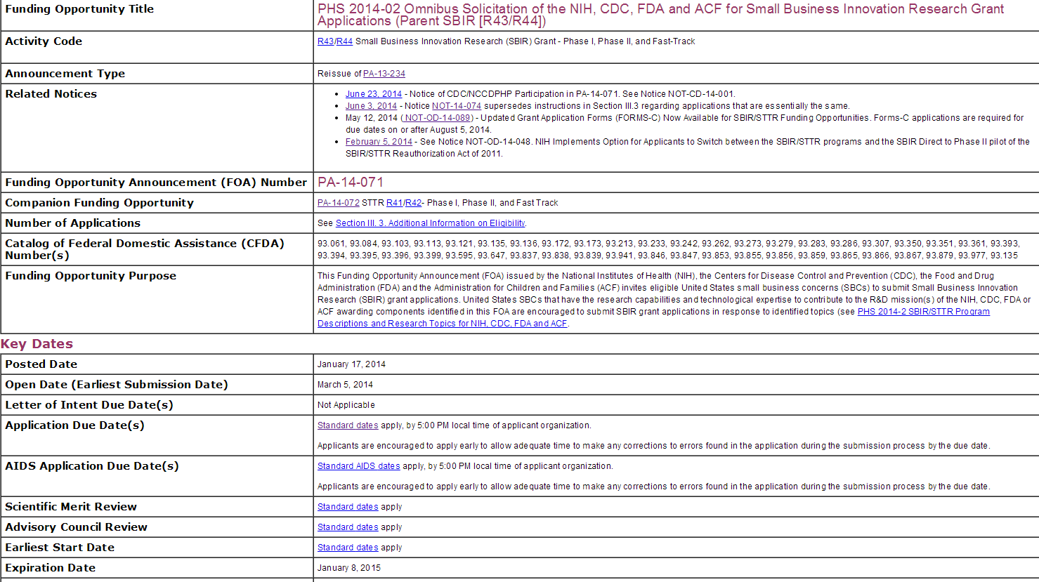
Funding Opportunity Announcement (FOA)
Carefully read full announcement.
Related Notices: Check for updates to FOA.
Standard SBIR/STTR Due Dates
Standard AIDS Due Dates

Slide 18
Standard SBIR/STTR Due Dates
Current
 | Cycle I | Cycle II | Cycle III
SBIR/STTR | April 5 | August 5 | December 5
AIDS | May 7 | Sept. 7 | Jan. 7
Change effective Sept. 5, 2015
  http://grants.nih.gov/grants/guide/notice-files/NOT-OD-15-038.html
 | Cycle I | Cycle II | Cycle III
SBIR/STTR | Sept. 5 | Jan. 5 | April 5
AIDS | Separate AIDS dates no longer apply.

Slide 19
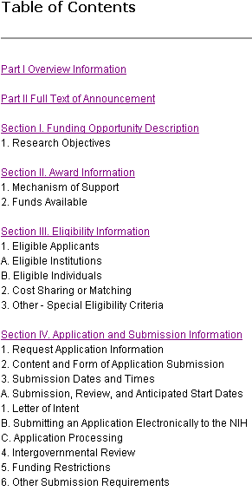
FOA-Specific Application Information
Read and follow all announcement instructions
Pay special attention to Section IV. Application and Submission Information
  Includes any FOA-specific submission instructions
  Instructions in FOA supersede instructions in the application guide

Slide 20
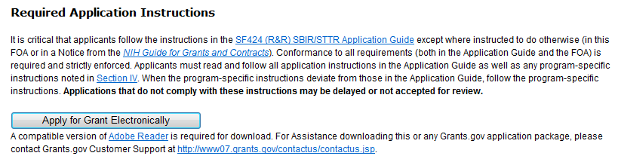
Download Application Package
Excerpt from announcement text
Links to Grants.gov Download Application Package page for the FOA
Download link brings you to Grants.gov page to download application instructions and application forms package.

Slide 21
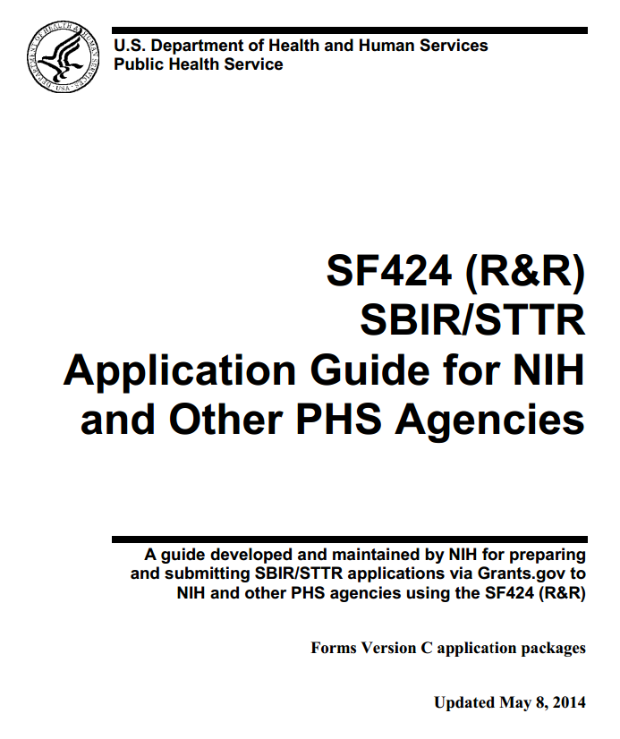

Application Guide
Read and follow application guide instructions
  Part I: Instructions for Preparing and Submitting an Application
Agency-specific instructions are marked with the
HHS logo
  http://grants.nih.gov/grants/funding/424/index.htm

Slide 22

Supplemental Instructions
Refer to Supplemental Instructions as needed
  Part II: Supplemental Instructions for Preparing the Protection of Human Subjects Section of Research Plan
  Part III: Policies, Assurances, Definitions and Other Information
  http://grants.nih.gov/grants/funding/424/index.htm

Slide 23

Preparing Your Application
Working with Grants.gov’s downloadable forms
Avoiding common errors
A smart man makes a mistake, learns from it, and never makes that mistake again.
But a wise man finds a smart man
and learns from him how to avoid
the mistake altogether.
-Roy H. Williams, Businessman

Slide 24
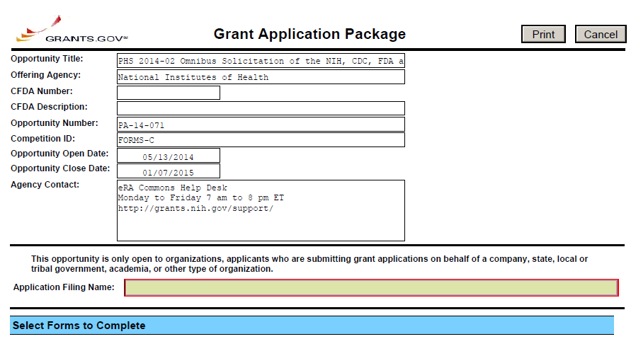
Working with Grants.gov’s Downloadable Forms
*Application Form Screen - Top*
Make sure you have the correct application package.
FOA information is automatically populated and not editable.
Mandatory Grants.gov fields highlighted with red box.
Not all fields required by NIH will be highlighted.

Slide 25
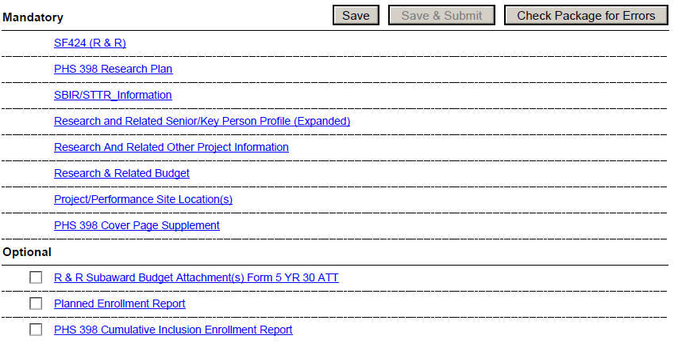
Working with Grants.gov’s Downloadable Forms
*Application Form Screen - Bottom*
Save the package locally.
Complete the SF 424 (R&R) form first—info from this form pre-populates fields in other forms in the package.
See application guide to determine which Optional forms you need to complete.

Slide 26
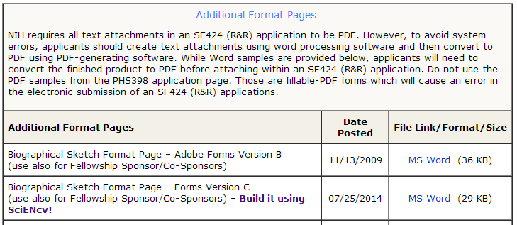
Tips
Follow FOA-specific (e.g., special attachments, specific section headings) and application guide requirements
  eRA systems will catch many, but not all errors – some items are checked by staff post-submission
Take advantage of posted ‘Additional Format Pages’
  http://grants.nih.gov/grants/funding/424/index.htm

Slide 27

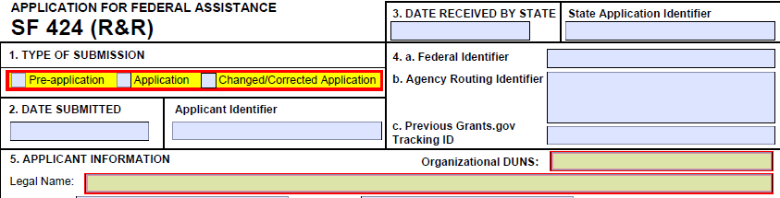
Avoid Common Errors
Make sure the DUNS number on the SF424 (R&R) cover form matches the DUNS number used for all registrations.
Submitter must be authorized to submit applications for organization DUNS.

Slide 28

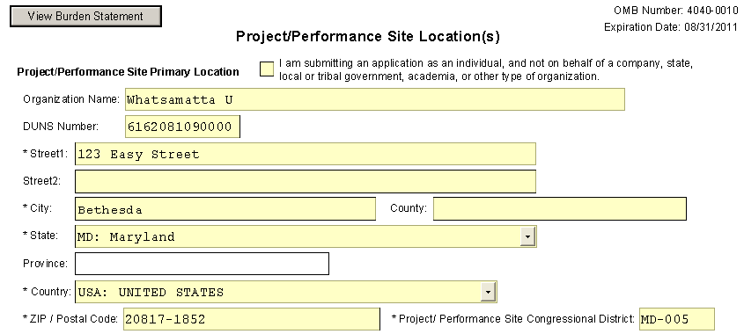
Avoid Common Errors
Watch out for fields required by NIH that are not marked required on forms used federal-wide.
Primary site DUNS is required by NIH

Slide 29
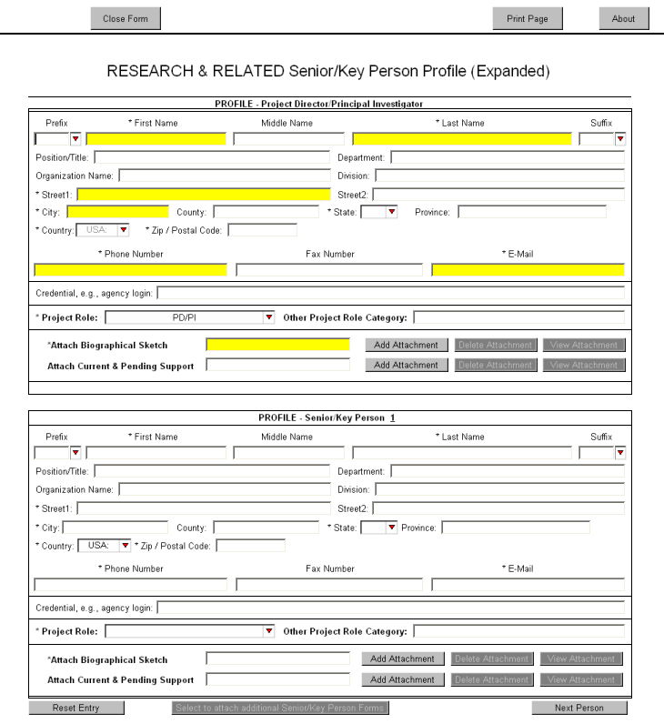
Avoid Common Errors
Avoid Common Errors
eRA Commons
username must be supplied in the Credential field
Enter PI Commons Username
For multiple PD/PI applications, select the PD/PI role for each PI and provide their eRA Commons username in the Credential field
Enter PI Commons Username
Select PD/PI for each PI

Slide 30

Avoid Common Errors
Organization Name
NIH requires the Organization name for all Sr/Key listed.
Enter Organization Name

Slide 31

Avoid Common Errors
Include all required attachments
  Whether an attachment is required or not is often based on how you answer specific questions throughout the application
    Examples:
      Human Subjects = Yes, then Human Subjects section of the PHS 398 Research Plan is required
      Vertebrate Animals = Yes, then Vertebrate Animals attachment is required
      More than one entry on the R&R Sr/Key Person Profile form with the role of “PD/PI,” then the Multiple PD/PI Leadership Plan attachment on the PHS 398 Research Plan
      form is required

Slide 32
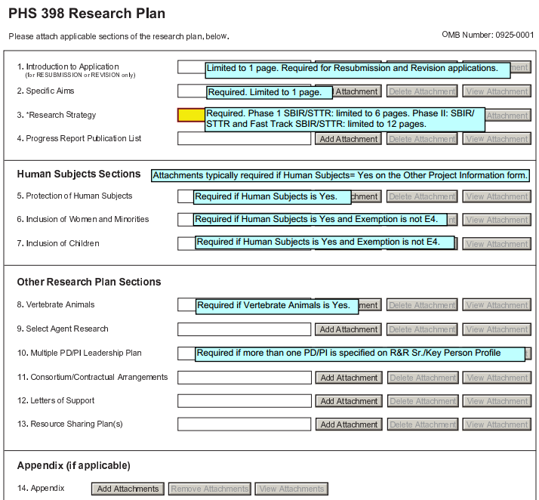

Avoiding Common Errors
Annotated form sets are a great resource for helping identify many conditional requirements.
Annotated form sets:
http://grants.nih.gov/grants/ElectronicReceipt/communication.htm

Slide 33

Avoid Common Errors
All application attachments must be in PDF format
  Use simple PDF-formatted files
    Do not use Portfolio or similar feature to bundle multiple files into a single PDF
    Disable security features such as password protection
  Keep file names to 50 characters or less
  Use meaningful filenames
  Do not include headers or footers
    Section headings as part of the text (e.g., Significance,
    Innovation, Approach) are encouraged
  Follow guidelines for fonts and margins
PDF Guidelines: http://grants.nih.gov/grants/ElectronicReceipt/pdf_guidelines.htm

Slide 34
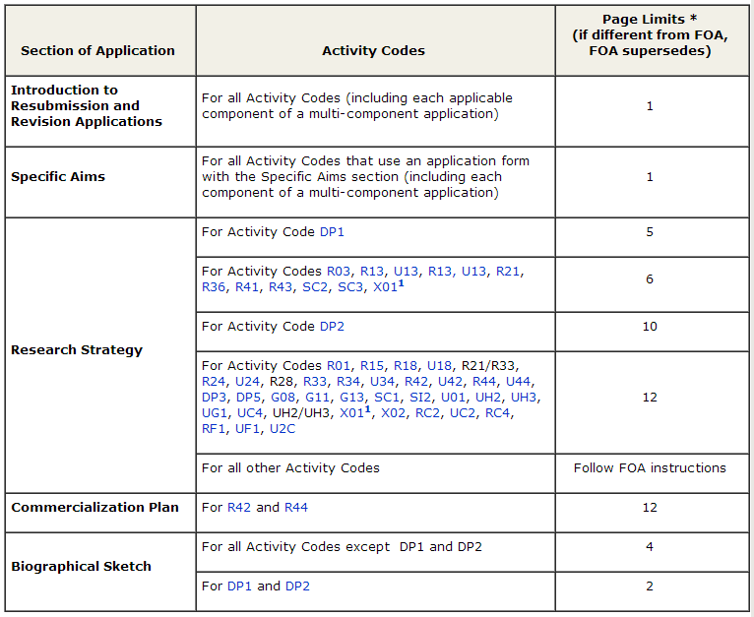

Avoid Common Errors
Follow specified page limits for attachments.
Page Limits: http://www.grants.nih.gov/grants/forms_page_limits.htm#other

Slide 35
Changes from NIH SBIR/STTR Reauthorization
In the Other Attachments section of the R&R Other Project Information form, include:
Attach proof of your SBA registration
If your organization is venture capital backed, attach the “SBIR Application VCOC Certification.pdf” found on the NIH SBIR forms page (http://grants.nih.gov/grants/forms.htm#sbir)
SBIR/STTR Reauthorization Act Of 2011: NIH Implementation Of Key Changes (What to Expect and When)
http://grants.nih.gov/grants/funding/sbir/reauthorization.htm

Slide 36
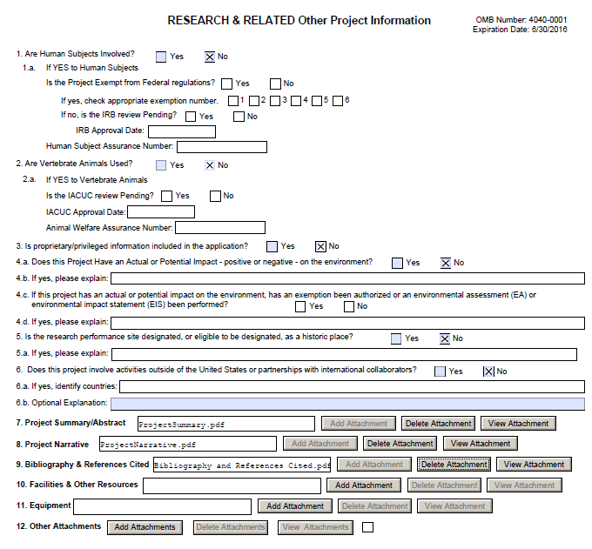
Avoiding Common Errors
R&R Other Project Information form
Other Attachments section

Slide 37


Submit
Submitting an application
On-time submission
I love deadlines. I like the whooshing sound they make as they fly by.
-Douglas Adams

Slide 38

Submit Application (AOR only)
Save & Submit button will not become active until application is saved and mandatory information is completed.
Check Package for Errors button only checks to make sure the application meets Grants.gov requirements. Agency requirements checked upon submission.

Slide 39
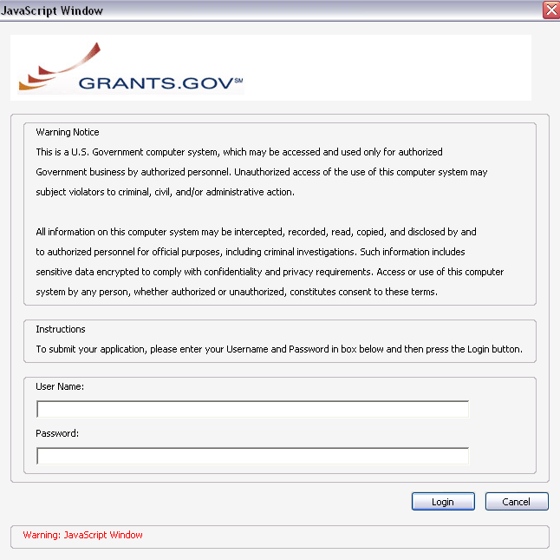
Submit Application
AORs: Enter your Grants.gov username and password—you must be fully registered to successfully submit an application.
Only AORs can submit!

Slide 40
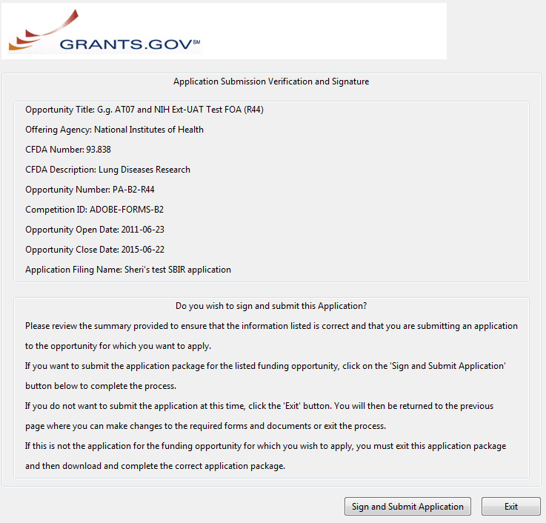
Submit Application
Click Sign and Submit Application button to record electronic signature and initiate submission process to Grants.gov.

Slide 41
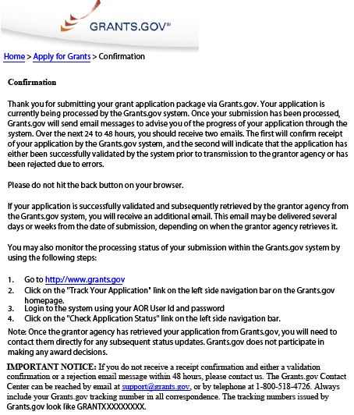
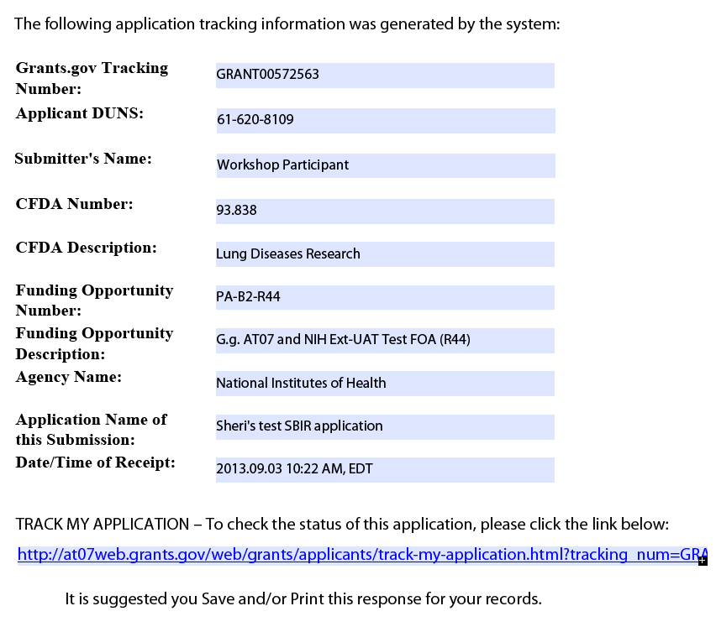
Submit Application
Print/save your confirmation screen info.
Grants.gov Tracking #
Date/Time Stamp - due 5 p.m. local time of the applicant organization on deadline date

Slide 42

On-time Submission
Important reminders:
  NIH recommends submitting early (days, not minutes!) to allow time for correcting any errors found during the application viewing window prior to the due date
  NIH’s late policy does not allow corrections after the due date
  All registrations must be completed before the due date
Error-free applications must be accepted by Grants.gov with a time stamp on or before 5:00 p.m. local time of the submitting organization on the due date.

Slide 43

Dealing with System Issues
You must follow NIH’s standard ‘system issue’ procedure if you run into problems beyond your control that threaten your on-time submission: http://grants.nih.gov/grants/ElectronicReceipt/support.htm#guidelines

Slide 44

You’re Not Finished Yet…
Application
Successfully
submitted
to NIH
Submitting to Grants.gov is NOT the last step in the process!

Slide 45

Track & View Application
Tracking Your application in eRA commons
Viewing your application in commons
Rejecting an application
Submission complete – happy dance!
Trust, but verify.
-Ronald Reagan

Slide 46
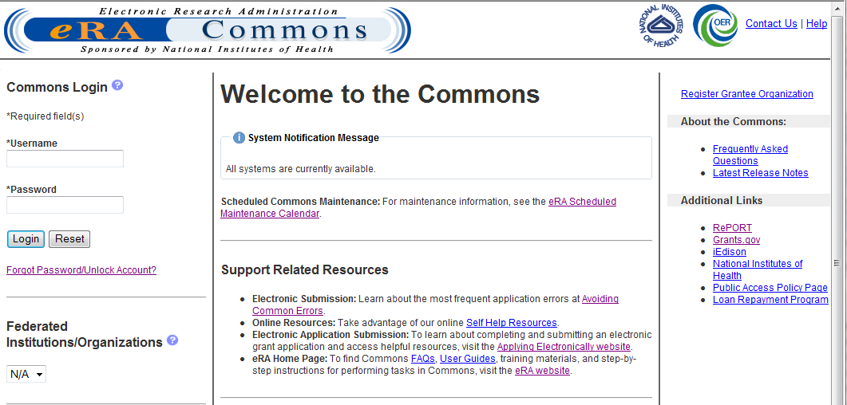
Time to Go to eRA Commons…
eRA Commons: https://public.era.nih.gov/commons

Slide 47
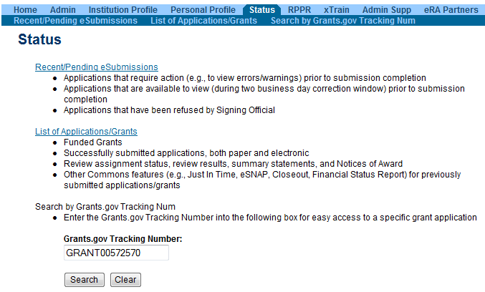
Track Application - Commons
Select Recent/Pending eSubmissions
Or provide Grants.gov tracking number from confirmation screen or email notification

Slide 48
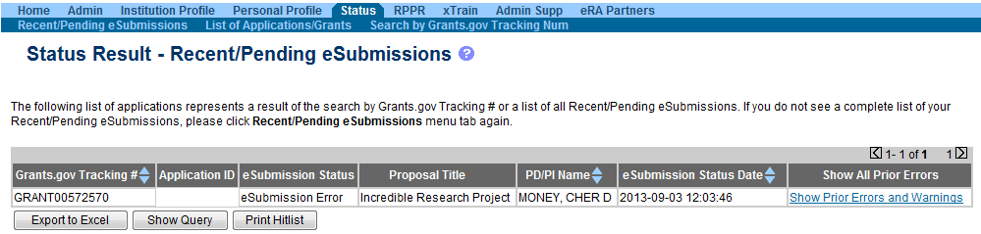
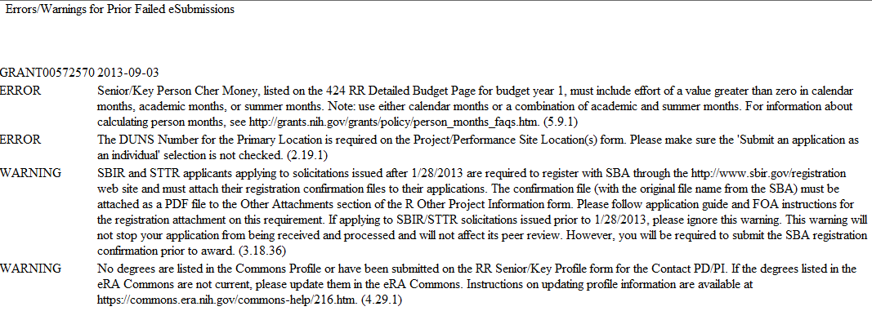
Track Application - Commons
Indicates eSubmission Error
Grants.gov tracking #

Slide 49



Corrective submissions must be made BEFORE the submission deadline and overwrite previous submissions.
Errors stop application processing and must be corrected
Warnings do not stop application processing and are corrected at the discretion of the applicant

Slide 50

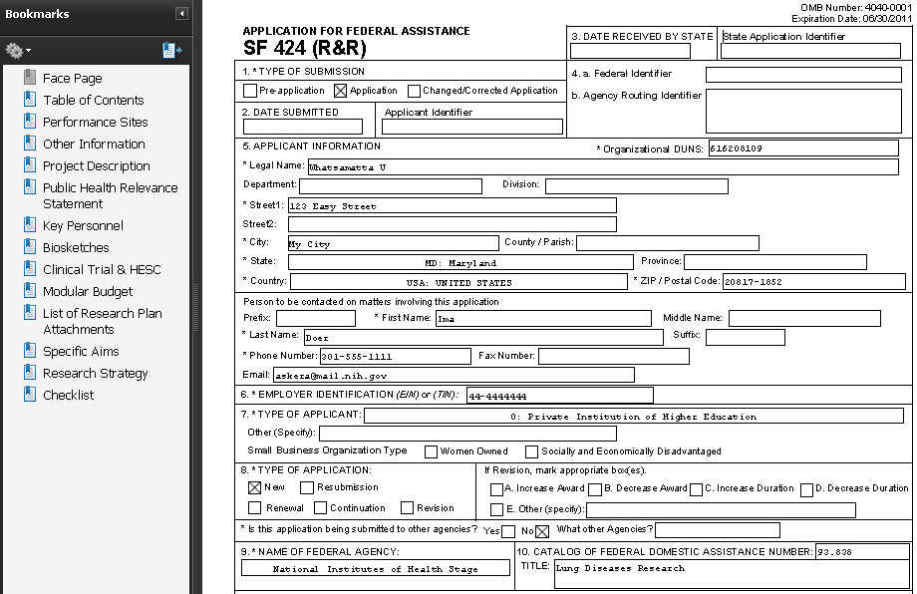
View Application Image
Once an error-free application is received by NIH, the eRA system will:
  Assemble the grant application image
  Insert headers (PI name) and footers (page numbers) on all pages
  Generate Table of Contents and bookmark important sections
  Post the assembled application image in the PD/PI’s eRA Commons account
  Send notification
    Email can be unreliable – proactively
    check eRA Commons for status

Slide 51

Application Viewing Window
Applicants have two (2) business days to view the assembled application image before the application automatically moves forward for further processing
SO can Reject application within viewing window and submit a Changed/Corrected application before the submission deadline
If you can’t VIEW it, we can’t REVIEW it!

Slide 52
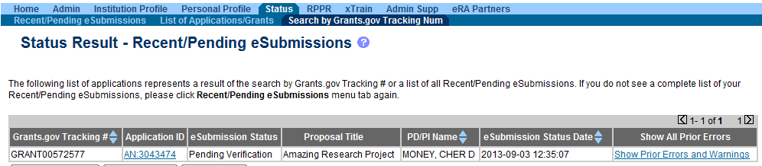
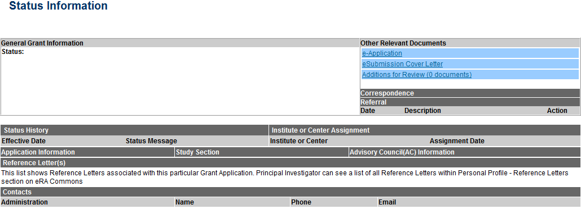
View Application Image in Commons
Status is Pending Verification
Application ID links to detailed status info
Follow e-Application link to view assembled application image
View Appendices and Cover Letter

Slide 53
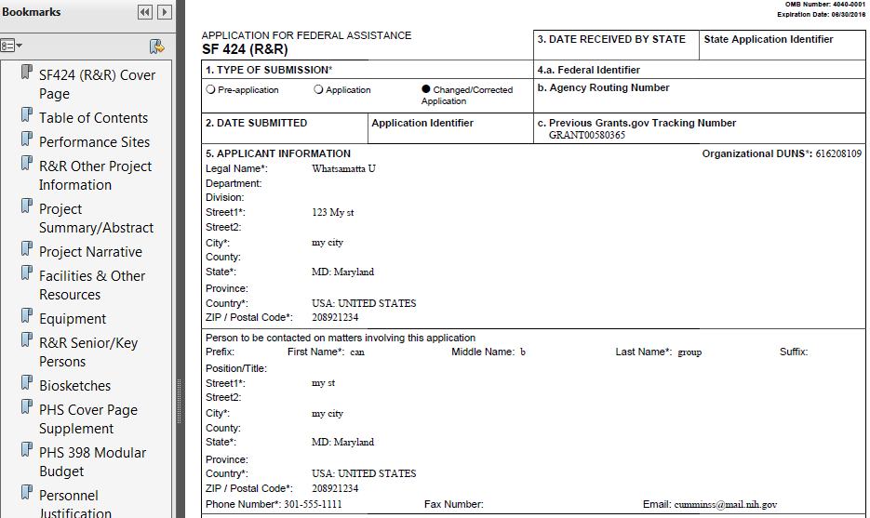
View Application Image in Commons
TIP: Carefully review the entire application.
This is your chance to view/print the same application image that will be used by Reviewers!

Slide 54
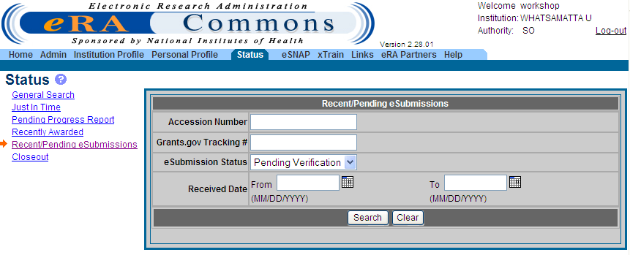
Reject eApplication
PIs: If the application image in the eRA Commons
does not properly reflect the submitted material, work
with your SO to reject the application!
Must have SO role
Enter Search Criteria
Click Search
Select Recent/ Pending eSubmissions

Slide 55
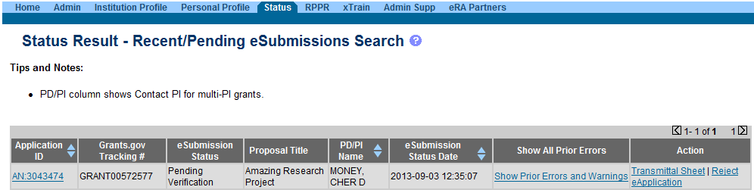
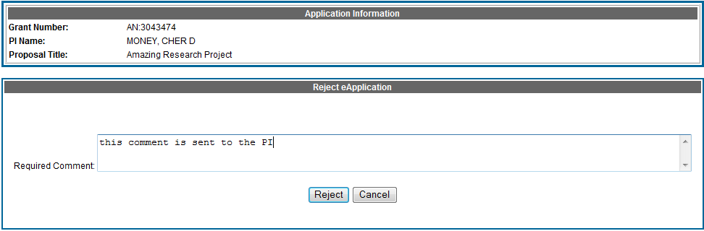
Reject eApplication
Enter comment to be sent with e-mail notification
55

Slide 56

Submission Complete!
If no action is taken during the two business day viewing window, the application automatically moves forward for further processing at NIH
Any subsequent application changes are subject to the NIH policy on late submission of grant applications and the NIH policy on post-submission application materials

Slide 57

Finding Help
Help Desks
On-line resources &Web sites

Slide 58
Help Desks
eRA Commons Help Desk
Grants.gov Contact Center
Web: http://grants.nih.gov/support/
Phone: 1-866-504-9552
TTY: 301-451-5939
Hours : Mon-Fri, 7a.m. to 8 p.m. ET
Toll-free: 1-800-518-4726
Hours : 24x7 (Except Federal Holidays)
Email : support@grants.gov
Resources: http://www.grants.gov/help/help.jsp

Slide 59




Take Advantage of Available Resources to
Avoid Common Errors
Application guide, supplemental instructions, format pages:
  http://grants.nih.gov/grants/funding/424/index.htm
Annotated Form Set:
  http://grants.nih.gov/grants/ElectronicReceipt/communication.htm#forms
Avoiding Common Errors Web page:
  http://grants.nih.gov/grants/ElectronicReceipt/avoiding_errors.htm
PDF Guidelines:
  http://grants.nih.gov/grants/ElectronicReceipt/pdf_guidelines.htm
Resources
Guides
Websites

Slide 60

Web Sites
eRA Commons:
https://commons.era.nih.gov/commons/
Electronic Research Administration:
http://era.nih.gov/
Applying Electronically: http://grants.nih.gov/grants/ElectronicReceipt/
NIH About Grants:
http://grants.nih.gov/grants/oer.htm
NIH SBIR/STTR site
  http://sbir.nih.gov/

Slide 61

Questions?

