Slide 1



NIH Grant Application Submission Process
June 2014
electronic Research Administration (eRA)
OER, OD, National Institutes of Health

Slide 2
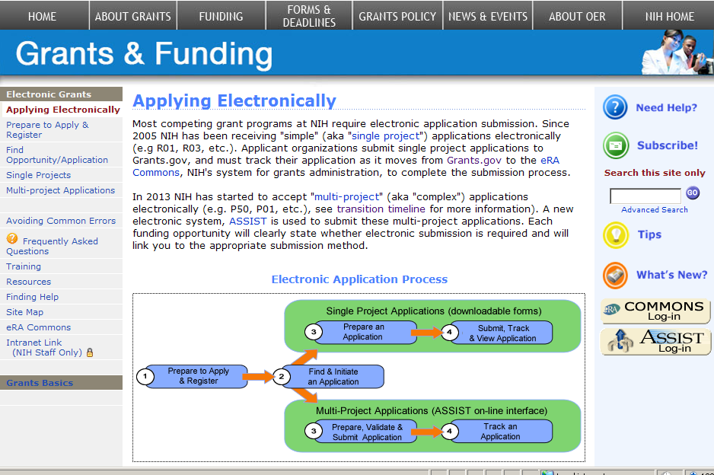
Electronic Application Submission (eSubmission)
http://grants.nih.gov/grants/ElectronicReceipt/

Slide 3
eSubmission: Prepare to Apply & Register
Registrations
High-level process
Software needed
Submission methods
Submission plan

Slide 4

Electronic Submission -100% electronic for competing applications
NIH is now receiving 100% competing grant applications electronically.
Electronic submission is required for all, except Non competing submissions, such as :
  Merit Extensions – Type 4
  For Multi Project Applications in response to:
    Administrative Supplements - Type 3
    Change of Organization Status – Type 6
    Change of Grantee Organization – Type 7

Slide 5

Separate, but linked systems
Grants.gov
  Federal-wide portal to find and apply for Federal grant funding
  Used by all 26 Federal grant-making agencies
eRA Commons
  Agency system that allows applicants, grantees and Federal staff to share application/grant information
  Used by NIH and a few other HHS divisions
IMPORTANT: Each system has its own registration and application requirements.

Slide 6


Get Registered
Grants.gov
  Applicant Organizations only
  Designate E-Business Point of Contact (E-Biz POC)
    Approves Authorized Organization Representatives (AORs) to submit applications
  No registration needed to find opportunities or download forms
eRA Commons
  Applicant Organization & PD/PI
  Project Leads for multi project applications
  Designate Signing Official (SO)
    Registers or affiliates Project Director/Principal Investigator (PD/PI)
  Commons IDs needed to prepare multi-project applications in ASSIST

Slide 7

Registration - Tips
If not yet registered, start the process at least 6 weeks before the deadline
  Once DUNS number is obtained, Grants.gov and eRA Commons registrations can be done in tandem
  NIH 2-week “good faith effort” for Commons registration
Set-up multiple AOR and SO accounts
Update System for Award Management (SAM) information yearly to keep credentials active
  Formerly called Central Contractor Registration (CCR)

Slide 8
Registration - Tips
Log in to accounts prior to deadline to ensure you have access to the systems
PIs should update their Commons profile prior to submitting (e.g., degree info used to determine Early Stage Investigator eligibility)

Slide 9
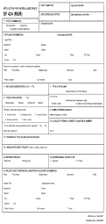
Process Overview
AOR/SO
Find and download announcement, instructions and form package.
Prepare application per institution & agency guidelines.
Authorized Organization Rep. (AOR) submits application via Grants.gov.
eRA downloads application and verifies compliance with application instructions.
PI/SO check submission status and view assembled application in eRA Commons.

Slide 10

Obtain Software
Adobe Reader required for form-based submission
Internet browser required for ASSIST application preparation/submission and to work within eRA Commons
  http://era.nih.gov/browser_support_ext.cfm
PDF conversion program
  Attachments must be converted to PDF format
Grants.gov download software page
  http://www.grants.gov/help/download_software.jsp

Slide 11
Identify Submission Method
Downloadable Adobe forms
  Single-project applications only
Commercial service provider or custom system-to-system (S2S) solution using XML data stream
  Ask your administrative office if this is an option
  http://grants.nih.gov/grants/ElectronicReceipt/sp.htm
ASSIST (Application Submission System & Interface for Submission Tracking)
  Multi-project applications only

Slide 12
Multi project Submissions - ASSIST
Submit application via a Web based interface (No more paper!)
Uses current eRA Commons credentials for access
Populates data from eRA Commons profiles
Prior to submission
  Runs validations on federal wide and agency business rules
  Print/preview applications in the format used by the agency
  Automatic generation of table of contents, headers, footers, page numbers, etc.

Slide 13

Make a Submission Plan
Application preparation responsibilities
Sharing applications in progress
Internal review & approval process
Internal deadlines
Post-submission responsibilities
Administrators and PIs must work together!

Slide 14
eSubmission: Find & Initiate an Application
Finding opportunities
Downloading application package
Application instructions

Slide 15



Search For Opportunity
NIH Guide for Grants & Contracts
Grants.gov Search Opportunity

Slide 16

Parent FOAs
http://grants.nih.gov/
Use for investigator-initiated research.
Select Parent FOA for your chosen grant program
(i.e. R01, R03, R21, etc.).

Slide 17
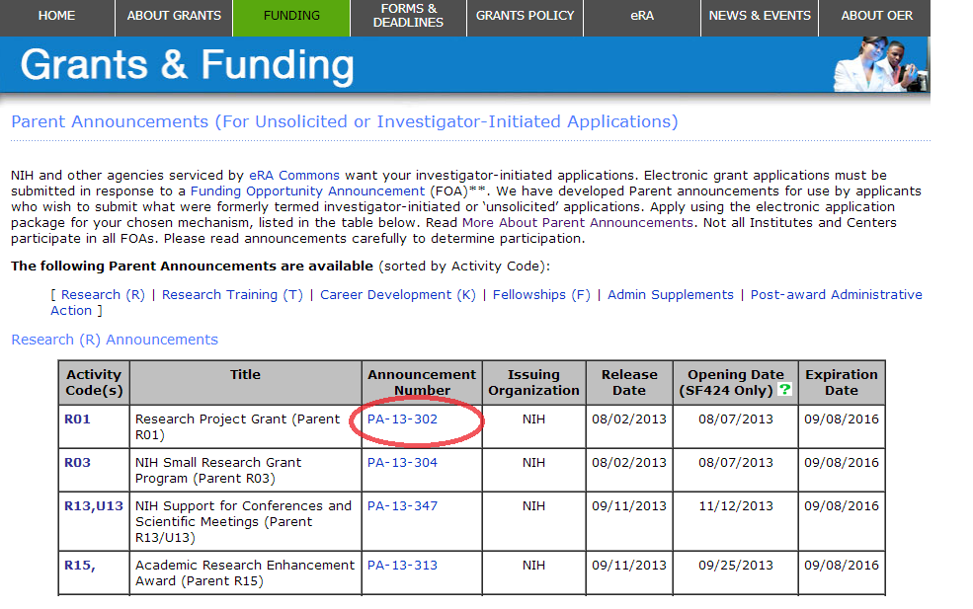
Use Announcement Number to link to FOA

Slide 18
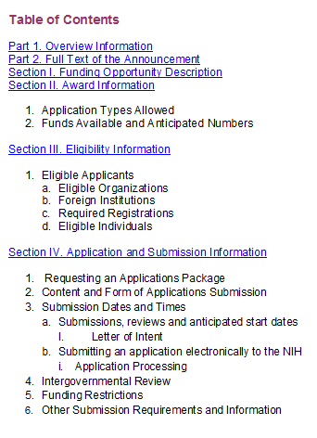
FOA-Specific Application Information
Pay special attention to Section IV. Application and Submission Information
  Includes any FOA-specific submission instructions
  Instructions in FOA supersede instructions in the application guide

Slide 19
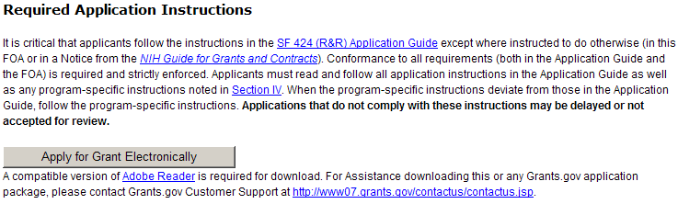
Download Application Package
Excerpt from PA-13-302 FOA
Links to Grants.gov Download Application page for the FOA
Competition ID & Title used to help identify appropriate application package.

Slide 20
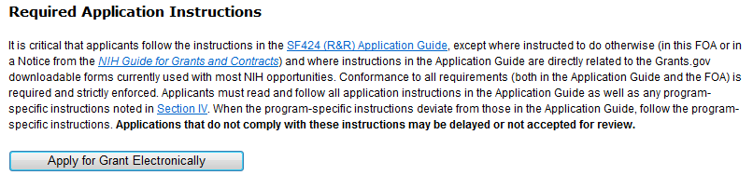

FOAs for Multi-project Programs Link to ASSIST

Slide 21
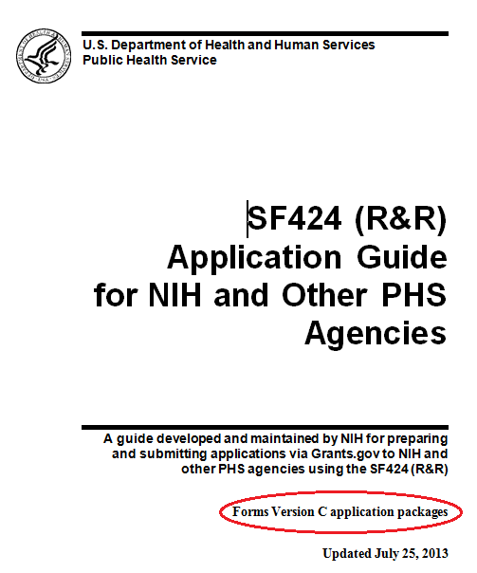

Application Guide
Read and follow application guide instructions
Agency-specific instructions are marked with the
HHS logo

Slide 22
Application Guide - Tips
Be sure to select the appropriate application Guide for your opportunity
  Based on type of grant program
    Application Guide SF424 (R&R)
    SBIR/STTR Application Guide SF424 (R&R)
    Individual Fellowship Application Guide SF424 (R&R)
  Supplemental Grant Applications instructions for human subjects and policies required for:
    All Competing Applications
    All Progress Reports
  http://grants.nih.gov/grants/funding/424/index.htm

Slide 23
eSubmission: Prepare Your Application
Working with adobe forms

Slide 24
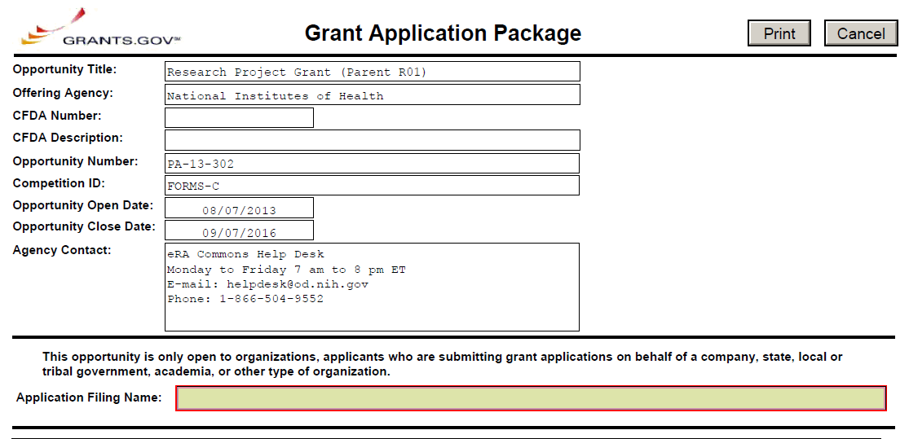
Downloadable ADOBE FORMS
*Application Form Screen - Top*
Make sure you have the correct application package.
FOA information is automatically populated and not editable.
Mandatory Grants.gov fields highlighted with red box.

Slide 25
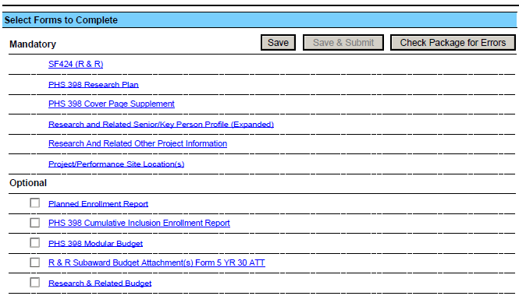
Downloadable ADOBE Forms
*Application Form Screen - Bottom*
Save the package locally.
Complete the SF 424 (R&R) form first—info from this form pre-populates fields in other forms in the package.
See application guide to determine which Optional documents you need to complete.

Slide 26
Tips
Follow FOA-specific guidelines (e.g., special attachments, specific section headings)
Follow application guide requirements
Follow guidelines for fonts and margins
Do not include headers or footers
  Section headings as part of the text are encouraged
Take advantage of posted ‘Additional Format Pages’
  http://grants.nih.gov/grants/funding/424/index.htm

Slide 27
Take Advantage of Available Resources to
Avoid Common Errors
FOA and Application Guide instructions:
  http://grants.nih.gov/grants/funding/424/index.htm
Annotated Form Set:
  http://grants.nih.gov/grants/ElectronicReceipt/communication.htm#forms
Avoiding Common Errors Web page:
  http://grants.nih.gov/grants/ElectronicReceipt/avoiding_errors.htm
PDF Guidelines:
  http://grants.nih.gov/grants/ElectronicReceipt/pdf_guidelines.htm
Excruciatingly detailed validations documentation:
  http://grants.nih.gov/grants/ElectronicReceipt/files/SF424RR_Validation.pdf

Slide 28
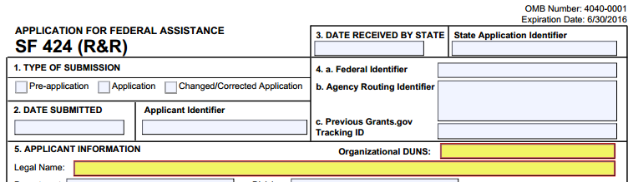
Avoid Common Errors
Does the DUNS number on the SF424 (R&R) cover form match the DUNS number used for Grants.gov & Commons registrations?

Slide 29
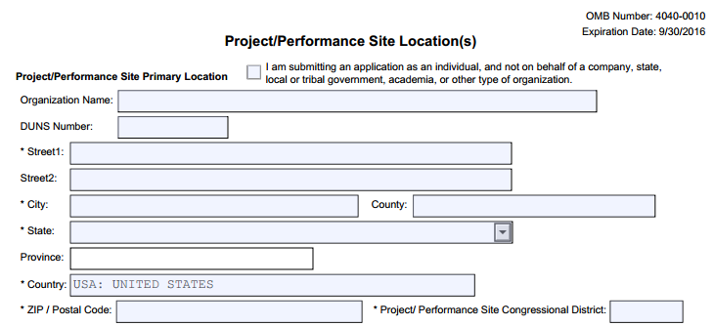
Avoid Common Errors
Primary site DUNS is required by NIH and is enforced with an agency validation

Slide 30
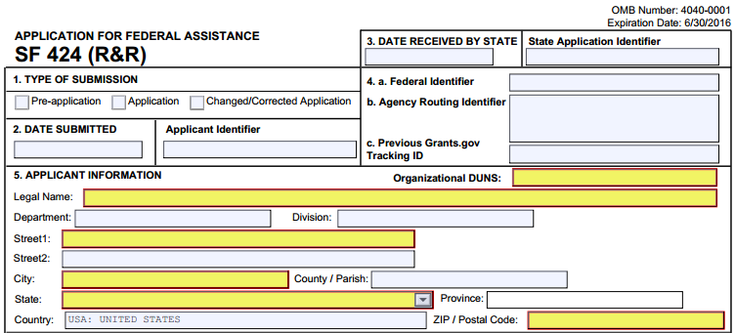
Avoid Common Errors
Did you provide correct Type of Submission (#1), Federal Identifier (#4), and Type of Application (#8) information on the SF 424 (R&R) cover form?
Use Application for first submission attempt for the same deadline
Use Changed/Corrected when submitting again to correct eRA-identified errors/warnings

Slide 31
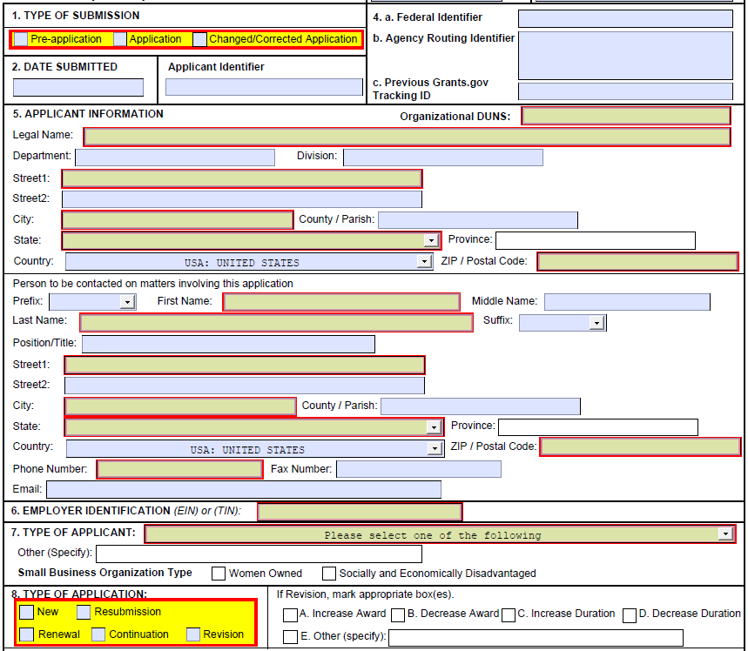
Fed ID & Type of Application
Federal ID & Types of Applicationis
If Resubmission/Renewal/Revision in field #8, use Institute and serial #
of previous NIH grant/app (e.g., use
CA987654 from 1R01CA987654-01)
If Changed/Corrected in field #1, then enter previous Grants.gov tracking number
See Application Guide for definition of application types

Slide 32

Terminology Check
Type of Application on SF424 (R&R), field #8
Term | Notes
New | An application that is submitted for funding for the first time. (Type 1)
Renewal | Competing for additional years of funding to continue original project. (Type 2)
Revision | Request for additional funds for a current award to expand the scope of work. Applicants should contact the awarding agency for advice on submitting any revision/supplement application. (Type 3)
Resubmission | Application previously reviewed. A revised or amended application that addresses reviewer feedback. (A1)
Continuation | NIH does not use the SF 424 (R&R) for Continuation applications. (Type 5; progress reports for simplified non-competing (SNAP) applications are submitted directly to eRA Commons; for others, paper apps. are still submitted.)

Slide 33
Avoid Common Errors
Did you include the eRA Commons ID in the Credential field of the R&R Sr/Key Person Profile form for all PD/PIs?
If submitting a Multiple-PD/PI application, did you give all PIs the PD/PI role on the Sr/Key Person Profile form?
  For multi-project, multi-PD/PI applications, all PD/PIs for the entire application should be included in the Overall Component

Slide 34
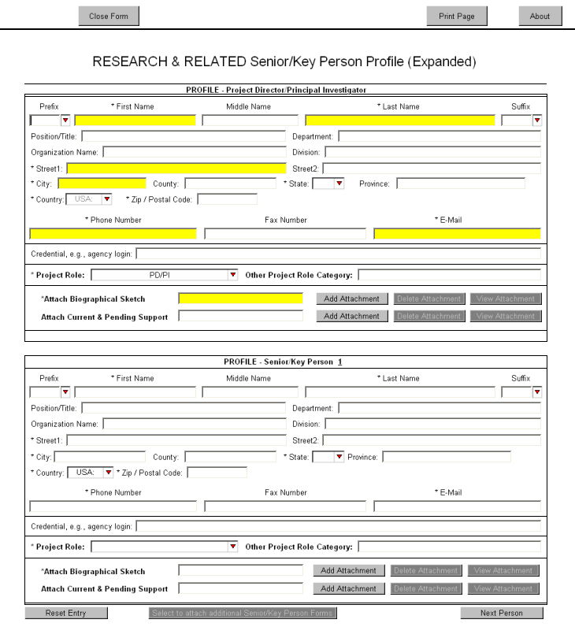
Credential Field
eRA Commons
username must be supplied in the Credential field
Enter PI Commons Username
For multiple PD/PI applications, select the PD/PI role for each PI and provide their eRA Commons username in the Credential field
Enter PI Commons Username
Select PD/PI role for each PI

Slide 35
Avoid Common Errors
Did you include Organization name for all Sr/Key listed on the R&R Sr/Key Person Profile (Expanded) form?
PD/PI Organization will auto-populate from SF 424 (R&R) cover if available.
NIH requires the Organization name for all Sr/Key listed.
Organization Name
Enter Organization Name

Slide 36
Avoid Common Errors
Did you include all required attachments?
  Whether an attachment is required or not is often based on how the applicant answers specific questions throughout the application
  Examples:
    Human Subjects = Yes, then Human Subjects section of the PHS 398 Research Plan required
    Vertebrate Animals = Yes, then Vertebrate Animals attachment is required
    More than one entry on the R&R Sr/Key Person Profile form with the role of “PD/PI,” then the Multiple PD/PI Leadership Plan attachment on the PHS 398 Research Plan form is required

Slide 37
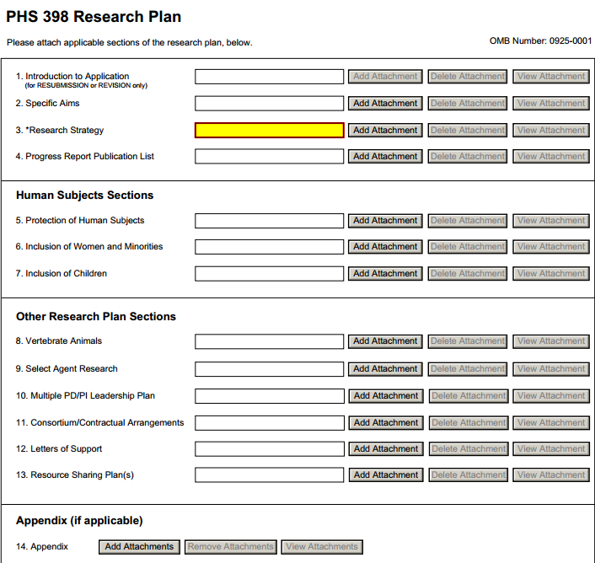
Conditional Requirements
Annotated form sets available on the Resources page of the Applying Electronically website are a great resource for helping identify many conditional requirements.
Annotated form sets:
http://grants.nih.gov/grants/ElectronicReceipt/communication.htm

Slide 38
Avoid Common Errors
Are all your attachments in PDF format?
  Use simple PDF-formatted files
    Do not use Portfolio or similar feature to bundle multiple files into a single PDF
    Disable security features such as password protection
  Keep file names to 50 characters or less
  Use meaningful filenames
    Other Project Information form, Other Attachments section
    Appendices
  Do not include headers or footers
    Section headings as part of the text (e.g., Specific Aims, Background & Significance) are encouraged
  Follow guidelines for fonts and margins
PDF Guidelines: http://grants.nih.gov/grants/ElectronicReceipt/pdf_guidelines.htm

Slide 39
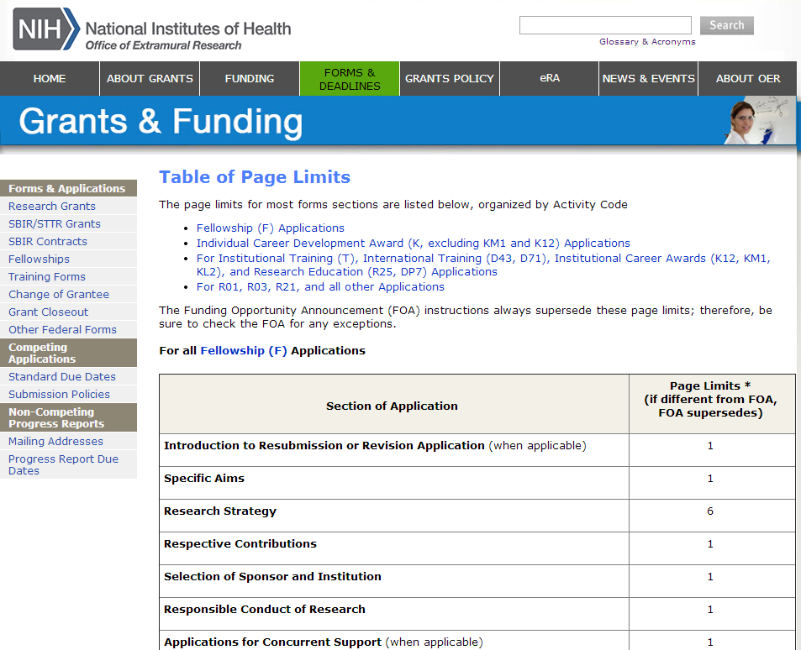
Avoid Common Errors
Did you follow all specified page limits?
Find page limits in:
FOA text
Application guide
Table of Page Limits web page
  http://grants.nih.gov/grants/forms_page_limits.htm

Slide 40
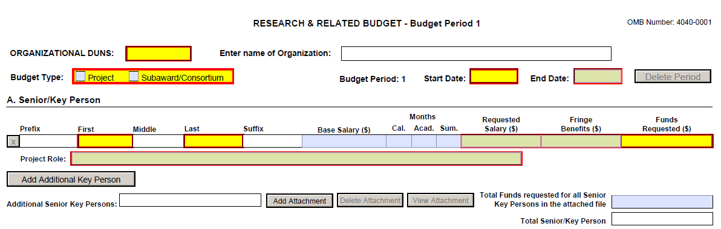
Avoid Common Errors
Did you include effort > 0 for all Sr/Key personnel listed on the R&R Budget form?
  Use either calendar months or a combination of academic and summer months
  PD/PI must have effort >0 for every budget period

Slide 41
Notes on Personnel
R&R Budget Form | Senior/Key Personnel
Include only personnel employed by (e.g., receiving salary from) your organization. | Include all personnel considered senior or key, regardless of employer.
Consultants should be included in Section F Line 3 Consultants, not in Sections A or B. | Include if considered senior or key, regardless of employer.
If effort is unknown include in Section B (e.g., other significant contributors). | Effort commitments not relevant to this section.

Slide 42
Avoid Common Errors
Did you follow all special instructions noted in Section IV. Application and Submission Information of the announcement?
  When the application guide and FOA instructions differ, the FOA wins
  FOA-specific requirements are not typically system-enforced
  Applications that do not comply with the instructions may be delayed or not accepted for review

Slide 43
eSubmission: Submit, Track & View Application
Submitting an application
On-time submission
Tracking - Grants.gov
Tracking - eRA commons
Viewing your application in commons
Rejecting an application
Submission complete – happy dance!

Slide 44
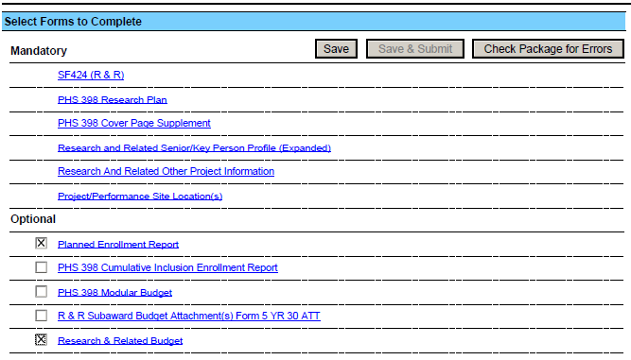
Submit Application (AOR only)
Save & Submit button will not become active until application is saved and mandatory information is completed.
Check Package for Errors button only checks to make sure the application meets Grants.gov requirements. Agency requirements checked upon submission.

Slide 45
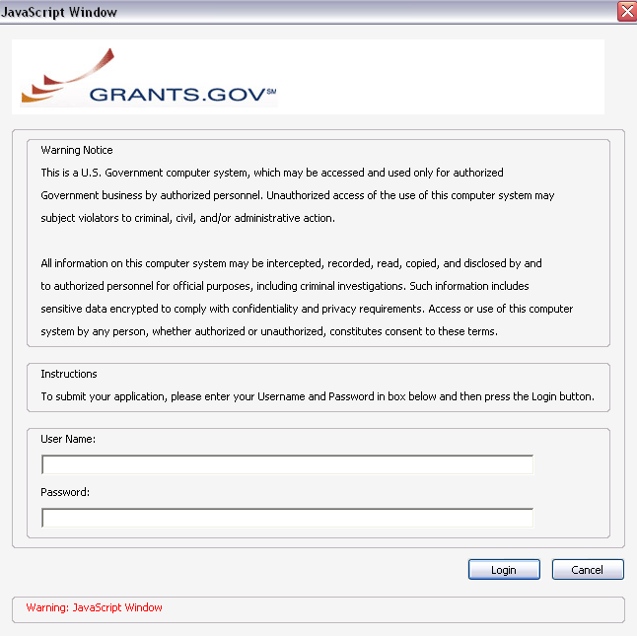
Submit Application
AORs: Enter your Grants.gov username and password—you must be fully registered to successfully submit an application.
Only AORs with active SAM registration can submit!

Slide 46
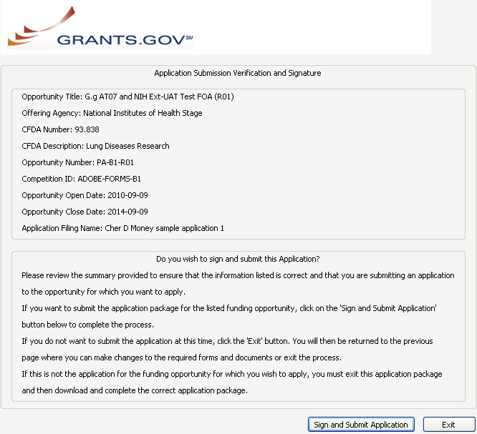
Submit Application
Click Sign and Submit Application button to record electronic signature and initiate submission process to Grants.gov.

Slide 47
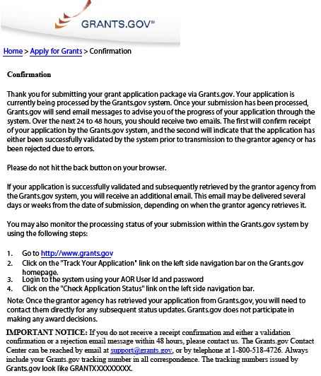
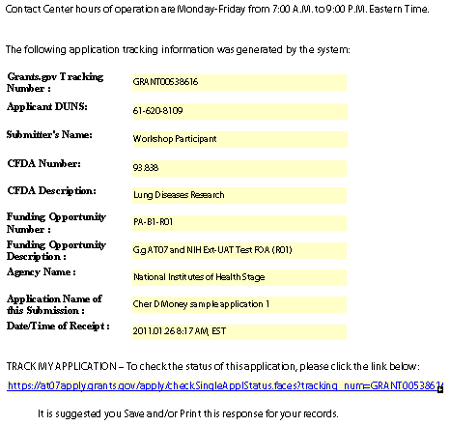
Submit Application
Print/save your confirmation screen info.
Grants.gov Tracking #
Date/Time Stamp - due 5 p.m. local time of the applicant organization on deadline date

Slide 48

On-time Submission
Important reminders:
  NIH recommends submitting early (days, not minutes!) to allow time for correcting any errors found during the application viewing window prior to the due date
  NIH’s late policy does not allow corrections after the due date
  All registrations must be completed before the due date
Error-free applications must be accepted by Grants.gov with a time stamp on or before 5:00 p.m. local time of the submitting organization on the due date.

Slide 49
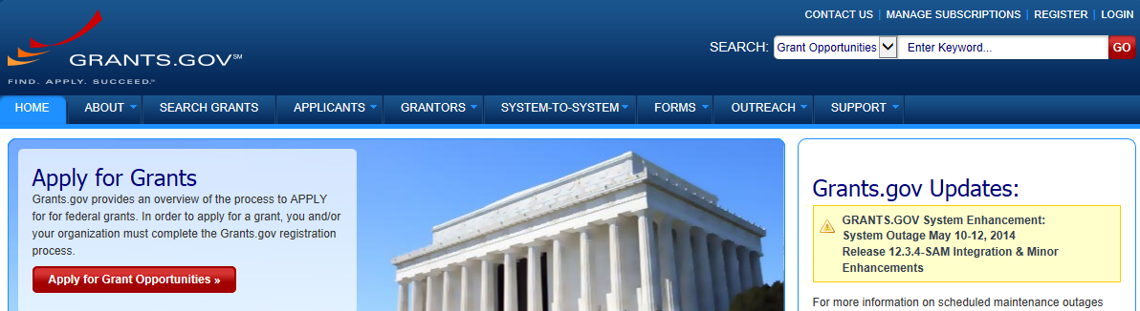
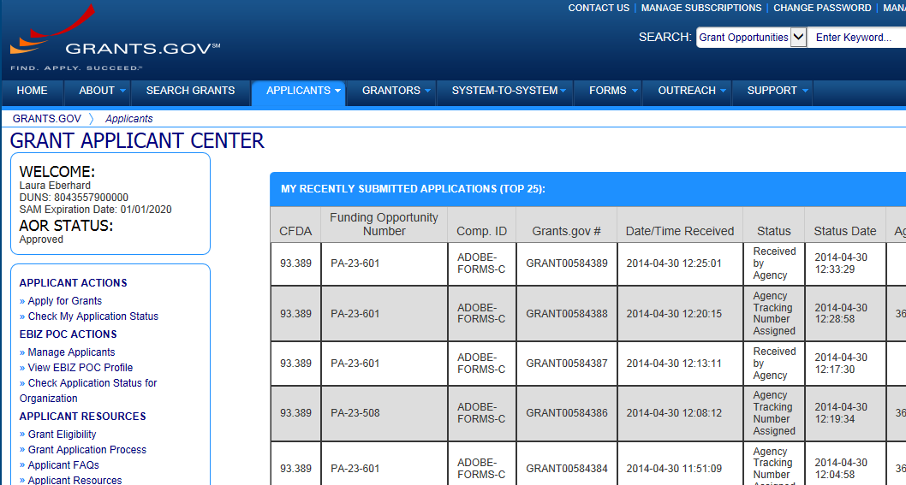
Track Application – Grants.gov
Grants.gov application status

Slide 50
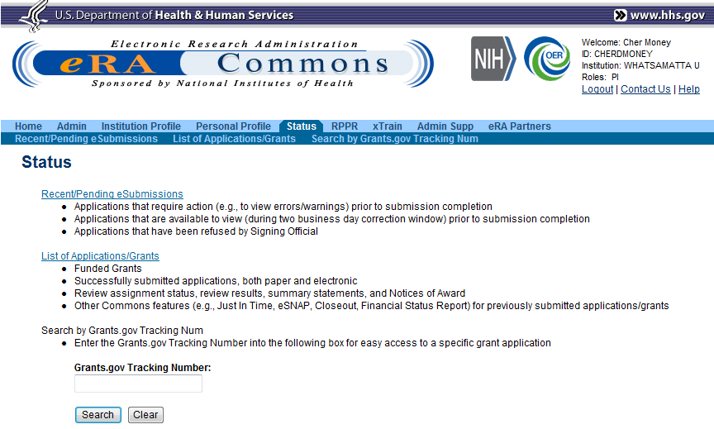
Track Application - Commons
Select Recent/Pending eSubmissions
Or provide Grants.gov tracking number from e-mail notification

Slide 51
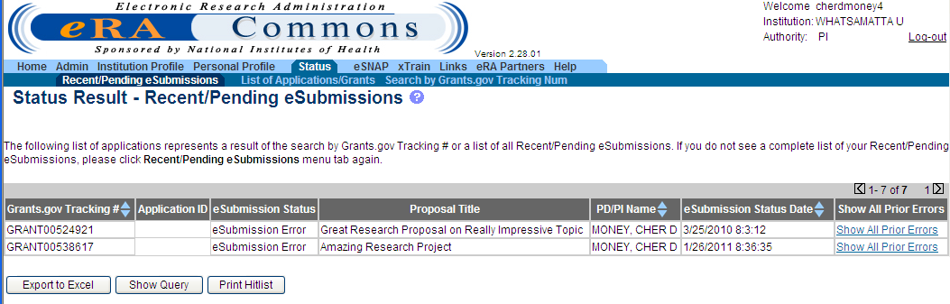
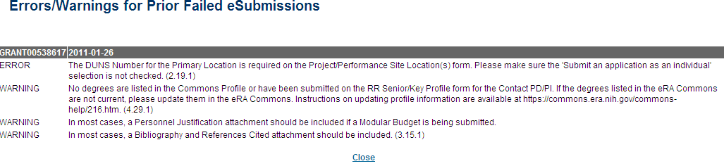
Track Application - Commons
Indicates eSubmission Error
Grants.gov tracking #
Grants.gov tracking #/date are displayed, followed by the list of errors/warnings for each submission attempt

Slide 52



Corrective submissions must be made BEFORE the submission deadline!
Errors stop application processing and must be corrected
  In ASSIST, cannot submit until errors are corrected
Warnings do not stop application processing and are corrected at the discretion of the applicant

Slide 53

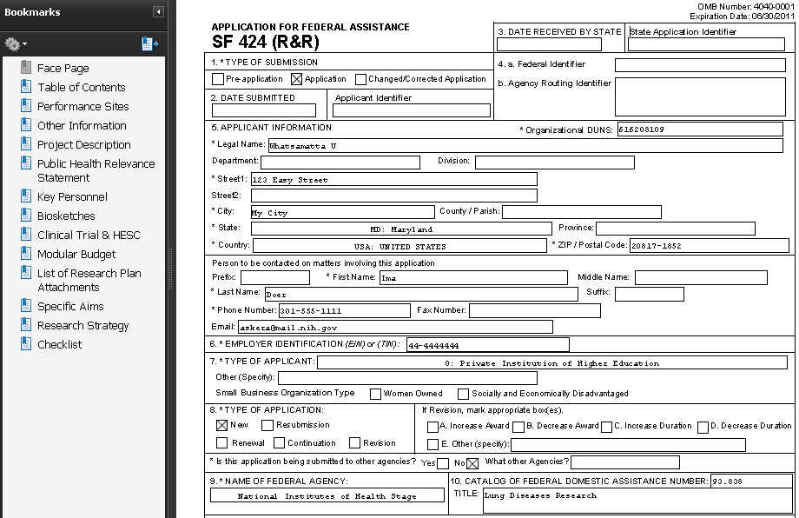
View Application Image
Once an error-free application is received by NIH, the eRA system will:
  Assemble the grant application image
  Insert headers (PI name) and footers (page numbers) on all pages
  Generate Table of Contents and bookmark important sections
  Post the assembled application image in the PD/PI’s eRA Commons account
  Send notification

Slide 54

Application Viewing Window
Applicants have two (2) business days to view the assembled application image before the application automatically moves forward for further processing
SO can Reject application within viewing window and submit a Changed/Corrected application before the submission deadline
If you can’t VIEW it, we can’t REVIEW it!

Slide 55
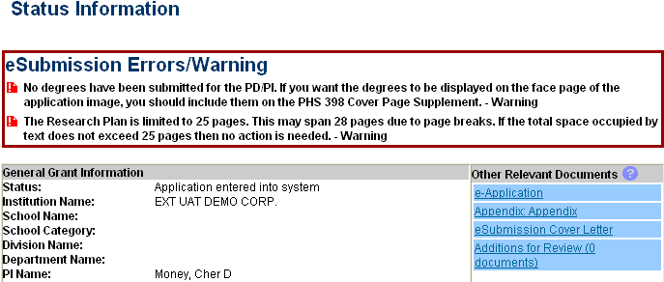
View Application Image in Commons
Status is Pending Verification
Follow link to detailed status info
Follow e-Application link to view assembled application image
View Appendices and Cover Letter

Slide 56
View Application Image in Commons
TIP: Carefully review the entire application.
This is your chance to view/print the same application image that will be used by Reviewers!

Slide 57
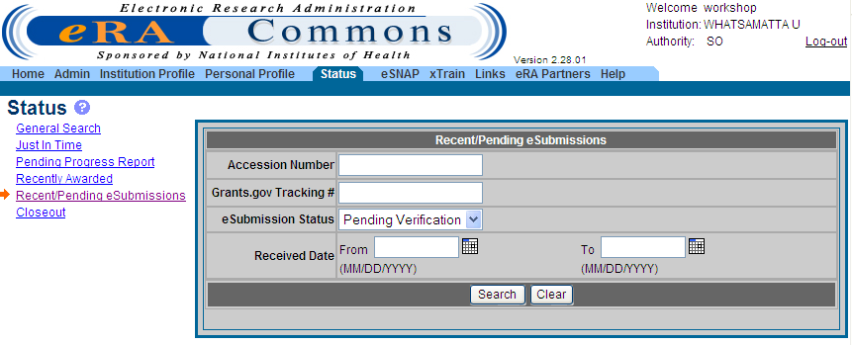
Reject eApplication
PIs: If the application image in the eRA Commons
does not properly reflect the submitted material, work
with your SO to reject the application!
Must have SO role
Enter Search Criteria
Click Search
Select Recent/ Pending eSubmissions

Slide 58
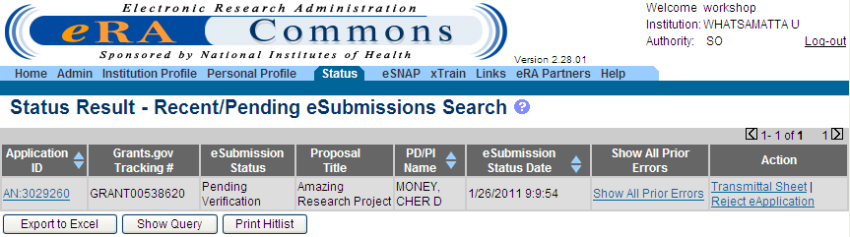
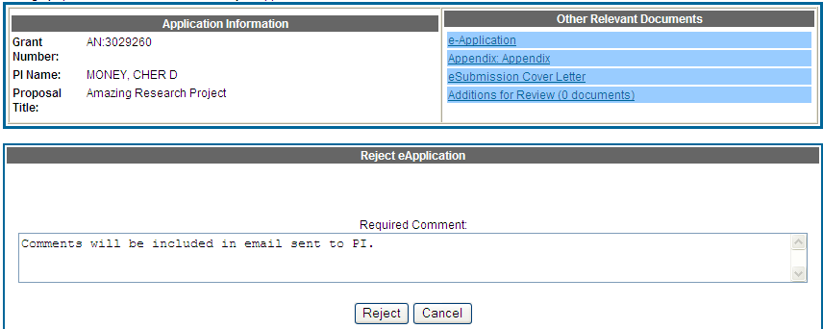
Reject eApplication
Enter comment to be sent with e-mail notification
58

Slide 59

Submission Complete!
If no action is taken during the two business day viewing window, the application automatically moves forward for further processing at NIH
Any subsequent application changes are subject to the NIH policy on late submission of grant applications and the NIH policy on post-submission application materials

Slide 60

Dealing with System Issues
Applicants should follow NIH’s standard ‘system issue’ procedure if they run into problems beyond their control that threaten their on-time submission: http://grants.nih.gov/grants/ElectronicReceipt/support.htm#guidelines

Slide 61
Finding Help
Help Desks
On-line resources &Web sites
Sheri

Slide 62
Help Desks
eRA Commons Help Desk
Grants.gov Contact
Center
Web: http://era.nih.gov/help/index.cfm#era
Phone: 1-866-504-9552
TTY: 301-451-5939
Hours : Mon-Fri, 7a.m. to 8 p.m. ET
Toll-free: 1-800-518-4726
Hours : 24x7 (Except Federal Holidays)
Email : support@grants.gov
Resources: http://www.grants.gov/help/help.jsp

Slide 63

Web Sites
eRA Commons: https://commons.era.nih.gov/commons/
Electronic Research Administration: http://era.nih.gov/
Applying Electronically: http://grants.nih.gov/grants/ElectronicReceipt/
NIH About Grants: http://grants.nih.gov/grants/oer.htm

Slide 64

Thank you

