Slide 1
NIH RPPR Training Webinar for Grantees
Carol Wigglesworth and Emily Linde
Office of Policy for Extramural Research Administration
National Institutes of Health
October 17, 2012

Slide 2


Speakers
Emily Linde
and
Carol Wigglesworth
Grants Policy Analysts
Office of Policy for Extramural Research Administration
National Institutes of Health

Slide 3
Research Performance Progress Report Background
Research Business Models Subcommittee effort, began 2004
OMB RPPR Final Format
  April 2010 directive to agencies to implement
  Standardizes information required by agencies
  Reduces administrative burden and costs
  Eases comparison of outcomes across agencies
NIH Implementation Plan
  Electronic format only
  Replaces PHS 2590, including use of eSNAP module, and 416-9 for Fellowships
  AHRQ, FDA and CDC partners will adopt

Slide 4
NIH RPPR TIMELINE
All NIH grantees given access to RPPR module
Use of RPPR is OPTIONAL
Progress Report Additional Materials (PRAM) functionality available
All FDP institutions given early access to RPPR module
RPPR Pilot with 7 grantee Institutions begins
NIH mandates use of RPPR for all SNAP and F awards
APRIL 2012 JUNE 2012 AUGUST 2012 OCTOBER 2012 JANUARY 2013 April 2013
RPPR for non SNAP awards TBD

Slide 5
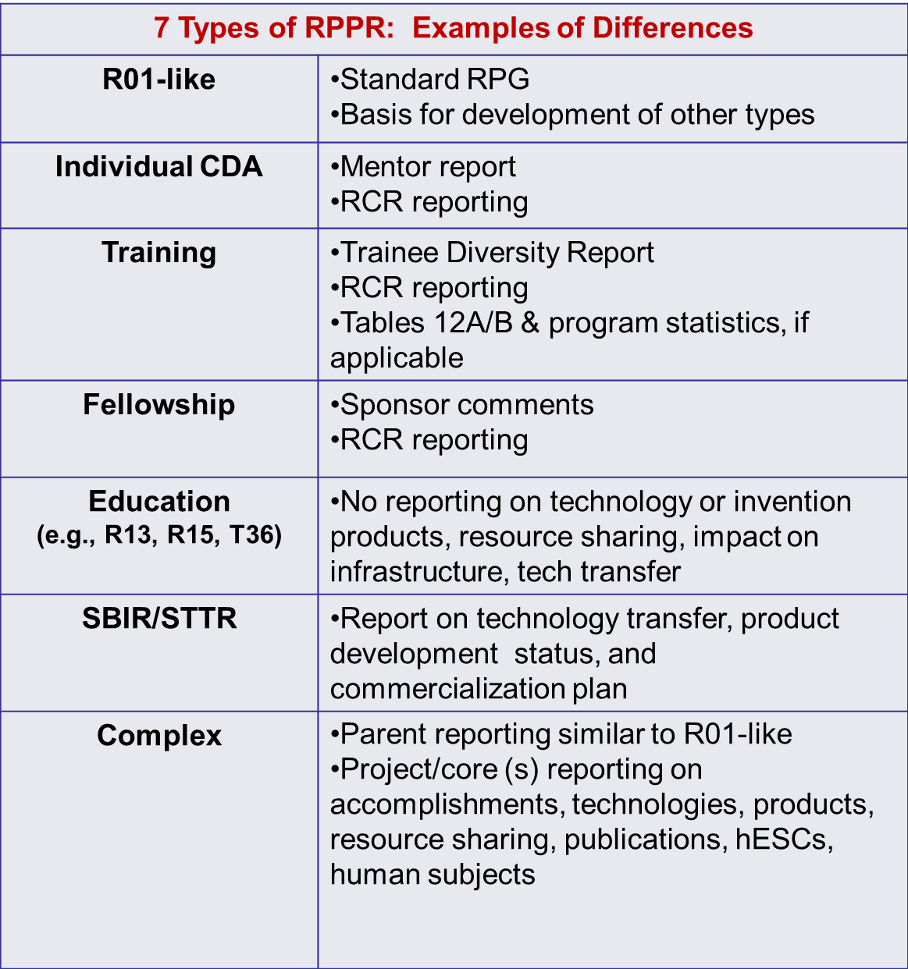
Input on NIH RPPR

Slide 6
RPPRs Available Now
 | Activity Codes
R01-like SNAPs | D71, DP1, DP5, G08, G11, G13, P40, R00, R01, R03, R18, R21, R33, R34, R36, R37, R56, RC1, RC2, RL1, S10, S21, S22, SC1, SC2, SC3, UB1, UC2, UH1, UH2, UH3, UP5, P01, P20, P30, P40, P41, P50, PL1, R24, S11, U01, U10, U19, U24, U34, U54
Individual K SNAPs | K01, K02, K05, K06, K07, K08, K18, K22, K23, K24, K25, K26, K99, KL1
Education SNAPs | D43, K30, R13, R25, RL5, T14, T36, U13, U2R
Fellowships | F05, F30, F31, F32, F33, F34, F37
SBIR/STTR SNAPs | R41, R42, R43, R44, U43, U44

Slide 7
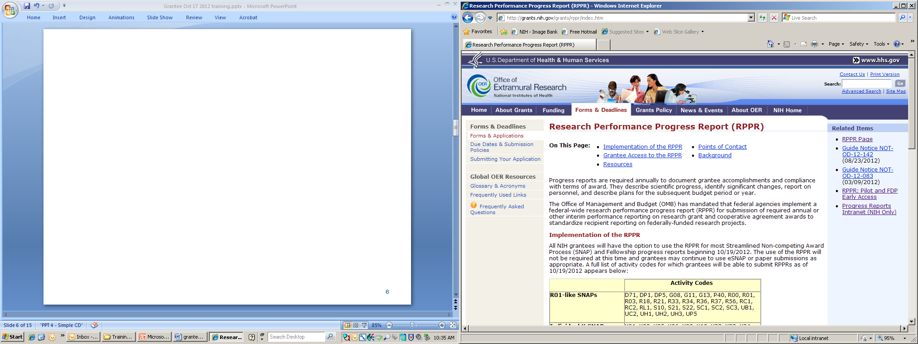

Slide 8
RPPR Structure
A. Cover Page
B. Accomplishments
C. Products
D. Participants
E. Impact
F. Changes
G. Special (NIH) Reporting Requirements
H. Budget – SF424 (R&R) forms

Slide 9
LIVE DEMO OF RPPR in eRA Commons

Slide 10
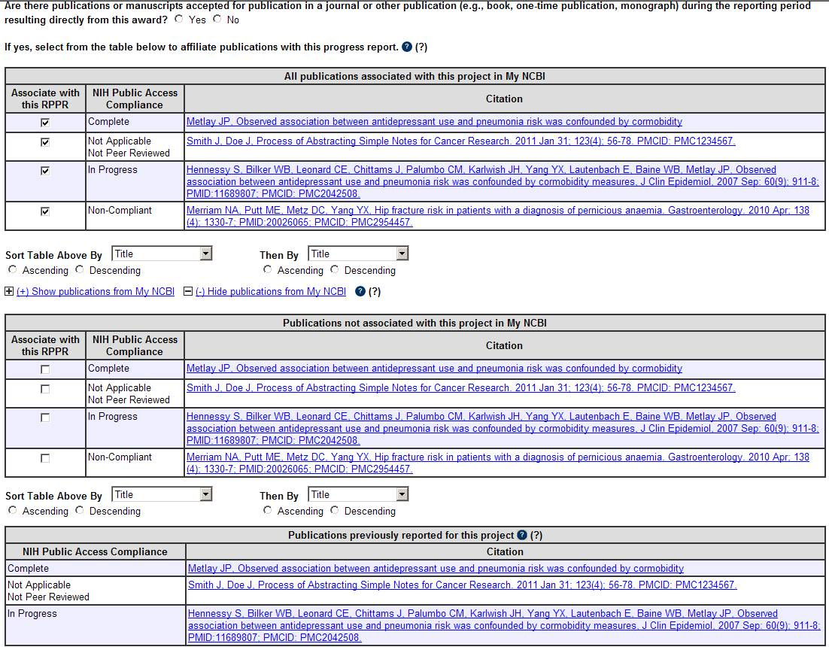
New RPPR

Slide 11
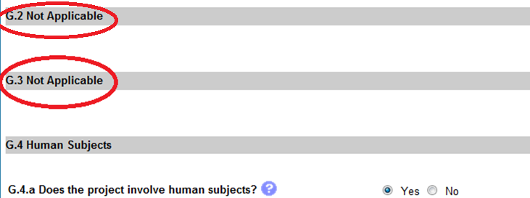
Dynamic Display
R01-like award

Slide 12
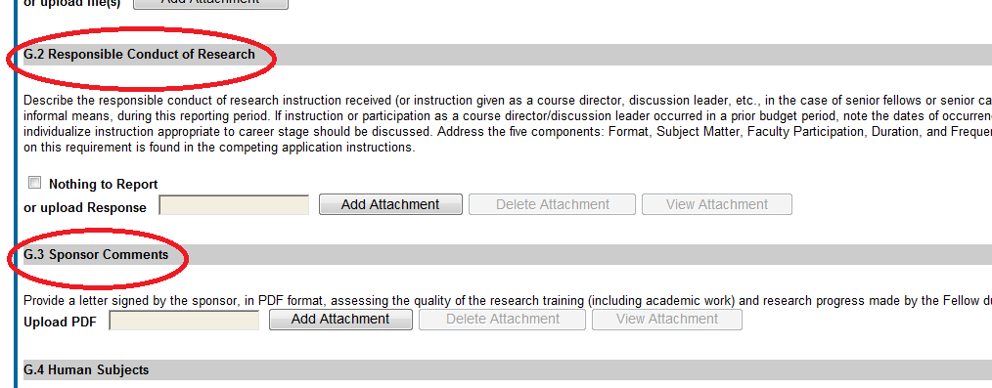
Dynamic Display
Fellowship Award
Notes:
Insert screen shot of G2 and G.3

Slide 13
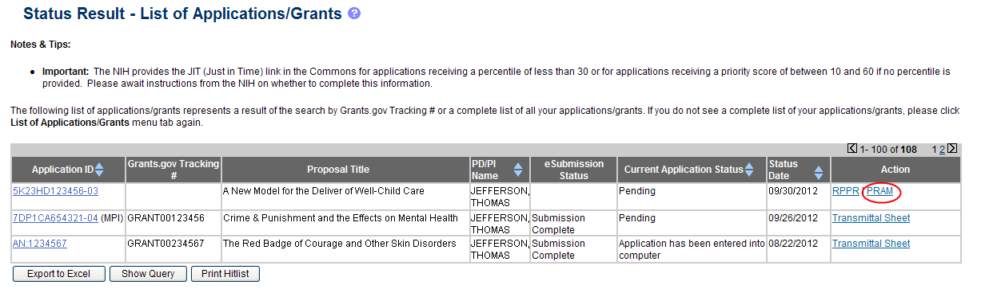
Progress Report Additional Materials - PRAM
Notes:
Insert screen shot of G2 and G.3

Slide 14
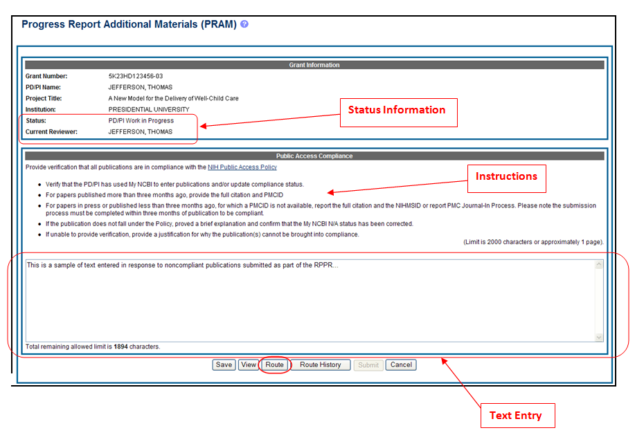
PRAM
Notes:
Insert screen shot of G2 and G.3

Slide 15
Summary of PRAM
Link opened automatically when RPPR submitted with non-compliant publications
Access PRAM link from Status Screen
Allows for text entry of 2,000 characters
Route and submit functionality are identical to functionality for RPPR
  Certification text when forwarding or submitting
  Must be submitted by SO or PD/PI with submit authority

Slide 16
Summary of New
Information Requested
Competitive revisions/administrative supplements
  Specific location to report aims & accomplishments (B.3)
Foreign Collaborations:
  Individual affiliation with foreign organization (D.1)
  Dollar amount of award spent in foreign country (E.4)
  Information about foreign components (G.9)
Participants – role on project
  New role-High School Student; slight rewording of other roles (D.1)
Level of Effort
  Prior approval request for reduction of >25% for PD/PI or other individual designated on NoA (D.2.a)
Estimated unobligated balance
  Provide estimated amount and description of how funds will be spent (G.10)

Slide 17
Points to Remember
Grantees are encouraged to use and become familiar with the RPPR
Once initiated, the format selected (RPPR or eSNAP) must be completed or user must contact eRA HelpDesk to change format
System checks for errors prior to submission; user cannot submit with errors
Only warning: publications non-compliant with Public Access Policy
  system will generate eNotification
  response to eNotification may via PRAM link

Slide 18
Points to Remember (continued)
Special characters not permitted in text boxes
  will not display properly in final PDF
Disregard items marked “Not Applicable”
Round person months to nearest whole number
Follow instructions, e.g., only report publications under C.1 Publications
Fellows are often unfamiliar with eRA Commons modules and MyNCBI

Slide 19
Information and Resources
RPPR Page: http://grants.nih.gov/grants/rppr/
  Background Information
  RPPR Instruction Guide
  Screen shots
  Archive of this training webinar
  Relevant Guide Notices
  Learn how the RPPR differs from eSNAP

Slide 20
RPPR Contacts
System Issues
  eRA Help Desk
    1-866-504-9552
    grants.nih.gov/support
Content Questions or Comments
  Email Emily Linde and Carol Wigglesworth
    lindee@mail.nih.gov
    wigglesc@od.nih.gov

