Slide 1







Preparing, Submitting & Tracking
Multi-project Applications Using
A
S
T
S
I
S
Sheri Cummins
cumminss@mail.nih.gov
September 2015

Slide 2

What is ASSIST?
ASSIST is NIH's
online system for the
preparation, submission & tracking
of grant applications through
Grants.gov to NIH

Slide 3

Electronic Submission Required
NIH requires electronic submission for all multi-project applications
Electronic submission options
  ASSIST
  Institutional system-to-system (S2S) solutions
Electronic submission is required.
Using ASSIST is optional.

Slide 4

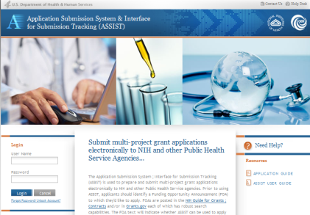




Submission Options

Slide 5
Key Benefits of ASSIST
Secure, online data entry
Collaboration of multiple users
Pre-submission validation of NIH and key Grants.gov business rules
Pre-population of data from eRA Commons profiles
Pre-submission print/preview of application in NIH format
Submission status tracking for both Grants.gov and eRA Commons within a single system

Slide 6

Before jumping into ASSIST, let’s take some time to get acclimated…

Slide 7

Application Format
All electronic multi-project applications include:
  A single Overall component
  Some number of additional components
  Automatically prepared data summaries

Slide 8







Multi-Project Application: Overall Component
Overall Component
Examples:
P01, P20, P50
PD/PIs: Cher D. Money, Ben A. Round
Organization: A
Project Title: Research Center to Cure the Diseases of the World
Component Type: Admin Core
Component Type: Core
Component Type: Project
Single Overall component
Provides an overview of the entire application
Admin Core-001
Core-001
Project-001
Project Title: Administrative Core
Project Lead: Jed I. Knight
Organization: A
Project Title: Research Core 1
Project Lead: Ben A. Round
Organization: A
Project Title: Fabulous Research Focus 1
Project Lead: Cher D. Money
Organization: A
Subaward Budget
Project-002
Organization: D
Project Title: Fabulous Research Focus 2
Project Lead: Quin T. Sential
Organization: B
Core-002
Project Title: Research Core 2
Project Lead: Abel Tu Lead
Organization: B
Project-003
Project Title: Fabulous Research Focus 3
Project Lead: Ima Doer
Organization: C

Slide 9
Multi-Project Application: Component Types
Overall Component
PD/PIs: Cher D. Money, Ben A. Round
Organization: A
Project Title: Research Center to Cure the Diseases of the World
Component Type: Admin Core
Component Type: Core
Component Type: Project
Admin Core-001
Core-001
Project-001
Project Title: Administrative Core
Project Lead: Jed I. Knight
Organization: A
Project Title: Research Core
Project Lead: Ben A. Round
Organization: A
Project Title: Fabulous Research Focus 1
Project Lead: Cher D. Money
Organization: A
Some number of additional component types
Component types allowed will vary by opportunity
Funding Opportunity Announcements (FOAs) will clearly indicate the types of components expected in a responsive application
Subaward Budget
Project-002
Organization: D
Project Title: Fabulous Research Focus 2
Project Lead: Quin T. Sential
Organization: B
Core-002
Project Title: Research Core 2
Project Lead: Abel Tu Lead
Organization: B
Project-003
Project Title: Fabulous Research Focus 3
Project Lead: Ima Doer
Organization: C

Slide 10
Multi-Project Application: Components
Overall Component
PD/PIs: Cher D. Money, Ben A. Round
Organization: A
Project Title: Research Center to Cure the Diseases of the World
Component Type: Admin Core
Component Type: Core
Component Type: Project
Admin Core-001
Core-001
Project-001
Some number of components within a component type
Announcements will clearly indicate the required minimum and/or maximum number of components expected
Project Title: Administrative Core
Project Lead: Jed I. Knight
Organization: A
Project Title: Research Core
Project Lead: Ben A. Round
Organization: A
Project Title: Fabulous Research Focus 1
Project Lead: Cher D. Money
Organization: A
Subaward Budget
Project-002
Organization: D
Project Title: Fabulous Research Focus 2
Project Lead: Quin T. Sential
Organization: B
Core-002
Project Title: Research Core 2
Project Lead: Abel Tu Lead
Organization: B
Project-003
Project Title: Fabulous Research Focus 3
Project Lead: Ima Doer
Organization: C

Slide 11
Multi-project Application Forms
Overall Component
PD/PIs: Cher D. Money, Ben A. Round
Organization: A
Project Title: Research Center to Cure the Diseases of the World
Required Forms
SF424 (R&R)
Project/Performance Sites
R&R Other Project Info
R&R Senior/Key Persons
PHS 398 Cover Page Supplement
PHS 398 Research Plan
Component Type: Admin Core
Component Type: Core
Component Type: Project
Admin Core-001
Core-001
Project-001
Project Title: Administrative Core
Project Lead: Jed I. Knight
Organization: A
Project Title: Research Core
Project Lead: Ben A. Round
Organization: A
Project Title: Fabulous Research Focus 1
Project Lead: Cher D. Money
Organization: A
“Optional” Forms
Required Forms
PHS Additional Indirect Costs
SF424 (R&R)
Project/Performance Sites
R&R Other Project Info
R&R Senior/Key Persons
PHS 398 Cover Page Supplement
PHS 398 Research Plan
R&R Budget
Subaward Budget
Project-002
Subaward Budget
Organization: D
Project Title: Fabulous Research Focus 2
Project Lead: Quin T. Sential
Organization: B
Organization: B
Core-002
Project Title: Research Core 2
Project Lead: Abel Tu Lead
Organization: B
“Optional” Forms
Project-003
R&R Subaward Budget
Planned Enrollment Report
Cumulative Inclusion Enrollment
Project Title: Fabulous Research Focus 3
Project Lead: Ima Doer
Organization: C

Slide 12

Multi-project Application Assembly
Understand how your application image will be assembled by NIH for funding consideration
  The Overall component is presented first
    Including system-generated data summaries
  Additional component types are presented in alphabetical order (e.g., Cores before Projects)
    Components of the same type are grouped together
    Components are identified by type and sequential number (e.g., Core-001, Core-002)
Check out this resource: http://grants.nih.gov/grants/ElectronicReceipt/files/multi-project_application_image.pdf

Slide 13








Overview of Process
Find
Opportunity
Enter
application
data
Initiate
application
Submit
Find
Plan
Initiate
Build Team
Enter Data
Finalize
Submit
Track
Make a submission
plan
Finalize
application and prepare for submission
Define team
and provide application access
Track status and view final application image

Slide 14
Find Opportunity
Find
Plan
Initiate
Build Team
Enter Data
Finalize
Submit
Track

Slide 15

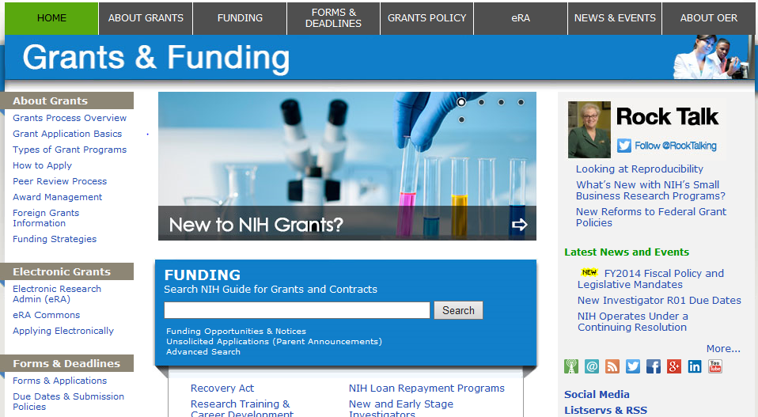
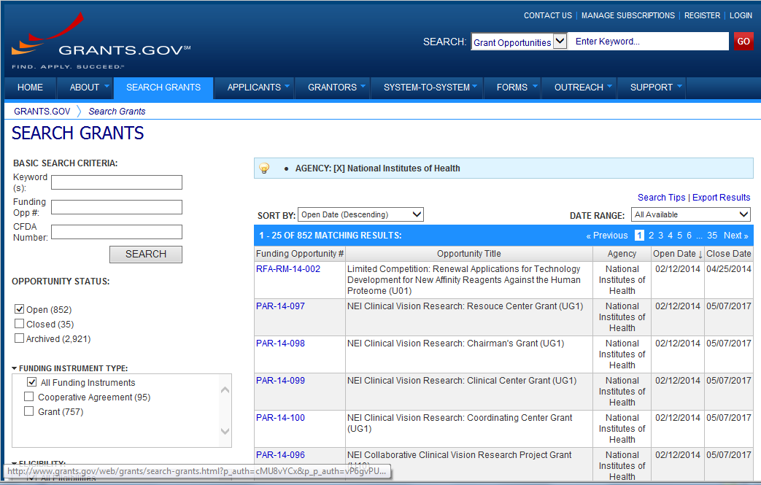
Find Multi-project FOAs in…
NIH Guide for Grants & Contracts
Grants.gov Search Grants

Slide 16
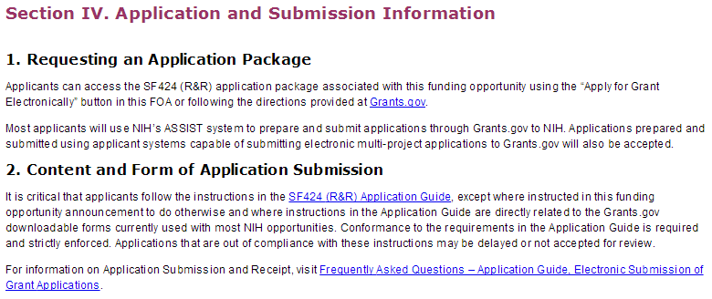
Multi-project FOAs
Section IV. Application and Submission Information of NIH FOAs includes important guidance for preparing your application in ASSIST
The SF424 (R&R) Application Guide provides general instructions for completing application forms

Slide 17

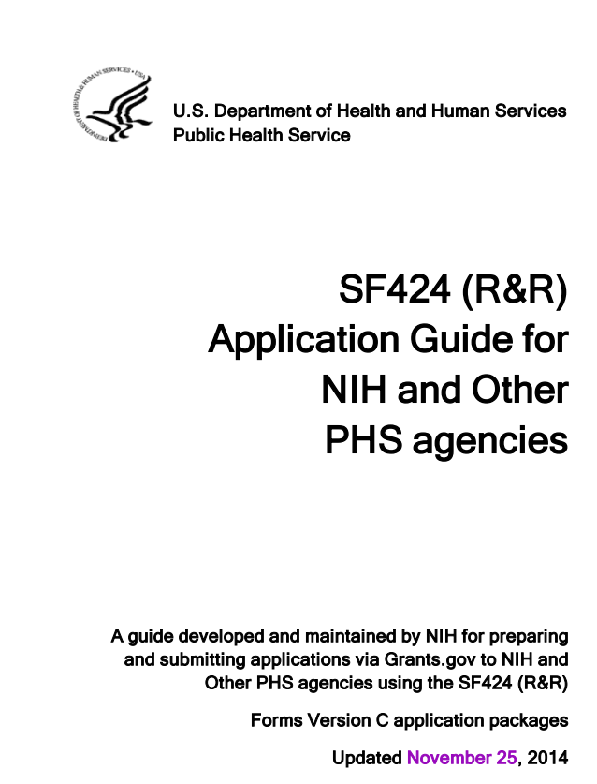
Application Guide
Agency-specific
instructions are
marked with the HHS logo.
Pay special attention to Section 9 - Instructions for Preparing a Multi-Project Application.
Refer to Supplemental Grant Instructions as needed (human subjects, policies, assurances, definitions and more).

Slide 18
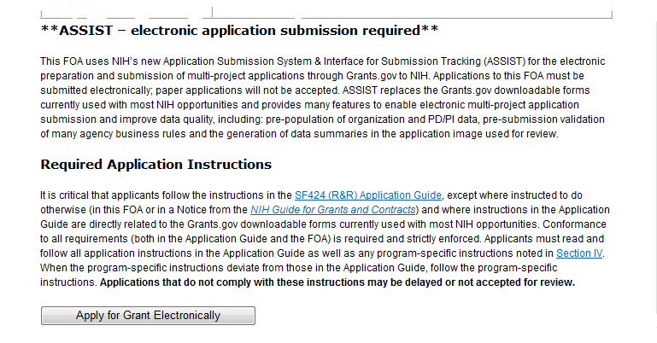
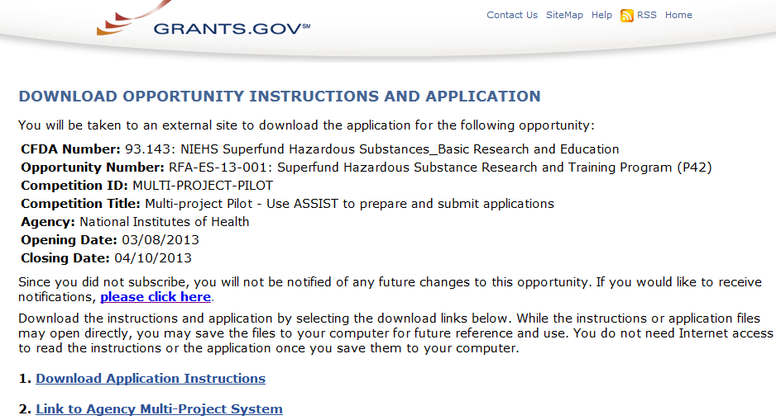

FOAs Link You to ASSIST
NIH Guide for Grants & Contracts
Grants.gov ‘Apply’

Slide 19
Make a
Submission Plan
Find
Plan
Initiate
Build Team
Enter Data
Finalize
Submit
Track

Slide 20
Make a Submission Plan
Ensure all registrations are in place
  All standard registrations requirements apply (DUNS, SAM, Grants.gov, eRA Commons)
    http://grants.nih.gov/grants/ElectronicReceipt/files/registration_handout.pdf
    Decide how to distribute the work
  Gather the Commons IDs for everyone who will be working on your application in ASSIST
Carefully read the FOA
  Note the allowable types of required/optional components and any special instructions
  Define the layout of your application (e.g., define components and who will lead each)

Slide 21
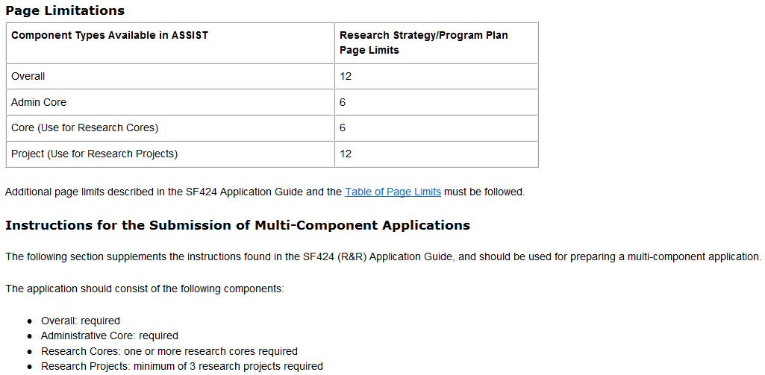
FOA Text Instructions
Sample excerpt from FOA (section IV)

Slide 22
Define the Layout of Your Application
Think about the components you plan to include
  PD/PI(s) for entire application
  Organization lead for each component
  Project lead for each component
  Project Title for application/components
  Start/End dates for application/components

Slide 23
Sample Application Layout
Overall Component
PD/PIs: Cher D. Money, Ben A. Round
Organization: A
Project Title: Research Center to Cure the Diseases of the World
Component Type: Admin Core
Component Type: Core
Component Type: Project
Admin Core-001
Core-001
Project-001
Project Title: Administrative Core
Project Lead: Jed I. Knight
Organization: A
Project Title: Research Core 1
Project Lead: Ben A. Round
Organization: A
Project Title: Fabulous Research Focus 1
Project Lead: Cher D. Money
Organization: A
Subaward Budget
Project-002
Organization: D
Project Title: Fabulous Research Focus 2
Project Lead: Quin T. Sential
Organization: B
Core-002
Project Title: Research Core 2
Project Lead: Abel Tu Lead
Organization: B
Project-003
Project Title: Fabulous Research Focus 3
Project Lead: Ima Doer
Organization: C

Slide 24

Initiate Your Application
Find
Plan
Initiate
Build Team
Enter Data
Finalize
Submit
Track

Slide 25


Create an Application Shell
Create an application shell by initiating the application and adding the components
  Components can be rearranged, added, deleted or abandoned at any time
    Applicants can rearrange components of the same type (e.g., have the third project entered in ASSIST appear first in the assembled application image)
    Applicants cannot control the order in which the component types appear (e.g., Cores will always be before Projects)

Slide 26
Log In to ASSIST
https://public.era.nih.gov/assist
Use your eRA Commons credentials to access ASSIST

Slide 27
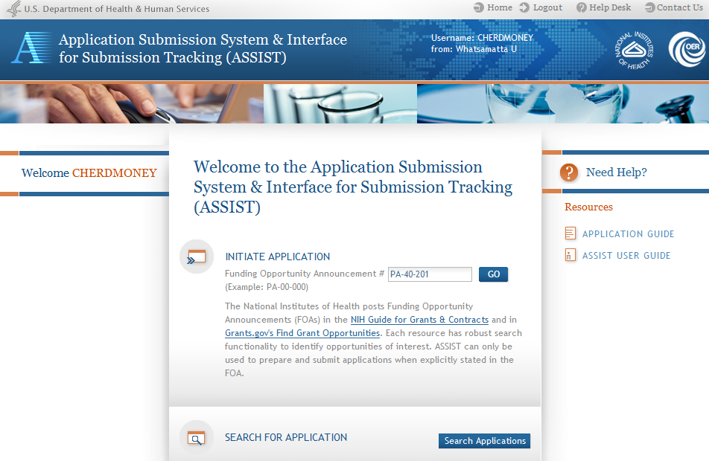
Initiate Application

Slide 28
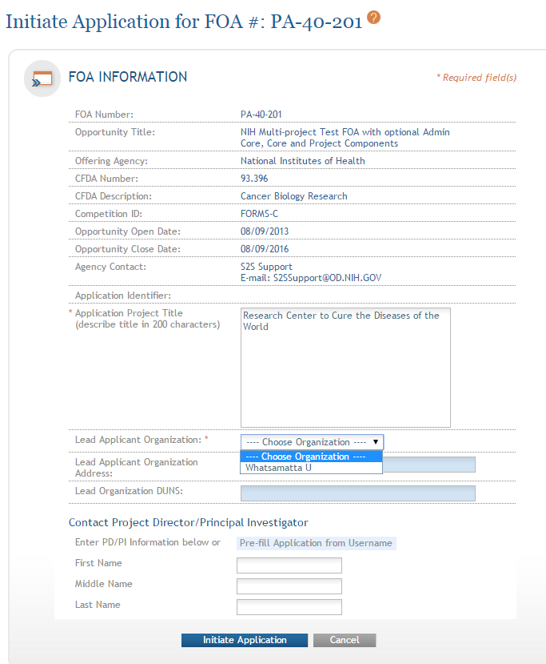
Initiate Screen
FOA information pulled from Grants.gov
Enter Project Title
Drop-down list of organizations affiliated with your eRA Commons account

Slide 29
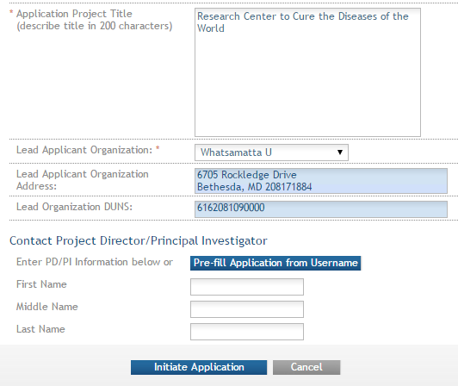
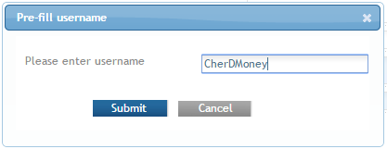
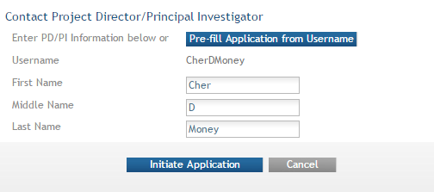
Initiate: Pre-population
Data pre-populated from organization selection
Can manually enter PD/PI information or provide
eRA Commons username to auto-populate

Slide 30
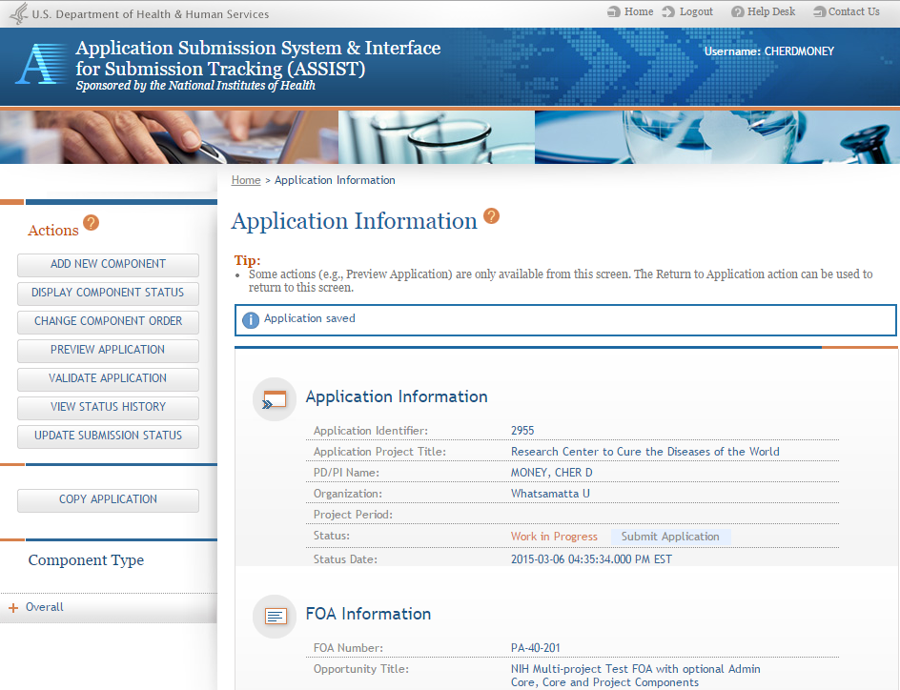
Using ASSIST
Access on-line help
Screen tips
ASSIST messages
Available actions vary based on application context and access

Slide 31
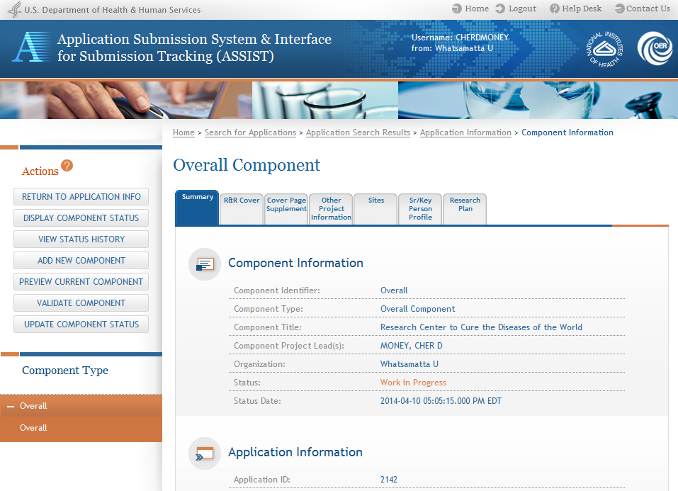
Overall Component
Form navigation for the selected component
The Overall Component is added to the component navigation

Slide 32
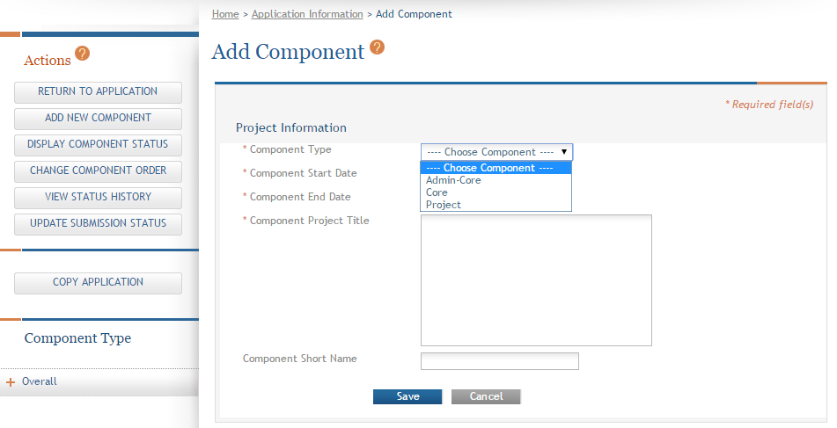
Adding Additional Components
Add additional components
Allowable component types defined in the FOA are presented

Slide 33
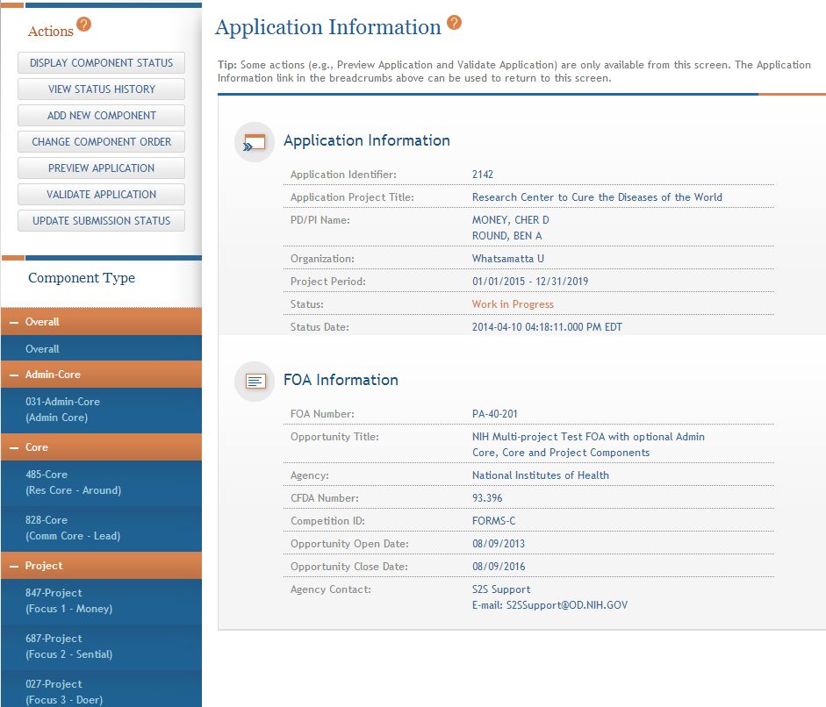
Adding Components
Continue adding components to build out the application shell

Slide 34
Define Your Team and Provide Application Access
Find
Plan
Initiate
Build Team
Enter Data
Finalize
Submit
Track

Slide 35

Automatic Application Access
ASSIST automatically provides application access to some individuals based on:
eRA Commons roles
  All SOs and AOs at the applicant institution have irrevocable edit access for the entire application
  All SOs and AOs at an organization leading a component
  have irrevocable edit access for their component
Role on the application
  The application initiator has edit access for the entire application
  All PD/PIs listed on the Overall application have edit
  access for the entire application
  The component Project Leads have edit access for their components

Slide 36

Managing Access
Application access can be given to additional users with Commons IDs
  Within or outside applicant organization
Application access can be controlled across these variables:
  Entire application vs. specific components
  View vs. Edit
  Budget vs. Non-budget data

Slide 37

Signing Officials (SOs)
SOs at the applicant institution can
  Manage application access for other users
  Manage application status all the way to Ready for Submission status
  Delegate Access Maintainer
  and Status Maintainer authority
  to other users within their
  institution
  Access the Submit action

Slide 38
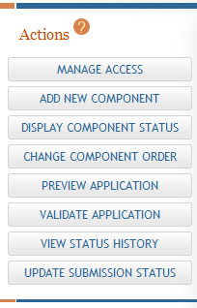
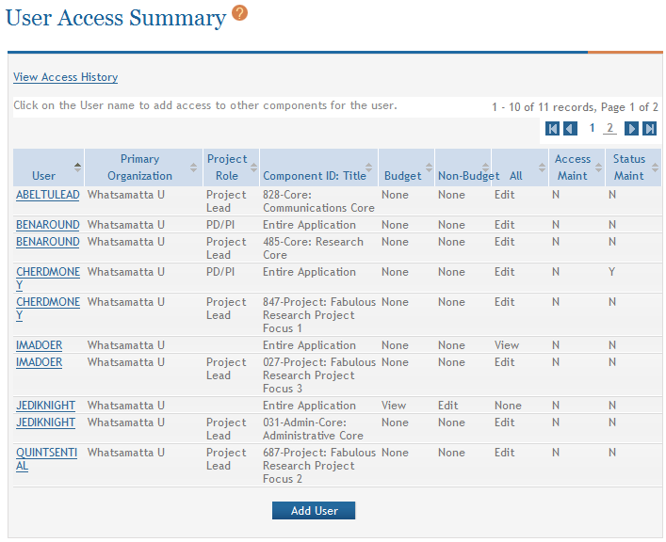
Managing Access
The Manage Access action can be used to provide access to additional users or modify access for existing users.
Modify access for existing user
Give access to additional users

Slide 39
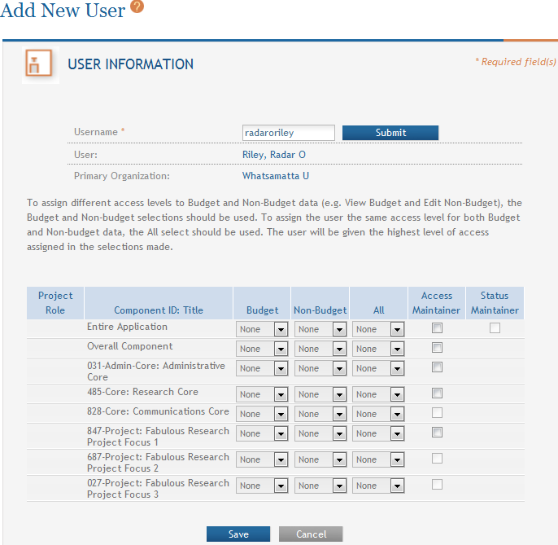
Add User
Provide Commons ID
User can be designated to manage access for the application or components
User can be designated to change application status
Change View/Edit/None access for the application or components

Slide 40
Enter Application Data
Find
Plan
Initiate
Build Team
Enter Data
Finalize
Submit
Track

Slide 41
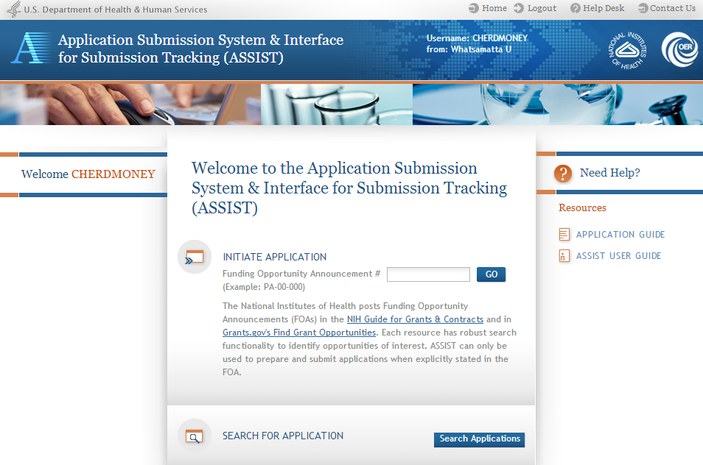
Searching for In-progress Applications
Use Search Applications to access your in progress application

Slide 42
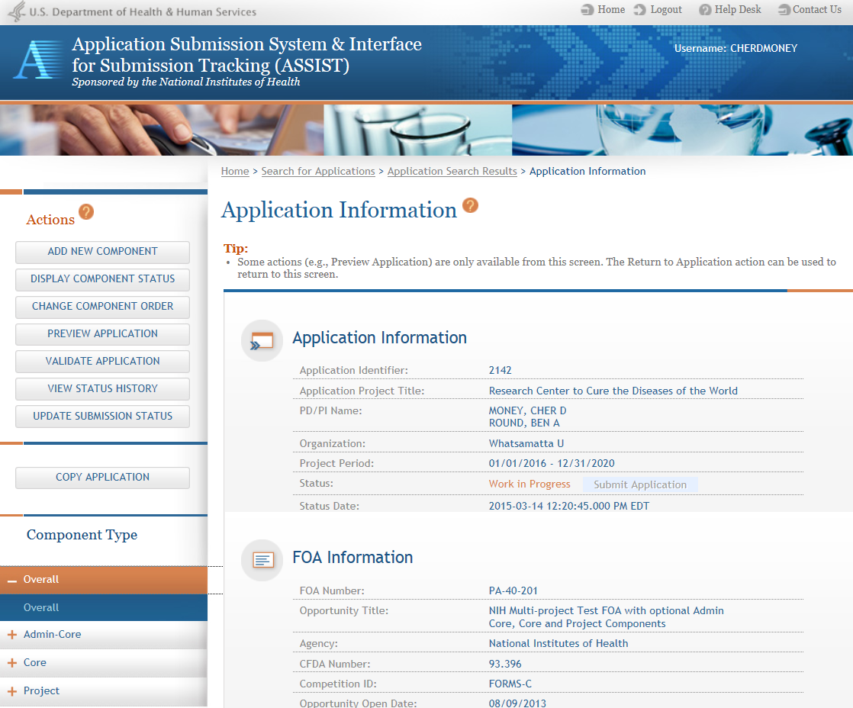
Navigating to a Specific Component
Use the component navigation to identify the component you want to work on

Slide 43
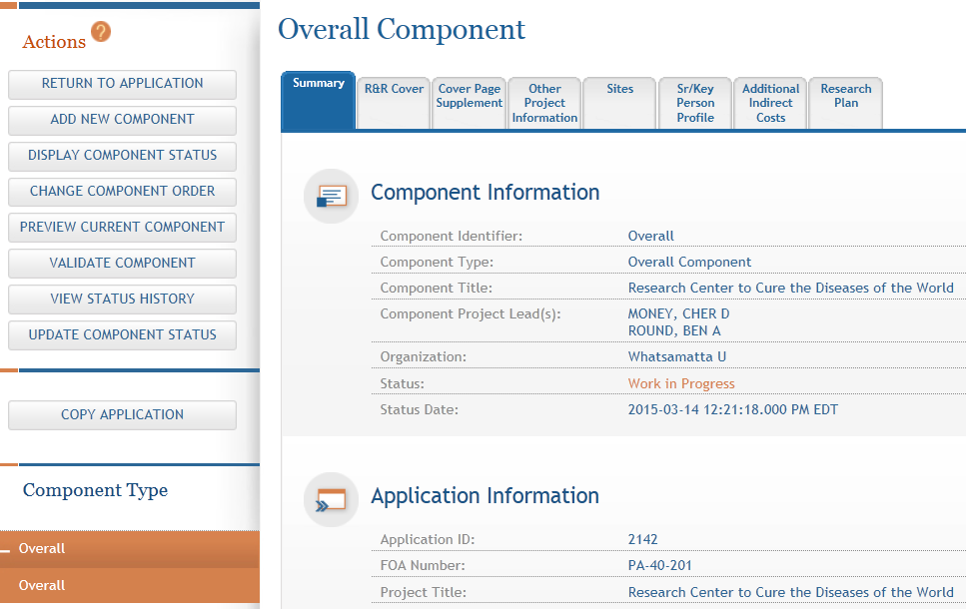
Summary Page
Every component has a Summary page
Some actions are only available from the Summary page

Slide 44
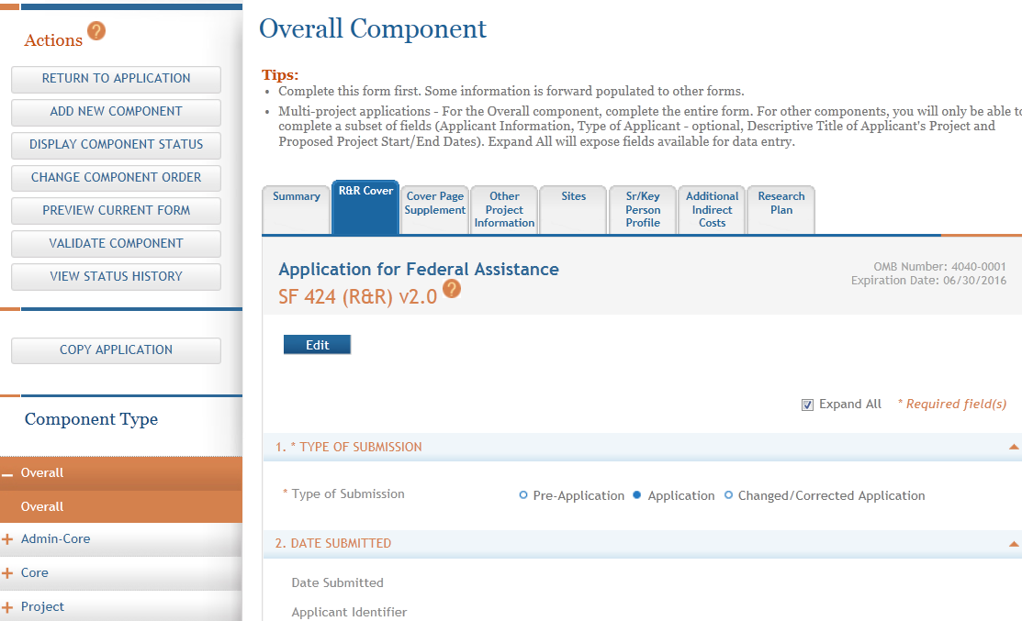
Entering Application Data
Click each tab to access form data entry screens
Clicking Edit blocks other users from editing form

Slide 45
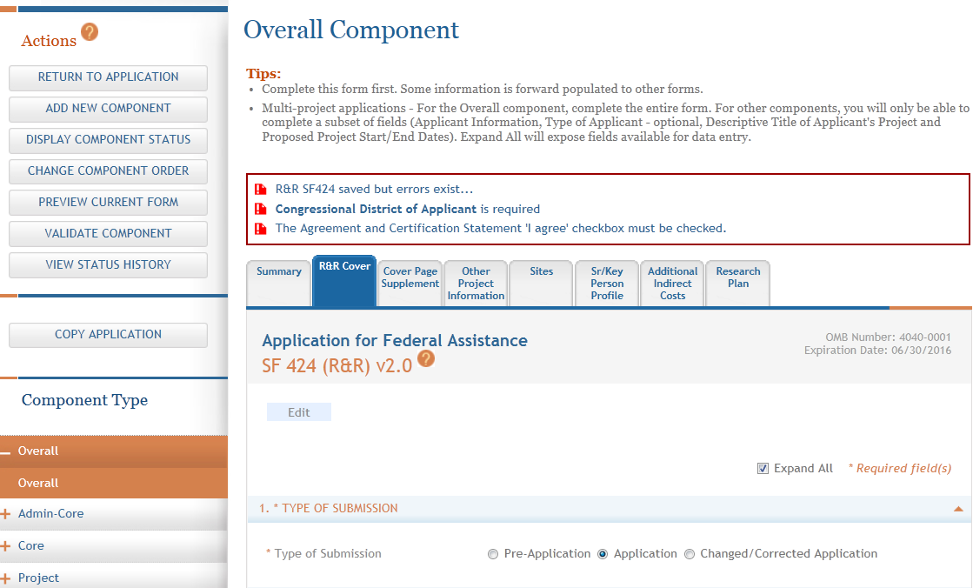
Data Entry Validation
ASSIST validates entered data and provides errors at the top of the screen when you Save

Slide 46
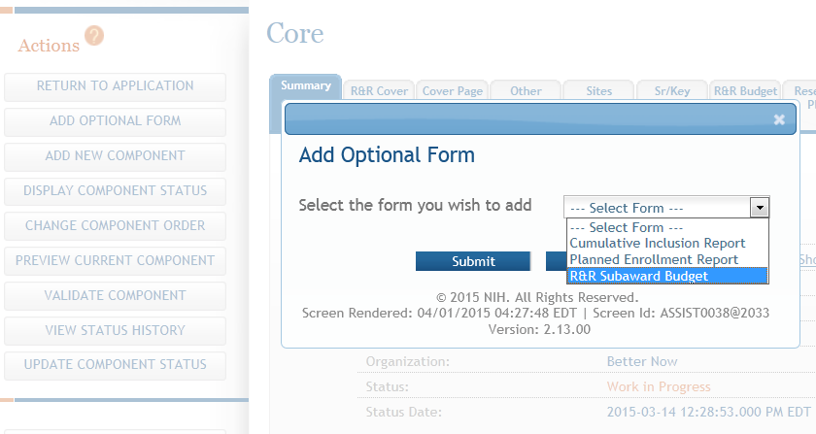
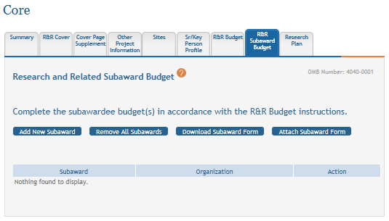
Adding Optional Forms
Select form and click Submit

Slide 47
Data Entry: General
Overall
  Describe the entire application
  Always completed with applicant organization information
All Other Components
  Reflect the activity in the specific component
  Completed from the perspective of organization leading the component

Slide 48
Data Entry: R&R Cover
Overall
  All form fields used
All Other Components
  Subset of fields used
    Field 5: Organization Information
    Field 7 (Optional): Type of Applicant
    Field 11: Descriptive Title of Applicant’s Project
    Field 12: Proposed Project Start/End Dates

Slide 49
Data Entry: Other Project Information
Overall
  Human Subjects & Vertebrate Animals: Answer all questions
  Project Narrative: Required
All Other Components
  Human Subjects: Answer only the ‘Are Human Subjects Involved?’ and Is the Project Exempt from Federal regulations?’ questions
  Vertebrate Animals: Answer only the ‘Are Vertebrate Animals Used?’ question
  Project Narrative: FOA may specify attachment is optional

Slide 50
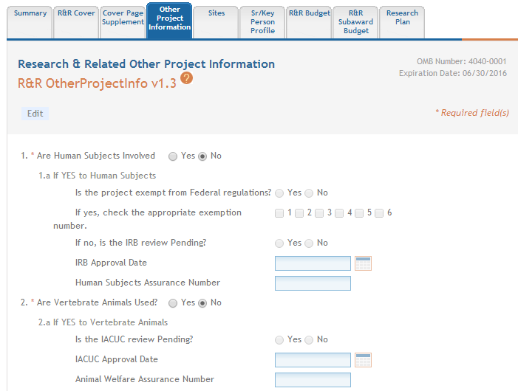
Data Entry: Other Project Information
ASSIST prevents data entry of additional Human Subject and Vertebrate Animal info on components other than Overall.

Slide 51
Data Entry: Sr/Key Person Profile
Overall
  Use the Project Director/Principal Investigator section to designate the Contact PD/PI
  Include any Multi-PD/PIs
    Use PD/PI Project Role
  Do not include other Sr/Key personnel
All Other Components
  Use the Project Director/Principal Investigator section to designate the Project Lead
    Must not use PD/PI Project Role
      ASSIST defaults Project Role to Other, Project Lead
    Follow FOA instructions
  Include all Sr/Key personnel associated with the component
Applications must include a single biosketch for each Sr/Key person regardless of the number of components they are listed on. Biosketch can be included with any entry – just pick one.

Slide 52
Avoid Common Errors
ASSIST screen tips
  Found at the top of many data entry screens
Application Guide
Annotated form sets
  http://grants.nih.gov/grants/ElectronicReceipt/communication.htm#forms
Ten Checks to Help Avoid Common Errors
  http://grants.nih.gov/grants/ElectronicReceipt/avoiding_errors.htm#10checks

Slide 53
Component Actions
As component data is entered several actions are available:
  Change Component Order
  Validate Component
  Preview Current Component
  Update Component Status
    Work In Progress – only status that allows editing
    Complete – component data entry is complete
    Final – component has been reviewed by applicant organization and incorporated into the application

Slide 54
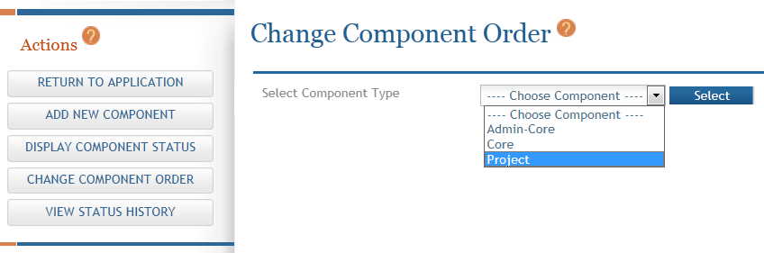
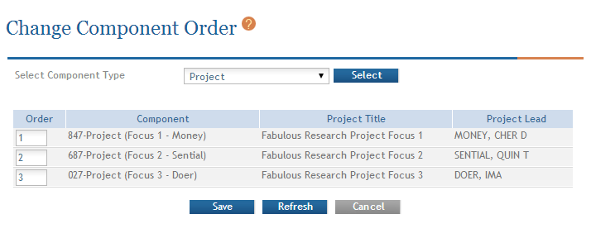
Change Component Order
Select Component Type to reorder
Provide desired sequence

Slide 55
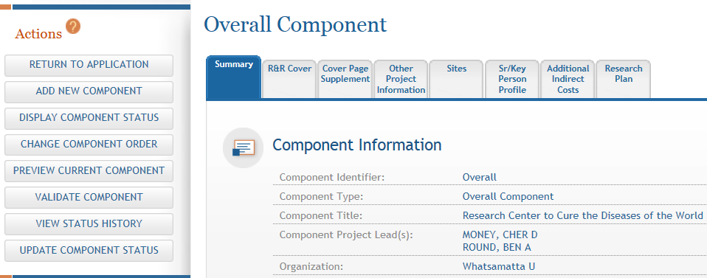
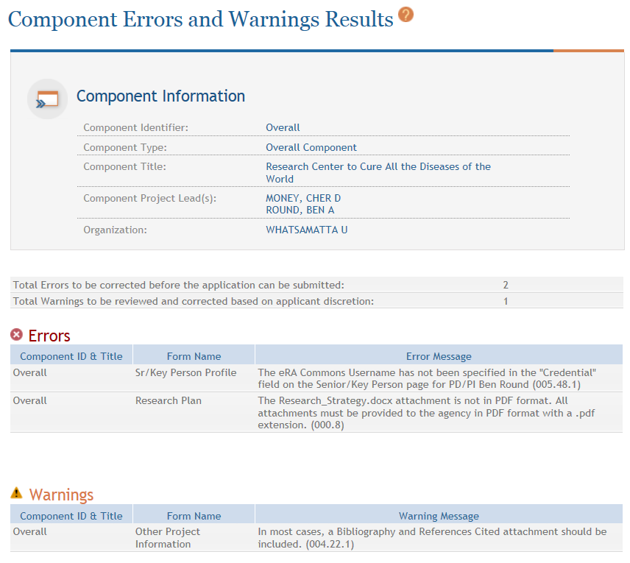
Validating a Component
Errors and Warnings are displayed

Slide 56


Errors & Warnings
Errors stop application submission and processing and must be corrected before the due date
  Can’t submit until error-free
Warnings do not stop application submission or processing and are corrected at the discretion of the applicant before the due date

Slide 57
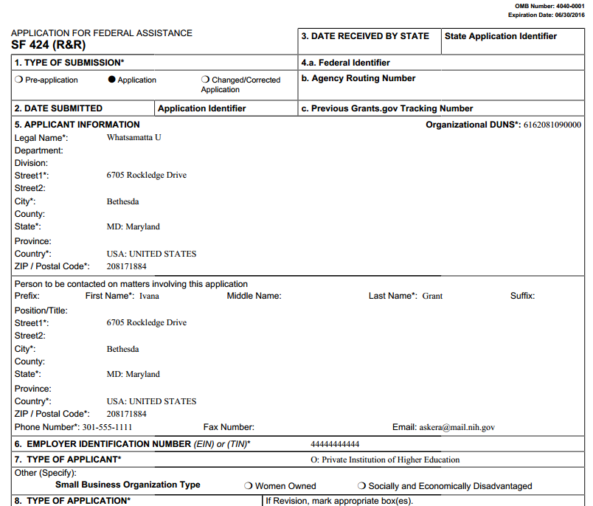
Previewing a Component
Component preview does not include bookmarks, Table of Contents, data summaries or biosketches

Slide 58
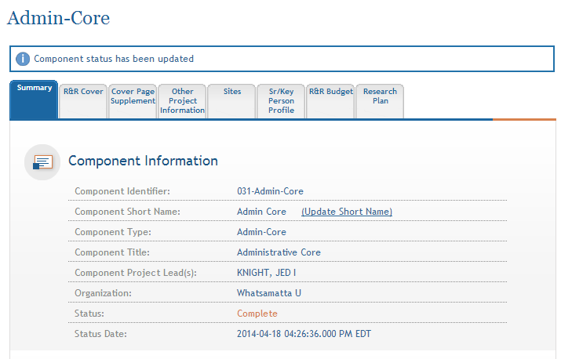
Updating Component Status to Complete
Select status and enter comment for Status History
Once a component is marked ‘Complete’ no additional edits can be made unless someone with appropriate authority (i.e. AO, SO, Status Maintainer, or Initiator) returns the status to ‘Work in Progress’.
Status on Summary page is updated

Slide 59

Finalize Application & Prepare for Submission
Find
Plan
Initiate
Build Team
Enter Data
Finalize
Submit
Track

Slide 60
Finalizing Components
As components are marked ‘Complete’, the applicant organization can preview them and incorporate those that are ready into the final application by updating the component status to ‘Final’
  Applicant organization AOs, SOs, users with Status Maintainer authority and application initiators have option to mark a component ‘Final’ directly from ‘Work in Progress’
All components must be marked ‘Final’ before an application can be prepared for submission

Slide 61
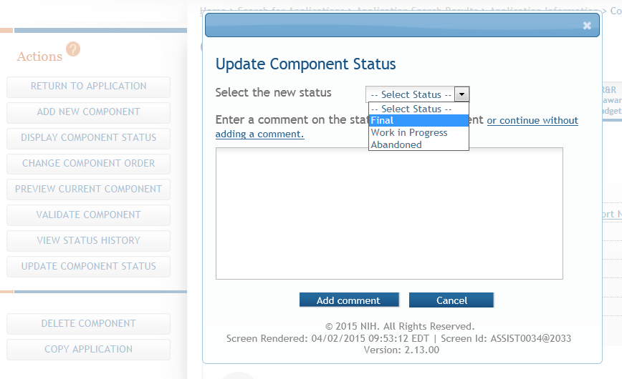
Finalizing Components
Update the component status to Final once you are satisfied that the component is ready to be included in the final application

Slide 62
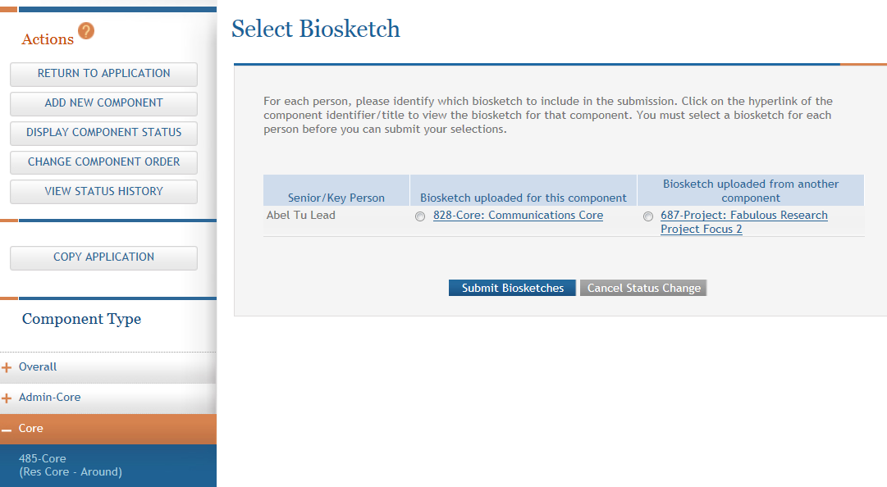
Finalizing Components
ASSIST will check to ensure that only one biosketch is included for every Senior/Key person in the application.
If a biosketch is already included for any Sr/Key, you will have the option to view each biosketch and select the one you wish to keep

Slide 63
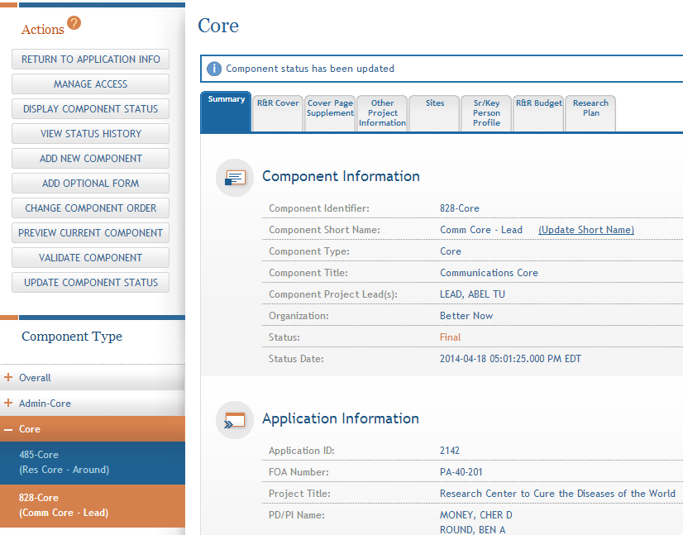
Finalizing Components
  After all biosketch issues are reconciled, the component status is set to Final

Slide 64
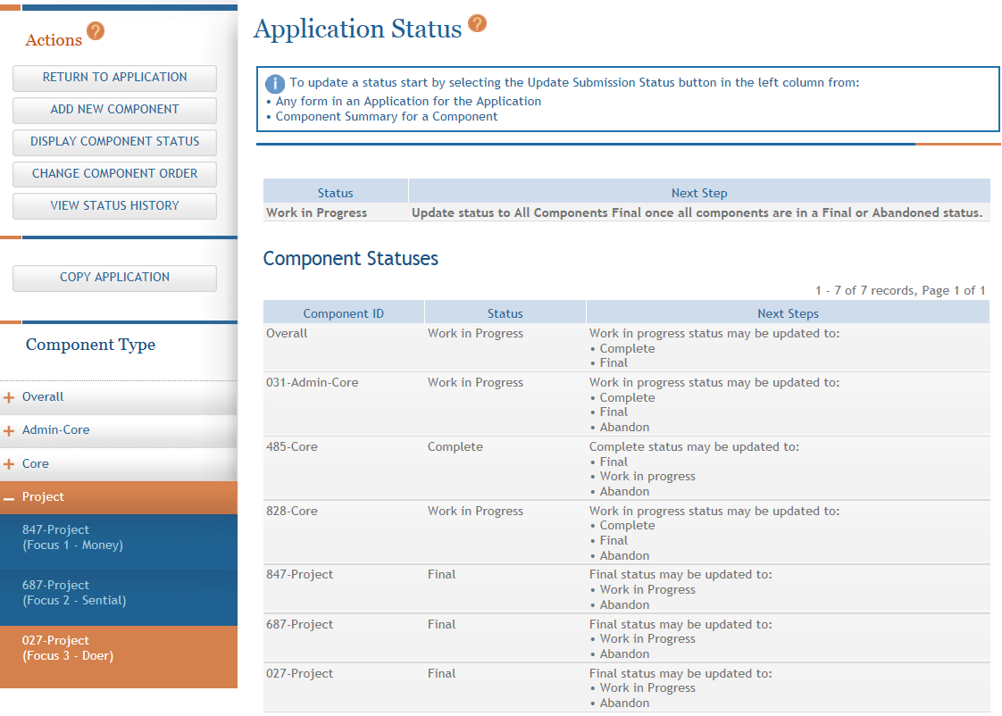
Display Component Status
Provides all application/component status on a single screen

Slide 65
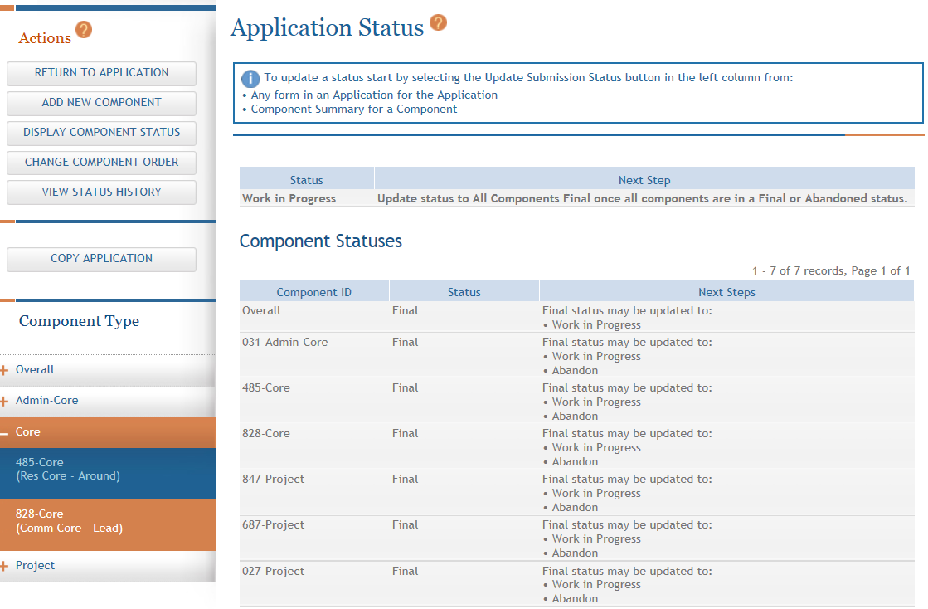
Updating Application Status
Although the Status is set to Final for each component, the Application Information still shows a Status of Work in Progress

Slide 66
Application Status Flow
Work In Progress – Allows editing
All Components Final – Can only be updated once each component status is Final; must Validate Application to move to next status
All Components Validated – Automatically set once Application Validation is error-free
Ready for Submission – Should be set after all internal reviews have taken place
Submitted – Automatically set after submitting to Grants.gov

Slide 67
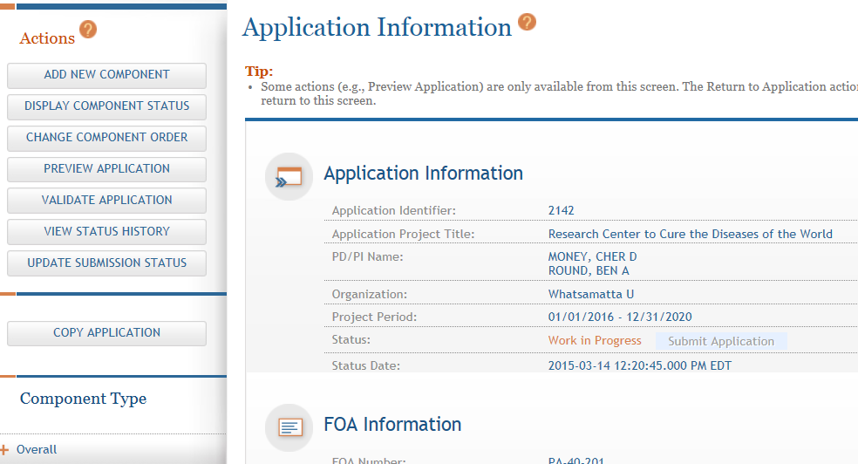
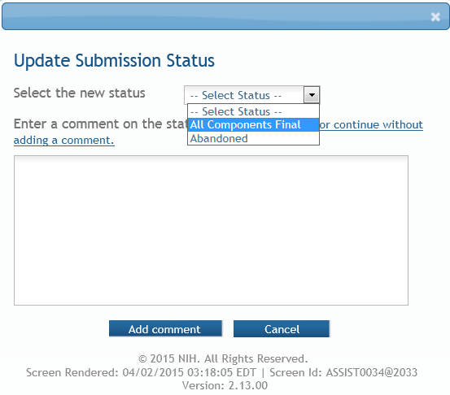
All Components Final
You can prepare your application for submission once the status for all individual components has been set to Final
Set the application status to All Components Final

Slide 68
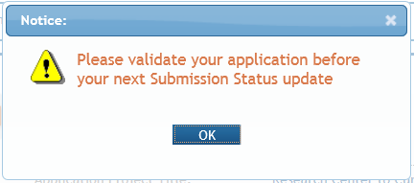
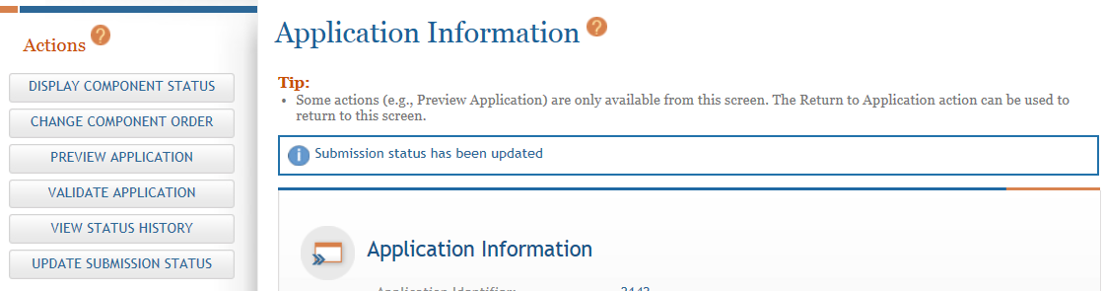
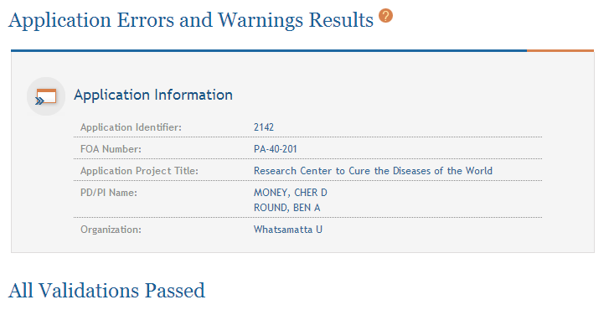
Final Validation Check
Before an application can be submitted, it must pass validations (Warnings are OK)

Slide 69
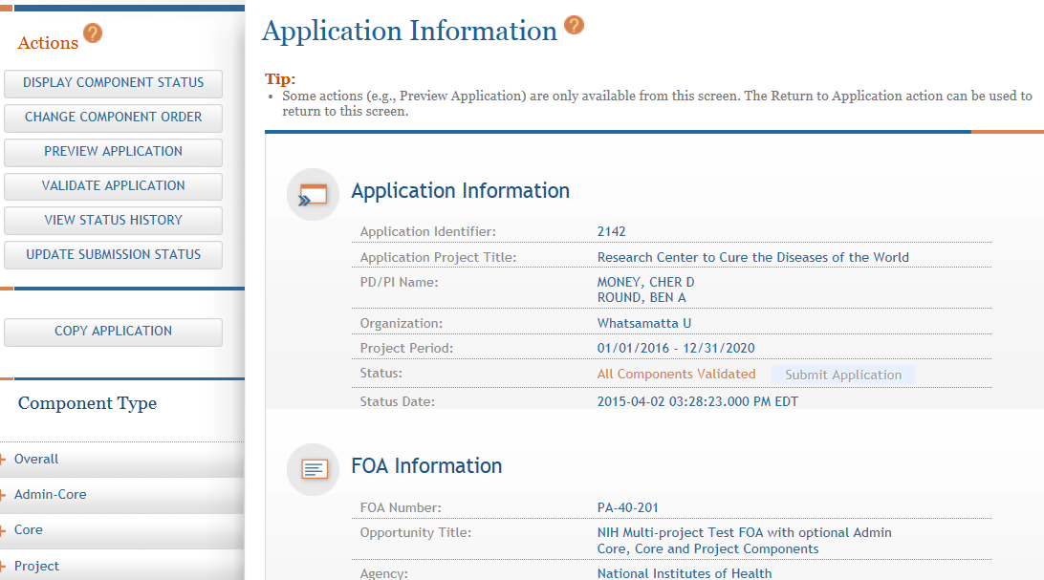
All Components Validated
If no errors found, then the application status is automatically updated to All Components Validated

Slide 70
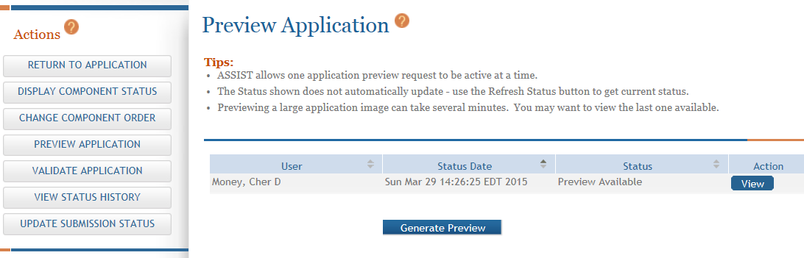
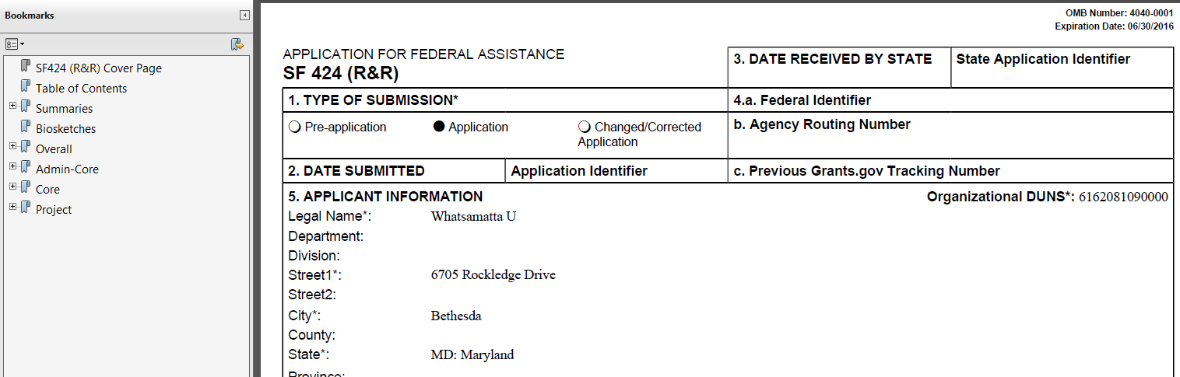
Preview Application
Before you submit, Preview the Application and verify that everything is just the way you want it to go to review.
Application preview does not include Cover Letter or Appendices which are maintained separately post-submission

Slide 71
Ready for Submission
Once all internal reviews are complete, update the application status to Ready for Submission.

Slide 72
Submit Your Application
Find
Plan
Initiate
Build Team
Enter Data
Finalize
Submit
Track

Slide 73

On-time Submission
Error-free submission must be made by 5:00 p.m. local time (of submitting organization) on due date
  It takes time to prepare your application for submission
  Submit early (days, not minutes)
  to have time to address any
  unforeseen issues and to view
  your assembled application

Slide 74
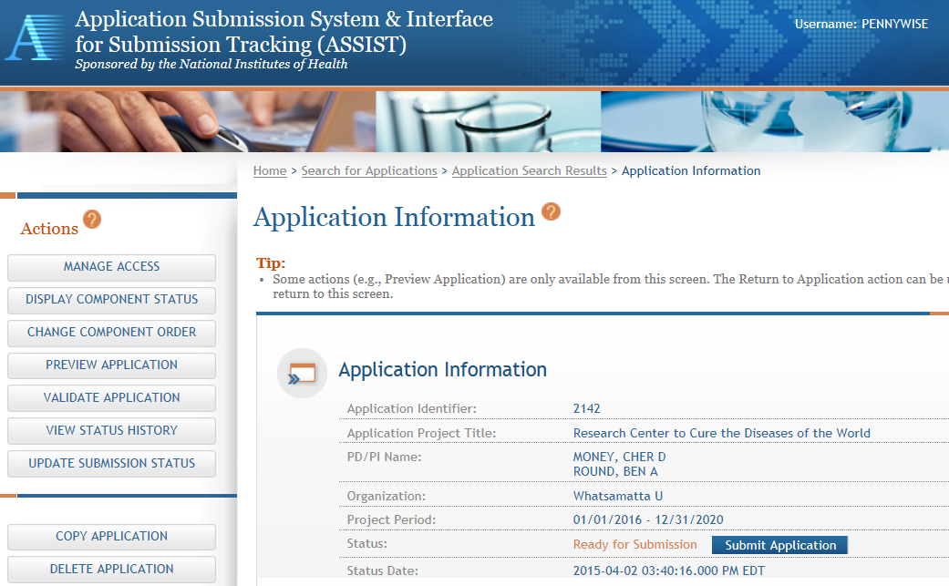
Submit Your Application
Must be a Signing Official (SO) in eRA Commons and an Authorized Organizational Representative (AOR) in Grants.gov to submit
Application Status must be set to Ready for Submission

Slide 75
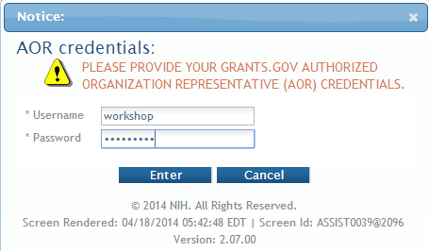
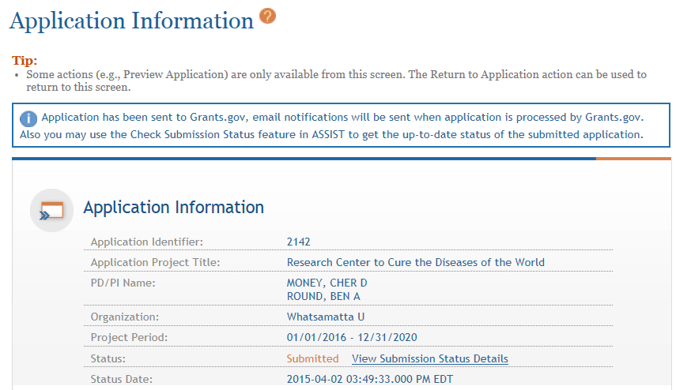
Submit Your Application
Applications are submitted from ASSIST to Grants.gov.
Enter your Grants.gov AOR credentials and click Enter
Message will appear indicating the application was sent to Grants.gov

Slide 76
Track Your Application
Find
Plan
Initiate
Build Team
Enter Data
Finalize
Submit
Track

Slide 77

Notifications
ASSIST sends out quite a few email notifications throughout the preparation
and submission process to help you
track your application
  Application access changes, component/application updates, component/application status changes, submission status updates and more
Check out this resource: http://grants.nih.gov/grants/electronicreceipt/files/ASSIST_eNotifications.pdf

Slide 78

Tracking Submission Status - ASSIST
ASSIST provides the ability to track both Grants.gov and NIH status
  Links to the eRA Commons Detailed Status Information to view your assembled application

Slide 79
Tracking Submission Status - ASSIST
After submitting to Grants.gov, submission status can be tracked in ASSIST.
Click View Submission Status Details

Slide 80

Tracking Submission Status - ASSIST
Top of screen
You must click Check for Status Updates to force ASSIST to poll Grants.gov and NIH for status
ASSIST will indicate if a status change was detected

Slide 81

Tracking Submission Status - ASSIST
ASSIST, Grants.gov and Agency submission status are available
Grants.gov status of Agency Tracking Number Assigned and Agency status of Processed is good news!
Agency Tracking # link brings you to the detailed status screen in eRA Commons

Slide 82

Viewing Your Application in Commons
eApplication is the application image reviewers will use so check it carefully.
You will also want to check the Cover Letter and Component Appendices which are stored separate from the image.

Slide 83

Application Viewing Window
Applicants have two (2) business days to view the assembled application image in Commons before it automatically moves forward to NIH staff for further processing
If you can’t VIEW it, we can’t REVIEW it!

Slide 84

Viewing Your Application in Commons
It is your responsibility to carefully review the entire
application to ensure it has been processed correctly!

Slide 85




Automatic Data Summaries

Slide 86

Automatic Data Summaries
The DUNS numbers on budget forms used to differentiate between applicant organization and subaward costs.

Slide 87


Automatic Data Summaries

Slide 88

Rejecting the Application
SO can Reject application in eRA Commons within viewing window and submit a Changed/Corrected application prior to the due date
Action cannot be done within ASSIST

Slide 89

Submission Complete!
If no action is taken to reject the application during the two business day viewing window, the application automatically moves forward to NIH for further processing.

Slide 90

Dealing with System Issues
Follow NIH’s standard ‘system issue’ procedure if you run into problems beyond your control that threaten your on-time submission: http://grants.nih.gov/grants/ElectronicReceipt/support.htm#guidelines

Slide 91

ASSISTance

Slide 92


On-line ASSIST Help
Click on question mark icon to access ASSIST help
Search feature
Access to Application Guide for additional guidance on field content information

Slide 93

Links & Resources
ASSIST: public.era.nih.gov/assist
Online help: era.nih.gov/erahelp/ASSIST/
Applying Electronically Website: http://grants.nih.gov/grants/ElectronicReceipt/index.htm
Annotated form set: grants.nih.gov/grants/ElectronicReceipt/files/annotated_multi-project.pdf
eRA ASSIST Training page: http://era.nih.gov/era_training/assist.cfm

Slide 94

Service Desk
eRA Service Desk
Web: http://era.nih.gov/help/
Toll-free: 1-866-504-9552
Phone: 301-402-7469
Hours: Mon-Fri, 7a.m. to 8 p.m. Eastern Time
(Except for Federal holidays)
Although we’ve worked closely with Grants.gov, ASSIST is a system developed and managed by NIH.
The eRA Service Desk should be an applicant’s first stop for support.

Slide 95







Questions
Q
S
S
I
U
E
T
O
N

